Slide 1
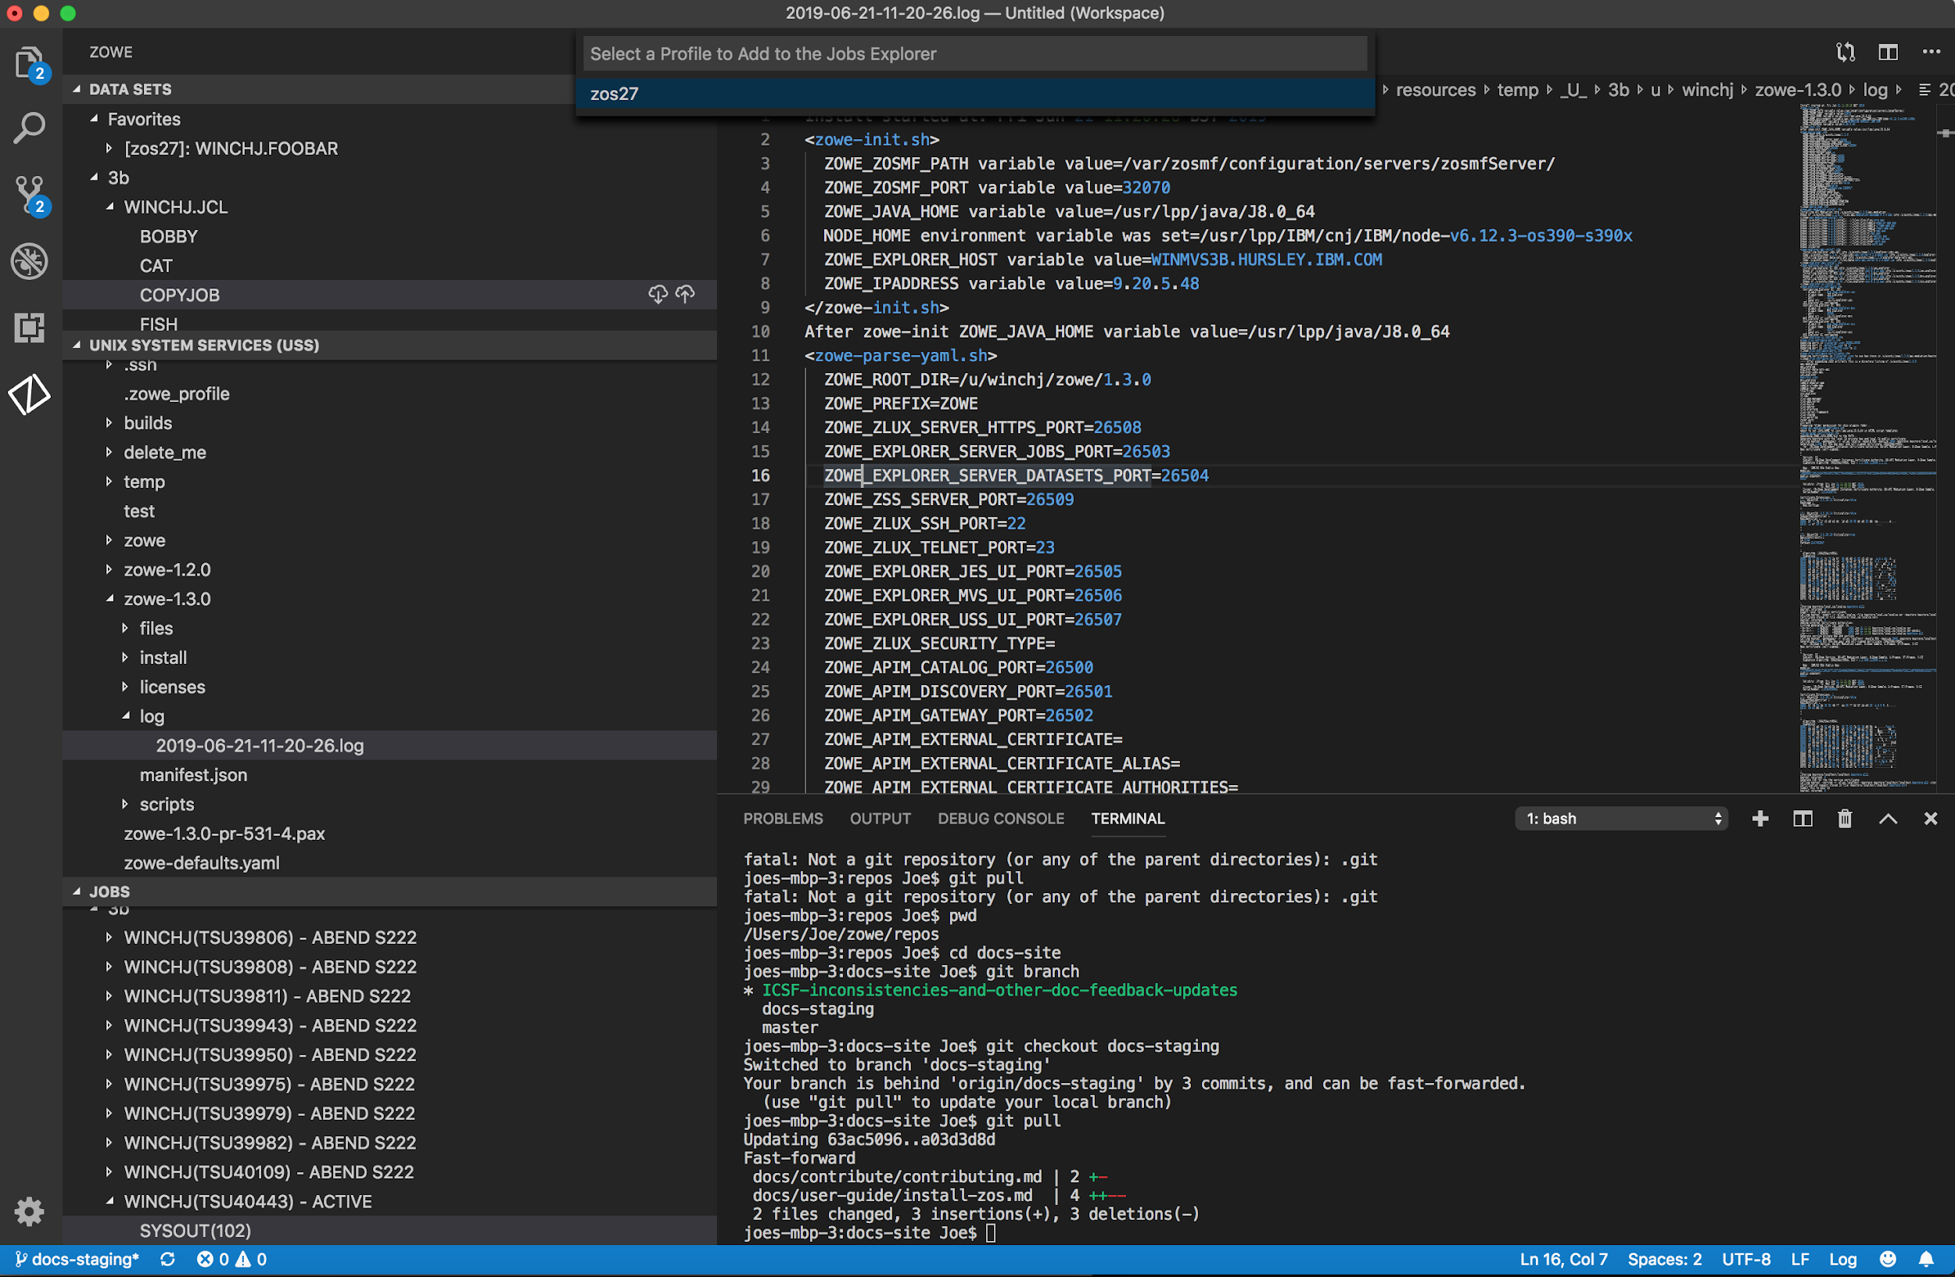

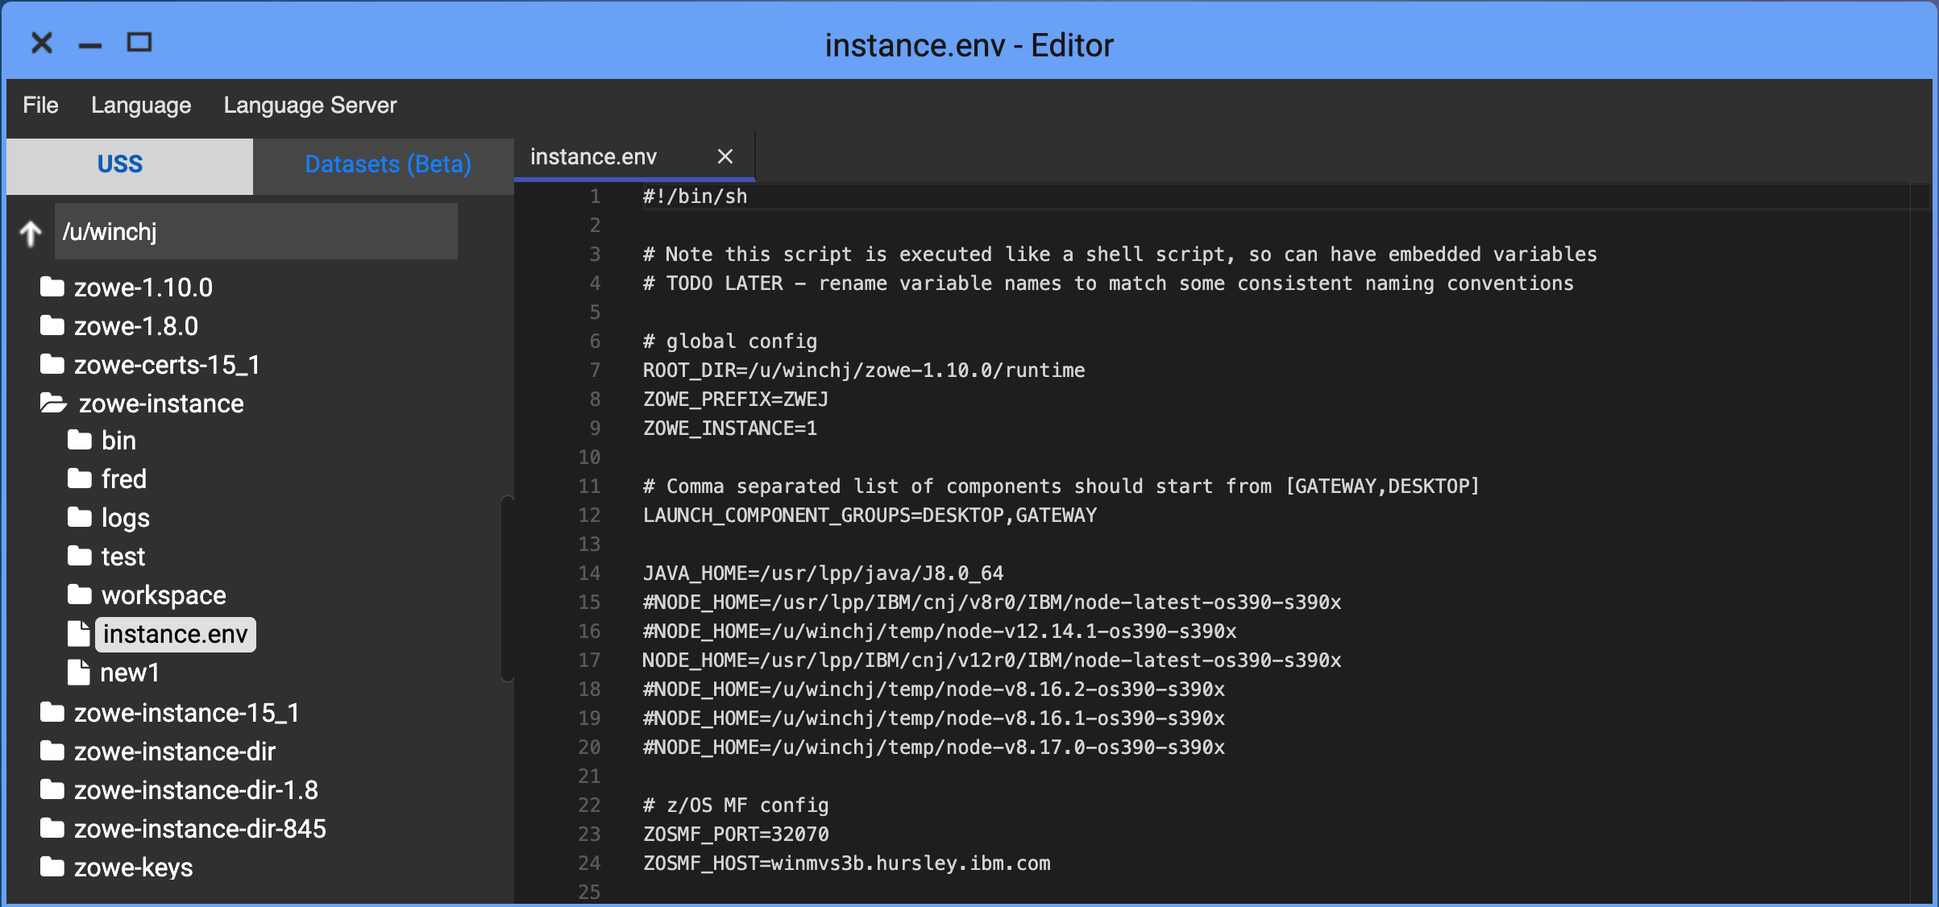
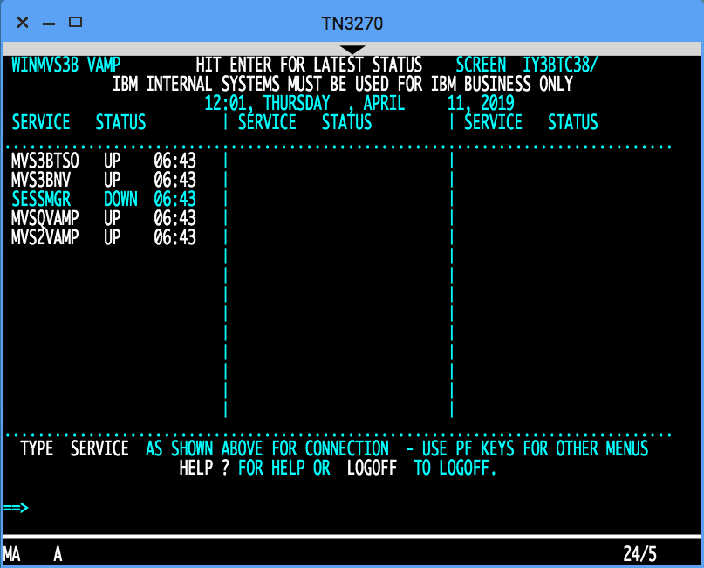
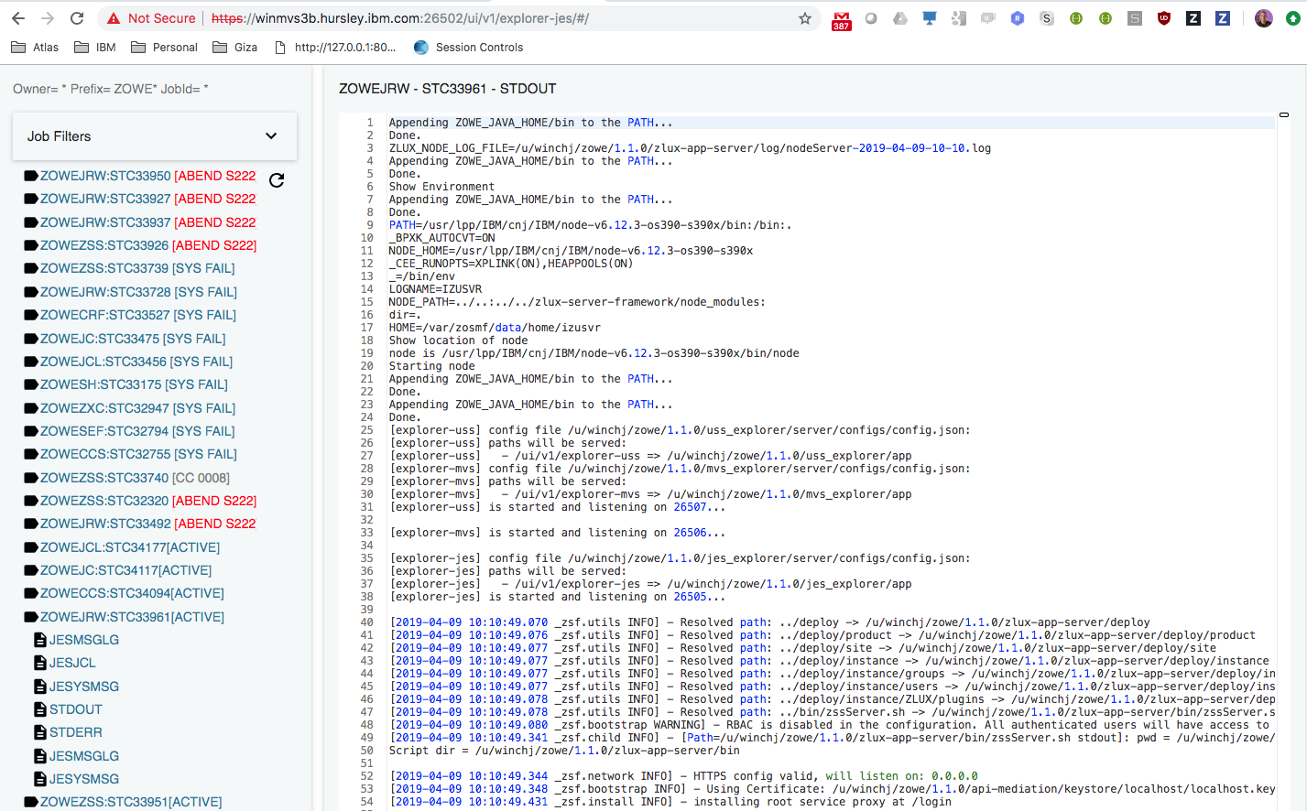
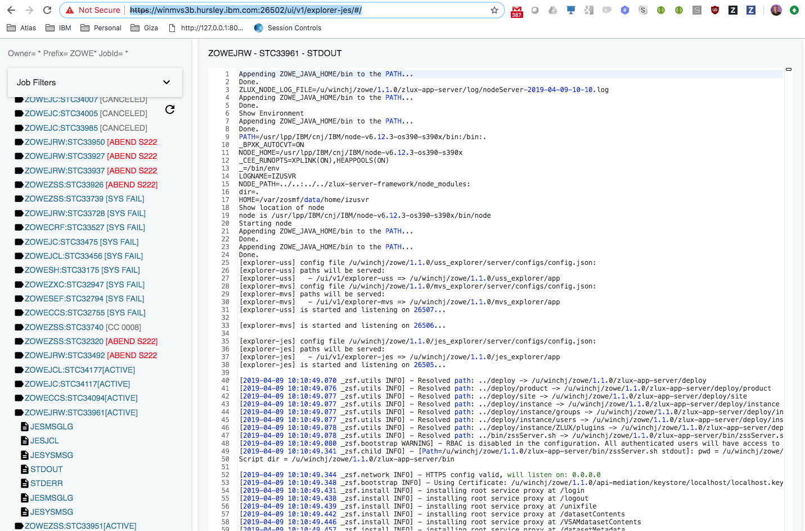
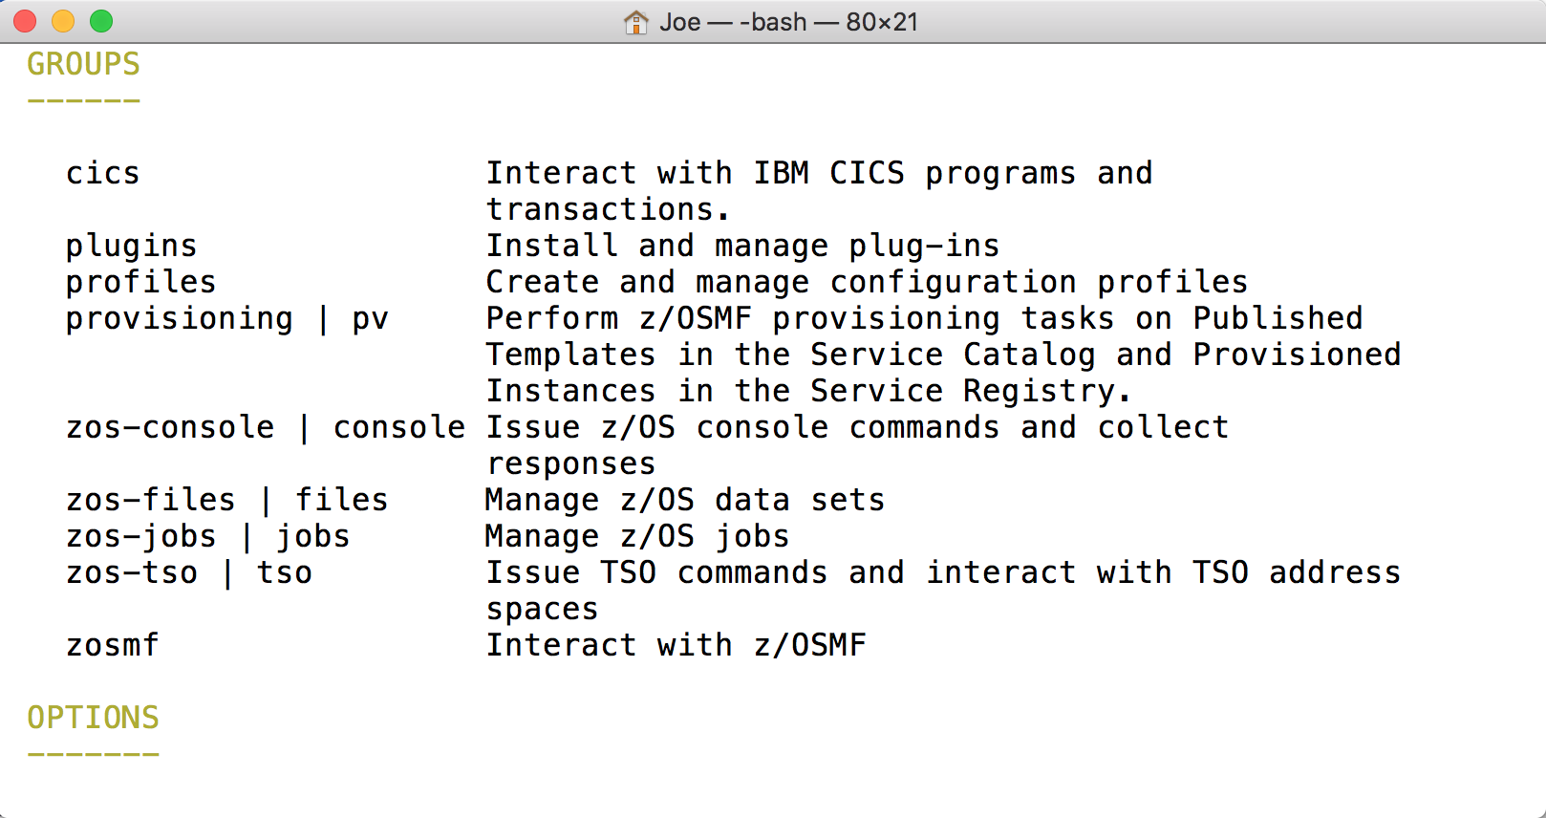
Zowe
Explorer
VS Code
Core desktop apps
Extension Plugins
Extension
Plugins
Core CLI
Core Extensions
File Editor
3270 Terminal
JES Explorer
IP Explorer
iFrame
HTML
CLI
extension
CICS
DB2
MQ
Node SDK
Zowe Desktop running in web browser
Zowe CLI running in desktop shell
ZWESLSTC
Running under USS
7554
API Gateway
(optional needed for SSO/MFA)
7555
7553
7552
7558
Caching
Service
API Discovery
API Catalog
ZAAS
7556
Apps…
7557
App Server
File Editor
ZSS
7557
VT Terminal
3270
(If API Gateway Disabled)
22
23
nnnn
7443
Cross Memory
SSH
Telnet
REST API Extension Server
z/OSMF
CICS CMCI
DB2
MQ Console
Java
REST APIs
Workflows
TSO / MVS / Console
Files, USS, JES
ZWESISTC
ZIS
Node.js
ZWESIS01
metal C / C
Notes:
If you update this diagram, please update “zowe-desktop-unable-to-logon.pptx” and PNG file as well.

Slide 2
Zowe
Explorer
VS Code
Core desktop apps
Extension Plugins
Extension
Plugins
Core CLI
Core Extensions
File Editor
3270 Terminal
JES Explorer
IP Explorer
iFrame
HTML
CLI
extension
CICS
DB2
MQ
Node SDK
Zowe Desktop running in web browser
Zowe CLI running in desktop shell
ZWESLSTC
Running under USS
7554
API ML
(optional needed for SSO/MFA)
7553
7556
Apps…
7557
App Server
File Editor
ZSS
7557
VT Terminal
3270
(If API Gateway Disabled)
22
23
nnnn
7443
Cross Memory
SSH
Telnet
REST API Extension Server
z/OSMF
CICS CMCI
DB2
MQ Console
Java
REST APIs
Workflows
TSO / MVS / Console
Files, USS, JES
ZWESISTC
ZIS
Node.js
ZWESIS01
metal C / C
Notes:
If you update this diagram, please update “zowe-desktop-unable-to-logon.pptx” and PNG file as well.

Slide 3

Zowe
Explorer
VS Code
Core desktop apps
Extension Plugins
Extension
Plugins
Core CLI
Core Extensions
File Editor
3270 Terminal
JES Explorer
IP Explorer
iFrame
HTML
CLI
extension
CICS
DB2
MQ
Node SDK
Zowe Desktop running in web browser
Zowe CLI running in desktop shell
Running in a Docker Container
7554
API Gateway
(optional needed for SSO/MFA)
7555
7553
7552
Caching
Service
API Discovery
API Catalog
7556
Apps…
App Server
File Editor
VT Terminal
3270
7557
7558
ZWESLSTC
ZSS
ZAAS
7443
22
23
nnnn
Running under USS
SSH
Telnet
REST API Extension Server
z/OSMF
CICS CMCI
DB2
MQ Console
Cross Memory
REST APIs
Workflows
TSO / MVS / Console
Files, USS, JES
ZWESISTC
ZIS.
Java
Node.js
ZWESIS01
metal C / C
Notes:
If you update this diagram, please update “zowe-desktop-unable-to-logon.pptx” and PNG file as well.

Slide 4
Zowe
Explorer
VS Code
Core desktop apps
Extension Plugins
Extension
Plugins
Core CLI
Core Extensions
File Editor
3270 Terminal
JES Explorer
IP Explorer
iFrame
HTML
CLI
extension
CICS
DB2
MQ
Node SDK
Zowe Desktop running in web browser
Zowe CLI running in desktop shell
Running in a Docker Container
7554
API ML
(optional needed for SSO/MFA)
7553
7556
Apps…
App Server
File Editor
VT Terminal
3270
7557
ZWESLSTC
ZSS
7443
22
23
nnnn
Running under USS
SSH
Telnet
REST API Extension Server
z/OSMF
CICS CMCI
DB2
MQ Console
Cross Memory
REST APIs
Workflows
TSO / MVS / Console
Files, USS, JES
ZWESISTC
ZIS.
Java
Node.js
ZWESIS01
metal C / C
Notes:
If you update this diagram, please update “zowe-desktop-unable-to-logon.pptx” and PNG file as well.

Slide 5

Zowe
Explorer
VS Code
Core desktop apps
Extension Plugins
Extension
Plugins
Core CLI
Core Extensions
File Editor
3270 Terminal
JES Explorer
IP Explorer
iFrame
HTML
CLI
extension
CICS
DB2
MQ
Node SDK
Zowe Desktop running in web browser
Zowe CLI running in desktop shell
Ingress
Running in a Kubernetes Cluster
7554
Deployment/Service
API Gateway
(optional needed for SSO/MFA)
Persistent Volume Claim
Pod
7555
7553
7552
Caching
Service
API Discovery
API Catalog
Workspace
API Discovery
Caching
Service
API Catalog
Namespace: zowe
StatefulSet/Service
7556
zowe-sa
ServiceAccount
Apps…
zowe-config
zowe-certificates-cm
zowe-launch-scripts
App Server
File Editor
ConfigMap
ConfigMap
initContainers
VT Terminal
zowe-certificates-secret
3270
Secret
7557
7558
ZWESLSTC
ZSS
ZAAS
7443
22
23
nnnn
Running under USS
SSH
Telnet
REST API Extension Server
z/OSMF
CICS CMCI
DB2
MQ Console
Cross Memory
REST APIs
Workflows
TSO / MVS / Console
Files, USS, JES
ZWESISTC
ZIS.
Java
Node.js
ZWESIS01
metal C / C
Notes:
If you update this diagram, please update “zowe-desktop-unable-to-logon.pptx” and PNG file as well.

Slide 6
Zowe
Explorer
VS Code
Core desktop apps
Extension Plugins
Extension
Plugins
Core CLI
Core Extensions
File Editor
3270 Terminal
JES Explorer
IP Explorer
iFrame
HTML
CLI
extension
CICS
DB2
MQ
Node SDK
Zowe Desktop running in web browser
Zowe CLI running in desktop shell
Ingress
Running in a Kubernetes Cluster
7554
Deployment/Service
API ML
(optional needed for SSO/MFA)
Persistent Volume Claim
7553
Pod
Workspace
Namespace: zowe
StatefulSet/Service
7556
zowe-sa
ServiceAccount
Apps…
zowe-config
zowe-certificates-cm
zowe-launch-scripts
App Server
File Editor
ConfigMap
ConfigMap
initContainers
VT Terminal
zowe-certificates-secret
3270
Secret
7557
ZWESLSTC
ZSS
7443
22
23
nnnn
Running under USS
SSH
Telnet
REST API Extension Server
z/OSMF
CICS CMCI
DB2
MQ Console
Cross Memory
REST APIs
Workflows
TSO / MVS / Console
Files, USS, JES
ZWESISTC
ZIS.
Java
Node.js
ZWESIS01
metal C / C
Notes:
If you update this diagram, please update “zowe-desktop-unable-to-logon.pptx” and PNG file as well.

Slide 7
z/OS LPAR A
7554
port sharing
z/OS LPAR B
ZWESLSTC
Sysplex Distributor
(Can be on different sysplex)
Running under USS
7554
Running under USS
7554
API Gateway
API Gateway
7555
Caching
Service
7555
Infinispan
Caching
Service
7553
API Discovery
7552
API Discovery
7558
ZAAS
7558
ZAAS
7553
API Catalog
API Catalog
7552
Apps…
Apps…
App Server
File Editor
App Server
File Editor
VT Terminal
VT Terminal
3270
3270
ZSS
ZSS
ZIS.
ZWESIS01
ZIS.
ZWESIS01
Notes:
If you update this diagram, please update “zowe-desktop-unable-to-logon.pptx” and PNG file as well.

Slide 8
z/OS LPAR A
7554
z/OS LPAR B
ZWESLSTC
Sysplex Distributor
(Can be on different sysplex)
Running under USS
7554
Running under USS
7554
API ML
API ML
Infinispan
Apps…
Apps…
App Server
File Editor
App Server
File Editor
VT Terminal
VT Terminal
3270
3270
ZSS
ZSS
ZIS.
ZWESIS01
ZIS.
ZWESIS01
Notes:
If you update this diagram, please update “zowe-desktop-unable-to-logon.pptx” and PNG file as well.

