Slide 1
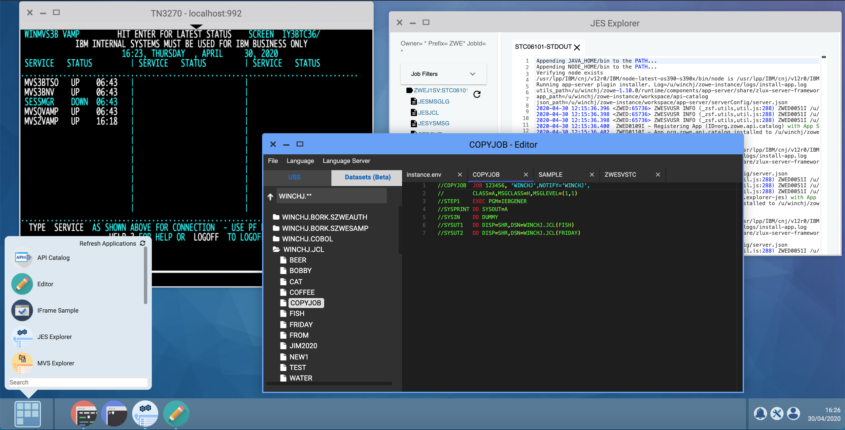
3270 emulator
JES Explorer
File Explorer
Available Apps
Logout and
User preferences
Pinned apps

