Slide 1

Final Capstone
What makes a good math student

Slide 2



What problem is being solved?
If you’re a smart student you’re always assigned to Classroom A or Classroom 1
What about the rest of the students?

Slide 3

Classroom Assignment vs Good Math Student
Math is a difficult subject
If we know the secrets of getting good grades from one of the hardest subjects…
We can apply it to other subjects
We can look into socio economic issues to enhance education
Better Student = Better Citizen

Slide 4




Who benefits?
Students
Parents
Teachers
Community
World

Slide 5

Student Performance Data Set
https://archive.ics.uci.edu/ml/datasets/Student+Performance
Source:
Paulo Cortez, University of Minho, Guimaraes, Portugal, http://www3.dsi.uminho.pt/pcortez
For this capstone, we’re using only the Math data portion on the data set.

Slide 6
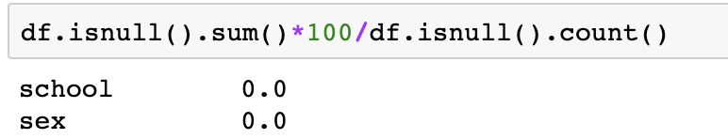
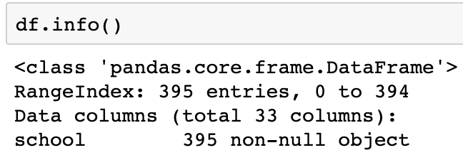
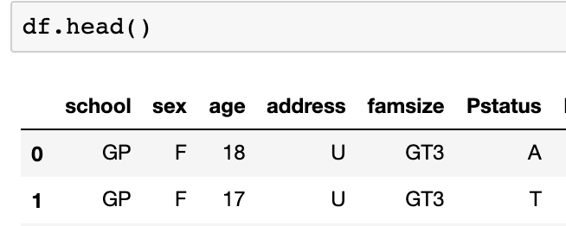
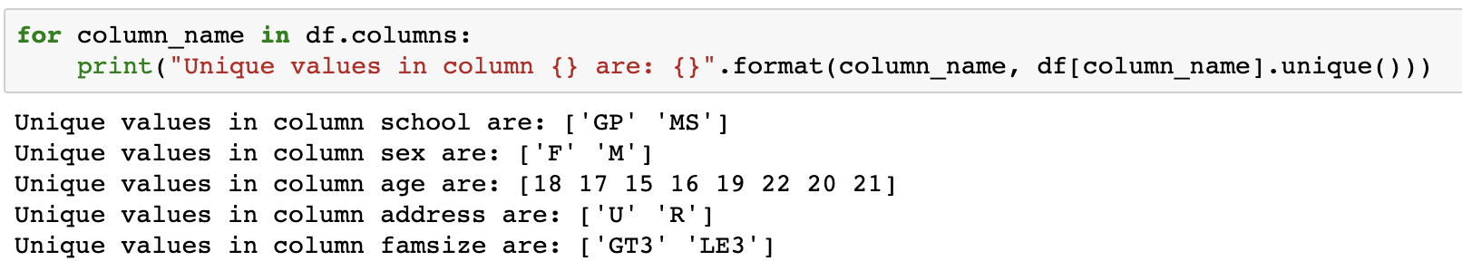
Data Exploration
Read the data
Review the dataset information and head
Look for missing data
Review the unique values for each column
No missing DATA!

Slide 7
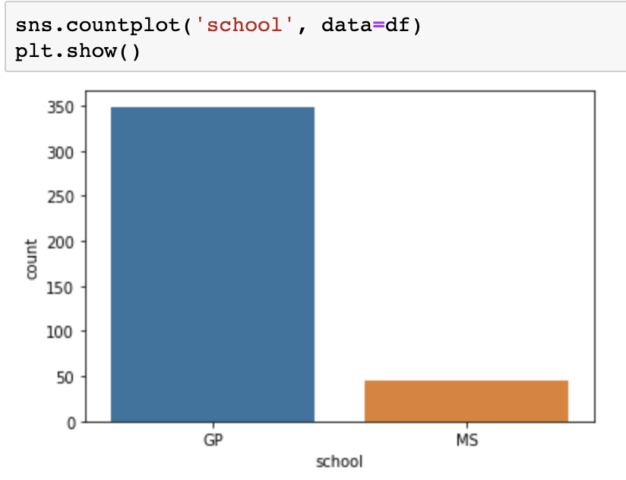
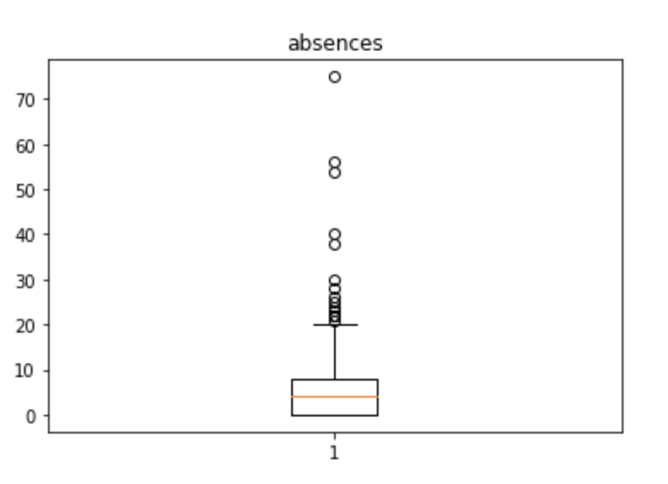

Slide 8

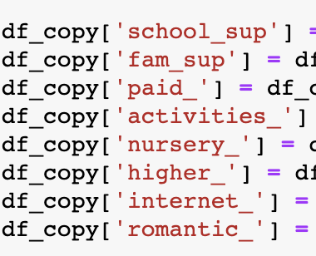
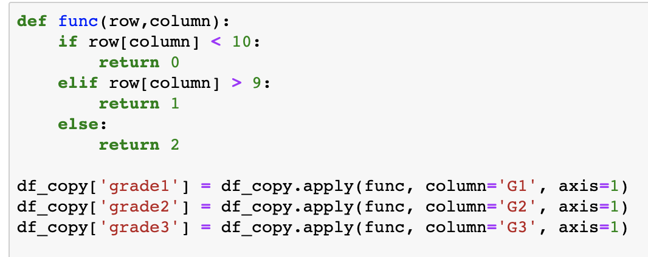

Feature Engineering

Slide 9
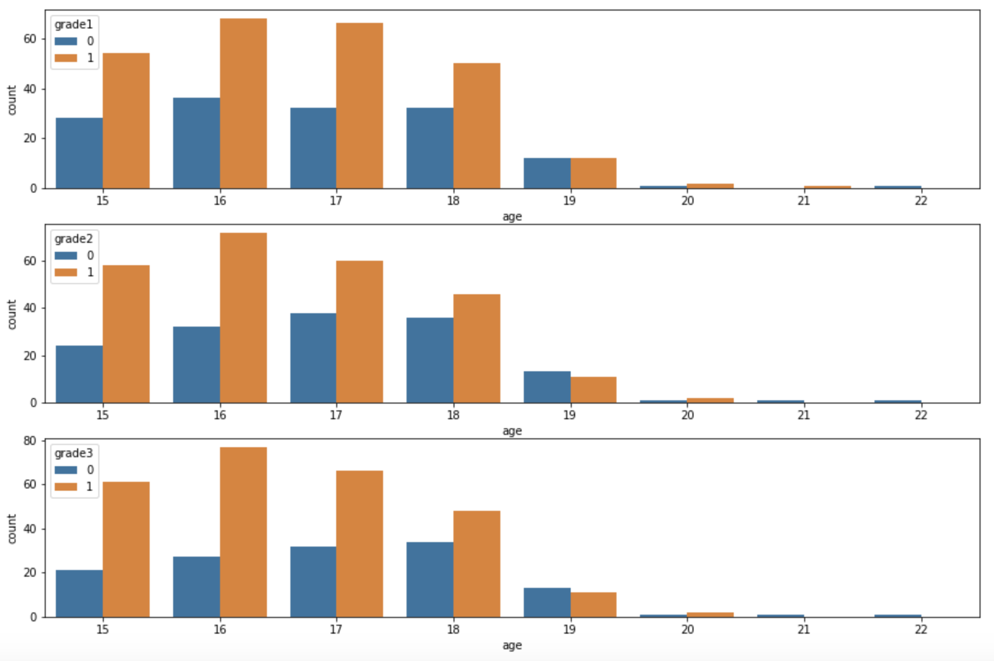

Slide 10
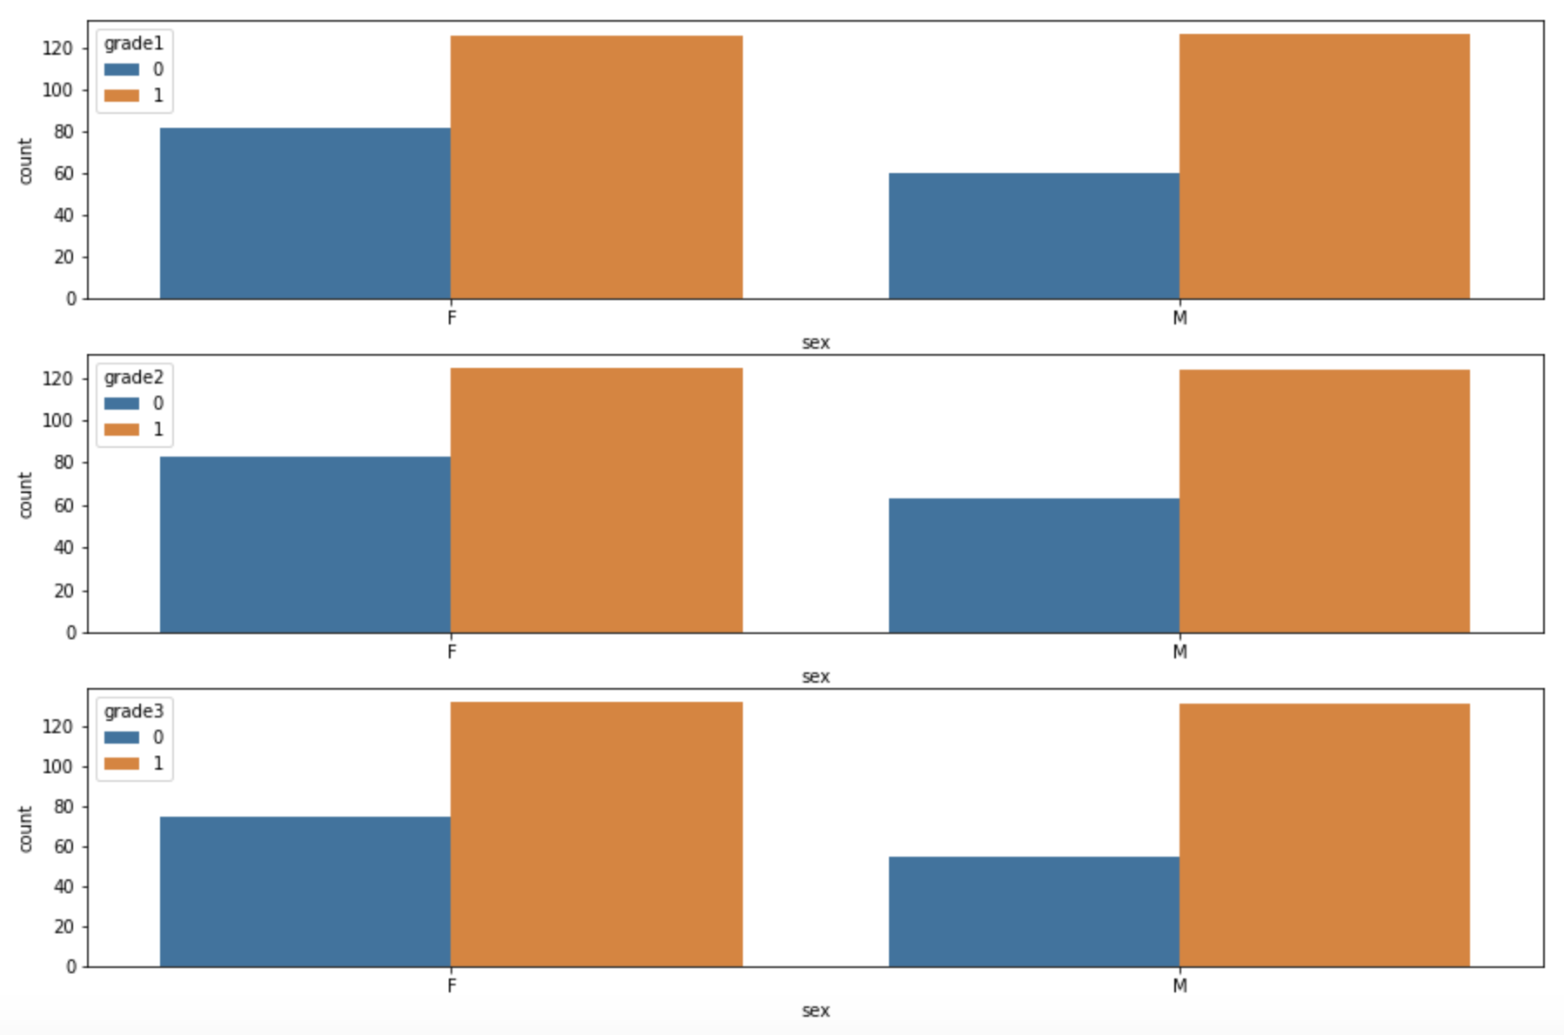
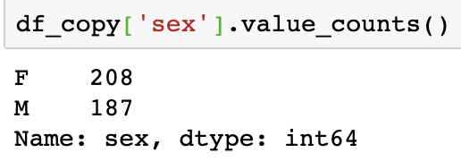

Slide 11
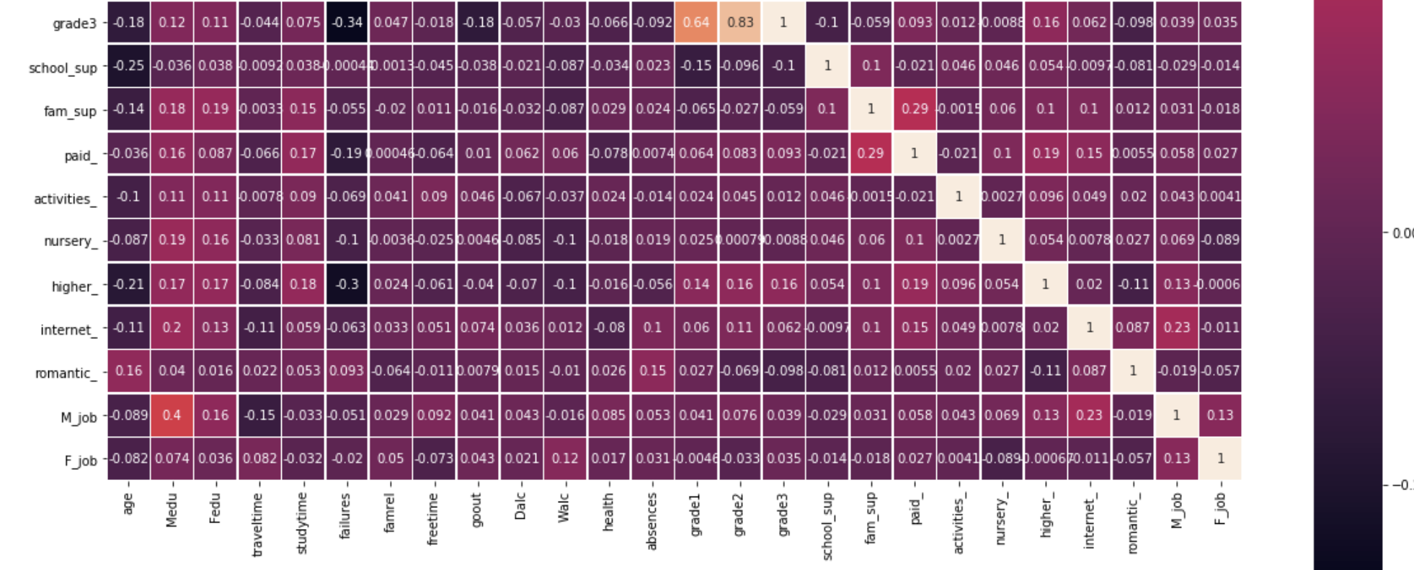
Correlation Matrix

Slide 12
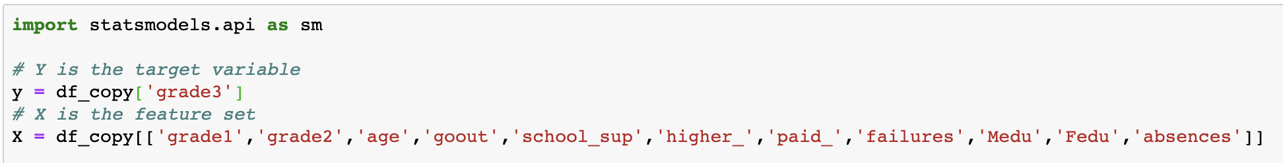
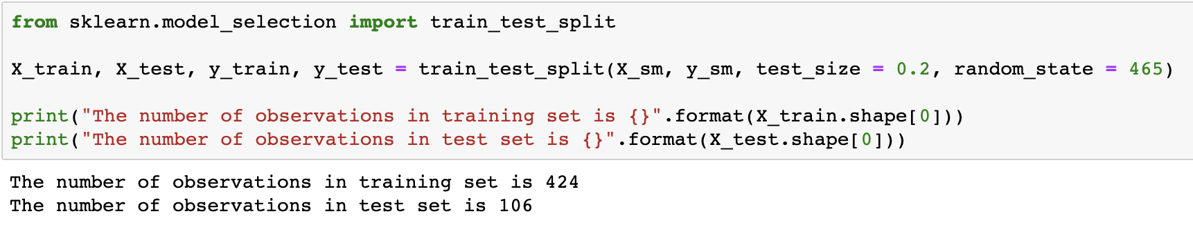
Testing and Training

Slide 13
Building a Model

Slide 14
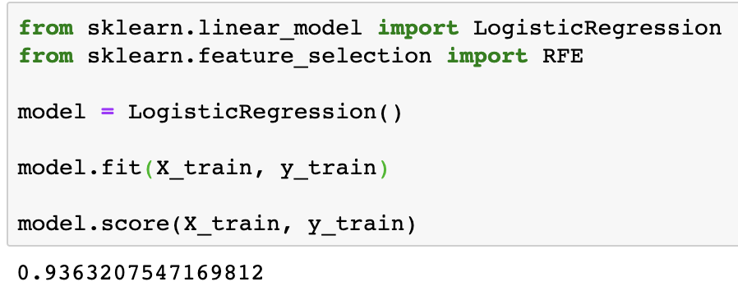
Logistic Regression Model

Slide 15
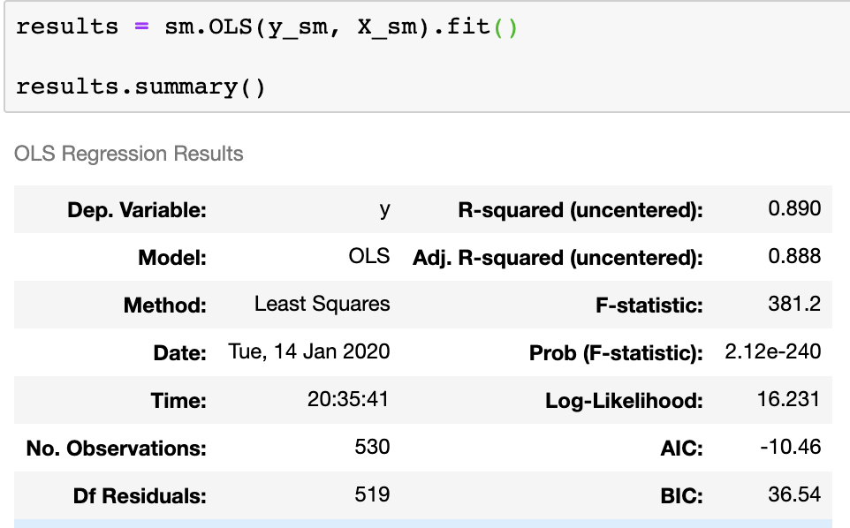
OLS (Ordinary Least Square) Regression

Slide 16
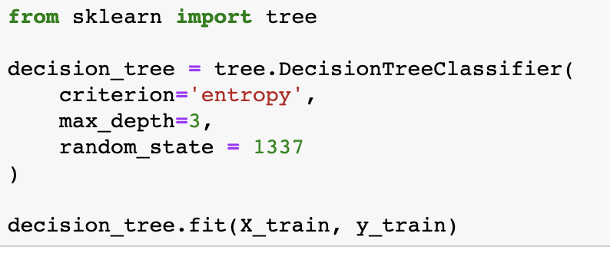
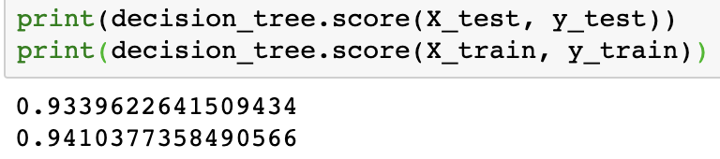

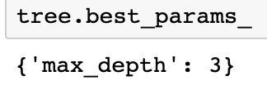
Decision Tree

Slide 17
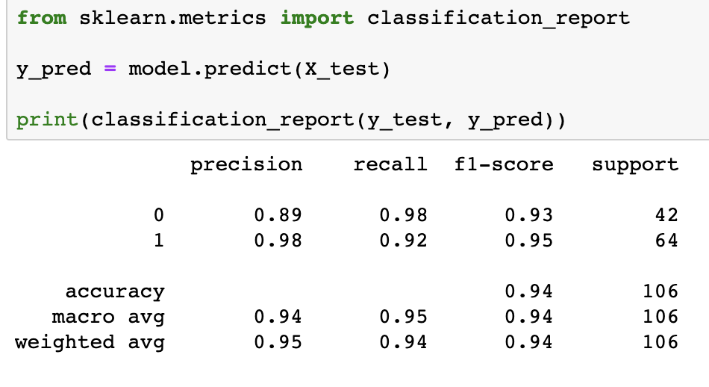
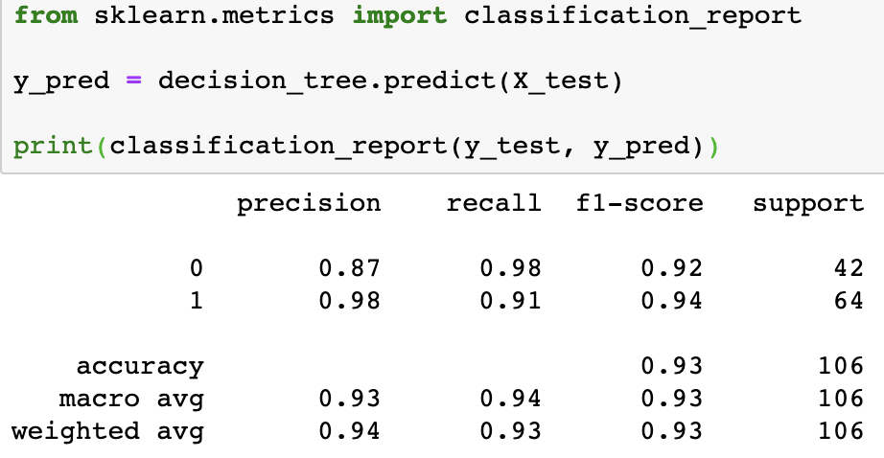
Model Comparison
Logistic
Decision Tree

Slide 18
Summary

Slide 19
Deciding on a model
Our target data is a moving target and in this capstone was changed to a categorical variable.
I used different models: Logistic, OLS, and Decision Models.

Slide 20
Why it works?
Logistic regression is used to describe data and to explain the relationship between one dependent binary variable and one or more nominal, ordinal, interval or ratio-level independent variables.

Slide 21
What problem it solves?
Factors related to getting good grades in math are determined.

Slide 22
How it will run in a production like environment?
Though I am trying to determine what factors makes a math genius, this can also be applied to helping students in other difficult subjects, such as science. If we know these factors, then we would plead a case to our educational board members on how to better allocate funds. This data will help us decide what is most important to help produce better quality students.

Slide 23
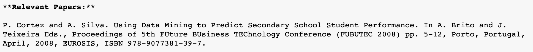
What are the next steps?
Analyze the original data set for a stronger buy-in
Be at the right place at the right time
Create a ripple effect
Continue to capture the data

