Slide 1
Single vs. Multispecies VAST Output
Sebastes alutus, S. polyspinis, S. variabilis

Slide 2
5-fold Cross Validation-RRMSE of predictions
 | Multispecies VAST Runs |  |  |  |  | Single-Species VAST Runs
 | No density covariates |  | Depth covariates |  |  | No density covariates | Depth covariates
 | 2 factors | 3 factors | 2 factors | 3 factors
Sebastes alutus | 6.0 | 5.2 | 8.0 | 5.5 |  | 4.8 | 4.63
Sebastes polyspinis | 12.7 | 11.0 | 10.5 | 8.2 |  | 9.0 | 7.92
Sebastes variabilis | 9.8 | 9.7 | 10.7 | 10.5 |  | 9.4 | 7.70
Average | 9.5 | 8.6 | 9.7 | 8.0

Slide 3
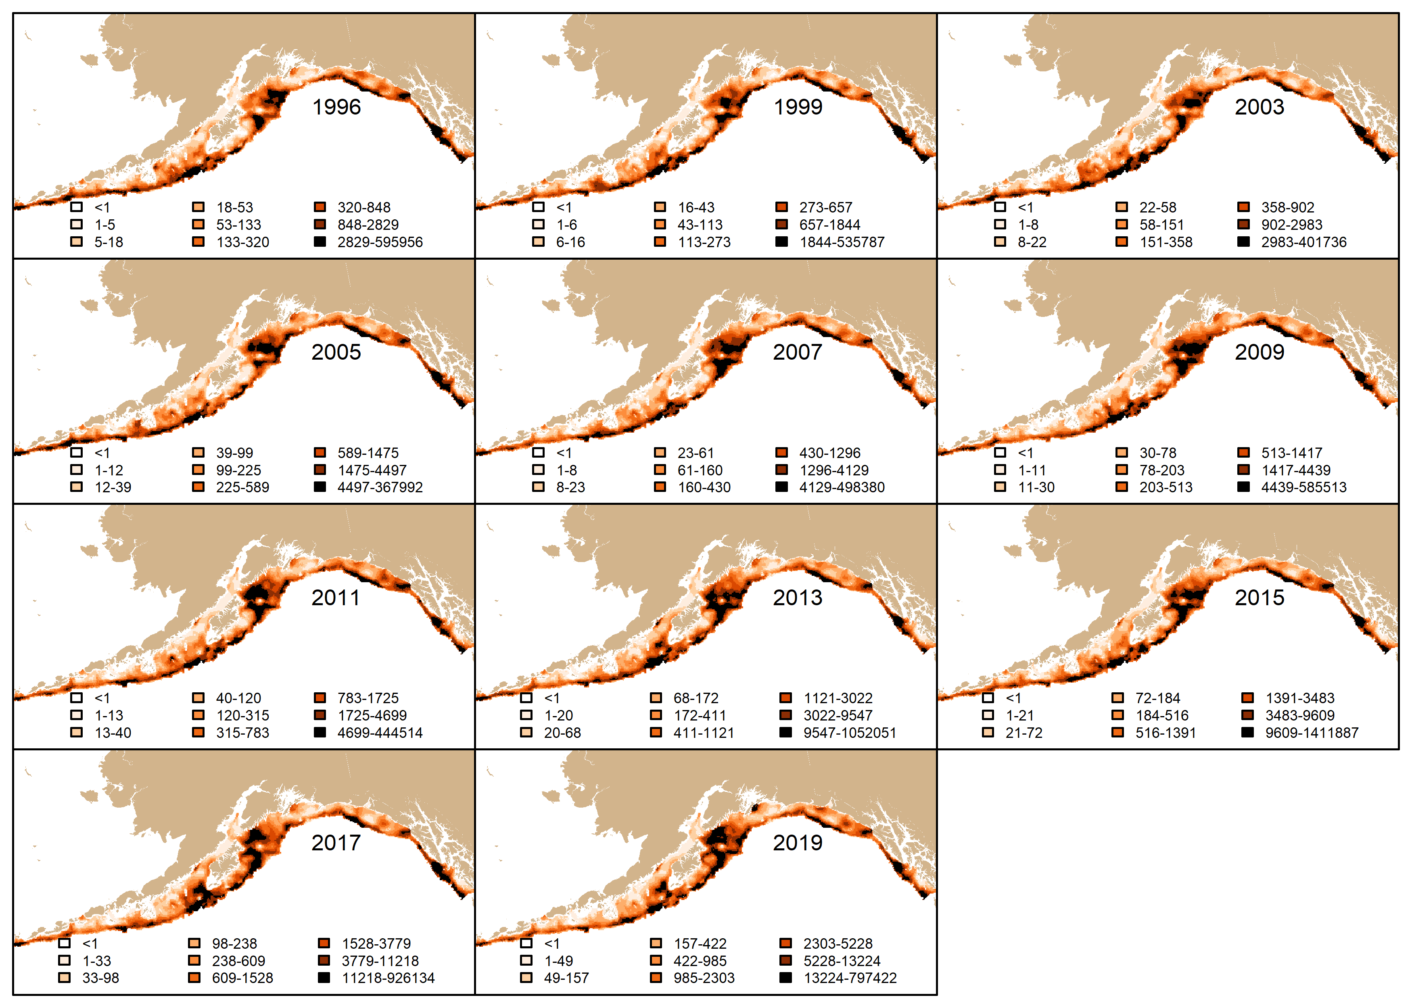
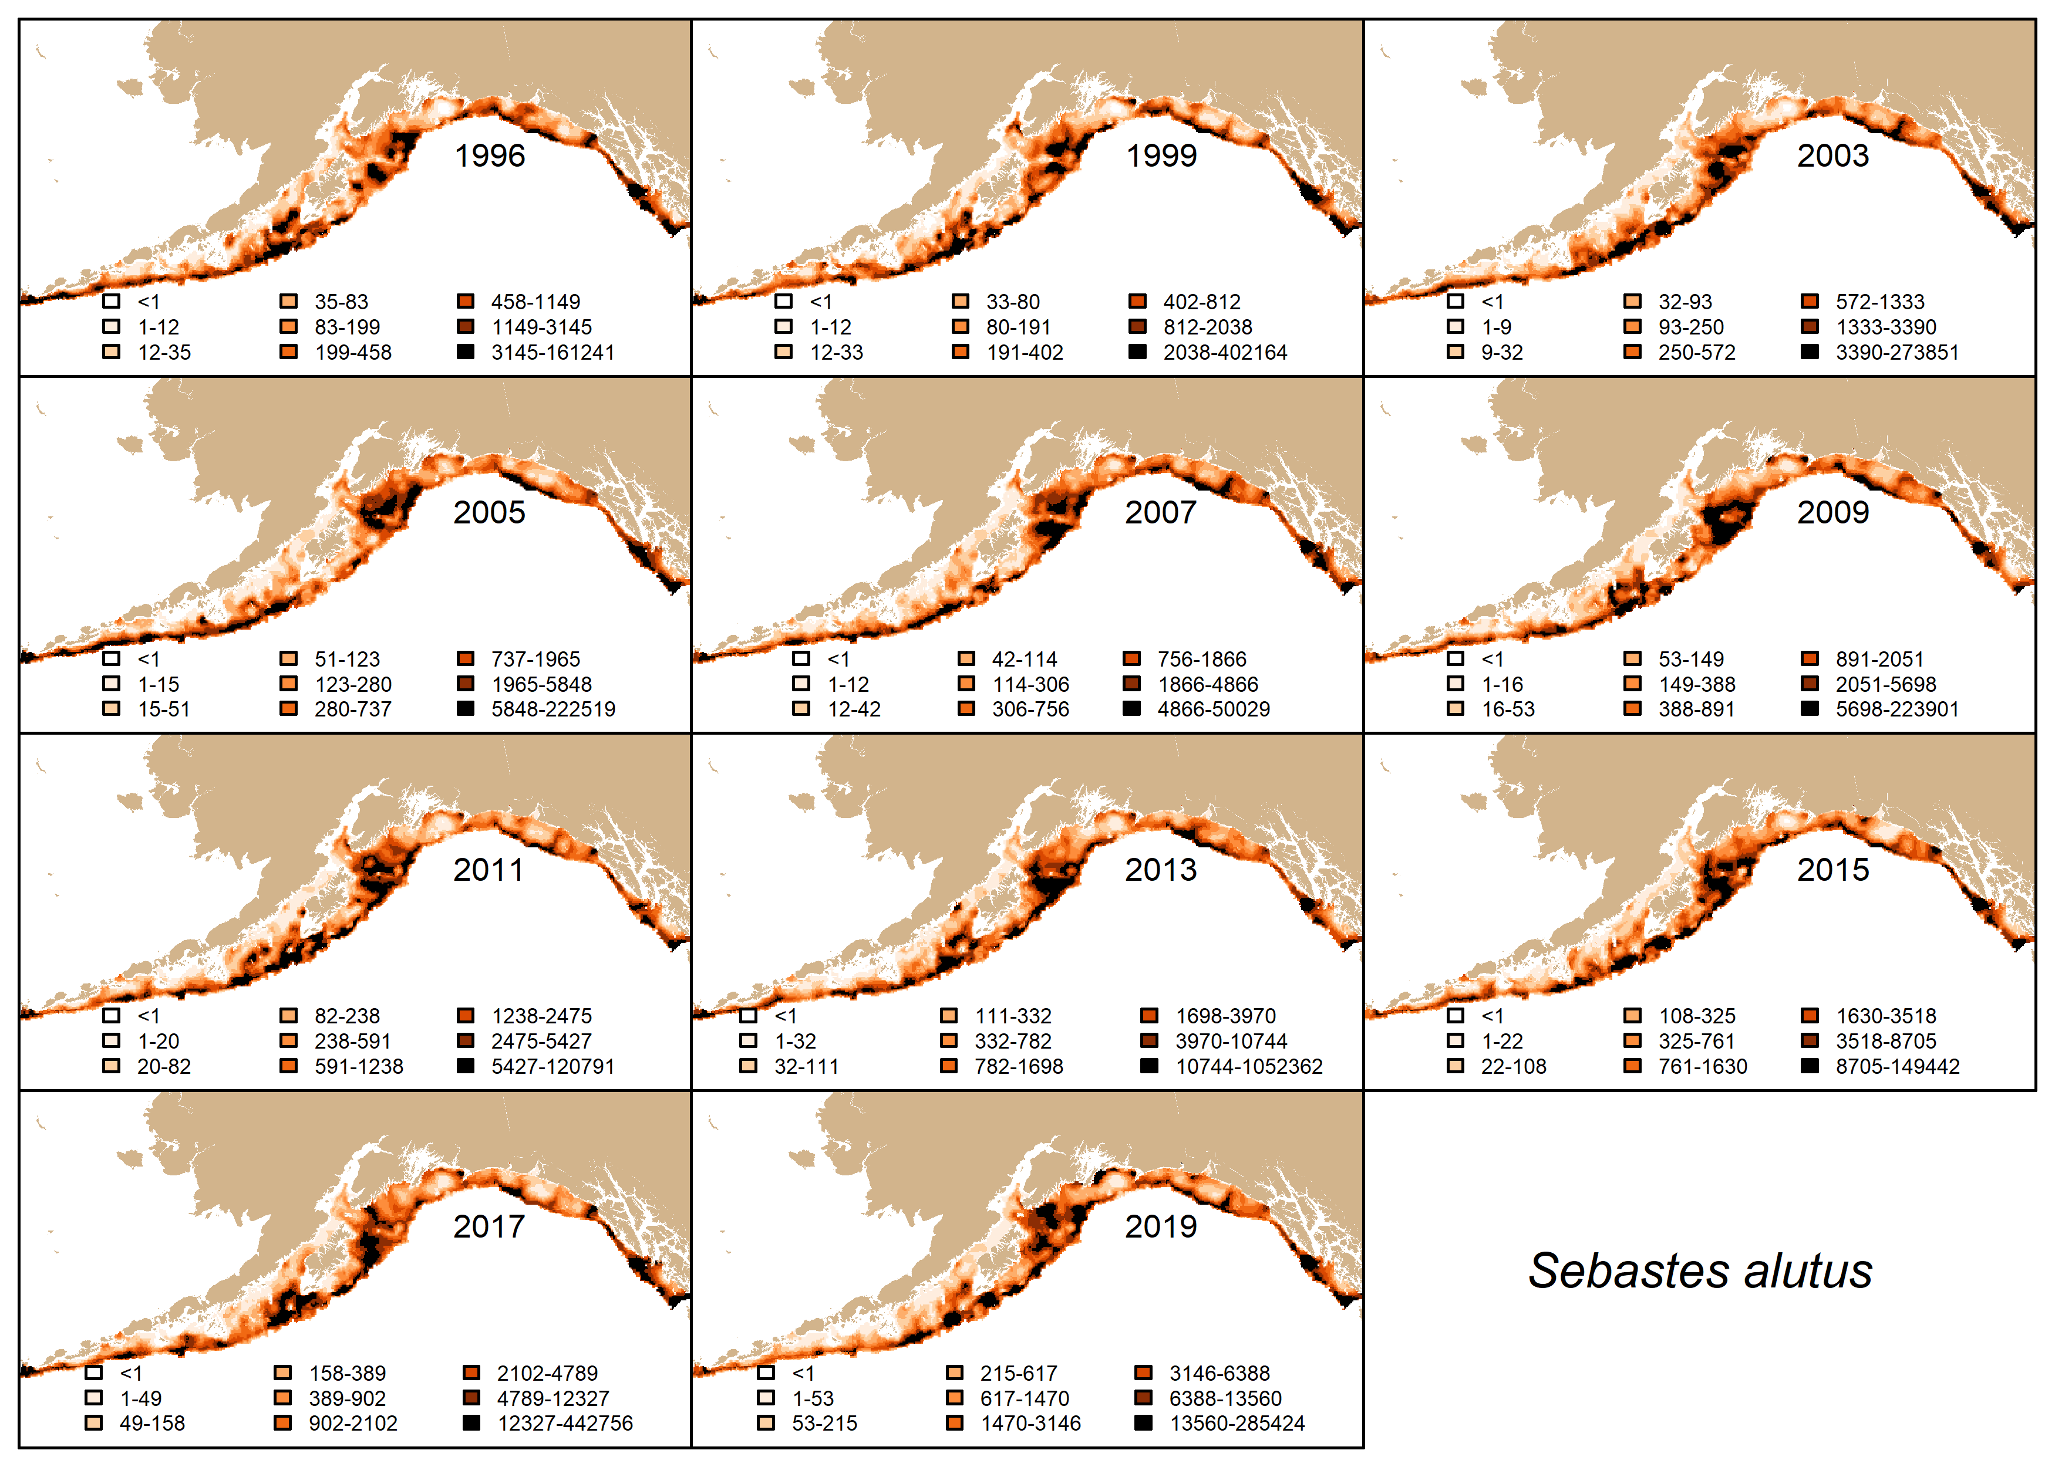
Density: Sebastes alutus
Single Species VAST
Multispecies VAST

Slide 4
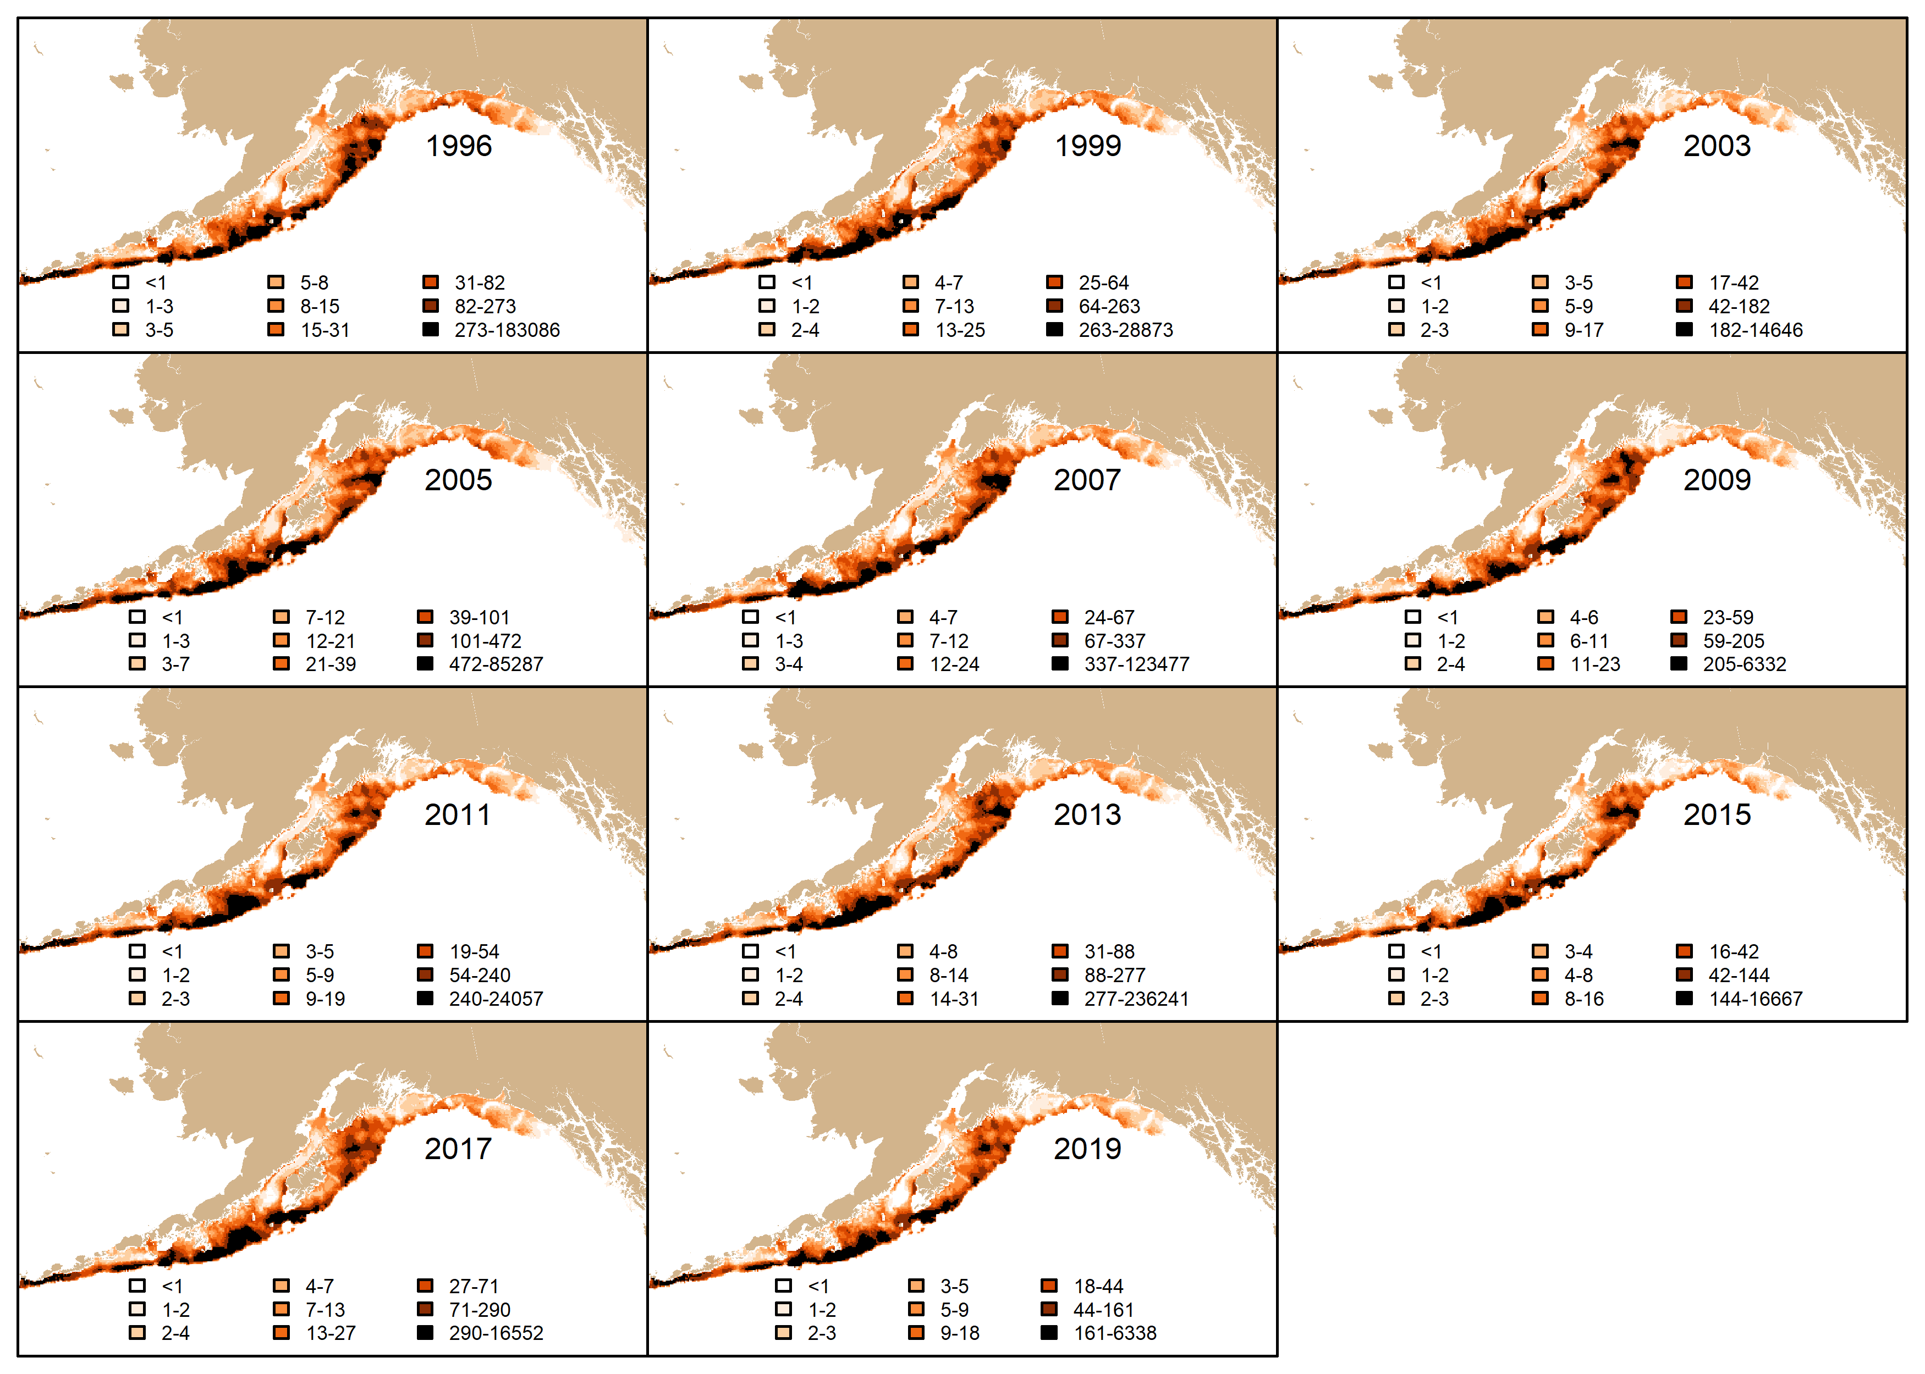
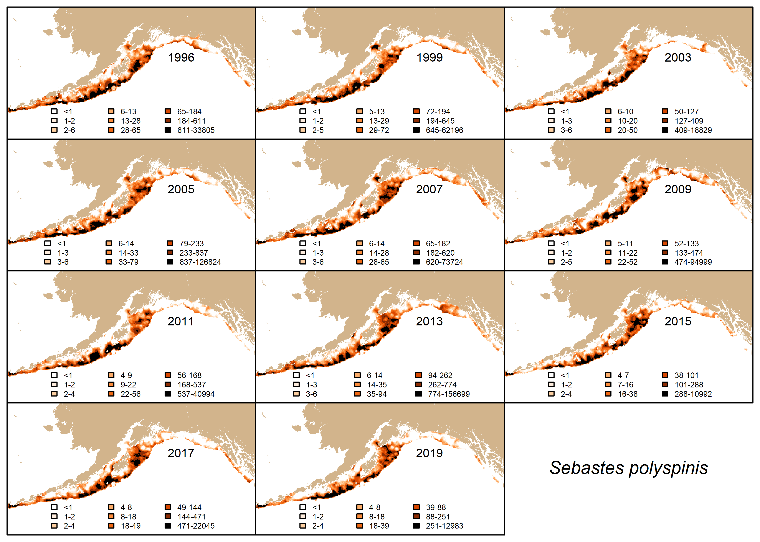
Density: Sebastes polyspinis
Single Species VAST
Multispecies VAST

Slide 5
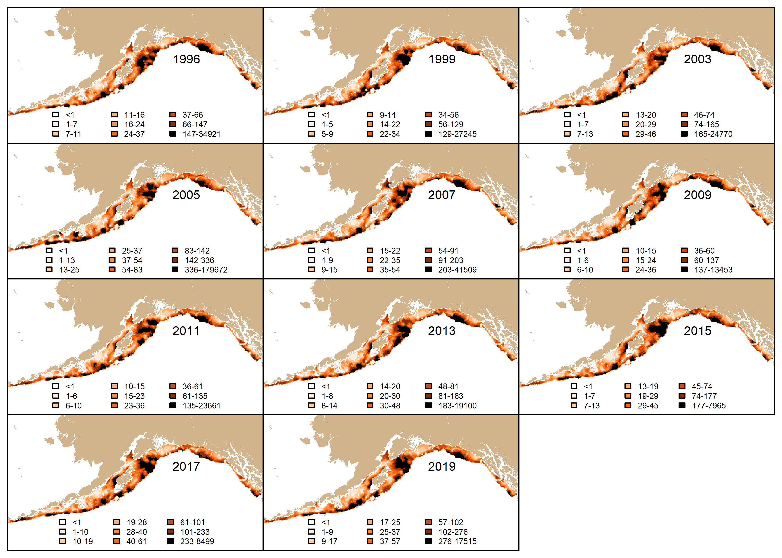
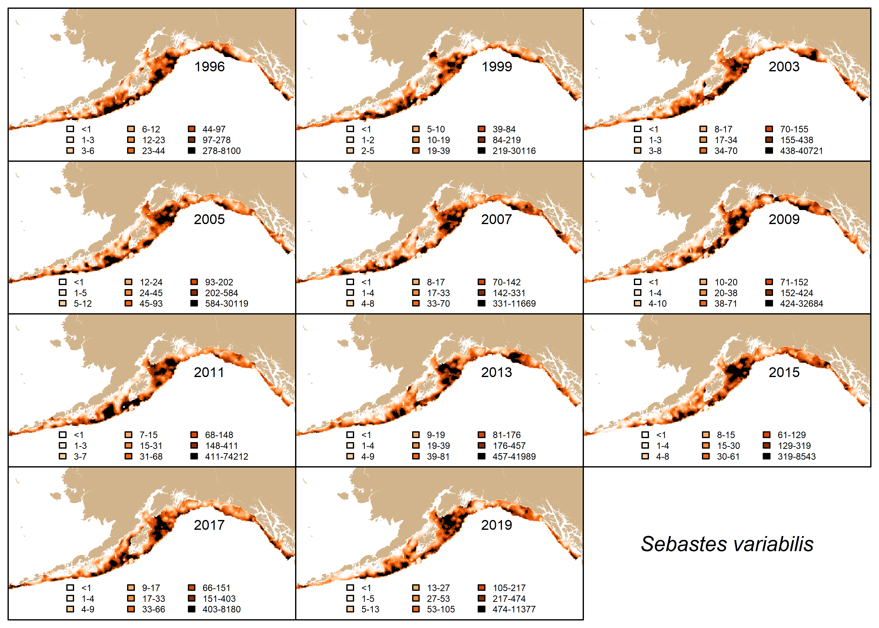
Density: Sebastes variabilis
Single Species VAST
Multispecies VAST

Slide 6
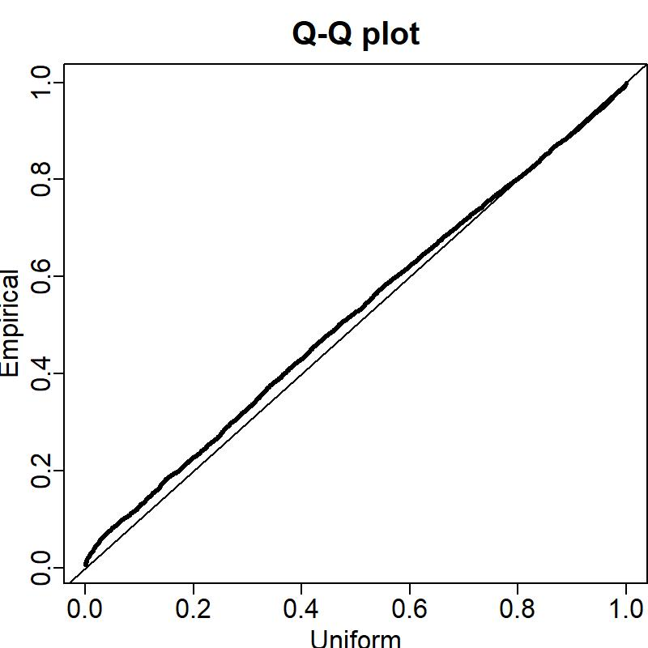
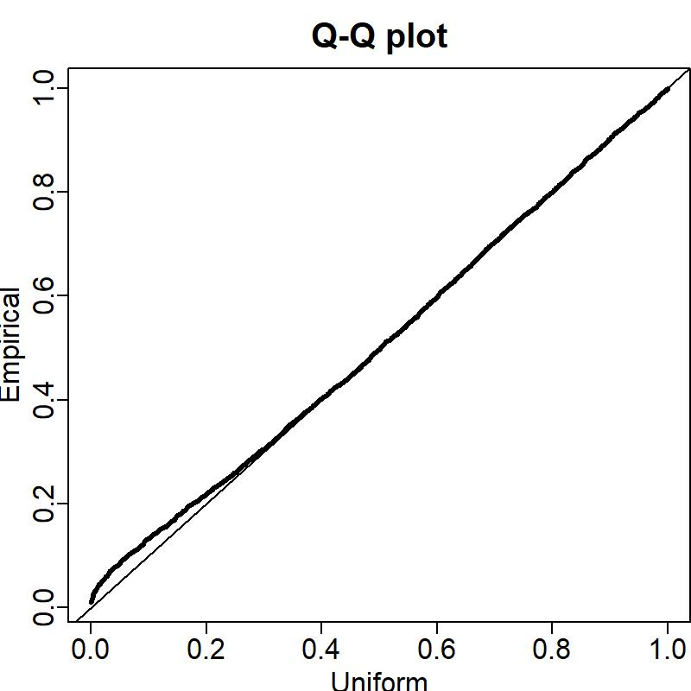
Diagnostics: QQ-Plots (Sebastes alutus)
Single Species VAST
Multispecies VAST

Slide 7
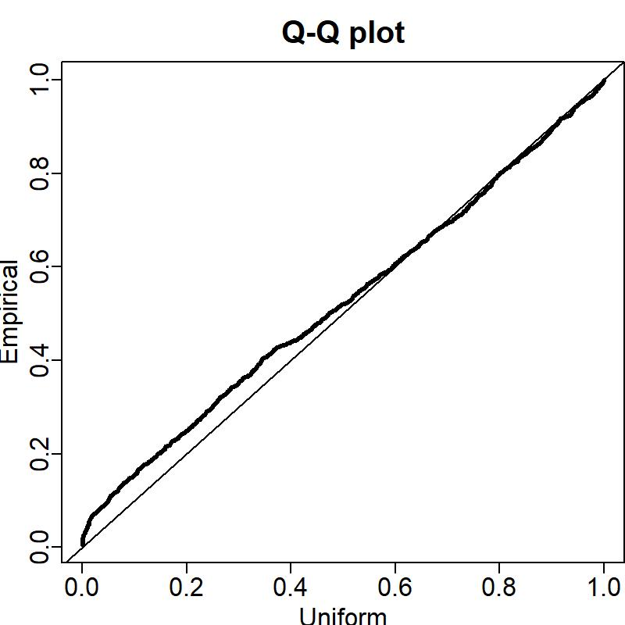
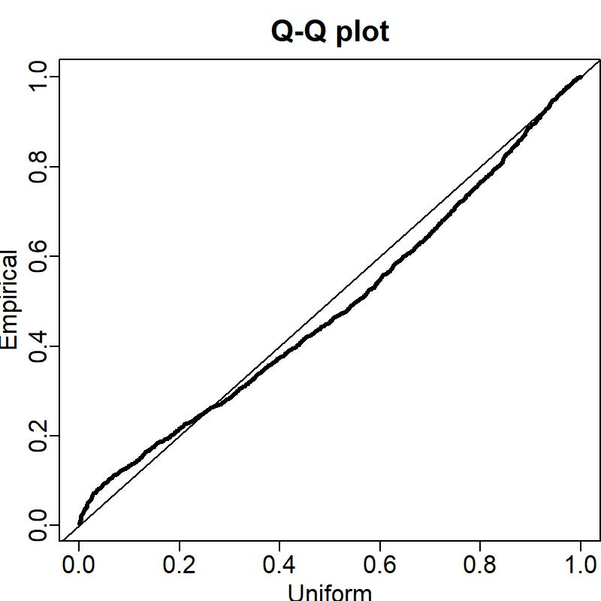
Diagnostics: QQ-Plots (Sebastes polyspinis)
Single Species VAST
Multispecies VAST

Slide 8
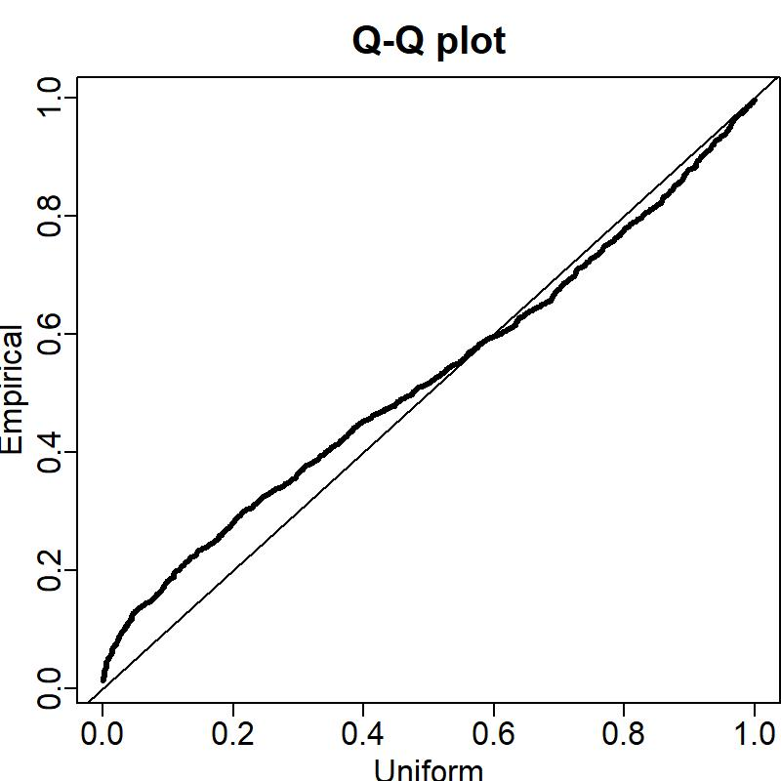
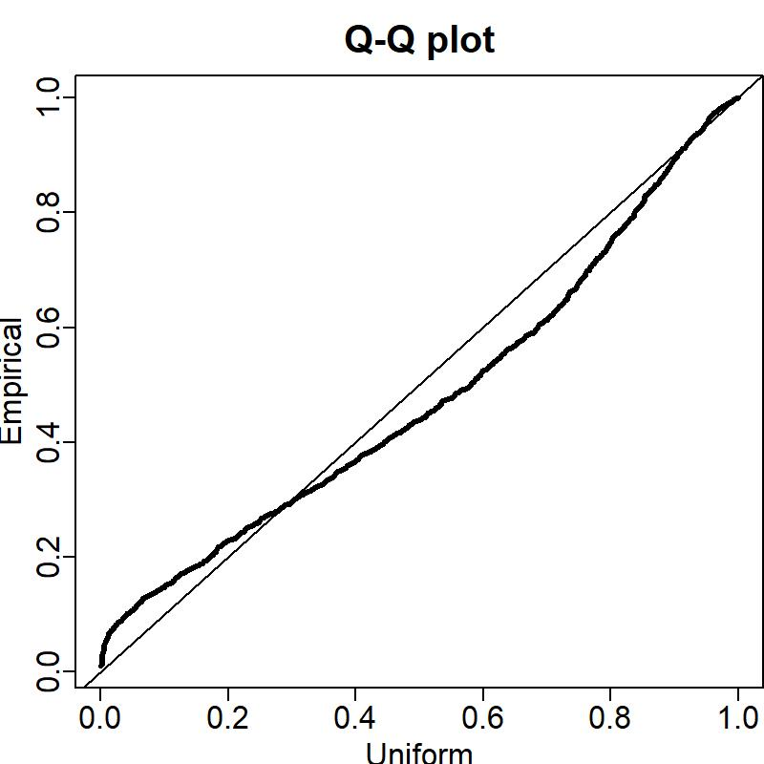
Diagnostics: QQ-Plots (Sebastes variabilis)
Single Species VAST
Multispecies VAST

