Slide 1
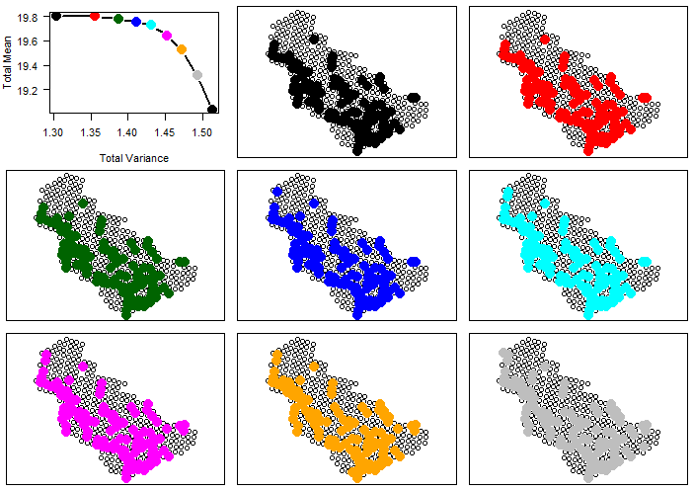
Notes:
Equal Weighting

Slide 2
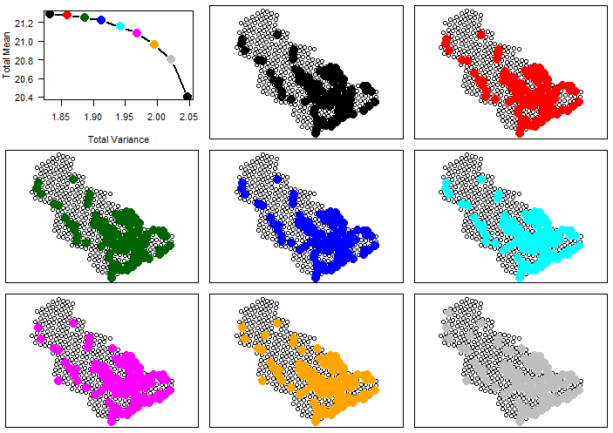
Notes:
Slightly more weight on yellowfin sole

Slide 3
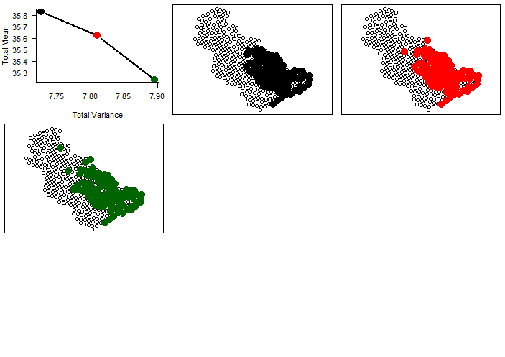
Notes:
Yellowfin sole dominant

Slide 4
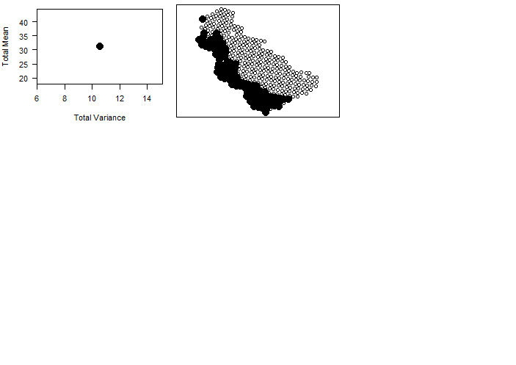
Notes:
ATF dominant

Slide 5
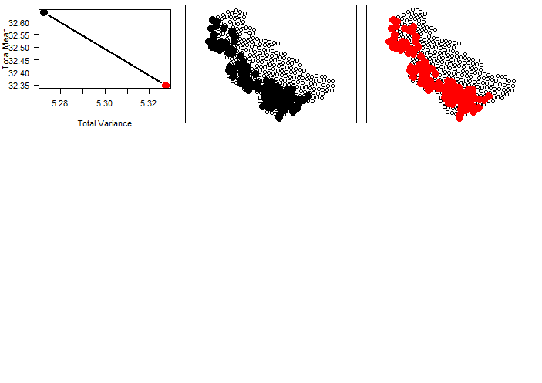
Notes:
Flathead sole dominant

Slide 6
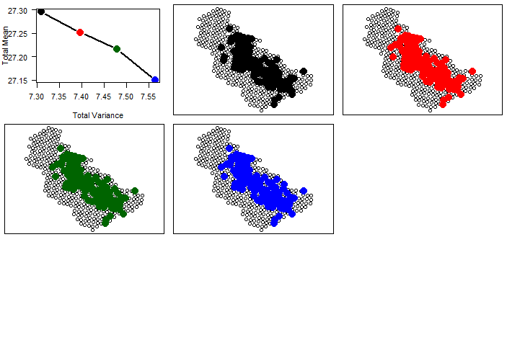
Notes:
Walleye pollock dominant

Slide 7
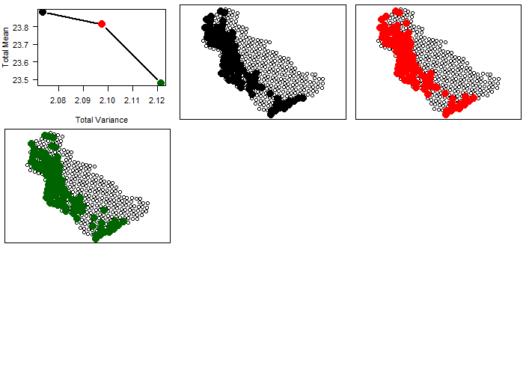
Notes:
AK_Plaice dominant

