Slide 1
Methods Updates
Updated VAST version to be consistent with ModSquad settings
Using new VAST-defaulted chukchi_sea_grid as the interpolation grid
Slightly different from grid that we were currently using
Increased range of sampling effort
Old → 40 – 100 stations
New → 50 – 160 stations
Upper limit set by
Total Sampling Effort
Survey Designs
Gear Types
VAST Fits
Slides 3-8
Simulate Densities
Simulate Surveys
Species Set
Survey Performance

Slide 2
Species List Modified from Stan and Duane’s input/information Otter: 6 fish spp. → 12 fish taxa and 8 invert taxa Beam: 5 fish spp. → 6 fish taxa and 7 invert taxa
Methods Updates
Scientific Name | Common Name | Gear
Pleuronectes quadrituberculatus | Alaska plaice | otter trawl
Boreogadus saida | Arctic cod | otter and beam trawl
Hippoglossoides robustus | Bering flounder | otter and beam trawl
Family: Zoarchidae | eelpouts | otter trawl
Family: Pleuronectidae | other flatfishes | otter trawl
Clupea pallasii | Pacific herring | otter trawl
Family: Agonidae | poachers | otter and beam trawl
Eleginus gracilis | saffron cod | otter and beam trawl
Family: Cottidae | sculpins | otter and beam trawl
Family: Liparidae | snailfishes | otter and beam trawl
Gadus chalcogrammus | walleye pollock | otter trawl
Limanda aspera | yellowfin sole | otter trawl
Class: Bivalvia | bivalves | beam trawl
Class: Anthozoa | corals | otter and beam trawl
Class: Scyphozoa | jellyfishes | otter trawl
Class: Asteroidea | other seastars | otter trawl
Asterias amurensis | purple-orange sea star | otter and beam trawl
Class: Holothuroidea | sea cucumbers | otter and beam trawl
Class: Gastropoda | snails | otter and beam trawl
Chionoecetes opilio | snow crab | otter and beam trawl
Subphylum: Tunicata | tunicates | otter and beam trawl

Slide 3
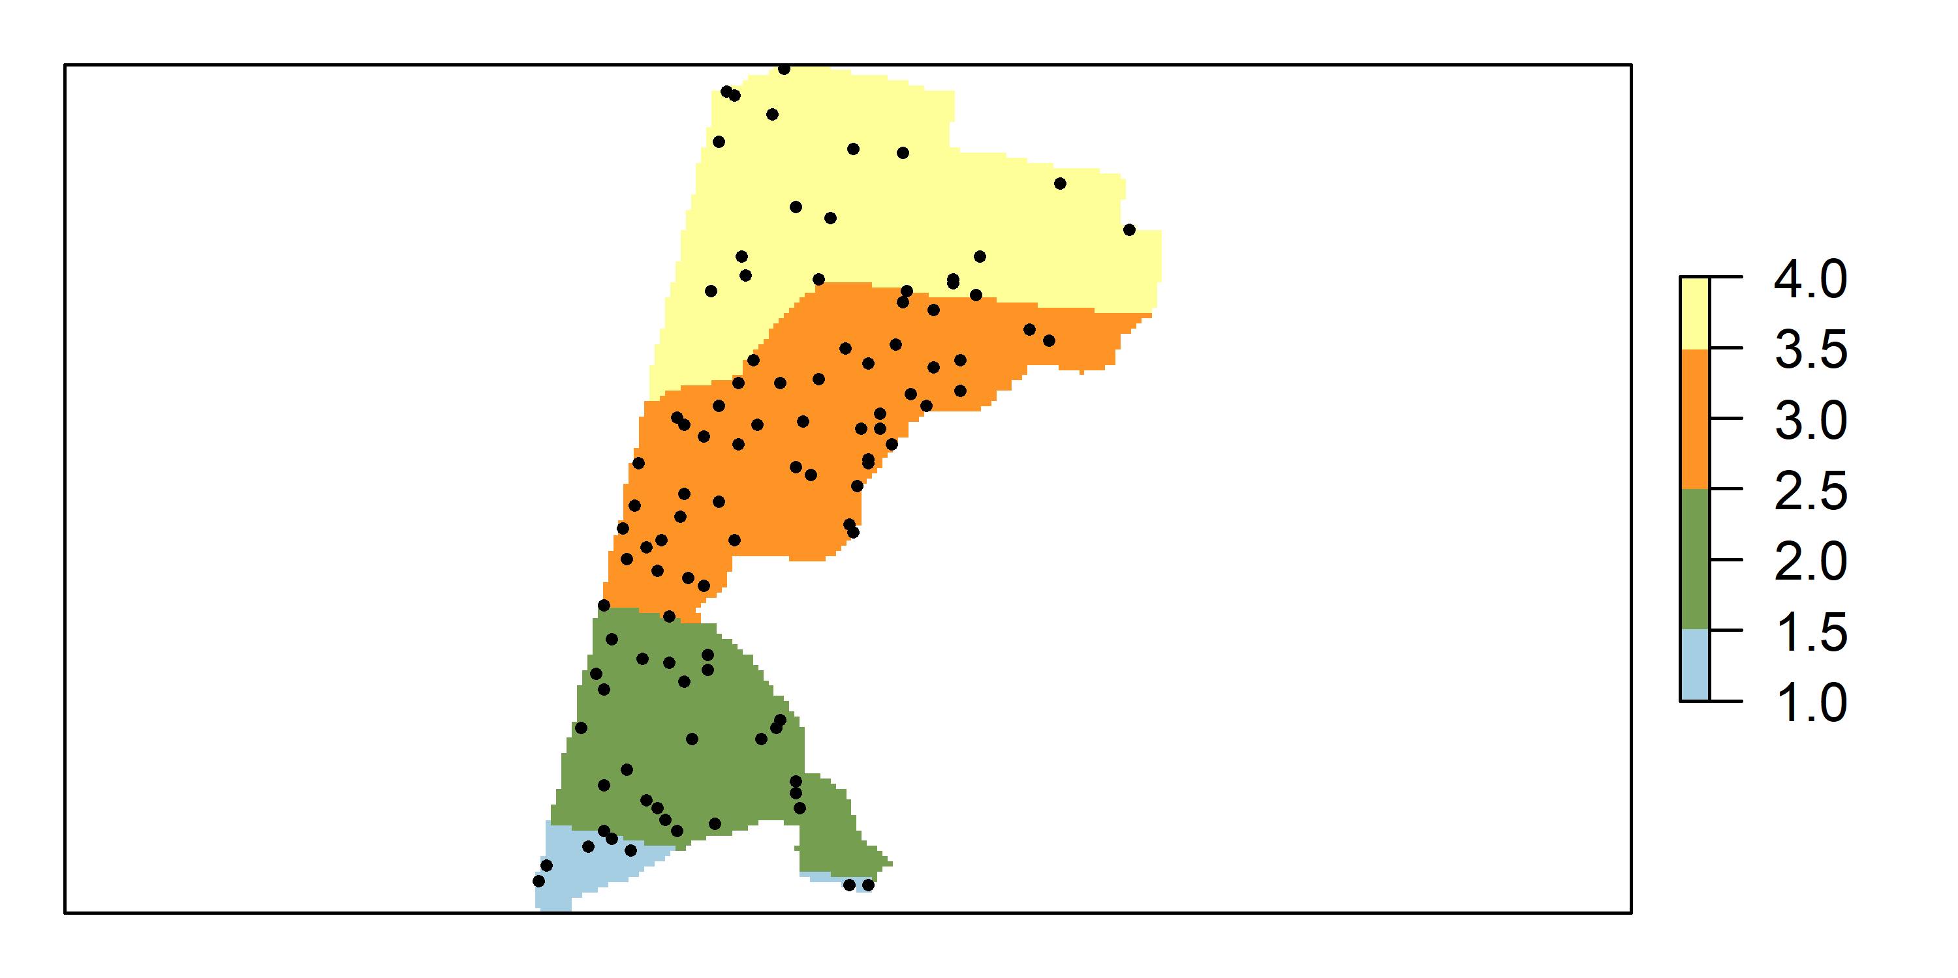
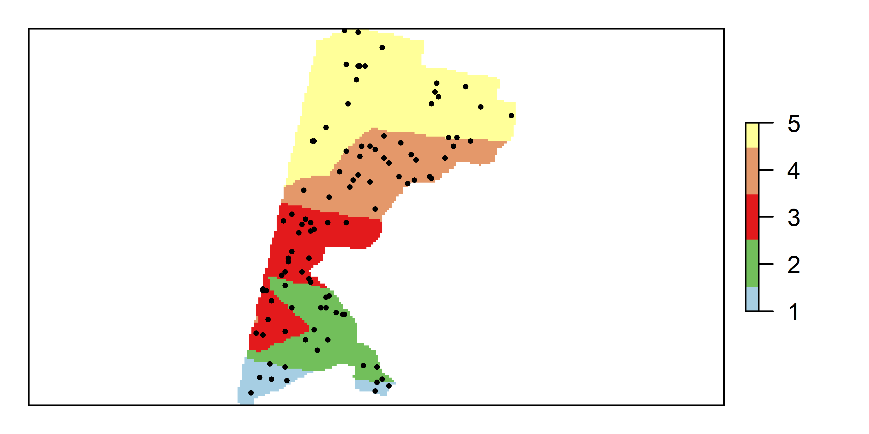
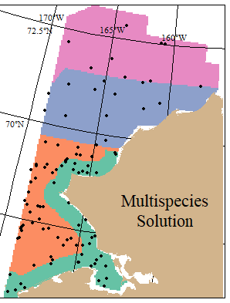
4 STRATA SOLUTION
5 STRATA SOLUTION
Updated: 12 fish taxa, 8 invert taxa
Old: 6 major fish species
OTTER TRAWL

Slide 4
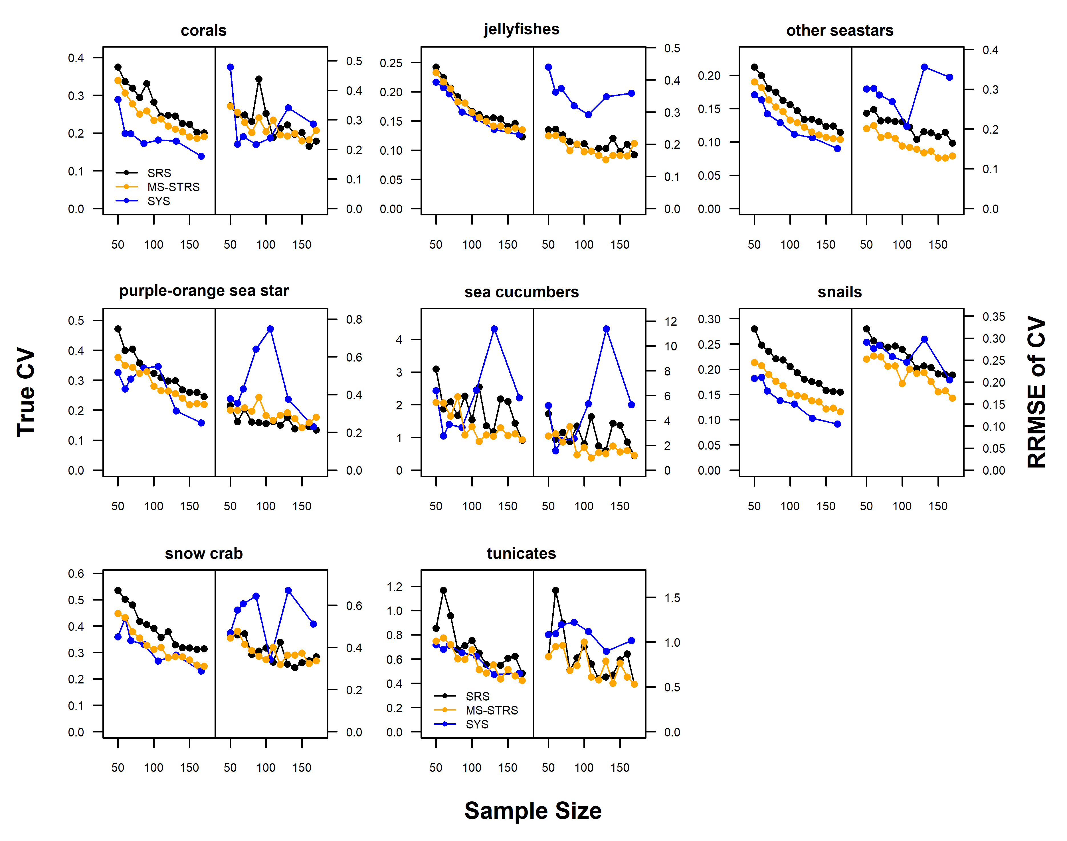
True CV (Left plots): Standard deviation of simulated indices, normalized by true index.
RRMSE of CV (Right plots): uncertainty and bias of CV about the true CV
Simple Random
Stratified Random
Systematic Grid

Slide 5
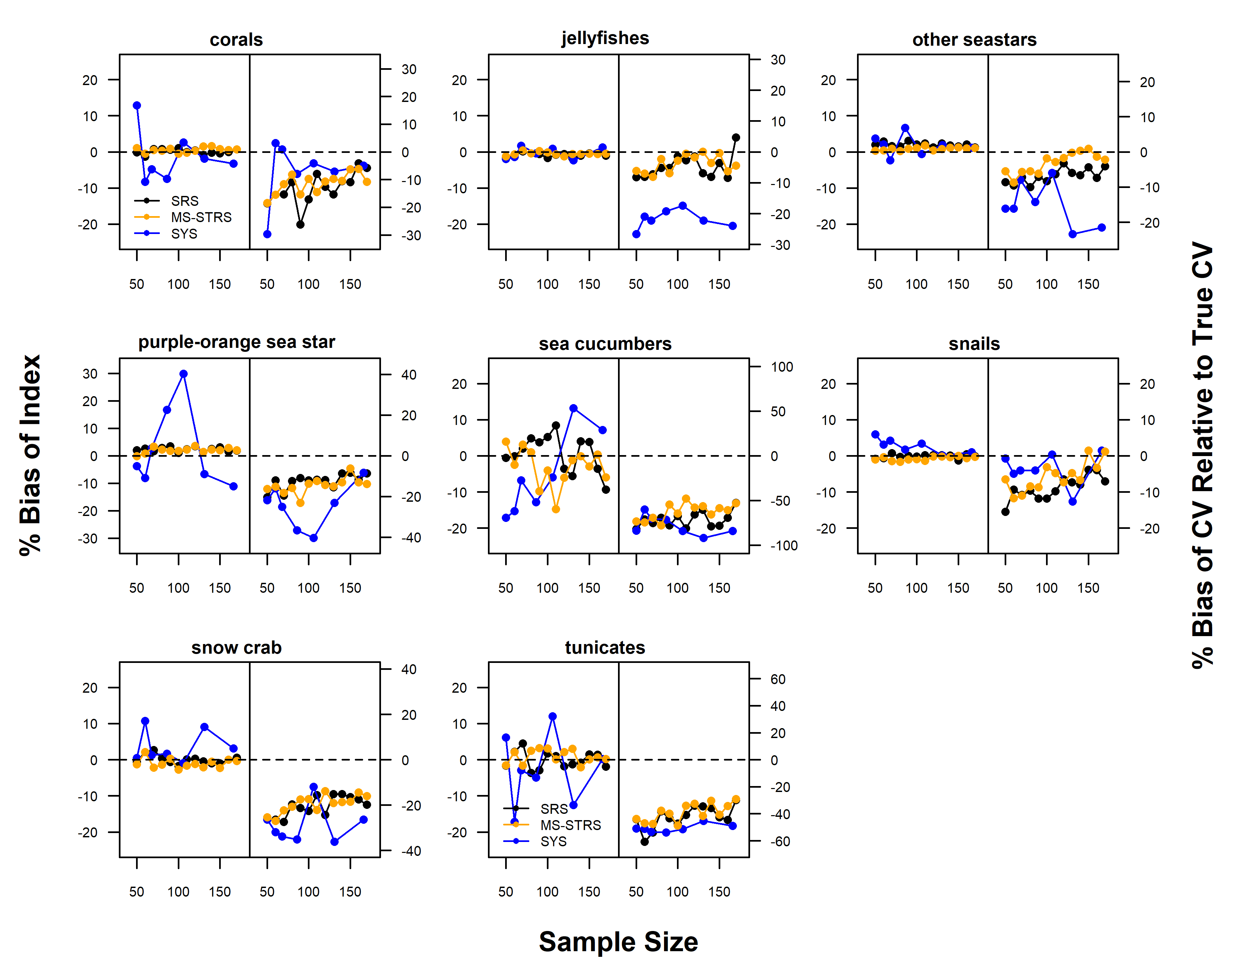
Average Percent Bias Plots
Index relative to true index (Left)
CV relative to True CV (Right)
Simple Random
Stratified Random
Systematic Grid

