Slide 1
Chukchi Survey Design Updates
17 May 2022

Slide 2
Background
Goal: plan a suite of survey designs in anticipation for a Chukchi and/or Beaufort sea bottom trawl survey
evaluate flexibility of random and systematic survey designs
Optimize STRS design similar to work done in the GOA
Historical surveys go back to the 1950s, periodic, spatially unbalanced, operations unstandardized
Otter trawl surveys: 1990 and 2012 (RACEBASE)
Beam trawl survey: 2012 (RACEBACE 2012), 2017, 2019 (Arctic IERP)
Taxa: commercially and/or culturally important fish and invertebrate taxa
Metric: abundance index, associated precision

Slide 3
Workflow
Total Sampling Effort
Gear Types
Optimized STRS design
Survey Designs
Species Set
Spatiotemporal distribution modelling
Simulate Densities
Simulate Surveys
Historical CPUE data
Survey Performance

Slide 4
Taxa List
Scientific Name | Common Name | Gear
Pleuronectes quadrituberculatus | Alaska plaice | otter trawl
Boreogadus saida | Arctic cod | beam and otter trawl
Hippoglossoides robustus | Bering flounder | beam and otter trawl
Family: Zoarchidae | eelpouts | otter trawl
Family: Pleuronectidae | other flatfishes | otter trawl
Clupea pallasii | Pacific herring | otter trawl
Family: Agonidae | poachers | beam and otter trawl
Family: Stichaeidae | pricklebacks | beam trawl
Eleginus gracilis | saffron cod | beam and otter trawl
Family: Cottidae | sculpins | beam and otter trawl
Family: Liparidae | snailfishes | beam and otter trawl
Gadus chalcogrammus | walleye pollock | otter trawl
Limanda aspera | yellowfin sole | otter trawl
Class: Bivalvia | bivalves | beam trawl
Phylum: Bryozoa | bryozoans | beam trawl
Class: Anthozoa | corals | beam and otter trawl
Class: Scyphozoa | jellyfishes | otter trawl
Class: Asteroidea | other seastars | otter trawl
Asterias amurensis | purple-orange sea star | beam and otter trawl
Class: Holothuroidea | sea cucumbers | beam and otter trawl
Class: Gastropoda | snails | beam and otter trawl
Chionoecetes opilio | snow crab | beam and otter trawl
Subphylum: Tunicata | tunicates | beam and otter trawl
Species Set
Gear Types
Spatiotemporal distribution modelling
Historical CPUE data

Slide 5
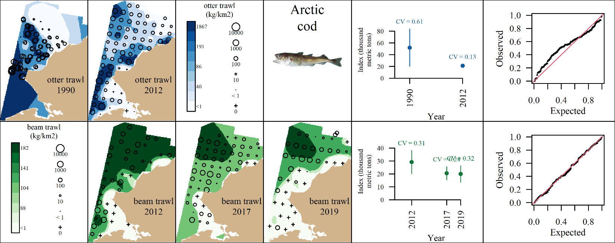
Species Set
Gear Types
Spatiotemporal distribution modelling
Historical CPUE data

Slide 6
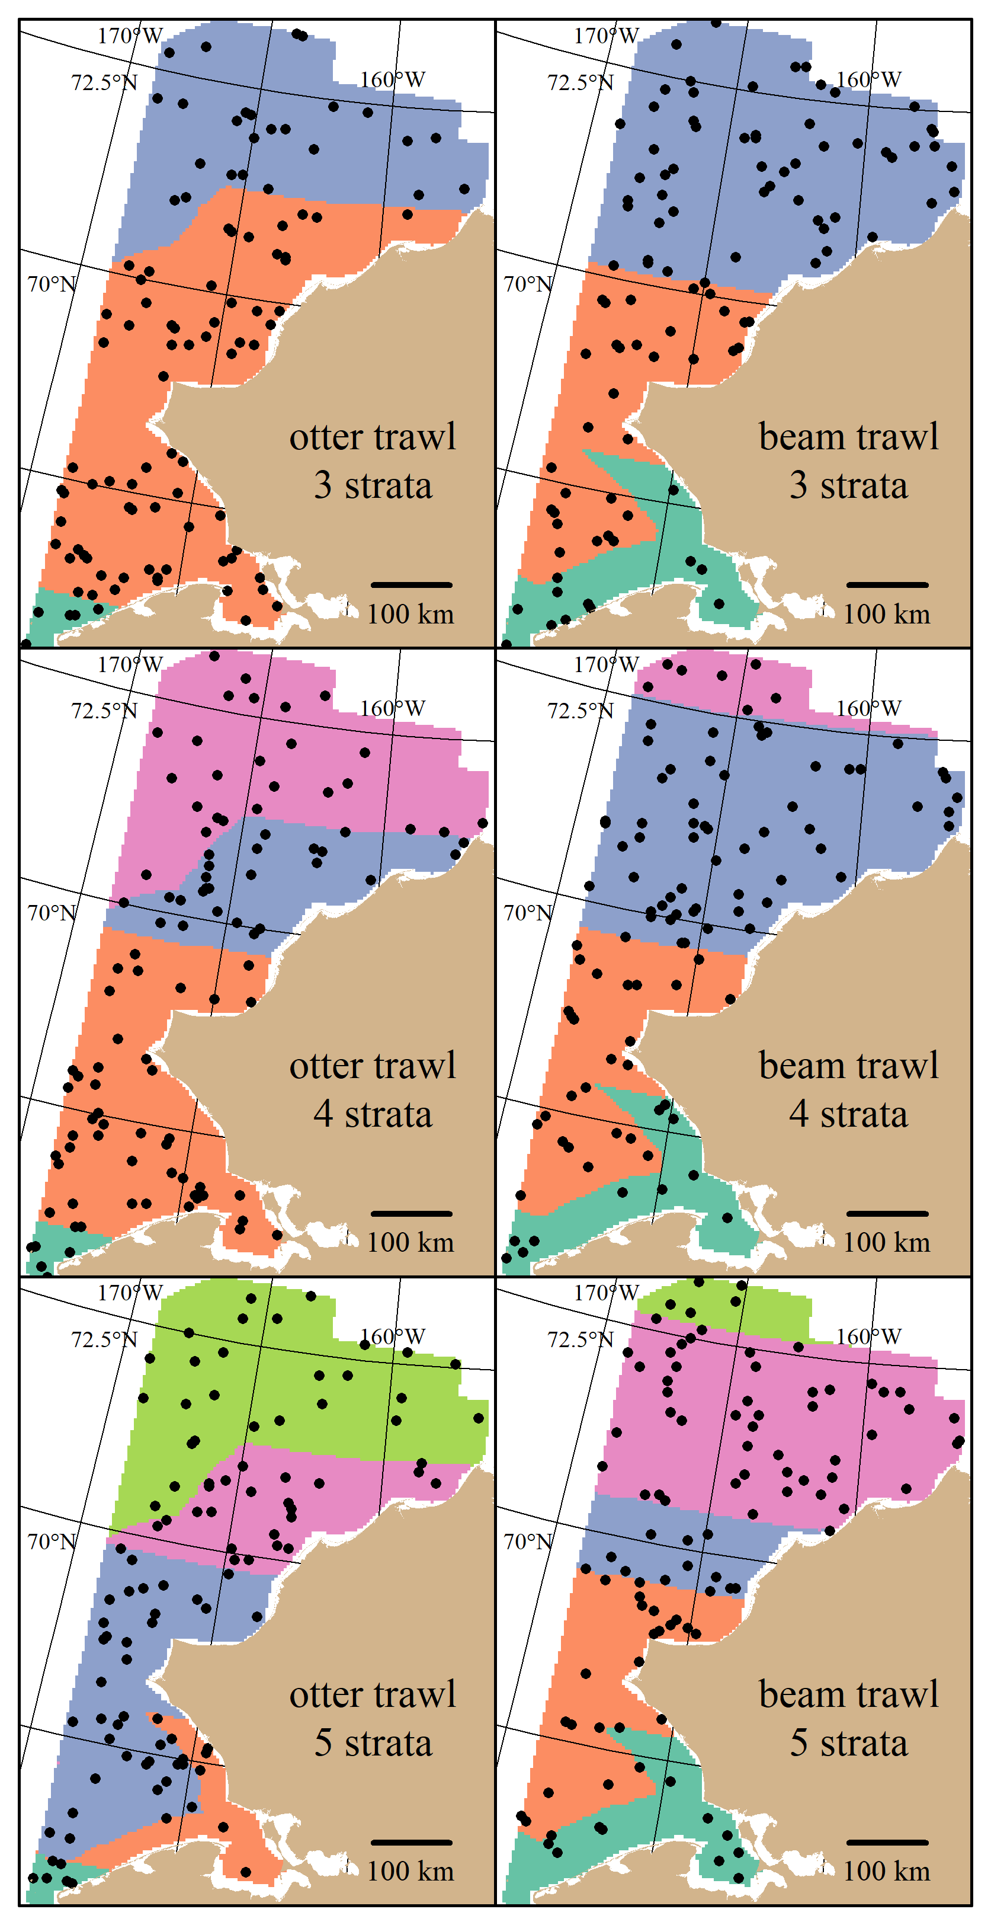
Optimization of STRS design
Optimization of strata boundaries and allocation similar to GOA BTS redesign
Stratum variables: latitude and distance to shore
Optimal allocation theory is used to flexibly allocate number of stations that minimize expected CV across taxa
3-5 strata
Latitudinal cutoff ~ 70 degrees N, inner stratum consisting of Kotzebue Sound/entrance of the Bering Strait
Beam trawl allocations proportional to stratum area (SRS)
Gear Types
Optimized STRS design
Total Sampling Effort
Species Set

Slide 7
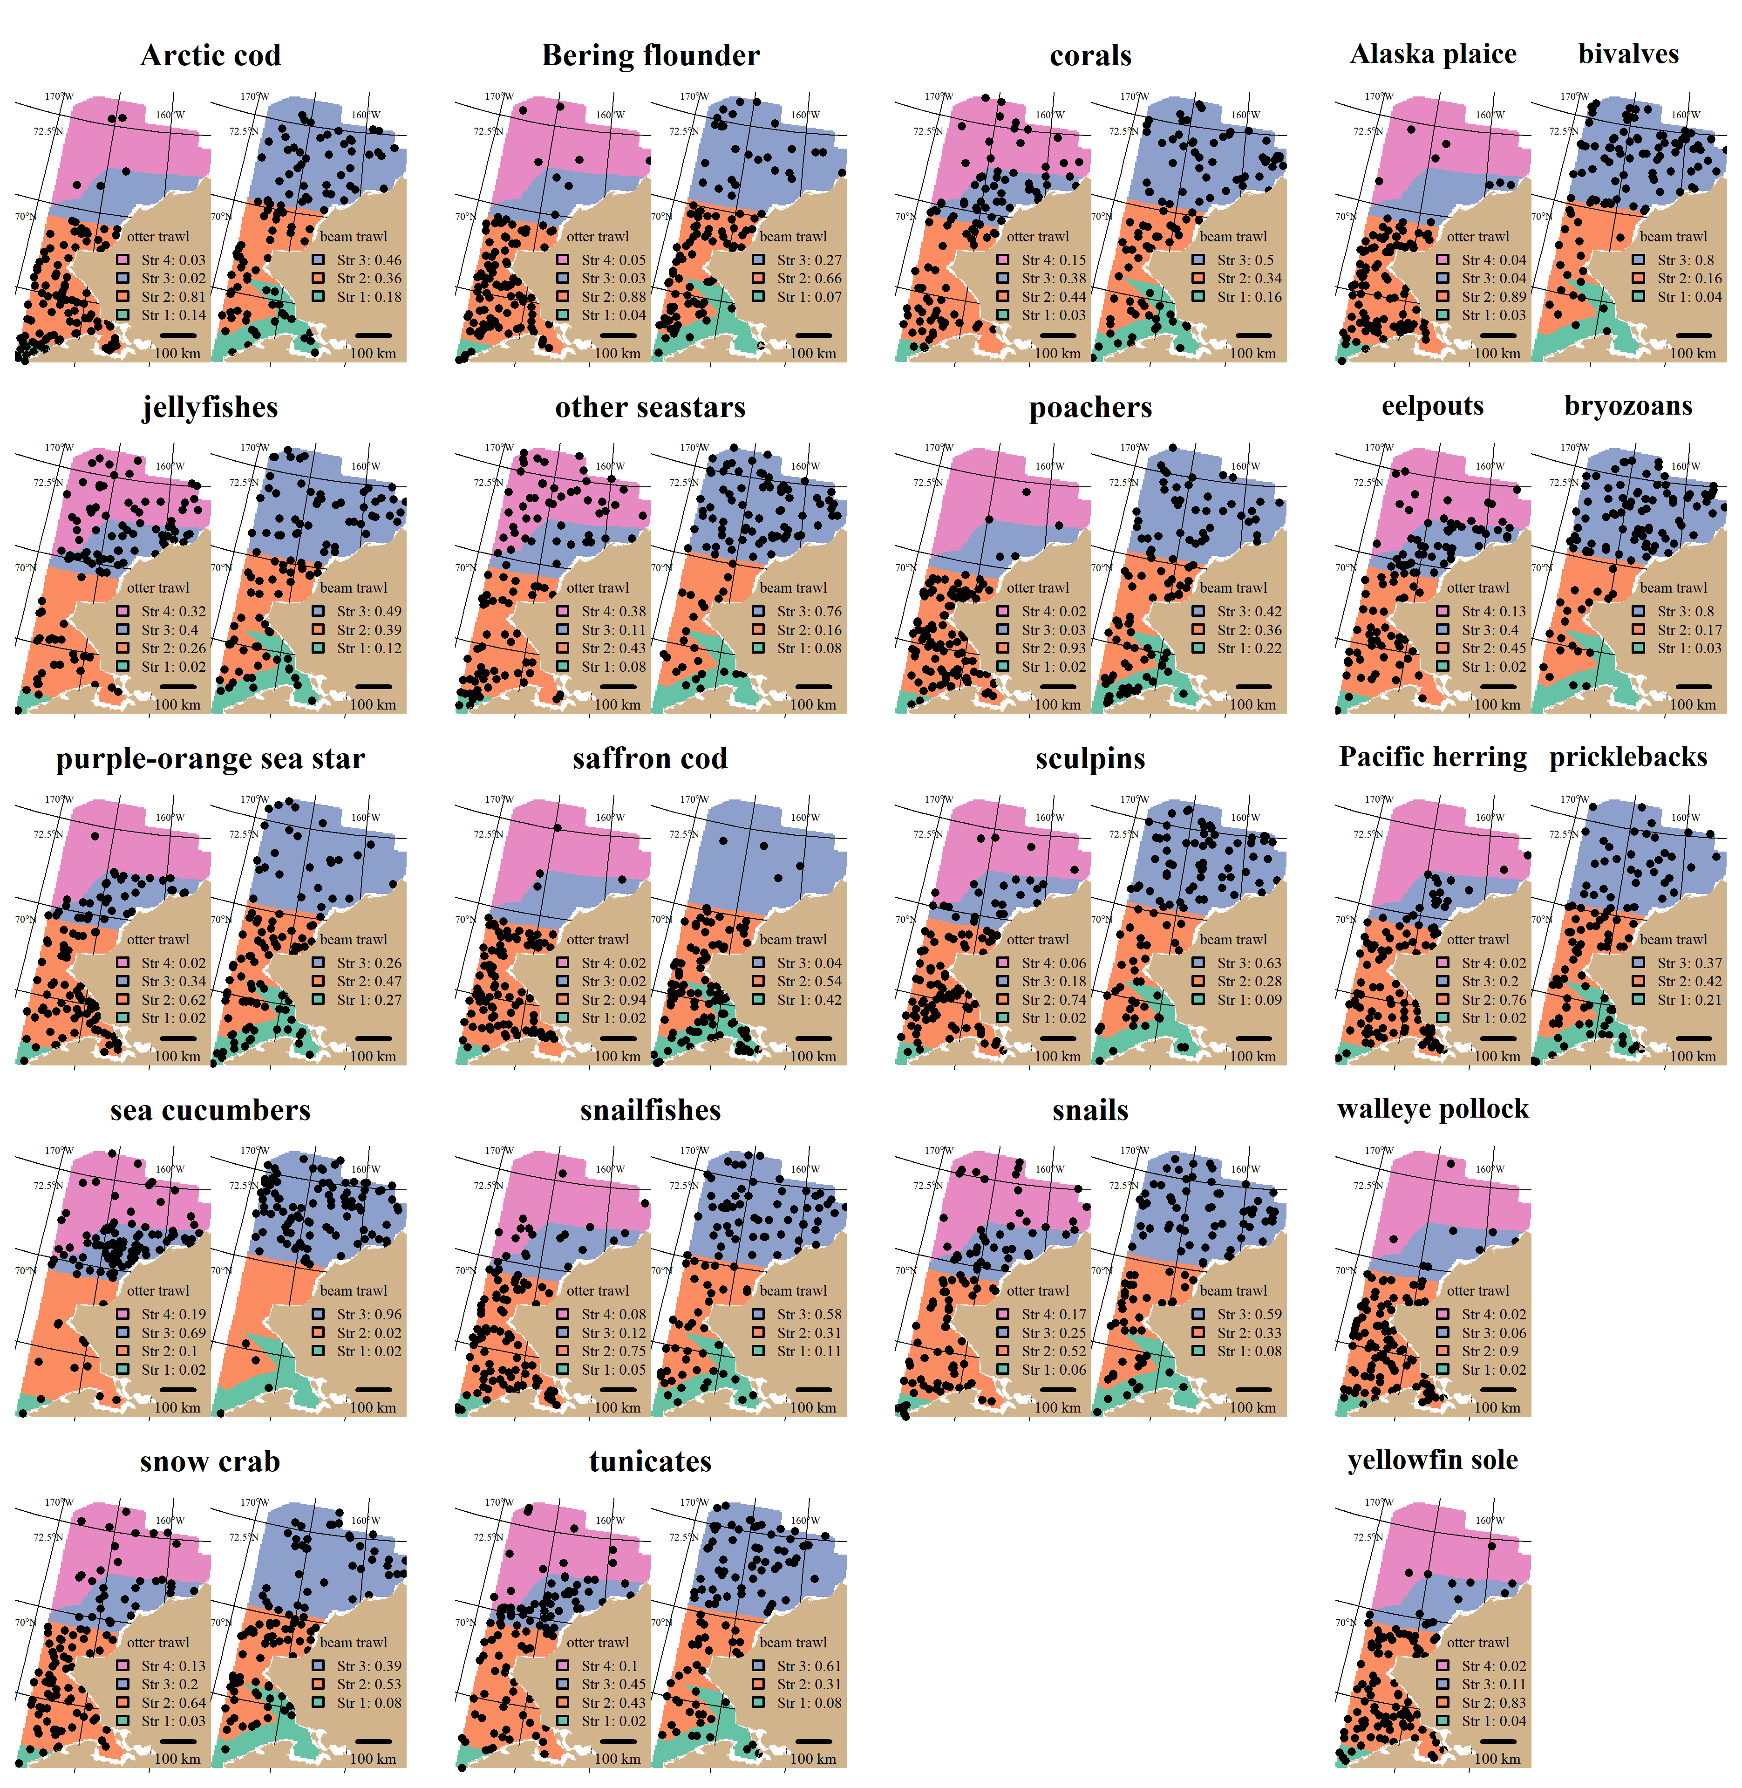

Slide 8
Survey Designs
Sampling range: 50 – 200 stations
Simple Random Designs
Systematic Designs
Increased the resolution of grid to increase stations
Random start versus fixed grid
Stratified Random Designs
(see previous slide)

Slide 9
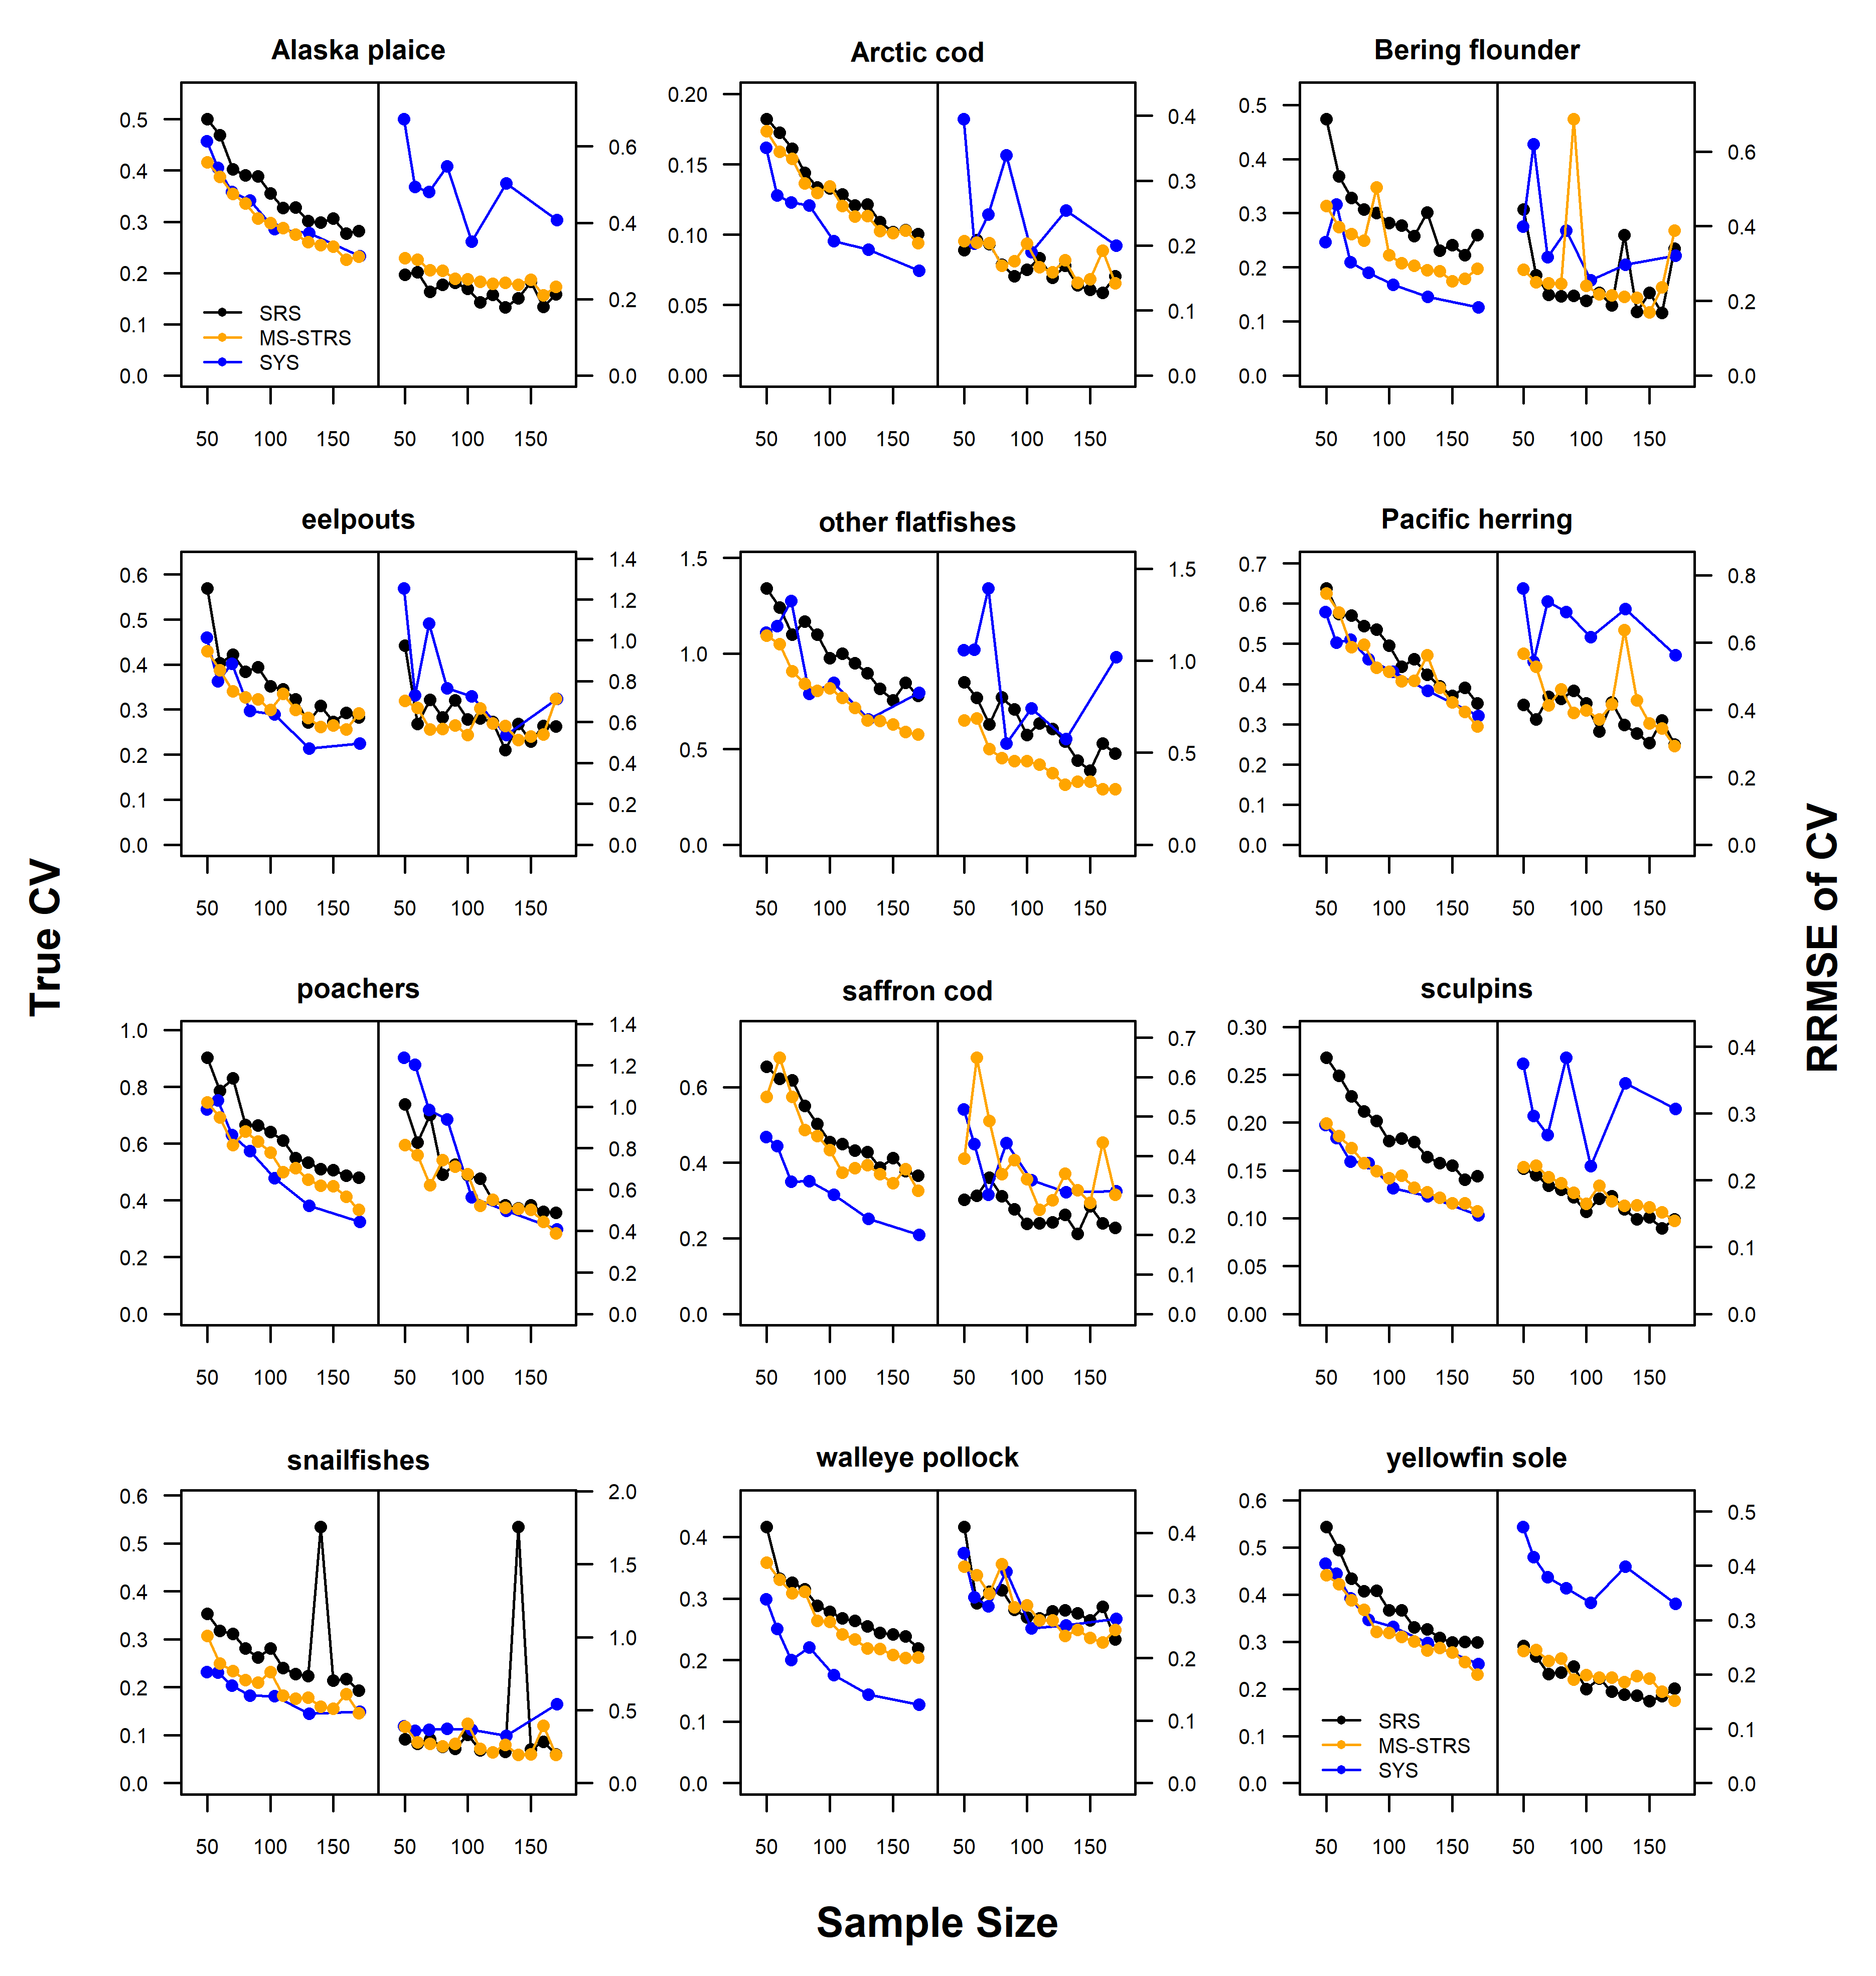
True CV (Left plots): Standard deviation of simulated indices, normalized by true index.
RRMSE of CV (Right plots): uncertainty and bias of CV about the true CV
Simple Random
Stratified Random
Systematic Grid
Total Sampling Effort
Survey Designs
Simulate Surveys

Slide 10
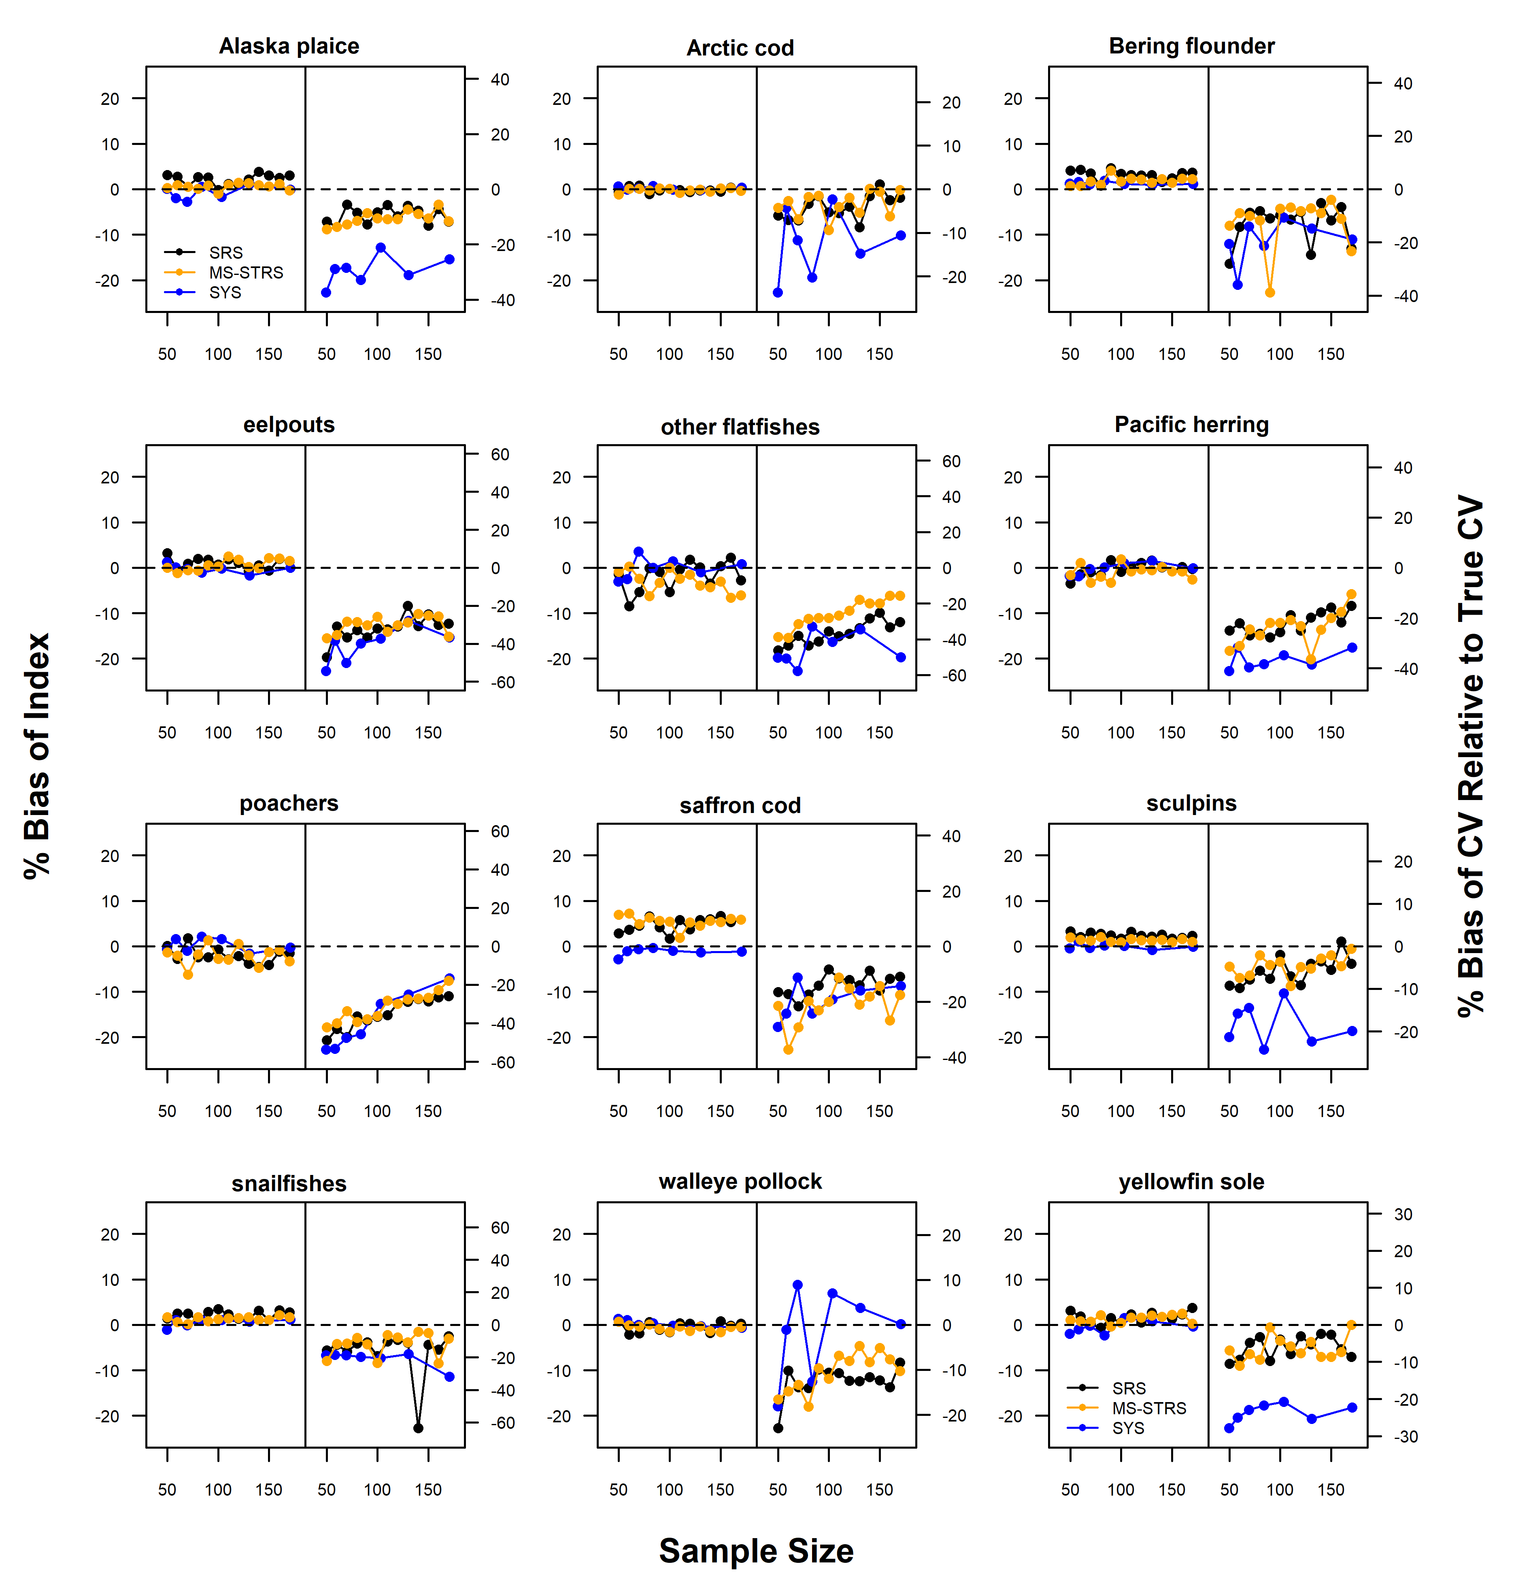
Average Percent Bias Plots
Index relative to true index (Left)
CV relative to True CV (Right)
Simple Random
Stratified Random
Systematic Grid
Total Sampling Effort
Survey Designs
Simulate Surveys

Slide 11
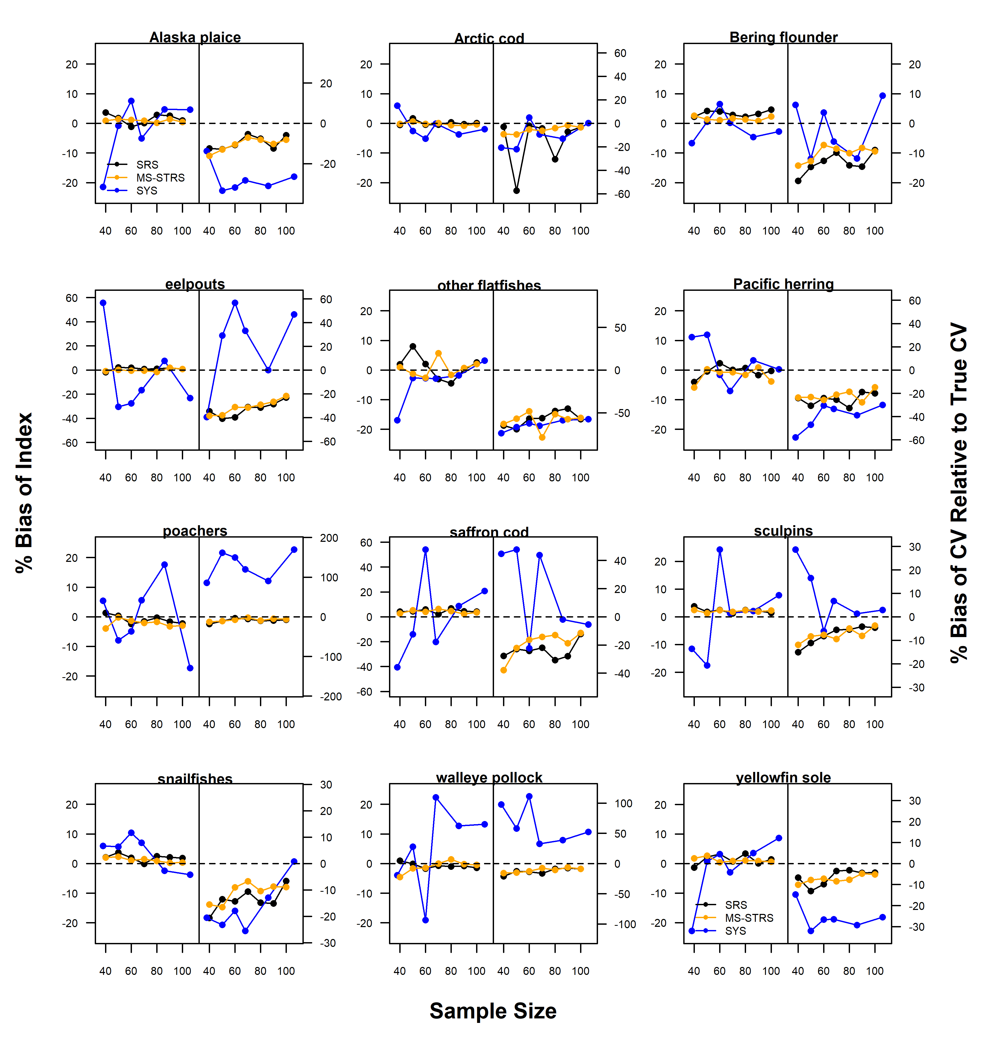
SYS: Stationary grid locations
SYS: Random start

