Slide 1
Zack Oyafuso, Lewis Barnett, Megsie Siple, Stan Kotwicki
WKUSER 2022
Galway, Ireland; September 2022

Slide 2
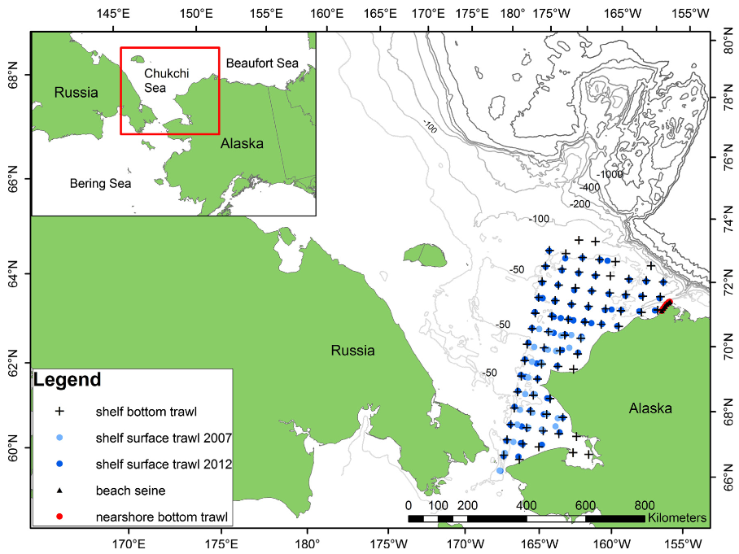
Chukchi Sea: Introduction
Loggerwell et al. 2015
Notes:
US Chukchi sea is the part of the US Arctic ocean that extends north of the Bering Strait bordered by Russian EEZ on the west
Covered by ice for most of the year
Climate change → decrease in the summer extent of the ice
Northward expansion of Bering groundfish species have been observed in NBS
More recent evidence of Bering species in Russian side of the Chukchi Sea (establishment of a fishery in 20XX)

Slide 3
Chukchi Sea: Ever changing
Climate change → decrease in the summer extent of the ice
Northward expansion of Bering groundfish species have been observed in NBS (Stevenson et al. 2019)
More recent evidence of Bering species in Russian side of the Chukchi Sea (establishment of a fishery in 20XX)
Loggerwell et al. 2015

Slide 4
Chukchi Sea: Need for a Survey
Monitor marine ecosystem in this ever-changing region (TORs 1, 3)
Stock definition for Bering Sea groundfishes may not be accounting for additional Nward expansion (TOR 2)
Loggerwell et al. 2015
Notes:
Many Bering strait and Arctic communities will experience these consequences wrt access to marine resources

Slide 5
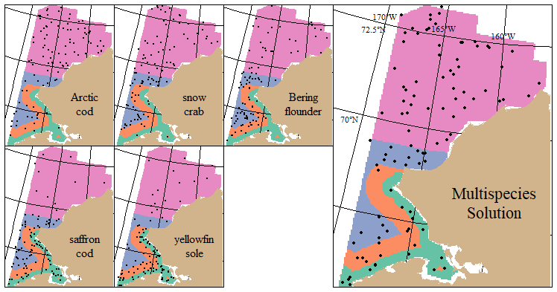
Multispecies Tradeoffs

Slide 6
Workflow
Total Sampling Effort
Gear Types
Optimized STRS design
Survey Designs
Species Set
Spatiotemporal distribution modelling
Simulate Densities
Simulate Surveys
Historical CPUE data
Survey Performance

Slide 7
Survey Metrics
“True CV”: uncertainty across survey simulation replicates
SD(abundance across replicates) / true abundance
RRMSE of CV: uncertainty of the sample CV estimates
Incorporates both the spread of the sample CV across replicates and the bias of the sample CVs with respect to the true CV
Biased CVs can lead to misleading conclusions about the strength of the survey CV, which is one measure of the quality of the survey.

