Slide 1
Survey design evaluation of a new multispecies bottom trawl survey in the US Chukchi Sea
Zack Oyafuso, Lewis Barnett, Stan Kotwicki
WKUSER 2022
Galway, Ireland; September 2022

Slide 2
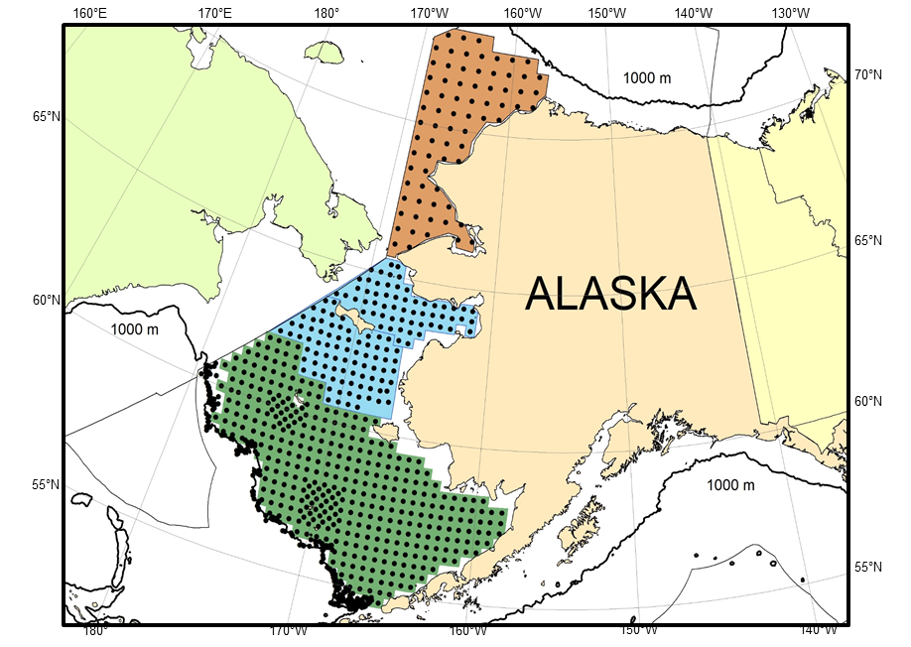
Chukchi Sea: Introduction
Notes:
(0.5 min) So some intro, this is the extent of our Bering Sea BTS in Alaska. The US Chukchi sea is this orange part of the US Arctic ocean that extends north of the Bering Strait longitudinally bordered by the US-Russian boundary on its west. While the Bering Sea shelf in green has been surveyed for over 40 years now, the Chukchi has seldom been sampled with only a handful of years of sampling in the same time frame.

Slide 3

Chukchi Sea: Ever changing
Climate change → decrease in the summer extent of the ice
Northward expansion of Bering groundfish species have been observed in NBS
More recent evidence of Bering species in Russian side of the Chukchi Sea
Notes:
(1 min) The Chukchi a naturally dynamic system. It is covered by ice for most of the year except in the summer when the ice recedes. But with a changing climate, the summer extent of the ice is shrinking. We’ve already highlighted why pole-ward extensions of populations have implications for our survey designs and we’ve already observed this migration into the NBS (blue) from our surveys. The Russians have recently observed large enough populations of Pollock in the Chukchi to establish a fishery in the past few years.

Slide 4
Goals for Analysis
Evaluate performance of different survey designs with varying total survey effort across groundfish species
Subset of groundfish complex: cods, flatfishes, and snow crab
Simple random, stratified, and systematic design
Impacts on survey precision, reliability of CV estimates
Notes:
(1 min) Due to the logical uncertainties of when and how we would conduct a BTS in the region, this analysis that I have been coleading is in anticipation of the eventual planning for this survey and as we’ll see by the end hits a lot of the TORs in this workshop. We evaluated the performance of different survey designs with varying total survey effort across a set groundfish species, in this case a reduced set of representative groundfish and crab species. We looked at simple random and gridded systematic designs as well as an optimized stratified design created using methods covered in Lewis’s previous talk on our work in the Gulf of Alaska. And, we wanted to look at the impacts of these designs on survey precision and reliability of the CV estimates on biomass indices.

Slide 5
Workflow
Optimize STRS design
Model Spatiotemporal distributions
Simulate Surveys
Simulate Densities
Survey Performance
Notes:
This is my roadmap for the analysis

Slide 6
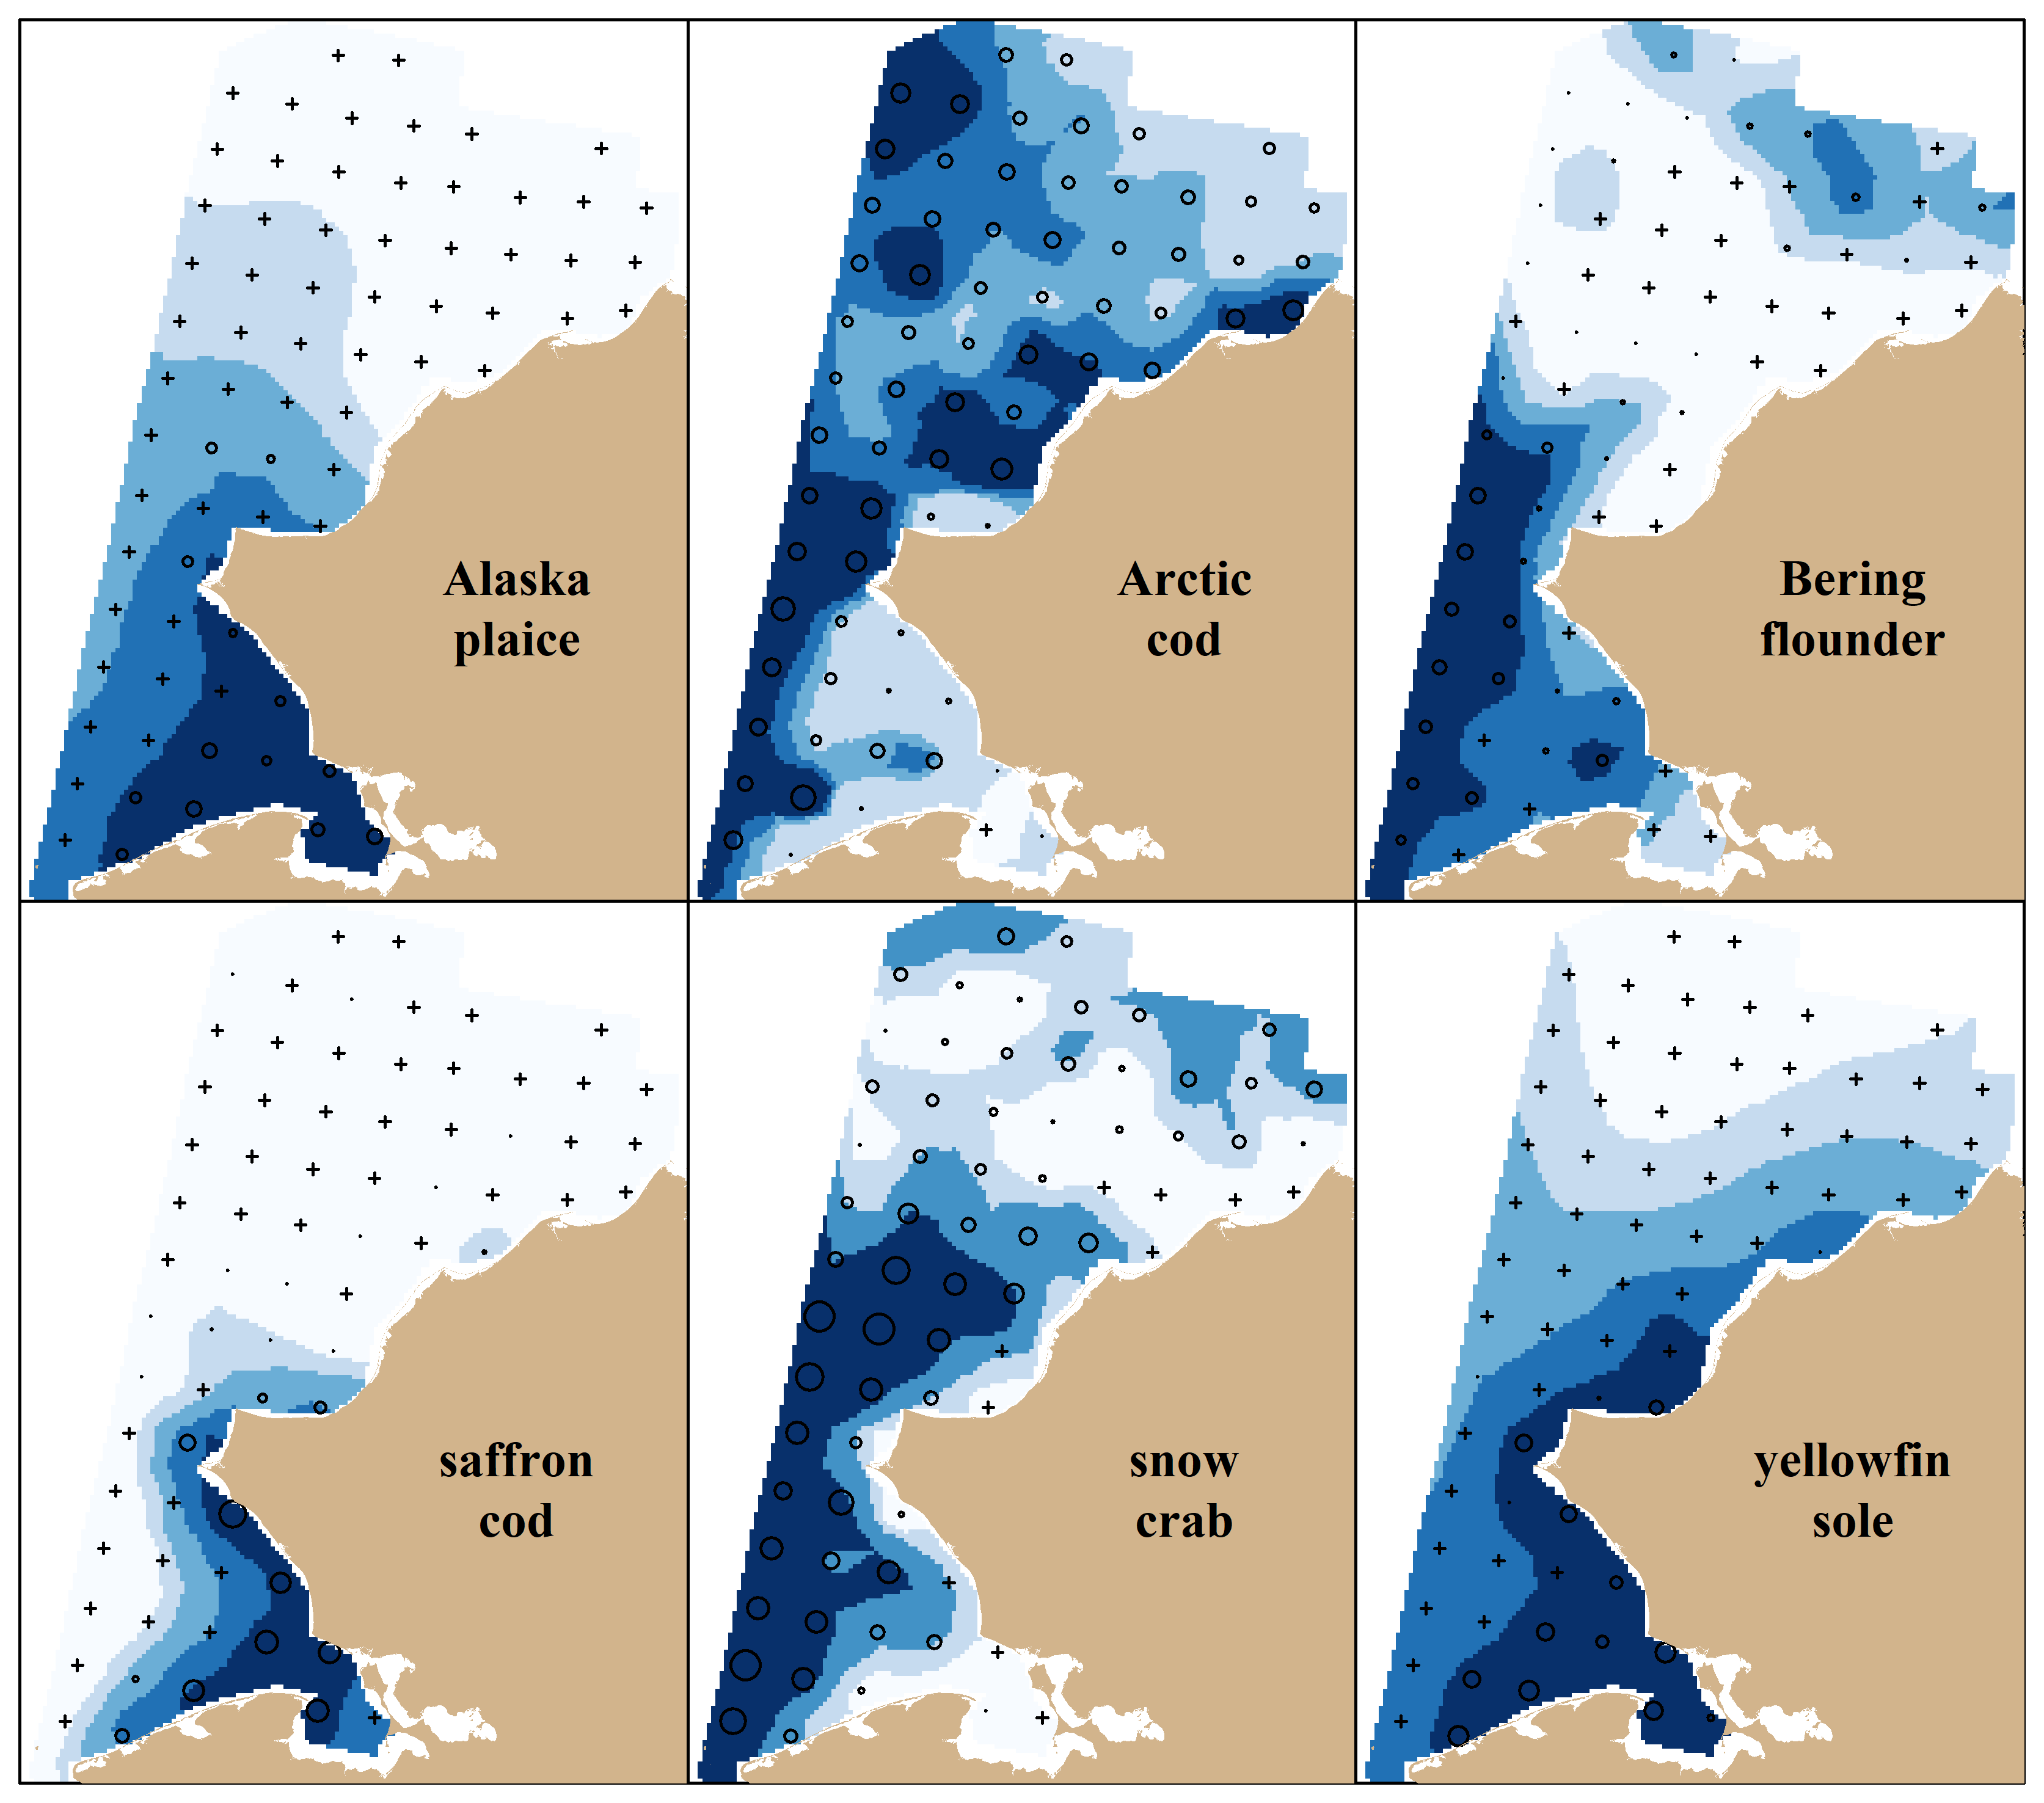
Workflow
Model Spatiotemporal distributions
VAST R Package
Notes:
(60 sec) First, we fitted VAST to our species of interest. Here are the predicted density distributions that come out of VAST. You can notice a variety of distribution types: Arctic cod are quite ubiquitous in the Chukchi, most are restricted to either the southern and nearshore part of the domain like saffron cod, plaice, and yellowfin sole. Bering flounder and snow crab have slightly more offshore distributions mostly restricted to the south.

Slide 7
Workflow
Model Spatiotemporal distributions
Simulate Densities
VAST R Package
Notes:
(15 sec) We also used VAST as our operating model to simulate densities with observation error. This will be important when we simulate surveys in a later step.

Slide 8
Workflow
Optimize STRS design
SamplingStrata R Package
Model Spatiotemporal distributions
Simulate Densities
VAST R Package
Notes:
(15 sec) The predicted densities from VAST are used as direct data inputs to optimize a stratified design like how we did in the Gulf of Alaska using the SamplingStrata R package.

Slide 9
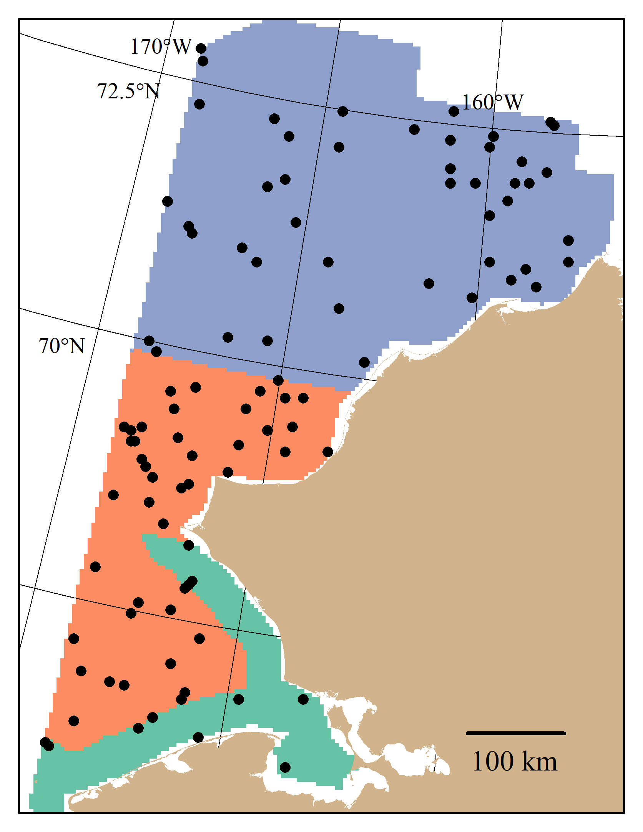
Stratified Random Design
Optimize STRS design
SamplingStrata R Package
Notes:
(1 min) Here is the solution that comes out of that stratified design optimization. Our goal here was to optimize the stratum boundaries and the effort across strata to minimize the expected CVs across our set of species for a given level of total survey effort. A three strata solution is shown here, with the different colors representing different strata and example locations of 200 stations drawn from this design. Relative to the stratum areas, sampling is more concentrated in the offshore orange stratum and slightly less concentrated in the northern part of the domain.

Slide 10
Workflow
Optimize STRS design
Model Spatiotemporal distributions
Simulate Surveys
Simulate Densities
Survey Performance
Notes:
(30 sec) Once we have our simulated densities and survey designs (so our stratified design along with a simple random and systematic design), we simulate those survey under a range of total survey effort 1000 times, estimate abundance and associated sample CV (I don’t have a “tool” that I used to simulate surveys, that was just hardcoded in the code that we wrote), and then the last step was to evaluate survey performance.

Slide 11
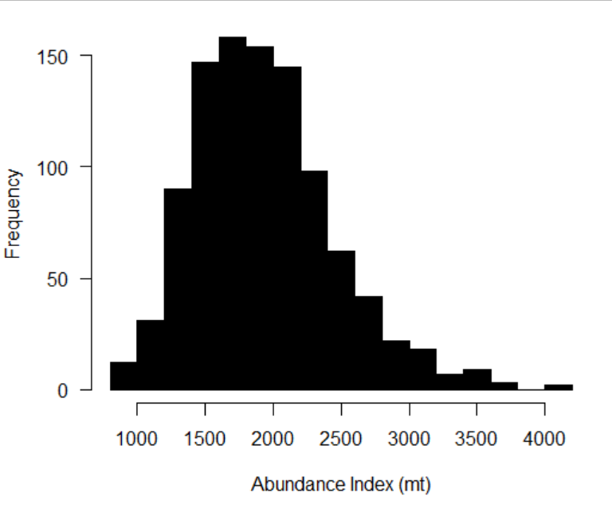
Survey Design Evaluation Metrics
True CV: CV of replicated estimated abundances
Survey Performance
Notes:
(30 sec) The first metric we will look at is “True CV”. If we look at the distribution of our 1000 replicated estimated abundances, the SD of this distribution / true abundance reflects what we are calling the “True” variability of the sampling design, i.e., the variability of the abundance index if we were able to replicate the survey design, which we can under simulation.

Slide 12
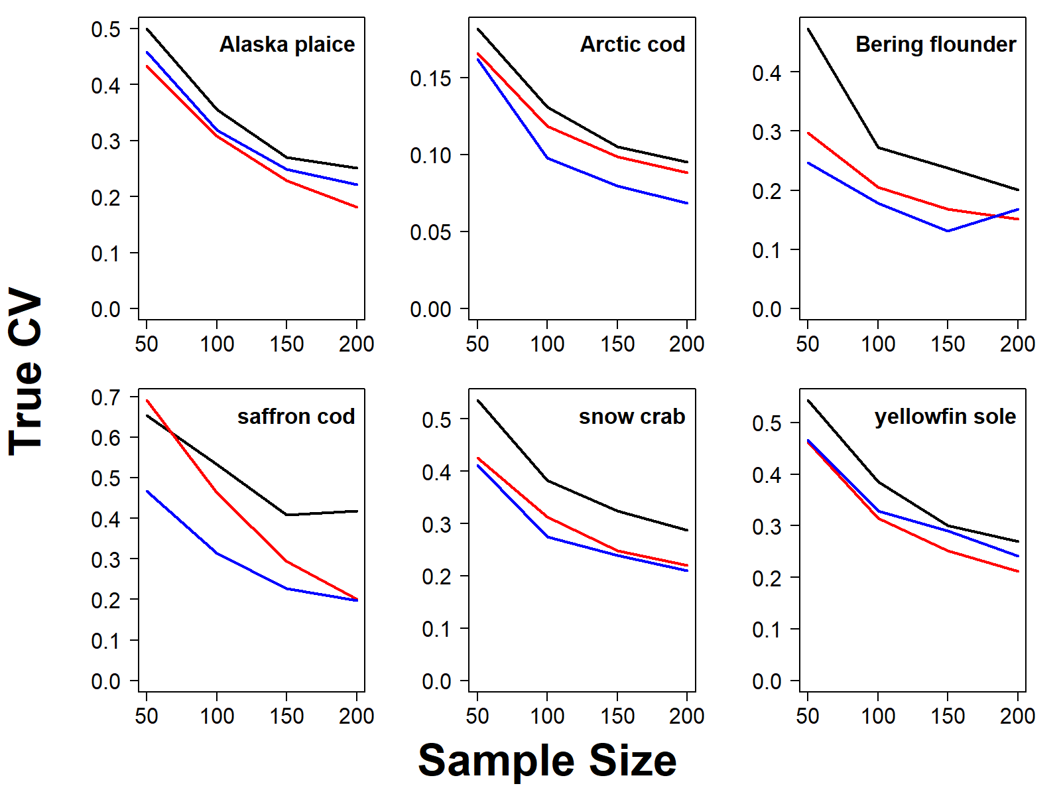

Survey Design Evaluation Metrics
True CV: CV of replicated estimated abundances
Survey Performance
Notes:
(30 sec) That’s what’s plotted on the y-axis under a range of sample sizes on the x-axis and our three designs are color coded: simple random design in black, systematic in blue, and stratified in red. You can observe first the decrease in CV over sample size in all cases as we would expect, and for a given sample size, SYS is slightly more precise than the stratified design, followed by the simple random design in black.

Slide 13
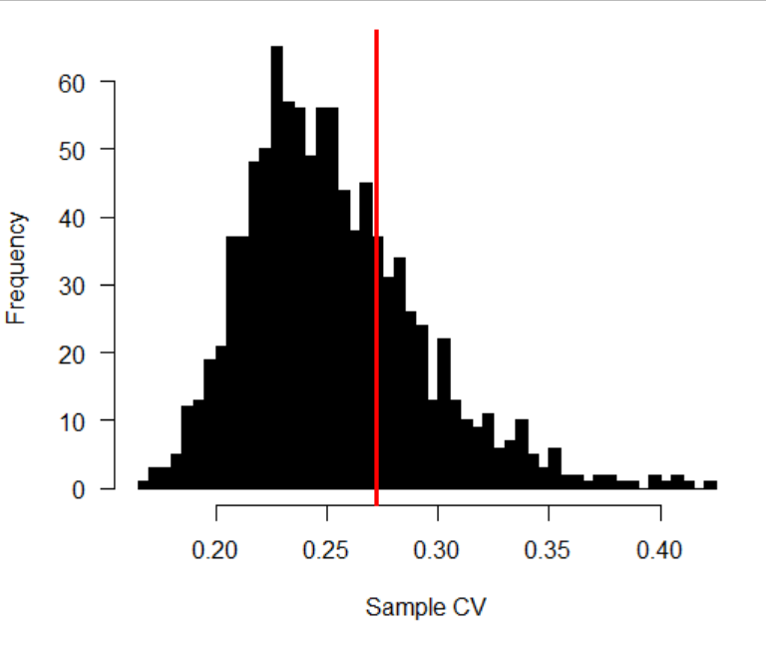
Survey Design Evaluation Metrics
RRMSE of CV: Uncertainty and bias of estimated CV replicates
Notes:
(30 sec) The second evaluation metric we will look at is what we are calling RRMSE of CV: if we are looking at the distribution of our 1000 sample CVs (associated with the abundance index) this metric combines both the spread of that distribution and the bias of those CVs with respect to the true CV (red line). Ideally, the CV that you estimate from a sample should be consistent with the true CV, the level of variability associated with that design.

Slide 14
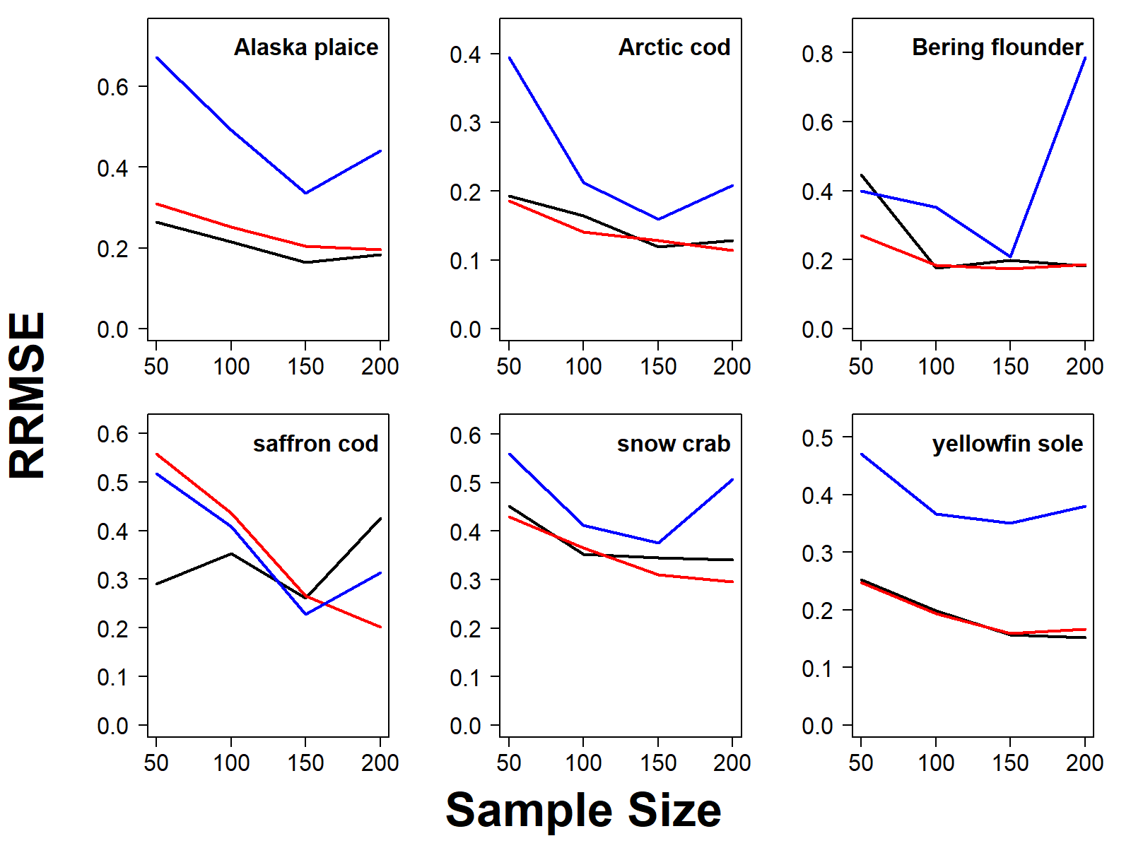
Survey Design Evaluation Metrics
RRMSE of CV: Uncertainty and bias of estimated CV replicates
Survey Performance
Notes:
(30 sec) Looking at our species, although systematic designs generally had lower True CV from the last slide, the relative error of those sample CVs of were higher than the two randomized designs. Specifically, the sample CVs were either more biased (negatively) or more spread out relative to the randomized designs. Between the two randomized designs, the RRMSEs of CVs were more comparable and decreased with sample size.

Slide 15
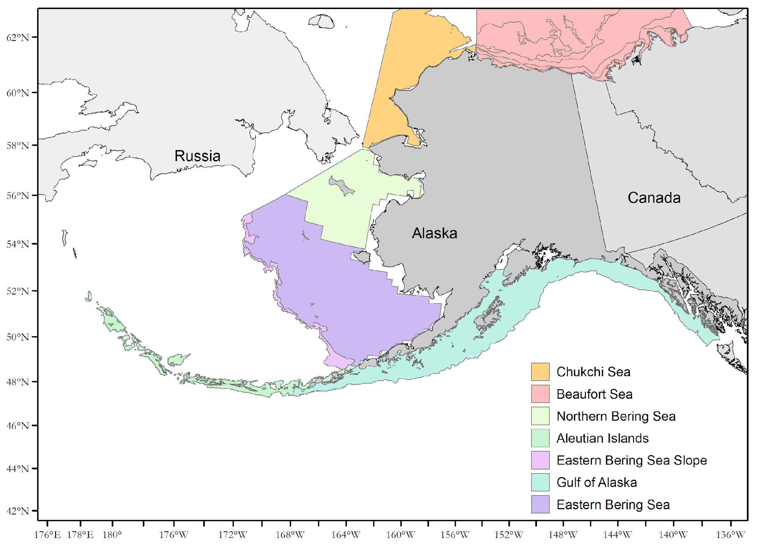
TOR 1: Survey Design for Flexibility
Chukchi is a naturally dynamic ecosystem, climate change bringing more changes that need to be monitored for ecosystem studies
N-ward expansion of Bering Sea stocks → change in stock area
Uncertainties of logical aspects of survey (e.g., funding)
Notes:
(45 sec)
I conclude this talk in more explicit terms related to the four TORs of this workshop.
The Chukchi sea is a naturally dynamic ecosystem, made even more dynamic with a warming climate
We have to anticipate and document the changes of surveys for expansions into new areas (you can think of this a new survey but it’s also in time as an expansion of the Bering sea survey)
Due to the uncertainties of the logistical aspects of this new survey, we need to be able to plan for a wide variety of survey effort levels, understand and communicate their potential effects to our survey products, as well any tradeoffs among species.

Slide 16
TOR 2: Combining Surveys, Data Gaps
Notes:
(30 sec) This analysis is contained within a broader and more complicated question at our center which is: okay we have a Chukchi survey, how do we integrate that with the many BTSs in the Bering region with different spatial and temporal footprints. We’ve had success integrating the NBS but it seems like it will be more of a challenge for the Chukchi. It seems like we may hear more about this during the workshop so I’m looking forward to that.

Slide 17
TOR 3: Modelling and Simulation TOR 4: Tools and Technology Development
Optimize STRS design
SamplingStrata R package
Model Spatiotemporal distributions
Simulate Surveys
Simulate Densities
VAST R Package
VAST R Package
Survey Performance
True CV RRMSE of CV
Notes:
(1 min) Lastly, in terms of how we go about using the tools that we have to conduct survey science and to address WKUSER issues, we used this general workflow with the tools in blue:
We used VAST to fit and simulate spatiotemporal distributions to our species of interest
Along with simple random and systematic designs, we also used the SamplingStrata package to help design a stratified random design. One of the biggest improvements of the stratified design is that multiple species can be included in the optimization which reflects the objectives of most surveys
We used simulation testing as a tool to compare the performance of different survey designs across a range of total survey effort across species, and used evaluation metrics like true CV and RRMSE of CV to compare the quality of survey products.

Slide 18
Links to tools used/analysis
Gulf of Alaska STRS optimization (paper, Tech Memo, GitHub)
Chukchi Sea STRS optimization (pending)
SamplingStrata package
VAST

Slide 19
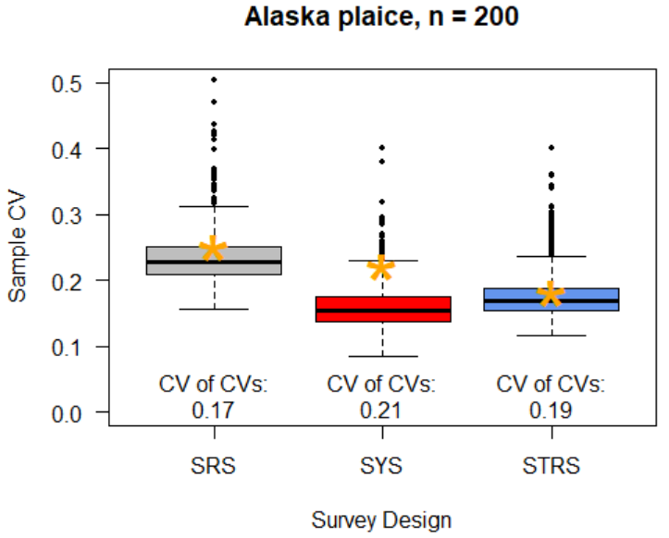
Extra: Breakdown of RRMSE of CV

Slide 20
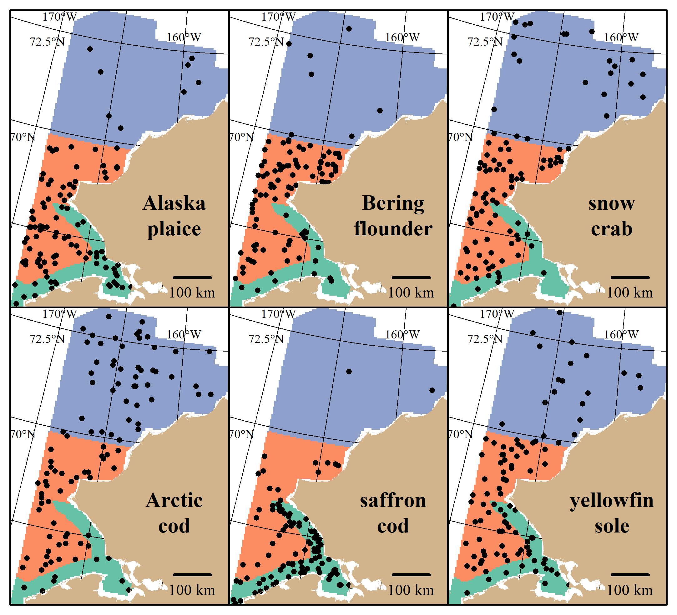
Extra: Multispecies Tradeoffs
Optimize STRS design
Notes:
(0.5 min) Plotted here on the right are the same strata but the station allocations are only informed by the variability from one species. It is seemingly trivial at first because we don’t design surveys for just one species but it is a good tool to visualize how the multispecies solution on the left is influenced by the spatial variability and overlap of the species that were used to inform the solution.

