Slide 1
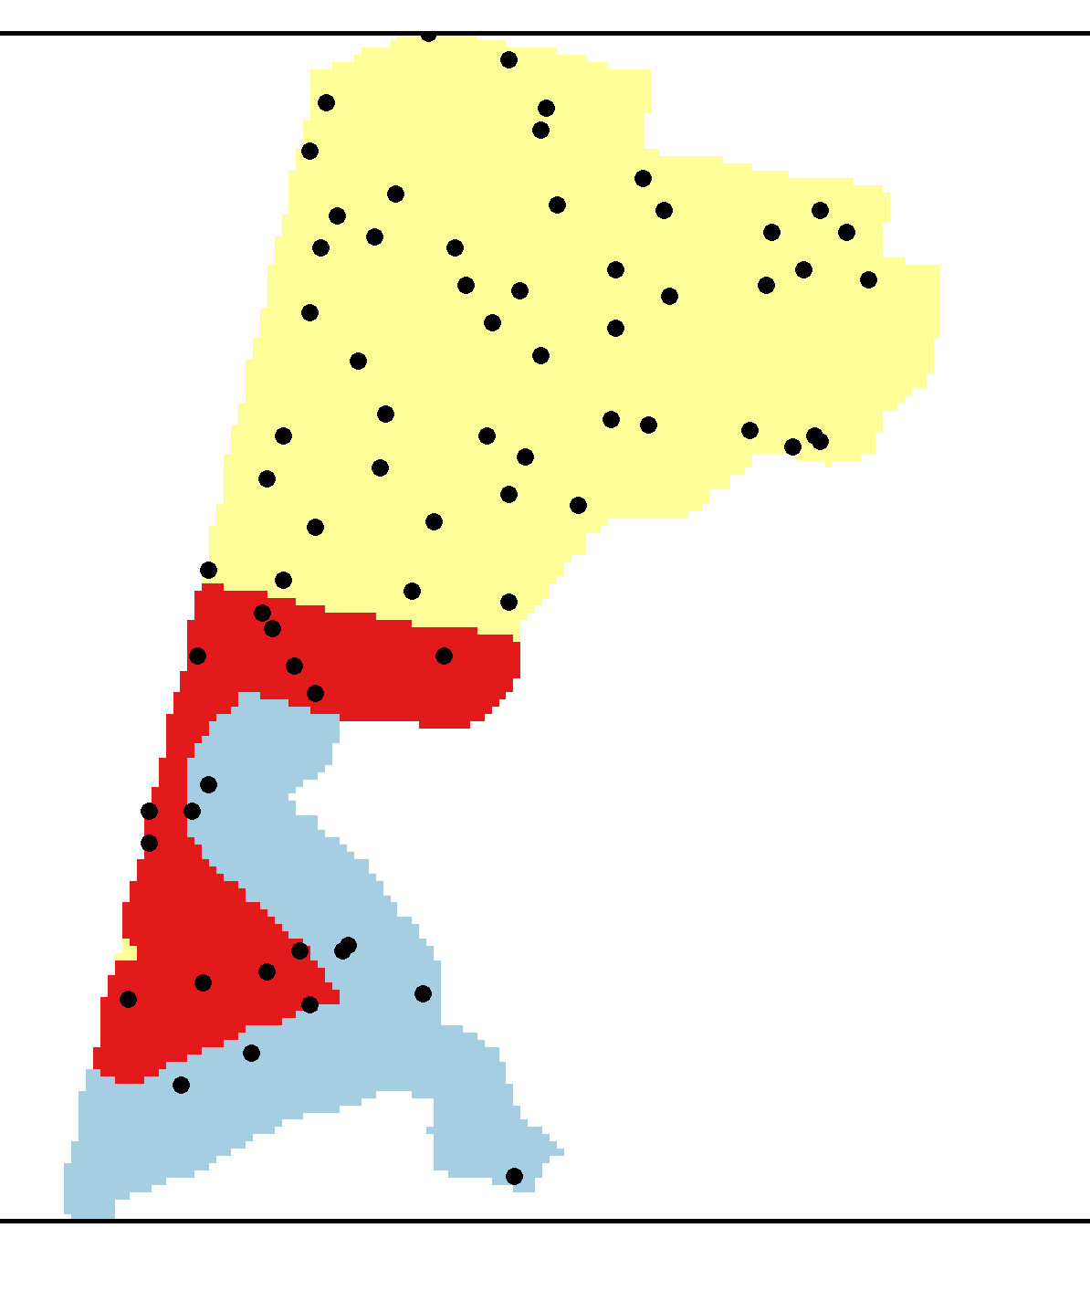
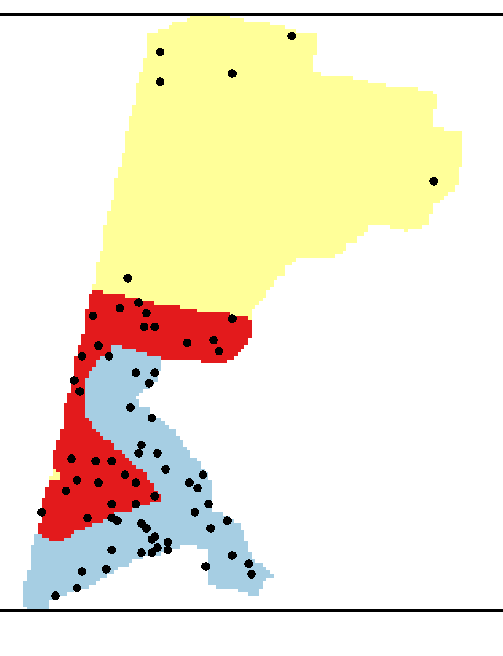





Arctic cod
saffron cod
SS Solutions
Bering flounder
yellowfin sole
Base Solution
MS Solutions
snow crab

Slide 2
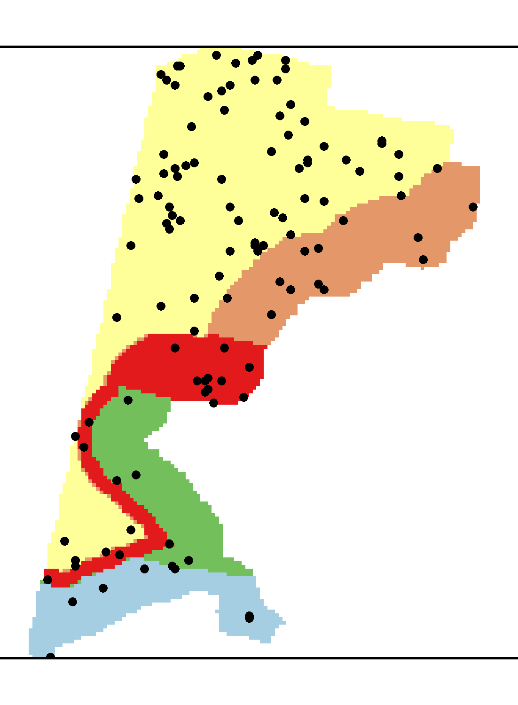
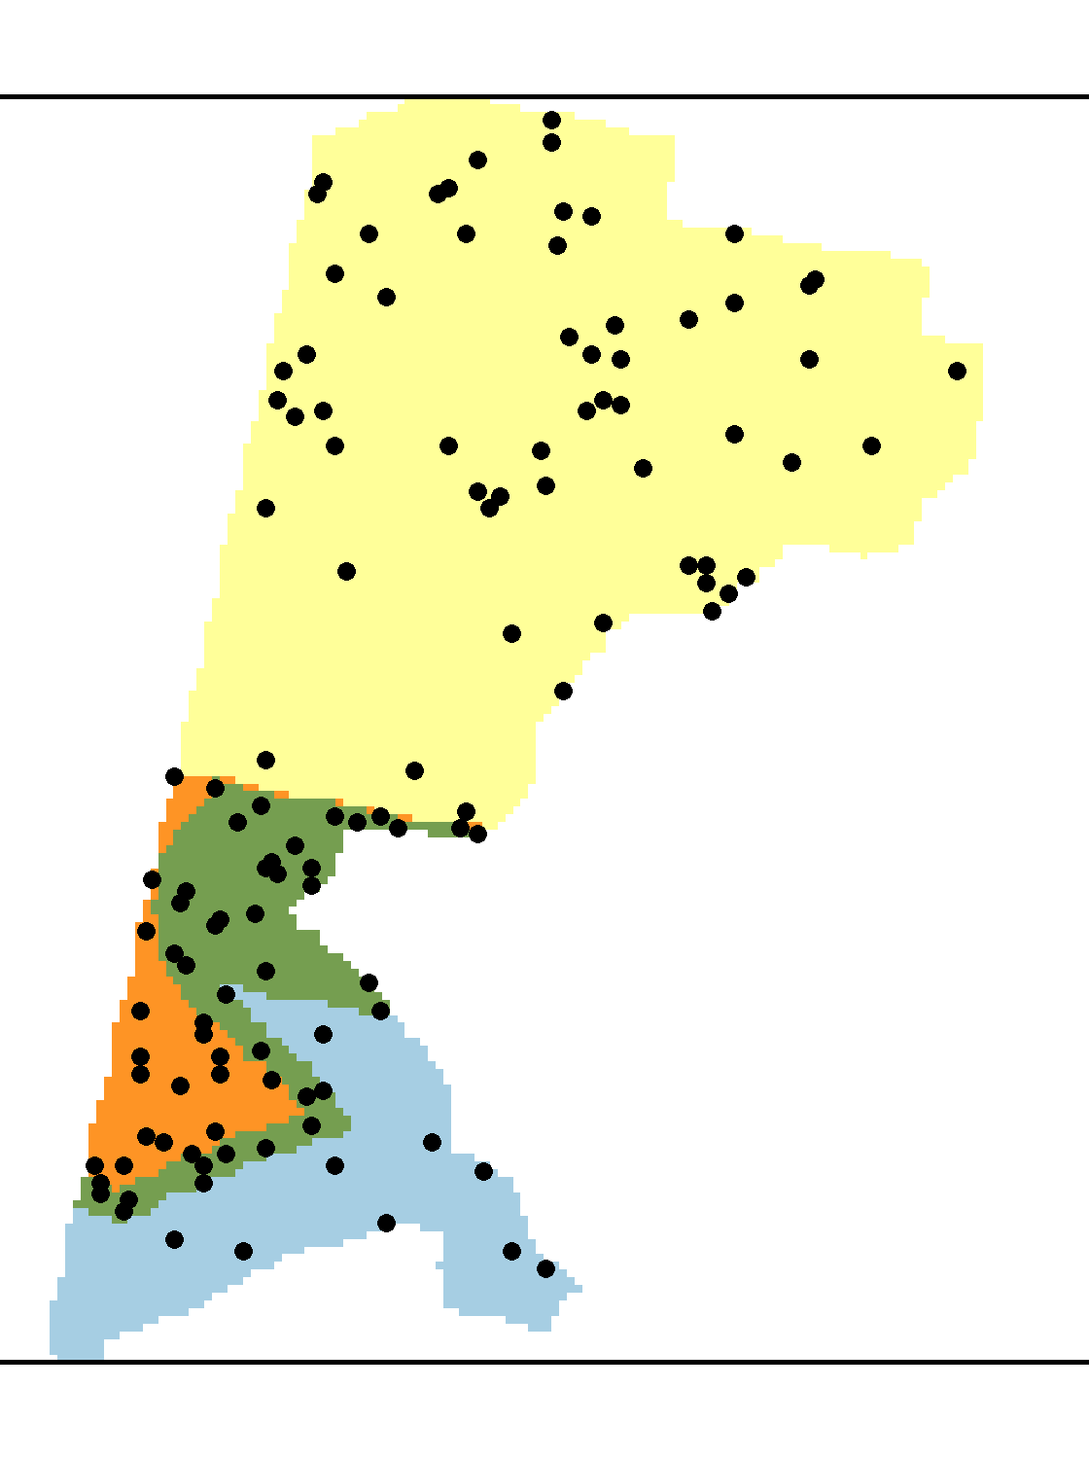
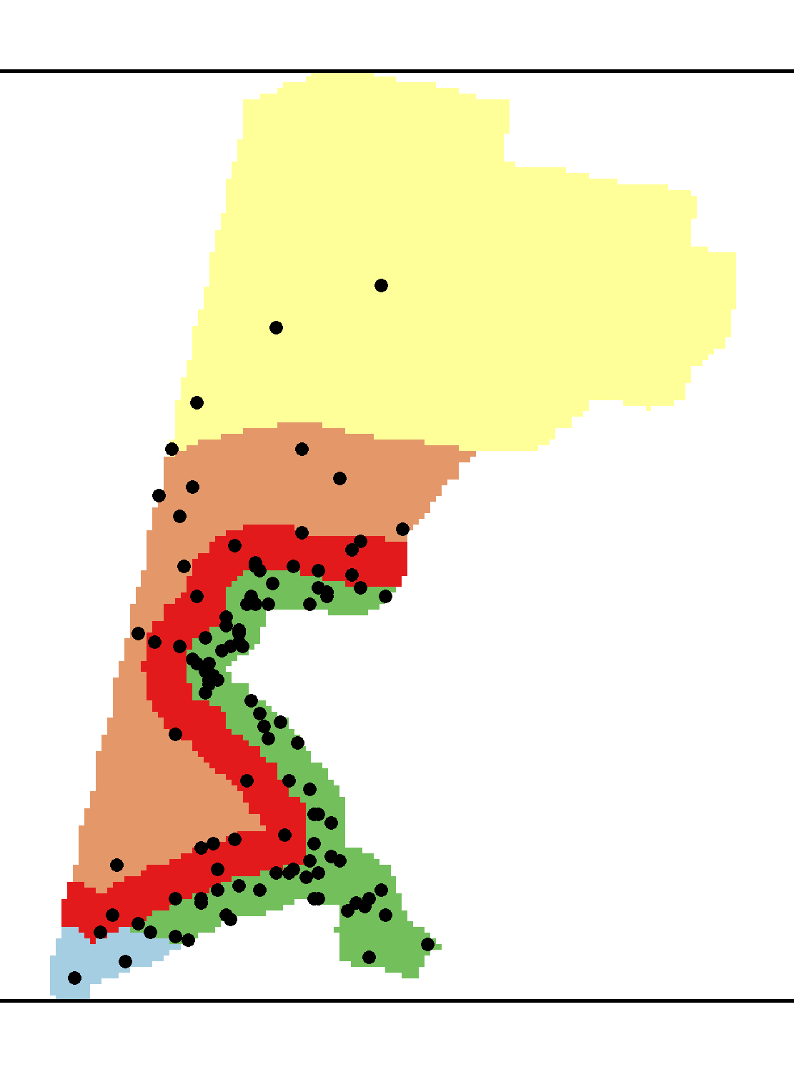
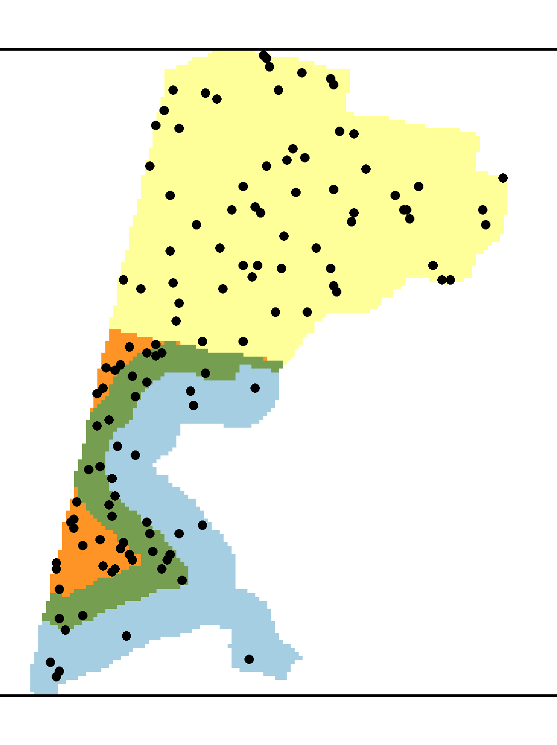
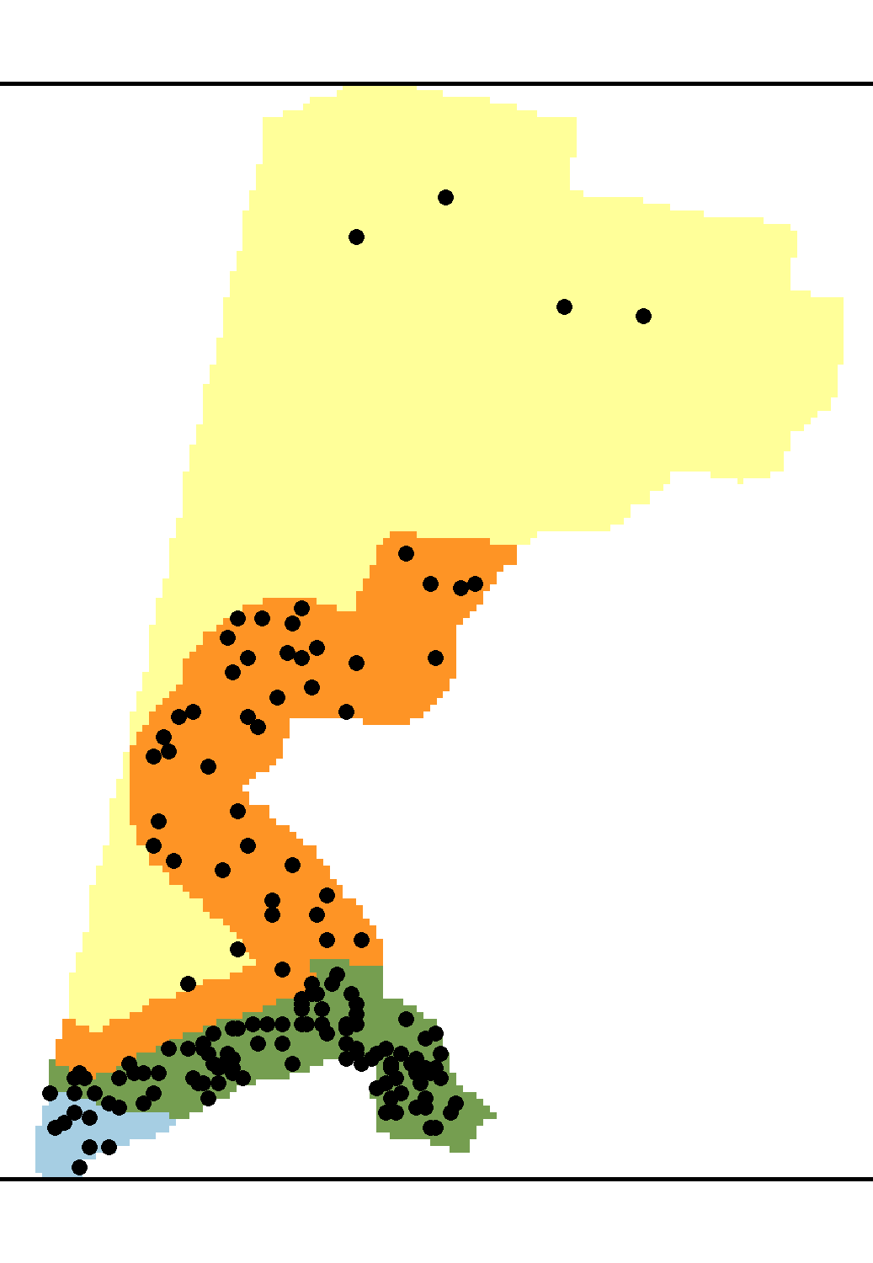
Arctic cod
Bering flounder
saffron cod
snow crab
yellowfin sole
Arctic cod
Bering flounder
saffron cod
snow crab
yellowfin sole

