Slide 1
Update Arctic Survey Planning Plots
8 March 2022

Slide 2
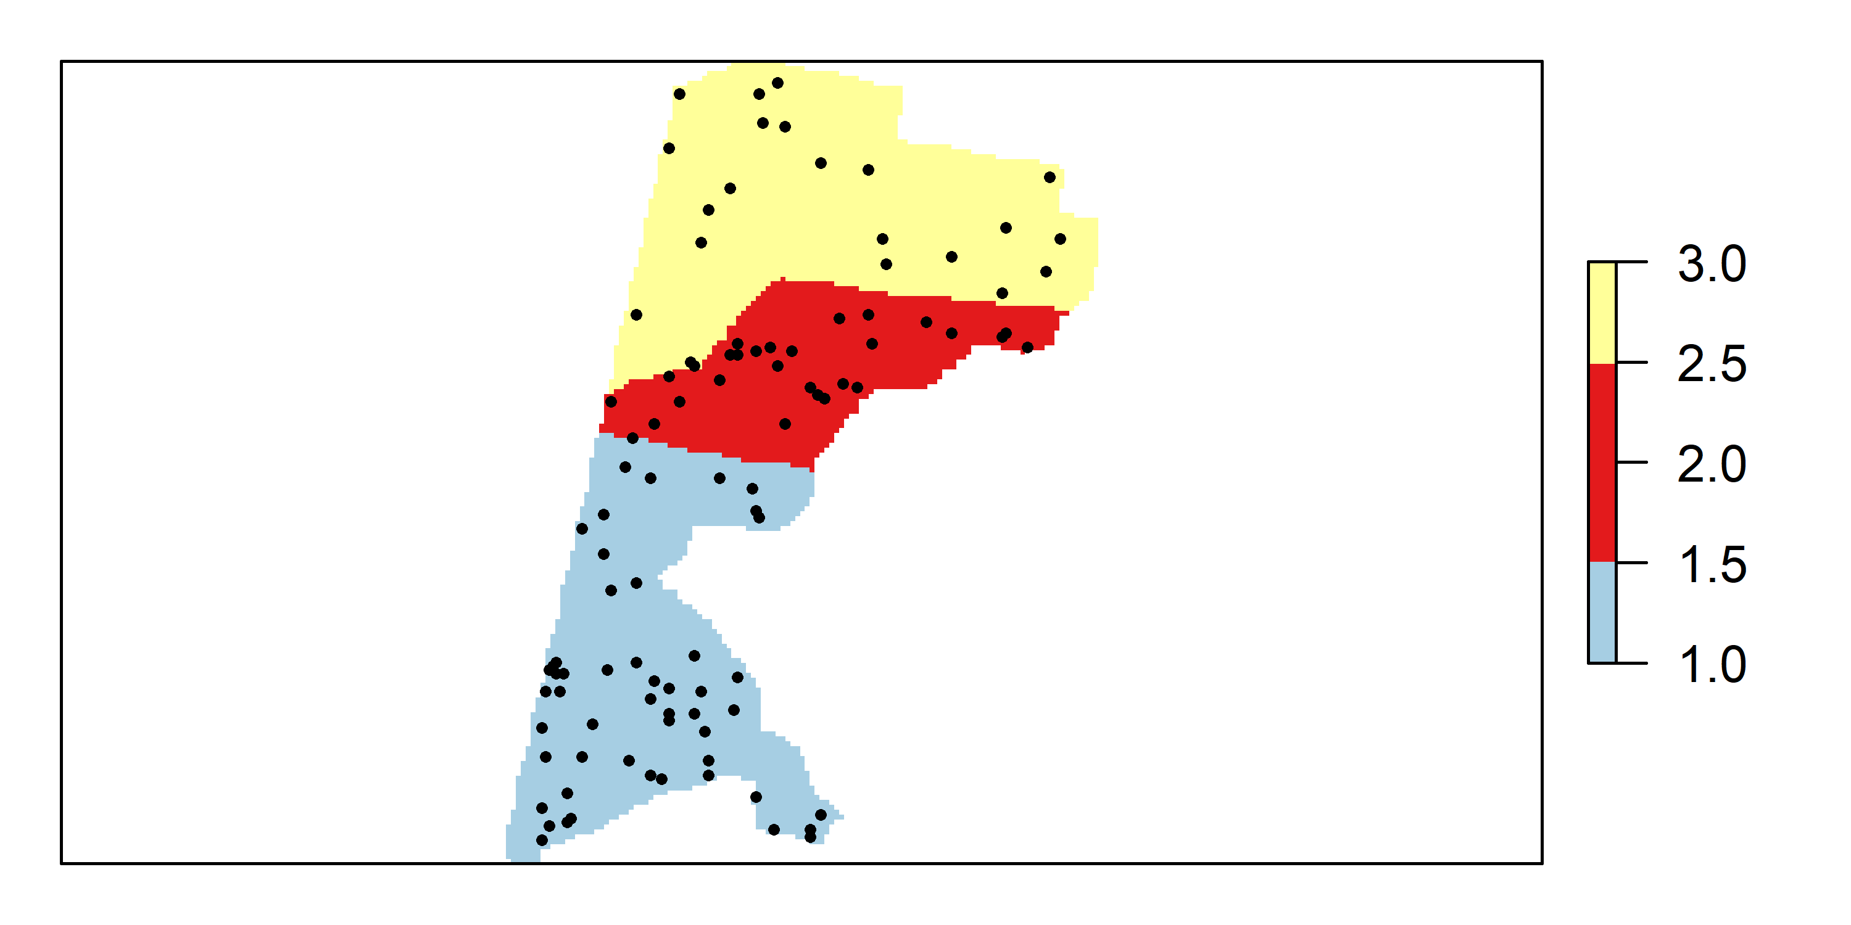
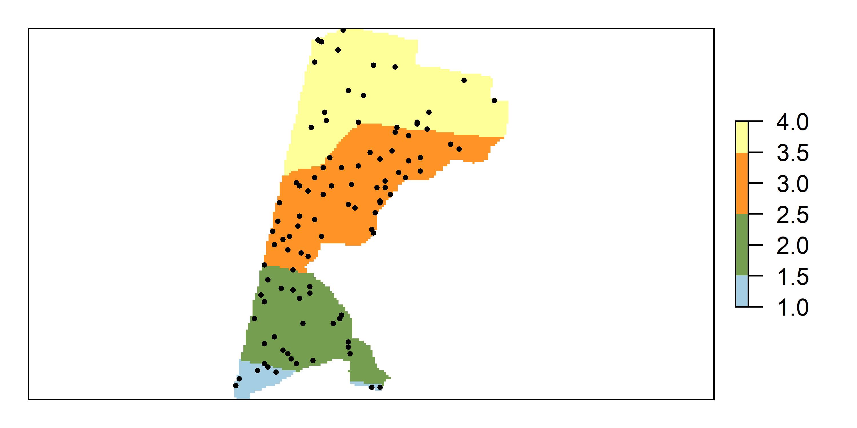
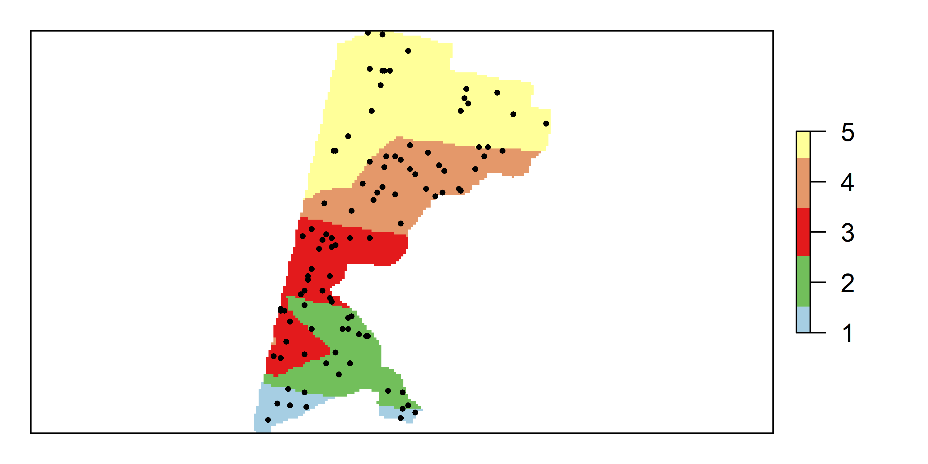
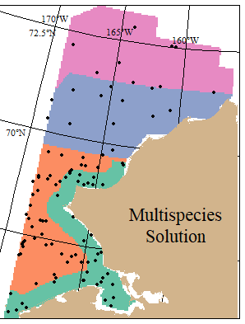
Updated: 12 fish taxa, 8 invert taxa
Old: 6 major fish species

Slide 3
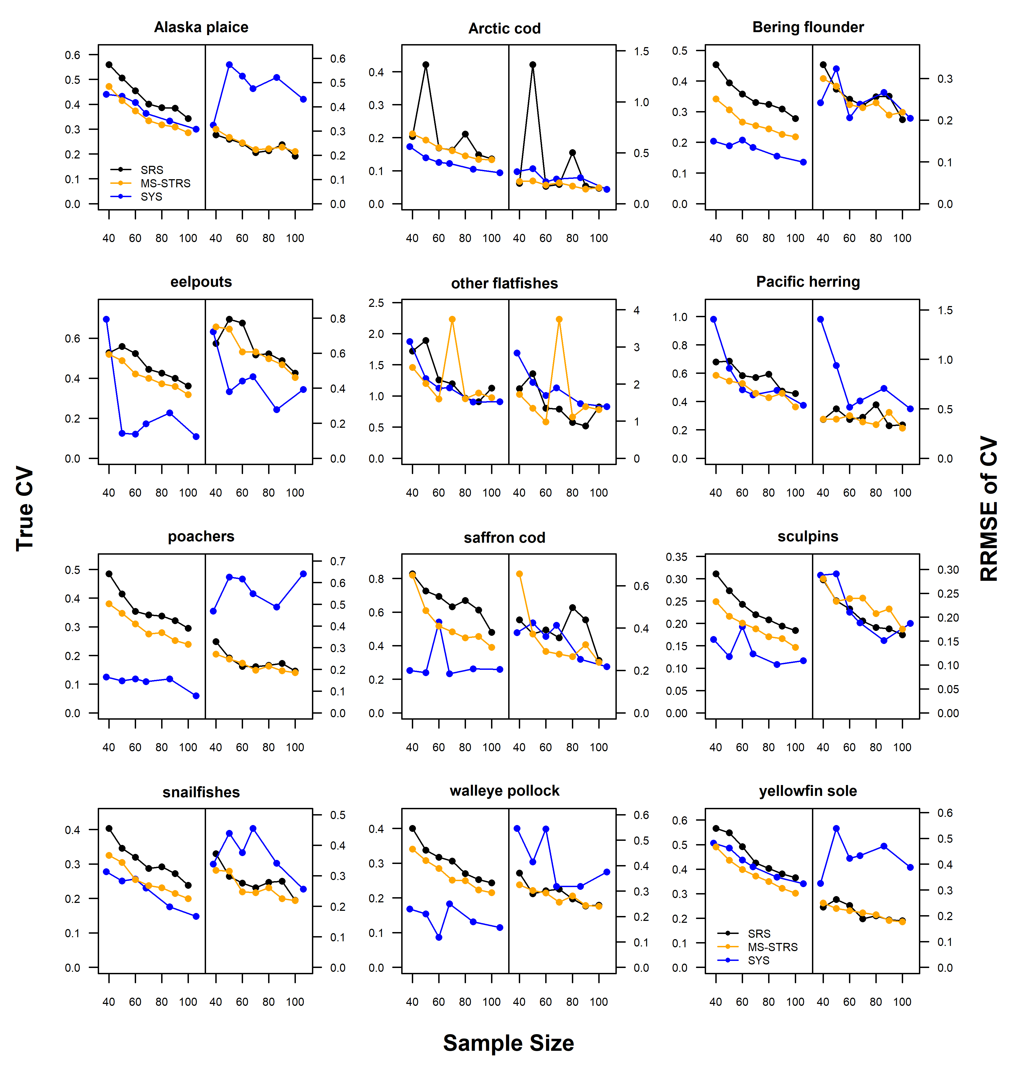

Slide 4
