Slide 1
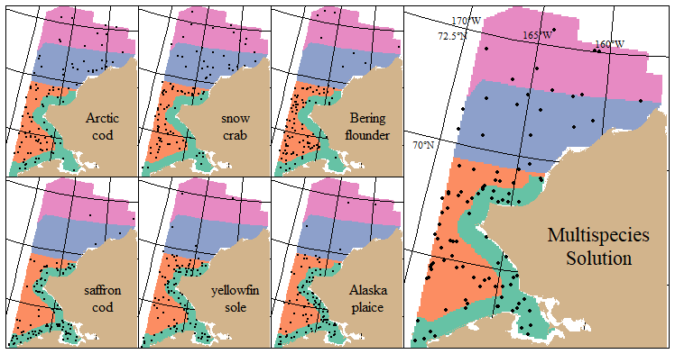
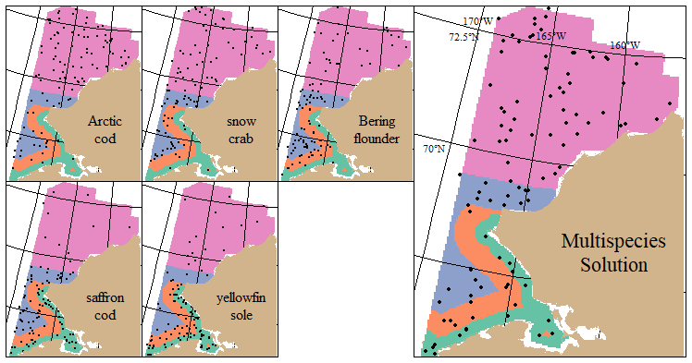
Optimal station allocations (w/sample locations) and stratum boundaries for otter (left) and beam (bottom) trawl surveys. Species tradeoffs in survey design are illustrated from comparing among single-species designs and the multispecies solution.
Notes:
Extra notes on interpretation:
Otter Trawl: Arctic cod, snow crab, and Bering flounder have designs that favor more sampling in the outer stratum (orange) and in the two northern strata whereas saffron cod, yellowfin sole, and AK plaice have designs that favor more inshore sampling in the SW (teal).
Beam: Arctic cod, snow crab, and Bering flounder have designs that favor more sampling in the northern and outer strata (purple and blue). Saffron cod and yellowfin sole have designs that favor more sampling inshore and SW.

