Slide 1
Chukchi Survey Simulations
18 April 2022

Slide 2
Background
Goal: plan a suite of survey designs in anticipation for a Chukchi and/or Beaufort sea bottom trawl survey
Goal: flexibility of random and systematic survey designs
Historical surveys go back to the 1950s, periodic, spatially restricted, operations unstandardized
Target: multispecies fish and invertebrate taxa that are commercially and/or culturally important

Slide 3
Workflow
Species Set
Gear Types
Total Sampling Effort
Survey Designs
Spatiotemporal distribution modelling
Simulate Densities
Simulate Surveys
Historical CPUE data
Survey Performance

Slide 4
Taxa List
Scientific Name | Common Name | Gear
Pleuronectes quadrituberculatus | Alaska plaice | otter trawl
Boreogadus saida | Arctic cod | beam and otter trawl
Hippoglossoides robustus | Bering flounder | beam and otter trawl
Family: Zoarchidae | eelpouts | otter trawl
Family: Pleuronectidae | other flatfishes | otter trawl
Clupea pallasii | Pacific herring | otter trawl
Family: Agonidae | poachers | beam and otter trawl
Family: Stichaeidae | pricklebacks | beam trawl
Eleginus gracilis | saffron cod | beam and otter trawl
Family: Cottidae | sculpins | beam and otter trawl
Family: Liparidae | snailfishes | beam and otter trawl
Gadus chalcogrammus | walleye pollock | otter trawl
Limanda aspera | yellowfin sole | otter trawl
Class: Bivalvia | bivalves | beam trawl
Phylum: Bryozoa | bryozoans | beam trawl
Class: Anthozoa | corals | beam and otter trawl
Class: Scyphozoa | jellyfishes | otter trawl
Class: Asteroidea | other seastars | otter trawl
Asterias amurensis | purple-orange sea star | beam and otter trawl
Class: Holothuroidea | sea cucumbers | beam and otter trawl
Class: Gastropoda | snails | beam and otter trawl
Chionoecetes opilio | snow crab | beam and otter trawl
Subphylum: Tunicata | tunicates | beam and otter trawl
Species Set
Gear Types
Spatiotemporal distribution modelling
Historical CPUE data

Slide 5
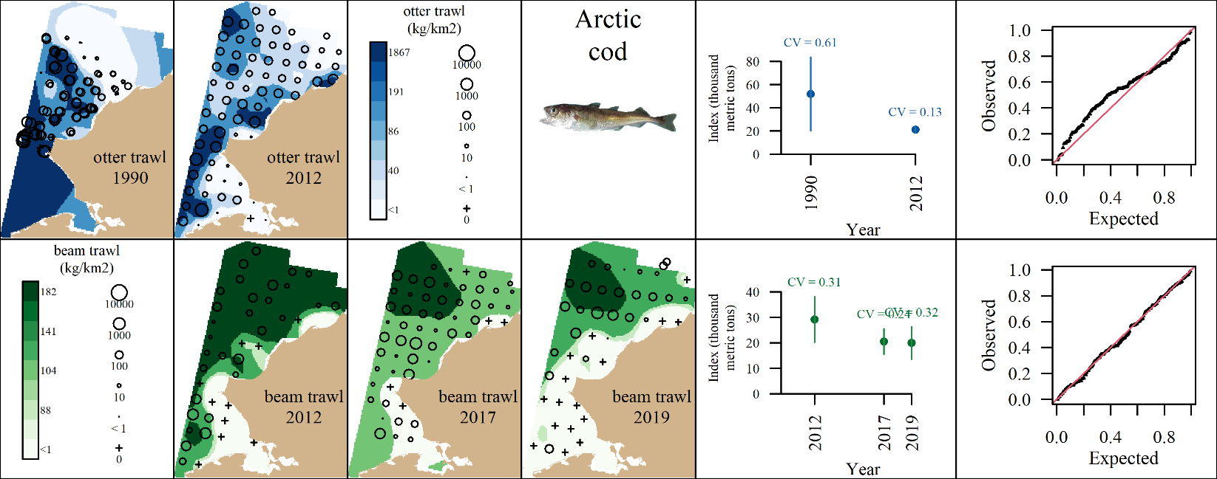
Species Set
Gear Types
Spatiotemporal distribution modelling
Historical CPUE data

Slide 6
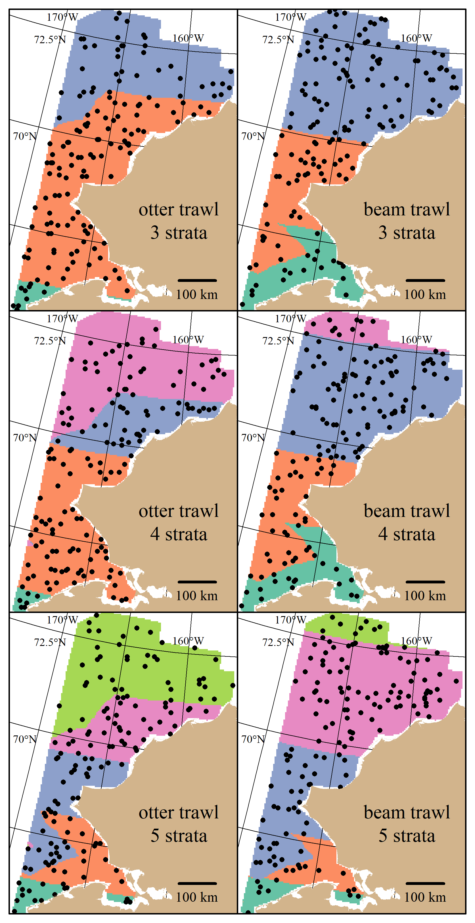
Survey Designs
Simple Random Designs
Systematic Designs
Stratified Random Designs
Optimization of strata boundaries and allocation similar to GOA BTS redesign
Stratum variables: latitude and distance to shore
3-5 strata
Latitudinal cutoff ~ 70 degrees N, inner stratum consisting of Kotzebue Sound/entrance of the Bering Strait
Optimal allocation theory is used to flexibly allocate number of stations that minimize expected CV across taxa list.
Total Sampling Effort
Survey Designs
Simulate Surveys

Slide 7
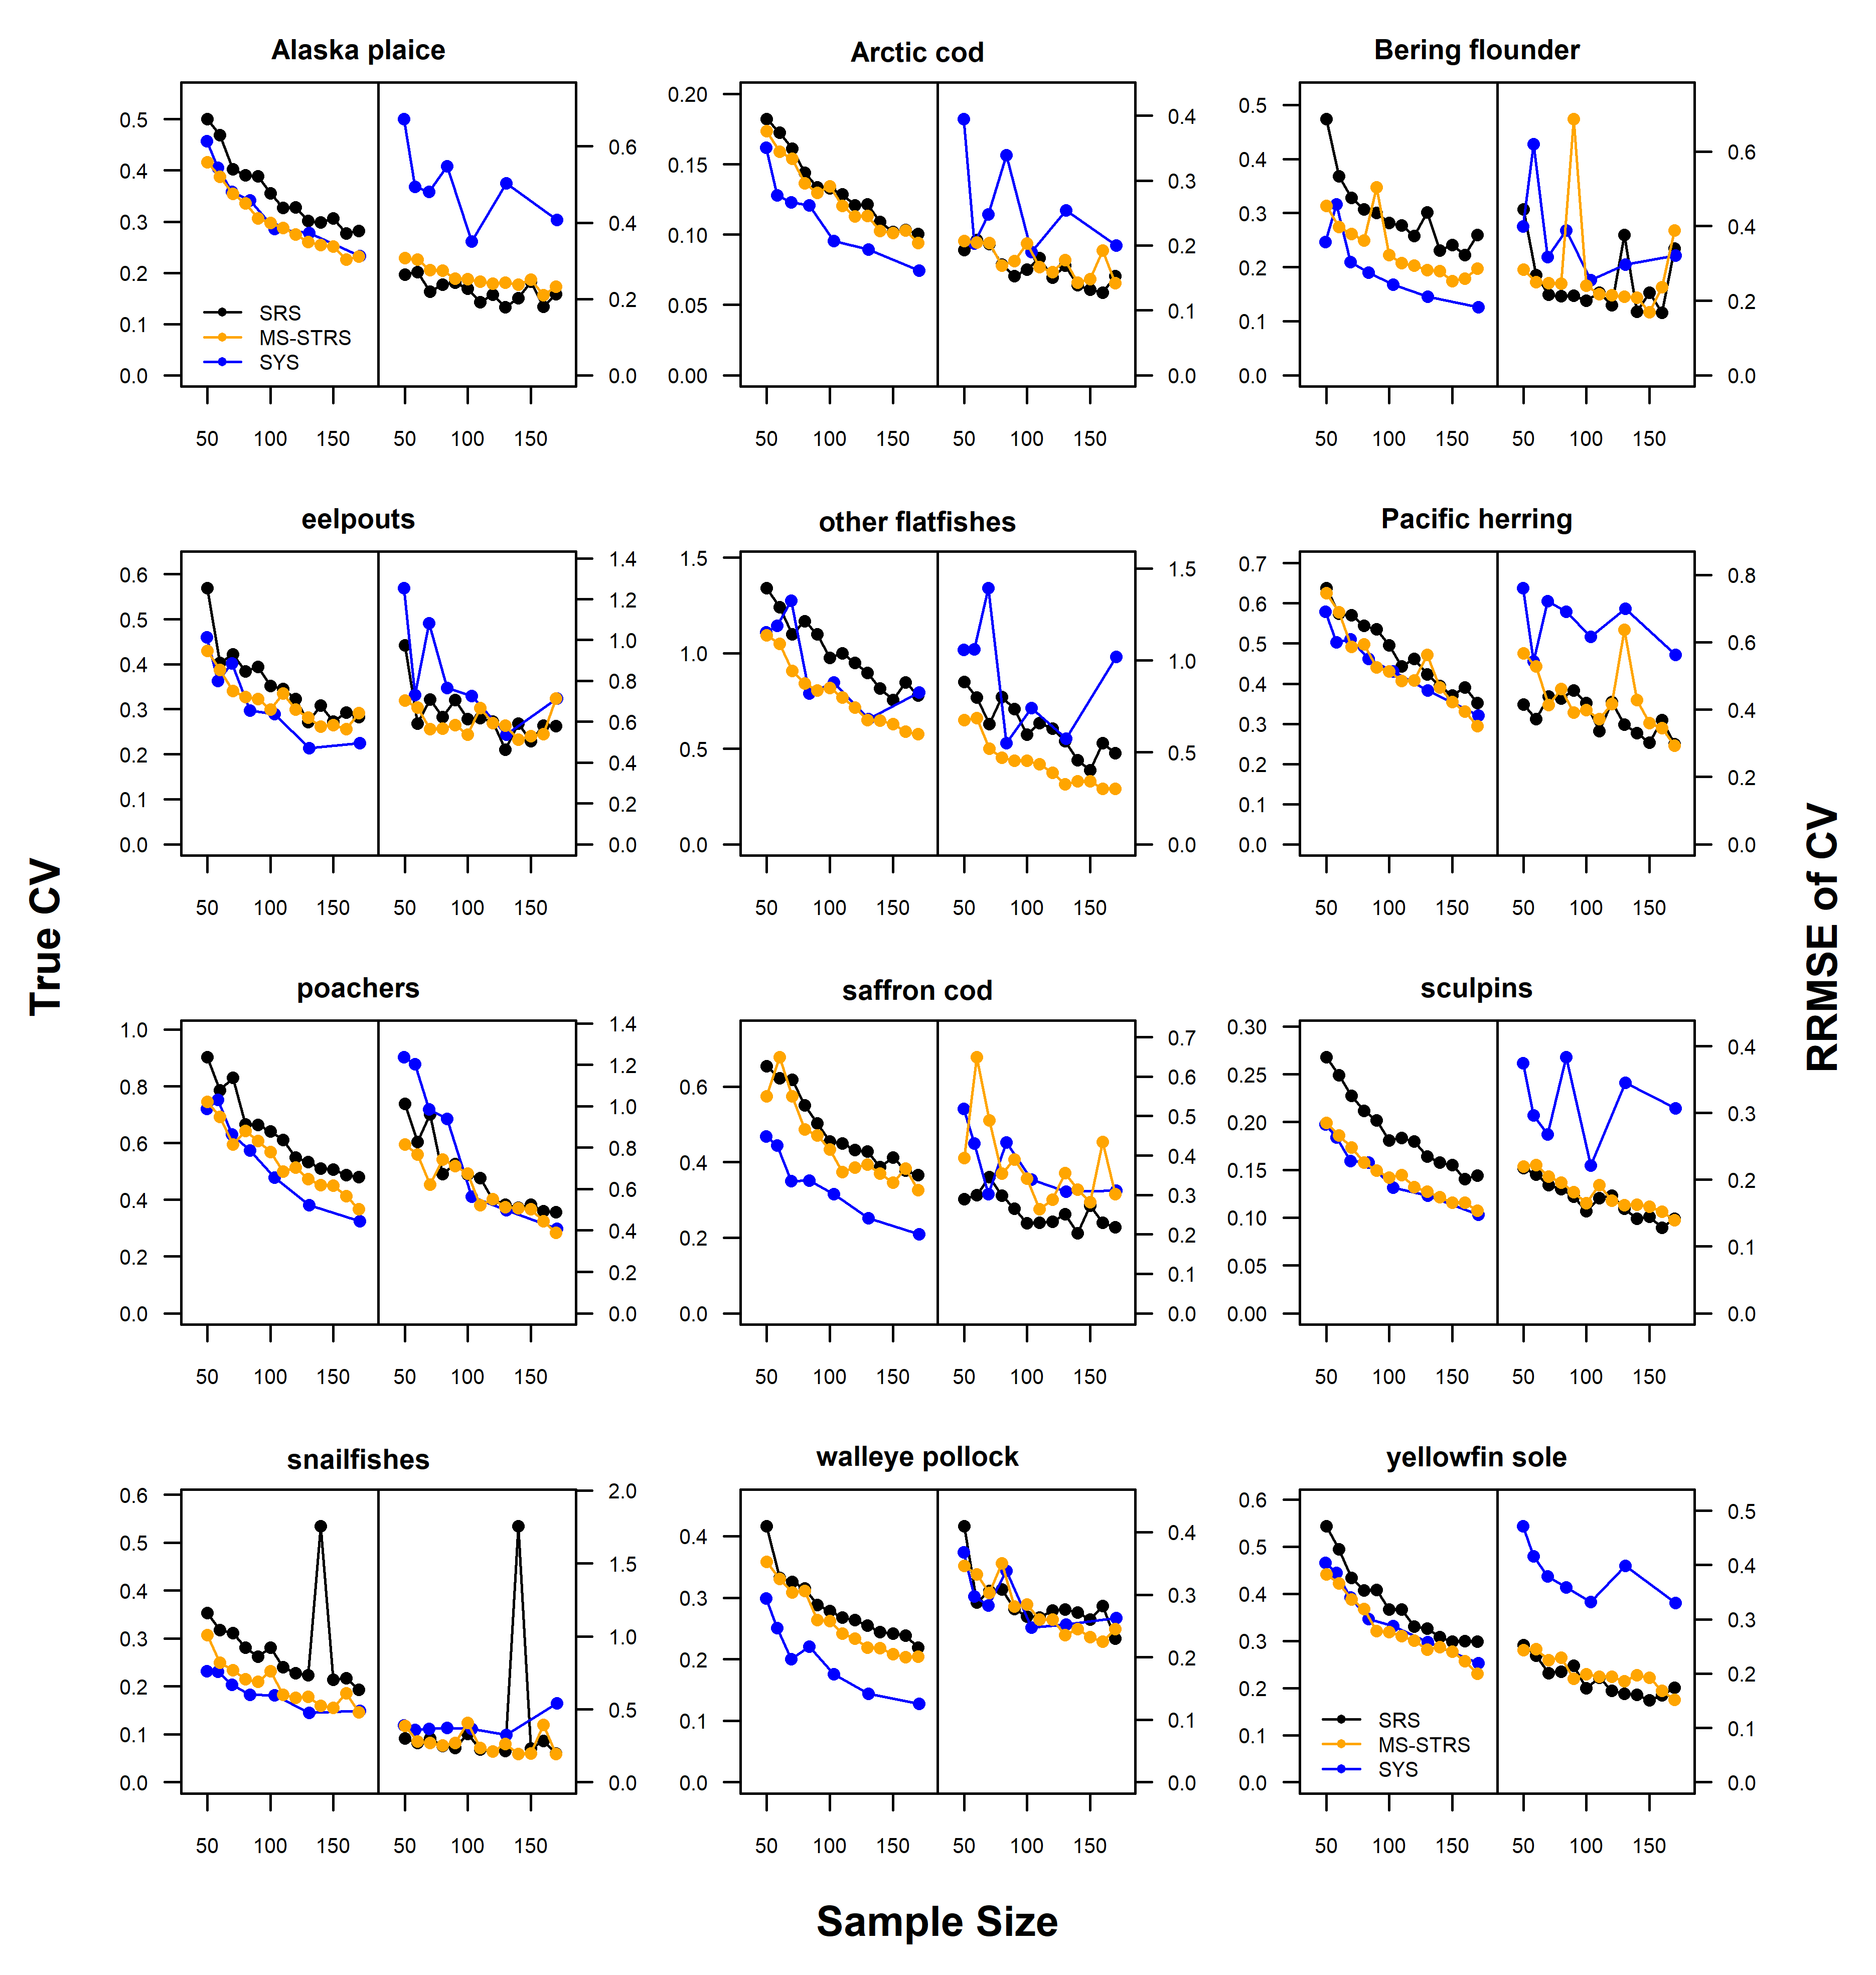
True CV (Left plots): Standard deviation of simulated indices, normalized by true index.
RRMSE of CV (Right plots): uncertainty and bias of CV about the true CV
Simple Random
Stratified Random
Systematic Grid
Total Sampling Effort
Survey Designs
Simulate Surveys

Slide 8
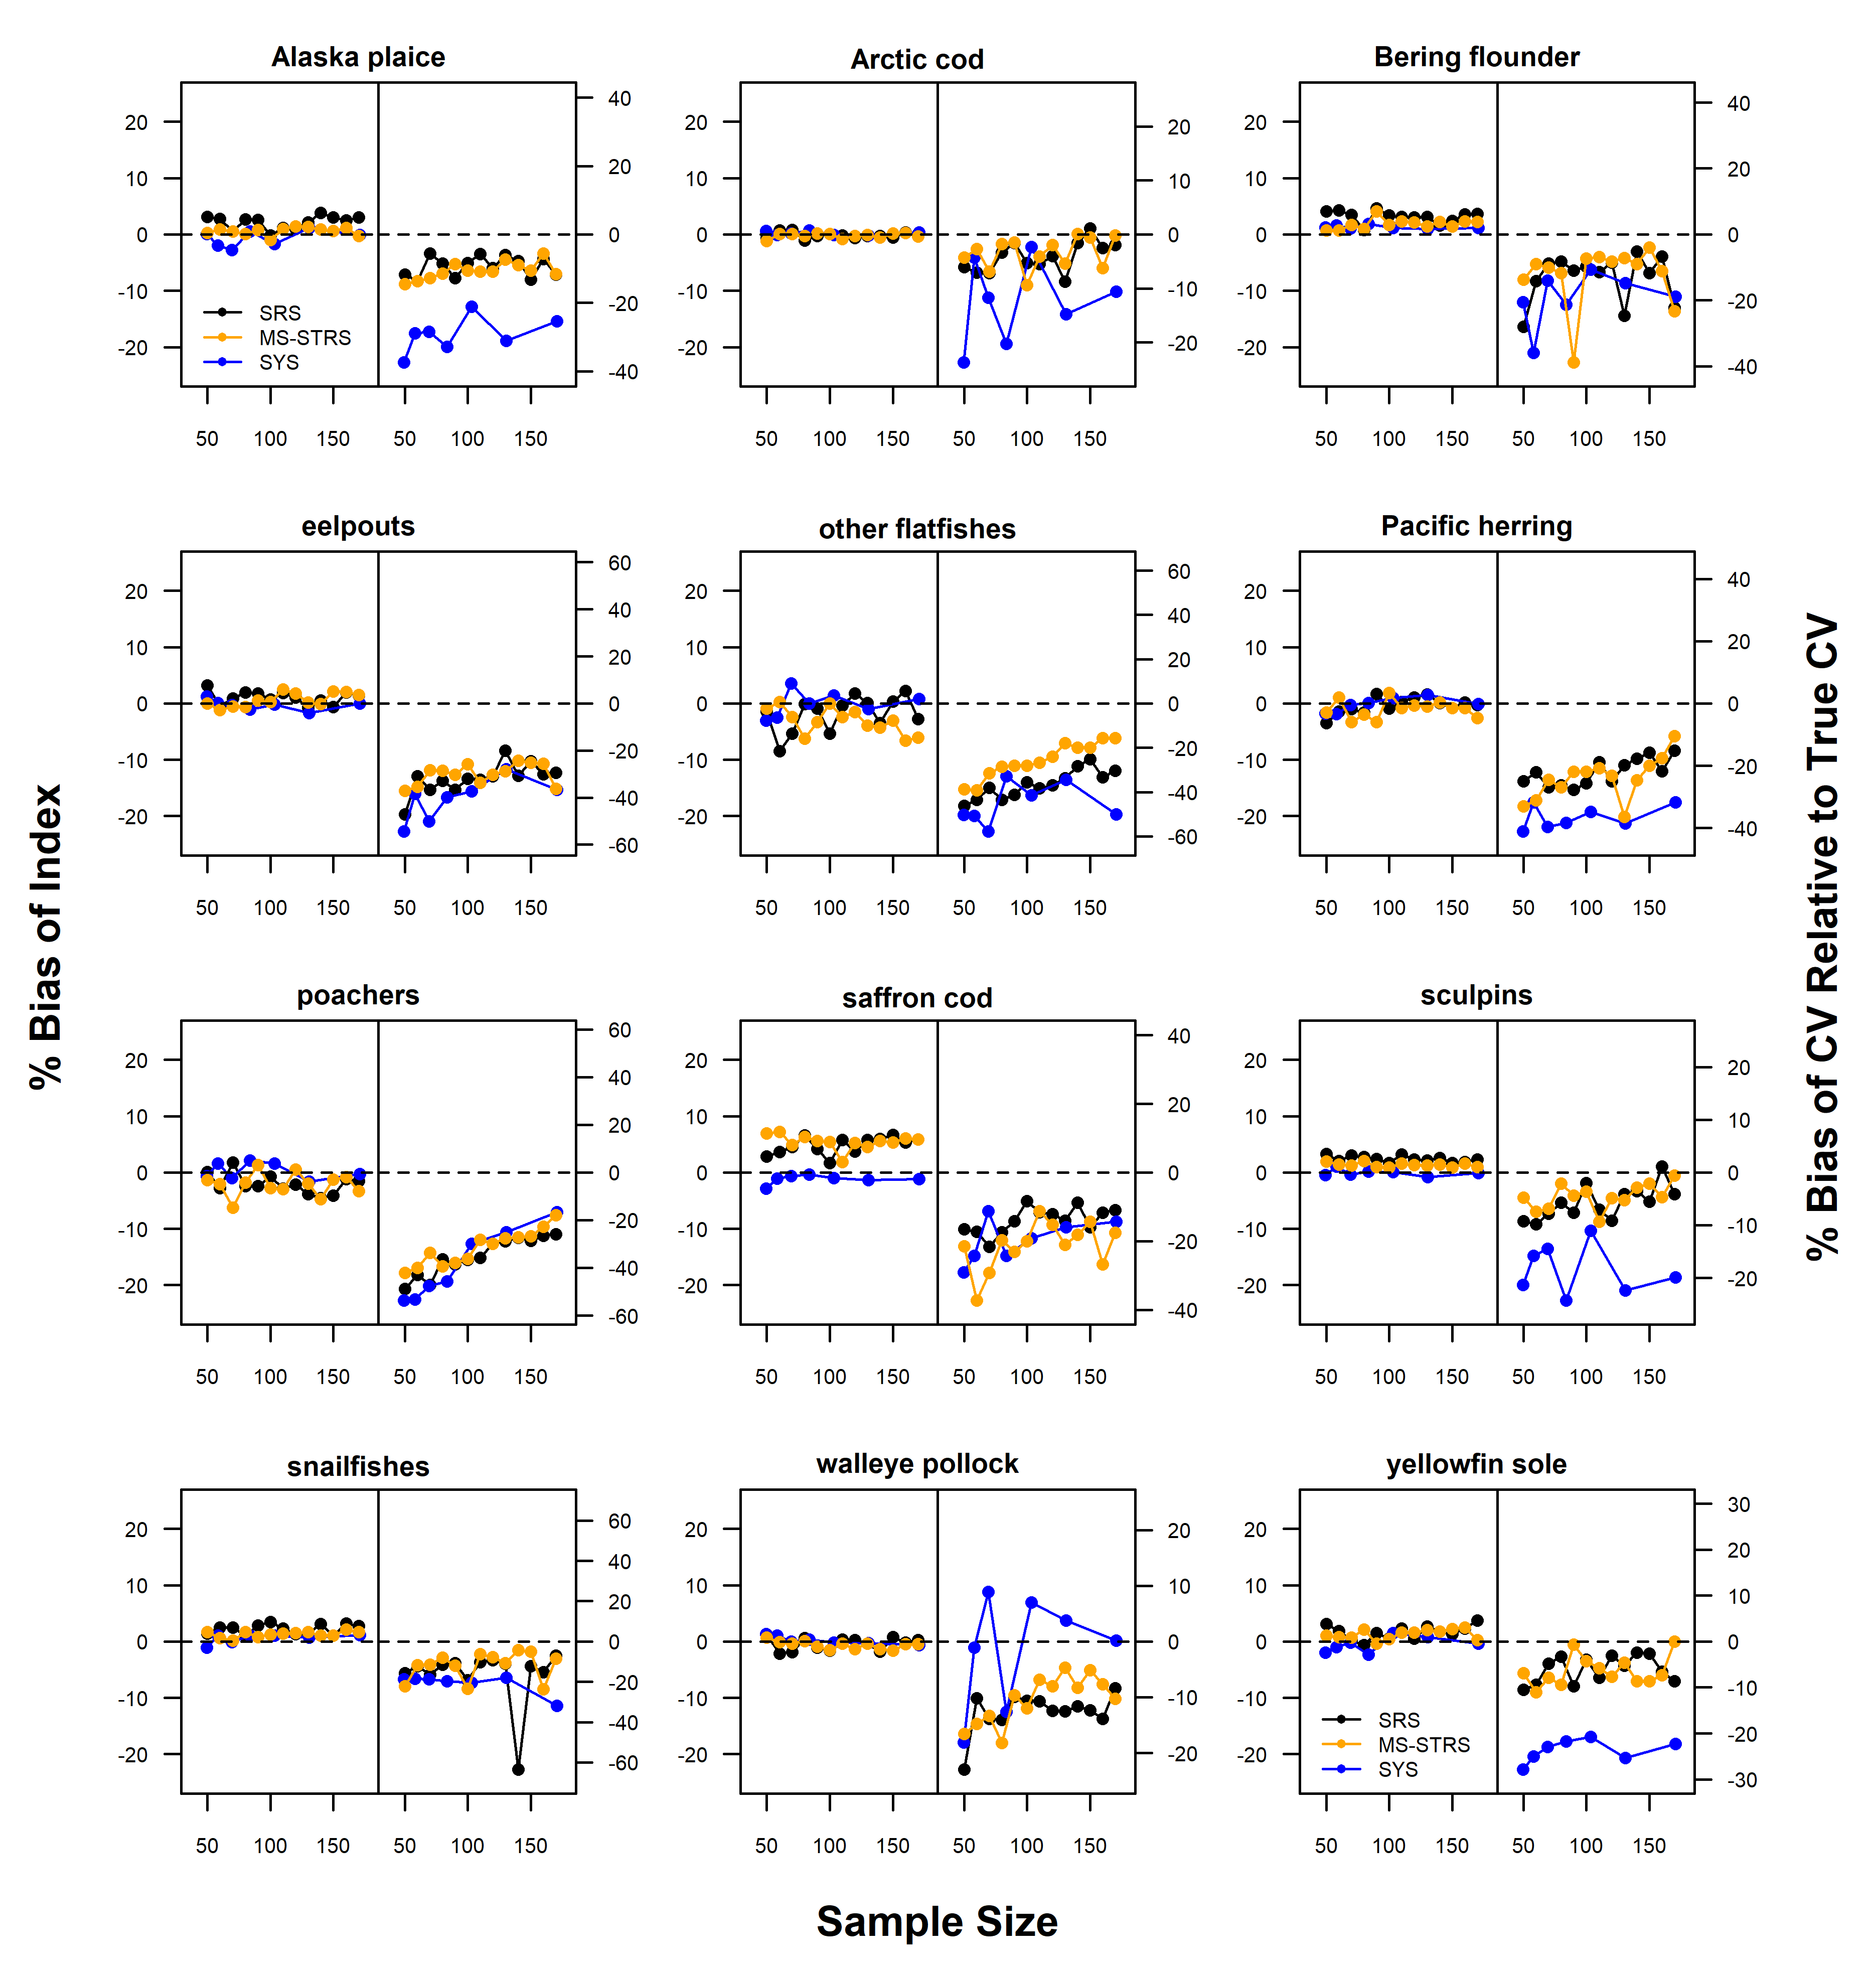
Average Percent Bias Plots
Index relative to true index (Left)
CV relative to True CV (Right)
Simple Random
Stratified Random
Systematic Grid
Total Sampling Effort
Survey Designs
Simulate Surveys

