Slide 1
Cybersecurity
A Strategic Corporate Priority

Slide 2

What is Cybersecurity?
Protection of systems and networks from digital attacks.
Ensures confidentiality, integrity, and availability (CIA triad).
Critical in banking, healthcare, and IT infrastructure.

Slide 3
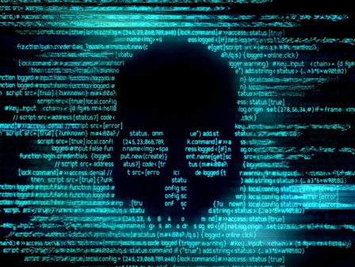
Cyber Threats.

Slide 4
Cybersecurity Solutions.
Threat | Defense Mechanism
Phishing | Awareness & Email Filters
Malware | Antivirus & Firewalls
Ransomware | Backup & Patch Management
DDoS | Load Balancers & Firewalls
Learn More

Slide 5
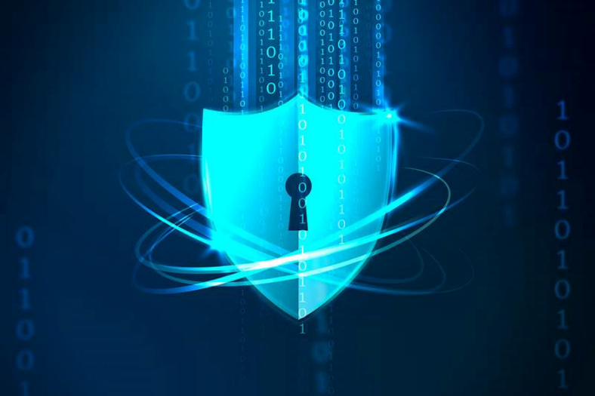
Future of Cybersecurity.
Advanced encryption methods.
Zero Trust Security.
AI-assisted threat detection.
Increasing demand for professionals.

Slide 6
Conclusions
Effective cybersecurity requires a holistic approach combining technology, risk management, response planning, and ongoing employee education to safeguard organizational assets and reputation.

