Slide 1
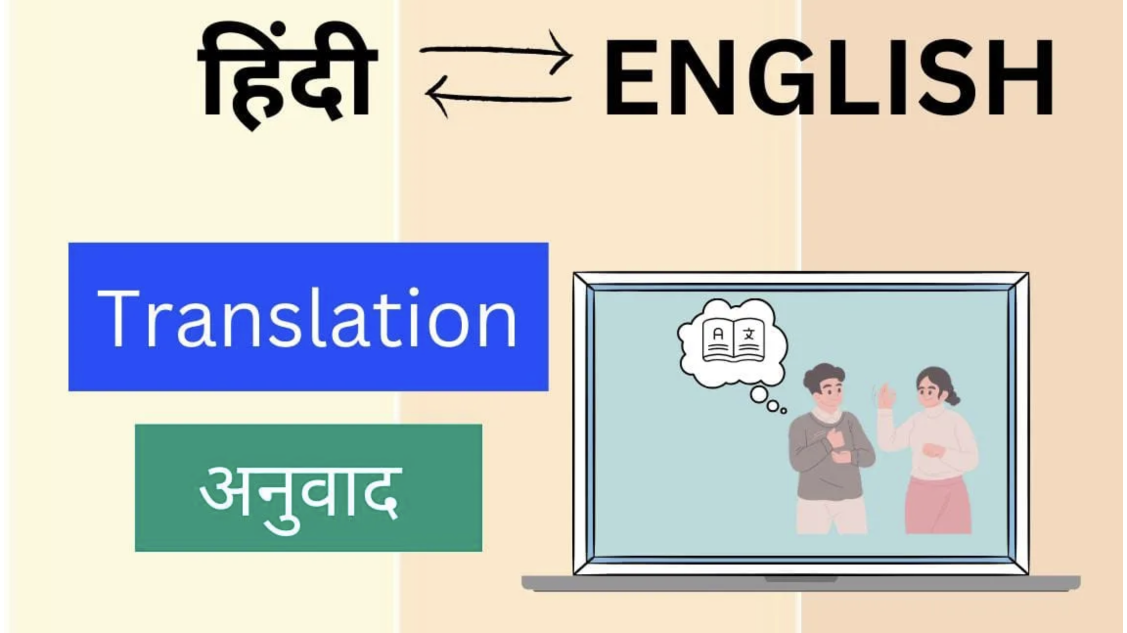
Hindi-English Translator

Slide 2

Group Members:
Student Name: Student ID:
Zoyeb Mansuri C0867190
Maaz Patel C0892303
Shubham Choksi C0894399
Ramandeep Kaur C0894968
Nagasai Velpuri C0896277
Rehan Khokhar C0896278

Slide 3

Overview
1.Introduction
2. Methods
3.Model Architecture
4.Data collection
5.Data cleaning
6.Modelling
7.Results
8.Conclusion
9.Future work

Slide 4
Introduction
Purpose: - Automatically convert text between Hindi and English - Break down language barriers - Enable cross-cultural communication Importance: - Hindi: Widely spoken in India English: Global language | Project Goal: Create precise and effective translation system Applications: - Education - Business - Media

Slide 5
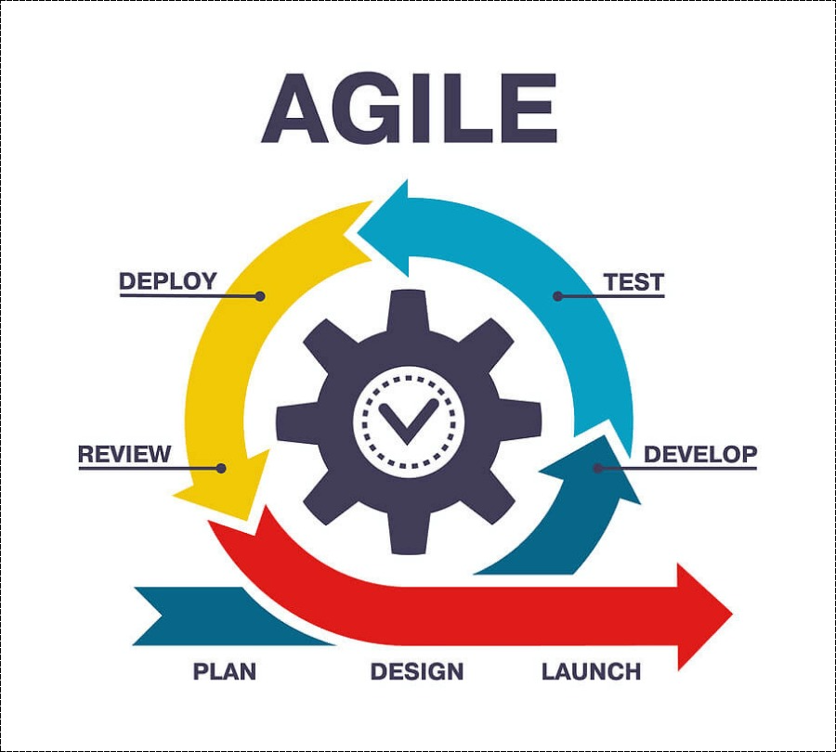
Software Development Method

Slide 6
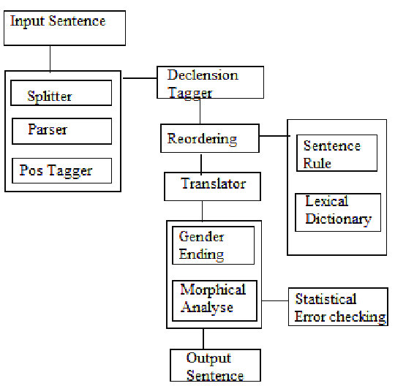
Project Architecture for Language Translation

Slide 7
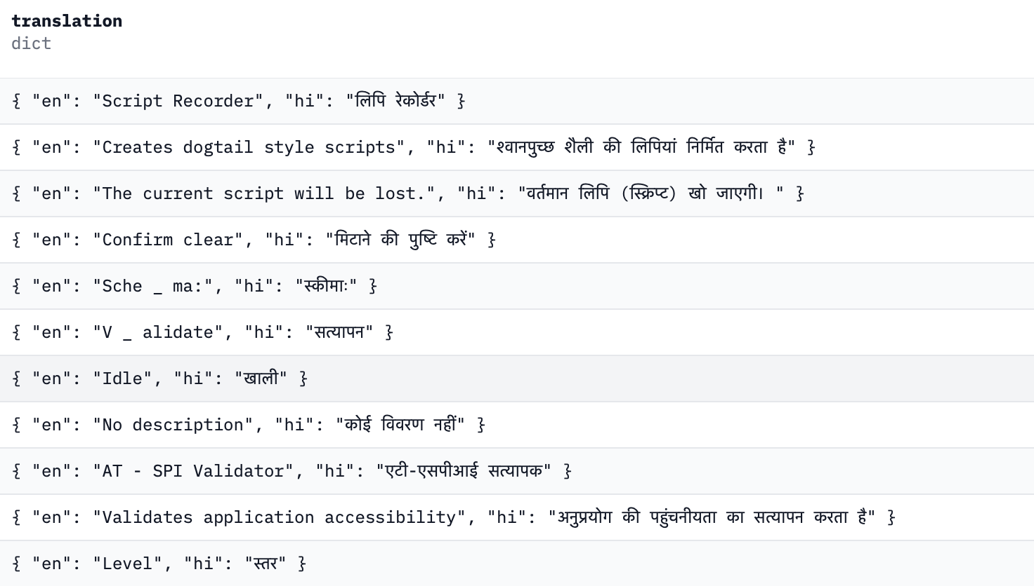

Dataset
The dataset was sourced from of The IIT Bombay English-Hindi corpus . It includes a parallel corpus of 1.49 million English-Hindi sentence pairs

Slide 8
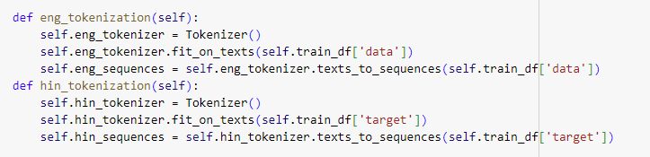
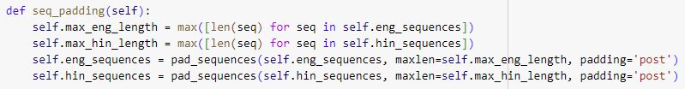
Dataset Cleaning:
Tokenization and Normalization: Tokenize the text into smaller units like words or sentences. Normalize the text by converting it to lowercase and removing stop words. We have used TensorFlow Keras Tokenizer Library for tokenization and normalization.
Padding and Sequence Preparation: Pad sequences to a fixed length to ensure uniform input size. Convert token sequences to integer sequences using the vocabulary mappings.

Slide 9
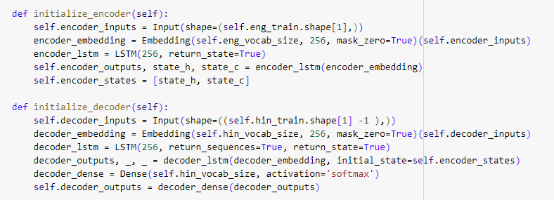
Dataset Cleaning Encoder-Decoder Architecture: Design an encoder to process the source language input, typically using LSTM or transformers. Create a decoder to generate the target language output, often employing attention mechanisms to focus on relevant parts of the encoded input.

Slide 10
We have tried to generate models with CNN and LSTM.
Modeling
CNN:CNNs in NLP typically use 1D convolutions over word embeddings or character sequences. The convolutional layers act as feature detectors, identifying patterns in local regions of text, while pooling layers help capture the most important features across the entire input. CNNs are effective at capturing local patterns and n-gram-like features in text. They are computationally efficient and can process inputs of varying lengths, making them suitable for tasks like text classification and sentiment analysis.

Slide 11
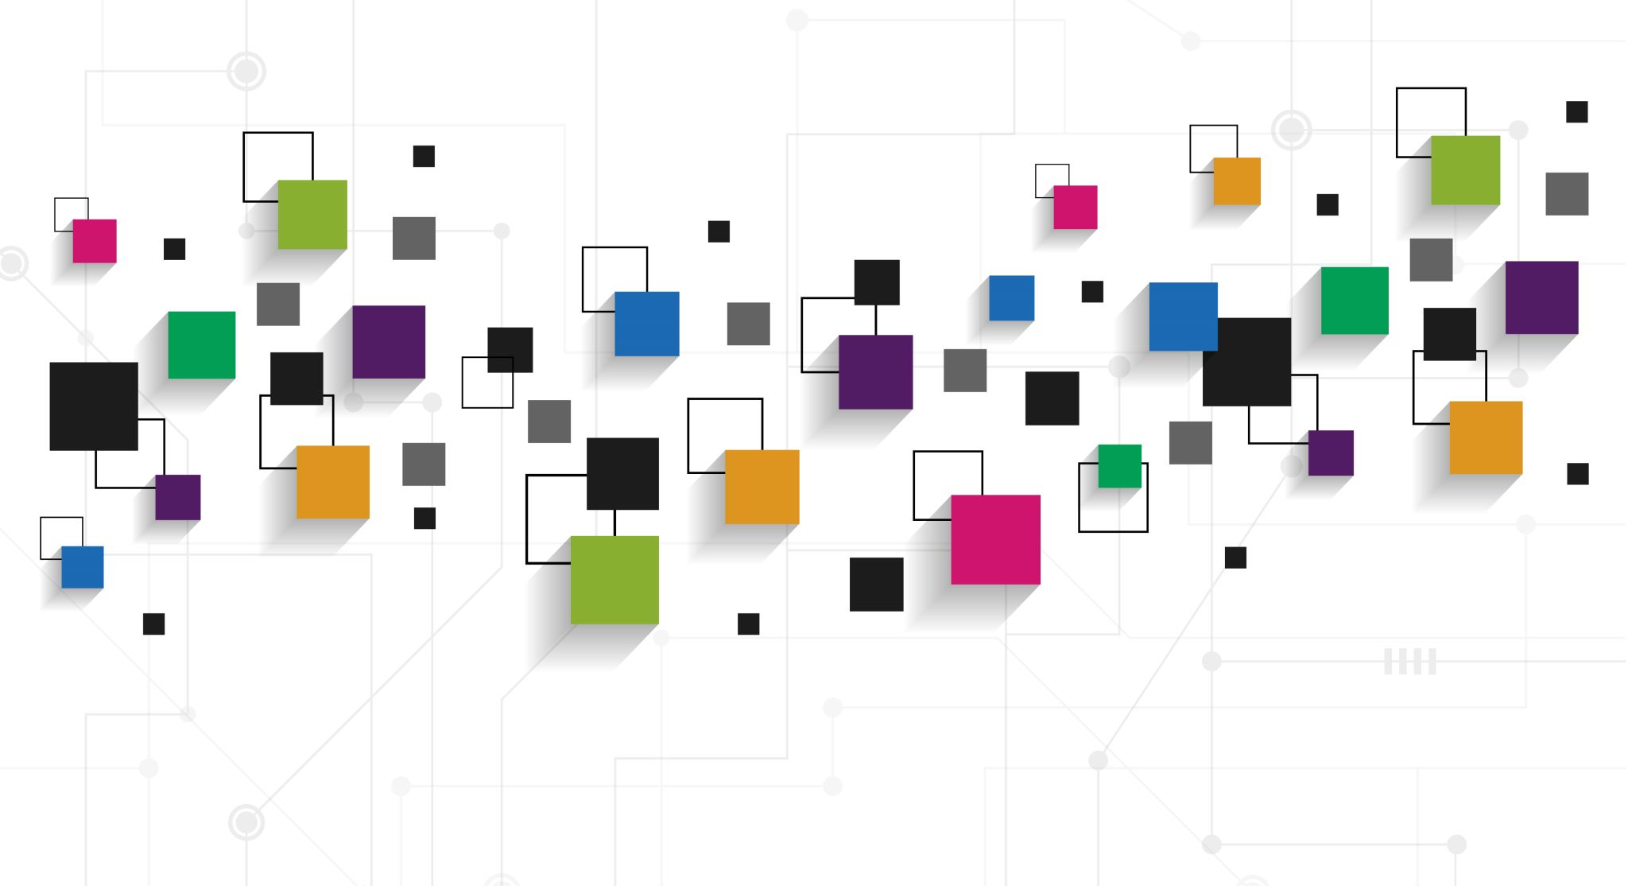
LSTM:
LSTMs are a type of recurrent neural network designed to capture long-range dependencies in sequential data. They use memory cells and gating mechanisms to selectively remember or forget information, allowing them to maintain context over long sequences of text. LSTMs excel at tasks requiring understanding of long-term dependencies, such as language modeling and machine translation. They can handle variable-length input sequences and are particularly effective for tasks involving sequential prediction or generation of text.

Slide 12
Web app development
After generating models and validating model results, we have started working on Website development.
Front-end: For front-end we have utilized HTML, CSS and React.JS. We have created forms which collect data from users and once you confirm and continue with data it will POST those data backend API endpoint to preprocess those data after validation and predict results from machine learning models and print language translation.
We have deployed our Web app with Heroku and train models with Azure Machine Learning studio.
Deployed Webpage Link: https://hi-en-translator-281cb51c1e9d.herokuapp.com/
GITHUB Link for Project: https://github.com/zoyeb-xoyal/AML3406Capstone

Slide 13
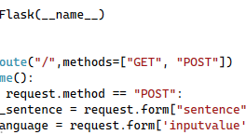
Back-end: We developed a backend using a Python Flask API The website has been tested for data validation and functionality, and we deployed the project, built with React JS and Python, on Heroku, enabling continuous deployment from our GitHub repository.

Slide 14
Failure Methods:
CNN limitations
LSTM challenges
Backpropagation issues

Slide 15
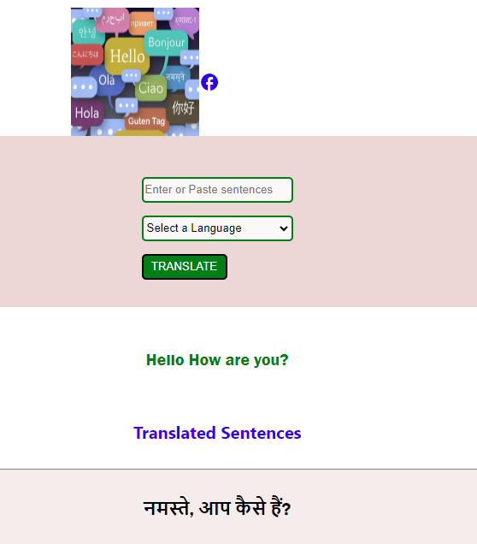
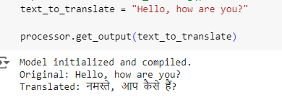
Results Below are the results generated from models while testing ML model in Jupiter Notebook and Web App.

Slide 16

Conclusion:
In this project, we have developed an English to Hindi translator system utilizing state-of-the-art natural language processing techniques. By leveraging a transformer-based model and an encoder-decoder architecture, we were able to achieve high-quality translations. The project highlights the potential of deep learning models in language translation, providing a tool to decrease the communication gap between English and Hindi speakers.

Slide 17

Future work
While the current version has achieved good results, there are further improvements that we would like to make. These improvements are given below:
Incorporation of additional language: Extending the translation system to support more languages
Context-Aware translation: Using models that consider document-level context
Real-time Translation: Developing a real-time translation feature
Speech-to-text: Using speech-to-text models for translations
User-Feedback ingestion: Taking feedback from user to refine and improve the quality

Slide 18

References
Deploying Machine Learning Models with Flask for Beginners. (n.d.). ProjectPro. https://www.projectpro.io/project-use-case/mlops-gcp-rossmann-sales-forcasting-flask
Azure ML Endpoint (Microsoft)https://learn.microsoft.com/en-us/azure/machine-learning/concept-endpoints?view=azureml-api-2
Azure Machine Learning (Microsoft) https://learn.microsoft.com/en-us/azure/machine-learning/how-to-deploy-online-endpoints?view=azureml-api-2&tabs=azure-cli
AWS Machine Translation (Amazon) https://aws.amazon.com/what-is/machine-translation/
NLP Data Cleaning (TowardsDataScience) https://towardsdatascience.com/nlp-in-python-data-cleaning-6313a404a470
IIT Bombay English-Hindi Corpus(IITBombay)https://www.cfilt.iitb.ac.in/iitb_parallel/

Slide 19

Thankyou

