Slide 1


Universal Plus Credit Risk Management System Proposal
FIVE SIGNETS CONSULTING

Slide 2

AGENDA
1
2
3
DELIVERABLES & WHY US?
MARKET
OVERVIEW
OUR SOLUTION

Slide 3
1. MARKET OVERVIEW

Slide 4
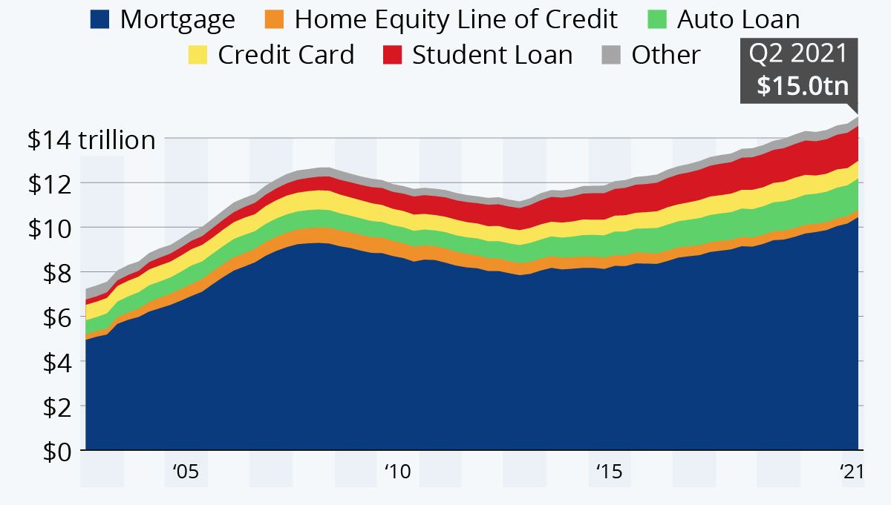
Household debt increase mainly due to mortgages
Total household debt balance in the US by category
Rising debt balance throughout the pandemic mostly driven by mortgages and auto loans
Declining credit card debt may point to increasing financial awareness in the general public
Source: New York Fed Consumer Credit Panel/Equifax on Statista (https://www.statista.com/chart/19955/household-debt-balance-in-the-united-states/)
Notes:
https://www.lendingtree.com/personal/personal-loans-statistics/

Slide 5
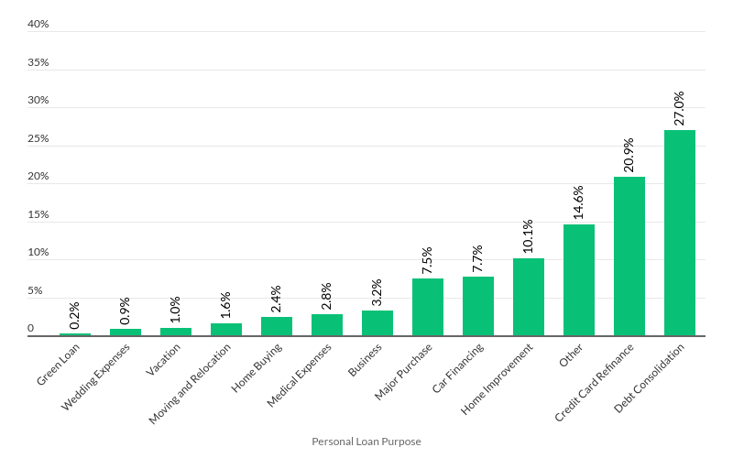
Personal loans mainly used to manage existing debt
Reasons for personal loan inquiries April 2021
Almost half of recent personal loan enquiries are aimed to deal with existing debt
Green loans still only a small portion, but this is likely to change throughout the decade
Source: Lendingtree (https://www.lendingtree.com/personal/personal-loans-statistics/)
Note: Limited to borrowers with credit scores above 640 seeking a 36-month loan.
Notes:
https://www.lendingtree.com/personal/personal-loans-statistics/

Slide 6
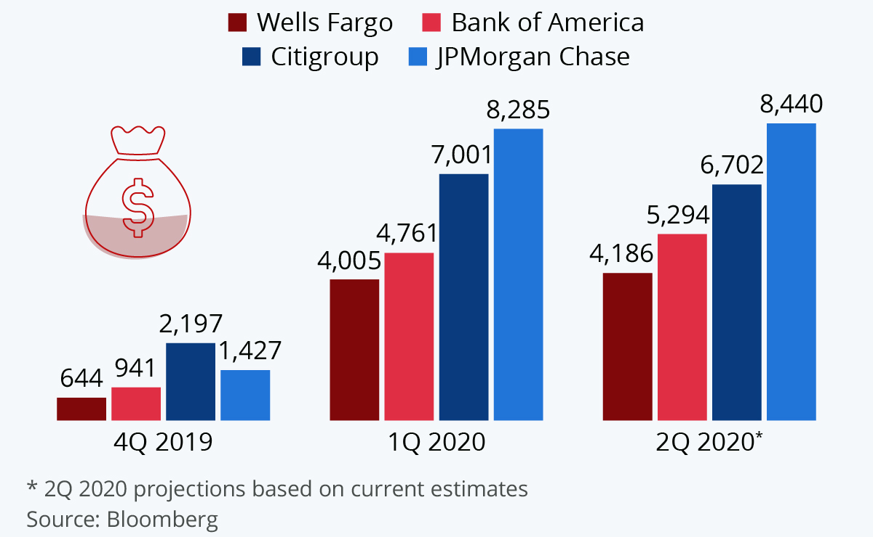
US Banks’ Loan Loss Provision in last three quarters ($M)
Banks preparing for Covid-driven credit default wave
Source: Statista (https://www.statista.com/chart/22266/bank-loan-loss-provisions/)
Notes:
https://www.investopedia.com/terms/l/loanlossprovision.asp
https://news.sky.com/story/barclays-sees-profits-slump-30-as-pandemic-bad-loan-provision-hits-4-8bn-12221422

Slide 7

Universal Plus should act risk averse in current market
Rising debt balance mostly driven by mortgages
Conservative risk management helps prevent impending default-wave
Most personal loan applications made to refinance or consolidate existing debt
Thorough behavioural data analysis required to assess debt management loan applications
Default-wave anticipated by major US lenders

Slide 8
Our understanding of Universal Plus
Universal Plus’ current loan processing system
Client
Credit officer
Credit processor
Accept loan
Reject loan
Note: Manual processing is assumed based on available information on Universal Plus

Slide 9
2. OUR OFFER

Slide 10
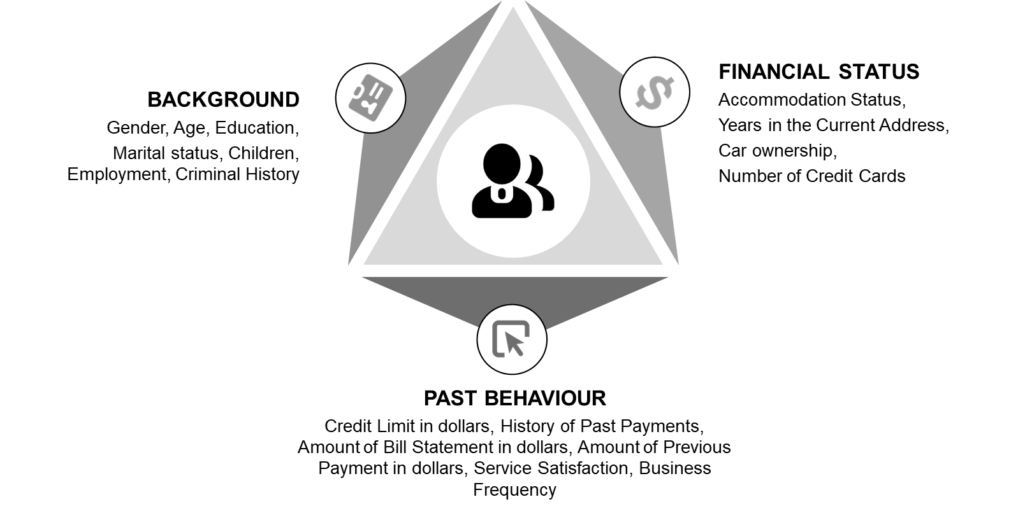

System designed to facilitate human processing
Outcomes¹ of risk classes
13.8%
1.5%
Default
53.8%
86.2%
98.5%
No default
46.2%
Evaluate outcome
Risk classes¹ and respective actions
Automatically
reject
Assign to credit processor
Automatically
accept
Anticipated probability of default
4.5%
Credit Risk Management Model
Risk classification
High risk
Medium risk
Low risk
¹Example outcome scenario based on 6000 unseen credit applications

Slide 11
Profit¹ gain proportional to labour quality
Expected increase in profit¹ when implementing our model
Sensitivity of profit¹ gain with respect to labour quality
Profit
+60.1%
$1.2M
$2.0M
Our approach
$0.8M
$1.5M
Baseline
$1.0M
+60.1%
Profit
$0.5M
Baseline
Our approach
High
Low
Labour quality
¹Example outcome scenario based on 6000 unseen credit applications

Slide 12
Conservative approach leads to increased net revenues
Expected profit composition in our evaluation scenario¹
Conservative automated handling of high-risk applications reduces loss from bad credit, driving higher profits
$2.2M
-$0.6M
$1.6M
-$0.4M
$1.2M
Our approach
Key assumptions of calculations
Assumption² | Value
Average Credit Size | $6,092
Average Interest-rate | 11%
Average Loan Application Review Cost | $88.89
$2.5M
-$1.2M
$1.3M
-$0.5M
$0.8M
Baseline
Revenues from good credit
Loss from bad credit
Net revenues
Review costs
Profit
¹Example outcome scenario based on 6000 unseen credit applications; ²Sources for assumptions: Average credit size (Lendingtree), Average Interest rate (Valuepenguin), Review cost calculated based on average credit processor wages (Glassdoor) and average monthly workload based on job descriptions (Indeed)
Notes:
How much we loss for default ( for 3 models)
Good : Average Credit size + Interest on Credit *Total Non-Default
Loss : Average Credit size + Interest on Credit *Total Default
Profit : Good Credit revenue - Loss from bad credit - Review cost
Gain (profit we gonna have)
Predict % increase in paying back loan on time (less risk) by identifying target groups
: graph show (ACCURACY)
COST analysis
20% Low ACCEPT
80% High Reject
Meduim
https://www.experian.com/blogs/ask-experian/whats-a-good-interest-rate-for-a-personal-loan/
Average interest

Slide 13
3. DELIVERABLES & WHY US?

Slide 14
Easy integration along four requirements
Digitizable application form
We will deliver:
Cutting-edge default probability prediction model
Risk classification model optimised to your workforce
Credit application form template
Training materials for IT personnel
5 years of software support
Fast and easy implementation
Credit processor assignment system
Data consistency checks
Universal Plus’ role
Provide processing environment
Engage HR and IT teams to implement an efficient credit processing assignment system
Inexpensive processing environment
Notes:
https://www.statista.com/chart/22266/bank-loan-loss-provisions/
https://www.investopedia.com/terms/l/loanlossprovision.asp
https://news.sky.com/story/barclays-sees-profits-slump-30-as-pandemic-bad-loan-provision-hits-4-8bn-12221422

Slide 15
WHY US?
5+ years of experience in Financial services, Management Consulting and Analytics
Specialist experience in:
Optimisation
Data Management
Predictive analytics.
Enthusiastic about providing you the best analytics service.
Notes:
Experience in marketing,

Slide 16

FIVE SIGNETS CONSULTING

Slide 17

CREDITS
Presentation template by Slidesgo
Icons by Flaticon

