Slide 1
ERC confirmation
Date : Jul.28.2016
Name : TamDo
Department/Group/Team : Backend/Backend3/IO

Slide 2


1. Lacking power/ground connection for PSW cell.
Power switch is not connect to Power/Ground as IP level. It will be connected at TOP by upper layer.
➔ We should virtual connect it by using text.lis file.
From LVS report:
X4743/X30530/M0(-4458.283,1886.477) MP(pch_svt_mac) ** unmatched instance **
X4743/X30530/M1(-4458.283,1885.421) MP(pch_svt_mac) ** unmatched instance **
…
** unmatched instance ** FSACA9SB0YSRSBSMAW120R12/MM0==199 MP(pch_svt_mac)
** unmatched instance ** FSACA9SB0YSRSBSMAW120R12/MM0==200 MP(pch_svt_mac)
It means that layout and netlist has these device, but it does not same connection when LVS compare
Solution. We set virtual connection for these line
LAYOUT TEXT "VDDM_A2VC1" -5204.880 2195.573 140 "u7795hrcah30vcd0_a2vc1_PV“
LAYOUT TEXT "VDD" -5204.880 2193.075 140 "u7795hrcah30vcd0_a2vc1_PV"
M10 core mesh
M10 core mesh
M10 core mesh
M10 core mesh
M10 core mesh
M10 power pin of PSW is not connected to PG mesh

Slide 3
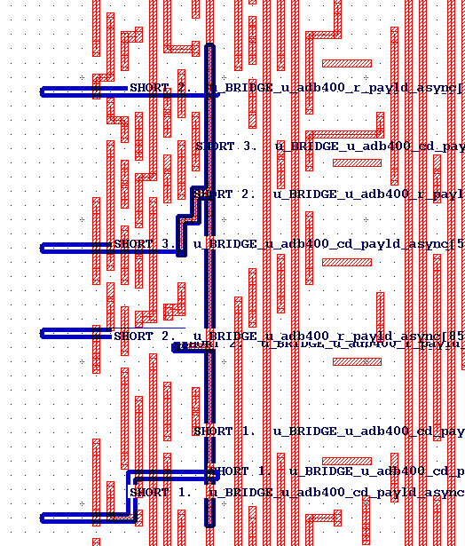
2. Short signal
Short signal which is defined in text.lis file
From LVS report
NUMBERS OF OBJECTS AFTER TRANSFORMATION
---------------------------------------
Layout Source Component Type
------ ------ --------------
Ports: 10322 10325 *
Nets: 561775 561780 *
…
**************************************************************************************************************
INCORRECT NETS
DISC# LAYOUT NAME SOURCE NAME
**************************************************************************************************************
1 ** missing net ** u_BRIDGE_u_adb400_r_payld_async[572]
--------------------------------------------------------------------------------------------------------------
2 ** missing net ** u_BRIDGE_u_adb400_r_payld_async[856]
--------------------------------------------------------------------------------------------------------------
3 ** missing net ** u_BRIDGE_u_adb400_cd_payld_async[660]
--------------------------------------------------------------------------------------------------------------
4 ** missing net ** u_BRIDGE_u_adb400_w_payld_async__489__OUT_PORT_BUF_net
--------------------------------------------------------------------------------------------------------------
5 ** missing net ** u_BRIDGE_u_adb400_w_payld_async__374__OUT_PORT_BUF_net
--------------------------------------------------------------------------------------------------------------
These net connected to port of IP. These port already defined in text.lis file
➔ LVS can export the lvs.rep.short file
LAYOUT TEXT "u_BRIDGE_u_adb400_cd_payld_async[660]" 755.89 -309.1 132 u7797hca53ss0_pva2ls_PV
LAYOUT TEXT "u_BRIDGE_u_adb400_cd_payld_async[572]" 755.89 -467.3 132 u7797hca53ss0_pva2ls_PV
LAYOUT TEXT "u_BRIDGE_u_adb400_cd_payld_async[856]" 755.89 -479.4 132 u7797hca53ss0_pva2ls_PV
To easy detect short, we should define net name into text.lis file

Slide 4
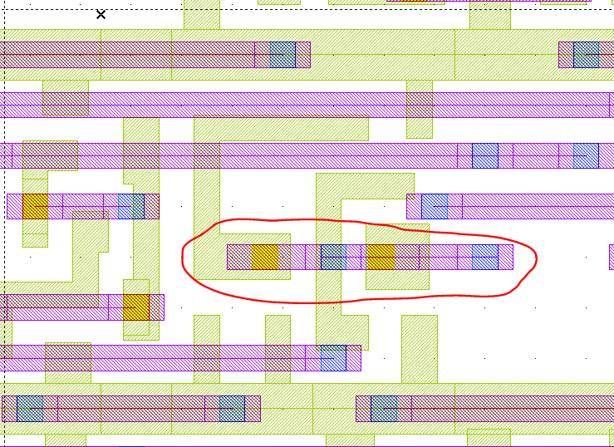
3. Short signal
Using Hcell to find properly short location
LVS report without define DCAP4BWP7T40P140 in Hcell ➔ 200 instance were reported (maximum) ➔ hard to find short location
Error: Different numbers of nets.
Error: Connectivity errors.
**************************************************************************************************************
INCORRECT NETS
DISC# LAYOUT NAME SOURCE NAME
**************************************************************************************************************
1 Net X272/X16317/6 Xxofiller_CAP_DCAP4BWP7T40P140_23035/net044
--- 3 Connections On This Net --- --- 3 Connections On This Net ---
-------------------------- --------------------------
--- Incorrect Devices On This Net ---
X272/X16317/X0/M1(-1865.240,1333.275) MP(pch_mac) Xxofiller_CAP_DCAP4BWP7T40P140_161727/MM27 MP(pch_mac)
s: VDD s: VDD
d: VDD d: VDD
b: VDD b: VDD
g: X272/X16317/6 ** Xxofiller_CAP_DCAP4BWP7T40P140_23035/net044 **
** X326/X56776/6 ** g: Xxofiller_CAP_DCAP4BWP7T40P140_161727/net044
…
200 Net X272/X17381/6 Xxofiller_CAP_DCAP4BWP7T40P140_23535/net044
--- 3 Connections On This Net --- --- 3 Connections On This Net ---
-------------------------- --------------------------
--- Incorrect Devices On This Net ---
X272/X17381/X1/M1(-1781.100,1333.275) MP(pch_mac) Xxofiller_CAP_DCAP4BWP7T40P140_23061/MM27 MP(pch_mac)
s: VDD s: VDD
d: VDD d: VDD
b: VDD b: VDD
g: X272/X17381/6 ** Xxofiller_CAP_DCAP4BWP7T40P140_23535/net044 **
** X272/X16330/6 ** g: Xxofiller_CAP_DCAP4BWP7T40P140_23061/net044
➔ We can guess there are short between internal wire of DCAP and signal.
LVS report after define DCAP4BWP7T40P140 in Hcell ➔ Only 1 DCAP cell reported ➔ short location.
Error: Cells with non-floating extra pins.
*******************************************************************************************
INSTANCES OF CELLS WITH NON-FLOATING EXTRA PINS
DISC# LAYOUT NAME SOURCE NAME
*******************************************************************************************
1 X284/X44462/X1(-1933.260,660.880) DCAP4BWP7T40P140 Xxofiller_CAP_DCAP4BWP7T40P140_91620 DCAP4BWP7T40P140
X284/X44462/X1/1:X284/46908 ** missing pin ** Xxofiller_CAP_DCAP4BWP7T40P140_91620/net044 ?
To easy detect short, we should define cell name into Hcell file

Slide 5
4. MISSING PIN at IP level
LVS report
------
Error: Connectivity errors.
Error: Cells with non-floating extra pins.
…
DISC# LAYOUT NAME SOURCE NAME
**************************************************************************************************************
1 X102/X0(-1833.245,-3570.710) u7797hrcav3mmm00 Xmm u7797hrcav3mmm00
X102/X0/2:VDDQ_MDPLL0 ** missing pin ** ? VDDQ_MDPLL0
X102/X0/3:VDDQ_MAPLL ** missing pin ** ? VDDQ_MAPLL
X102/X0/5:VDDQ_MDPLL1 ** missing pin ** ? VDDQ_MDPLL1
------
This error is caused by using wrong FRAM. FRAM of MM is missing PORT VDDQ_MDPLL0, VDDQ_MDPLL0, VDDQ_MDPLL0
So, The PG connect is not effected.

Slide 6
4. LVS INCORRECT at STD/DCAP cell
Using Hcell to find properly short location
LVS report
------
Error: Cells with non-floating extra pins.
…
INCORRECT AN3D0BWP7D5T24P96CPD AN3D0BWP7D5T24P96CPD
…
------
In correct at std-cell can judge by:
--- lacking PG connect for these cell
--- short signal caused incorrect PIN

Slide 7
5. LVS INCORRECT at CAP/BOUND cell
Hcell: collection of extracted cells in layout design
Lacking of CAP/BOUND cells: not remove placement blockage? Gdsmerge exists any error?
**************************************************************************************************************
INCORRECT INSTANCES
DISC# LAYOUT NAME SOURCE NAME
**************************************************************************************************************
1 ** missing instance ** Xboundarycell_ENDCAP_TSHFILL20T_153503__PUSHDOWN TSHFILL20T
--------------------------------------------------------------------------------------------------------------
2 ** missing instance ** Xboundarycell_ENDCAP_TSHFILL20T_153504__PUSHDOWN TSHFILL20T
--------------------------------------------------------------------------------------------------------------
3 ** missing instance ** Xboundarycell_ENDCAP_TSHFILL20T_153533__PUSHDOWN TSHFILL20T

Slide 8
Renesas System Design Co., Ltd.

