Slide 1
Blockage & GuardRing
Naming Rule
2022/8/3
Y.Mori
ABDD/ABB12
ルネサス エレクトロニクス株式会社

Slide 2
Scope of description in this document
This document describes the procedure for creating Row, Voltage Area and Guard Ring using INNOVUS.
floor plan flow (100_init.tcl)
Die Setting
Pre check
Guar Ring Overlap
Definition
IO Place
Create non default Row
SHDB setting
Make core7T Row Area
Guar Ring Cell insertion
Restore SHDB
Generate Track
Create Power Domain
Create Floor Plan
Place Hard Macro
Check Row align
This document describes this part.
Check Floor Plan
Read UPF
Insert
EndCap & Tap Cell
Custom(P/G) Route
Cut core7T Row
Check Fplan
Initial Setting
Set Blockage for Non default Row
Insert
TDC dummy cell
Additional User Setting
Check Blockage coordinate
5V Level Shifter place
core107T,core79TD
Appendix
・Blockage naming rule
・Guard ring naming rule
・Guard ring distance rule
Custom STA Setting
Create Guard Ring blockage
Place EPD Cell
Save database

Slide 3
Image of row creation procedure
Floor plan designs using INNOVUS utilize shapes drawn using placement blocks.
Row and voltage area are created based on blockage data.
Please complete the design of IO placement and HM place in advance.

Slide 4
Image of the scope of this document
It does not mention the procedure of IO placement and macro placement.
IO.def
HM_place.def( or Tcl)
Create core7T Row
Cut Row(core7T)
Create Row(core48T/core79TD/core107)
Create Voltage Area
Insert End Cap / Tap Cell
Place Guard Ring Cell
die
Scope of description in
this document
How to create Row and
inserted guardring and
end/tap cell ?
Floor Plan

Slide 5
Image of row creation procedure
Make 4 type Blockage shape
Make Blockage shape for create core48T
Make Blockage shape for create core79TD
Make Placement Blockage shape for cut core7T
Make Blockage shape for create core107T
(Make by manual)
Make Blockage shape for nondefault
Voltage area on core7T
(Make by manual)
Fill core7T
Cut out row under the
placement blockage
Create other core rows

Slide 6
Image of Voltage Area creation procedure
Create a Voltage Area by referring to the blockage shape and blockage attribute.
Core48 blockage shapes
utility
Core79 blockage shapes
Core107 blockage shapes
Generate Voltage Area
core7 blockage shapes
(non default Domain)
Row position expressed by blockage shapes.

Slide 7
Image of Insert End Cap / TapcelL procedure
End Cap and Tap cell are inserted using the INNOVUS native command.
Native CMD
After the create Row and Voltage Area
have been designed…
Place End Cap and Tap Cells.

Slide 8
Image of Insert Guard Ring Cell procedure
Guard Ring cell is automatically inserted based on the placement blockage shape.
Utility
Singl Ring
Double Ring
Guard Ring Cell

Slide 9
Scripts to help create floor plans
We have utilities to help you create floorplans.
/design04/u2c8be1/data/u2c8/5_layout/50_PnR/501_INNOVUS/COMMON_INNO_7T
~/UTIL/util_create_core_box_and_row_for_u2c.tcl
~/UTIL/util_set_row_pd_island_for_u2c_v013a.tcl
~/UTIL/util_inn_check_misaligned_row.tcl
~/UTIL/util_regen_tracks_for_u2c.tcl
~/UTIL/NIMH.command.v4.1.etf
~/UTIL/util_change_row_for_moving_const_box_v003.tcl
~/UTIL/util_create_top_guardring_const_box.tcl
~/UTIL/util_insert_TCD_dummy.tcl
~/UTIL/utl_check_narrow_placement_space_v2.etf
~/UTIL/utl_check_tech_site_and_library_cell_site_in_PD_v2.etf
~/UTIL/util_check_pg_diff.tcl
~/UTIL/util_dump_phycell_prefix_v001.tcl
~/CMD/endcap_tap_insertion_NIMHR_site_v007.tcl
~/CMD/endcap_tap_insertion_default_site_v006.tcl
~/CMD/check_fplan_for_u2c_v007.tcl
~/UTIL/util_CutRow_around_SoftBlkg.tcl

Slide 10
Die Size Definition
detailed Design

Slide 11
Die size definition
Die size
There are rules for Die size dimensions.
X size must be an integral multiple of the standard Row site.
Y size must be an integral multiple of the standard Row height.
NG
OK
X (0,0)
X (0,0)
Die
0.7um x 2n
core7T height
In Innovus, Placement Grid is made
based on the lower left corner of the chip.
Std cell is placed at the row site.
If there is a gap in the coordinate,
a large number of grid errors will occur
when the placement check is performed.
core7T site
0.14um x 2n
In the IO.def definition…
DIEAREA ( -6475000 -5716200 ) ( 6475000 5716200 ) ;
Row unit x 2n
Die size must be designed so that the Placement Grid and the Row site match.
Row Hight x 2n

Slide 12
Die size definition
It does not mention the procedure of IO placement and macro placement.
IO.def
100_init.tcl
The IO.def will be provided by physics design team.
The chip size is set to INNOVUS to the value described
in DIEAREA of DEF.
#### 2.1 shiftOrigin ####
shiftOrigin -center
#### 2.2 io place ####
defin $IO_def
# IO Y flip request from ABB13. 2022/7/26
source /design04/u2c8be2/u2c8/data/u2c8/6_layoutchk/MASTER_PG/06_IO/IO_SOSC_upper_flip.tcl
#### 2.3 HM place ####
defIn $HM_def
deleteHaloFromBlock -allIOPad
deleteHaloFromBlock -allBlock
HM.def
HM_place.def( or Tcl)
Consider the placement of HM in advance
and keep the placement information.

Slide 13
UPF Setting
detailed Design

Slide 14
READ UPF
Merge the master UPF and subfiles into one file.
#### 2.6 read upf ####
source -e -v $mask_list_upf ; # Variable Settings For Reading UPF File Correctly
read_power_intent -1801 ${upf_file}
commit_power_intent -keepRows -power_domain
Variable settings defined in UPF（If necessary)
Merged into one file
***worst.upf + ***worst_srsn.tcl (cat)
If you want to change the UPF during design,
Execute the above command repeatedly.
Power assign will be changed to the new setting.

Slide 15
Row creation procedure
detailed Design

Slide 16
Make Blockage shape for cut core7T
Cut core7T Row
Generates a core7T row for the whole chip.
X {0 0}
Die
util
core7T Row
X {0 0}
100_init.tcl
+
### 2.4 resette core box and base row ####
deleteRow -all
util_create_core_box_and_row_for_u2c
createPlaceBlockage -type hard -box {0 0 10 10} -name origin
Full core7T
{0 0｝
core7T Row
put origin marker
Use this mark to check if the origin position is correct.

Slide 17
Make Blockage shape for cut core7T
Cut core7T Row
Create placement blockage that removes areas where the core7T is not needed.
PHY
5V area
AWO area
ISO area
SYS area
core7T area
ISO area
AD area
5V repater
Cut core7T row area
Placement blockage file
IO
IO
Consider a floor plan
Create a blockage that
covers areas other than
the Core7T area
Dump to placement blockage file

Slide 18
Make Blockage shape for cut core7T
Cut core7T Row
There are naming rules for blockage shapes.
createPlaceBlockage -type partial -density 50 -name For_Cut_row_pb -box {-1477.840 2155.300 -777.140 2566.900}
createPlaceBlockage -type partial -density 50 -name For_Cut_row_pb -box {1820.140 2127.300 1894.200 2566.900}
createPlaceBlockage -type partial -density 50 -name For_Cut_row_pb -box {2459.940 2114.700 2905.900 2179.100}
:
:
①
②
①：-type can be decided arbitrary.
②：-name should be “For_Cut_Row_pb*”
Cut Row under the Placement Blockage.
In 100_init.tcl, the cut row is executed with this name.
Be sure to give “For_Cut_Row_pb*” to blockage
name.
X {0 0}
Full core7T
Cut unnecessary rows

Slide 19
Make Blockage shape for cut core7T
Cut core7T Row
Corresponding part in the 100_init.tcl
createPlaceBlockage -type partial -density 50 -name For_Cut_row_pb -box {-1477.840 2155.300 -777.140 2566.900}
createPlaceBlockage -type partial -density 50 -name For_Cut_row_pb -box {1820.140 2127.300 1894.200 2566.900}
createPlaceBlockage -type partial -density 50 -name For_Cut_row_pb -box {2459.940 2114.700 2905.900 2179.100}
:
:
100_init.tcl
Content
:##### 2.7 create core7T Row ####
source $pKl_for_CutRow_core7T
set cutRow_area [dbShape [dbGet top.fPlan.pBlkgs.boxes]]
foreach i $cutRow_area {
cutRow -site core7T -area $i
}
cutRow -halo 0.14
Cut Row under the Placement Blockage.
Cut Row under the Hard Macro sets halo 0.14 to avoid DRV.
HM
Row
Space is required around the HM.

Slide 20
Create non default Row procedure
core48T, cre79TD core107T

Slide 21
Make Blockage shape for except core7T row
Set Blockage for Non default Row
Make Blockage shape for except core7T row
Multi-height Row and Voltage areas are generated based on the shape expressed by the blockage.
Non default voltage core7 area
core107
Blockage file
core48
Work manually.
core79

Slide 22
Create non default Row procedure
Guar Ring Cell insertion
Non default Row are created by referring to the blockage shape and blockage attribute.
P12~P16
core48 blockage shape
core79 blockage shape
core107 blockage shape
Use the utility to create Row.
Innovus > util_set_row_pd_island_for_u2c -job_type row

Slide 23
Make Blockage shape for create core48T
Set Blockage for Non default Row
blockage shape
Make a Placement Blockage for create core48T row.
The blockage shapes expresses where you want
to make the core48T.
Core48T row and voltage area creation and Guard
Ring cell are automatically generate based on this
created placement blockage attribute.
There are naming rules for blockage.
createPlaceBlockage -type hard -name core48T%PD_SYSVCC_VSS%5V%woDNW -box { …}
createPlaceBlockage -type hard -name core48T%PD_VCC_VSS%5V%woDNW -box { …}
createPlaceBlockage -type hard -name core48T%PD_A1VCC_A1VSS%5V%wDNW -box { …}
:
:
①
②
➂
①： The blockage type for generating the core48T
area is hard
②：Naming rules are strictly defined. see the
“Blockage Naming Rule for row Generation”
page for more information.
➂： The coordinates are required to be aligned with
the core47T placement grid.
Point: To make core 48T, set type to hard.
Only core7T rows
Add core48T rows

Slide 24
Make Blockage shape for create core79TD
Set Blockage for Non default Row
blockage shape
Make a Placement Blockage for create core79TD row.
The blockage shapes expresses where you want
to make the core79TDT.
Core79TD row, voltage area creation, and Guard Ring
Cell place are automatically generate based on this
Created placement blockage attribute.
There are naming rules for blockage.
createPlaceBlockage -type soft -name core79TD%PD_AWOVDD_VSS%E0VCC%VSS%1V%woDNW -box { …}
createPlaceBlockage -type soft -name core79TD%PD_PLLVDD_PLLVSS%AWOVDD%VSS%1V%woDNW -box { …}
createPlaceBlockage -type soft -name core79TD%PD_ISOVDD_VSS%A1VCC%A1VSS%1V%woDNW -box { …}
:
:
①
②
➂
①： The blockage type for generating the core79TD
area is soft
②：Naming rules are strictly defined. see the
“Blockage Naming Rule for row Generation”
page for more information.
➂： The coordinates are required to be aligned with
the core79TD placement grid.
Point: To make core 79TD, set type to soft.
Add core79TD rows

Slide 25
Make Blockage shape for create core107T
Set Blockage for Non default Row
blockage shape
Make a Placement Blockage for create core107T row.
The blockage shapes expresses where you want
to make the core107T.
Core107T row, voltage area creation, and Guard Ring
Cell place are automatically generate based on this
Created placement blockage attribute.
Point: To make core 107T, set type to macroOnly.
There are naming rules for blockage.
createPlaceBlockage -type macroOnly -name core107T%PD_A1VCC_A1VSS%ISOVDD%VSS%V5%woDNW%UL% -box {}
createPlaceBlockage -type macroOnly -name core107T%PD_E0VCC_VSS%ISOVDD%VSS%V5%woDNW%UL% -box { …}
createPlaceBlockage -type macroOnly -name core107T%PD_SYSVCC_VSS%AWOVDD%VSS%V5%woDNW%UL% -box {}
:
:
①
②
➂
①： The blockage type for generating the core107T
area is macroOnly
②：Naming rules are strictly defined. see the
“Blockage Naming Rule for row Generation”
page for more information.
➂： The coordinates are required to be aligned with
the core107T placement grid.
Add core107T rows

Slide 26
Make Blockage shape for nondefault Voltage area on core7T
Set Blockage for Non default Row
blockage shape
There are naming rules for blockage.
Make a Placement Blockage for create nondefault
Voltage area on core7T.
Non default voltage area creation and Guard Ring
Cell place are automatically execute based on this
Created placement blockage attribute.
createPlaceBlockage -type partial -density 10 -name core7T%PD_AWOVDD_VSS%1V%woDNW -box {…}
createPlaceBlockage -type partial -density 10 -name core7T%PD_PLLVDD_PLLVSS%1V%wDNW -box { …}
createPlaceBlockage -type partial -density 10 -name core7T%PD_HOCOVDD_VSS%1V%woDNW-box {}
:
:
①
②
➂
①：The blockage type for generating the non default
area is partial (density value is arbitrary)
②：Naming rules are strict. see the
“Blockage Naming Rule for row Generation”
page for more information.
➂： The coordinates are required to be aligned with
the core7T placement grid.
Point: To define VA on core7T, set type to partial.
Put on non def voltage shape

Slide 27
Create non default Row procedure
Guar Ring Cell insertion
Note
Innovus > util_set_row_pd_island_for_u2c -job_type row
This command can generate core7T row under blockage name core7T*.
but core7T row was existed in the first step.
It don't need to create the core7T in this phase.
(You will need this blockage file in a later process.)
Cut core7T Row
In 100_init.tcl , delete core7T* before execute this command.
Then source the blockage file again.
100_init.tcl
#### 2.11 create non default row area ####
deletePlaceBlockage core7T*
util_set_row_pd_island_for_u2c -job_type row
source $pKl_for_NonDefaultVA_core7T

Slide 28
background knowledge
During the row generation process, create a dummy row
indicating the reference position at the left side of the chip.
Die
100_init.tcl
# reference(dummy) row creation ###
set rows {core7T core48T core79TD core107T}
set x1 [lindex [dbGet top.fplan.coreBox] 0 0]
set y1 [lindex [dbGet top.fplan.coreBox] 0 1]
set y2 [lindex [dbGet top.fplan.coreBox] 0 3]
set offset "0"
foreach i $rows {
cutRow -site core7T -area [expr $x1 + $offset] $y1 [expr $x1 + $offset + 20] $y2
createRow -site $i -area [expr $x1 + $offset] $y1 [expr $x1 + $offset + 20] $y2
set offset [expr $offset + 25]
}
Put dummy row
core7T,core48T,core79TD,core107
The row coordinate check is based on the referenced row.
After checking the coordinates of all Rows, it will be deleted because it is no longer needed.

Slide 29
Guard Ring Insertion procedure

Slide 30
Insert Guard Ring Cell procedure
There are three types of guard rings.
・IO Guard Ring Cell
・Row Guard Ring Cell
・Hard Macro Guard Ring Cell
IO guard ring
AD
Row
*For Soft IP ( like Fusa) guard ring generate is
the almost same procedure as the Row guard
ring. See page 36 for details
IO guard Ring
Row guard Ring
HM guard Ring
There is a utility that places the guard ring cell along the edge of the placement block.
At first, You need to prepare placement blockage file for the guard ring implementation.
１）Blockage for generate IO guard ring ; >> There is utility to create it .
２）Blockage for generate Row guard ring ; >> Use the blockage file for row creation.(don’t need re-make it)
３）Blockage for generate HM guard ring ; >> Must be made by hand.

Slide 31
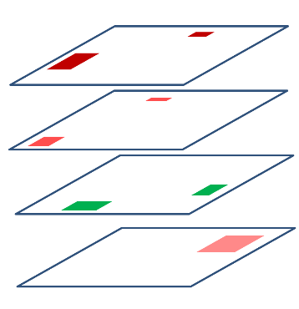
Insert Guard Ring Cell procedure
Pre check
Guar Ring Overlap
Guard Ring Cell insertion .
Image
Step 1
Prepare the blockage
AD
IO guard ring
For IO
For Row
For HM
Step 2
Pre-check the overlap of
Guard ring cells using the
blockage shape.
Blockage shape check
Utility
Step 3
execute utility.
IO guard ring
AD

Slide 32
Insert Guard Ring Cell procedure
Create Guard Ring blockage
How to make Placement blockage for IO guard ring.
You can use the utility to create a template blockage file.
Offset
Offset
I/O
I/O
Blockage
Offset must be set
gap
Utility
IO guard ring
gap
G/R
G/R
Blockage edge
Generate Blockage
ESD LUP rule >10.0um
G/R Hight 2um
Use the utility to create a placement blockage.
Innovus > util_create_top_guardring_const_box -multistage_row_gap 30.0 -offset 8.0
The recommended offset value is 8.0 or less.
If generated blockage shape is not expected, you will need to modify the shape by manual.
And dump the blockage information.
Innovus > select_obj [dbGet top.fplan.pBlkgs.name top_guardring_const_box -p]
Innovus > writeFPlanScript -selected –filename mod_top_guardring_const_box.tcl
This is the guard ring insertion specification ＞＞
21-5 RV28F_ラッチアップ対策チップ実装ガイド_V1.0.pptx

Slide 33
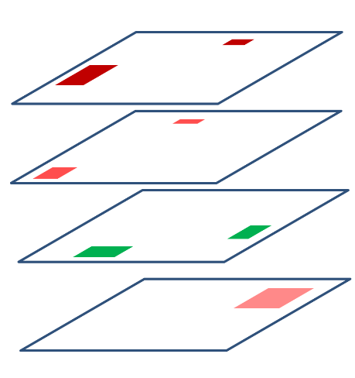
Insert Guard Ring Cell procedure
Create Guard Ring blockage
How to make Placement blockage for Row guard ring.
You can use the same blockage files as for Row generation.
So, you don't need remake blockage for row guard ring.
Row
A guard ring is generated based on same files.
Blockage shapes for row generation

Slide 34
Insert Hard Macro Guard Ring Cell procedure
Create Guard Ring blockage
How to make Placement blockage for HM guard ring.
AD
It is necessary to make a placement blockage shapes for the HM guard ring cell implementation.
AD
AD
Utility
This blockage also has a naming rule.
See the Naming Rules chapter in the appendix.
Blockage naming rule; HardIP%Power_Domain_name%%%5V%woDNW%<IP>%<Suffix>

Slide 35
Insert Hard Macro Guard Ring Cell procedure
Create Guard Ring blockage
Precautions for HM blockage generation
PB
Offset 1.9um
Edge from PB
3.1um
HM
PB
HM
Space> 5um
Space=3.1um
Space> 5um
Offset 1.9um
Space> 5um
Space=3.1um
Edge from PB
3.1um
Space> 5um
G/R cell
G/R cell
G/R cell
specification
The utility script is generated
guardring cells at a distance of
3.1um from the blockage edge.
You need to extend the
placement blockage.
We are considering a revision of the script.

Slide 36
Insert Guard Ring Cell around Soft IP (Fusa)
Create Guard Ring blockage
.
How to make Placement blockage for Soft IP guard ring.
Place G/R
Make a placement blockage cover the target soft IP area
Soft IP
(Fusa IP)
Blockage naming rule; SoftIP%Power_Domain_name%%%1V%woDNW%<IP>%<Suffix>
Use the utility to cut the Row around the blockage.
Utiliy; CutRow_around_SoftBlkg
This command finds blockage with the name SoftIP* and cut row around it.
Cut Row
Soft IP
3um
G/R Cell
Cut Row area by CutRow_around_SoftBlkg CMD.
3um

Slide 37
Insert Guard Ring Cell procedure
Pre check
Guar Ring Overlap
・Pre-check
You can pre-check guard ring cell overlap from each blockage shape using the command below.
Innovus > util_set_row_pd_island_for_u2c -job_type check_all -gr_setting_file gr_setting_file.txt
Such overlap can be detected from the pre-check.
Release with the utility.
IO cells
IO guard Ring
Over lap
Row blockage
Over lap
Implementing the Guard ring insert takes about an hour.
By checking the overlap of guard rings cells in advance,
it is possible to prevent failures after cell insert.
Row guard Ring
HM
HM guard Ring

Slide 38
Insert Guard Ring Cell procedure
Guar Ring Cell insertion
Inert Guard Ring
For IO Guard Ring cell insertion utility command.
Innovus > util_set_row_pd_island_for_u2c -job_type gr -gr_setting_file gr_setting_file.txt -sites top_guardring_const_box
Innovus > deletePlaceBlockage top_guardring_const_box*
Before insert row & HM guard Ring,
delete IO placement blockage.
Release with the utility.
For Row and HM and Soft IP guardring cell insertion utility command.
Innovus > util_set_row_pd_island_for_u2c -job_type gr -gr_setting_file gr_setting_file.txt

Slide 39
Insert Guard Ring Cell procedure
Guar Ring Cell insertion
100_init.tcl
In the first step, execute this line to create a
reference blockage file.
### 2.9 create_IO_guardring_const_box ###
# util_create_top_guardring_const_box -multistage_row_gap 30.0 -offset 2.0
source $FP_Blockage/tmp_top_guardring_const_box_1113.tcl
#suspend
#### 2.10 Check Guard Ring Overlap ####
util_set_row_pd_island_for_u2c -job_type check_all -gr_setting_file $FP_data/gr_setting_file_v004.txt -out_file set_pd_site_info.tcl
#### 2.11 create non default row area ####
deletePlaceBlockage core7T*
util_set_row_pd_island_for_u2c -job_type row
###
source $pKl_for_NonDefaultVA_core7T
#### 2.12 Guard ring cell insertion ####
Puts "Start: Guard ring cell insertion"
report_resource -start GR_cell
deletePowerSwitch
util_set_row_pd_island_for_u2c -job_type gr -gr_setting_file $FP_data/gr_setting_file_v004.txt -sites top_guardring_const_box
deletePlaceBlockage top_guardring_const_box*
util_set_row_pd_island_for_u2c -job_type gr -gr_setting_file $FP_data/gr_setting_file_v004.txt
report_resource -end GR_cell
P30
Next step, read the edited reference blockage file.
P37
Check the overlap of guard rings in advance.
Make creo48T,core79TD,creo107T Site Rows.
P26
Restore the core7T blockage to generate a guard ring.
P38

Slide 40
Create power domain (voltage area) procedure

Slide 41
Create Power domain (voltage area) procedure
Create Power Domain
Power domain are create by referring to the placement blockage shape and placement blockage attribute.
P18~P25
core48 blockage shape
core79 blockage shape
core107 blockage shape
core7 non defolt blockage shape
Use the utility to create voltage area.
Innovus > util_set_row_pd_island_for_u2c -job_type pd -gr_setting_file gr_setting_file.txt

Slide 42
Create Power domain (voltage area) procedure
Create Power Domain
Note
There is a Power Domain whose elements are only HM.
PD_HSFD0RVCC_VSS
PD don't have a STD
HM
HM
In ICC2 , such a Power Domain does not make a Row and does not make Power Domain shapes.
But in INNOVUS it is an error.
Do the check to find such a power domain.
Innovus > check_design -type {power_intent} -out_file ${rpt_dir}/check_design_power_intent.rep
Log;
---------------------------------------------------------------------------------------------------------------------------------
| ID | Severity | Count | Description |
---------------------------------------------------------------------------------------------------------------------------------
| IMPMSMV-8620 | error | 1 | Power domain (%s) has not given a legal fence. |
check_design_power_intent.rep
If there is an error
HM
HM
dict set design_checks power_intent IMPMSMV-8620 {
severity error
count 1
violations {
{PD_HSFD0RVCC_VSS}
}
}
← Add PD_HSFD0RVCC_VSS Shape
FloorPlan
setObjFPlanBoxList Group $pd_name {boxlist}
setObjFPlanBoxList Group PD_HSFD0RVCC_VSS {2120.815 1969.94 2261.815 2037.94}

Slide 43
Insert EndCap & TaPCell procedure

Slide 44
Inert Endcap & tapcell procedure
Insert
EndCap & Tap Cell
Endcap & Tapcell are insert by referring to the placement blockage shape and placement blockage name.
No additional work is required.
P18~P25
Use the utility to create voltage area.
# insert for non default site Row
Innovus > source $COMMON_INNO/CMD/endcap_tap_insertion_NIMHR_site.tcl
# insert for default site Row
Innovus > source $COMMON_INNO/CMD/endcap_tap_insertion_default_site.tcl

Slide 45
Check Fplan
Check Fplan
Check the floor plan you created using the script below.
~/RPT
checkFPlan_all.rep
checkPlace_*.rep
verify*
special_net_short_check.rep
100_init.tcl
### ============================================================================
### --- check Fplan
### ============================================================================
Puts "Start: check Fplan"
set rpt_dir RPT
source $COMMON_INNO/CMD/check_fplan_for_u2c_v006.tcl
## SRAM Orientation check ##
source ${COMMON_INNO}/UTIL/safety_enable_macro_orientation_check_v7.tcl
read_macro_orientation_file -file ../../Top/U2C8_TCL/FP_data/check_tbl_RV28F_u2c8
check_macro_orientation -rule HM_chk_SPRAM_RV28F -summaryReport ${rpt_dir}/check_sum_sram_orientation_rule_HM_chk_SPRAM_RV28F.rep
check_macro_orientation -rule HM_chk_DPRAM_RV28F -summaryReport ${rpt_dir}/check_sum_sram_orientation_rule_HM_chk_DPRAM_RV28F.rep
## For Power domain check
check_design -type {power_intent} -out_file ${rpt_dir}/check_design_power_intent.rep
Output files
In log file
Macro orientation check: PASSED
Macro orientation check: PASSED
Output file
~/RPT
check_design_power_intent.rep
* Checkpoint is discrived in chapter “Create Power Domain”

Slide 46
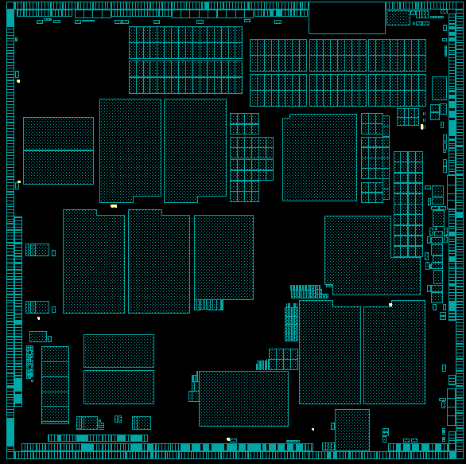
Insert TCD dummy Cell
Insert
TDC dummy cell
A
B
C
D
E
F
TCD dummy cell placement specifications
⑤
⑩
⑮
⑳
㉕
G
TCD dummy cells are placed for 50% of the
2 mm x 2 mm compartments.
Example: Dummy placement is required in 13
sections, which is half of the 25 sections divided
by 2 mm x 2 mm.
Sections less than 2 mm square can be ignored.
（ Example: It is not necessary to insert DCT Cell
the A to K sections in the figure on the right. ）
④
⑨
⑭
⑲
㉔
H
2mm
③
⑧
⑬
⑱
㉓
I
2mm
②
⑦
⑫
⑰
㉒
J
①
⑥
⑪
⑯
㉑
K

Slide 47
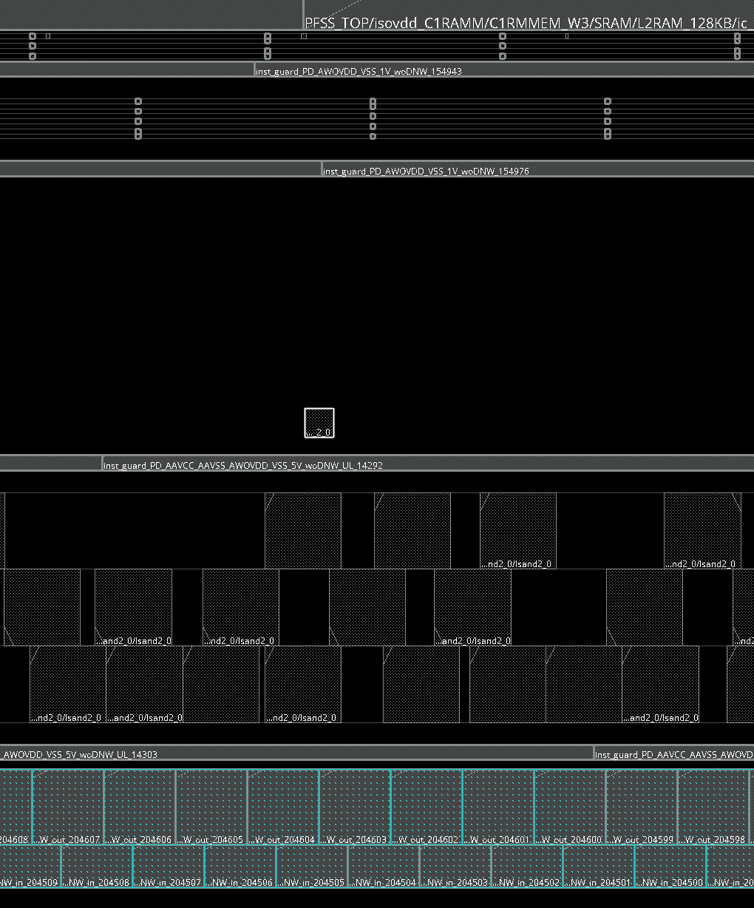
Insert TCD dummy
Insert
TDC dummy cell
Provides a utility that automatically finds no row area and places TCD Cells.
100_init.tcl
### ============================================================================
### --- TCD dummy cell place
### ============================================================================
Puts "Start: TCD dummy cell place"
set tcd_dummy_lef {BEOL_small_FDM1_20110323.lef BEOL_small_FDM2_20110323.lef BEOL_small_FDM3_20110323.lef BEOL_small_FDM4_20110323.lef BEOL_small_FDM5_20110323.lef}
foreach i $tcd_dummy_lef {
loadLefFile /eda01/Foundry2/TSMC/28HPL/Rules/DesignRule/LOGIC/v2.0/N28_TCD_library_kits_20110323/lef/BEOL_MX_4X/$i
}
if {[file exists $TCD_DUMMY_def]} {
defIn $TCD_DUMMY_def
} else {
util_insert_TCD_dummy -block_size 2000
util_insert_TCD_dummy -block_size 2000 -check
#saveDesign $db_dir/TCD_dummy_place.enc
}
Puts "End: TCD dummy cell place"
i_BEOL_small_FDM1_2_0
The automatically placed location is not always appropriate.
Please be sure to check.

Slide 48
5V Level Shifter place (core79TD,core107)
5V Level Shifter place
core107T,core79TD
INNOVUS cannot automatically place NIMH(Non Integer Multi Height) cells during PlaceOpt phase (200_place_opt).
( core79TD, core107T site cell =5V level down/Up shifter)
NIMH cell (5V Level shifter) is placed in the 100_init phase.
NIMH cells are placed using a “placeInstsWithSites” command.
100_init.tcl
# 5V place(core107T,core79TD)
### COMMNET OUT. This is Guide for Level shifter placement.
### Temporarily comment out and therefore Innovus placer places LS to appropriate location.
### After above trial PnR , if we find wrong LS location, we will make new guide file for CN.
if { ${5V_flag} == "Y" } {
source ${COMMON_INNO}/UTIL/NIMH.command.v4.1.etf
setPlaceMode -place_global_exp_allow_missing_scan_chain true
enable_metric -off
placeInstsWithSites "core107T"
dbSet [dbGet top.insts.cell.site.name core107T -p3].pStatus fixed
placeInstsWithSites "core79TD"
dbSet [dbGet top.insts.cell.site.name core79TD -p3].pStatus fixed
enable_metric -on
saveDesign DBS/100_init_5V.enc
} else {
defIn ${5V_def}
}
Note!1
The location of the cells placed using “placeInstsWithSites”
is not best location.
Please understand that this command considers power domain
but is just a function for placing cell on row. So be sure to check
the cell location.
Where is the best place?
Please review by the engineer
“placeInstsWirhSites”
select this row, but….
?
?
row
LS
row
row
Disjoint row

Slide 49
5V Level Shifter place (core79TD,core107)
5V Level Shifter place
core107T,core79TD
Note２！
NIMH.command.v4.1.etf have a bug.
If cpre107T and coe79TD are execute at the same time, cell overlap will occur.
In order to avoid this bug, core107T and core79TD place are executed separately.
placeInstsWithSites “core107T core79TD“ << NG!
placeInstsWithSites "core107T"
dbSet [dbGet top.insts.cell.site.name core107T -p3].pStatus fixed
placeInstsWithSites "core79TD"
dbSet [dbGet top.insts.cell.site.name core79TD -p3].pStatus fixed
executed separately
Also, the DRV between the OBS in the cell and P/G mesh line is not considered during placement.
Currently, there is no choice but to fix it by hand.
Bug fixed command will be released soon.

Slide 50
Appendix
・Know-how to debug disjoined blockage coordinates
・Blockage Naming Rule for Row generation
・GuardRing Naming Rule
・GuardRing distance Rule

Slide 51
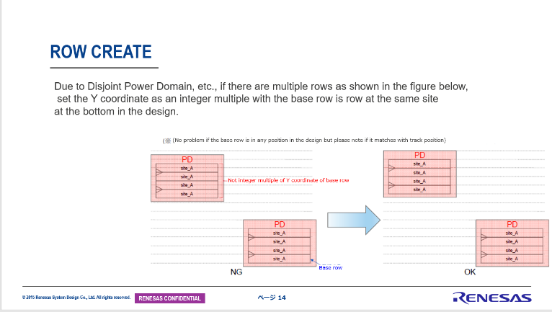
Know-how to debug disjoined blockage coordinates
Check Blockage coordinate
INNOVUS requires alignment disjoint Rows.
This chapter will show you how to efficiently align blockage shape to the coordinates that fit the rules.
This is the rule.
Efficiently aligning the coordinates of the disjoint rows is a very laborious task.
Next page introduces know-how and utilities to help you debug efficiently.

Slide 52
Know-how to debug disjoined blockage coordinates
Check Blockage coordinate
There is a check command if the disjoined blockage coordinates is not alignment.
source $COMMON_INNO/UTIL/util_set_row_pd_island_for_u2c.tcl
util_set_row_pd_island_for_u2c -job_type check_off_grid
Debugging the blockage coordinates is done for each blockage.
Check alignment for core48T
Command;
util_change_row_for_moving_const_box -site core48T
util_set_row_pd_island_for_u2c -job_type check_off_grid -site core48T
-> if no error, output blockage tcl file.
Check alignment for core79TD
Command;
util_change_row_for_moving_const_box -site core79TD
util_set_row_pd_island_for_u2c -job_type check_off_grid -site core79TD
-> if no error, output blockage tcl file.
Check alignment for 107T
Command;
util_change_row_for_moving_const_box -site core107T
util_set_row_pd_island_for_u2c -job_type check_off_grid -site core107T
-> if no error, output blockage tcl file.
For details, see the next page.

Slide 53
Know-how to align disjoined blockage
Check Blockage coordinate
1st step:
Set the following when creating a blockage.
Innovus > setFPlanMode -snapPlaceBlockageGrid inst
2nd step:
DEF output of CORE7T
The shape of core7T is created by Cut Row, so off-grid Row does not occur.
When debugging other ROWs, core7T ROW is deleted. so core7T is dumped
to DEF in advance.
Innovus > util_change_row_for_moving_const_box -save_org_row
Dump DEF file

Slide 54
Know-how to align disjoined blockage
Check Blockage coordinate
3rd step: (case core48T)
In order to align the coordinates of each blockage of core48T,
fill whole chips with Row of core48T.
Innovus > util_change_row_for_moving_const_box -site core48T
Fill with core48T
> 4th step:
work to fit each blockage to the grid.
Align the shape of the Core48T blockage to match the Row.
Fit on grid
Fit on grid
Correct only the blockage for CORE48T.
> 5th step:
Check off-the-grid blockage.
You can check the misalignment blockage with the following command.
Innovus > util_set_row_pd_island_for_u2c -job_type check_off_grid -site core48T
Adjust the coordinates until there are no errors.
Align the blockage shapes.

Slide 55
Know-how to align disjoined blockage
Check Blockage coordinate
6th Step:
If the error disappears in 5th step, output the blockage file of core48T.
Innovus > deselectAll
Innovus > select_obj [dbGet top.fplan.pBlkgs.name core47T* -p]
Innovus > writeFPlanScript -selected –filename modify_BK_4_create_row_box_fplan.tcl
Innovus > deselectAll
select
select
After debugging core48T, change the target to core79TD and core107T
and continue debugging.
Dump blockage tcl
Blockage file for core48T

Slide 56
Know-how to align disjoined blockage
Check Blockage coordinate
7th Step:
Restore the core7T DEF output in step 2.
Dump DEF file
Innovus > setFPlanMode -snapPlaceBlockageGrid manufacturing
Innovus > util_change_row_for_moving_const_box -restore_org_row

Slide 57
Know-how to make blockage
Check Blockage coordinate
Corresponding part in the 100_init.tcl
if {0} {
puts "suspend after PD area creation check"
setFPlanMode -snapPlaceBlockageGrid inst
util_change_row_for_moving_const_box -save_org_row
suspend
util_change_row_for_moving_const_box -site core48T
util_set_row_pd_island_for_u2c -job_type check_off_grid -site core48T
### save modified pBlk box(setting for PD and row) ###
deselectAll
select_obj [dbGet top.fplan.pBlkgs.name core48T* -p]
writeFPlanScript -selected -fileName modify_BK_4_create_48row_box_fplan.tcl
deselectAll
suspend
util_change_row_for_moving_const_box -site core79TD
util_set_row_pd_island_for_u2c -job_type check_off_grid -site core79TD
### save modified pBlk box(setting for PD and row) ###
deselectAll
select_obj [dbGet top.fplan.pBlkgs.name core79TD* -p]
writeFPlanScript -selected -fileName modify_BK_4_create_79row_box_fplan.tcl
deselectAll
suspend
util_change_row_for_moving_const_box -site core107T
util_set_row_pd_island_for_u2c -job_type check_off_grid -site core107T
### save modified pBlk box(setting for PD and row) ###
deselectAll
select_obj [dbGet top.fplan.pBlkgs.name core107* -p]
writeFPlanScript -selected -fileName modify_BK_4_create_107row_box_fplan.tcl
deselectAll
setFPlanMode -snapPlaceBlockageGrid manufacturing
util_change_row_for_moving_const_box -restore_org_row
}
#####

Slide 58
Know-how to make blockage
Check Blockage coordinate
If the chip has multiple Rows, INNOVUS will align the blockage coordinates with the grid of nearby core rows.
X
If you place a core48T blockage near core7T, the Core48T placement blockage
coordinates will be automatically snaped to the core7T placement grid.
PBK for Core48T
X
Innovus is snaped to the core7T grid automatically.
CORE7T
X
X
When debugging Row coordinates, it is recommended to fill the target Row with the chip.
PBK for Core48T
X
Align for core48T grid.
Fill CORE48T
X

Slide 59
Blockage Naming Rule for Row generation
Blockage Name format; Column1%Column2%Column3%Column4%Column5%Column6%Column7%Column8
unit7T unit7T%Power_Domain_name%%%1V%woDNW%%<Suffix> Single Guard Ring
unit7T unit7T%Power_Domain_name%%%1V%wDNW%%<Suffix> Double Guard Ring
unit48T unit48T%Power_Domain_name%%%5V%woDNW%%<Suffix> Single Guard Ring
unit48T unit48T%Power_Domain_name%%%5V%wDNW%%<Suffix> Double Guard Ring
unit79TD unit79TD%Power_Domain_name%2nd_Power%2nd_Gnd%1V%woDNW%<DL>%<Suffix> Single Guard Ring
unit107T unit107T%Power_Domain_name%2nd_Power%2nd_Gnd%5V%woDNW%<UL>%<Suffix> Single Guard Ring
HardIP HardIP%Power_Domain_name%%%5V%woDNW%<IP>%<Suffix> Single Guard Ring
SoftIP SoftIP%Power_Domain_name%%%1V%woDNW%<IP>%<Suffix> Single Guard Ring
* If column1 is unit7T or unit48T , column3 and column4 can be omitted. The delimiter “%” cannot be omitted.
Naming E.g. unit7T%PD_AWOVDD_VSS%%%1V%woDNW%%
unit79TD%PD_OSCVCC_OSCVSS%AWOVDD%VSS%1V%woDNW%DL%
HardIP%PD_AAVCC_AAVSS%%%5V%woDNW%ADA%

Slide 60
GuardRing Naming Rule
unit7T inst_guard_<Power_Domain_name>_1V_woDNW_<Suffix> FHFV1GRGV*
unit7T inst_guard_<Power_Domain_name>_1V_wDNW_in_<Suffix> FHFV1GRGV*
inst_guard_<Power_Domain_name>_1V_wDNW_out_<Suffix> ARV28OTR0005P10S*
unit48 inst_guard_<Power_Domain_name>_5V_woDNW_<Suffix> FHFV5GRGV*
unit48 inst_guard_<Power_Domain_name>_5V_wDNW_in_<Suffix> ARV28OTR0005NP9S*
inst_guard_<Power_Domain_name>_5V_wDNW_out_<Suffix> ARV28OTR0005P10S*
unit79TD inst_guard_<Power_Domain_name>_<2nd_Power>_<2nd_Gnd>_1V_woDNW_<DL>_<Suffix> FHFV1GRGV*
unit107T inst_guard_<Power_Domain_name>_<2nd_Power>_<2nd_Gnd>_5V_woDNW_<UL>_<Suffix> FHFV5GRGV*
HardIP inst_guard_<Power_Domain_name>_5V_woDNW_<IP>_<Suffix> ARV28OTR0005P10S*
SoftIP inst_guard_<Power_Domain_name>_1V_woDNW_<IP>_<Suffix> FHFV1GRGV*
IO inst_guard_IO_<Suffix>
Name E.g. inst_guard_PD_AWOVDD_VSS_1V_woDNW_0001
inst_guard_PD_OSCVCC_OSCVSS_AWOVDD_VSS_1V_woDNW_DL_0001
inst_guard_PD_AAVCC_AAVSS_5V_woDNW_ADA_0001

Slide 61
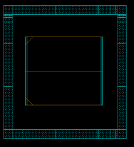
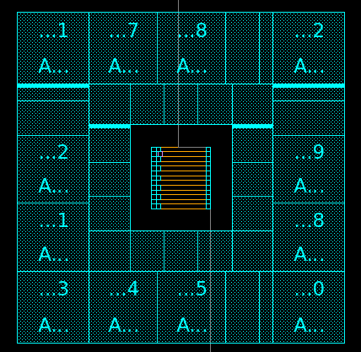
Blockage Naming Rule for Row generation
Blockage Name format; Column1%Column2%Column3%Column4%Column5%Column6%Column7%Column8
Column1;unitName [core7T / core48T / core79TD / core107T]
Column2;PowerDomainName Match with the name defined in UPF
Column3;2nd_Power Level shifter secondary power Name
Column4;2nd_Gnd Level shifter secondary Ground Name
Column5:Voltage [1V / 5V] Voltage of area shielded by guard ring
Column6;Gurdring Line [woDNW / wDNW] ：Single Ring / Double Guard Ring
Column7;LevelShifter Type [DL / UL / IP/ Non define ] : （Possible to omit）
Column8;Suffix Suffix （Possible to omit）
How to judge?
See the next page.
Power Domain name
secondary
power
Primary
power
secondary
power
Primary
power
Unit Name
Primary Power
1V or 5V ?
Down
Shifter
Up
Shifter
Single Guard Ring
Double Guard Ring
Secondary
Ground
Primary
Ground
Secondary
Ground
Primary
Ground

Slide 62
How to decide the guard ring type
?
Single Guard Ring
Double Guard Ring
Which one to choose?
Check the VSS name.
If the VSS name is the same as the default domain, a single guard ring is required.
If the VSS name is different from the default domain, a double guard ring is required.
Default Domain = PD_ISOVDD_VSS
Default Domain = PD_ISOVDD_VSS
‡
=
PD_PLLVDD_PLLVSS
PD_SYSVCC_VSS
Single Guard Ring
Double Guard Ring
Be sure to consult with the PV team as there are exceptions.

Slide 63
Blockage Naming Rule for Row generation
Blockage Name format; Column1%Column2%Column3%Column4%Column5%Column6%Column7%Column8
unit7T core7T%Power_Domain_name%%%1V%woDNW%%<Suffix> Single Guard Ring
unit7T core7T%Power_Domain_name%%%1V%wDNW%%<Suffix> Double Guard Ring
unit48T core48T%Power_Domain_name%%%5V%woDNW%%<Suffix> Single Guard Ring
unit48T core48T%Power_Domain_name%%%5V%wDNW%%<Suffix> Double Guard Ring
unit79TD core79TD%Power_Domain_name%2nd_Power%2nd_Gnd%1V%woDNW%<DL>%<Suffix> Single Guard Ring
unit107T core107T%Power_Domain_name%2nd_Power%2nd_Gnd%5V%woDNW%<UL>%<Suffix> Single Guard Ring
HardIP HardIP%Power_Domain_name%%%5V%woDNW%<IP>%<Suffix> Single Guard Ring
SoftIP SoftIP%Power_Domain_name%%%1V%woDNW%<IP>%<Suffix> Single Guard Ring
* If column1 is unit7T or unit48T , column3 and column4 can be omitted. The delimiter “%” cannot be omitted.
Naming E.g. core7T%PD_AWOVDD_VSS%%%1V%woDNW%%
core79TD%PD_OSCVCC_OSCVSS%AWOVDD%VSS%1V%woDNW%DL%
HardIP%PD_AAVCC_AAVSS%%%5V%woDNW%ADA%

Slide 64
GuardRing Naming Rule
unit7T inst_guard_<Power_Domain_name>_1V_woDNW_<Suffix> FHFV1GRGV*
unit7T inst_guard_<Power_Domain_name>_1V_wDNW_in_<Suffix> FHFV1GRGV*
inst_guard_<Power_Domain_name>_1V_wDNW_out_<Suffix> ARV28OTR0005P10S*
unit48 inst_guard_<Power_Domain_name>_5V_woDNW_<Suffix> FHFV5GRGV*
unit48 inst_guard_<Power_Domain_name>_5V_wDNW_in_<Suffix> ARV28OTR0005NP9S*
inst_guard_<Power_Domain_name>_5V_wDNW_out_<Suffix> ARV28OTR0005P10S*
unit79TD inst_guard_<Power_Domain_name>_<2nd_Power>_<2nd_Gnd>_1V_woDNW_<DL>_<Suffix> FHFV1GRGV*
unit107T inst_guard_<Power_Domain_name>_<2nd_Power>_<2nd_Gnd>_5V_woDNW_<UL>_<Suffix> FHFV5GRGV*
HardIP inst_guard_<Power_Domain_name>_5V_woDNW_<IP>_<Suffix> ARV28OTR0005P10S*
SoftIP inst_guard_<Power_Domain_name>_1V_woDNW_<IP>_<Suffix> FHFV1GRGV*
IO inst_guard_IO_<Suffix>
Name E.g. inst_guard_PD_AWOVDD_VSS_1V_woDNW_0001
inst_guard_PD_OSCVCC_OSCVSS_AWOVDD_VSS_1V_woDNW_DL_0001
inst_guard_PD_AAVCC_AAVSS_5V_woDNW_ADA_0001

Slide 65
ENDCap Cell Naming Rule
unit7T (DefaultDomain)
boundarycell_ENDCAP_<PowerDomain>_<SerialNumber>
(e.g.) boundarycell_ENDCAP_PD_ISOVDD_VSS_88403
(where CellType name is “BOUNDARY_RIGHTBWP7T40P140”)
unit7T (Not DefaultDomain)
<PowerDomainHierarchy>/boundarycell_ENDCAP_<PowerDomain>_<SerialNumber>
(e.g.) MEM_TOP/awovdd_scdshold/boundarycell_ENDCAP_PD_AWOVDD_VSS_9210
unit48T
<PowerDomainHierarchy>/boundarycell_ENDCAP48 _<PowerDomain>_<SerialNumber>
(e.g.) LVS_TOP/vcc33_LVS/boundarycell_ENDCAP48_PD_SYSVCC_VSS_1176
unit79TD
<PowerDomainHierarchy>/boundarycell_ENDCAP79_<2nd_Power>_to_<PowerDomain>_<SerialNumber>
(e.g.) MEM_TOP/awovdd_scdshold/boundarycell_ENDCAP79_ SYSVCC_ to_PD_AWOVDD_VSS_92
unit107T
<PowerDomainHierarchy>/boundarycell_ENDCAP107_<2nd_Power>_to_<PowerDomain>_<SerialNumber>
(e.g.) LVS_TOP/vcc33_LVS/ boundarycell_ENDCAP107_AWOVDD_to_PD_VCC_VSS_1

Slide 66
WELLTAP Cell Naming Rule
unit7T (DefaultDomain)
tapfiller_WTAP_<CellTypeName>_<PowerDomain>_<SerialNumber>
(e.g.) tapfiller_WTAP_TAPCELLBWP7T40P140_PD_ISOVDD_VSS_108164
(where CellType name is “TAPCELLBWP7T40P140”)
unit7T (Not DefaultDomain)
<PowerDomainHierarchy>/tapfiller_WTAP_<CellTypeName>_<PowerDomain>_<SerialNumber>
(e.g.) MEM_TOP/awovdd_scdshold/tapfiller_WTAP_TAPCELLBWP7T40P140_PD_AWOVDD_VSS_9210
unit79TD
<PowerDomainHierarchy>/tapfiller_WTAP79_<2nd_Power>_to_<PowerDomain>_<SerialNumber>
(e.g.) MEM_TOP/awovdd_scdshold/tapfiller_WTAP79_SYSVCC_ to_PD_AWOVDD_VSS_1
unit107T
<PowerDomainHierarchy>/tapfiller_WTAP107_<2nd_Power>_to_<PowerDomain>_<SerialNumber>
(e.g.) LVS_TOP/vcc33_LVS/ tapfiller_WTAP107_AWOVDD_to_PD_VCC_VSS_1

Slide 67
fILLER/CAP Cell Naming Rule
unit7T
<PowerDomainHierarchy>/xofiller_FILL(CAP)_<SerialNumber>
(e.g.) U_tb_wrap_3834/xofiller_FILL_5115
(e.g.) U_tb_wrap_3834/xofiller_CAP_10544
unit48T
<PowerDomainHierarchy>/xofiller_FILL(CAP)48 _<SerialNumber>
(e.g.) SYS_TOP/pllvdc_top/xofiller_FILL48_24
(e.g.) SYS_TOP/pllvdc_top/xofiller_CAP48_41
unit79TD
<PowerDomainHierarchy>/xofiller_FILL79_<2nd_Power>_ to_<PowerDomain>_<SerialNumber>
(e.g.) MEM_TOP/awovdd_scdshold/xofiller_FILL79_ SYSVCC_ to_PD_AWOVDD_VSS_92
unit107T
<PowerDomainHierarchy>/xofiller_FILL107_ <2nd_Power>_to_<PowerDomain>_<SerialNumber>
(e.g.) SYS_TOP/pllvdc_top//xofiller_FILL107_AWOVDD_to_PD_VCC_VSS_1

Slide 68
GuardRing distance Rule
Cell used: FHFV1GRGV*
FHFV5GRGV*
Stdcell or RAM
frame
Stdcell or RAM
frame
NW
NW
>3um
>3um
ISOVDD region of the chip
Blockage
1V/5V area
VDD/VCC
VSS

Slide 69
GuardRing distance Rule
Cell used: FHFV1GRGV*/ ARV28OTR0005P10S*
Stdcell or RAM
frame
Stdcell or RAM
frame
NW
NW
>3um
>3um
ISOVDD region of the chip
Blockage
1V/5V area
VDD
VSS
VSS

Slide 70
GuardRing distance Rule
Cell used: ARV28OTR0005P10S*
Stdcell or RAM
frame
HardIP frame
NW
>5um
>3um
ISOVDD region of the chip
Blockage
HardIP area
VSS
VSS

Slide 71
GuardRing Rule DNW（1V）
Cell used:
ARV28OTR0005P10S*
Cell used:
FHFV1GRGV*/FHFV1GRGVCORNER
ARV28OTR0005P10S*
Stdcell or RAM
frame
FHFV1GRGV*
NW
>0.1um
>3um
FHFV1GRGV*
FHFV1GRGV*
ARV28OTR0005P10S*
FHFV1GRGVCORNER
ARV28OTR0005P10S*
AVDD/AVSS region of the chip
FHFV1GRGV*
ARV28OTR0005P10S*
VSS
VSS
AVDD
AVSS

Slide 72
Renesas.com

