Slide 1

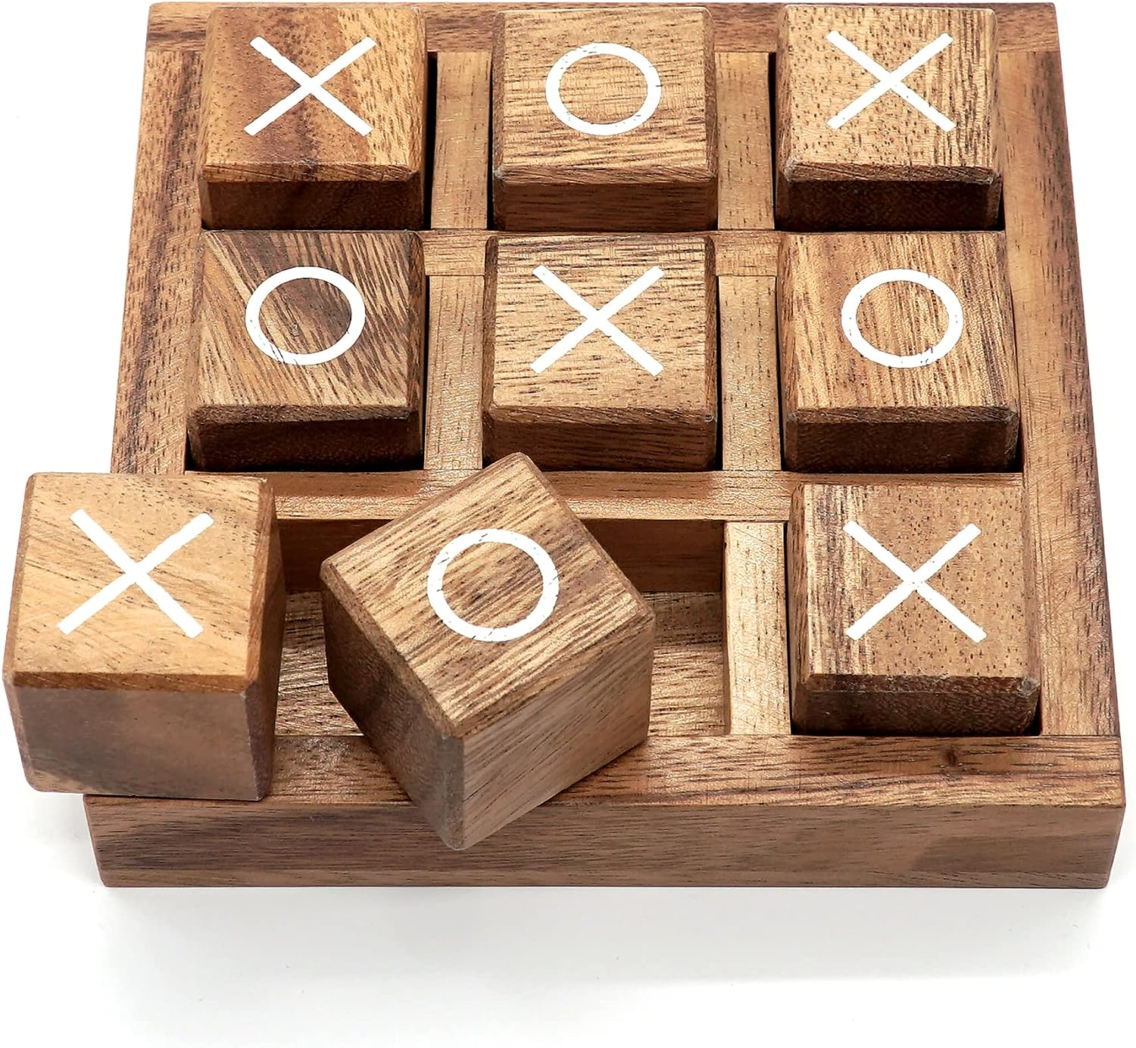



Landing Page
Play Mingle
Home
Games
Contact
Login
Leaderboard
New Released
Recommended Friends
Tags
Browse Categories
New Released
Top Seller
Special
Upcoming
Browse by Genre
Arcade
Logical
Casual
Indie
Early Release
Tic Tac Toe Strategically place Xs and Os to outwit your opponent in this classic game of wits and strategy.
Hangman Guess the hidden word before you runs out of your moves in this word-guessing game.
Rock Paper Scissor Quickly decide your move and challenge your opponent in the ultimate hand-based showdown.
Number Guesser Test your number intuition by guessing the correct number within a specified range.
© 2023 Play Mingle Created by Team 2 for Coding in Color
Play Mingle : Where Fun Meets Community
Welcome to Play Mingle, your gateway to a world of engaging web games and social interaction.
Privacy Policy
Terms of Service

Slide 2
Game Page
Play Mingle
Home
Games
Contact
Login
Leaderboard
Back
Score: 0
Objective
The goal of Tic-Tac-Toe is to be the first player to get three of your symbols (either "X" or "O") in a row horizontally, vertically, or diagonally on the game grid.
How To Play
The first player (X) makes their move by choosing an empty cell on the grid to place an “X”.
The second player (O) then takes their turn placing “O” in an empty cell of their choice.
Players take turns, one move at a time until one player achieves three of their symbols in a row horizontally, vertically, or diagonally or until grid is filled, resulting in a draw.
Recommended Friends
Tags
Browse Categories
New Released
Top Seller
Special
Upcoming
Browse by Genre
Arcade
Logical
Casual
Indie
Early Release
Tic Tac Toe
“X” wins the game
Replay
© 2023 Play Mingle Created by Team 2 for Coding in Color
Play Mingle : Where Fun Meets Community
Welcome to Play Mingle, your gateway to a world of engaging web games and social interaction.
Privacy Policy
Terms of Service

Slide 3


Contact Page
Play Mingle
Home
Games
Contact
Login
Leaderboard
GET IN TOUCH
Recommended Friends
Tags
Browse Categories
New Released
Top Seller
Special
Upcoming
Browse by Genre
Arcade
Logical
Casual
Indie
Early Release
Don’t hesitate to contact us
Enter your name
We're here to help! If you have any questions, feedback, or just want to say hello, feel free to reach out. Your input is important to us, and we're excited to hear from you.
We'll get back to you as soon as possible. Thank you for being a part of the Play Mingle community!
Enter valid email address
Contacting about
Enter your message
+1 2345678901
I accept the Terms of Service
team2@gmail.com
Submit
© 2023 Play Mingle Created by Team 2 for Coding in Color
Play Mingle : Where Fun Meets Community
Welcome to Play Mingle, your gateway to a world of engaging web games and social interaction.
Privacy Policy
Terms of Service

Slide 4
GreenLight : #fede0cff
Header, Footer, Sidebar Color : #fede0cff
Body Color : #00042eff
Heading font : Poppins-SemiBold
Footer font : Poppins-Normal

