Slide 1
Hubble Frontier Fields
New ACS (and K-band) photometry of Abell 2744-Y1
Zach Pace & Gabe Brammer

Slide 2
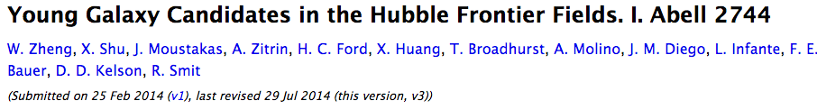
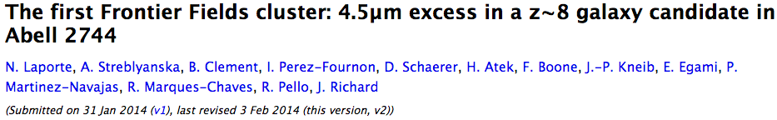
High-redshift galaxies
Lyman break lets us estimate z-phot
LOTS of new 5 < z < 8.5 candidates from HFF
Notes:
First, let’s talk about high-z galaxies in general.
Recall Gabe’s talk
Talk about how Lyman break works

Slide 3
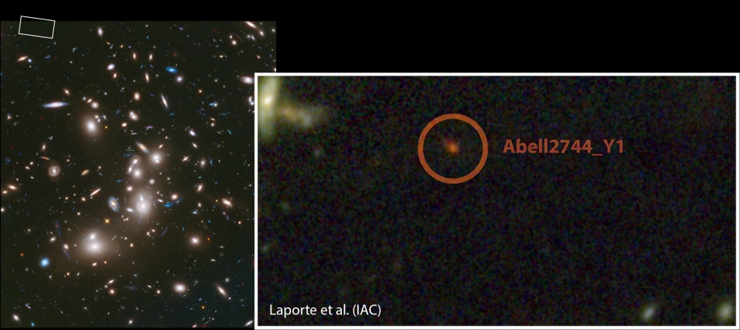
Notes:
Here’s a picture of Abell 2744-Y1: 30x smaller than MW, forming stars at 10x normal rate

Slide 4
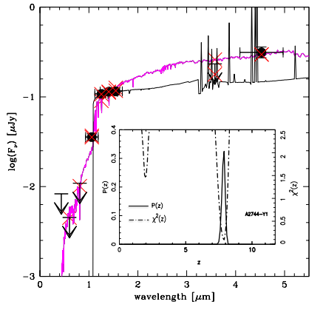
Laporte et al.
primary detection at z~8
secondary peak at z~2
is it distant or dusty?
non-detections in ACS
Notes:
SED of the galaxy: point out ACS and WFC3 bands
With previous results, could be a z~8 or z~2 galaxy (black is z~8, pink is z~2)
Need better data to squish the z~2 peak down (note gap between the WFC3 and IRAC bands—there’s a “waggle” there)

Slide 5
New images!
New ACS photometry (better detections)
new images released end of July
New K-band images from HAWK-I (ESO)
Notes:
New ACS images reduce errors, and we have some new VLT images (basically the deepest ever taken, anywhere)

Slide 6
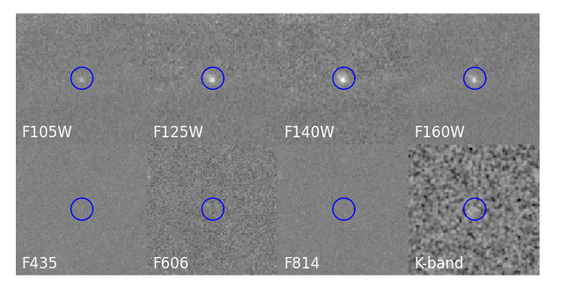

More error modeling (opt.)
images
Aperture Photometry
Cutouts
SED Fits*
(includes dusty models!)
(Brammer, van Dokkum, and Coppi, 2009)
Notes:
Flowchart of analysis
SED fits now include dusty models (since dust & age are degenerate).

Slide 7
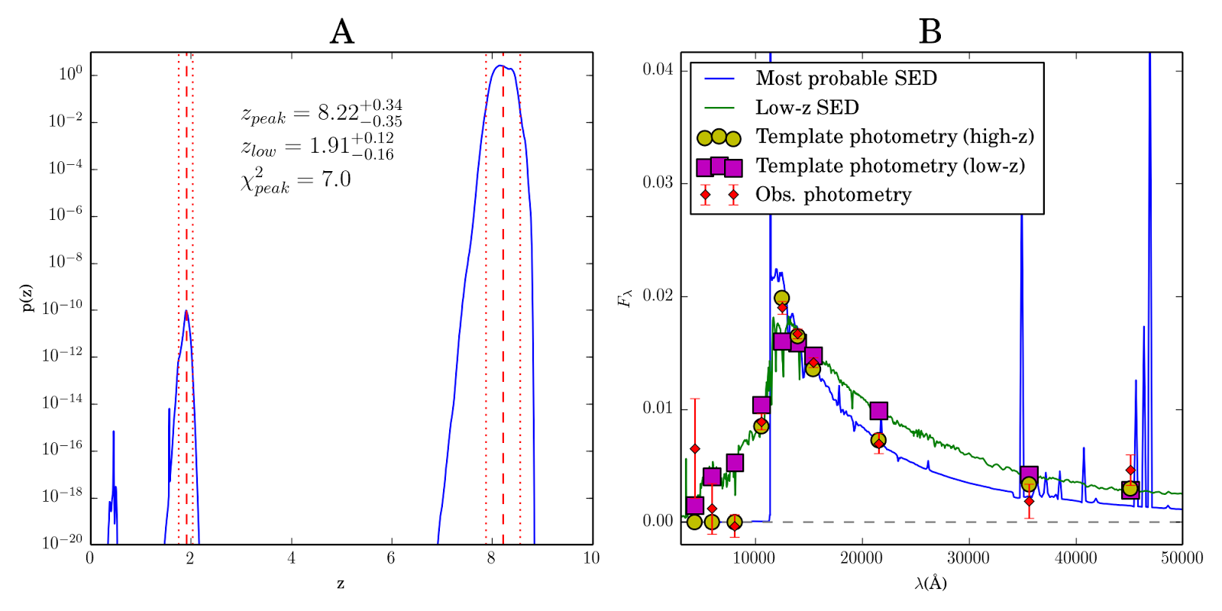
Results
Notes:
Pane A in log-prob space wrt z: now the z~2 peak is 10 OOM less than z~8 peak
Pane B is SED with detections, high-z and low-z SEDs, and what the detections should look like for those SEDs

Slide 8
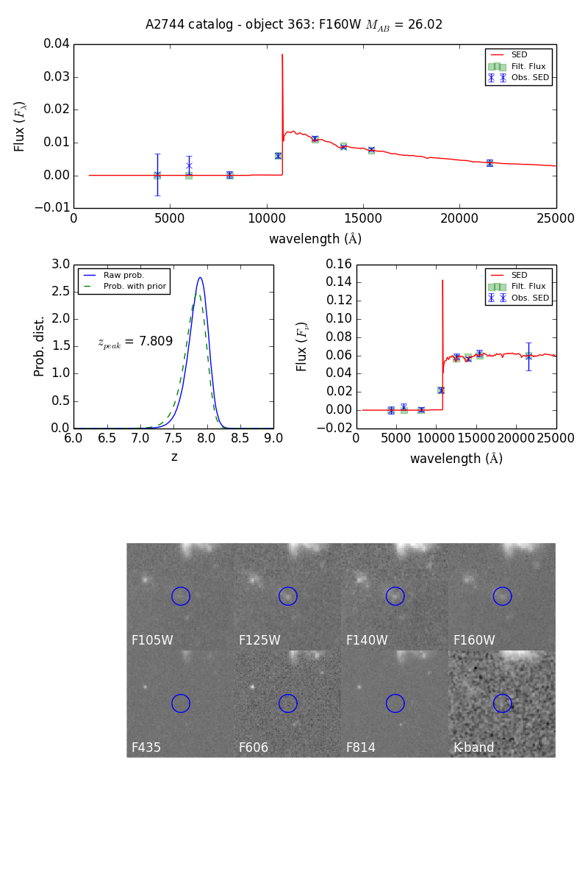
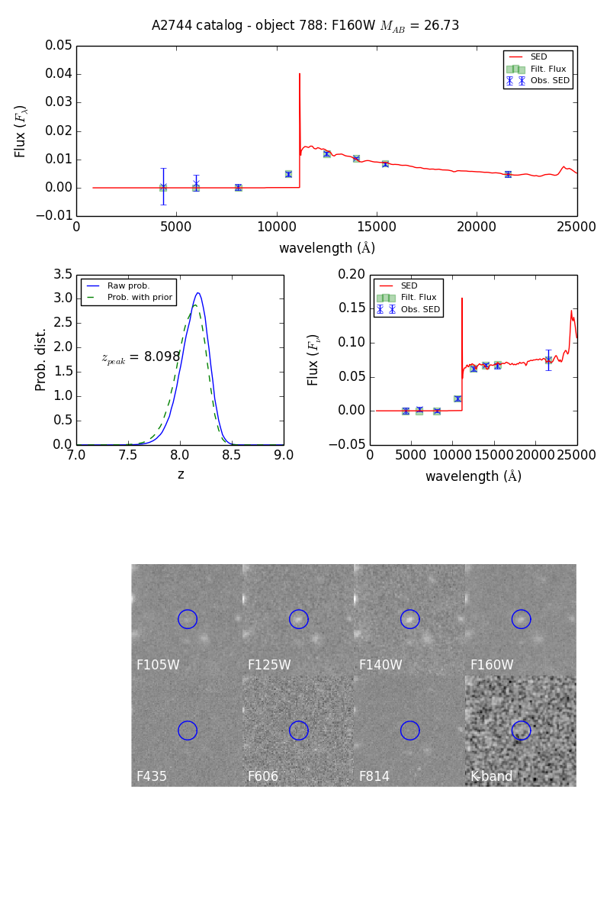
We can do this to catalogs, too!
Two candidates from Zheng 2014 w/better ACS photometry + K
(Measurements will be improved with IRAC detections--a little more difficult to work with)
Notes:
Takes a lot longer, but we can apply the models to ~3000 objects at a time and get all info
We’re pretty confident that results are good, because our measurement of the main cluster’s center was only off by 5 or 10% (v. good for photo-z measurements)

Slide 9
Questions?

