Slide 1
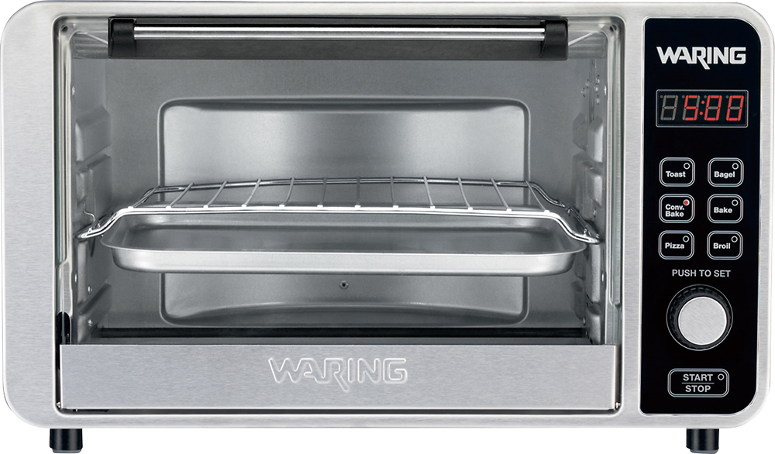
On/off
Broil
F°
C°
Temperature
On/off
C°
F°
Timer
ON
Functions:
Temperature
Bake/Toast
Broil
C
Temperature:
130
140
150
165
177
190
250
275
300
325
350
375
400
425

Slide 2
Picture credit: http://img.bbystatic.com/BestBuy_US/images/products/6982/6982056_rd.jpg
https://www.google.com/imgres?imgurl=http://www.inspiredtaste.net/wp-content/uploads/2016/07/Oven-Temperature-Conversion-Chart-from-Inspired-Taste.jpg&imgrefurl=http://www.inspiredtaste.net/23326/oven-temperature-conversion/&h=1600&w=1200&tbnid=cxFVQF4jXl4nLM:&vet=1&tbnh=160&tbnw=119&docid=Dg2K09q_n-TAhM&usg=__tilYaZBRSddF_nSKYV5g00CwKqI=&sa=X&ved=0ahUKEwjd0u-qpPfRAhWhxVQKHZ9qAr8Q9QEIIDAA#h=1600&imgrc=cxFVQF4jXl4nLM:&tbnh=160&tbnw=119&vet=1&w=1200
https://www.google.com/search?q=bread+outline&rlz=1C5CHFA_enUS706US706&tbm=isch&imgil=5CcX52787a5xkM%253A%253Bki017f5z-_6jTM%253Bhttps%25253A%25252F%25252Fwww.pinterest.com%25252Fpin%25252F325455510547907864%25252F&source=iu&pf=m&fir=5CcX52787a5xkM%253A%252Cki017f5z-_6jTM%252C_&usg=__qtx9ZRuN9e13H955-nSJlUij7fM%3D&biw=819&bih=624&dpr=2&ved=0ahUKEwi8-cLjgfzRAhWMy4MKHYJjBPAQyjcIKQ&ei=xrSYWLz-OYyXjwSCx5GADw#tbm=isch&q=bread+toast+outline+shades&imgrc=fO5OmpoodH3dIM:
https://www.google.com/search?q=bread+outline&rlz=1C5CHFA_enUS706US706&tbm=isch&imgil=5CcX52787a5xkM%253A%253Bki017f5z-_6jTM%253Bhttps%25253A%25252F%25252Fwww.pinterest.com%25252Fpin%25252F325455510547907864%25252F&source=iu&pf=m&fir=5CcX52787a5xkM%253A%252Cki017f5z-_6jTM%252C_&usg=__qtx9ZRuN9e13H955-nSJlUij7fM%3D&biw=819&bih=624&dpr=2&ved=0ahUKEwi8-cLjgfzRAhWMy4MKHYJjBPAQyjcIKQ&ei=xrSYWLz-OYyXjwSCx5GADw#imgrc=5CcX52787a5xkM:
http://www.psdgraphics.com/file/sticky-notes.jpg
https://lh3.googleusercontent.com/D9g1fZm1b1qpL7E3FTBSBnmPCsVPvxuAd5SrYdsziJCEAL1iCuOhVAE8JTo1ZIJJQA=h900
http://www.pngmart.com/image/31997

Slide 3
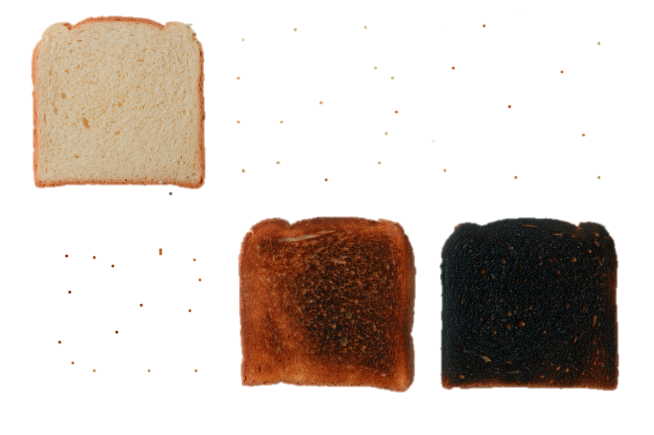

Timer (minutes)
1
3
5
10
1
1
Timer
30
Seconds
1
Minute
2
Minute
5
Minute
10
Minute
15
Minute
20
Minute
25
Minute
30
Minute
35
Minute
45
Minute
60
Minute
Start
END

Slide 4

Add Notes

Slide 5
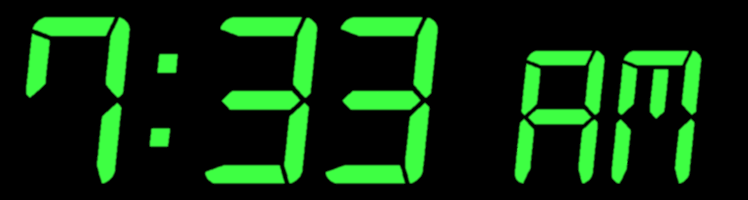

Slide 6


