Slide 1


Getting Started with Data Science in your Organization
The Laziest Path to Data Science
Zp Bappi
Senior Consultant
Readify

Slide 2
Contents for today
Enterprise Data Science (NOT!)
A bit about the “Data” part
Very less about the “Science” part
No maths
Near end-to-end pipeline for production deployment
Lots of demos
Where to next

Slide 3
Data Science – Simplified View
Data
Storage
Processing
Intelligence
Delivery
Consume

Slide 4
Data Science – Over Simplified View
Data
Processing
Intelligence
Delivery
Notes:
ML as a service from Microsoft and Google.

Slide 5
Everything – As a service
Google, Microsoft (and, possibly every other cloud provider)
Vision
Text
Audio
Structured Data
Links
https://azure.microsoft.com/en-us/services/cognitive-services/directory/
https://cloud.google.com/products/ai/
Notes:
Azure and Google cloud services from browser

Slide 6
Demo – 1 : Detect facial features
Data
Processing
Intelligence
Delivery
Using Face API - from Microsoft Cognitive Services
https://azure.microsoft.com/en-us/services/cognitive-services/face/
Notes:
Face API from browser > code from VSCode > run html in browser

Slide 7
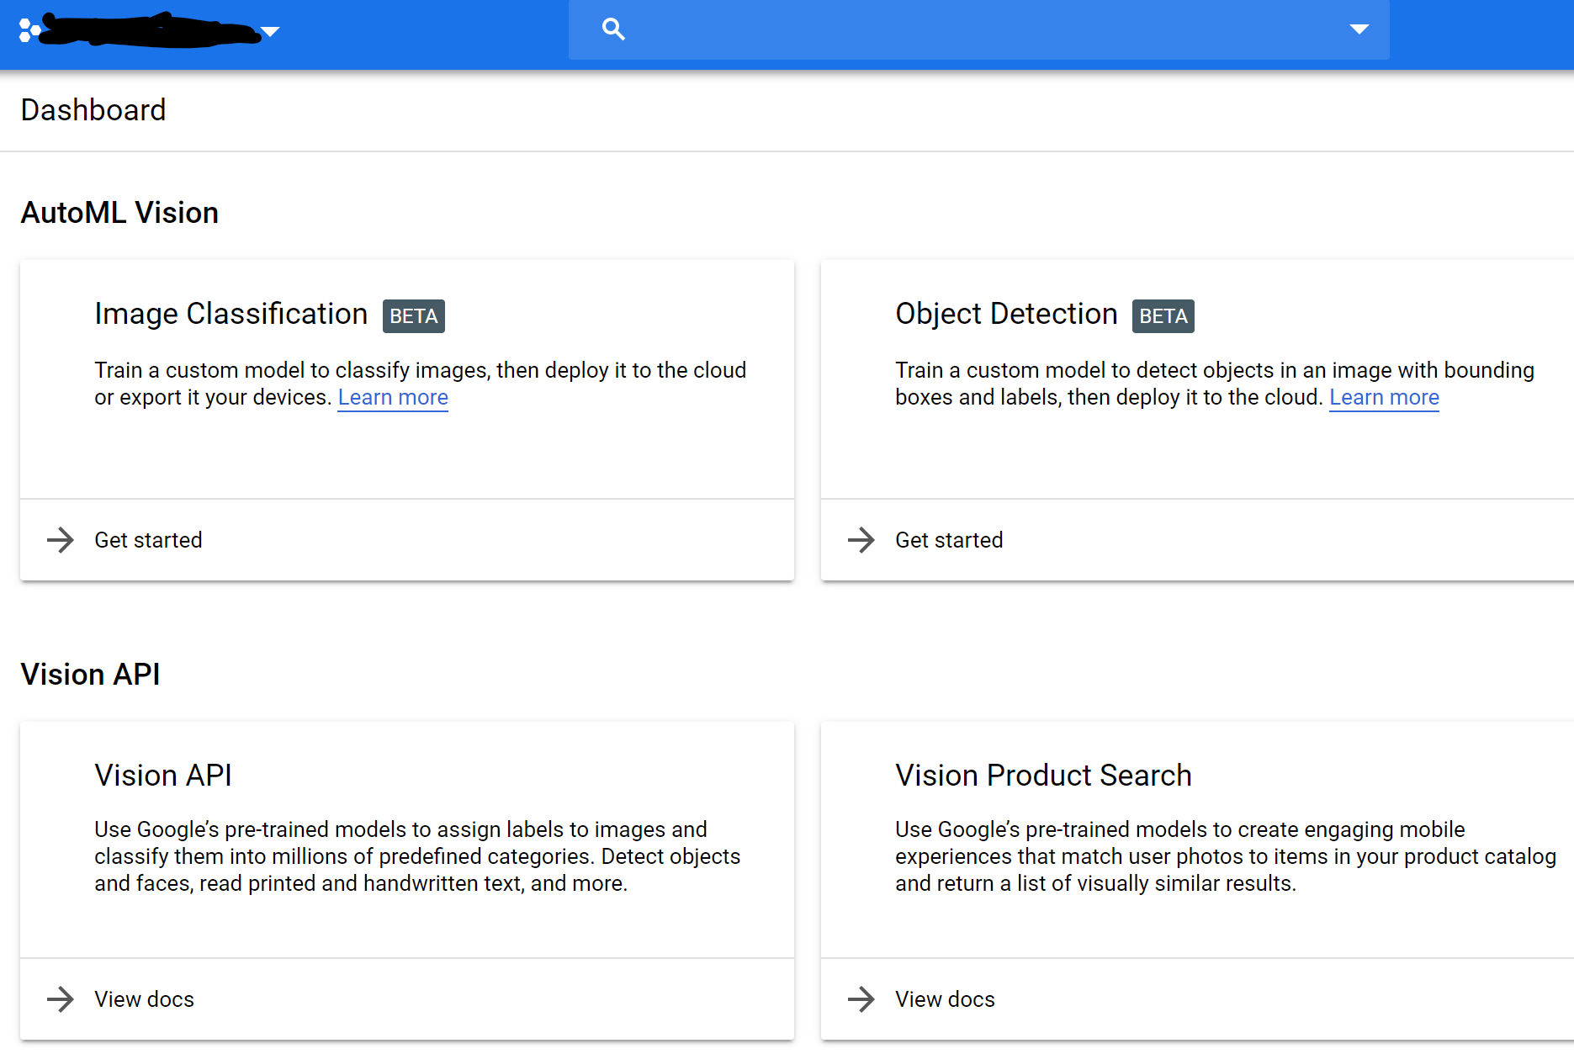
Yes, but…
You have your own images
You would like to do something else with the images
i.e. classifying them to some categories
or, detect custom objects
want to run the service yourself
Links
https://www.customvision.ai/
https://cloud.google.com/vision/

Slide 8
Demo – 2 : Recognize Bangla Digits
Data
Processing
Intelligence
Delivery
Using Custom vision and Docker
Dataset: https://www.kaggle.com/debdoot/bdrw
Notes:
Custom vision from browser > the project iterations > download model > code from VSCode > run from terminal

Slide 9
Back to real world problems
Real world situations
May not relate to images
Text
Structured data
You want to feel in control
Tweak the data
Pick what you think is the best from many
You don’t want to manage everything
Tools – Automated Machine Learning
Machine learning service workshop by Azure
Cloud AutoML by Google

Slide 10
Demo – 3 : Fraudulent Transaction Detection
Data
Processing
Intelligence
Delivery
Automated Machine Learning – Azure
Predict locally - Python
Notes:
AutoML in Azure from Browser > Code in VSCode > Run from terminal

Slide 11
DIY Data Science
You can code (and, want to)
You know your data and domain
You can clean and do feature engineering
You don’t know ML/ AI/ “Science-y” things

Slide 12
DIY Data Science contd.
Training
raw = load_my_data()
data = clean_and_reshape(data)
(training_data, test_data) = split(data)
model = magically_find_the_best_model(training_data, test_data)
save(model)
Prediction
input_data = clean_and_reshape(user_input)
model.predict(input_data)

Slide 13
Skipping the “Science” part
Auto sklearn
TPOT
H2O AutoML
AutoKeras
HyperAS
more extensive list at: https://www.automl.org/automl/

Slide 14
Demo – 4 : Autokeras code sample
Data
Processing
Intelligence
Delivery
Using docker image for autokeras
https://autokeras.com/
Notes:
Still in the early stages > only 2D image processing is available

Slide 15
Machine Learning libraries
Tensorflow
PyTorch
CNTK
Caffe
Theano
Keras
Don’t start a war
ONNX

Slide 16
A silver bullet?
There is none.
Azure ML Studio
Nice graphical interface
Handles large data
Seamless integration with Azure storage services
Tensorflow Extended (TFX)
Uses the fastest growing and the most popular library
End-to-end platform for deploying production ML pipeline
Integrates with any Google data storage + BigQuery
Can run anywhere
Cloud
On-prem
IoT
Mobile

Slide 17
Questions?
Do I need to know math?
At some point.
Delegate to a researcher.
Is it too late to start?
No, but it will be. Start ASAP.
How do I learn more about Machine Learning?
Study
How do I get in touch with you?
{twitter, linkedin, github} / zpbappi
Something else?
Ask me, if you can

Slide 18

Thank you!

