Slide 1


Introduction to TensorFlow, CNTK, Theano, MXNet*
Or, simply – keras
Zp Bappi
Senior Developer
Readify

Slide 2
super-quick overview of “things” in machine learning
Learning to map from input to output (function approximation)
Problem domains (text, image, sound, video, etc.)
Tasks (regression, classification, summarization, generation, translation, search, etc.)
ML algorithms (supervised, unsupervised, semi-supervised, reinforcement learning, etc.)
Overfitting or underfitting
DL architecture (CNN, RNN, GAN, AE, Capsule, …)

Slide 3
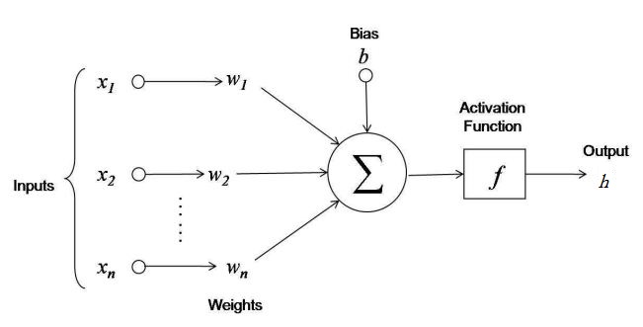
ML > hello, World!
#Room | Area | Age | … | Price
2 | 240 | 5 | … | 650
3 | 260 | 2 | … | 680
… | … | … | … | …
A.k.a. House price prediction

Slide 4
How do we implement?
Make a guess for weights
Calculate the predicted value and measure the difference from actual value (error)
Change the weights in such a way so that it minimizes the error (backpropagation)
Keep repeating until you are satisfied
Tools:
C++
MATLAB
Python
??

Slide 5
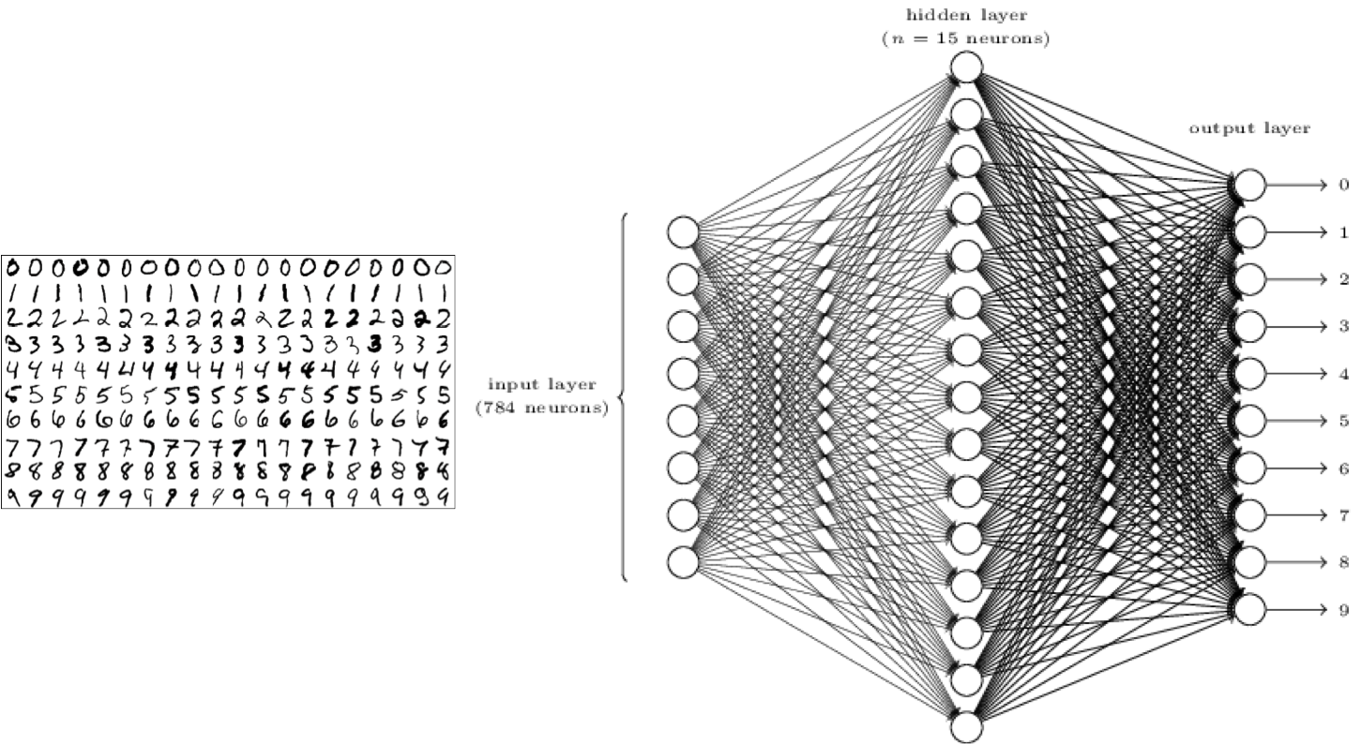
Classification > hello, World!
A.k.a. MNIST Digit Classification

Slide 6
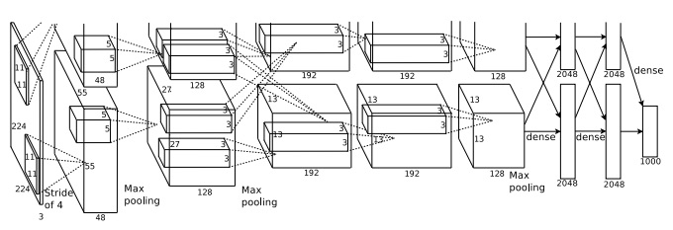
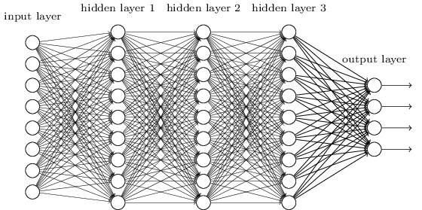
Deep learning

Slide 7
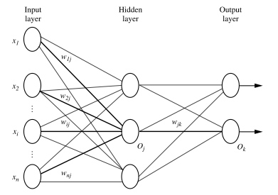
Now, how do we implement?
Writing codes from the scratch is probably not the best idea
We need some sort of re-usable abstractions
Abstractions that will allow quick experimentations

Slide 8
Layers
Input Layer [N x 784]
Hidden Layer [N x 15]
Output Layer [N x 10]

Slide 9
Demo
MNIST digit classification using TensorFlow (intentionally misleading)

Slide 10
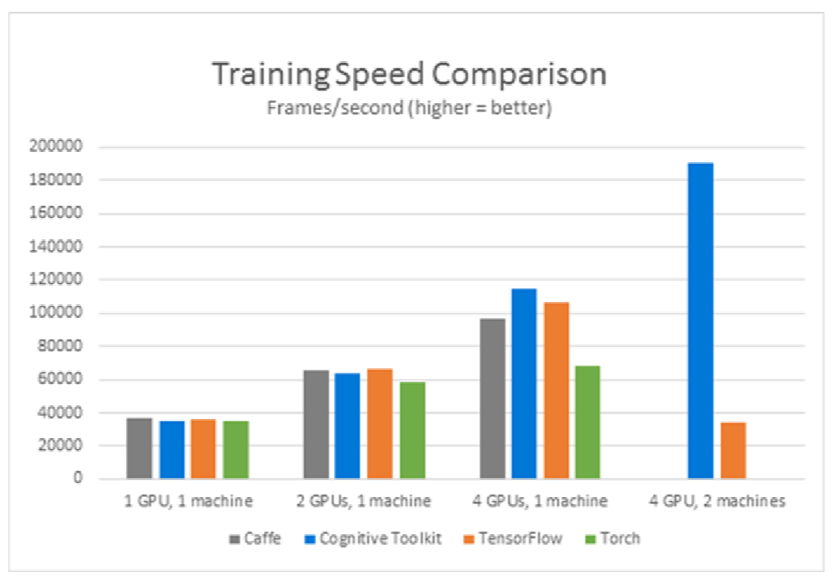
Why Keras?
TensorFlow is awesome!
So is CNTK!
MXNet* is going to be the next best thing!
Theano? Yeah, that too.

Slide 11
Keras
framework
run
One ring to rule them all
API is designed for human beings, including researchers
Easy to learn and extend
Easy to use backend specific features (e.g. TensorBoard)
Access to the backend using keras.backend
Runs on CPU, GPU, Cloud, TPU
Regularly updated and very active community
Backed by Google, Microsoft, Nvidia, AWS
More at: keras.io/why-use-keras

Slide 12
demo
MNIST digit classification
Quick experimentation with activation functions and learning rates

Slide 13
demo
Input
Conv
Pooling
Conv
Flatten
Dense (FCC)
Output
MNIST digit classification using CNN

Slide 14
Still, Don’t want to use keras…
Okay, lets check TensorFlow then
Consider ONNX

Slide 15
Questions?
How do I learn more about Keras?
keras.io
How do I learn more about Machine Learning?
Study
How do I get in touch with you?
{twitter, linkedin, github} / zpbappi
Something else?
Ask me, if you can

