Slide 1


Quantum Computing - 101
Zp Bappi
Senior Developer
Readify

Slide 2

What is Quantum Computer
Uses quantum states of subatomic particles to store information
Uses quantum-mechanical phenomena to perform computation
Superposition
Entanglement
Ψ =

Slide 3
What Quantum Computer Is *NOT*
A very fast computer
A super-hyper-parallel computer with many cores
Imaginary
Affordable as a personal computer *

Slide 4
Core Concepts
Qubits
Superposition
Quantum Gates
Entanglement
Measurement
Visual playground for some core quantum concepts:
https://davidbkemp.github.io/QuantumComputingArticle/index.html

Slide 5
Core Concepts
Classical Bits
Can be either 0 or 1
Example
Switch
Up/down
Good/bad
Qubits
Can be 0, 1, or both
Example
???
Qubits
Superposition
Measurement
Quantum Gates
Entanglement

Slide 6

Core Concepts
The state when a qubit is
Neither 0 nor 1
or, both 0 and 1
well, we don’t know for sure
What is it good for then?
Represent all possible states
For n qubits, it can consider all 2^{n} combinations at the same time.
Qubits
Superposition
Measurement
Quantum Gates
Entanglement

Slide 7
Core Concepts
The process of collapsing superposition into either 0 or 1
A qubit, when measured, has x% chance to become 0, and (100-x)% chance to become 1
Measurement destroys superposition
It is an irreversible operation
Qubits
Superposition
Measurement
Quantum Gates
Entanglement

Slide 8
Core Concepts
Operates on one or many qubits
Similar to logic gates in classical computers
Unitary matrices
Applying twice reverses the effect
Some commonly used gates
Hadamard gate (H)
Brings a qubit into superposition
Applying again will take the qubit to initial state
Pauli-X or NOT gate (X)
Works on 0, 1, or superposition state of qubits
Conditional NOT or CNOT gate
Applies NOT to input qubit only if control is 1
Qubits
Superposition
Measurement
Quantum Gates
Entanglement

Slide 9
Core Concepts
Measuring one qubit immediately collapses another
“Spooky action at a distance” – Albert Einstein.
Qubits
Superposition
Measurement
Quantum Gates
Entanglement

Slide 10
Example Gate Operations (Hadamard)
|0>
[H]
|0> (50%)
|1> (50%)

Slide 11
Example Gate Operations (Hadamard)
|0>
[H]
|0> (50%) |1> (50%)
[H]
|0>

Slide 12
Example Gate Operations (Hadamard)
|1>
[H]
|0> (50%) |1> (50%)
[H]
|1>

Slide 13
Example Gate Operations (NOT, X, Pauli-X)
|0>
[NOT]
|1>
|1>
[NOT]
|0>

Slide 14
Example Gate Operations (Controlled NOT)
|p> |q>
[CNOT]
|p>
if |p>==1 then |~q>
else |q>

Slide 15
Example Gate Operations (Entanglement)
|0> |0>
[H] ---
[CNOT]
|p>
|q>
?
?
* |p>,|q> can only be |0>,|0> or |1>,|1>

Slide 16
Demo
Basic Gate Operations using Qiskit

Slide 17
Where to get a Quantum Computer
Cloud offerings
IBM ❤💕💖
Up to 14 qubits processor free for public
20 qubits commercial processor
Microsoft
40 qubit simulator only. Claims to be building a scalable cloud offering.
Google
Has a 72 qubits quantum processor. Doesn’t want to share, yet.
AWS
Joined the race just a year ago.
Personal (!)
D-Wave

Slide 18
Programming a Quantum Computer
Basic Lego Skills
IBM Q Experience (https://quantumexperience.ng.bluemix.net/qx/editor)
Python
Qiskit (https://qiskit.org/)
Cirq [alpha release] (https://github.com/quantumlib/Cirq)
Custom language
Q# (https://docs.microsoft.com/en-us/quantum/language/)

Slide 19
Why Quantum Computing?
Quadratic speedup in lookup searches
Exponential speed up in optimizations
The breaker of the encryption... S
D-Wave 2x machine processed a problem within 1 sec, which would take classical computer 10,000 years to solve.
New business ideas
Drug/protein synthesis
Quantum assisted AI, analytics, etc.
Quantum supremacy

Slide 20
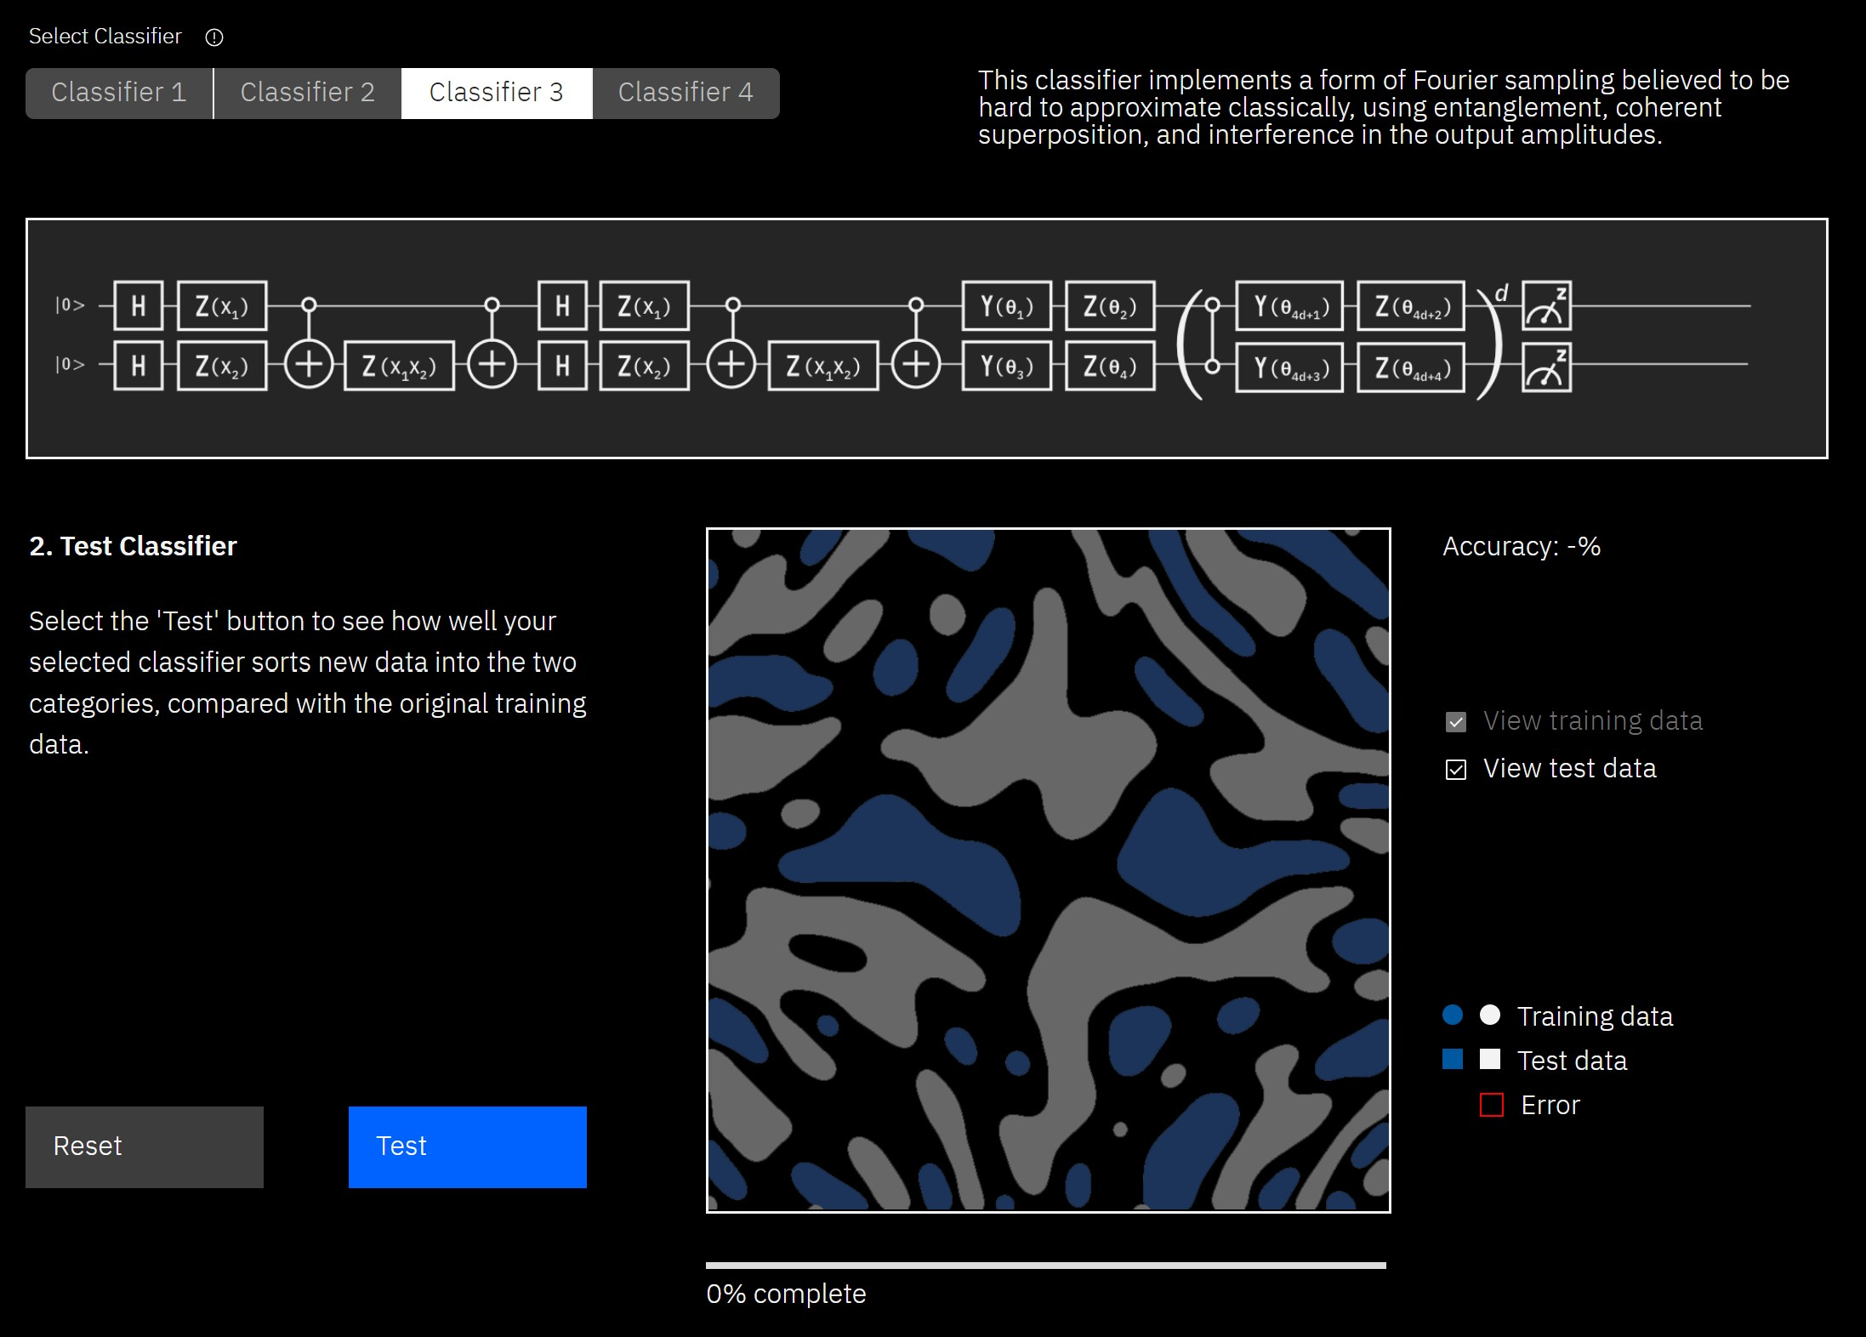
Quantum Classifier https://ibm-q4ai.mybluemix.net/

Slide 21
Further Learning
Books
Quantum Computing for Computer Scientists
Courses
https://www.coursera.org/learn/quantum-computing-algorithms
Google Quantum AI
https://ai.google/research/teams/applied-science/quantum-ai/
Qiskit tutorials
https://github.com/Qiskit/qiskit-tutorials

Slide 22
Questions
How do I learn more about it?
Study
How do I get in touch later?
Teams, Email, {twitter, github}/zpbappi
Where do I find the slides?
Will tweet the link to github repo with @readify soon
Something else?
Sure, go ahead.

Slide 23
Thank you

