Slide 1
Machine Learning with - Keras - Tensorflow - Theano

Slide 2
$ whoami
Zp Bappi
Readifarian [/redifarian/] one who works at Readify.
zpbappi.com
{github, linkedin, twitter} / zpbappi

Slide 3
Target Audiences
Newbies
python? machine learning??
Beginners
moderate python, knows about ML, knows Geoffrey Hinton
Intermediate users
python, ML techniques, <any>NNs, somewhat understands Geoffrey Hinton
Advanced users
42, fully understands Geoffrey Hinton and argues with him

Slide 4
End of Newbies Section

Slide 5
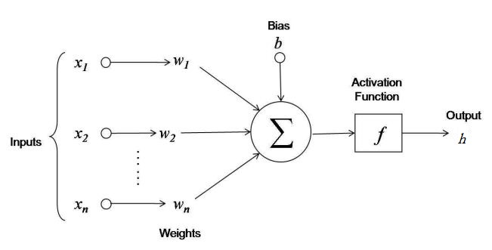
Quick ML recap for beginners
Neuron

Slide 6
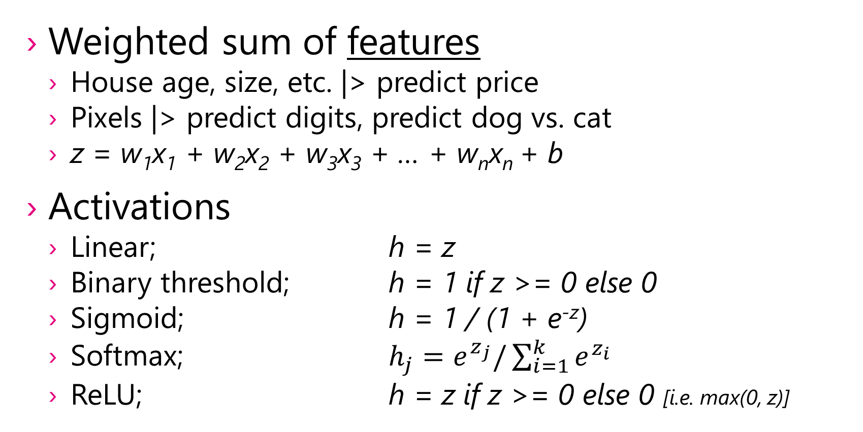
ML high-speed recap cont.
Weighted sum of features
House age, size, etc. |> predict price
Pixels |> predict digits, predict dog vs. cat
z = w₁x₁ + w₂x₂ + w₃x₃ + … + w_{n}x_{n} + b
Activations
Linear; h = z
Binary threshold; h = 1 if z >= 0 else 0
Sigmoid; h = 1 / (1 + e^{-z})
Softmax; $h_{j}=e^{z_{j}}/\sum_{i=1}^{k}{e^{z_{i}}}$
ReLU; h = z if z >= 0 else 0 [i.e. max(0, z)]

Slide 7
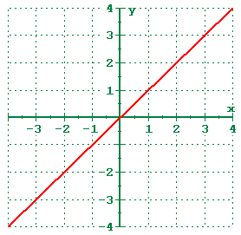
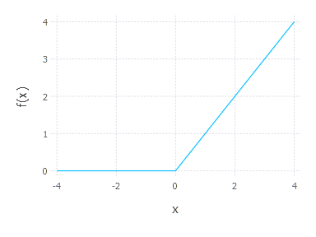
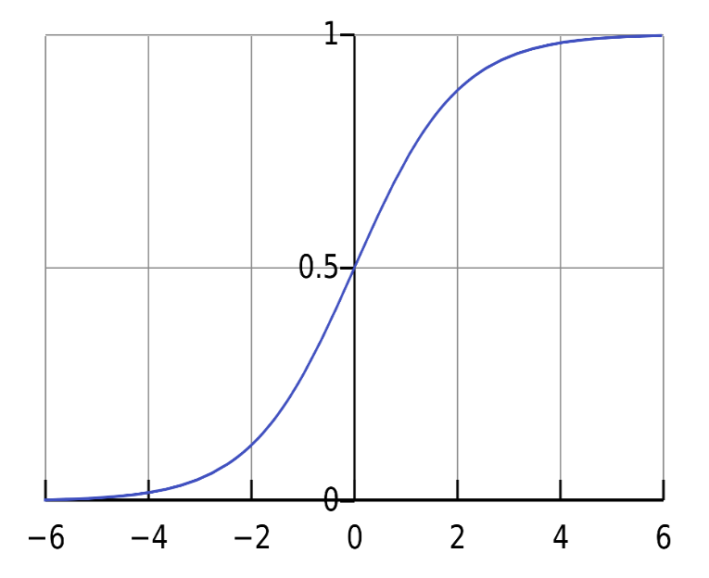
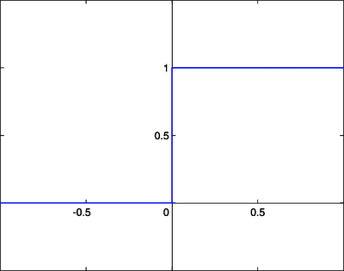
ML high-speed recap cont.

Slide 8
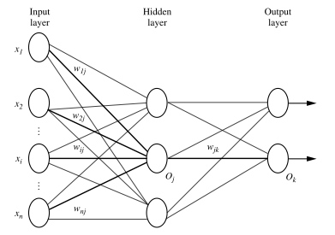
Neural Network

Slide 9
Why Layers?
Easier abstraction to deal with
No concern about inner nodes or connection weights
Learning process is abstracted away
No need to think about gradients and backprop
Re-usability
Easier programming model

Slide 10
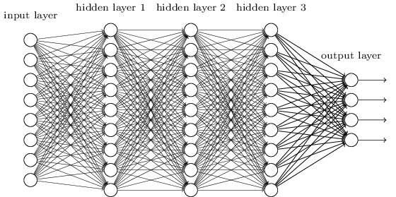
Deep Neural Network

Slide 11
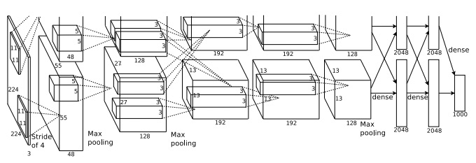
Another DNN (CNN)

Slide 12
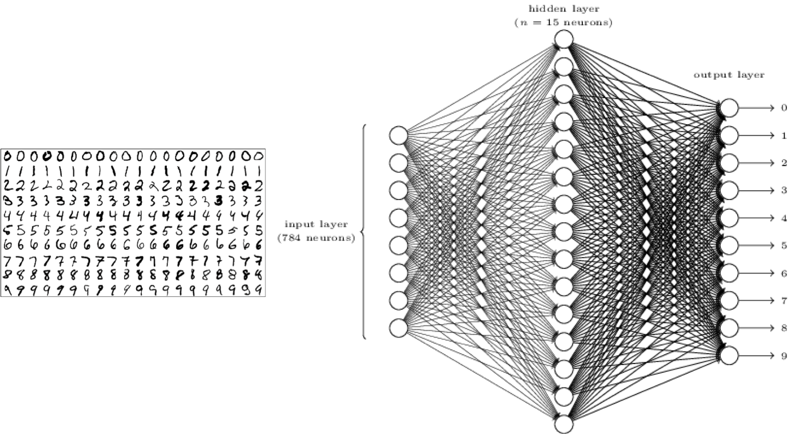
Demo
Hello world of classification with Keras
Train on handwritten digit samples
Classify handwritten digits
Analyze results

Slide 13
Demo
Analyze MNIST example with simpler network
x₁
0
x₂
1
2
3
4
5
6
7
8
9
x₇₈₄

Slide 14
Re-using existing models
Specialization of a general purpose model
Feature extraction
Synthetic data generation
Being lazy!

Slide 15
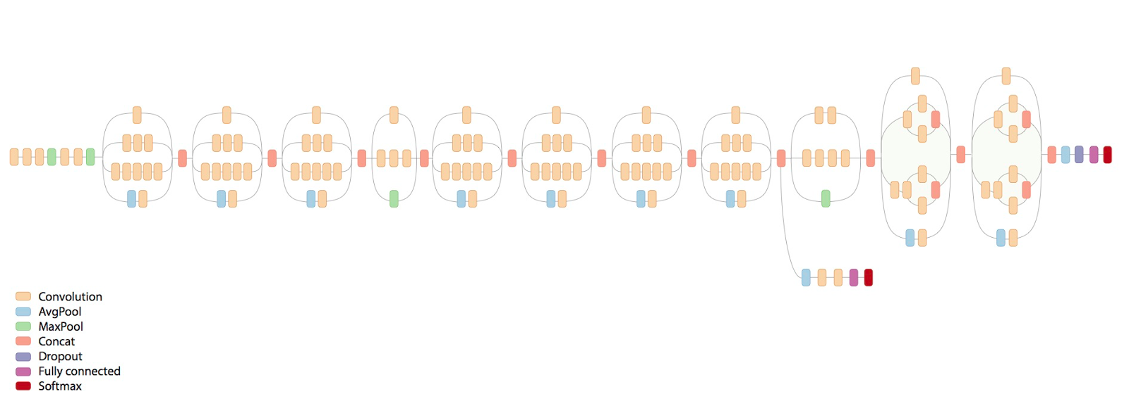
Demo (not really!)
Example of using InceptionV3 to classify dog/cat
In original form, it can identify 1000 different objects, including dogs and cats

Slide 16
Image courtesy…
DNN used by Google Image Search

Slide 17
Thank you
Questions?

