Slide 1
CNTK > http://cntk.ai > github.com/microsoft/cntk/wiki
Rebranded as- The Microsoft Cognitive Toolkit

Slide 2
Background
Machine learning
math looks good, diagram looks even better
implementing something, meh…
training your network… most people live for finite amount of time
Possible solutions
GPU
multiple GPUs
multiple machines with multiple GPUs
How?
Tensorflow or Theano (read- Keras), Caffe, Torch, etc…
CNTK

Slide 3
Why CNTK
rich library of layers and optimizers, easy to customize
production ready, already being used in many places
cortana, congnitive services, skype, bing, …
runs anywhere, even on Docker!
super fast!

Slide 4
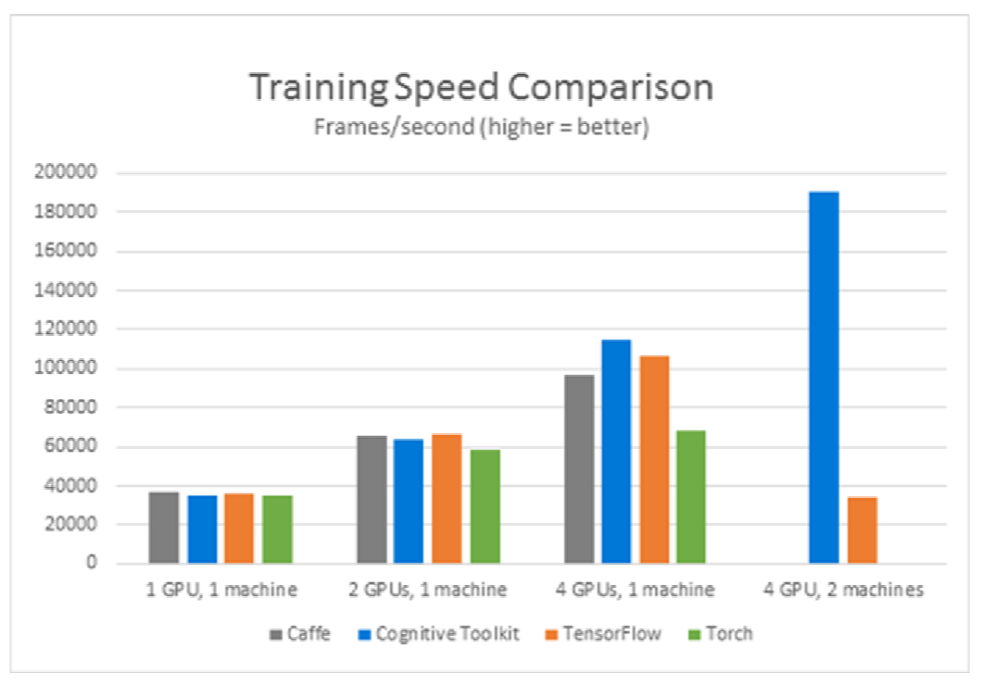
Why CNTK (contd.)
comparison- https://thenewstack.io/microsoft-adds-python-support-cntk-deep-learning-toolkit/
1-bit SGD (proprietary)
block-momentum SGD, model-averaging SGD, ASGD (with Miltiverso)
local, docker, vm
easy to design, easy deployment
Use C++, BrainScript, python, C# (almost)

Slide 5
$ whoami
** Non-paid Advertisement **
We are hiring:
Data & Analytics ✓
BI ✓
Machine Learning ✓
Zp Bappi
Readifarian [/redifarian/] one who works at Readify.
zpbappi.com
{github, linkedin, twitter} / zpbappi

Slide 6
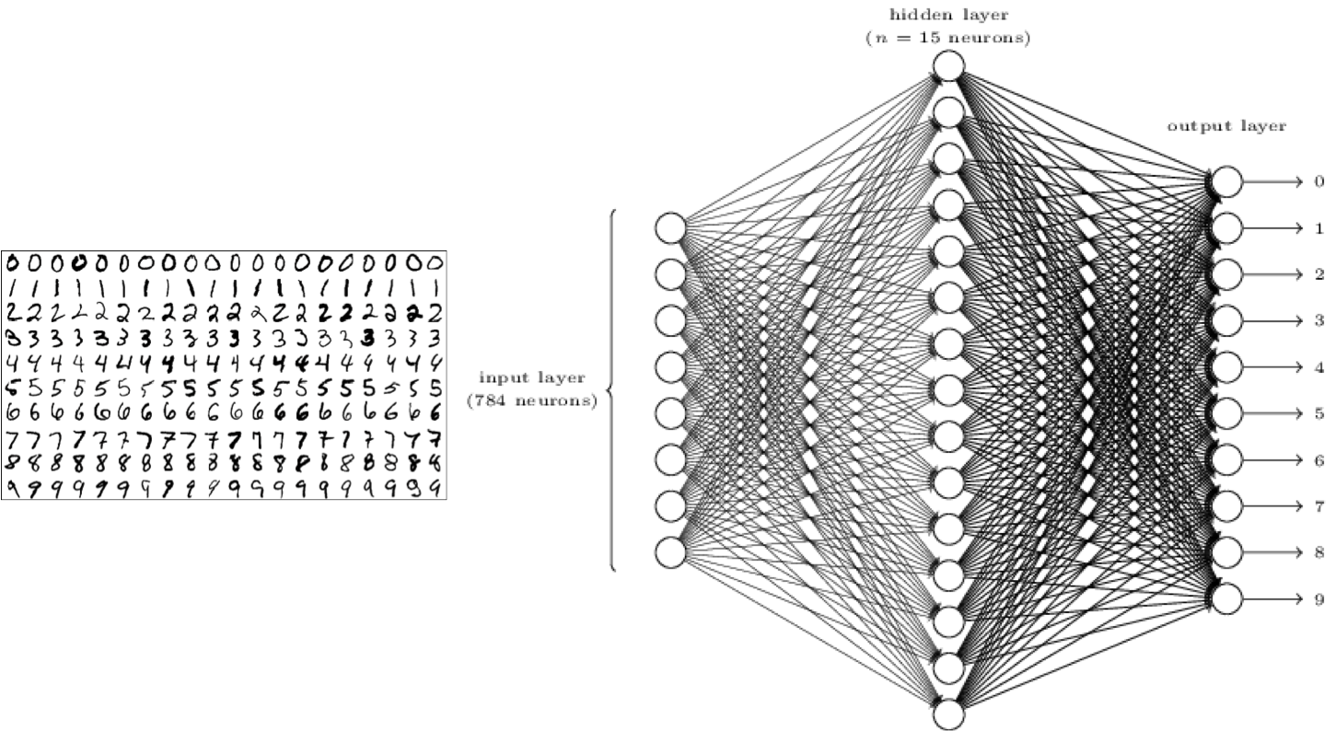
Demo
Basic MNIST example with CNTK
Train on handwritten digit samples

Slide 7
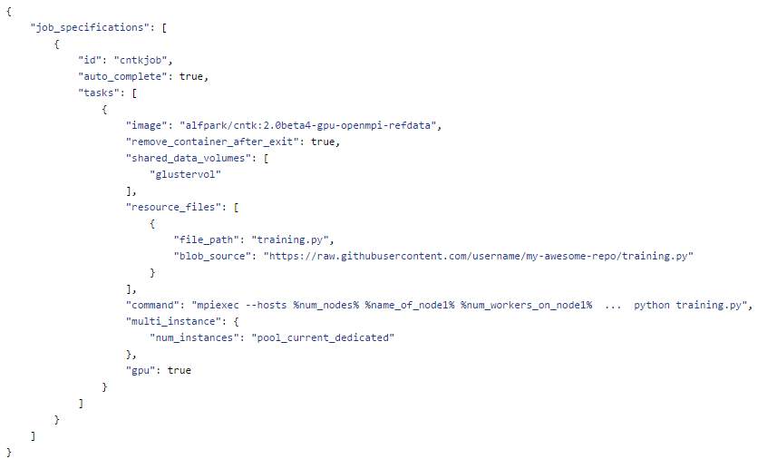
Other usages
Transfer learning
Reinforcement Learning Ready
Training on Azure NC Series cluster using batch-shipyard

Slide 8
Thank you
Questions?

