Slide 1
Introduction

Slide 2
Proposed vs Completed Tasks
Proposed Work
Create a Neural Network Library
Implement neurons, layers
Be capable of both forward and backward propogation
Can learn Non-linear problems
Using created library, train a NN on MNIST
Compare to SotA
Compare to Keras
Implement Convolutional Layers
Finished Work
Create a Neural Network Library
Implement neurons, layers
Be capable of both forward and backward propogation
Can learn Non-linear problems
Using created library, train a NN on MNIST
Compare to SotA
Compare to Keras

Slide 3
Problem Definition
Develop a Neural Network Library from scratch
The develop a stronger understanding of the underlying concepts used in building Artificial Neural Networks

Slide 4
Related Work
Tensor Flow/Keras
PyTorch
NeuroLab
Numerous Blogs and youtube videos
[1] Lokesh Das, XYZ, and ZYK “A custom activation function for image classification”. Arxiv 2024

Slide 5
Proposed Method
Rely primarily on the numpy library
Create Classes for:
Activation Functions
Relu, sigmoid, tanh, softmax
Loss Functions
MeanSquaredError, CategoricalCrossEntropy
Layers (contains neurons and their weights)
Compute forward pass and save the output of each neuron for use in back propagation
Network Model
Responsible for both forward pass through the whole network and back propagation

Slide 6
Proposed Method
2 hidden layers
First hidden layer: 100
Second hidden layer: 50
Both layers used ReLU
No Bias
Output Activation: Softmax
Weight Initialization: Random Normal Distribution
All weights regularized by a factor of 10
Loss: CategoricalCrossEntropy
SGD
learning rate: .001

Slide 7
Proposed Method
Used MNIST
Used a subset of the training data
Training time on whole set: 102 min/epoch
Training time on subset(1000): ~100 sec/epoch
Image data was flattened and converted to a 1D numpy array

Slide 8
Proposed Method
Training Details
100 Epochs
No batching
Use the first 1000 training samples from MNIST

Slide 9
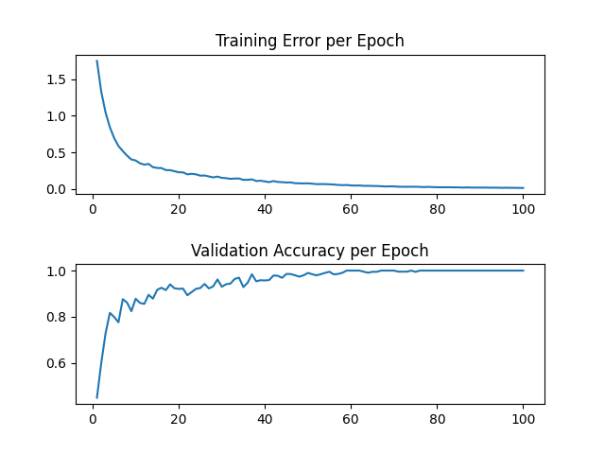
Proposed Method
Results*
Library | Test Accuracy (%) | Training Time(min)
My Library | 85.9 | 171.45
TensorFlow/Keras | 85.3 | 1.25
Branching/Merging CNN + Homogeneous Vector Capsules | 99.87
EnsNet | 99.84

Slide 10
Proposed Method
Sub-optimal computation time
Nearly 3 hours to run 100 epochs over small subset of training data
Same architecture and number of epochs in Tensorflow took 75 seconds

Slide 11
Conclusion

Slide 12
Future Work
Optimize Computations to speed up training
Implement Convolutional Layers
Implement Batching

