Slide 1
Zachary Pearson Fall 2024 Deep Learning Project Develop Neural Network Library

Slide 2
Proposed vs Completed Tasks
Proposed Work
Create a Neural Network Library
Implement neurons, layers
Be capable of both forward and backward propogation
Can learn Non-linear problems
Using created library, train a NN on MNIST
Compare to SotA
Compare to Keras
Implement Convolutional Layers
Finished Work
Create a Neural Network Library
Implement neurons, layers
Be capable of both forward and backward propogation
Can learn Non-linear problems
Using created library, train a NN on MNIST
Compare to SotA
Compare to Keras

Slide 3
Introduction
Develop a Neural Network Library from scratch
TensorFlow and other existing libraries feel like a black box
Get my hands dirty with the specific implementation
Use minimal number libraries

Slide 4
Problem Definition
Develop a Neural Network Library from scratch
The develop a stronger understanding of the underlying concepts used in building Artificial Neural Networks
Bridge gap between theoretical understanding and practical application

Slide 5
Related Work
Tensor Flow/Keras - https://www.tensorflow.org
PyTorch - https://pytorch.org/
NeuroLab - https://pypi.org/project/neurolab/
Numerous Blogs and youtube videos
https://www.youtube.com/@sentdex
https://www.youtube.com/@TheCodingTrain
https://www.freecodecamp.org/news/building-a-neural-network-from-scratch/

Slide 6
Proposed Method
Rely primarily on the numpy library
Create Classes for:
Activation Functions
Relu, sigmoid, tanh, softmax
Loss Functions
MeanSquaredError, CategoricalCrossEntropy
Layers (contains neurons and their weights)
Compute forward pass and save the output of each neuron for use in back propagation
Network Model
Responsible for both forward pass through the whole network and back propagation

Slide 7
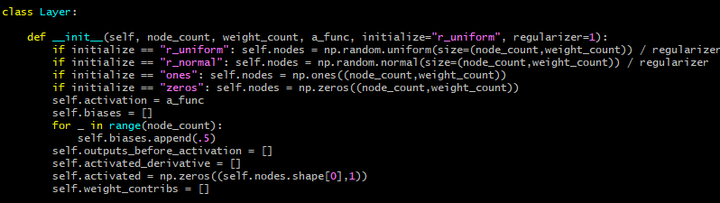
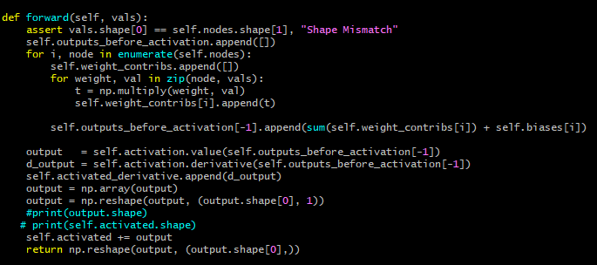
Proposed Method
Layer Class

Slide 8
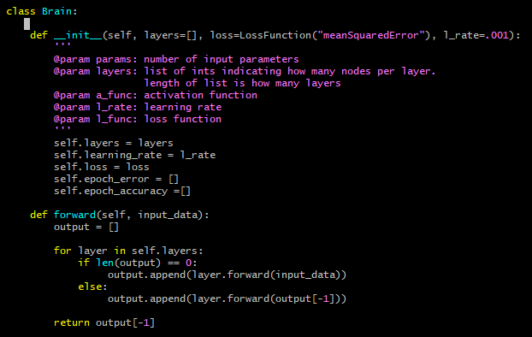
Proposed Method
Neural Network Class

Slide 9
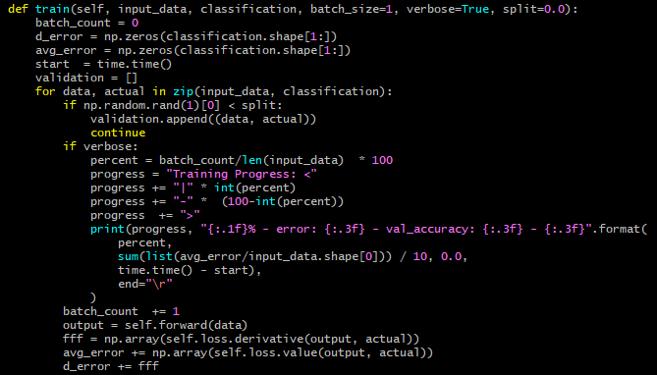
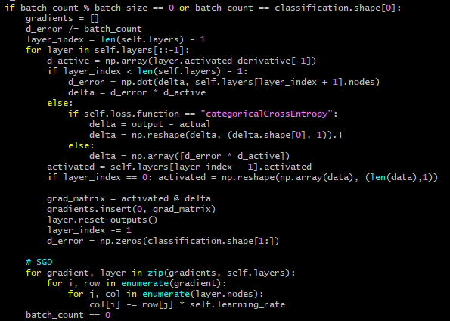
Proposed Method
Neural Network Class (Continued)

Slide 10
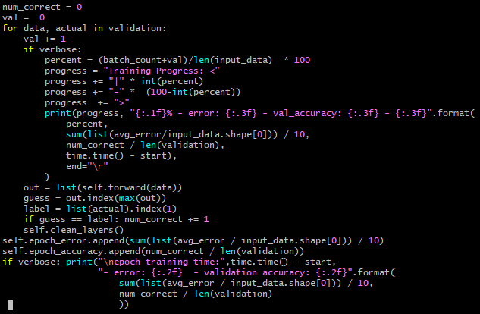
Proposed Method
Neural Network Class (Continued)

Slide 11
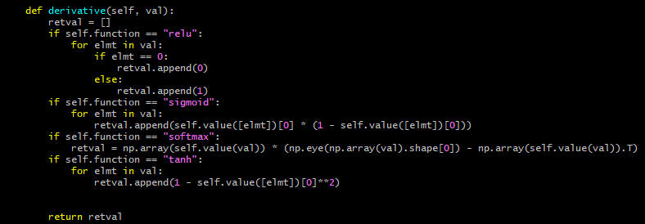
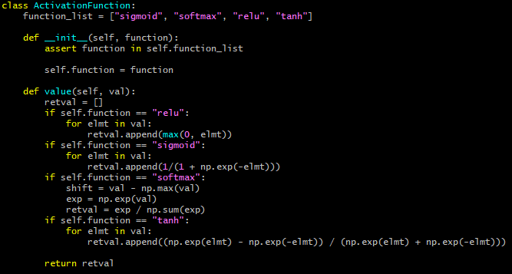
Proposed Method
Activation Function Class

Slide 12
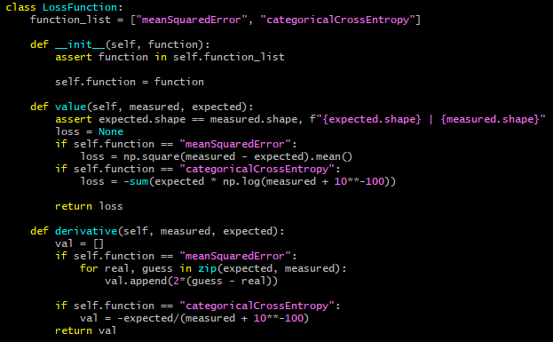
Proposed Method
Loss Function Class

Slide 13
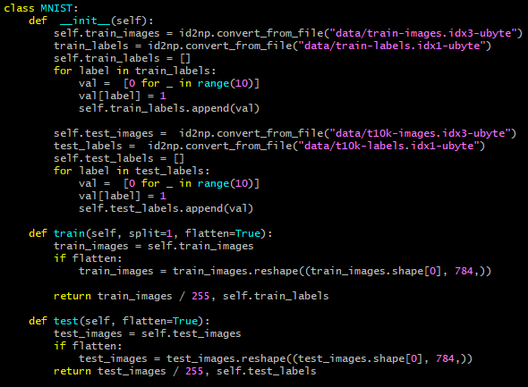
Proposed Method
MNIST Data Class

Slide 14
Proposed Method
2 hidden layers
First hidden layer: 100
Second hidden layer: 50
Both layers used ReLU
Output Activation: Softmax
Weight Initialization: Random Normal Distribution
All weights regularized by a factor of 10
Loss: CategoricalCrossEntropy
SGD
learning rate: .001
Used MNIST
Used a subset of the training data
Training time on whole set: 102 min/epoch
Training time on subset(1000): ~100 sec/epoch
Image data was flattened and converted to a 1D numpy array
Training Details
100 Epochs
No batching
Validation Rate: .2

Slide 15
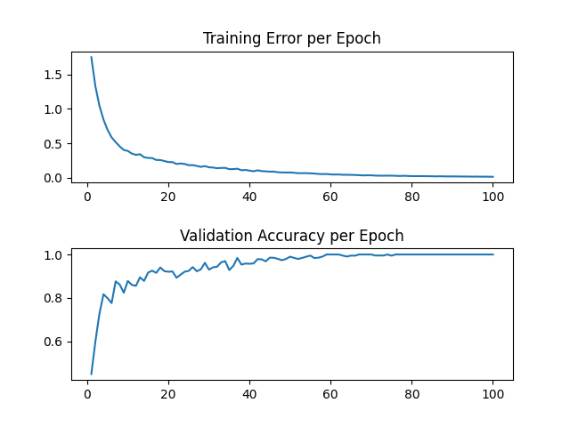
Proposed Method
Results*
Library | Test Accuracy (%) | Training Time(min)
My Library | 85.9 | 171.45
TensorFlow/Keras | 85.3 | 1.25
Branching/Merging CNN + Homogeneous Vector Capsules | 99.87
EnsNet | 99.84

Slide 16
Proposed Method
Sub-optimal computation time
Nearly 3 hours to run 100 epochs over small subset of training data
Same architecture and number of epochs in Tensorflow took 75 seconds
Batching not enough to bridge gap
Using subset of training data is not optimal
To keep training time down while making use of larger portion of data, use random samples of the whole dataset each epoch
Drawback to random sampling would potentially be fewer features learned

Slide 17
Conclusion
Key Takeaways
Stronger Intuition of First Principles
Model Sensitivity to Hyper-parameter selection
Importance of weight initialization
Library performs comparably to TensorFlow/Keras on MNIST
Computationally heavy processes may need to be implemented in lower level language (C/C++)
Pytorch and TensorFlow both use C++ for computational processes

Slide 18
Future Work
Optimize Computations to speed up training
Move Portions Responsible calculating matrices to C++
Implement Batching
Implement Convolutional Layers

Slide 19

Future Work
Thank You

