Slide 1
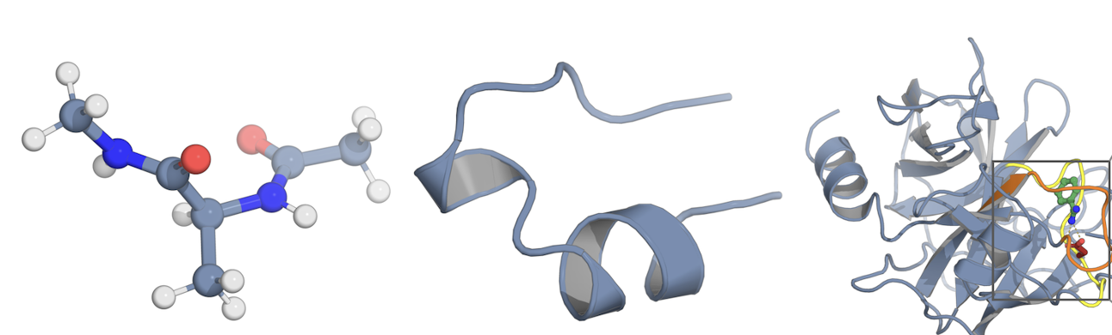
THESIS DEFENSE
Representation and Reinforcement Learning
for Molecular Dynamics
Zihan Pengmei
Department of Chemistry
The University of Chicago
Advisor: Aaron R. Dinner
Alanine dipeptide
Trp-cage
Trypsin–benzamidine
What to represent, and where to simulate, in molecular dynamics
Zihan Pengmei · Department of Chemistry · The University of Chicago
01 / 37
Notes:
01. Representation and Reinforcement Learning for Molecular Dynamics
SCRIPT (about 0:30):
Thank you all for coming. My thesis applies several machine learning methods to molecular dynamics, but they all address two long-standing bottlenecks that limit what MD simulations can tell us: how to represent a molecular configuration so that we can gain insight from the simulations, and where to spend the simulation budget so that we can observe biologically important rare events.
I will develop methods for both, and test them on these benchmark systems you see here.
DETAIL / Q&A:
Opening, about 30 s. Title, affiliation, advisor.
One sentence on the thesis: what to represent, and where to simulate, in molecular dynamics. The three test systems on the right return in Part II: alanine dipeptide, Trp-cage, and trypsin–benzamidine.

Slide 2
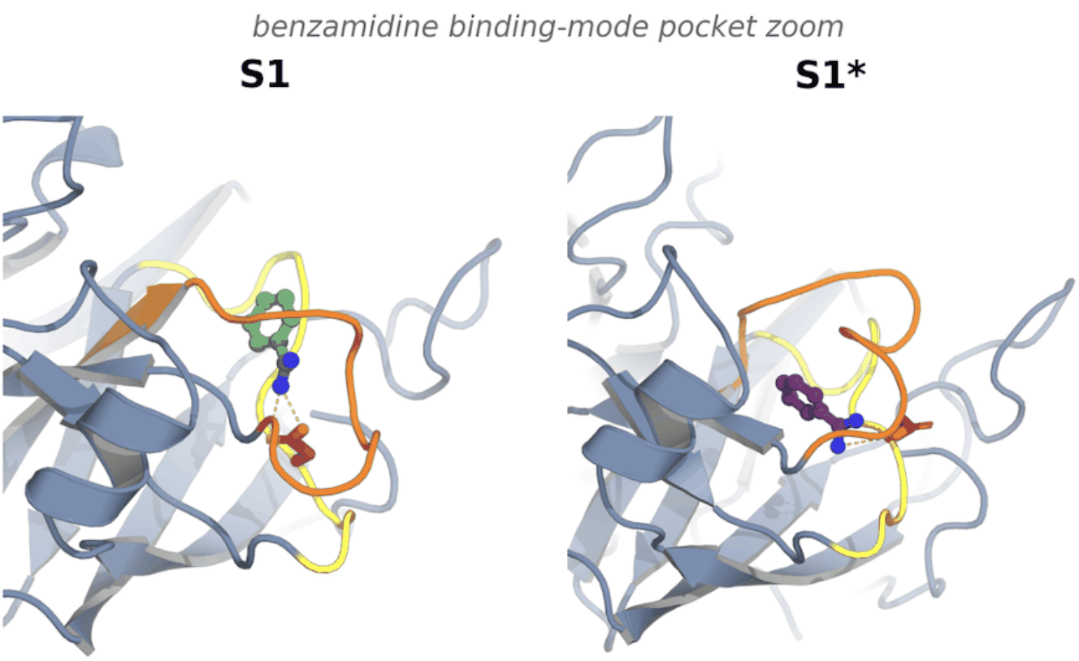
THE MD QUESTION
A binding pose does not reveal a binding mechanism
Route
How does the ligand enter or leave?
Receptor motion
What changes in the binding pocket?
Ordering
Which change occurs first?
S1 native mode, Trp215 loop closed S1* alternative mode, Trp215 loop open
Trp215 loop orange · Asp189 loop yellow · Asp189 side chain red · Asp189–benzamidine salt bridge dashed
The target is the dynamics connecting these conformations
Trypsin–benzamidine structures; S1/S1* binding modes as defined by Plattner & Noé, Nat. Commun. 6, 2015
02 / 37
Notes:
02. A binding pose does not reveal a binding mechanism
SCRIPT (about 1:00):
Let me start with the question that motivates the work. Here is trypsin with benzamidine. On the left is the native binding mode, S1, with the Trp215 loop closed. On the right is an alternative mode, S1-star, where that loop is open.
A structure tells us where the ligand sits. It does not tell us how the ligand gets in or out, how the pocket changes along the way, or which of those changes happens first. Those are questions about kinetics, and that is what I mean by mechanism. We will come back to exactly this system at the end of the talk.
DETAIL / Q&A:
A structure is a snapshot; binding is a process. The two panels show benzamidine in trypsin in the native S1 mode (Trp215 loop closed) and the alternative S1* mode (loop open), as defined by Plattner & Noé.
The questions on the right are the ones a pose cannot answer: the route in and out, how the pocket changes, and which change comes first. Say that trypsin returns as Test 3.

Slide 3
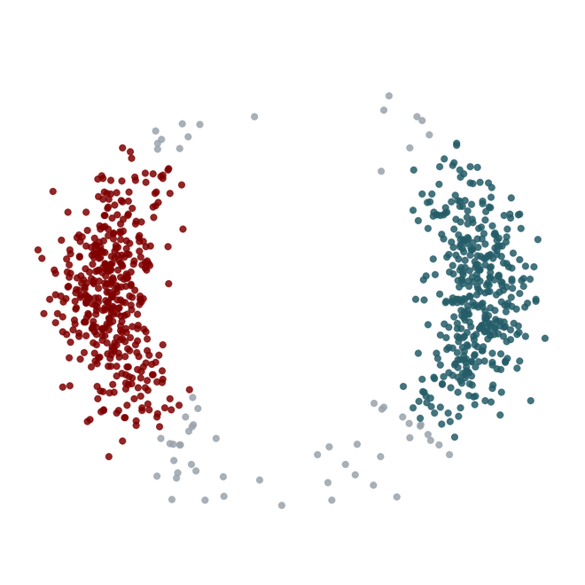
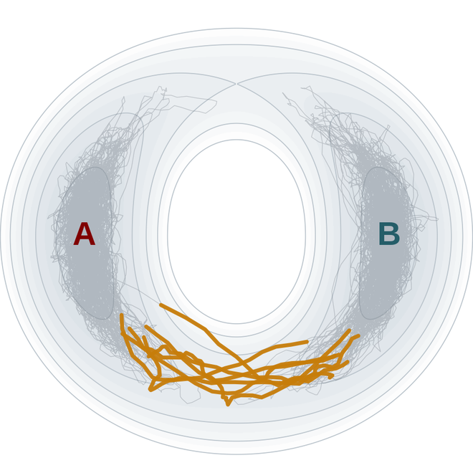
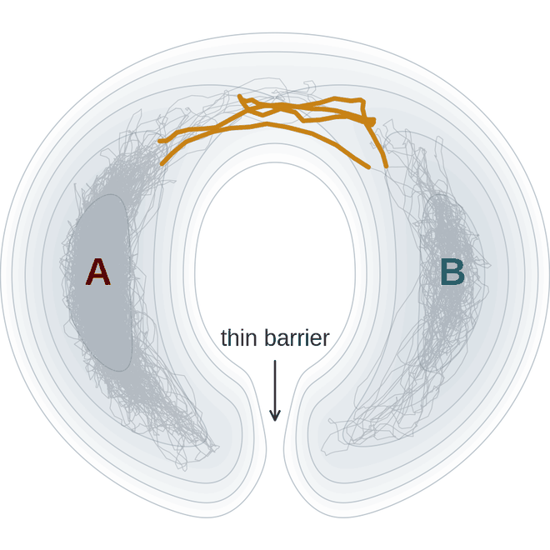
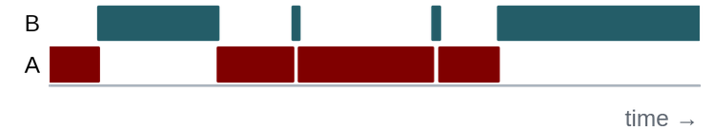
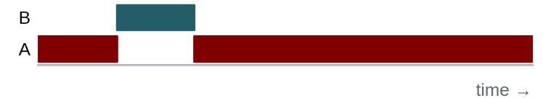
TIME-ORDERED EVIDENCE
Structures show where; MD shows how and how fast
Independent structures
MD on landscape 1
MD on landscape 2
Where the states are
How and how often they connect
With one thin barrier
Identical for both landscapes
The two ensembles differ by less than 1%, and few samples fall between the basins.
Mostly the lower route
Rerouted over the top, fewer transitions
Toy 2D model, overdamped Langevin dynamics (kT = 1). Ensemble difference and rates from 200 independent trajectories per landscape.
03 / 37
Notes:
03. Structures show where; MD shows how and how fast
SCRIPT (about 1:30):
Here is a toy model that makes the point concrete. On the left are independent samples from a two-dimensional energy landscape. They tell us there are two states, A and B, and very few samples sit between them.
[click] Now we run dynamics on that landscape. The trajectory stays in A for a long time, then occasionally crosses to B. The orange segments are the crossings. Eighty percent of them take the lower route, and the strip below shows how often they happen. That frequency is a rate, which no set of structures can give us.
[click] On the right is a second landscape. I added one thin barrier on the lower route. Its equilibrium ensemble differs from the first by less than one percent, so the samples on the left describe both landscapes equally well. But the dynamics are different: transitions now go over the top, and they are four and a half times less frequent.
So the mechanism of these rare events lives in regions that structures barely visit, and dynamical simulation is what describes them.
DETAIL / Q&A:
Suggested window: about 90 seconds (three clicks).
LEFT (on entry): Independent structures, whether from experiment, structure prediction or an equilibrium generator, tell us where the long-lived states are. Here: two basins, A and B. Very few samples sit between them, because transition regions have low equilibrium probability.
CLICK 1: Now run dynamics on this landscape. The trajectory rattles in A, then occasionally crosses to B (orange = transition paths). The crossings go along the lower route, and the strip below shows how often they happen. That frequency is a rate, which a set of structures cannot give.
CLICK 2: Second landscape. I added one thin barrier on the lower route. Its equilibrium ensemble is essentially identical (the two differ by less than 1%), so the structures on the left describe both systems equally well. But the dynamics are different: transitions now go over the top and are about 4.5 times less frequent.
BRIDGE (say it here, pay it off at chignolin): the thin barrier is the toy version of a side chain blocking a route. It barely changes the ensemble but changes the mechanism. The Thr6/Thr8 side-chain result on the chignolin slides is the molecular example: a learned coordinate has to keep side-chain detail to see it.
TAKEAWAY: Pathways and rates are set in the regions structures rarely visit. Time-ordered MD is what reaches them. This motivates both bottlenecks on the next slide: representing trajectories and sampling the rare crossings.
If asked: 2D overdamped Langevin, kT = 1, D = 1, dt = 0.002; route barriers 3.5 and 5 kT; thin Gaussian barrier 6 kT. Rate ratio from 200 independent trajectories per landscape (0.042 vs 0.0095 transitions per unit time). This is a toy model, not a molecular system.

Slide 4
THE THESIS PROBLEM
Two bottlenecks of MD
Representation
Sampling
fast coordinate
rare crossing
A
B
slow coordinate
sampled basin
unvisited basin
Both states are present,
but their distinction is lost.
The states are distinguishable,
but transitions are missing.
Representation learning: keep slow distinctions visible
Reinforcement learning: choose where to sample
Dissertation Ch. 1, Fig. 1.1
04 / 37
Notes:
04. Two bottlenecks of MD
SCRIPT (about 1:00):
Molecular dynamics has two bottlenecks for this kind of question.
The first is representation. Even with perfect sampling, interpreting trajectories in a high-dimensional space is hard. On the left, both states have been sampled, but if we describe them with a coordinate chosen for geometric variance, they project onto each other and the slow process disappears.
The second is sampling. On the right, the coordinate would separate the states, but the trajectory never crosses the barrier, so the transition is missing from the data. Worse, we usually do not know whether important basins are missing at all. Enhanced sampling methods need a human prior, such as a choice of collective variables, so their results are biased toward that prior, and they can be less trustworthy than they appear.
The two halves of my thesis address these two problems. Representation learning keeps slow collective variables visible. Reinforcement learning decides where to sample. And the two questions are coupled: the representation decides which trajectories count as informative, and each new batch of trajectories improves the representation. That coupling runs through the rest of this talk.
DETAIL / Q&A:
Two bottlenecks. Left, representation: both states are sampled, but a coordinate chosen for geometric variance projects them onto each other. Right, sampling: the coordinate would separate the states, but the trajectory never crosses.
The bottom row states what each part of the thesis does: representation learning keeps slow distinctions visible; reinforcement learning chooses where to sample.

Slide 5
THESIS ROADMAP
A closed loop links representation, kinetics, and sampling
Ch. 3–4 · SubFormer, all-atom pretraining
Ch. 5–6 · Geom2Vec, token merging
Geometric representation
Kinetic model
Pretrained all-atom encoders map each configuration to transferable, multiscale features
Time-lagged objectives (VAMP, SPIB) learn slow coordinates and metastable states
structural
embeddings
new trajectory
data
trajectory-level
rewards
Ch. 7 · GESPO
Unbiased molecular dynamics
Generative sampling policy
Short parallel trajectories propagate under a fixed force field
Learns a probability distribution over initial conformations to explore kinetically significant regions
sampled initial
conformations
Dissertation Ch. 1
05 / 37
Notes:
05. A closed loop links representation, kinetics, and sampling
SCRIPT (about 1:00):
This loop is the roadmap, and each box is tagged with its chapters in the thesis.
We start from a geometric representation: pretrained all-atom encoders turn each configuration into features. A kinetic model, trained with time-lagged objectives, turns those features into slow coordinates and states. The kinetic model then scores trajectories, and a generative sampling policy learns where to start the next ones. Those short trajectories are ordinary unbiased molecular dynamics, and their data flow back into the representation in a recursive way.
Part I covers the top of this loop; Part II closes it.
DETAIL / Q&A:
Roadmap. The loop has four parts, each tagged with its chapters: geometric representation (Ch. 3–4, SubFormer and pretraining), kinetic model (Ch. 5–6, Geom2Vec and token merging), the generative sampling policy (Ch. 7, GESPO), and unbiased MD.
The policy decides where to sample; it never touches the equations of motion. The same loop returns on the synthesis slide.

Slide 6
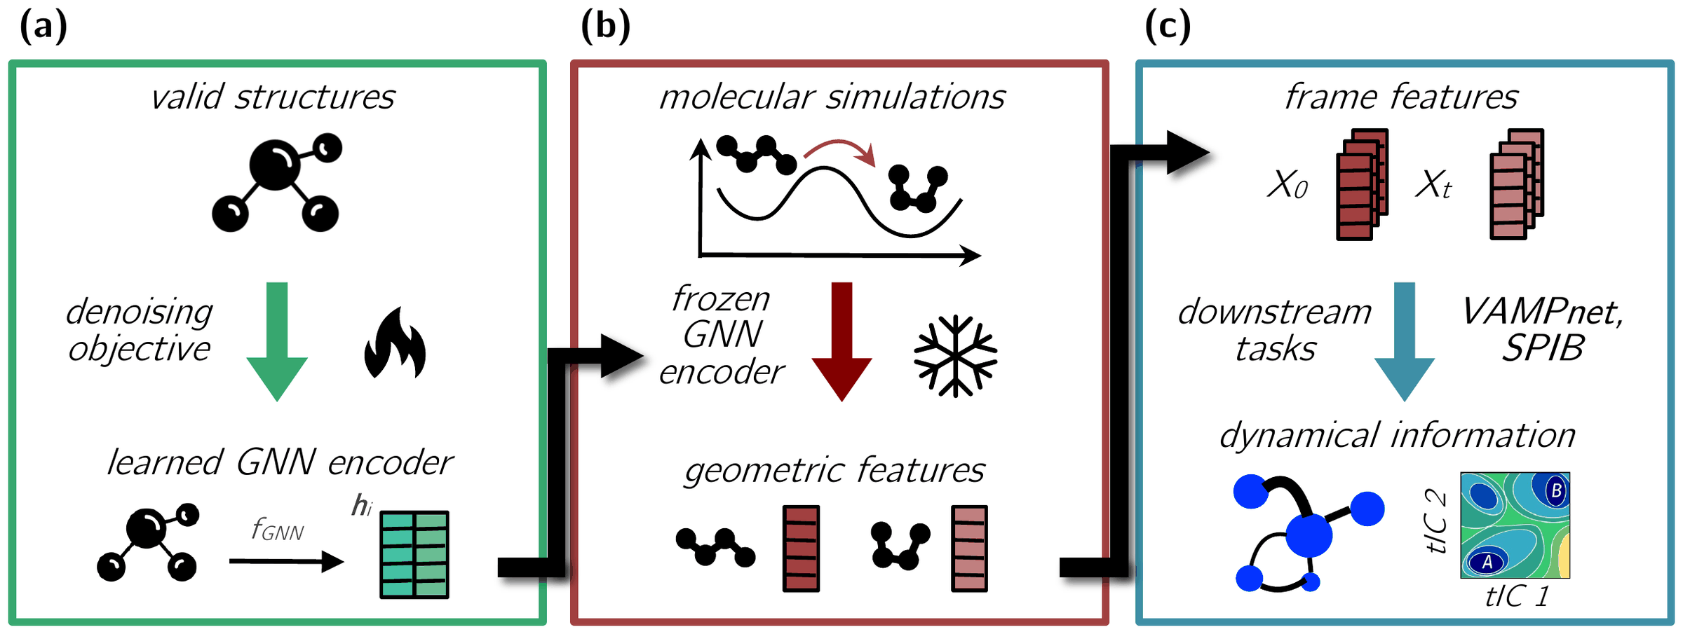
REPRESENTATION LEARNING · GEOM2VEC
Pretrain once, then featurize every MD frame
Pretrain once
Denoising on 2.3 M conformations of 215 k molecules (OrbNet Denali)
Featurize frames
A frozen ViSNet encodes all heavy atoms; atoms pool into residue tokens
Train only the head
A token mixer (SubFormer, SubMixer) with a VAMP or SPIB objective
Freezing the geometric encoder makes all-atom kinetic learning fit on a single GPU.
Pengmei et al., J. Chem. Phys. 162, 044107 (2025)
06 / 37
Notes:
06. Pretrain once, then featurize every MD frame
SCRIPT (about 1:30):
Part I is about representation. The idea is called Geom2Vec, by analogy with word2vec: learn a general vector representation once, then reuse it for many tasks.
It has three steps. First, we pretrain an equivariant graph neural network, with a denoising objective: we perturb the coordinates of 2.3 million conformations of small molecules and train the network to predict the noise. No energies or labels are needed.
Second, we freeze that encoder and apply it to every frame of an MD trajectory. Every heavy atom gets a feature vector, and we pool the atoms of each residue into one token.
Third, only a small head is trained for the downstream task: a token mixer followed by a kinetic objective such as VAMP or SPIB.
Why freeze the encoder? Kinetic objectives need very large batches of frame pairs to estimate their covariance matrices. Recomputing an all-atom network for every pair at that batch size would need far more memory than a single GPU, or even several, and would recompute the same frames over and over. With precomputed features, training fits on one GPU at orders of magnitude lower cost.
DETAIL / Q&A:
Geom2Vec in three steps. Pretrain an equivariant GNN (ViSNet) once by denoising 2.3 million conformations of 215,000 molecules (OrbNet Denali). Freeze it and featurize every MD frame, pooling heavy atoms into residue tokens. Train only a small head: a token mixer with a VAMP or SPIB objective.
Why freezing matters: VAMP training needs large batches of time-lagged frame pairs (1,000–5,000) to estimate the covariance matrices stably. Recomputing an all-atom GNN for every pair at that batch size would not fit on a single GPU; for Trp-cage we estimated about 100 GB of memory at a batch of 1,000. With precomputed features, a VAMPnet trains in minutes on one GPU.

Slide 7
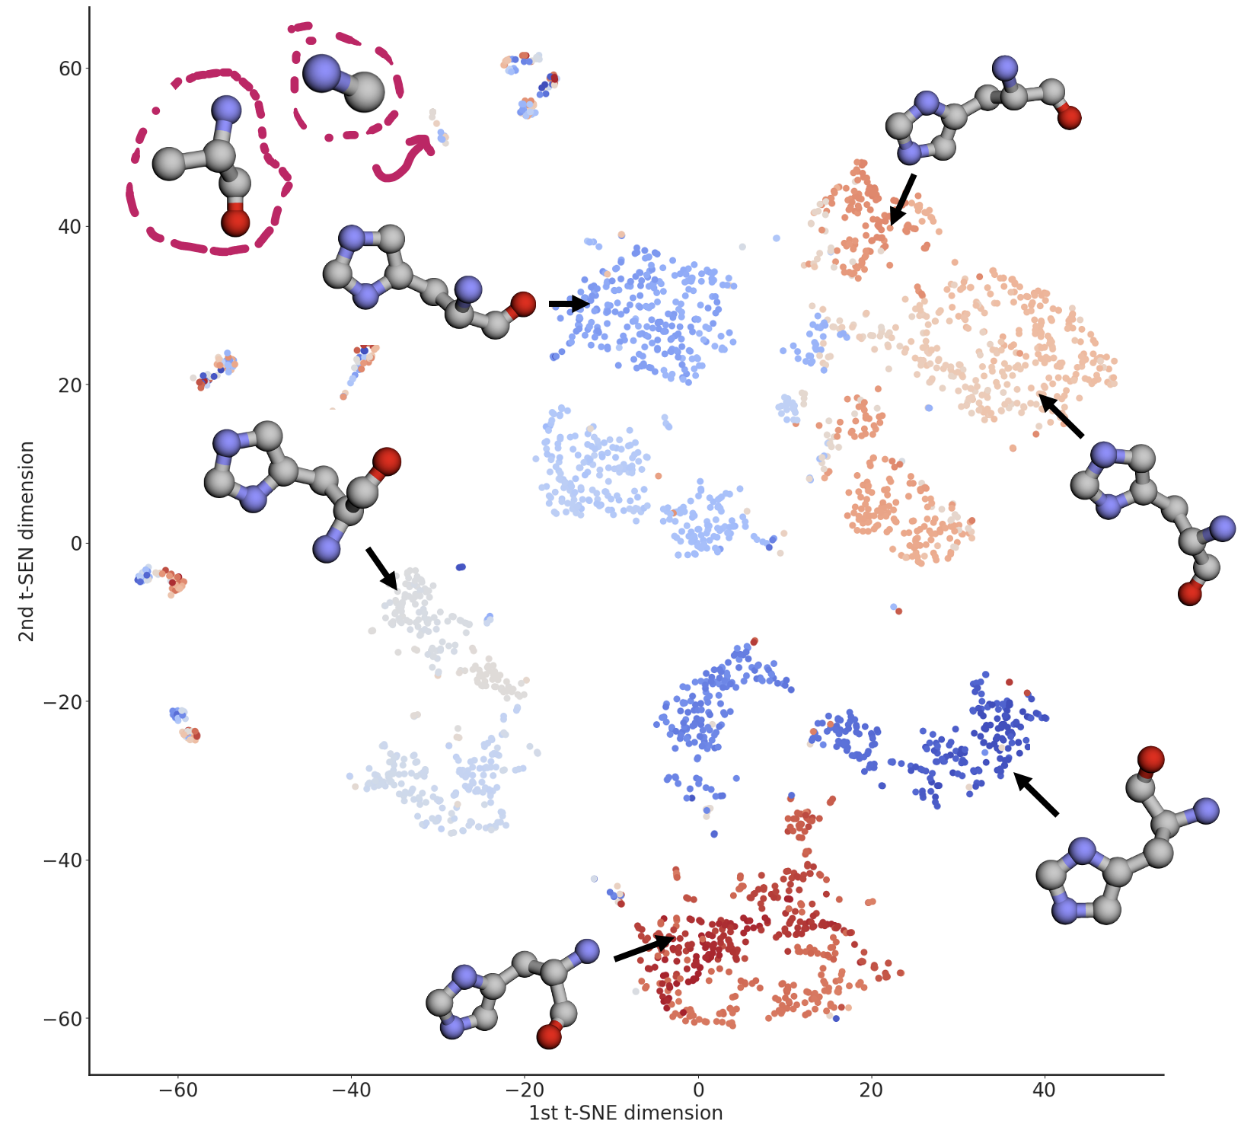
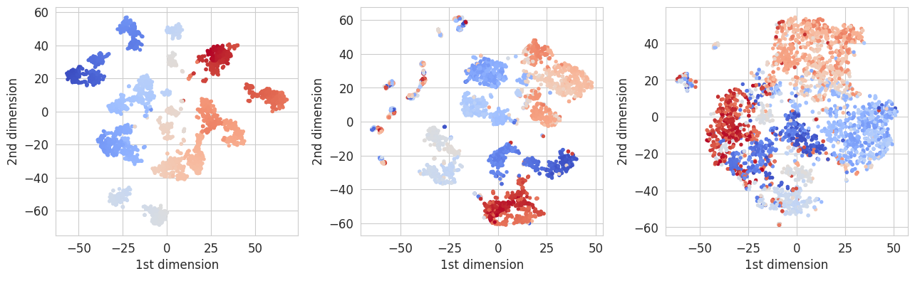
REPRESENTATION LEARNING · WHAT THE FEATURES ENCODE
Pretrained features organize residues by local geometry
Angles (φ, ψ, χ)
Pretrained embedding
Untrained embedding
Clusters by construction: the reference.
The same color groups stay together as compact clusters.
Groups overlap; the structure comes from pretraining.
The encoder never saw these angles: it was pretrained only to denoise coordinates of small molecules, yet residues with similar backbone and side-chain geometry map to nearby embeddings.
Each cluster is one side-chain conformation. Isolated points (circled) are broken fragments from dataset preprocessing errors.
Denoising pretraining alone yields features that resolve residue conformation, the input the kinetic models build on.
Pengmei et al., “Pushing the Limits of All-Atom Geometric Graph Neural Networks: Pre-Training, Scaling and Zero-Shot Transfer,” ICLR 2025, appendix. Histidine residues, HomologyTAPE validation set; color: 1D t-SNE of backbone and side-chain angles.
07 / 37
Notes:
07. Pretrained features organize residues by local geometry
SCRIPT (about 1:15):
Before using these features for dynamics, we should ask whether they encode anything about protein geometry at all, since the encoder only ever saw small molecules.
Here we take histidine residues from a protein-fold dataset and project their embeddings to two dimensions. On the left is the reference: the residues' backbone and side-chain angles, which cluster by construction. That projection also sets the colors in all three panels.
In the middle, the pretrained embedding keeps the same color groups together as compact clusters. On the right, the same network without pretraining mixes them. So the organization comes from pretraining, not from the architecture alone.
On the right, each cluster corresponds to one side-chain conformation. The isolated points turned out to be broken residues from preprocessing errors in the dataset, which the embedding exposes. So these features resolve local geometry. They do not yet know anything about time.
DETAIL / Q&A:
Does a network pretrained only to denoise small-molecule coordinates encode anything about protein geometry? Here each histidine residue from a protein fold dataset is embedded with its sequence neighbors, and the embeddings are projected to 2D with t-SNE.
Left: t-SNE of the residue's backbone and side-chain angles, which clusters by construction; this is the reference, and its 1D projection sets the colors in every panel. Middle: the pretrained embedding. The same color groups stay together as compact clusters. Right: the same architecture untrained. Groups overlap, so the organization comes from pretraining, not the architecture alone.
Right panel: representative structures for the pretrained clusters; each is a distinct side-chain conformation. The circled isolated points turned out to be broken fragments from preprocessing errors in the dataset, which the embedding exposes and angle features hide.
Point to make: these features are geometric, not kinetic. The next slide adds time.
If asked: angle features lack all-atom resolution and environment, so the comparison is for consistency, not a ranking. The same pattern holds for Asp, Cys and Met in the appendix.

Slide 8
LEARNING FROM MD
Time-lagged learning asks which distinctions persist
Configuration
X(t)
Geometric encoder
h(X)
Kinetic coordinate
χ(h(X))
Time-lagged
objective
frozen / shared
trainable / shared
Configuration
X(t + τ)
Geometric encoder
h(X)
Kinetic coordinate
χ(h(X))
Training: first half of the trajectory
Validation: second half, held out in time
simulation time
Split by time/trajectory, not by frame: random splits reward memorizing correlated neighbors.
Time-based split as in Pengmei et al., J. Chem. Phys. 162, 044107 (2025)
08 / 37
Notes:
08. Time-lagged learning asks which distinctions persist
SCRIPT (about 1:15):
This is how we add time. We take a configuration at time t and another at time t plus tau from the same trajectory. Both go through the same frozen encoder, and a trainable projection, chi, maps them to a few coordinates.
The time-lagged objective rewards coordinates that stay correlated across the lag. Fast fluctuations decorrelate quickly and are ignored; slow conformational changes persist and are kept.
One methodological point matters here. Neighboring frames in a trajectory are almost identical, so a random train-validation split lets a model score well by memorizing. We train on the first half of each trajectory and validate on the second half. Or we split by trajectories.
DETAIL / Q&A:
Time-lagged learning. The same frozen encoder embeds X(t) and X(t + τ); a trainable projection χ is shared across both times; the objective rewards features that stay correlated over the lag.
Validation must respect time. Neighboring frames are highly correlated, so a random split rewards memorization. We train on the first half of each trajectory and validate on the second half.

Slide 9
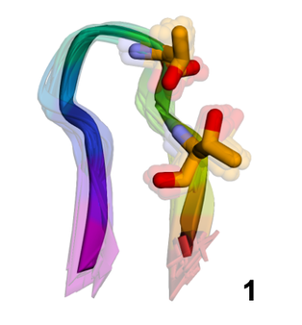
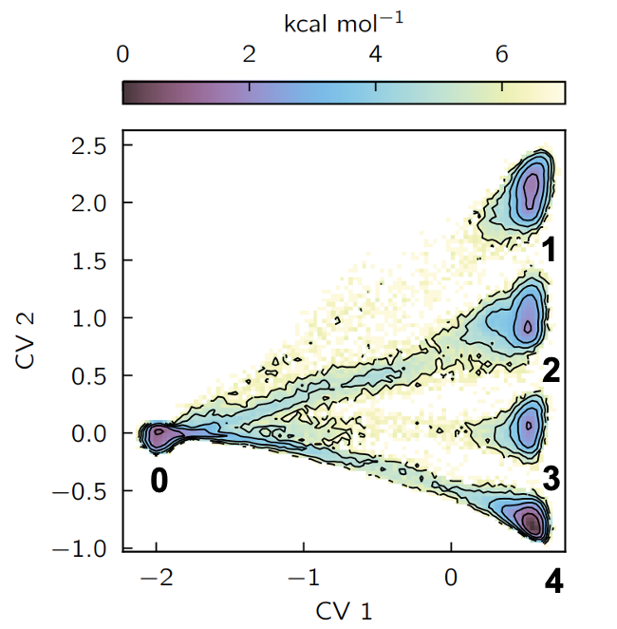
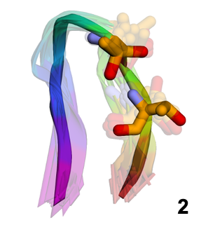
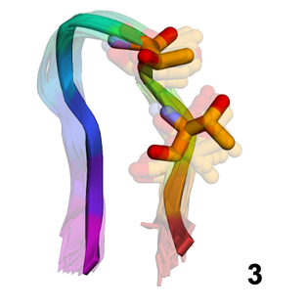
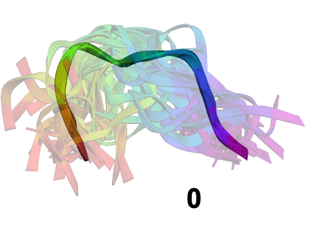
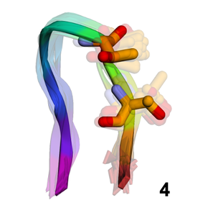
TEST 1 · CHIGNOLIN
All-atom features resolve four folded substates
10-residue chignolin
106 μs unbiased trajectory at 340 K; all heavy atoms as input
Folding
CV 1 separates unfolded (0) from folded configurations.
Folded substates
CV 2 splits the folded ensemble into four substates (1–4).
Pengmei et al., J. Chem. Phys. 162, 044107 (2025); VAMPnet with SubMixer; trajectory: Lindorff-Larsen et al., Science 334, 517 (2011)
09 / 37
Notes:
09. All-atom features resolve four folded substates
SCRIPT (about 1:15):
The first test is chignolin, a ten-residue hairpin, using a 106-microsecond trajectory from D. E. Shaw Research. Every heavy atom enters the model.
The VAMP model learns two slow coordinates. The first separates unfolded from folded configurations, which is expected. The second is more interesting: it splits the folded ensemble into four substates.
DETAIL / Q&A:
Chignolin, 10 residues, 106 μs at 340 K from D. E. Shaw Research. All heavy atoms enter the model.
CV 1 separates unfolded from folded configurations. CV 2 splits the folded ensemble into four substates; the next slide shows what they are.

Slide 10
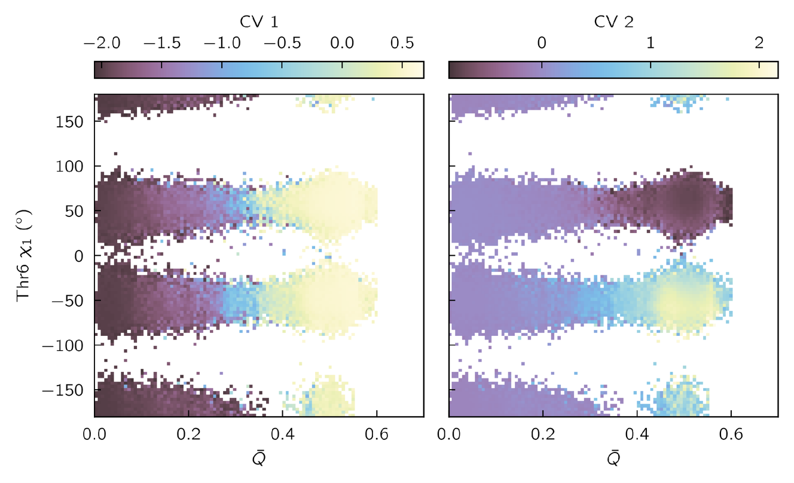
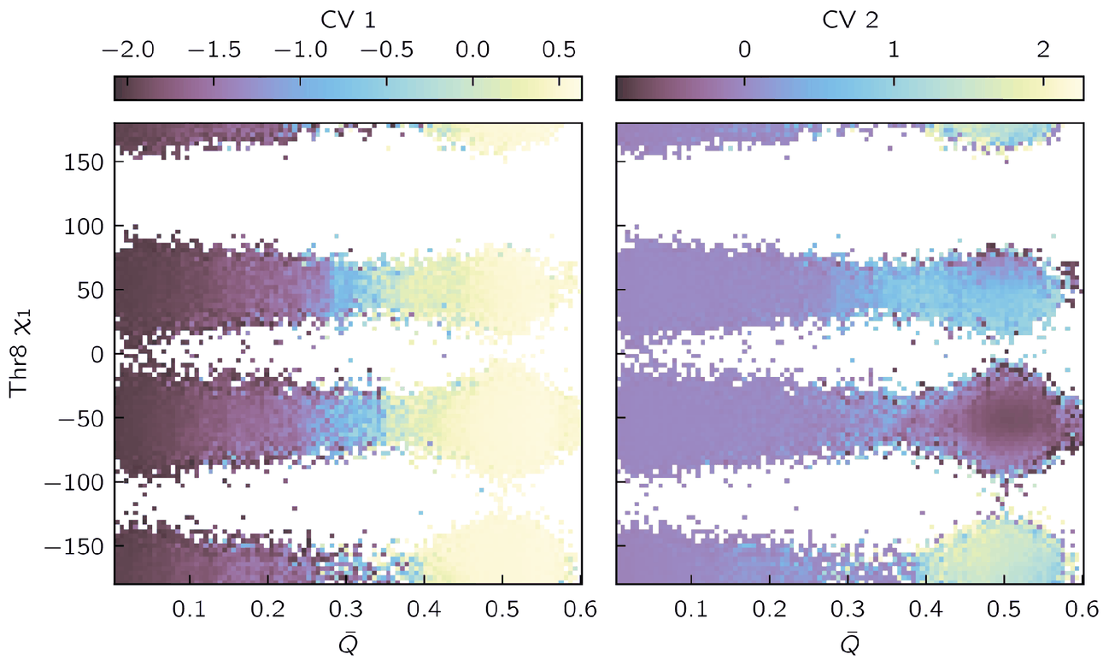
TEST 1 · PHYSICAL INTERPRETATION
Thr6 and Thr8 rotamers define the four folded substates
Thr6
Thr8
x: fraction of native contacts Q̄ · y: χ₁ side-chain dihedral · color: mean CV value. CV 1 tracks Q̄; CV 2 tracks the rotamers.
No side-chain angle was hand-picked, and backbone-only inputs cannot see these substates.
Pengmei et al., J. Chem. Phys. 162, 044107 (2025); VAMPnet with SubMixer
10 / 37
Notes:
10. Thr6 and Thr8 rotamers define the four folded substates
SCRIPT (about 1:15):
To see what those substates are, we plot the learned coordinates against physical ones: the fraction of native contacts, and the chi-1 side-chain angle of threonine 6 or threonine 8.
The first coordinate tracks native contacts, so it is folding. The second tracks the two threonine side chains. Each has two rotamers, which gives four combinations and four folded substates.
This is the molecular version of the thin barrier from the toy model. The backbone barely changes, so backbone coordinates and structure ensembles treat these substates as one, yet they are kinetically distinct. No side-chain angle was given to the model; the all-atom features kept that detail on their own.
DETAIL / Q&A:
Each panel plots the mean learned CV against the fraction of native contacts and a threonine χ1 angle. CV 1 tracks folding. CV 2 tracks the rotamers of Thr6 and Thr8: two each, four combinations, four folded substates.
No side-chain angle was given to the model, and backbone-only inputs cannot resolve these substates. An earlier study found them only after adding hand-picked side-chain distances.
CALLBACK to slide 3: this is the molecular version of the thin barrier. Two rotamers each for Thr6 and Thr8 barely change the backbone, yet the substates are kinetically distinct. The all-atom features keep that detail without anyone choosing χ1 as an input.

Slide 11
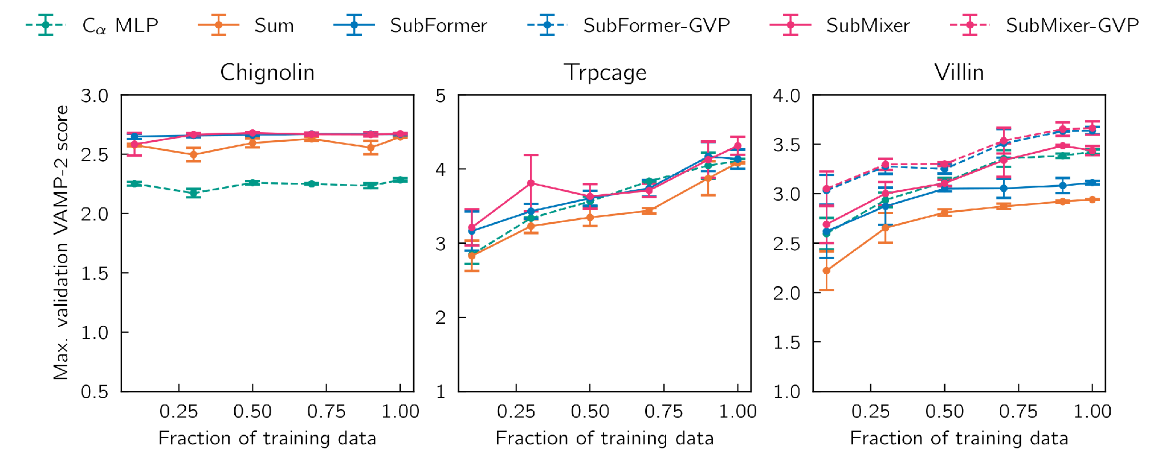
TEST 1 · VALIDATION
All-atom features help most where side chains matter
Chignolin: side chains matter
Every all-atom GNN variant beats the Cα-distance MLP.
Trp-cage: Cα distances suffice
Summed features score lowest; token mixers match the Cα MLP.
Pengmei et al., J. Chem. Phys. 162, 044107 (2025); error bars: standard error over 3 runs
11 / 37
Notes:
11. All-atom features help most where side chains matter
SCRIPT (about 1:15):
These are VAMP-2 scores on the held-out half of each trajectory, as a function of how much training data we use.
For chignolin, where the slow process involves side chains, every all-atom variant beats a model built on distances between C-alpha atoms. For Trp-cage, folding is well described by C-alpha distances, so the distance model and the token mixers perform comparably. Summing the features without a mixer does worst there.
So all-atom features help most when the slow process involves side chains, and a token mixer matters when the protein gets larger. The absolute scores are lower than some published values because we validate on data held out in time.
DETAIL / Q&A:
Held-out VAMP-2 scores as a function of training data. Chignolin: every all-atom GNN variant beats an MLP on Cα distances, because the slow process involves side chains. Trp-cage: Cα distances already describe folding, so the distance MLP and the mixers perform comparably, and simple summation is lowest.
Scores are lower than some published values because validation is on the second half of each trajectory, held out in time.

Slide 12
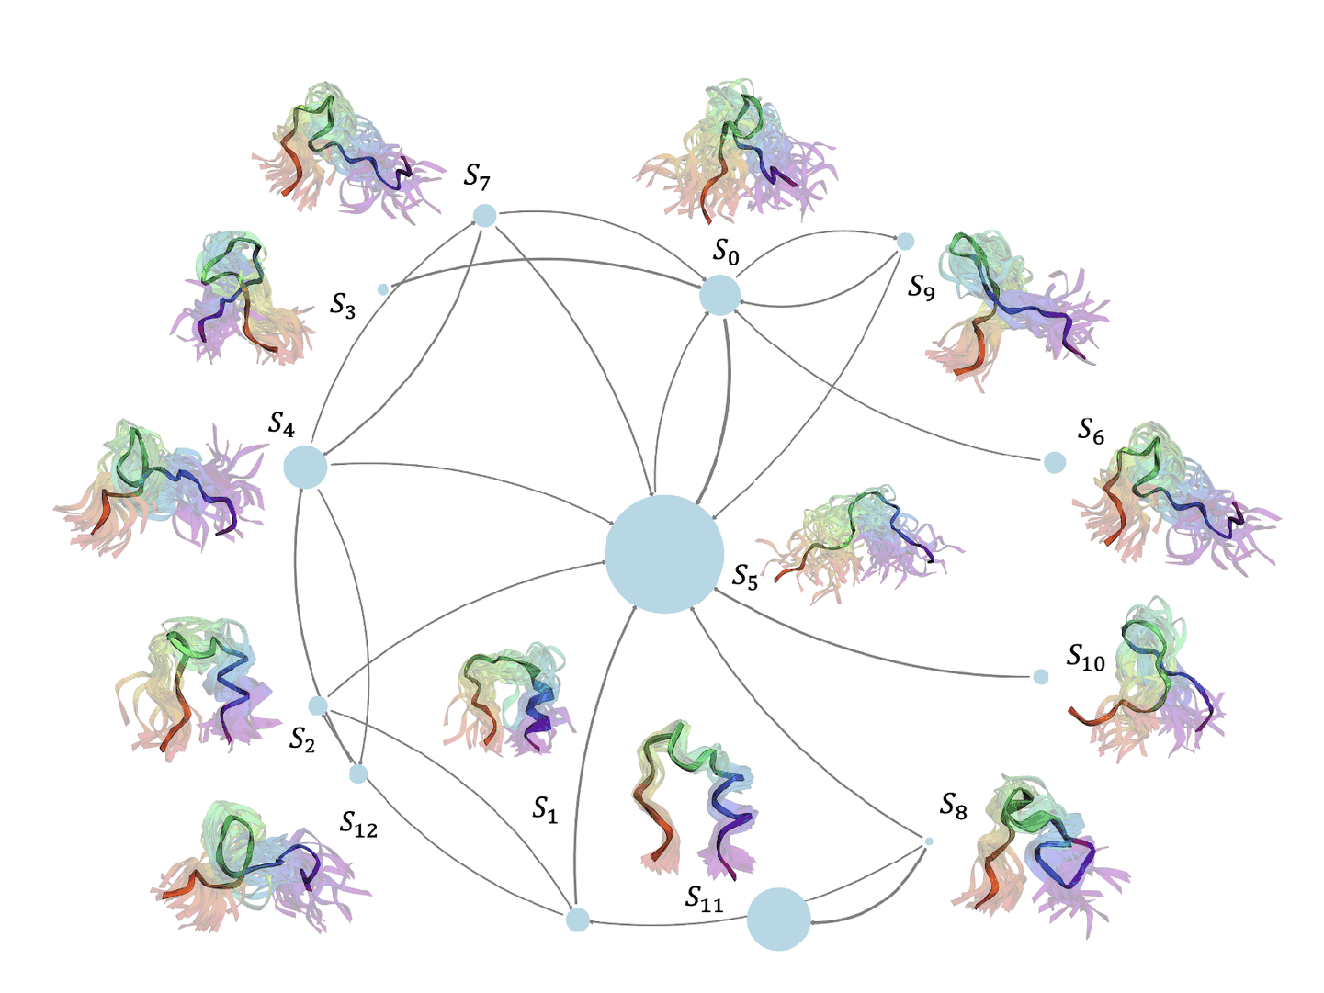
GEOM2VEC · TRP-CAGE STATES
A learned state map can be read in molecular terms
13 metastable states
S11 is folded; S1 and S2 keep the α-helix; S8 keeps the 3₁₀-helix.
An unfolded hub
S5 links every intermediate to the folded state; edges come from time-ordered transitions.
Pengmei et al., J. Chem. Phys. 162, 044107 (2025); SPIB with SubFormer-GVP; Markov state model at 20 ns lag
12 / 37
Notes:
12. A learned state map can be read in molecular terms
SCRIPT (about 1:00):
The same features also support state discovery. Here we use SPIB on the 208-microsecond Trp-cage trajectory and build a Markov state model at a 20-nanosecond lag.
It finds thirteen metastable states. State 11 is the folded structure. States 1 and 2 keep the alpha-helix, and state 8 keeps the 3-10 helix. State 5 is an unfolded hub that connects the intermediates to the folded state.
So Part I gives us a representation that sees atomistic detail and a kinetic model built on it. But all of this used a long trajectory that someone had already run. Part II asks how to collect such data ourselves, efficiently. Trp-cage will come back there.
DETAIL / Q&A:
SPIB on Geom2Vec features of the 208 μs Trp-cage trajectory, Markov model at 20 ns lag. Thirteen metastable states. S11 is folded; S1 and S2 keep the α-helix; S8 keeps the 3₁₀-helix; S5 is an unfolded hub that connects the intermediates to the folded state.
This same protein returns in Part II, where GESPO collects its own data.

Slide 13
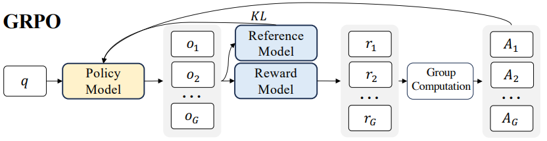
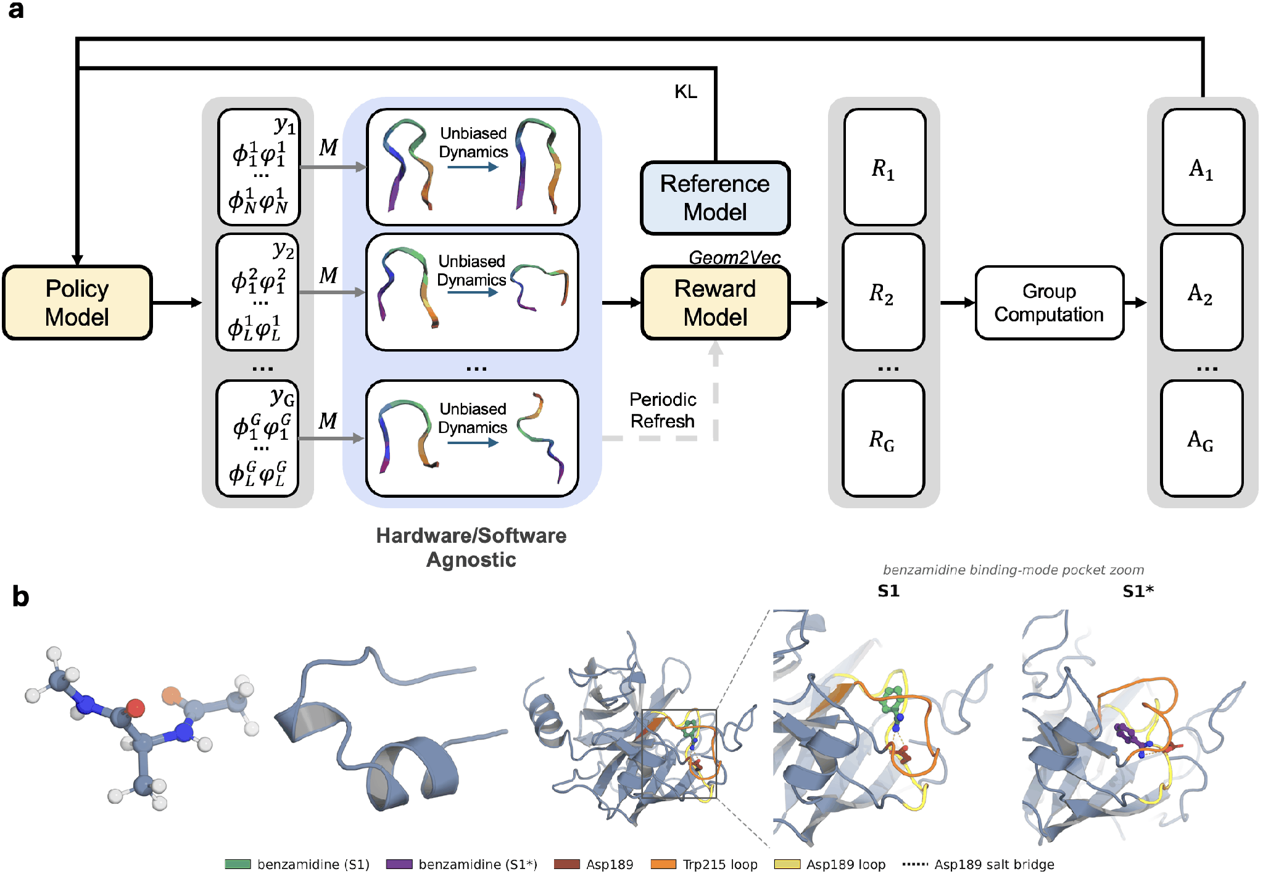
PART II · ADAPTIVE SAMPLING
Adaptive sampling as policy optimization
Language models (GRPO)
A pretrained model generates a group of responses; a reward model scores each one; group-relative advantages update the model. GESPO keeps this update and derives the reward from simulated dynamics.
GESPO, one epoch
1
3
1
Proposal: the policy draws G initial conformations yᵢ.
2
Realization (ℳ): a nearby bank frame is restrained toward yᵢ, then released.
5
4
3
Propagation: short unbiased trajectories run in parallel.
2
4
Reward: the Geom2Vec kinetic model scores each trajectory.
5
Update: group-relative advantages drive a GRPO step.
The first RL-trained sampling policy for biomolecular MD; the dynamics remain unbiased.
Top: GRPO for language models (Shao et al., 2024). Bottom: GESPO loop, Pengmei et al., GESPO (manuscript, 2026)
13 / 37
Notes:
13. Adaptive sampling as policy optimization
SCRIPT (about 1:45):
Part II turns to the second bottleneck: sampling. The idea comes from how large language models are post-trained. At the top is group relative policy optimization, or GRPO. A pretrained model generates a group of answers, a reward model scores each one, and the model is updated toward the answers that did better than the rest of their group.
GESPO applies the same update to molecular simulation. Follow the numbers. One: a generative policy proposes a group of initial conformations. Two: each proposal is realized as an all-atom structure, by taking a nearby frame from the data collected so far, steering it briefly toward the proposal, and releasing it. Three: short unbiased trajectories run in parallel from those structures. Four: a kinetic model built on Geom2Vec scores each trajectory. Five: rewards are compared within the group, and the policy is updated.
Two points matter here. The policy only decides where to sample; the dynamics themselves are never biased. And to our knowledge, this is the first sampling policy for biomolecular MD that is trained by reinforcement learning on trajectory outcomes.
DETAIL / Q&A:
Part II. Top: GRPO as used to post-train language models. Bottom: the GESPO loop, with numbered steps. (1) The policy proposes a group of initial conformations. (2) Realization restrains a nearby bank frame toward each proposal and releases it. (3) Short unbiased trajectories run in parallel. (4) The Geom2Vec kinetic model scores each trajectory. (5) Group-relative advantages drive the policy update.
The update rule is shared with language models; the reward comes from the simulated dynamics.
CLAIM (bottom line): to our knowledge, GESPO is the first adaptive sampling method for biomolecular MD that trains its sampling policy by reinforcement learning, i.e. policy optimization on trajectory-level rewards, while the dynamics stay unbiased.
If asked about earlier "RL" samplers:
- REAP (Shamsi 2018), MA-REAP (Kleiman & Shukla 2022), Adaptive CVgen (2024), RL weighted ensemble (Yang 2024): a small optimization of CV weights each round; no policy is trained.
- AdaptiveBandit (Pérez 2020): a UCB bandit over existing MSM states with rewards from visited free energies; a table of per-state values, no parametric policy, and it can only choose among structures already sampled.
- Reinforced dynamics (Zhang, Wang & E 2018): learns a biasing potential; the dynamics are biased.
- Rose, Mair & Garrahan 2021; Das et al. 2021: genuine policy-gradient / actor-critic RL, but the policy is a control force that biases the dynamics, on low-dimensional model systems.
- Lin, Zhong & Ren 2024: DDPG for minimum-action transition paths on model potentials, not a sampler of MD trajectories.

Slide 14
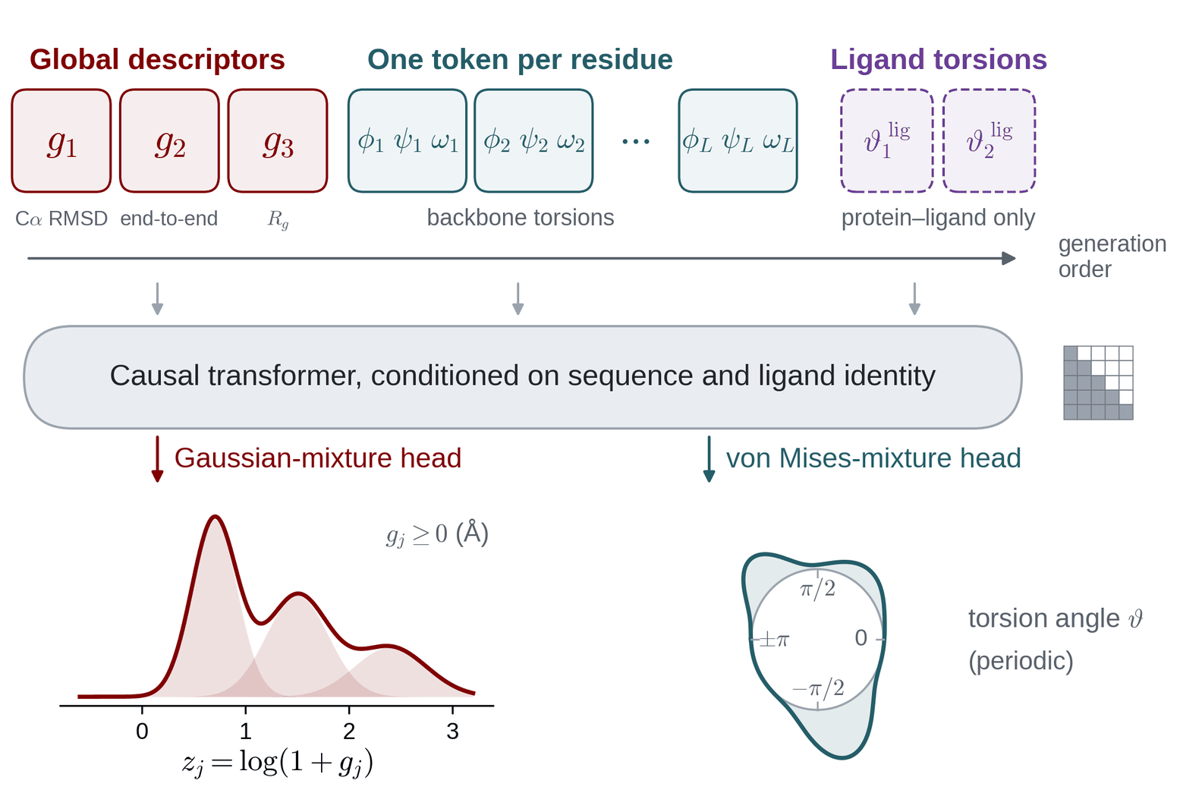
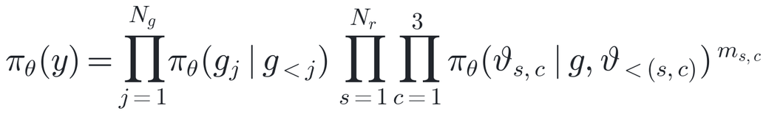
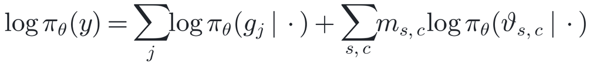
GESPO · POLICY MODEL
The policy generates an initial conformation token by token
Autoregressive factorization
Global descriptors: Gaussian mixture
Torsions: von Mises mixture
Exact log-likelihood
Every conditional is a normalized density, so log π_{θ}(y) is exact.
Pengmei et al., GESPO (manuscript, 2026). Trp-cage: 3 descriptors, 20 residue tokens; 4 layers, d = 256, 8 heads, 8 mixture components.
14 / 37
Notes:
14. The policy generates an initial conformation token by token
SCRIPT (about 1:30):
What does the policy actually generate? A compact description of a conformation, written as a sequence of tokens.
First come a few global descriptors: for Trp-cage, the C-alpha RMSD to a reference, the end-to-end distance, and the radius of gyration. Then one token per residue with its backbone torsions, phi, psi, and omega. For trypsin, the ligand's rotatable torsions follow as extra tokens.
A causal transformer generates these in order. The global descriptors come first, so a policy update can move the whole distribution between regions through a few tokens. Each token has its own output head: a Gaussian mixture for the descriptors, and a von Mises mixture for the angles, which respects their periodicity.
Why autoregressive and not a diffusion model? The policy update needs the exact probability of each proposal under the current and previous policies. Here that is simply a sum of per-token log-probabilities, as the equations on the right show. For a diffusion model it can only be estimated, which adds noise to every update.
DETAIL / Q&A:
Tokens. A proposal y is a sequence of continuous tokens. First a few global descriptors g: for Trp-cage, Cα RMSD to a reference, end-to-end distance and radius of gyration. Then one token per residue carrying the backbone torsions φ, ψ, ω. For the ligand-bound system, the ligand rotatable-bond torsions follow as extra rows (two for benzamidine). A mask m removes undefined entries, such as terminal torsions.
Order. The descriptors come first and condition everything after them. They act as a coarse summary that the torsions are then generated to satisfy, and a policy update can shift the distribution between regions through a few tokens instead of coordinating hundreds of torsion conditionals.
Heads. Nonnegative descriptors are modeled in z = log(1 + g) with a Gaussian mixture. Periodic torsions use a von Mises mixture: κ is a concentration, like an inverse variance. Both are normalized densities with closed-form sampling.
Why autoregressive and not diffusion: the policy gradient needs the likelihood of each proposal under the current and the behavior policy. Here it is an exact sum of per-token log-probabilities; for a diffusion model it can only be bounded or estimated, which adds variance to the GRPO update. There is no discrete vocabulary: each token is a continuous variable.
Pretraining: maximum likelihood on the initial trajectory corpus gives a physically plausible prior before any reward is applied.

Slide 15
GESPO · WHERE GEOM2VEC ENTERS
Geom2Vec is the kinetic model inside GESPO
Reward: scores each trajectory
Analysis: interprets the data
Leave-one-out VAMP-2 contribution
Change in S when trajectory i is removed
SPIB metastable states
Trp-cage: 23 states. Trypsin: 7 receptor macrostates
Geom2Vec
Frozen all-atom encoder
↓ residue (and ligand) tokens
↓ token merging (trypsin)
↓ VAMP projector χ, refit each epoch
Coverage bonus
Visits to sparsely sampled bins in the first two slow coordinates
DGA committors
Basis functions built on the SPIB states
Transition information gain
New transitions among k-means states in the slow coordinates
Reactive flux and exchange
Networks over the SPIB macrostates
Not Geom2Vec: the policy proposes torsions and global descriptors; realization matches frames by torsions; alanine dipeptide uses (φ, ψ) directly.
What counts as kinetic information, for the reward and for the analysis, is defined in Geom2Vec coordinates.
Pengmei et al., GESPO (manuscript, 2026), Methods and Appendix. Trypsin: TensorNet encoder on all heavy atoms, 224 tokens, token merging on.
15 / 37
Notes:
15. Geom2Vec is the kinetic model inside GESPO
SCRIPT (about 1:15):
This slide connects the two halves of the thesis. GESPO needs to decide which trajectories carried kinetic information, and that decision is made in Geom2Vec coordinates.
On the left is the pipeline from Part I, refit on the accumulated data every epoch. In the middle, all three reward terms are computed in its slow coordinates: the leave-one-out change in the VAMP-2 score, a coverage bonus for visiting sparsely sampled regions, and an information gain for new transitions between states. On the right, the analysis you will see later, the metastable states, the committors, and the flux networks, is built on the same representation.
The policy itself does not use Geom2Vec; it proposes torsions and descriptors. So the representation defines what counts as information, and the policy learns how to find it.
DETAIL / Q&A:
This slide connects Part I to Part II. GESPO needs a way to decide which trajectories carried kinetic information; that is the job of a Geom2Vec kinetic model, trained on the accumulated trajectories and refit as data arrive.
Left: the Geom2Vec pipeline from Part I. A frozen all-atom encoder produces residue tokens (and a ligand token for trypsin), token merging compresses them, and a VAMP projector χ gives the slow coordinates.
Middle, the reward. All three terms are computed in these coordinates: the leave-one-out change in the VAMP-2 score when a trajectory is removed (next two slides); a coverage bonus for visits to sparsely sampled bins in the first two slow coordinates; and an information gain for new transitions among k-means states in the slow coordinates.
Right, the analysis. The SPIB metastable states (23 for Trp-cage, 7 receptor macrostates for trypsin) are learned on Geom2Vec features; the DGA committors use those states as basis functions; the reactive-flux and exchange networks are drawn over them. The slides marked with a Geom2Vec tag depend on this model.
What does not use Geom2Vec: the policy proposes torsions and a few global descriptors, and realization retrieves bank frames by torsion similarity. Alanine dipeptide, the control, uses (φ, ψ) directly.

Slide 16
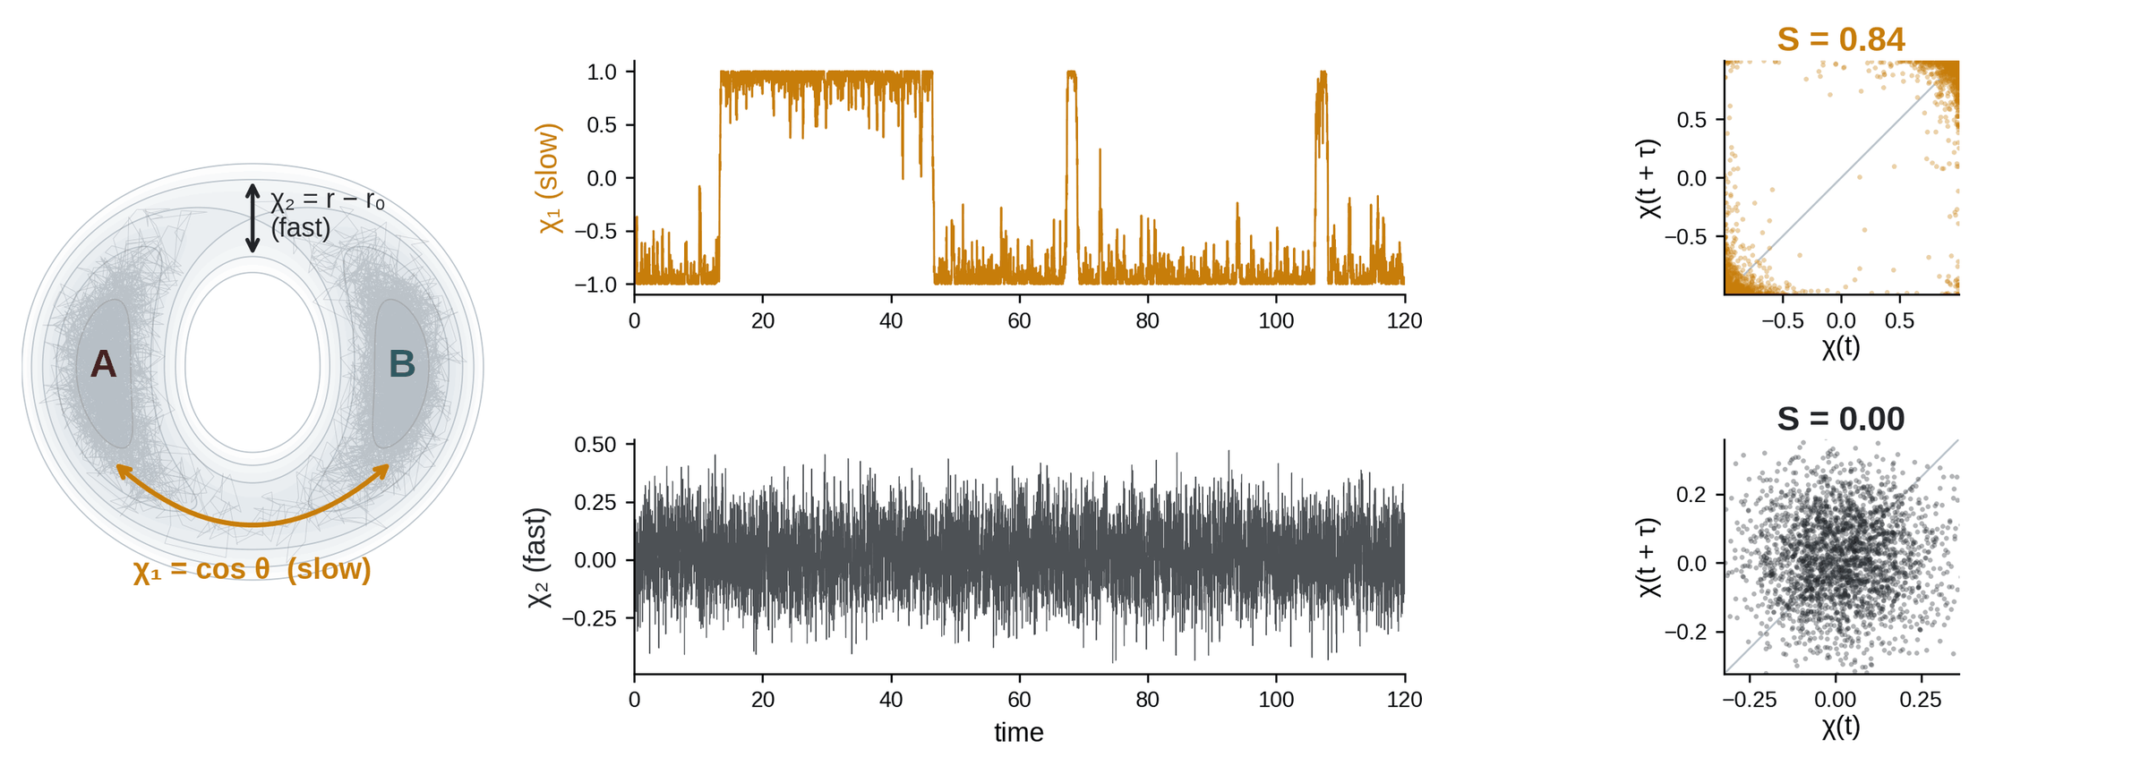
GESPO · KINETIC SCORE
VAMP-2 rewards features that remain correlated after a lag
S(𝒟) = ‖ C₀₀^{−1/2} C_{0τ} C_{ττ}^{−1/2} ‖_{F}² = Σ_{k} σ_{k}²
C₀₀, Cττ: instantaneous covariances; C₀τ: lagged covariance, from pairs within each trajectory. For one feature, S is the squared lag correlation.
The reward asks how much each trajectory contributes to this score.
Toy model from slide 3 (landscape 1), 24 trajectories, τ = 1. In GESPO, χ is learned from Geom2Vec features and scored the same way.
16 / 37
Notes:
16. VAMP-2 rewards features that remain correlated after a lag
SCRIPT (about 1:15):
Let me unpack the main reward term with the toy landscape from earlier. Suppose we have two candidate features. Chi-1 follows the slow coordinate between A and B. Chi-2 is fast radial motion.
In the middle, the time series: chi-1 switches between two levels and stays there; chi-2 is noise. On the right, each feature at time t is plotted against its value one lag later. The slow feature stays on the diagonal, and its VAMP-2 score is 0.84. The fast one forms a cloud, and scores zero.
The formula at the bottom is the general version. It uses covariance matrices of the features and their lagged pairs, taken within each trajectory. For a single feature it is just the squared lag correlation.
DETAIL / Q&A:
VAMP-2 on the toy landscape from slide 3. Two candidate features: χ1 = cos θ follows the slow A–B coordinate; χ2 = r − r0 is fast radial motion. Plot each feature at t against t + τ. The slow feature keeps its correlation (S = 0.84); the fast one loses it (S = 0.00).
In GESPO, χ is learned from Geom2Vec features and scored the same way. The next slide asks how much each trajectory contributes to this score.

Slide 17
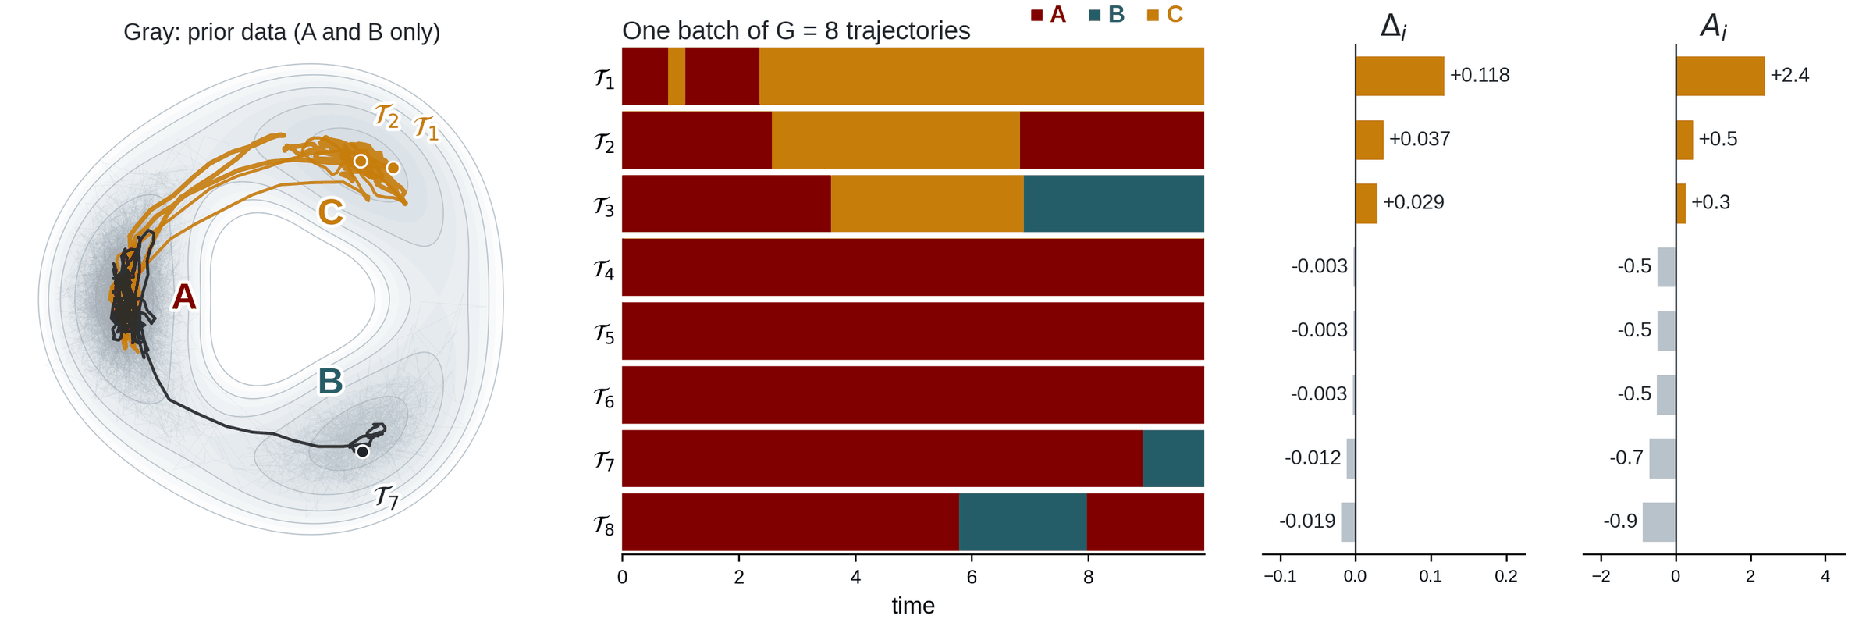
GESPO · TRAJECTORY CREDIT
Leave-one-out credit, compared within a batch
Δ_{i} = S(𝒟) − S(𝒟 ∖ {𝒯_{i}})
A_{i} = (R_{i} − ⟨R⟩) / s_{R}
χ held fixed; means and covariances recomputed. Advantages standardize within the batch.
The trajectory that settles in the new state C earns the largest advantage.
Three-state toy model; χ = (cos θ, sin θ) held fixed; 𝒟 = 40 prior trajectories (A, B only) plus the batch; T = 10, τ = 1. Here Rᵢ = Δᵢ; GESPO adds coverage and transition terms.
17 / 37
Notes:
17. Leave-one-out credit, compared within a batch
SCRIPT (about 1:30):
The policy needs credit for each trajectory, not for the whole dataset. So we ask: how much does the VAMP-2 score change if we remove this one trajectory, with the kinetic model held fixed during that comparison.
Here is a three-state example. The prior data, in gray, cover only A and B state. Then a batch of eight short trajectories arrives. The one that settles in the new state C gets the largest contribution, plus 0.118, and the largest advantage. Trajectories that visit C briefly get smaller credit. Those that stay in A, or repeat the already known A-to-B transition, get slightly negative credit.
Two points. First, the credit is relative within each batch: the advantage says which trajectories were more informative than their batch mates. Second, the contribution alone does not always reward novelty, so the full reward also includes the coverage and transition terms from the previous slide.
DETAIL / Q&A:
Prior data cover A and B only, so the feature direction that separates C carries no slow signal yet (second singular value 0.01).
One batch of eight short trajectories is added. The trajectory that settles in C (T1) raises the second singular value to 0.46 and gets the largest contribution, +0.118. Trajectories that visit C and leave get smaller positive credit. Those that stay in A, or repeat the known A→B transition, get slightly negative credit.
Credit is relative: rewards are standardized within the batch, so the advantage says which trajectories were more informative than their batch mates, not whether a trajectory is good in absolute terms. If two trajectories reveal the same new state, they share the credit.
Caveat for questions: the contribution alone can be negative for a first transition when the data overstate persistence, so the GESPO reward also includes coverage and transition-count terms.

Slide 18
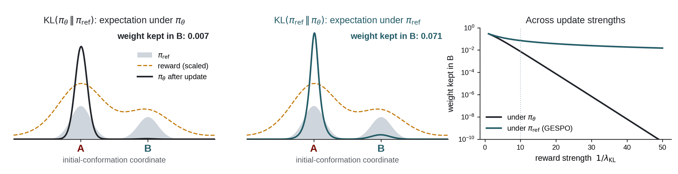
GESPO · POLICY UPDATE
A coverage-preserving KL term regularizes the update
max_{θ} 𝔼_{y∼πθ}[R(y)] − λ_{KL} D_{KL}(π_{ref} ‖ π_{θ}) + λ_{H} H(π_{θ})
Optimized with the GRPO clipped surrogate on ρ_{i} = π_{θ}(y_{i}) / π_{old}(y_{i}) and group advantages A_{i}; π_{ref} = π_{old}, resynchronized each epoch.
Under π_{θ}, leaving B costs almost nothing: its weight decays as e^{−ΔR/λ}.
Under π_{ref}, leaving B is penalized: its weight decays only in proportion to λ.
The ordering matters: a sampling distribution that contracts each epoch eventually concentrates on a single basin.
Taken under π_{ref}, the KL term keeps weight on every basin the reference samples.
Toy example: exact optimum of the regularized objective for a fixed reference (λ_{KL} = 0.1 in the left panels). GRPO: Shao et al. (2024); GESPO: Pengmei et al. (manuscript, 2026).
18 / 37
Notes:
18. A coverage-preserving KL term regularizes the update
SCRIPT (about 1:30):
The objective is the expected reward, minus a KL penalty that keeps each update close to the previous policy, plus an entropy bonus.
The direction of the KL term matters more than it might seem. In language models, the KL is averaged over the new policy. Here we average it over the reference policy instead. In this example, both basins are informative, but A is twice as rewarding as B. With the language-model convention, basin B keeps less than one percent of the weight after one update. With our convention, it keeps seven percent. On the right, as the update gets stronger, the first convention abandons B exponentially fast, while ours loses it only slowly.
For adaptive sampling, collapsing onto one basin is exactly the failure to avoid, so we use the ordering that penalizes abandoning a region.
DETAIL / Q&A:
Objective: expected trajectory-level reward, minus a KL penalty, plus an entropy bonus. In practice it is optimized with the GRPO clipped surrogate, and π_ref is the behavior policy π_old, resynchronized after each epoch, so the KL acts as a trust region.
Toy example: the reference samples two basins; both are informative, A more so (reward 1.0 vs 0.5). With the KL taken under π_θ (the language-model convention), the optimum is π_ref·exp(R/λ), so B is suppressed exponentially: 0.007 of the weight at λ = 0.1. With the KL taken under π_ref (GESPO), the policy is penalized wherever the reference has weight it abandons: B keeps 0.071, and its weight falls only in proportion to λ.
Why it matters: collapse onto one basin is the failure mode for adaptive sampling. Proposing an implausible conformation is not a risk the KL has to absorb, because realization always restrains an existing bank frame.
Check after the fact: the per-residue torsion marginals broaden over epochs (Trp-cage policy slide).

Slide 19
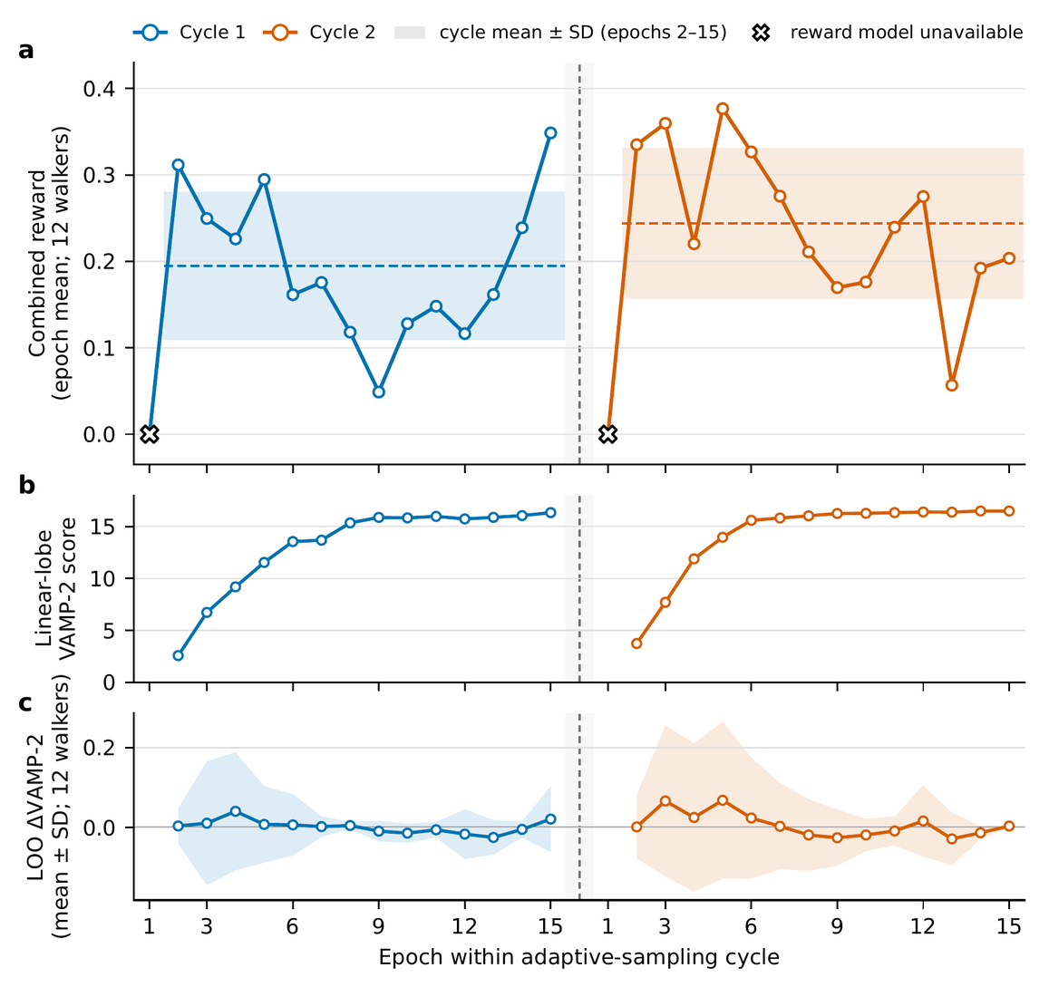
GESPO · TRAINING DIAGNOSTICS
Geom2Vec reward
Diagnostics: the kinetic model converges within each round
(a) Combined reward
Epoch mean over 12 trajectories: the leave-one-out contribution plus coverage and transition terms.
(b) VAMP-2 score of the refitted model
Refitted before every epoch; rises and plateaus within each round.
(c) Leave-one-out contribution Δᵢ
Mean near zero with a wide spread across trajectories, as in the toy example: credit is relative within each batch.
The reward ranks trajectories within a batch; the kinetic model improves across epochs.
Pengmei et al., GESPO (manuscript, 2026); benzamidine-bound trypsin, two independently initialized rounds, 12 trajectories per epoch; reward values are relative to each round’s model
19 / 37
Notes:
19. Diagnostics: the kinetic model converges within each round
SCRIPT (about 1:15):
These are the training curves for the benzamidine-bound trypsin campaign: two independently initialized rounds, with twelve trajectories per epoch.
Panel a is the combined reward per epoch. Panel b is the VAMP-2 score of the kinetic model, refit before each epoch: it rises and then levels off within each round, as the model resolves more slow processes. Panel c is the leave-one-out contribution. Its mean stays near zero with a wide spread, which is what the toy example predicts: the reward ranks trajectories within a batch rather than growing over time.
So the kinetic model improves across epochs, and within each batch the reward tells the policy which trajectories were worth more.
DETAIL / Q&A:
Diagnostics for the benzamidine-bound trypsin campaign, two independently initialized rounds, 12 trajectories per epoch. (a) The combined reward per epoch. (b) The VAMP-2 score of the kinetic model, refitted before every epoch, rises and plateaus within each round. (c) The leave-one-out contribution: mean near zero with a wide spread.
As in the toy example, credit is relative within a batch; the reward ranks trajectories, and the kinetic model improves across epochs. Reward values are relative to each round's model.

Slide 20
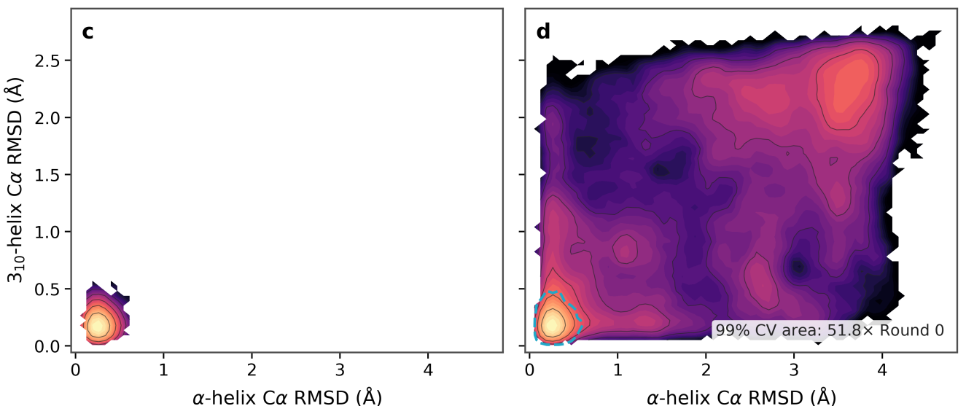
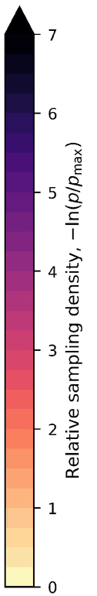
TEST 2 · TRP-CAGE
Trp-cage: sampled area grows 52-fold beyond the initial data
Initial data (round 0): 4.8 ns
All rounds: 115.2 ns
51.8×
area of the sampled region vs. the initial data (99% contour)
115.2 ns
cumulative production
12 × 200 ps
trajectories per epoch
Pengmei et al., GESPO (manuscript, 2026). Color: relative sampling density, −ln(p/p_{max}), not a free energy. Dashed contour: extent of the round-0 data.
20 / 37
Notes:
20. Trp-cage: sampled area grows 52-fold beyond the initial data
SCRIPT (about 1:00):
The first real test is Trp-cage, the same twenty-residue protein from Part I. This time GESPO collects its own data, in short trajectories of 200 picoseconds each.
On the left is the initial data, 4.8 nanoseconds, which stays close to the folded structure. On the right is everything GESPO collected, 115 nanoseconds in total. The region enclosing 99 percent of the sampled density grows by a factor of about 52.
The colors here are sampling density, not free energy. Every trajectory is unbiased; the only thing that changed is where we chose to sample.
DETAIL / Q&A:
Trp-cage. Left: the round-0 data, 4.8 ns, stay near the folded structure in helix-RMSD coordinates. Right: all rounds, 115.2 ns of 200 ps trajectories. The area enclosing 99% of the sampled density grows 51.8-fold (56.3-fold in RMSD vs. radius of gyration).
Color is sampling density, not free energy. The dynamics within each trajectory are unbiased; only where to sample changed.

Slide 21
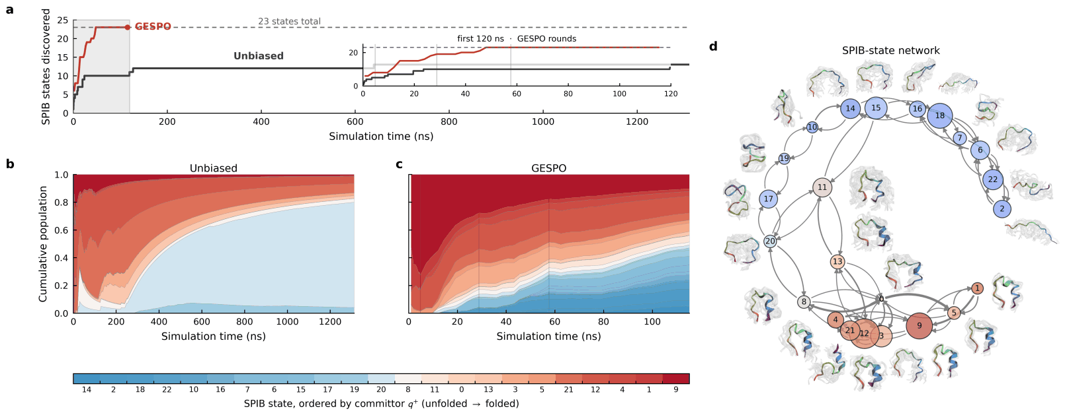
TEST 2 · STATE DISCOVERY
Geom2Vec · SPIB
All 23 states in ~50 ns; unbiased MD reaches 12 in 1.3 μs
Pengmei et al., GESPO (manuscript, 2026). States ordered by DGA committor q⁺ (unfolded → folded); node sizes in (d) require validation.
21 / 37
Notes:
21. All 23 states in ~50 ns; unbiased MD reaches 12 in 1.3 μs
SCRIPT (about 1:15):
Coverage alone could mean scattered, disconnected structures, so we ask a kinetic question: how many metastable states do we find? A SPIB model on Geom2Vec features resolves 23 states.
In panel a, GESPO reaches all 23 within about 50 nanoseconds of aggregate simulation. A single unbiased trajectory under the same conditions finds 12 in 1.3 microseconds. I should be clear that the states were learned from the GESPO data, so full coverage by GESPO is expected. The point is that an order of magnitude more continuous simulation finds only half of them.
Panels b and c show where the time goes. The unbiased trajectory leaves the folded basin and then spends about three quarters of its time in one extended state. GESPO keeps its data spread across the committor range. Panel d shows that the states form a connected network, with the committor changing smoothly from unfolded to folded.
DETAIL / Q&A:
(a) A SPIB model on Geom2Vec features resolves 23 metastable states. GESPO reaches all 23 within roughly 50 ns of aggregate production; a continuous unbiased trajectory under the same conditions visits 12 in 1.3 μs, and 13 only at its end.
Caveat to state up front: the decomposition is learned from the GESPO trajectories, so complete coverage by GESPO is expected by construction. The comparison shows that an order of magnitude more continuous simulation recovers about half of the states.
(b, c) Once the unbiased trajectory leaves the folded basin it settles in one extended state, which holds about three quarters of its occupancy. GESPO occupancy stays spread across the committor range: compact high-q⁺ states are covered first, intermediates next, extended states last.
(d) The states form a network with compact, intermediate and extended sectors; the committor varies coherently around it. Node sizes are not validated equilibrium populations.

Slide 22
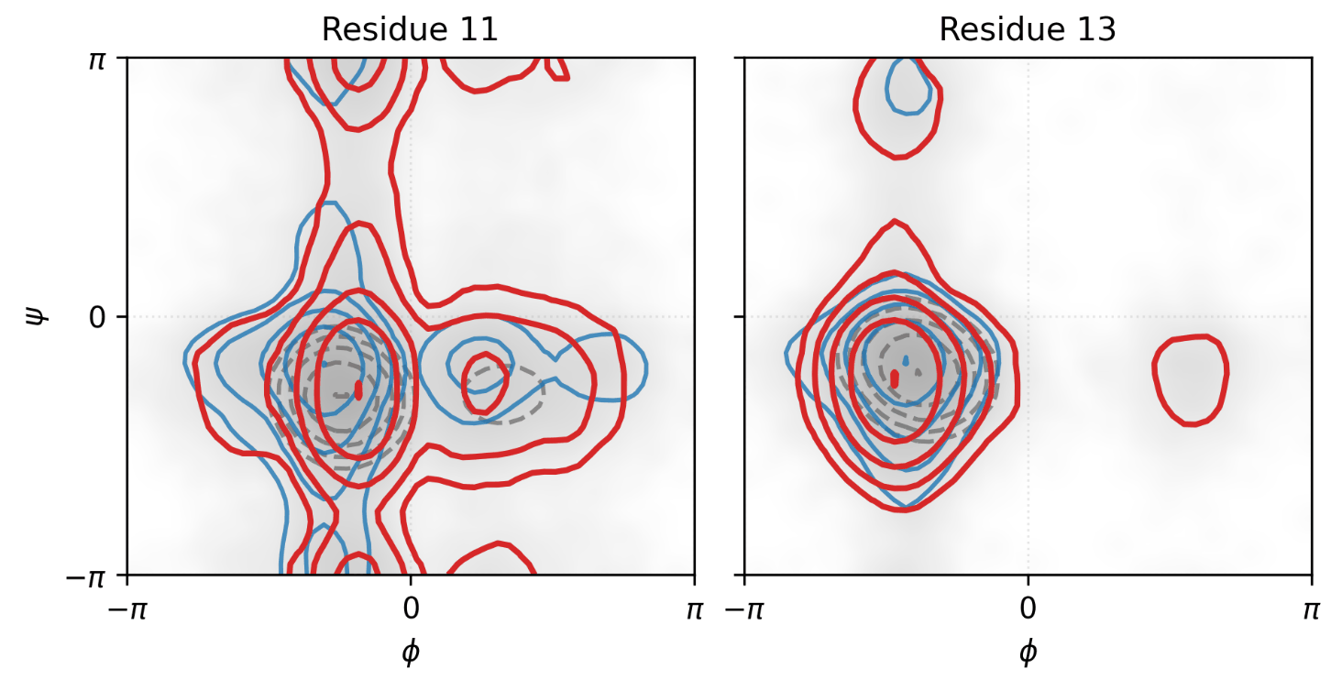
TEST 2 · POLICY DIAGNOSTICS
The sampling distribution broadens rather than collapsing
Epochs 0 → 3 → 6
The torsion marginals widen into φ > 0 and toward ψ = ±π, regions the initial policy did not populate.
Consistent with the KL ordering
No contraction onto a subset of the initial distribution (slide 15).
Marginals do not show the joint distribution over all residues.
The update adds new torsion regions.
Pengmei et al., GESPO (manuscript, 2026). Policy torsion marginals for Trp-cage residues 11 and 13; all ten residues in backup.
22 / 37
Notes:
22. The sampling distribution broadens rather than collapsing
SCRIPT (about 0:50):
What did the policy learn? Each panel is the distribution of backbone angles the policy proposes for one residue, at epochs 0, 3, and 6.
The distributions broaden. At residue 11, the original region is kept and the policy extends toward psi near plus or minus phi. At residue 13, a new region appears at positive phi, which the initial policy did not propose at all. This is the behavior that the capability of the model grows as the RL post-training goes.
DETAIL / Q&A:
How to read it: each panel is the (φ, ψ) marginal of the policy at one residue. Gray shading is the accumulated sampling density (log scale). Contours show the policy at epoch 0 (dashed gray), epoch 3 (blue) and epoch 6 (red).
Residue 11: the epoch-6 marginal keeps the original basin and extends toward ψ = ±π. Residue 13: a new mode appears at φ > 0, a region the initial policy did not populate.
Link to slide 15: with the KL taken under the reference, the update should not contract onto a subset of the initial distribution. These marginals are the after-the-fact check: they broaden instead.
Caveat: these are single-residue marginals, not the joint distribution over all residues. All ten residues are in backup.

Slide 23
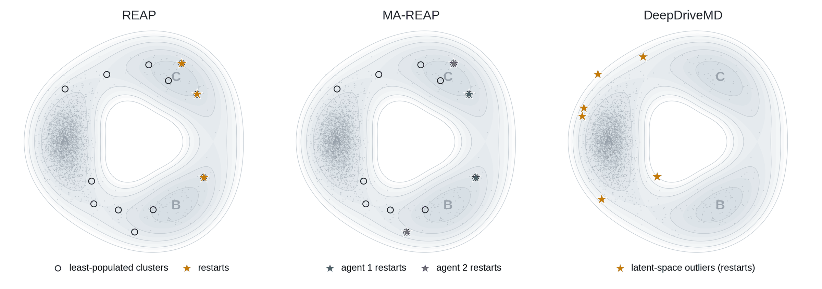
TEST 2 · BASELINE METHODS
Established adaptive samplers rank candidates by novelty
REAP Shamsi et al., 2018
Cluster the data; among the least-populated clusters, restart from those farthest along weighted CVs. The weights are refit each round.
MA-REAP Kleiman & Shukla, 2022
Several REAP agents, each with its own CV weights, share the sampled data and choose restarts jointly.
DeepDriveMD Lee et al., 2019
An autoencoder embeds the structures; restarts come from outliers in its latent space.
Each rule scores candidates from structures alone, before any trajectory is run.
Toy illustration on the three-state ring: 40 short trajectories from A; clustering and REAP reward computed on these data; the DeepDriveMD latent space is drawn in the toy coordinates.
23 / 37
Notes:
23. Established adaptive samplers rank candidates by novelty
SCRIPT (about 1:15):
Before comparing with other methods, let me show how they choose where to sample, on the same three-state toy model.
REAP clusters the data it has, looks at the least-populated clusters, and restarts from the ones farthest along a weighted set of collective variables. The weights are adjusted each round. MA-REAP runs several such walkers with different weights on shared data. DeepDriveMD embeds structures with an autoencoder and restarts from outliers in that embedding.
What they share is that each rule scores candidates from the structures alone, before any trajectory is run. Notice that outliers are not always useful: in the toy model some of them are just high-energy fluctuations at the edge of basin A.
DETAIL / Q&A:
All three are adaptive sampling: many short unbiased trajectories, restarted from selected structures each round. They differ in how the restarts are chosen.
REAP: cluster the data in chosen CVs; take the least-populated clusters as candidates; score each by r = Σ_k w_k |x_k − ⟨x_k⟩| / σ_k, its standardized distance from the data mean along each CV; refit the weights w to maximize the reward of the top candidates, then restart from them. In the toy, the weights favor the direction of C, so REAP restarts at the frontier toward C and B.
MA-REAP: several REAP agents with separate weights share the data. In the toy, two agents with different weights pick different frontier clusters.
DeepDriveMD: a variational autoencoder embeds structures (contact maps in the original work); restarts come from outliers in the latent space. Outliers are unusual structures, which need not lie on a path to a new state; in the toy they include high-energy fluctuations at the edge of A.
Common point: each rule ranks candidates by quantities computable from structures, before any trajectory is run. Adaptation changes weights or the embedding, not a rule trained on trajectory outcomes.

Slide 24
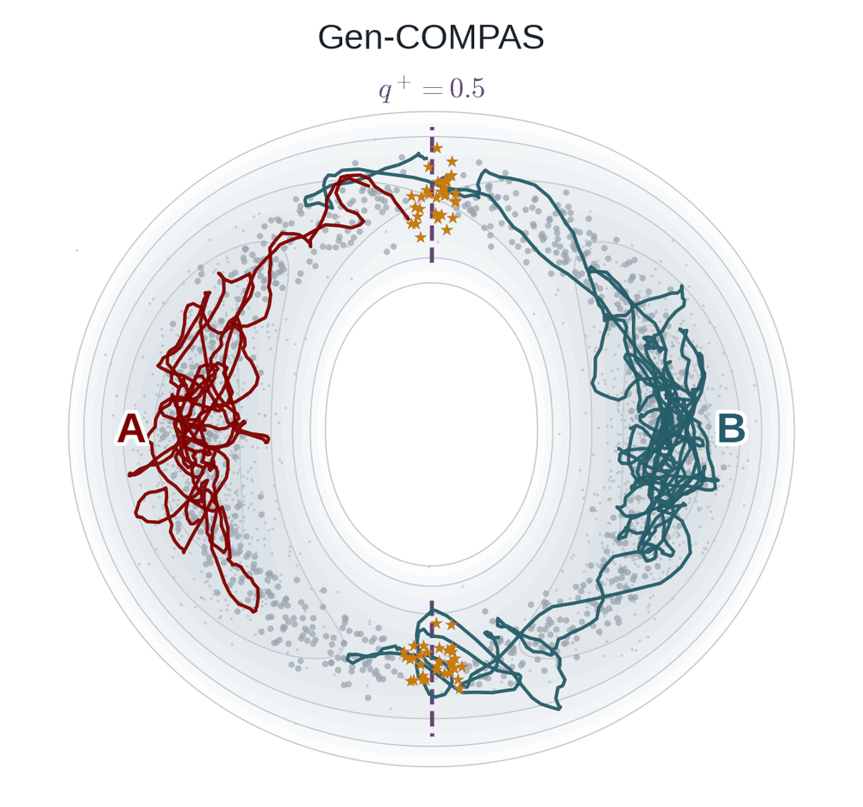
TEST 2 · BASELINE METHODS
Gen-COMPAS shoots trajectories from the separatrix
1
Train a diffusion model on short unbiased trajectories from reactant A and product B.
2
Generate intermediates; keep those with a learned committor q⁺ ≈ 0.5 (stars).
3
Shoot unbiased trajectories from them; refit both models each round.
Method
Chooses where to sample by
Requires
REAP, MA-REAP
Novelty along weighted CVs
Collective variables
DeepDriveMD
Outliers in a learned latent space
An autoencoder
Gen-COMPAS
Generated structures near q⁺ = 0.5
Reactant and product states
GESPO
A policy trained on trajectory-level rewards
No predefined end states
GESPO trains a generative policy on trajectory outcomes; the others rank existing structures.
Gen-COMPAS: Tang et al., arXiv:2510.24979 (2025). Toy illustration on the slide 3 landscape; generated structures and committor are schematic (1D angular committor).
24 / 37
Notes:
24. Gen-COMPAS shoots trajectories from the separatrix
SCRIPT (about 1:00):
Gen-COMPAS is a more recent method on Nature that uses a generative model. It trains a diffusion model on short trajectories started from a reactant and a product state, generates intermediates, keeps those with a committor near one half, and shoots unbiased trajectories from them.
It needs no low-dimensional reaction coordinate, but it does need both end states in advance, and its generator is refit to the data rather than updated by how informative each proposal turned out to be.
The table summarizes the difference. The other methods rank existing structures, or sample between known states. GESPO trains a generative policy on trajectory outcomes.
DETAIL / Q&A:
Gen-COMPAS (Chipot and co-workers, 2025) couples a generative model to shooting. A diffusion model is trained on short unbiased simulations started in the reactant and product. Generated intermediates are filtered by a committor learned in configuration space, and unbiased trajectories are shot from those near the separatrix, q⁺ ≈ 0.5. Both models are retrained each round.
In the toy: gray points are data near A and B; stars are generated structures kept at q⁺ ≈ 0.5 on both routes; the curves are trajectories shot from them, colored by the state they reach.
Strengths: no low-dimensional reaction coordinate is needed, and it iterates. Limits relevant here: the committor is defined relative to end states fixed in advance, and the diffusion model is refit to accumulated configurations, not updated by how informative each proposal proved to be. Shooting can also stall in long-lived intermediates.
The table summarizes what each method uses to decide where to sample. This is why Gen-COMPAS starts from both an unfolded and a folded conformation in the comparison on the next slide.

Slide 25
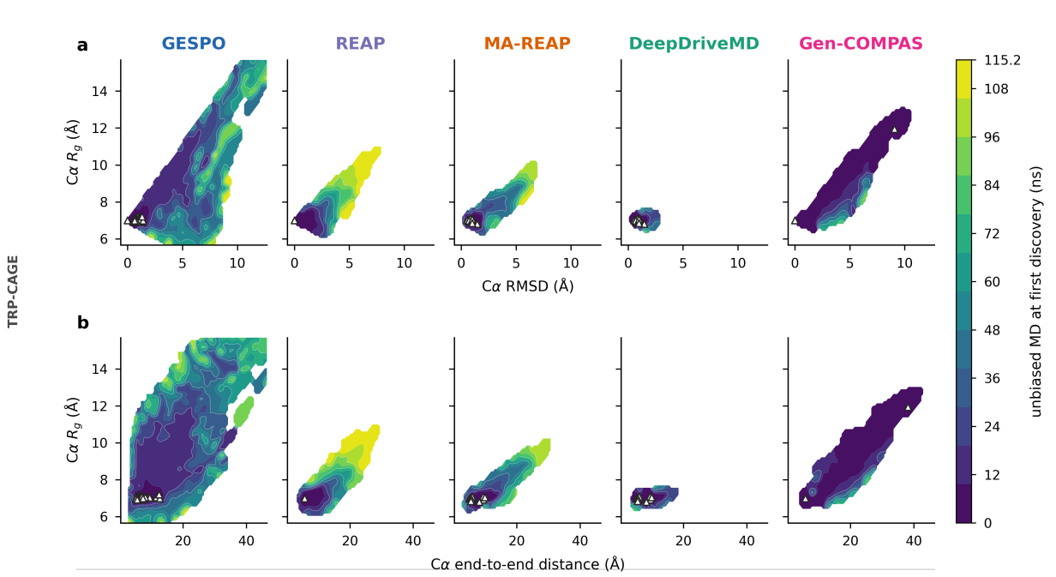
TEST 2 · BASELINES
At equal budget, GESPO covers the widest region
GESPO
Reaches Cα RMSD 12 Å and end-to-end distances near 50 Å; still discovering late in the budget.
REAP, MA-REAP
Stop near 8–9 Å RMSD and 30 Å end-to-end distance.
DeepDriveMD
Stays within 3 Å of the folded state.
Gen-COMPAS
Extends to ~10 Å, but along one narrow band, reached early.
Same system and budget: only the choice of where to sample differs.
Pengmei et al., GESPO (manuscript, 2026). 115.2 ns per method; same engine, force field and prepared system. Color: budget at first discovery; triangles: initial conformations.
25 / 37
Notes:
25. At equal budget, GESPO covers the widest region
SCRIPT (about 1:15):
Here are all five methods on Trp-cage with the same engine, force field, prepared system, and 115 nanoseconds each. Color shows when each region was first reached: dark is early, yellow is late, white is never.
GESPO reaches C-alpha RMSDs of 12 angstroms and end-to-end distances near 50 angstroms, and it is still discovering new regions late in the budget. REAP and MA-REAP stop around 8 to 9 angstroms. DeepDriveMD stays within 3 angstroms of the folded state. Gen-COMPAS extends to about 10 angstroms, but along one narrow band that it covers early.
DETAIL / Q&A:
Setup: GESPO, REAP, MA-REAP, DeepDriveMD and Gen-COMPAS run with the same MD engine, force field and prepared system, at 115.2 ns of aggregate unbiased simulation each. Baselines use their public implementations with published settings. REAP, MA-REAP and DeepDriveMD start from the conformations the matching GESPO trajectories used in round 1 (triangles); the published REAP code launches every round from one structure.
How to read it: top row is Cα RMSD vs. radius of gyration, bottom row is end-to-end distance vs. radius of gyration. Color is the budget at which each grid region was first reached: dark early, yellow late, white never.
Result: GESPO reaches Cα RMSD 12 Å and end-to-end distances near 50 Å and is still reaching new regions at the end. MA-REAP and REAP stop near 8–9 Å and 30 Å. DeepDriveMD stays within 3 Å of the folded state. Gen-COMPAS reaches about 10 Å, but along one narrow diagonal band that it covers early and then stops extending (next slide quantifies this).
Gen-COMPAS starts from both an unfolded and a folded conformation (its markers at the two ends of the band), because it needs reactant and product sets. Say this if asked why its markers differ.
If asked: a repeat with baseline trajectories started from random round-0 conformations gives the same conclusions (backup).

Slide 26
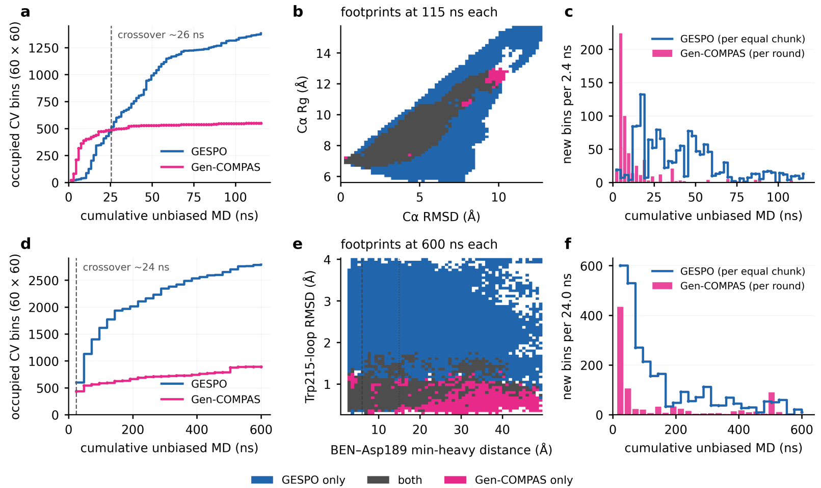
BASELINES · COVERAGE OVER TIME
Gen-COMPAS plateaus early; GESPO keeps discovering
Trp-cage, 115 ns
≈2.5× more occupied bins (≈1,380 vs. ≈550).
Trypsin, 600 ns
≈3× more occupied bins (≈2,800 vs. ≈900).
Early lead, then plateau
Gen-COMPAS leads for the first ~25 ns; most of its new bins come in its first rounds (c, f).
Footprints (b, e)
Gen-COMPAS covers a band between its end states; GESPO extends across both coordinates.
Sampling between known end states saturates; a learned policy continues to find new regions.
Pengmei et al., GESPO (manuscript, 2026). Occupied bins on a 60 × 60 CV grid. Top: Trp-cage, 115 ns per method; bottom: trypsin–benzamidine, 600 ns per method.
26 / 37
Notes:
26. Gen-COMPAS plateaus early; GESPO keeps discovering
SCRIPT (about 1:15):
This slide looks at the same comparison over time, counting occupied bins on a fixed grid of collective variables.
Gen-COMPAS is ahead for the first 25 nanoseconds or so. That is expected: it starts from both end states, so it spans them immediately. Then it plateaus. GESPO overtakes it and is still rising at the end, with about two and a half times more occupied bins on Trp-cage. The bottom row shows the same pattern for trypsin, which is our next system, with about three times more.
The footprints in the middle show why. Gen-COMPAS fills a band between its end states. GESPO keeps extending in both directions. Sampling between known end states saturates, while a learned policy keeps finding new regions.
DETAIL / Q&A:
What is measured: the number of occupied bins on a fixed 60 × 60 grid of collective variables, as a function of cumulative unbiased simulation. Top row Trp-cage (115 ns per method), bottom row trypsin–benzamidine (600 ns per method).
(a, d) Gen-COMPAS is ahead for roughly the first 25 ns: it starts from both end states, so its first rounds already span them. It then plateaus. GESPO overtakes it near 26 ns (Trp-cage) and 24 ns (trypsin) and is still rising at the end: about 2.5× more occupied bins on Trp-cage and about 3× on trypsin.
(b, e) Footprints at equal budget: blue GESPO only, gray both, pink Gen-COMPAS only. Gen-COMPAS covers a band between its end states; GESPO extends across both coordinates. For trypsin, GESPO covers Trp215-loop displacements that Gen-COMPAS does not reach.
(c, f) New bins per chunk of simulation: most Gen-COMPAS discoveries come in its first rounds; GESPO keeps adding bins throughout.
Caveat if asked: bin counts measure coverage, not accuracy of kinetics; the trypsin comparison here uses 600 ns per method, while the other trypsin comparison uses 720 ns. Numbers on the slide are read from the figure and rounded.

Slide 27
TEST 3 · TRYPSIN–BENZAMIDINE
Trypsin–benzamidine: resolving ligand and receptor together
The question
Through which receptor conformations does benzamidine bind and leave?
Production
12 trajectories × 2 ns × 30 epochs = 720 ns of unbiased dynamics
Initial data: 100 ns of metadynamics, used only to pretrain the policy and fill the conformation bank; excluded from all kinetic estimates.
Structures as on slide 2; Pengmei et al., GESPO (manuscript, 2026)
27 / 37
Notes:
27. Trypsin–benzamidine: resolving ligand and receptor together
SCRIPT (about 1:00):
Now we return to the system from the beginning of the talk. This is the one case where the ligand and the receptor have to be resolved together. Benzamidine reaches its binding site, Asp189, through the canonical S1 pocket or the alternative S1-star pocket, and access to both is controlled by the Trp215 and Asp189 loops.
The question is: through which receptor conformations does benzamidine bind and leave?
The production data are twelve trajectories of 2 nanoseconds per epoch, for 30 epochs, which is 720 nanoseconds of unbiased dynamics. The policy was pretrained on 100 nanoseconds of metadynamics. Those biased data were used only to pretrain the policy and to fill the conformation bank, and they are excluded from every kinetic estimate.
DETAIL / Q&A:
Test 3: the only system where ligand and receptor must be resolved together. Benzamidine reaches Asp189 through the canonical S1 pocket or the alternative S1* pocket; access is controlled by the Trp215 and Asp189 loops.
Production: 12 trajectories × 2 ns × 30 epochs = 720 ns of unbiased dynamics. The 100 ns of metadynamics used only to pretrain the policy and fill the conformation bank is excluded from every kinetic estimate.

Slide 28
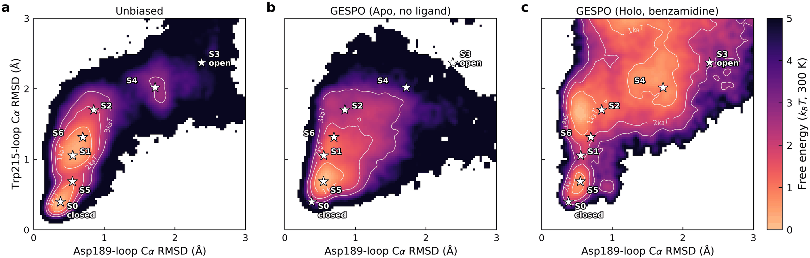
TEST 3 · RECEPTOR LANDSCAPE
With and without ligand, GESPO sampling follows the physics
(a) Unbiased reference (holo), 100 μs
Seven receptor states (stars); the open states lie several k_{B}T above the main band.
(b) GESPO, apo
Same protocol without benzamidine: covers the reference receptor states, and the Trp215 gate still opens.
(c) GESPO, holo
Benzamidine shifts sampling further, with both loops displaced together.
Same policy, different system: the apo–holo difference comes from the physics, not the sampler.
(a) 52 unbiased trajectories, 100 μs total (Plattner & Noé, 2015). (b, c) GESPO sampling density −ln p_{sample}, not a free energy. Stars: the seven reference receptor states.
28 / 37
Notes:
28. With and without ligand, GESPO sampling follows the physics
SCRIPT (about 1:15):
These maps use the RMSDs of the two loops, the same coordinates the reference study used to define receptor states.
Panel a is that reference: 100 microseconds of unbiased simulation with benzamidine bound. The stars are its seven receptor states. Most of the density lies in a narrow band from closed to partly open, and the open states are several k-T above it.
Panel b is a control. We ran the same policy and protocol without the ligand. It still covers the reference states, and the Trp215 gate still opens. So the open-gate conformations do not require the ligand, and the sampler does not invent ligand-specific states when there is no ligand.
Panel c is the holo system. With benzamidine bound, sampling reaches further, with both loops displaced together. Because the dynamics are unbiased and only the choice of where to sample differs, the difference between b and c reflects the effect of the ligand on the receptor, not the sampler.
DETAIL / Q&A:
Coordinates: Cα RMSD of the Asp189 and Trp215 loops to the closed crystal structure, the loops the reference study uses to classify receptor states. Stars: the seven receptor states of the reference (labeled S0–S6 on the figure).
(a) The 100 μs unbiased reference with benzamidine bound (Plattner & Noé): a narrow band from closed to partly open; the open states lie several kBT above it.
(b) The apo run is a control. Same policy and protocol, no ligand. Sampling covers the reference receptor states and the Trp215 gate still opens, so the open-gate conformations do not require the ligand, and the sampler does not produce ligand-specific states in its absence.
(c) With benzamidine bound, sampling extends further, with both loops displaced together while the closed basin is retained.
Point to make: the dynamics are unbiased, so GESPO changes only where to sample. The difference between (b) and (c) reflects the effect of the ligand on the receptor, not an artifact of the method.
If asked: panels b and c are sampling densities, −ln p_sample, not free energies.

Slide 29
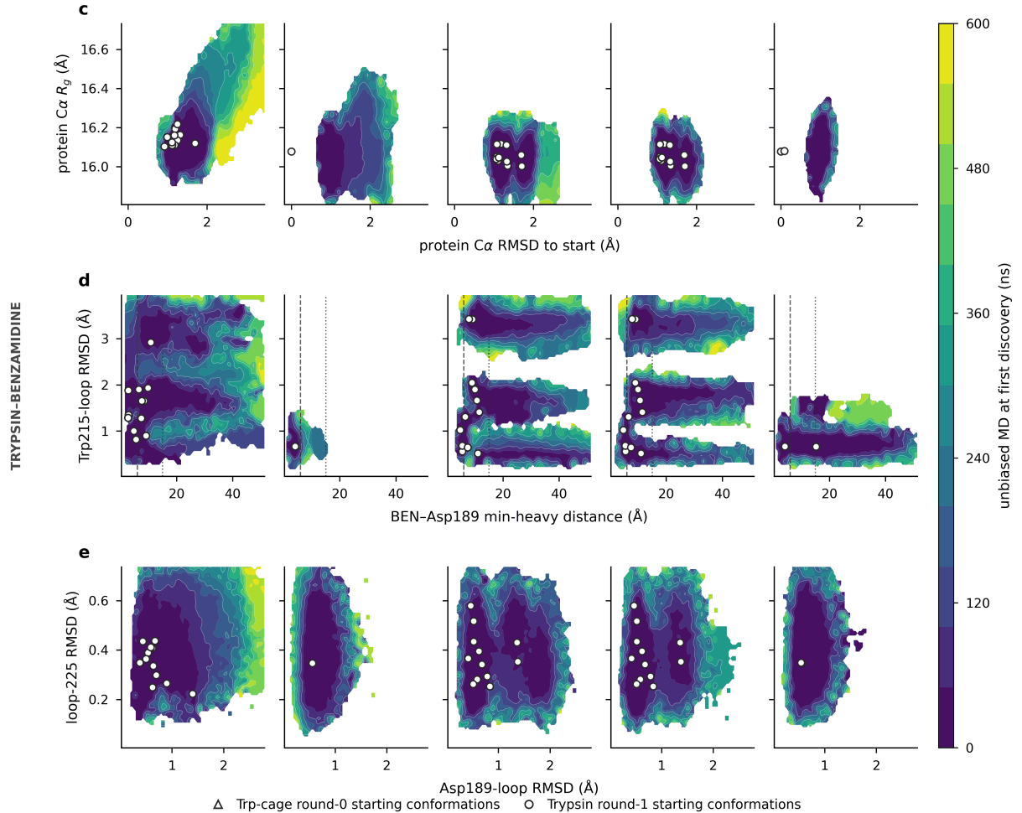
TEST 3 · BASELINES
MA-REAP and DeepDriveMD: ligand leaves, gate stays
(d) Ligand vs. gate
MA-REAP and DeepDriveMD carry benzamidine past 40 Å, but their late discoveries sit at nearly fixed Trp215-loop RMSD.
(c) Receptor
REAP, MA-REAP and DeepDriveMD stay within 3 Å Cα RMSD of the start; GESPO is still moving outward at 10 Å.
(e) Loops
GESPO covers Asp189-loop and loop-225 displacements the baselines do not reach.
Pengmei et al., GESPO (manuscript, 2026); 720 ns per method, matched launch conformations; color: budget at first discovery
29 / 37
Notes:
29. MA-REAP and DeepDriveMD: ligand leaves, gate stays
SCRIPT (about 1:00):
Here are the baselines on trypsin, with the same budget and the same starting conformations.
Look at the middle row, ligand distance against the Trp215 loop. MA-REAP and DeepDriveMD also carry benzamidine beyond 40 angstroms. But their late discoveries sit along narrow bands at almost fixed loop RMSD: the ligand leaves while the gate stays where it started. GESPO's late discoveries lie at the outer edge along both axes.
The other rows tell the same story. The baselines stay within 3 angstroms of the starting receptor structure, while GESPO is still moving outward at 10 angstroms, and it covers loop displacements the baselines never reach.
DETAIL / Q&A:
Baselines on trypsin at matched budget (720 ns) and matched initial conformations. (d) MA-REAP and DeepDriveMD also carry benzamidine past 40 Å, but their late discoveries lie along narrow bands at nearly fixed Trp215-loop RMSD: the ligand leaves while the gate stays where it started. (c) All baselines stay within 3 Å Cα RMSD of the start; GESPO is still moving outward at 10 Å. (e) GESPO covers Asp189-loop and loop-225 displacements the baselines do not reach.
If asked: a repeat with baseline trajectories started from random round-0 conformations gives the same conclusions.

Slide 30
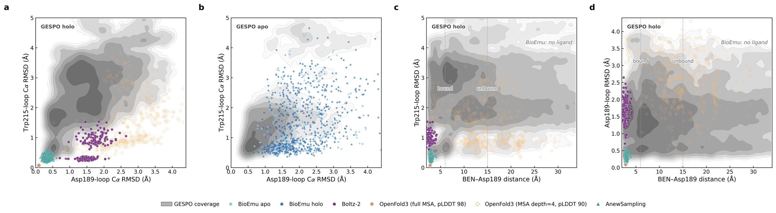
TEST 3 · STRUCTURAL PRIORS
Generators supply priors; trajectories supply the mechanism
Co-folding and equilibrium generators
Boltz-2, OpenFold3 (full MSA) and AnewSampling collapse onto the closed, bound pose: benzamidine within ~4 Å of Asp189.
Shallow-MSA OpenFold3
Broad scatter set by an inference setting (MSA depth 4): no S1* region, 44% of samples beyond 15 Å; gone by depth 16.
BioEmu
A receptor-only prior: open and closed Trp215 gates without ligand, so it cannot be placed on the association coordinate.
The second binding mode and the route out of the pocket come from the trajectories.
Gray: GESPO coverage. Boltz-2 (Passaro et al., 2025); OpenFold3; BioEmu (Lewis et al., 2025); AnewSampling (2026). Dotted lines: bound (6 Å) and unbound (15 Å) distances.
30 / 37
Notes:
30. Generators supply priors; trajectories supply the mechanism
SCRIPT (about 1:15):
This slide returns to the question from slide 2: can a structure predictor tell us the mechanism? In gray is the GESPO coverage. The colored points are samples from current structure generators on the same coordinates.
Boltz-2, OpenFold3 with a full alignment, and AnewSampling all collapse onto the closed, bound pose, with benzamidine within about 4 angstroms of Asp189. They reproduce the crystal pose very well. Subsampling OpenFold3's alignment to four sequences scatters the samples, but that spread comes from an inference setting, not from physics. It misses the S1-star region, and it disappears by a depth of 16. BioEmu gives a broad receptor prior with open and closed gates, but it has no ligand, so it cannot say anything about binding.
So the generators give us one bound basin very sharply, or a receptor without a ligand. The second binding mode and the route out of the pocket come from the trajectories. These methods are complementary: they could supply initial structures for a method like GESPO.
DETAIL / Q&A:
This returns to the opening question on slide 2: does a structure tell us the mechanism?
Gray is GESPO coverage; colored points are samples from structure generators, on the same coordinates: loop RMSDs (a, b) and benzamidine–Asp189 distance (c, d).
Boltz-2 and OpenFold3 at full MSA depth, and the all-atom equilibrium generator AnewSampling, all collapse onto a tight cluster at the closed bound state, with benzamidine within about 4 Å of Asp189 in every sample. They reproduce the native pose sharply.
Subsampling the MSA to four sequences scatters OpenFold3 broadly, but that spread is set by an inference hyperparameter, not by physics: it leaves the S1* region empty, puts 44% of samples beyond 15 Å, and disappears by depth 16.
BioEmu gives a broad ligand-free receptor prior; its apo and holo-biased ensembles are indistinguishable and already contain open and closed Trp215 gates, so the receptor states needed for binding exist without ligand. With no ligand, it cannot be placed on the association coordinate at all.
Takeaway: the generators describe one bound basin sharply, or a receptor prior without a ligand. The second binding mode and the route out of the pocket come from the propagated trajectories. The generators are complementary: they can suggest or initialize structures.

Slide 31
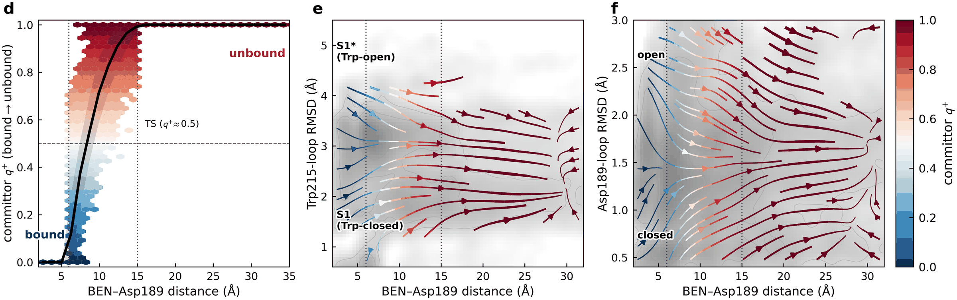
TEST 3 · COMMITMENT
Geom2Vec · SPIB
Ligand distance alone does not determine commitment
(d) Committor vs. distance
q⁺ crosses 0.5 near 8–9 Å, as free diffusion between these shells would; the spread at fixed distance stays broad.
(e) Trp215 loop
At equal ligand distance, open-gate configurations sit further toward dissociation.
(f) Asp189 loop
Smaller effect; the Asp189 loop stays near its closed geometry.
The receptor coordinate carries part of the reaction progress that distance misses.
DGA committor q⁺ between bound (d < 6 Å) and unbound (d > 15 Å) sets. (e, f) Mean displacement per lag time, colored by q⁺; a drift field, not a probability current. Pengmei et al., GESPO (manuscript, 2026).
31 / 37
Notes:
SCRIPT (about 1:15):
Now the mechanism. Panel d shows the committor, the probability of reaching the unbound state before the bound state, against the ligand distance. It rises from zero in the pocket to one beyond 15 angstroms and crosses one half near 8 to 9 angstroms.
That crossing point by itself is not informative. Free diffusion between absorbing shells at 6 and 15 angstroms would cross one half at about the same distance, with no barrier at all. What is informative is the spread: at a fixed distance, the committor still ranges widely.
Panels e and f show part of the reason. These are mean displacements of the trajectories, colored by committor. At the same ligand distance, configurations with the Trp215 loop open are further along toward dissociation. So the receptor coordinate carries part of the reaction progress that distance alone misses.

Slide 32
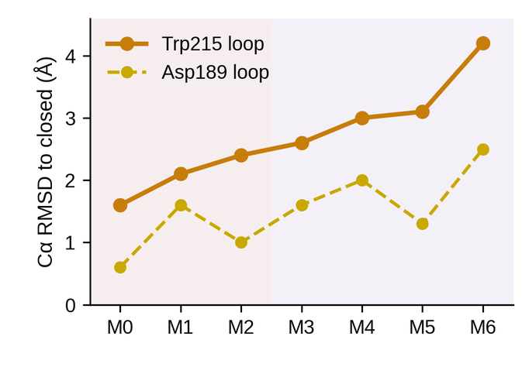
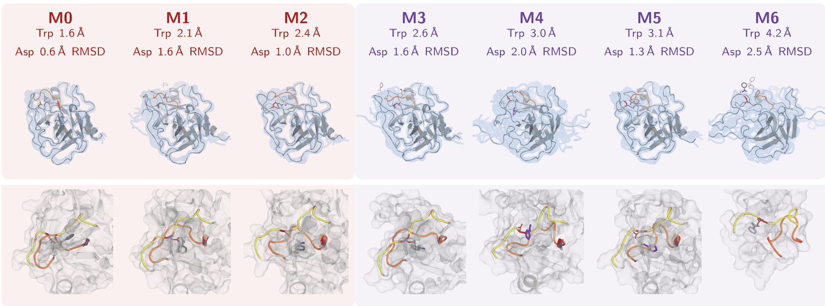
TEST 3 · RECEPTOR MACROSTATES
Geom2Vec · SPIB
The Trp215 loop gates the pocket between S1 and S1*
S1 · gate closed
S1* · gate open
Trp215 is the gate
Its RMSD rises monotonically, 1.6 → 4.2 Å. The Asp189 loop stays within 2 Å in all but M6.
Bound benzamidine appears in the closed M0 and throughout the open-gate states: the S1* mode is observed in the trajectories, not inferred from endpoints.
Seven receptor states, ordered by how far the Trp215 gate opens.
SPIB on Geom2Vec features (holo), seven macrostates as in Plattner & Noé (2015). Pocket: Asp189 loop yellow, Trp215 loop orange. Pengmei et al., GESPO (2026).
32 / 37
Notes:
32. The Trp215 loop gates the pocket between S1 and S1*
SCRIPT (about 1:15):
To describe the receptor, we trained SPIB on Geom2Vec features of the holo trajectories and coarse-grained it into seven macrostates, the same number as the reference study.
They run from the closed S1 geometry, M0, to the open S1-star geometry, M6. The top row shows each state and its loop RMSDs; the bottom row shows the pocket. The chart on the right makes the pattern clear: the Trp215 loop RMSD rises steadily from 1.6 to 4.2 angstroms across the states, while the Asp189 loop stays within 2 angstroms in all but the last. So Trp215 is the gate.
Bound benzamidine appears not only in the closed state but throughout the open-gate states. The S1-star mode is observed directly in the trajectories, not inferred from the endpoints.
DETAIL / Q&A:
How the states were made: a SPIB model trained on Geom2Vec features of the holo trajectories, coarse-grained into seven receptor macrostates, M0–M6, the same number resolved in the 100 μs reference study.
Top row: whole-protein views with the two loop RMSDs for each state. Bottom row: pocket close-ups, Asp189 loop yellow, Trp215 loop orange, benzamidine in sticks (green in S1-like, purple in S1*-like).
The ordering runs from the closed S1 geometry (M0: Trp215 loop 1.6 Å, Asp189 loop 0.6 Å) to the open S1* geometry (M6: 4.2 and 2.5 Å). The Trp215 loop is the gate: its RMSD increases monotonically from M0 to M6, while the Asp189 loop stays within 2 Å of the closed structure in all but the most open state.
Bound configurations occur not only in the closed M0 but throughout the open-gate macrostates, so the S1* binding mode appears in the trajectories themselves.
Next two slides: how these states connect during dissociation (reactive flux) and how the receptor exchanges between them within each committor tier.

Slide 33
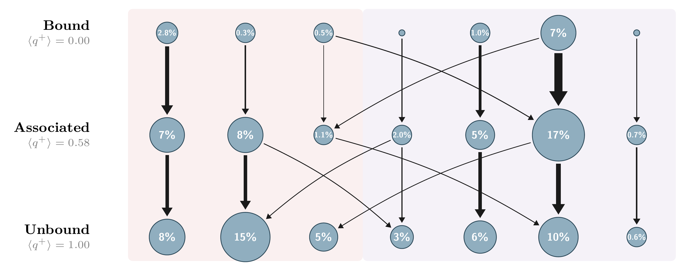
TEST 3 · REACTIVE FLUX
Geom2Vec · SPIB
Most dissociation flux leaves the pocket through M5
M0
M1
M2
M3
M4
M5
M6
Reading the network
Rows: committor tiers, bound → associated → unbound. Arrow width: net reactive flux; circle area: stationary weight.
Result
The largest flux passes through the open-gate state M5; M0 and M4 follow; M2 carries the least. All arrows point toward dissociation.
Scope
Weights are reweighted from adaptive data (π/p_{sample})
Dissociation runs mainly through the open-gate state M5; M0 and M4 are secondary routes.
Net reactive flux max(f_{ij} − f_{ji}, 0), f_{ij} = π_{i} q⁻_{i} T_{ij} q⁺_{j}, after reweighting each frame by π/p_{sample}. Pengmei et al., GESPO (manuscript, 2026).
33 / 37
Notes:
33. Most dissociation flux leaves the pocket through M5
SCRIPT (about 1:15):
This network combines the two descriptions. Columns are the seven receptor states. Rows are committor tiers: bound, associated, and unbound. Circle area is the stationary weight, and arrow width is the net reactive flux toward dissociation. Both are computed after reweighting each frame to correct for the adaptive sampling.
The largest flux passes through M5, an open-gate state. M0 and M4 carry the next largest, and M2 the least. Every arrow points the same way, from bound toward unbound.
Two cautions. The weights come from reweighted adaptive data, so they are model estimates, not validated populations. And because the unbound tier is defined by a distance cutoff, this network does not tell us whether ligand release is the last event.
DETAIL / Q&A:
Layout: columns are the seven receptor macrostates from the previous slide, closed S1 on the left to open S1* on the right. Rows are committor tiers from DGA: bound (mean q⁺ = 0), associated (≈ 0.58) and unbound (q⁺ = 1). Each macrostate-tier cell is a node.
Circle area is the adjoint weight π, the stationary distribution of the transition-count matrix. Black arrow width is the net reactive flux, max(f_ij − f_ji, 0), with f_ij = π_i q⁻_i T_ij q⁺_j. Both are computed after reweighting each frame by π/p_sample, which corrects for the adaptive sampling.
Result: most dissociation flux passes through the open-gate macrostate M5, the dominant gateway. M0 and M4 carry the next largest fluxes; M2 the least. All black arrows point the same way, from bound toward unbound.
Benzamidine stays within encounter range in the bound and associated tiers and separates on entering the unbound tier. Because the unbound set is defined by d > 15 Å, that separation follows from the tier boundary; it does not show that release is the last event. Ordering events would need statistics along reactive paths.
If asked about populations: node weights come from reweighted adaptive data and should be treated as model estimates, not validated equilibrium populations.

Slide 34
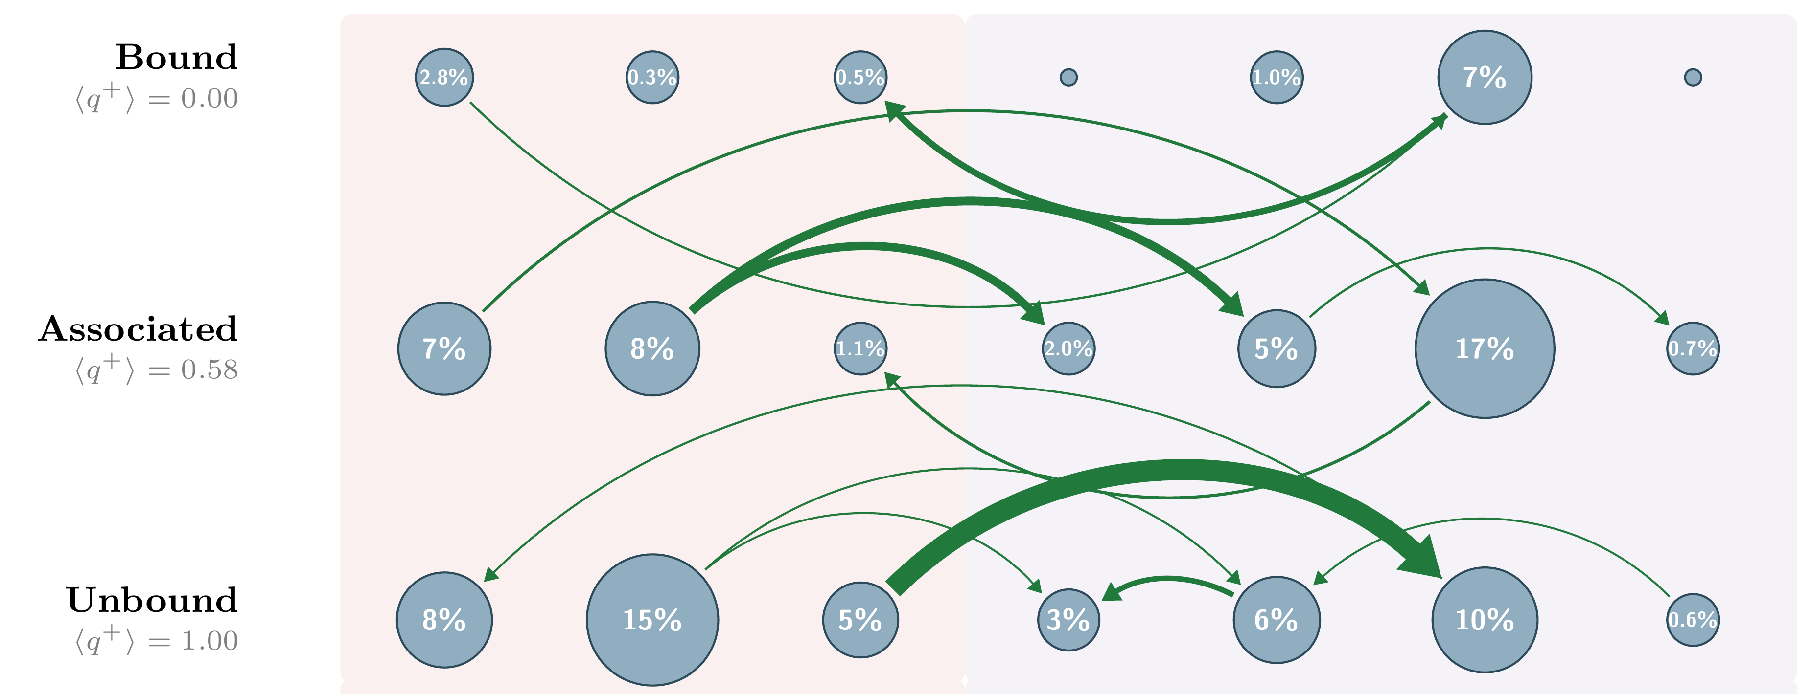
TEST 3 · CONFORMATIONAL EXCHANGE
Geom2Vec · SPIB
The receptor interconverts across the full S1–S1* range
M0
M1
M2
M3
M4
M5
M6
Reading the network
Green arrows: net conformational exchange between macrostates. Width: size of the net current.
Result
Every macrostate appears in the associated tier; exchange is strongest between M2 and M5.
The gate opens and closes throughout binding
Same macrostates, tiers and reweighting as the reactive-flux network. Pengmei et al., GESPO (manuscript, 2026).
34 / 37
Notes:
34. The receptor interconverts across the full S1–S1* range
SCRIPT (about 1:00):
The green arrows show the net exchange between receptor states while the ligand is bound or nearby. Every state appears in the associated tier, and the exchange is strongest between M2 and M5.
What it shows is that the gate is not a one-time switch: the receptor keeps sampling open and closed geometries throughout binding. That is a mechanistic statement that requires trajectories, and it is exactly where the structural predictors cannot supplement.
DETAIL / Q&A:
Same layout as the previous slide: macrostates in columns, committor tiers in rows. Green arrows show the net conformational exchange between macrostates; width is the size of the net current.
Result: every macrostate appears in the associated tier, so the receptor interconverts across the whole S1–S1* range while benzamidine stays within encounter distance. Exchange is particularly strong between M2 and M5.
Important caveat, say it: these net currents are small compared with the underlying two-way traffic, and most arrow directions are not robust to bootstrap resampling. So the green network is not a directed pathway. It cannot establish whether gate opening precedes ligand approach or the reverse, and it cannot distinguish conformational selection from induced fit.
What it does show: the gate is not a one-time switch; the receptor keeps sampling open and closed geometries throughout binding.
Transition to the closing slides: this is the kind of mechanistic statement that requires trajectories, which is where the structural priors on slide 28 stop.

Slide 35
LIMITATIONS AND FUTURE DIRECTIONS
What the evidence supports, and what it does not yet
Limitations
Future directions
1
Statistical scope
Pooled frames from adaptive sampling are not equilibrium samples; populations, free energies and rates need reweighting or independent validation.
1
Estimators for adaptive data
Connect adaptive sampling to statistically justified equilibrium and kinetic estimators.
2
Force field fidelity
The quality of potential function limits the correct distribution that we are sampling from.
2
Richer actions
Let the policy also choose resolution, number of trajectories and duration.
3
Generators with kinetic feedback
Post-train structure predictors toward initial conformations that are informative under the dynamics.
Dissertation Ch. 7 (statistical scope) and Ch. 8 (synthesis and outlook).
35 / 37
Notes:
35. What the evidence supports, and what it does not yet
SCRIPT (about 1:15):
Let me be clear about the limits of these results.
First, statistical scope. Data from adaptive sampling are not equilibrium samples, because we chose where to start each trajectory. So populations, free energies, and rates need reweighting or independent validation. Second, the dynamics and kinetics are determined by the quality of the force field, how to improve force field with affordable price is still an open question
These also point to the next steps: estimators that turn adaptive data into calibrated kinetics; policies that choose not only where to sample but also resolution, trajectory length, and how many trajectories to run; and structure generators post-trained with kinetic feedback, so that the predictors we saw earlier propose structures that are informative under the dynamics.
DETAIL / Q&A:
Limitations. Statistical scope: pooled frames from adaptive sampling are not equilibrium samples, so populations, free energies and rates need reweighting or independent validation. Kinetic-model uncertainty: finite transition counts, lag time and state discretization. Replicates: discovery was compared in single campaigns.
Future directions from Ch. 8: estimators that turn adaptive data into equilibrium and kinetic statistics; richer policy actions (resolution, number of trajectories, duration); and structure generators post-trained with kinetic feedback.

Slide 36
THESIS SYNTHESIS
Representation and reinforcement learning meet at kinetics
Geometric representation
Kinetic model
Pretrained all-atom encoders map each configuration to transferable, multiscale features
Time-lagged objectives (VAMP, SPIB) learn slow coordinates and metastable states
structural
embeddings
new trajectory
data
trajectory-level
rewards
Unbiased molecular dynamics
Generative sampling policy
Short parallel trajectories propagate under a fixed force field
Learns a probability distribution over initial conformations to explore kinetically significant regions
sampled initial
conformations
Features retain slow motion; kinetic evidence decides where to sample.
Dissertation Ch. 1 and Ch. 8. Geom2Vec: Pengmei et al., J. Chem. Phys. (2025); GESPO: Pengmei et al. (manuscript, 2026).
36 / 37
Notes:
36. Representation and reinforcement learning meet at kinetics
SCRIPT (about 1:00):
To close, here is the loop from the beginning.
Pretrained geometric features keep the atomistic detail that slow modes depend on, like the threonine side chains in chignolin. Time-lagged objectives turn those features into kinetic coordinates and states. The same kinetic model scores trajectories, and a generative policy learns from those scores where to sample next, with the dynamics left unbiased. The new trajectories feed back into the representation.
In one sentence: the features retain slow motion, and the kinetic evidence decides where to simulate next.
DETAIL / Q&A:
Synthesis, same loop as the roadmap. Pretrained geometric features keep slow distinctions; time-lagged objectives turn them into kinetic coordinates; the kinetic model scores trajectories; the policy learns where to sample next; unbiased MD supplies the evidence.
One sentence to close: features retain slow motion, and kinetic evidence decides where to simulate next.

Slide 37
ACKNOWLEDGMENTS
Thank you
Aaron R. Dinner
Geom2Vec and token merging
Chatipat Lorpaiboon · Spencer C. Guo · Jonathan Weare
Advisor
GESPO
Nhan D. Nguyen · Zhengyuan Shen · Jonathan Weare
Committee
Suriyanarayanan Vaikuntanathan
Rebecca Willett
All-atom pretraining
Zhengyuan Shen · Zichen Wang · Marcus Collins · Huzefa Rangwala
Data and computing
D. E. Shaw Research (trajectories) · UChicago RCC (Beagle-3) · AWS
Questions
Funding: NIH R35 GM136381; NSF DMS-2054306; UChicago Data Science Institute AI+Science Research Initiative; AWS.
37 / 37
Notes:
37. Thank you
SCRIPT (about 0:45):
None of this would have been possible without many people. I want to thank my advisor, Aaron, for his guidance throughout, and my committee for their time and feedback.
I also thank my collaborators on each project; Chatipat Lorpaiboon, Spencer Guo, and Jonathan Weare on Geom2Vec and token merging; Nhan Nguyen, Zhengyuan Shen, and Jonathan Weare on GESPO; and Zhengyuan Shen, Zichen Wang, Marcus Collins, and Huzefa Rangwala at AWS. Thank you as well to D. E. Shaw Research for trajectory data, and to the Research Computing Center and AWS for computing.
Thank you, and I am happy to take questions.
DETAIL / Q&A:
Thank the advisor, committee, collaborators by project, and the data, computing and funding sources. Then open for questions.

Slide 38
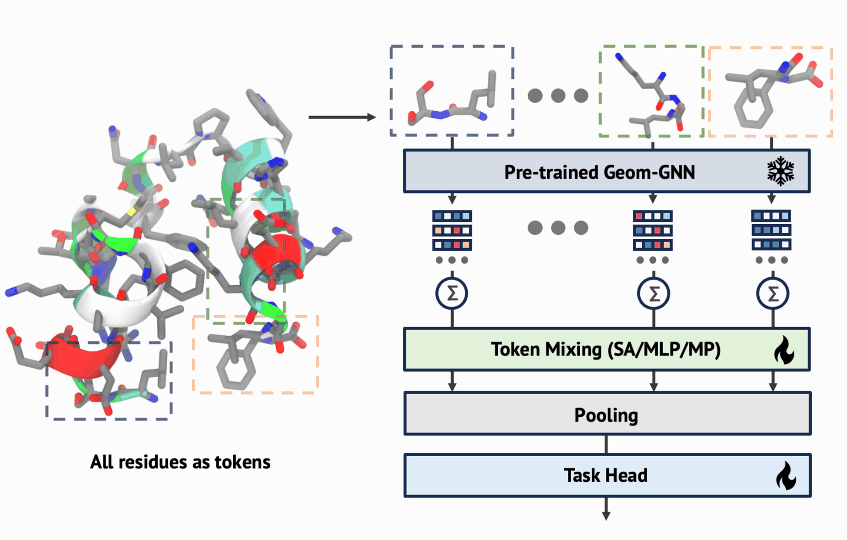
BACKUP · GEOM2VEC ARCHITECTURE
Frozen residue tokens feed a trainable token mixer
Pengmei et al., J. Chem. Phys. 162, 044107 (2025)
BACKUP 01

Slide 39
BACKUP · MESSAGE PASSING
Local message passing has distinct information limits
Local update
Under-reaching
Aggregate neighboring features.
Distant domains require more hops.
Over-squashing
Over-smoothing
fixed-size
vector
Many signals share a fixed-size channel.
Repeated mixing erases feature contrast.
Dissertation Ch. 1, Fig. 1.2; over-squashing: Alon & Yahav (2021); over-smoothing: Oono & Suzuki (2020).
BACKUP 02
Notes:
B02. Local message passing has distinct information limits
Backup. Message passing and its limits (Dissertation Fig. 1.2): a local update aggregates neighbors; distant domains need many hops; over-squashing compresses many signals into a fixed-size vector; over-smoothing erases contrast after repeated mixing.

Slide 40
BACKUP · TOKEN UPDATES
Sequence, graph and attention updates mix different inputs
Sequence-local
Graph
Self-attention
Nearby sequence positions
Bond or contact neighbors
All unmasked tokens
z1
z2
z3
z4
z5
z1
z2
z3
z4
z5
z1
z2
z3
z4
z5
z′3
z′3
z′3
Dissertation Ch. 1, Fig. 1.3 (a–c).
BACKUP 03
Notes:
B03. Sequence, graph and attention updates mix different inputs
Backup. Three token-update rules (Fig. 1.3 a–c): sequence-local windows, graph neighbors, and self-attention over all unmasked tokens.

Slide 41
BACKUP · MOLECULAR HIERARCHY
Hierarchy changes the representation, not the MD resolution
SubFormer: atoms → chemical fragments
f2
f1
f2
f3
f1
f3
Token merging: spatial exchange → sequence windows
f2
f1
f2
f3
f1
f3
local atomic / residue information
learned pooled representation
global mixing
Dissertation Ch. 1, Fig. 1.3 (d, e). SubFormer: Pengmei et al. (2023); token merging: Pengmei et al., J. Chem. Phys. (2026).
BACKUP 04
Notes:
B04. Hierarchy changes the representation, not the MD resolution
Backup. Two hierarchical constructions (Fig. 1.3 d–e). SubFormer pools atoms into chemical fragments before attention; the token-merging module exchanges information over spatial residue contacts and then merges sequence windows. Both reduce the number of tokens for global attention; the MD resolution is unchanged.

Slide 42
BACKUP · VAMP ESTIMATOR
The kinetic score uses centered empirical covariances
u = χ(X_{t}), v = χ(X_{t+τ})
C₀₀ = ⟨(u − μ_{u})(u − μ_{u})⊤⟩
C_{0τ} = ⟨(u − μ_{u})(v − μ_{v})⊤⟩
C_{ττ} = ⟨(v − μ_{v})(v − μ_{v})⊤⟩
Removing a segment changes the empirical means as well as the cross-products.
Pengmei et al., GESPO (manuscript, 2026), Eqs. for the VAMP-2 estimator.
BACKUP 05
Notes:
B05. The kinetic score uses centered empirical covariances
Backup. VAMP-2 estimator. Features are centered by their empirical means over the lagged pairs, and the covariances are computed from pairs within each trajectory. When one trajectory is removed for the leave-one-out contribution, the means and all covariances are recomputed with χ held fixed.

Slide 43
BACKUP · GESPO SETTINGS
GESPO settings for the two production campaigns
Trp-cage
Trypsin–benzamidine
Force field, T
CHARMM36, TIP3P; 300 K
AMBER14 + GAFF2, TIP3P; 298 K
Trajectories
G = 12 per epoch, 200 ps each
G = 12 per epoch, 2 ns each
Campaign
3 rounds (10, 12, 24 epochs); 115.2 ns
2 rounds × 15 epochs; 720 ns
Initial data
4.8 ns bootstrap (discrete-state variant)
100 ns well-tempered metadynamics (excluded from kinetics)
Policy
4 layers, d = 256, 8 heads, 8 mixtures; 3 descriptors + 20 residues
5 descriptors + 223 residues + 2 ligand torsions
GRPO
lr 2×10⁻⁴; 10 iterations/epoch; ε = 0.1; KL 0.2; entropy 0.1–0.2
lr 5×10⁻⁵; 20 iterations/epoch; ε = 0.1; KL 0.1; entropy 0.15
Realization
Restrain bank frame toward proposal, release before production
Same; ligand–pocket flat-bottom restraint only during realization
Pengmei et al., GESPO (manuscript, 2026), Appendix: reproducibility tables.
BACKUP 06
Notes:
B06. GESPO settings for the two production campaigns
Backup. Settings for the two production campaigns, from the reproducibility tables in the appendix. Use if asked about budgets, policy size or GRPO coefficients.

Slide 44
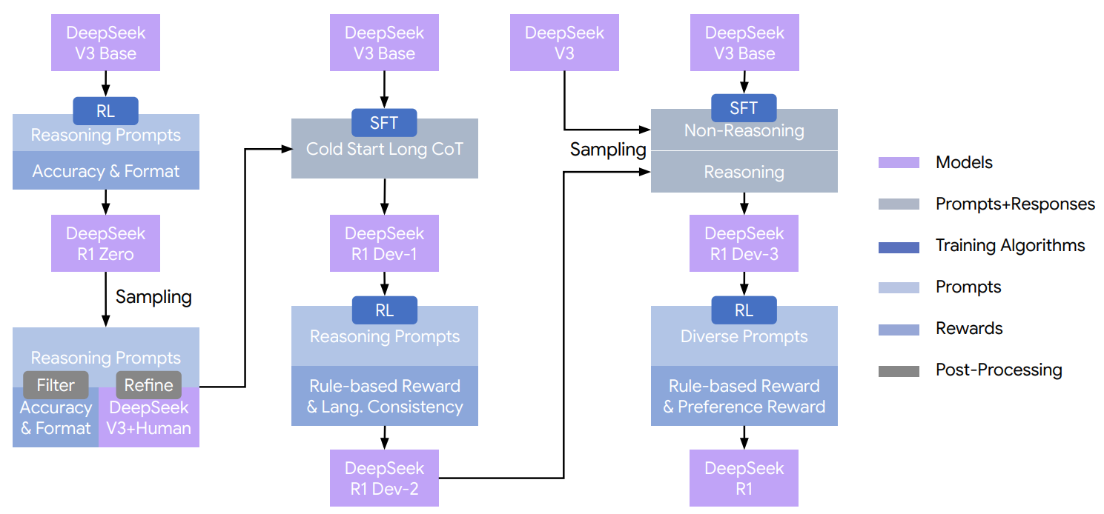
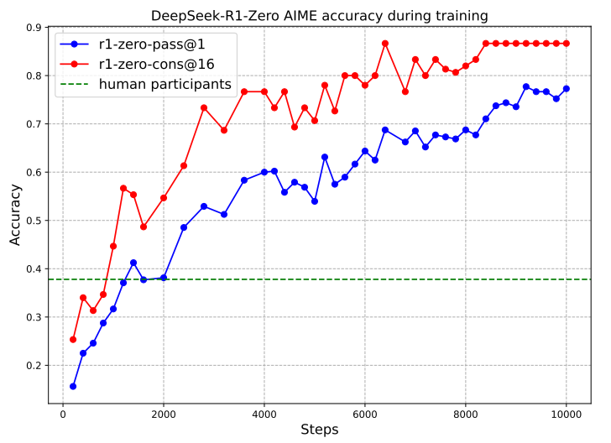
BACKUP · RL POST-TRAINING IN LANGUAGE MODELS
Analogy: RL post-training of a language model (DeepSeek-R1)
GESPO borrows the update rule (GRPO), not the model or the data.
Figure: DeepSeek-AI, DeepSeek-R1 (2025); shown as an analogy only
BACKUP 07
Notes:
B07. Analogy: RL post-training of a language model (DeepSeek-R1)
Backup, use only if asked where the idea comes from. DeepSeek-R1 applies GRPO to a pretrained language model: sample a group of answers, score them, and update toward the relatively better ones. GESPO borrows this update rule. The model, the data and the reward are different: the policy proposes initial conformations, and the reward comes from unbiased MD.

Slide 45
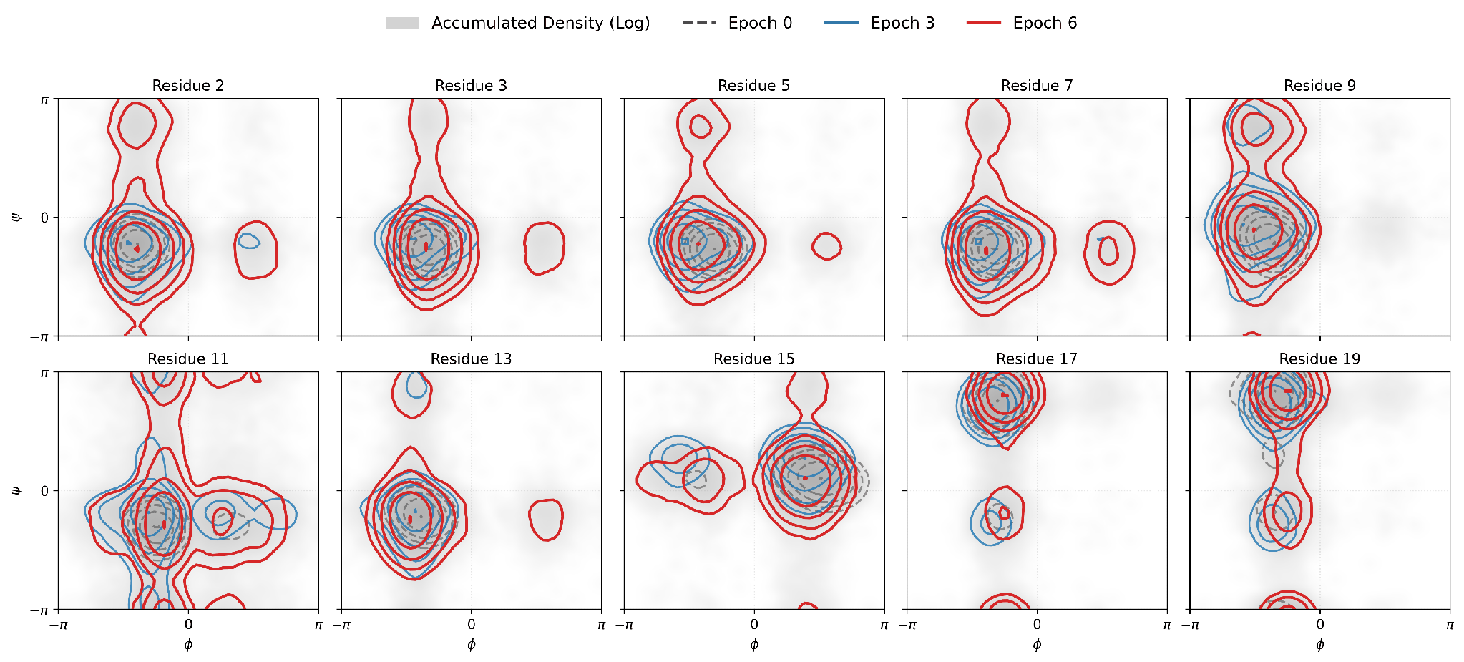
BACKUP · POLICY MARGINALS
Launch-policy torsion marginals for ten Trp-cage residues
Pengmei et al., GESPO (manuscript, 2026). Epochs 0 (dashed gray), 3 (blue) and 6 (red) over the accumulated sampling density.
BACKUP 08
Notes:
B08. Launch-policy torsion marginals for ten Trp-cage residues
Backup. Policy torsion marginals for ten Trp-cage residues at epochs 0, 3 and 6. The marginals broaden rather than contract; several residues gain density at φ > 0 or toward ψ = ±π.

Slide 46
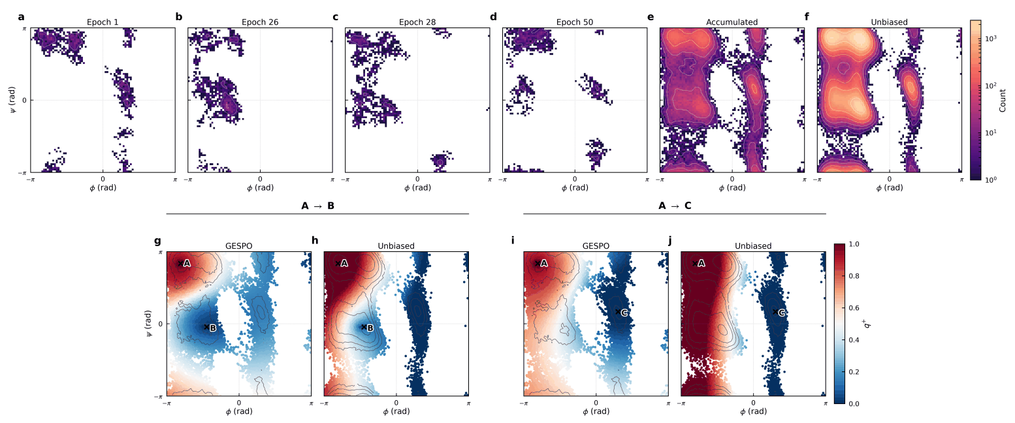
BACKUP · ALANINE DIPEPTIDE
Alanine dipeptide: basins and committors from 0.8 ns
Pengmei et al., GESPO (manuscript, 2026). Reference: three 250 ns unbiased trajectories (mdshare), same force field and temperature.
BACKUP 09
Notes:
B09. Alanine dipeptide: basins and committors from 0.8 ns
Backup. Alanine dipeptide control: 0.8 ns of 2 ps trajectories recover the β, αR and αL basins and give committors whose organization matches the reference. No single trajectory contains a basin-to-basin transition; basin weights differ from the reference, as expected for adaptive data.

Slide 47

BACKUP · TRP-CAGE COMMITTOR
The Trp-cage committor varies smoothly across coordinates
Pengmei et al., GESPO (manuscript, 2026). DGA committor q⁺ on pairwise projections of the GESPO data.
BACKUP 10
Notes:
B10. The Trp-cage committor varies smoothly across coordinates
Backup. The DGA unfolded-to-folded committor on pairwise projections of the Trp-cage GESPO data; it varies smoothly across helix-sensitive coordinates.

Slide 48


BACKUP · TRP-CAGE REFERENCE
The 208 μs reference and GESPO share one topography
Anton reference: 208.8 μs
GESPO: 115.2 ns of short trajectories
Pengmei et al., GESPO (manuscript, 2026). Left: Anton, K8A TC10b, CHARMM22*, 290 K (Lindorff-Larsen et al., 2011). Right: GESPO, CHARMM36, 300 K; sampling density, not equilibrium.
BACKUP 11
Notes:
B11. The 208 μs reference and GESPO share one topography
Backup. The 208.8 μs Anton trajectory (CHARMM22*, 290 K) and the GESPO data (CHARMM36, 300 K) projected on the same coordinates show the same topography. Different force fields and temperatures, so the agreement reflects the folding landscape; the GESPO maps are sampling densities.

Slide 49

BACKUP · OPENFOLD3 MSA DEPTH
OpenFold3 sample spread is set by the MSA depth
Pengmei et al., GESPO (manuscript, 2026). Top: holo, benzamidine–Asp189 distance; bottom: loop RMSDs. Gray: GESPO coverage.
BACKUP 12
Notes:
B12. OpenFold3 sample spread is set by the MSA depth
Backup. OpenFold3 at MSA depths 4, 8, 16 and 256. The spread of samples is set by the MSA depth, an inference setting, and collapses to the bound pose by depth 16.

