Slide 1
Queen and Messengers Jason Petrov and Matthew Yaswinski

Slide 2
Goals
Use Promela to accept multiple message into one critical section
Use a channel to transmit messages between processes
Consume message with lowest priority
Consume priority 1 rather than priority 2
Continue until all messages are consumed

Slide 3
Initial Implementation
Began with trying to implement C code
Would embed C to read file with messages and message ID’s/priorities
Could read file, but could not convert C data into Promela data
Decided to purely use Promela

Slide 4
Structure of Program
Global variables
Counter for consuming all messages
Variable for signaling active critical section
Structure msg for holding ID, priority, text
mtype for holding possible text (“AA” – “ZZ”)
Array for holding messages
Channel for sending messages to queen

Slide 5
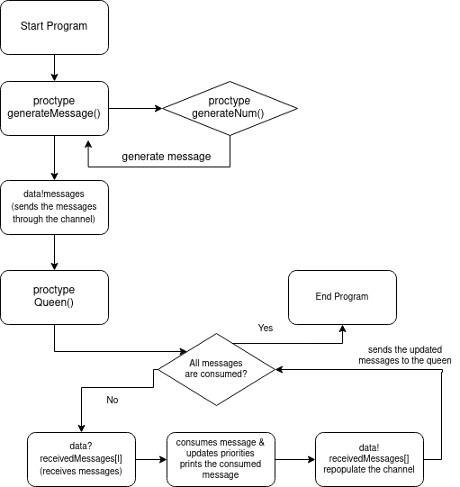
Flow Chart

Slide 6
Creating Messages
Method generateNum() creates a random number from 1 to 26
Method generateMessage() creates 26 messages
Uses loop to make all messages
Unique ID for all messages based on counter in loop starting at 0
Uses generateNum() to create priority
Uses generateNum() separately for index of mtype for message text
All messages are stored into array of size bufferLength = 26

Slide 7
Sending Data to Queen
Channel called “data” is used to send messages to queen
Uses loop to send each element of array into channel
“data!messages[i];”
No sorting is done with the array or by the channel

Slide 8
Queen Reading Data
Queen is a separate process
Checks if all messages have been consumed (do loop later)
Checks if critical section is active (criticalSection = 0)
If it is, set equal to 1
Use loop to receive data from the channel and add messages to new array
“data?receivedMessages[l];”

Slide 9
Finding Lowest Priority
Use if statement within loop to find lowest priority
Check each element’s priority and set value lowestPriority to that element’s priority
If later element has lower priority, update variable
Update indexRedMsg for position of element with lowest priority

Slide 10
Updating Priorities
After finding lowest priority, change priorities of all other messages by decrementing by 1 if priority is greater than 1 and less than 101
Copy messages with new priorities to new array
Exit critical section by setting criticalSection to 0

Slide 11
Consuming Message
Update priority of consumed element to 101
Minimum priority is 1, maximum priority is 26
101 is out of bounds of all other priorities, so that message cannot be read again
Prevents same message from being read multiple times
Prevents starvation

Slide 12
Consuming More Messages
Program prints out all messages with original priorities, then prints the message consumed by the queen
The channel is repopulated with the messages and their updated priorities
Variable loopCounter is incremented by 1 (originally set to 0)
Continues in a loop until all 26 messages have been consumed
Printout is done for each iteration, showing updated priorities and consumed message

Slide 13
Synchronization Techniques
Use the criticalSection variable
Signals that the critical section is active
Ensures that no other processes can read from channel and modify lowest priority at the same time
Setting priorities of consumed messages to 101
Ensures that previously consumed messages are not consumed again
Prevents starvation among any messages

Slide 14
Synchronization Techniques (cont’d)
Updating priorities of unread messages
Priorities of unread messages are decremented by 1
Ensures that every message eventually has the lowest priority
Only done if message priority is between 1 and 101, exclusively
Especially useful if more messages are created after some are consumed
Not done in this program

Slide 15
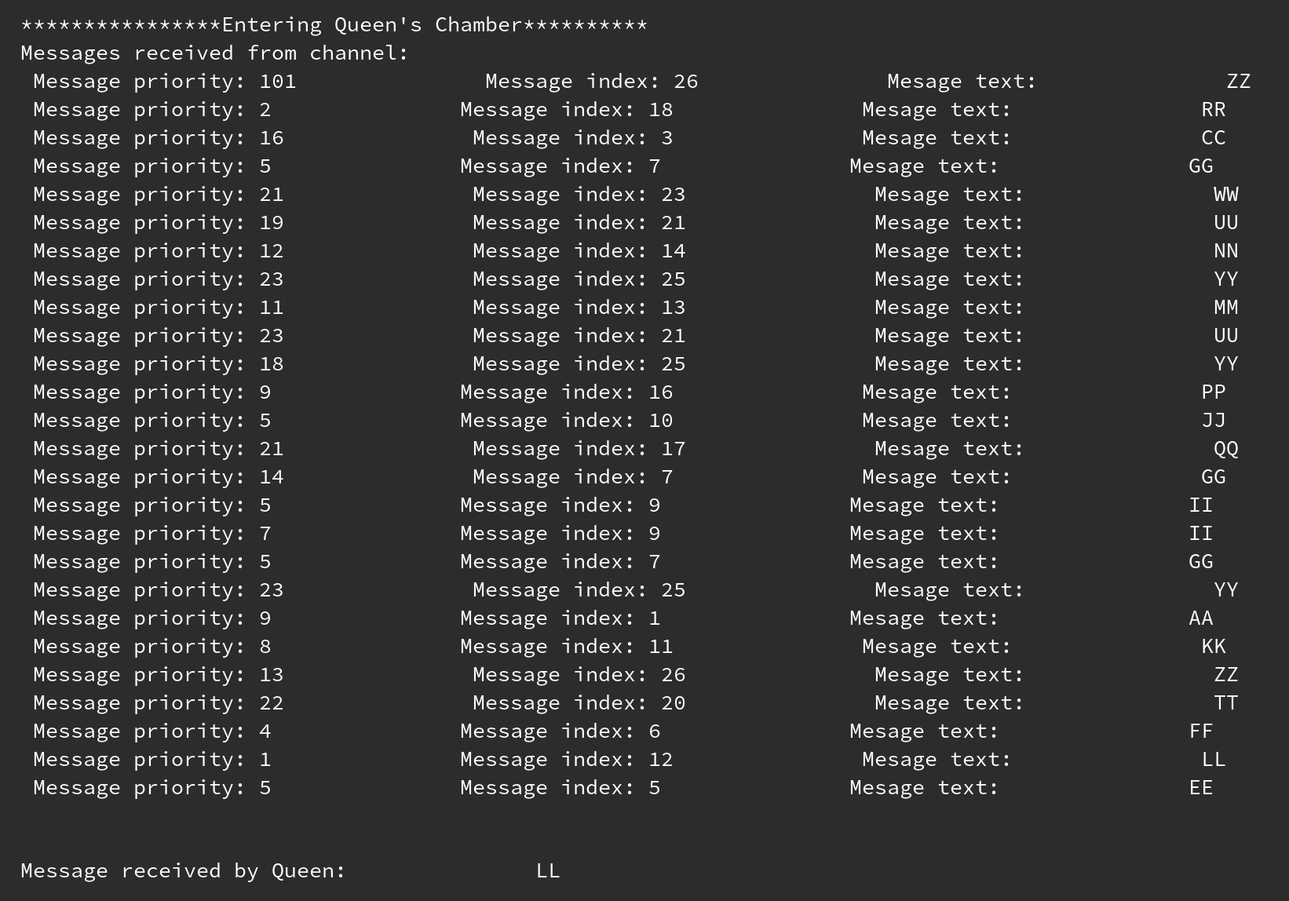
Example Output

Slide 16
Example Output Explained
Second iteration of loop
Shows all messages with priorities
One of the messages has priority 101
This message will not be consumed again by the queen
Message index 12 has the lowest priority, so it is consumed by the queen
Prints the text of the consumed message

Slide 17
In an Ideal Situation
Program would consume messages, but more would keep being generated
No end state – would only end when the program is canceled by force

Slide 18
References
[1] Promela reference -- chan(2). [Online]. Available: https://spinroot.com/spin/Man/chan.html. [Accessed: 23-Nov-2021].
[2] Promela V4 reference -- c_code(7). [Online]. Available: https://spinroot.com/spin/Man/c_code.html. [Accessed: 23-Nov-2021].
[3] Promela V4 reference -- c_decl(7). [Online]. Available: https://spinroot.com/spin/Man/c_decl.html. [Accessed: 23-Nov-2021].
[4] Promela V4 reference -- c_expr(7). [Online]. Available: https://spinroot.com/spin/Man/c_expr.html. [Accessed: 23-Nov-2021].

Slide 19
References (cont’d)
[5] Promela reference -- mtype(2). [Online]. Available: https://spinroot.com/spin/Man/mtype.html. [Accessed: 23-Nov-2021].
[6] Promela reference -- receive(4). [Online]. Available: https://spinroot.com/spin/Man/receive.html. [Accessed: 23-Nov-2021].
[7] Promela reference -- send(4). [Online]. Available: https://spinroot.com/spin/Man/send.html. [Accessed: 23-Nov-2021].

