Slide 1
Sampling Distributions
IPS Chapter 5
5.1: The Sampling Distribution of a Sample Mean
5.2: Sampling Distributions for Counts and Proportions
© 2012 W.H. Freeman and Company
Notes:
Alternate to slide 1

Slide 2
Sampling Distributions
5.1 The Sampling Distribution of a Sample Mean
© 2012 W.H. Freeman and Company

Slide 3

Objectives
5.1 Sampling distribution of a sample mean
The mean and standard deviation of
For normally distributed populations
The central limit theorem
Weibull distributions

Slide 4
Reminder: the two types of data
Quantitative
  Something that can be counted or measured and then averaged across individuals in the population (e.g., your height, your age, your IQ score)
Categorical
  Something that falls into one of several categories. What can be counted is the proportion of individuals in each category (e.g., your gender, your hair color, your blood type—A, B, AB, O).
How do you figure it out? Ask:
  What are the n individuals/units in the sample (of size “n”)?
  What is being recorded about those n individuals/units?
  Is that a number (→ quantitative) or a statement (→ categorical)?

Slide 5
Reminder: What is a sampling distribution?
The sampling distribution of a statistic is the distribution of all possible values taken by the statistic when all possible samples of a fixed size n are taken from the population. It is a theoretical idea—we do not actually build it.
The sampling distribution of a statistic is the probability distribution of that statistic.

Slide 6
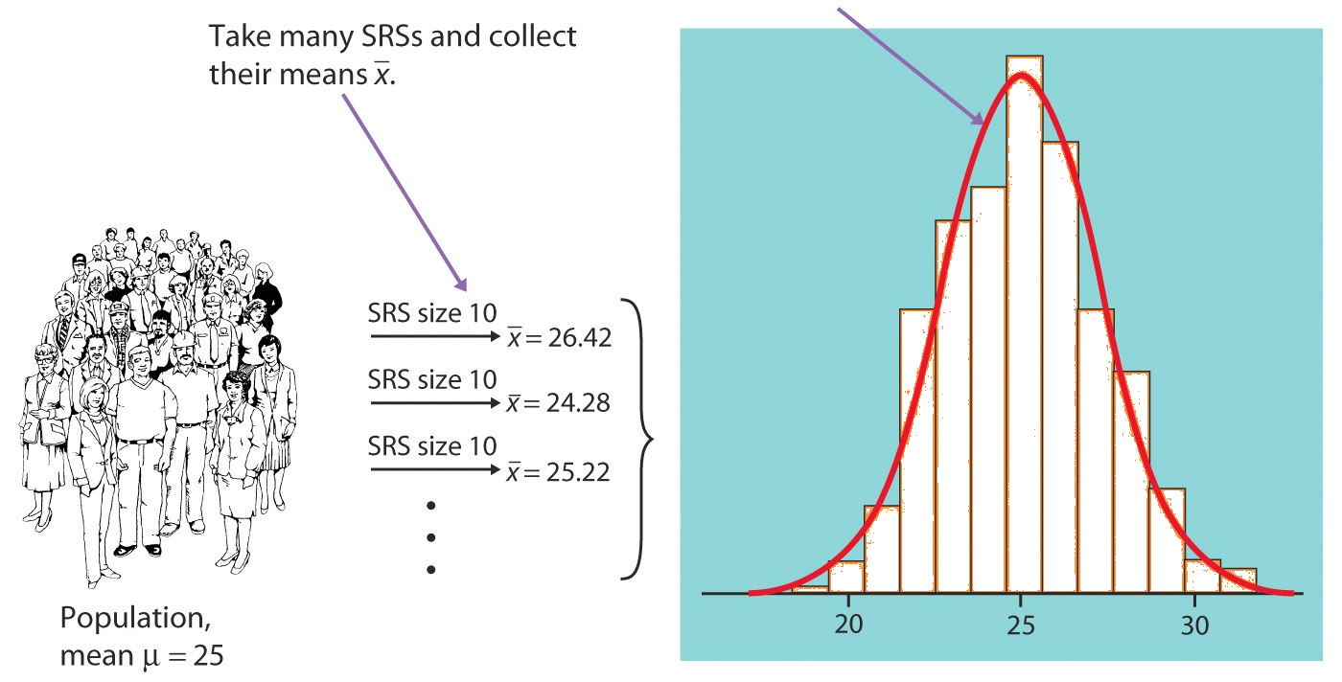
Sampling distribution of the sample mean
We take many random samples of a given size n from a population with mean μ and standard deviation σ.
Some sample means will be above the population mean μ and some will be below, making up the sampling distribution.
Sampling distribution of “x bar”
Histogram of some sample averages

Slide 7



For any population with mean μ and standard deviation σ:
The mean, or center of the sampling distribution of , is equal to the population mean μ : .
The standard deviation of the sampling distribution is σ/√n, where n is the sample size : .
Sampling distribution of x bar
σ/√n
μ

Slide 8
Mean of a sampling distribution of
  There is no tendency for a sample mean to fall systematically above or below μ, even if the distribution of the raw data is skewed. Thus, the mean of the sampling distribution is an unbiased estimate of the population mean μ — it will be “correct on average” in many samples.
Standard deviation of a sampling distribution of
  The standard deviation of the sampling distribution measures how much the sample statistic varies from sample to sample. It is smaller than the standard deviation of the population by a factor of √n. ➔ Averages are less variable than individual observations.

Slide 9
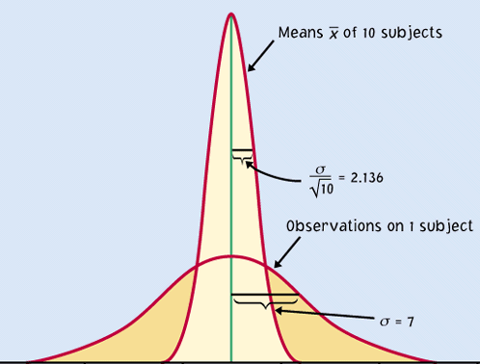
For normally distributed populations
When a variable in a population is normally distributed, the sampling distribution of for all possible samples of size n is also normally distributed.
Sampling distribution
If the population is N(μ, σ) then the sample means distribution is N(μ, σ/√n).
Population

Slide 10
IQ scores: population vs. sample
In a large population of adults, the mean IQ is 112 with standard deviation 20. Suppose 200 adults are randomly selected for a market research campaign.
The distribution of the sample mean IQ is:
A) Exactly normal, mean 112, standard deviation 20
B) Approximately normal, mean 112, standard deviation 20
C) Approximately normal, mean 112 , standard deviation 1.414
D) Approximately normal, mean 112, standard deviation 0.1
C) Approximately normal, mean 112 , standard deviation 1.414
Population distribution : N(μ = 112; σ = 20)
Sampling distribution for n = 200 is N(μ = 112; σ /√n = 1.414)

Slide 11
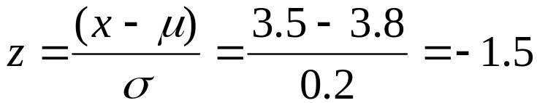
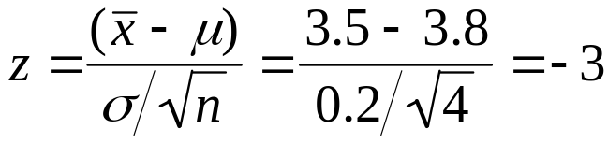
Application
Hypokalemia is diagnosed when blood potassium levels are below 3.5mEq/dl. Let’s assume that we know a patient whose measured potassium levels vary daily according to a normal distribution N(μ = 3.8, σ = 0.2).
If only one measurement is made, what is the probability that this patient will be misdiagnosed with Hypokalemia?
, P(z < −1.5) = 0.0668 ≈ 7%
Instead, if measurements are taken on 4 separate days, what is the probability of a misdiagnosis?
, P(z < −3) = 0.0013 ≈ 0.1%
Note: Make sure to standardize (z) using the standard deviation for the sampling distribution.

Slide 12
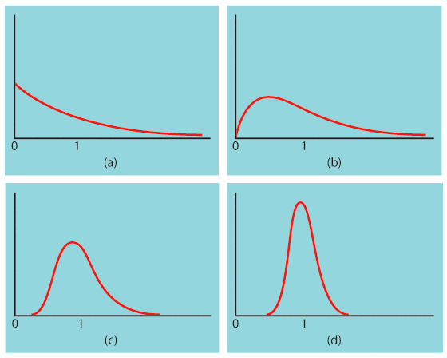
The central limit theorem
Central Limit Theorem: When randomly sampling from any population with mean μ and standard deviation σ, when n is large enough, the sampling distribution of is approximately normal: ~ N(μ, σ/√n).
Population with strongly skewed distribution
Sampling distribution of for n = 2 observations
Sampling distribution of for n = 10 observations
Sampling distribution of
for n = 25
observations

Slide 13
Practical note
Large samples are not always attainable.
  Sometimes the cost, difficulty, or preciousness of what is studied drastically limits any possible sample size.
  Blood samples/biopsies: No more than a handful of repetitions are acceptable. Oftentimes, we even make do with just one.
  Opinion polls have a limited sample size due to time and cost of operation. During election times, though, sample sizes are increased for better accuracy.
Not all variables are normally distributed.
  Income, for example, is typically strongly skewed.
  Is still a good estimator of μ then?

Slide 14
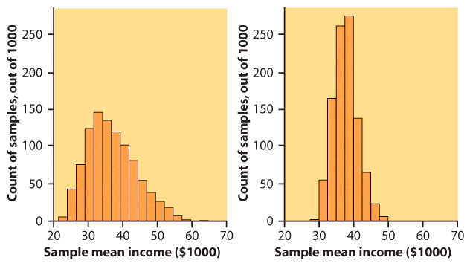
Income distribution
Let’s consider the very large database of individual incomes from the Bureau of Labor Statistics as our population. It is strongly right skewed.
  We take 1000 SRSs of 100 incomes, calculate the sample mean for each, and make a histogram of these 1000 means.
  We also take 1000 SRSs of 25 incomes, calculate the sample mean for each, and make a histogram of these 1000 means.
Which histogram corresponds to samples of size 100? 25?
$$$

Slide 15
How large a sample size?
It depends on the population distribution. More observations are required if the population distribution is far from normal.
  A sample size of 25 is generally enough to obtain a normal sampling distribution from a strong skewness or even mild outliers.
  A sample size of 40 will typically be good enough to overcome extreme skewness and outliers.
In many cases, n = 25 isn’t a huge sample. Thus, even for strange population distributions we can assume a normal sampling distribution of the mean and work with it to solve problems.

Slide 16

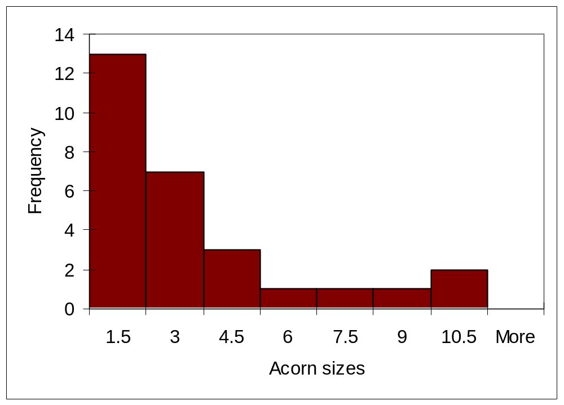
Sampling distributions
Atlantic acorn sizes (in cm³)
— sample of 28 acorns:
Describe the histogram.
What do you assume for the
population distribution?
What would be the shape of the sampling distribution of the mean:
  For samples of size 5?
  For samples of size 15?
  For samples of size 50?

Slide 17
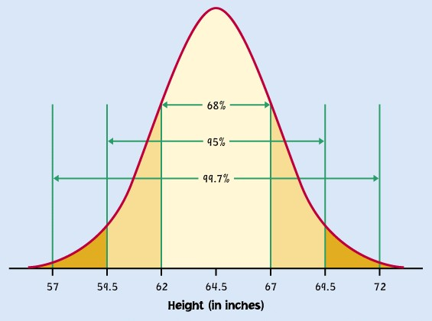
Further properties
Any linear combination of independent normal random variables is also normally distributed.
More generally, the central limit theorem is valid as long as we are sampling many small random events, even if the events have different distributions (as long as no one random event dominates the others).
Why is this cool? It explains why the normal distribution is so common.
Example: Height seems to be determined by a large number of genetic and environmental factors, like nutrition. The “individuals” are genes and environmental factors. Your height is a mean.

Slide 18
Weibull distributions
There are many probability distributions beyond the binomial and normal distributions used to model data in various circumstances.
Weibull distributions are used to model time to failure/product lifetime and are common in engineering to study product reliability.
Product lifetimes can be measured in units of time, distances, or number of cycles for example. Some applications include:
Quality control (breaking strength of products and parts, food shelf life)
Maintenance planning (scheduled car revision, airplane maintenance)
Cost analysis and control (number of returns under warranty, delivery time)
Research (materials properties, microbial resistance to treatment)

Slide 19
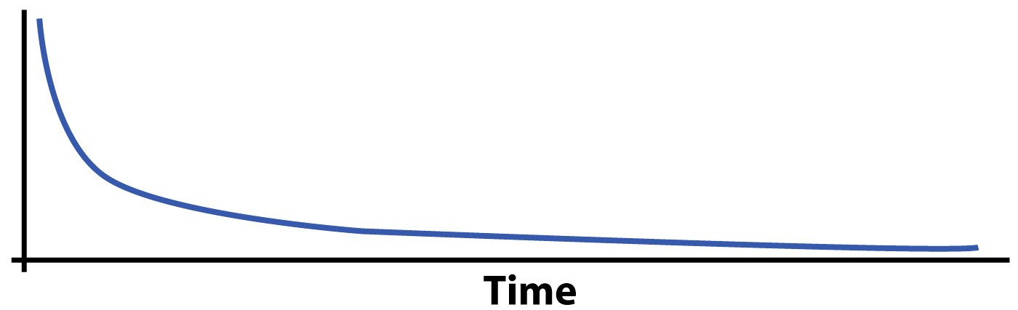
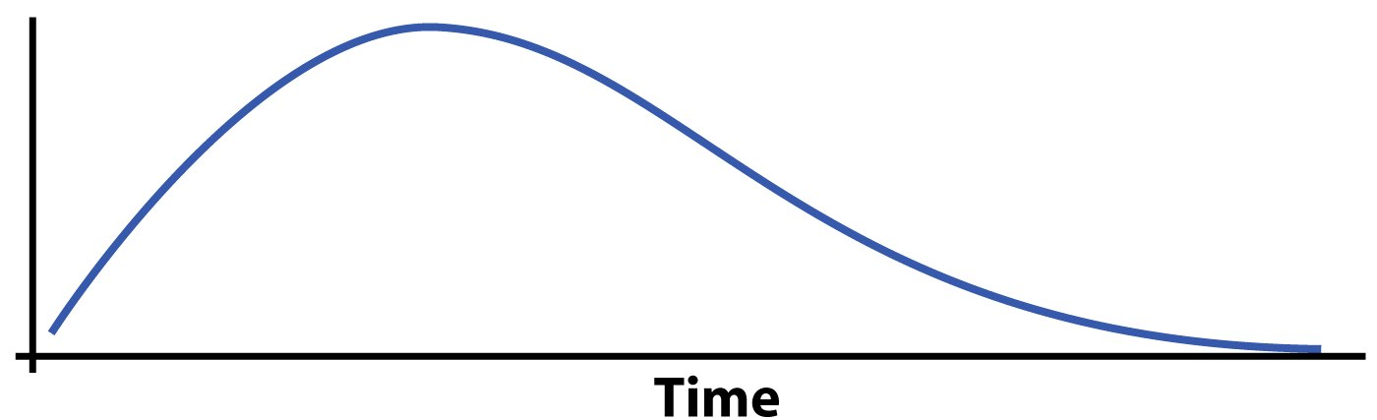
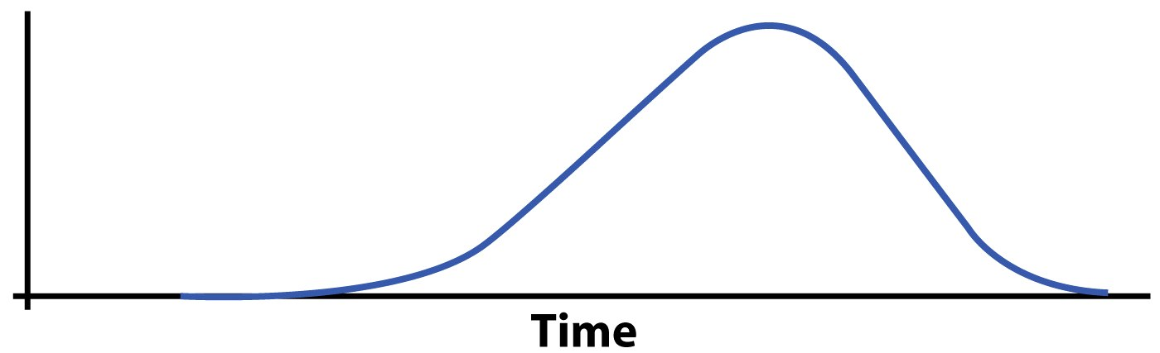
Density curves of three members of the Weibull family describing a different type of product time to failure in manufacturing:
Infant mortality: Many products fail immediately and the remainders last a long time. Manufacturers only ship the products after inspection.
Early failure: Products usually fail shortly after they are sold. The design or production must be fixed.
Old-age wear out: Most products wear out over time, and many fail at about the same age. This should be disclosed to customers.

Slide 20
Sampling Distributions
5.2 Sampling Distributions For Counts and Proportions
© 2012 W. H. Freeman and Company

Slide 21
Objectives
5.2 Sampling distributions for counts and proportions
Binomial distributions for sample counts
Binomial distributions in statistical sampling
Binomial mean and standard deviation
Sample proportions
Normal approximation
Binomial formulas

Slide 22
Binomial distributions for sample counts
Binomial distributions are models for some categorical variables, typically representing the number of successes in a series of n trials.
The observations must meet these requirements:
  The total number of observations n is fixed in advance.
  Each observation falls into just 1 of 2 categories: success and failure.
  The outcomes of all n observations are statistically independent.
  All n observations have the same probability of “success,” p.
We record the next 50 births at a local hospital. Each newborn is either a boy or a girl; each baby is either born on a Sunday or not.

Slide 23
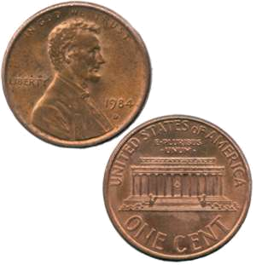
We express a binomial distribution for the count X of successes among n observations as a function of the parameters n and p: B(n,p).
The parameter n is the total number of observations.
The parameter p is the probability of success on each observation.
The count of successes X can be any whole number between 0 and n.
A coin is flipped 10 times. Each outcome is either a head or a tail.
The variable X is the number of heads among those 10 flips, our count of “successes.”
On each flip, the probability of success, “head,” is 0.5. The number X of heads among 10 flips has the binomial distribution B(n = 10, p = 0.5).

Slide 24
Applications for binomial distributions
Binomial distributions describe the possible number of times that a particular event will occur in a sequence of observations.
They are used when we want to know about the occurrence of an event, not its magnitude.
  In a clinical trial, a patient’s condition may improve or not. We study the number of patients who improved, not how much better they feel.
  Is a person ambitious or not? The binomial distribution describes the number of ambitious persons, not how ambitious they are.
  In quality control we assess the number of defective items in a lot of goods, irrespective of the type of defect.

Slide 25

Imagine that coins are spread out so that half of them are heads up, and half tails up. Close your eyes and pick one. The probability that this coin is heads up is 0.5.
However, if you don’t put the coin back in the pile, the probability of picking up another coin and having it be heads up is now less than 0.5. The successive observations are not independent.
Likewise, choosing a simple random sample (SRS) from any population is not quite a binomial setting. However, when the population is large, removing a few items has a very small effect on the composition of the remaining population: successive observations are very nearly independent.

Slide 26
Binomial distribution in statistical sampling
A population contains a proportion p of successes. If the population is much larger than the sample, the count X of successes in an SRS of size n has approximately the binomial distribution B(n, p).
The n observations will be nearly independent when the size of the population is much larger than the size of the sample. As a rule of thumb, the binomial sampling distribution for counts can be used when the population is at least 20 times as large as the sample.

Slide 27
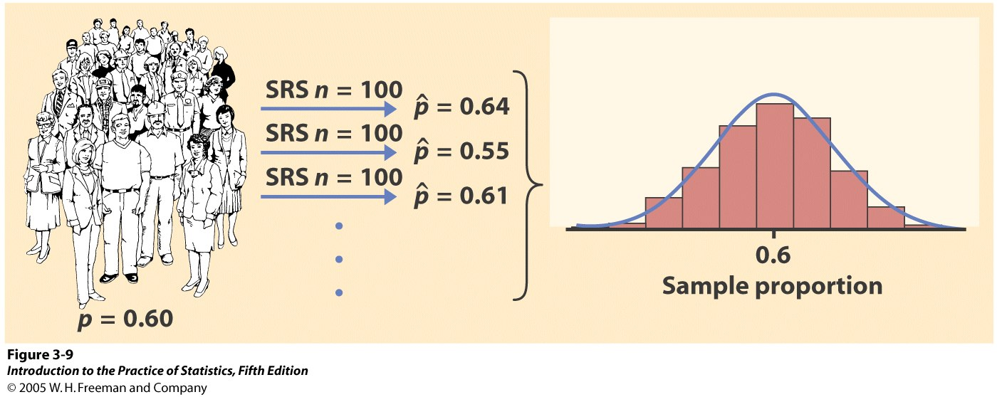
Reminder: Sampling variability
Each time we take a random sample from a population, we are likely to get a different set of individuals and calculate a different statistic. This is called sampling variability.
If we take a lot of random samples of the same size from a given population, the variation from sample to sample—the sampling distribution—will follow a predictable pattern.

Slide 28
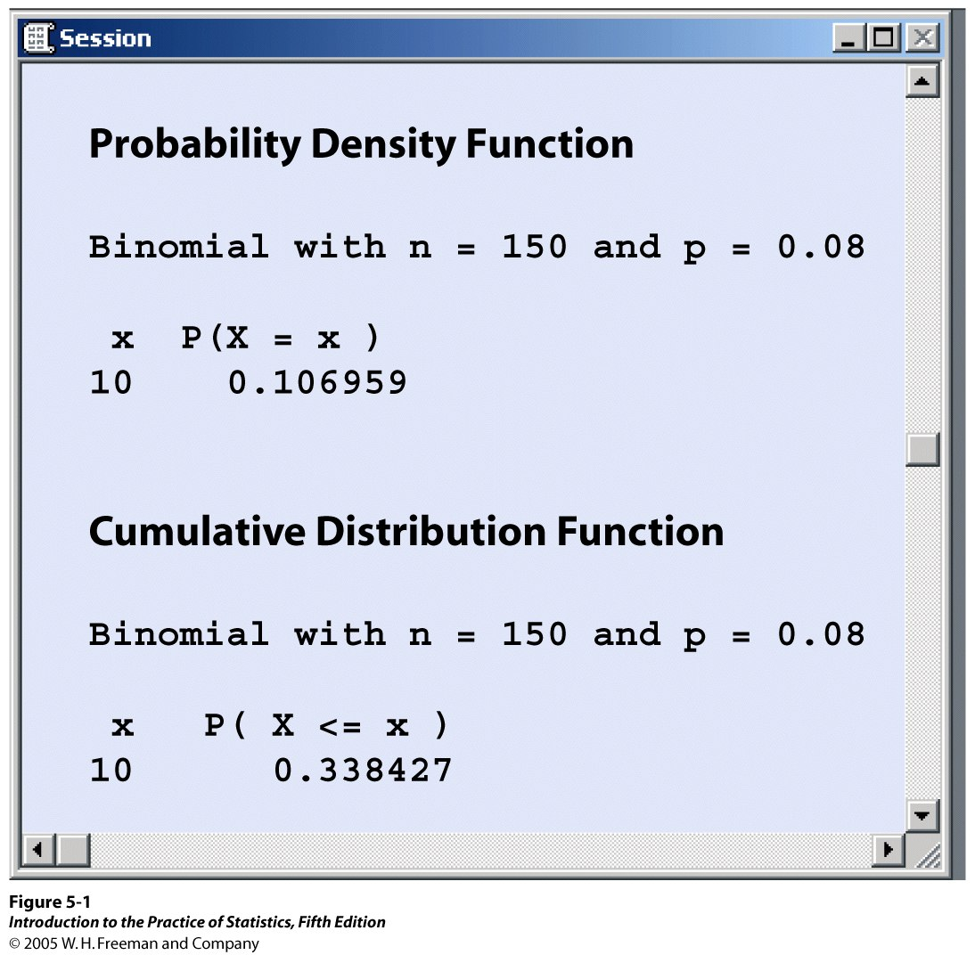
Calculations
The probabilities for a Binomial distribution can be calculated by using software.
In Minitab,
Menu/Calc/
Probability Distributions/Binomial
Choose “Probability” for the
probability of a given number of
successes P(X = x)
Or “Cumulative probability” for
the density function P(X ≤ x)

Slide 29
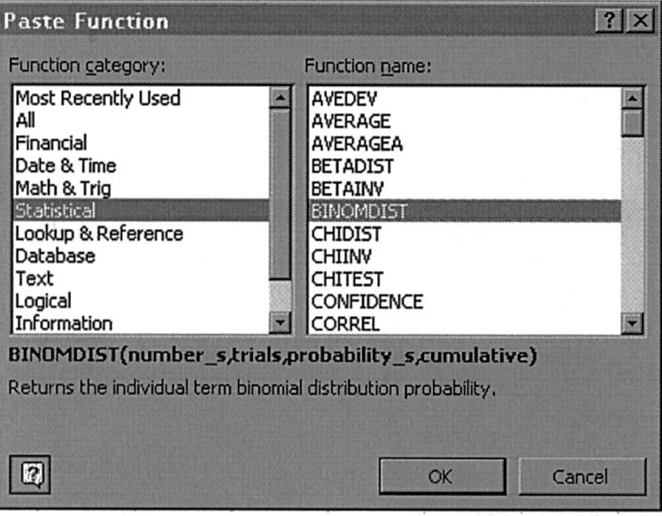
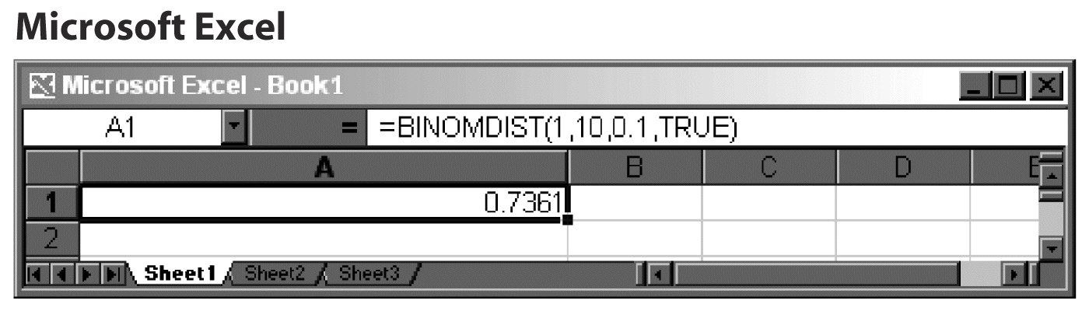
Software commands: Excel:
=BINOMDIST (number_s, trials, probability_s, cumulative)
Number_s:
number of successes in trials.
Trials:
number of independent trials.
Probability_s:
probability of success on each trial.
Cumulative:
a logical value that determines
the form of the function.
  TRUE, or 1, for the cumulative
  P(X ≤ Number_s)
  FALSE, or 0, for the probability
  function P(X = Number_s).

Slide 30
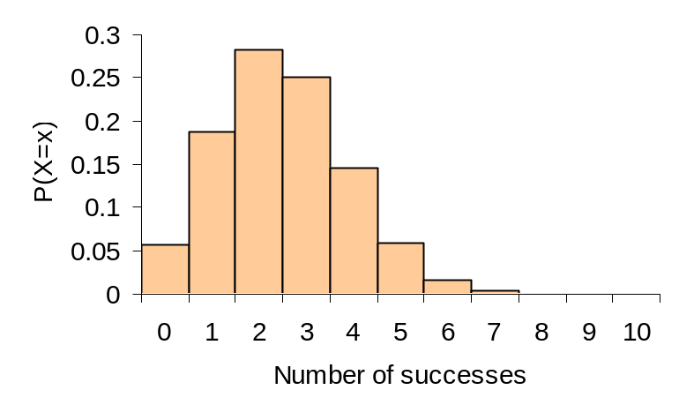
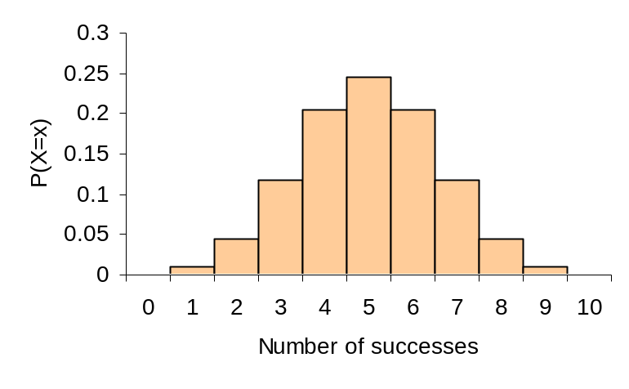
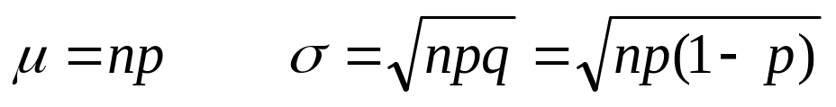
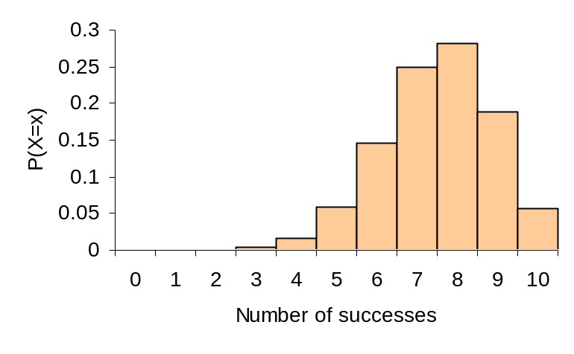
Binomial mean and standard deviation
The center and spread of the binomial distribution for a count X are defined by the mean μ and standard deviation σ:
a)
b)
We often write q as 1 – p.
Effect of changing p when n is fixed.
a) n = 10, p = 0.25
b) n = 10, p = 0.5
c) n = 10, p = 0.75
For small samples, binomial distributions are skewed when p is different from 0.5.
c)

Slide 31
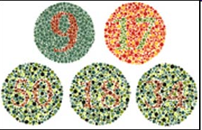
Color blindness
The frequency of color blindness (dyschromatopsia) in the
Caucasian American male population is estimated to be
about 8%. We take a random sample of size 25 from this population.
The population is definitely larger than 20 times the sample size, thus we can approximate the sampling distribution by B(n = 25, p = 0.08).
What is the probability that five individuals or fewer in the sample are color blind?
  Use Excel’s “=BINOMDIST(number_s,trials,probability_s,cumulative)”
  P(x ≤ 5) = BINOMDIST(5, 25, .08, 1) = 0.9877
What is the probability that more than five will be color blind?
  P(x > 5) = 1 − P(x ≤ 5) =1 − 0.9877 = 0.0123
What is the probability that exactly five will be color blind?
  P(x = 5) = BINOMDIST(5, 25, .08, 0) = 0.0329

Slide 32
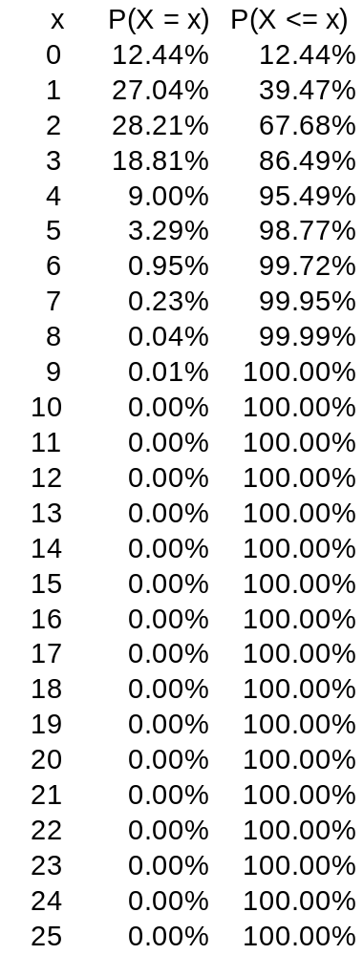
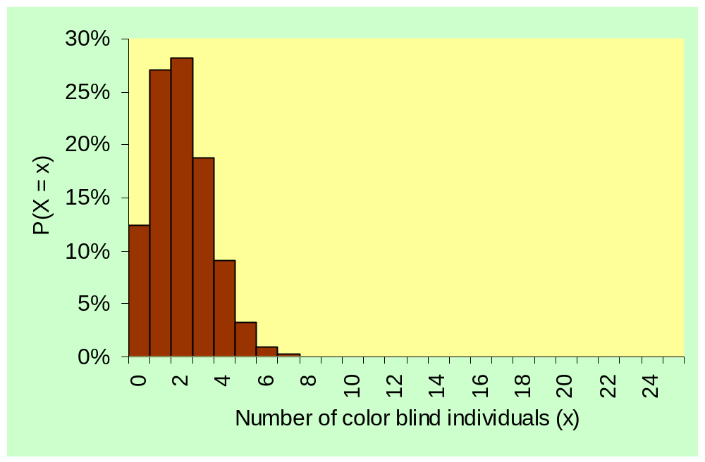
B(n = 25, p = 0.08)
Probability distribution and histogram for the number of color blind individuals among 25 Caucasian males.

Slide 33
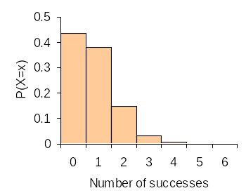
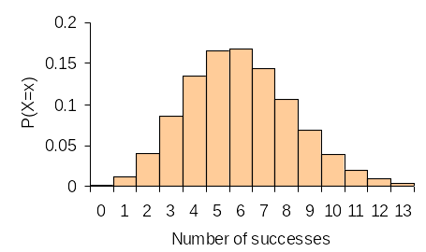
What are the mean and standard deviation of the count of color blind individuals in the SRS of 25 Caucasian American males?
µ = np = 25*0.08 = 2
σ = √np(1 − p) = √(25*0.08*0.92) = 1.36
What if we take an SRS of size 10? Of size 75?
µ = 10*0.08 = 0.8 µ = 75*0.08 = 6
σ = √(10*0.08*0.92) = 0.86 σ = √(75*0.08*0.92) = 3.35
p = .08
n = 10
p = .08
n = 75

Slide 34

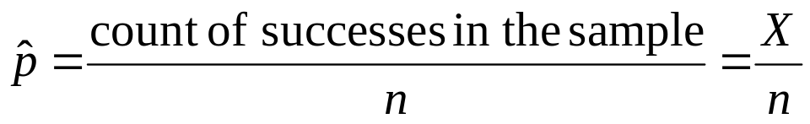
Sample proportions
The proportion of “successes” can be more informative than the count. In statistical sampling the sample proportion of successes, , is used to estimate the proportion p of successes in a population.
For any SRS of size n, the sample proportion of successes is:
In an SRS of 50 students in an undergrad class, 10 are Hispanic:
= (10)/(50) = 0.2 (proportion of Hispanics in sample)
The 30 subjects in an SRS are asked to taste an unmarked brand of coffee and rate it “would buy” or “would not buy.” Eighteen subjects rated the coffee “would buy.” = (18)/(30) = 0.6 (proportion of “would buy”)

Slide 35
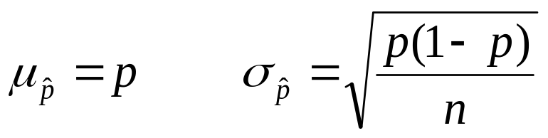
If the sample size is much smaller than the size of a population with proportion p of successes, then the mean and standard deviation of
are:
Because the mean is p, we say that the sample proportion in an SRS is an unbiased estimator of the population proportion p.
The variability decreases as the sample size increases. So larger samples usually give closer estimates of the population proportion p.

Slide 36
Normal approximation
If n is large, and p is not too close to 0 or 1, the binomial distribution can be approximated by the normal distribution N(μ = np, σ² = np(1 − p)). Practically, the Normal approximation can be used when both np ≥10 and n(1 − p) ≥10.
If X is the count of successes in the sample and = X/n, the sample proportion of successes, their sampling distributions for large n, are:
  X approximately N(µ = np, σ² = np(1 − p))
  is approximately N (µ = p, σ² = p(1 − p)/n)

Slide 37
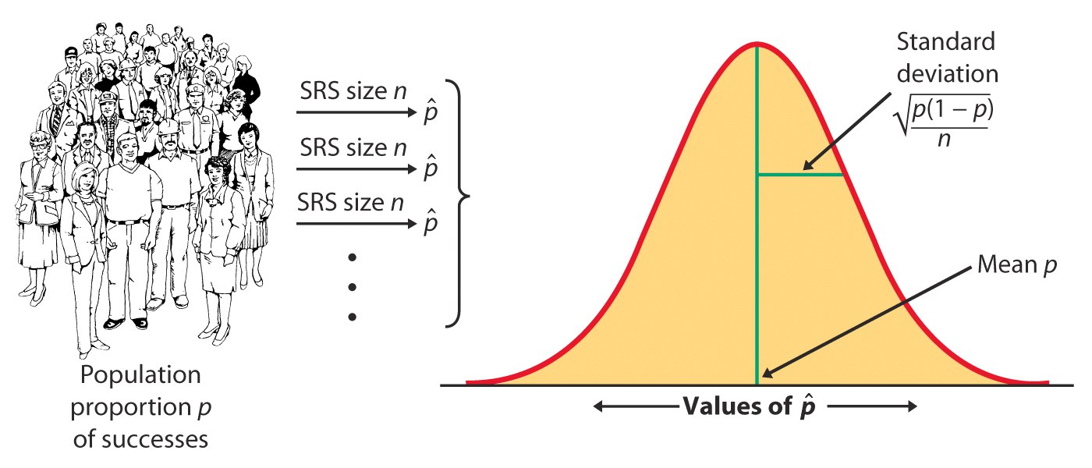
Sampling distribution of the sample proportion
The sampling distribution of is never exactly normal. But as the sample size increases, the sampling distribution of becomes approximately normal.
The normal approximation is most accurate for any fixed n when p is close to 0.5, and least accurate when p is near 0 or near 1.

Slide 38
Color blindness
The frequency of color blindness (dyschromatopsia) in the
Caucasian American male population is about 8%.
We take a random sample of size 125 from this population. What is the probability that six individuals or fewer in the sample are color blind?
  Sampling distribution of the count X: B(n = 125, p = 0.08) → np = 10
  P(X ≤ 6) = BINOMDIST(6, 125, .08, 1) = 0.1198 or about 12%
  Normal approximation for the count X: N(np = 10, √np(1 − p) = 3.033)
  P(X ≤ 6) = NORMDIST(6, 10, 3.033, 1) = 0.0936 or 9%
  Or z = (x − µ)/σ = (6 −10)/3.033 = −1.32 → P(X ≤ 6) = 0.0934 from Table A
The normal approximation is reasonable, though not perfect. Here p = 0.08 is not close to 0.5 when the normal approximation is at its best.
A sample size of 125 is the smallest sample size that can allow use of the normal approximation (np = 10 and n(1 − p) = 115).

Slide 39
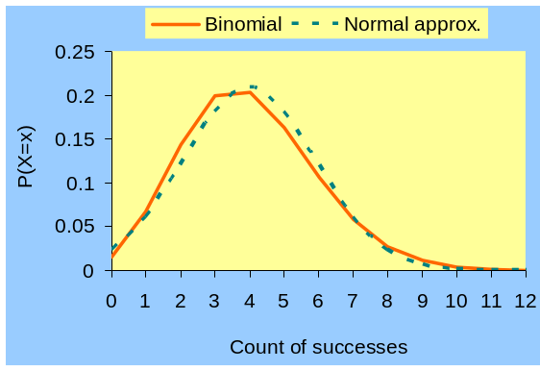
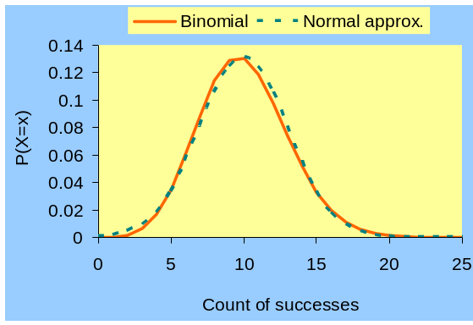
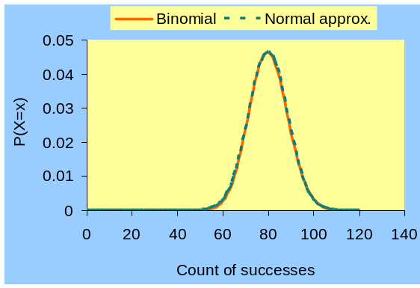
Sampling distributions for the color blindness example.
n = 50
The larger the sample size, the better the normal approximation suits the binomial distribution.
Avoid sample sizes too small for np or n(1 − p) to reach at least 10 (e.g., n = 50).
n = 125
n =1000

Slide 40
Normal approximation: continuity correction
The normal distribution is a better approximation of the binomial distribution, if we perform a continuity correction where x’ = x + 0.5 is substituted for x, and P(X ≤ x) is replaced by P(X ≤ x + 0.5).
Why? A binomial random variable is a discrete variable that can only take whole numerical values. In contrast, a normal random variable is a continuous variable that can take any numerical value.
P(X ≤ 10) for a binomial variable is P(X ≤ 10.5) using a normal approximation.
P(X < 10) for a binomial variable excludes the outcome X = 10, so we exclude the entire interval from 9.5 to 10.5 and calculate P(X ≤ 9.5) when using a normal approximation.

Slide 41
Color blindness
The frequency of color blindness (dyschromatopsia) in the
Caucasian American male population is about 8%. We
take a random sample of size 125 from this population.
  Sampling distribution of the count X: B(n = 125, p = 0.08) → np = 10
  P(X ≤ 6.5) = P(X ≤ 6) = BINOMDIST(6, 125, .08, 1) = 0.1198
  P(X < 6) = P(X ≤ 5) = BINOMDIST(5, 125, .08, 1) = 0.0595
  Normal approximation for the count X: N(np =10, √np(1 − p) = 3.033)
  P(X ≤ 6.5) = NORMDIST(6.5, 10, 3.033, 1) = 0.1243
  P(X ≤ 6) = NORMDIST(6, 10, 3.033, 1) = 0.0936 ≠ P(X ≤ 6.5)
  P(X < 6) = P(X ≤ 6) = NORMDIST(6, 10, 3.033, 1) = 0.0936
The continuity correction provides a more accurate estimate:
Binomial P(X ≤ 6) = 0.1198 → this is the exact probability
Normal P(X ≤ 6) = 0.0936, while P(X ≤ 6.5) = 0.1243 → estimates

Slide 42
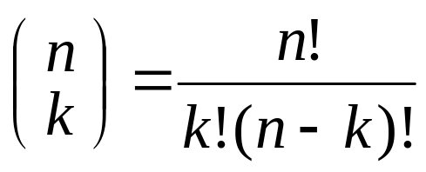
Binomial formulas
The number of ways of arranging k successes in a series of n observations (with constant probability p of success) is the number of possible combinations (unordered sequences).
This can be calculated with the binomial coefficient:
Where k = 0, 1, 2, ..., or n.

Slide 43
Binomial formulas
The binomial coefficient “n_choose_k” uses the factorial notation “!”.
The factorial n! for any strictly positive whole number n is:
n! = n × (n − 1) × (n − 2) × · · · × 3 × 2 × 1
For example: 5! = 5 × 4 × 3 × 2 × 1 = 120
Note that 0! = 1.

Slide 44
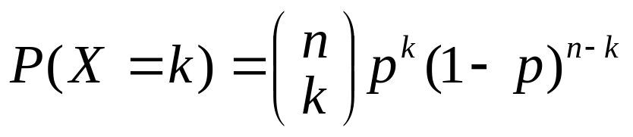
Calculations for binomial probabilities
The binomial coefficient counts the number of ways in which k successes can be arranged among n observations.
The binomial probability P(X = k) is this count multiplied by the probability of any specific arrangement of the k successes:
X | P(X)
0 1 2 … k … n | _{n}C₀ p⁰q^{n} = q^{n} _{n}C₁ p¹q^{n-1} _{n}C₂ p²q^{n-2} … _{n}C_{x} p^{k}q^{n-k} … _{n}C_{n} p^{n}q⁰ = p^{n}
Total | 1
The probability that a binomial random variable takes any range of values is the sum of each probability for getting exactly that many successes in n observations.
P(X ≤ 2) = P(X = 0) + P(X = 1) + P(X = 2)

Slide 45
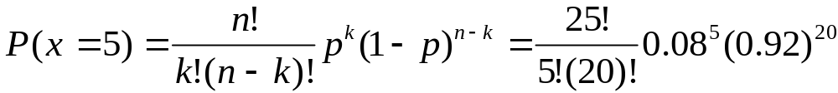
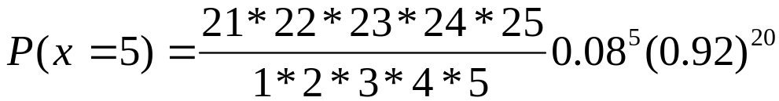
Color blindness
The frequency of color blindness (dyschromatopsia) in the
Caucasian American male population is estimated to be
about 8%. We take a random sample of size 25 from this population.
What is the probability that exactly five individuals in the sample are color blind?
  Use Excel’s “=BINOMDIST(number_s,trials,probability_s,cumulative)”
  P(x = 5) = BINOMDIST(5, 25, 0.08, 0) = 0.03285
  P(x = 5) = 53,130 * 0.0000033 * 0.1887 = 0.03285

Slide 46
Alternate Slides
The following slides offer alternate software output data and examples for this presentation.

Slide 47
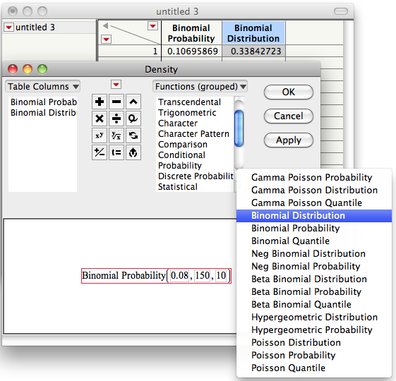
Calculations
The probabilities for a Binomial distribution can be calculated by using software.
In JMP,
Highlight a column,
click the column triangle ( ), and click formula to open the box on the right.
Select Discrete Probability
Choose “Binomial Probability” for the probability of a given number of
successes P(X = x)
Or “Binomial Distribution” for
the density function P(X ≤ x)
Enter values for p, n and x as shown in the diagram.
Click “OK.”
P(X≤x) is illustrated.
Notes:
Alternate to slide 28, using JMP.

Slide 48
Color blindness
The frequency of color blindness (dyschromatopsia) in the
Caucasian American male population is estimated to be
about 8%. We take a random sample of size 20 from this population.
What is the probability that exactly five individuals in the sample are color blind?
  Use JMPs: Probability ➔ Binomial Probability (0.08, 20, 5)
  P(x= 5) = Binomial Probability (0.08, 20, 5) = 0.0145 – or use Table C
  P(x= 5) = (n! / k!(n −k)!)p^{k}(1 −p)^{n-k} = (20! / 5!(15)!) 0.08⁵0.92¹⁵
  P(x= 5) = (16*17*18*19*20 / 1*2*3*4*5) 0.08⁵0.92¹⁵
  P(x= 5) = 15,504 * 0.0000033 * 0.286297 = 0.0145
Notes:
Alternate to slide 31.

Slide 49
Color blindness
The frequency of color blindness (dyschromatopsia) in the
Caucasian American male population is estimated to be
about 8%. We take a random sample of size 20 from this population.
The population is definitely larger than 20 times the sample size, thus we can approximate the sampling distribution by B(n = 20, p = 0.08).
What is the probability that five individuals or fewer in the sample are color blind?
  Use JMPs: Probability ➔ Binomial Distribution (0.08, 20, 5)
  P(x≤ 5) = Binomial Distribution(0.08, 20, 5) = 0.9962
What is the probability that more than five will be color blind?
  P(x> 5) = 1 −P(x≤ 5) =1 − 0.9962 = 0.0038
What is the probability that exactly five will be color blind?
  P(x= 5) = Binomial Probability (0.08, 20, 5) = 0.0145 – or use Table C
Notes:
Alternate to slide 31 with cumulative probabilities in example.

Slide 50
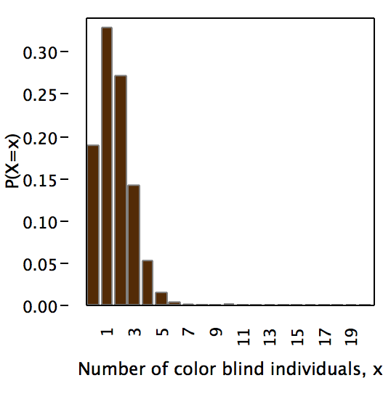
B(n = 20, p = 0.08)
Probability distribution and histogram for the number of color blind individuals among 20 Caucasian males.
Notes:
Alternate to slide 32.

Slide 51
What are the mean and standard deviation of the count of color blind individuals in the SRS of 25 Caucasian American males?
µ = np = 20*0.08 = 1.6
σ = √np(1 −p) = √(20*0.08*0.92) = 1.213
What if we take an SRS of size 10? Of size 75?
µ = 10*0.08 = 0.8 µ = 75*0.08 = 6
σ = √(10*0.08*0.92) = 0.86 σ = √(75*0.08*0.92) = 3.35
p = .08
n = 10
p = .08
n = 75
Notes:
Alternate to slide 33.

Slide 52
Color blindness
The frequency of color blindness (dyschromatopsia) in the
Caucasian American male population is estimated to be
about 8%. We take a random sample of size 20 from this population.
What is the probability that exactly five individuals in the sample are color blind?
  Use JMPs: Probability ➔ Binomial Probability (0.08, 20, 5)
  P(x= 5) = Binomial Probability (0.08, 20, 5) = 0.0145 – or use Table C
  P(x= 5) = (n! / k!(n −k)!)p^{k}(1 −p)^{n-k} = (20! / 5!(15)!) 0.08⁵0.92¹⁵
  P(x= 5) = (16*17*18*19*20 / 1*2*3*4*5) 0.08⁵0.92¹⁵
  P(x= 5) = 15,504 * 0.0000033 * 0.286297 = 0.0145
Notes:
Alternate to slide 45 with JMP in example and using n = 20 to allow use of Table C.

