Slide 1
Graphs
Chapter 10

Slide 2
Chapter Summary
Graphs and Graph Models
Graph Terminology and Special Types of Graphs
Representing Graphs and Graph Isomorphism
Connectivity
Euler and Hamiltonian Graphs
Shortest-Path Problems
Planar Graphs
Graph Coloring

Slide 3
Graphs and Graph Models
Section 10.1

Slide 4
Section Summary
Introduction to Graphs
Graph Taxonomy[tæk’sɔnəmi]
Graph Models

Slide 5
Graphs
Definition: A graph G = (V, E) consists of a nonempty set V of vertices (or nodes) and a set E of edges. Each edge has either one or two vertices associated with it, called its endpoints. An edge is said to connect its endpoints.
Remarks:
The graphs we study here are unrelated to graphs of functions studied in Chapter 2.
We have a lot of freedom when we draw a picture of a graph. All that matters is the connections made by the edges, not the particular geometry depicted. For example, the lengths of edges, whether edges cross, how vertices are depicted, and so on, do not matter
A graph with an infinite vertex set is called an infinite graph. A graph with a finite vertex set is called a finite graph. We (following the text) restrict our attention to finite graphs.
Example:
a
b
This is a graph with four vertices and five edges.
d
c

Slide 6
Some Terminology
In a simple graph each edge connects two different vertices and no two edges connect the same pair of vertices.
Multigraphs may have multiple edges connecting the same two vertices. When m different edges connect the vertices u and v, we say that {u,v} is an edge of multiplicity m.
An edge that connects a vertex to itself is called a loop.
A pseudograph may include loops, as well as multiple edges connecting the same pair of vertices.
Example:
This pseudograph has both multiple edges and a loop.
a
b
Remark: There is no standard terminology for graph theory. So, it is crucial that you understand the terminology being used whenever you read material about graphs.
c

Slide 7
Directed Graphs
Definition: An directed graph (or digraph) G = (V, E) consists of a nonempty set V of vertices (or nodes) and a set E of directed edges (or arcs). Each edge is associated with an ordered pair of vertices. The directed edge associated with the ordered pair (u,v) is said to start at u and end at v.
Remark:
Graphs where the end points of an edge are not ordered are said to be undirected graphs.

Slide 8
Some Terminology (continued)
A simple directed graph has no loops and no multiple edges.
A directed multigraph may have multiple directed edges. When there are m directed edges from the vertex u to the vertex v, we say that (u,v) is an edge of multiplicity m.
Example:
a
b
This is a directed graph with three vertices and four edges.
c
Example:
In this directed multigraph the multiplicity of (a,b) is 1 and the multiplicity of (b,c) is 2.
a
b
c

Slide 9
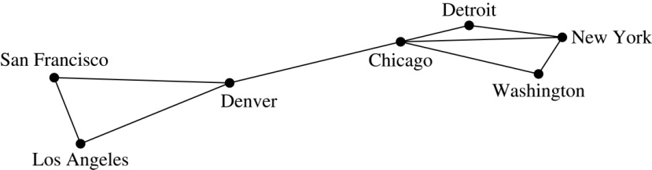
Graph Models: Computer Networks
When we build a graph model, we use the appropriate type of graph to capture the important features of the application.
We illustrate this process using graph models of different types of computer networks. In all these graph models, the vertices represent data centers and the edges represent communication links.
To model a computer network where we are only concerned whether two data centers are connected by a communications link, we use a simple graph. This is the appropriate type of graph when we only care whether two data centers are directly linked (and not how many links there may be) and all communications links work in both directions.

Slide 10
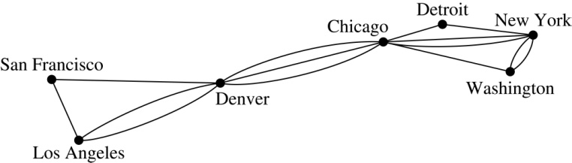
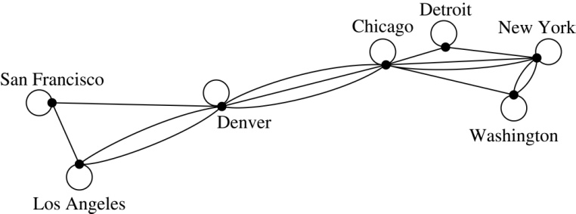
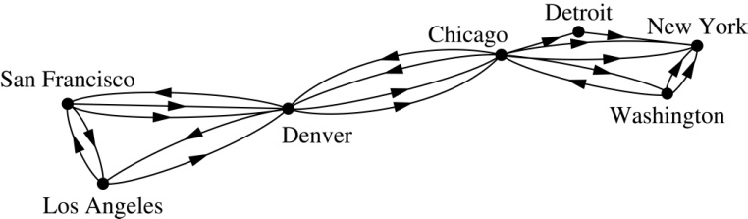
Graph Models: Computer Networks (continued)
To model a computer network where we care about the number of links between data centers, we use a multigraph.
To model a computer network with diagnostic links at data centers, we use a pseudograph, as loops are needed.
To model a network with multiple one-way links, we use a directed multigraph. Note that we could use a directed graph without multiple edges if we only care whether there is at least one link from a data center to another data center.

Slide 11
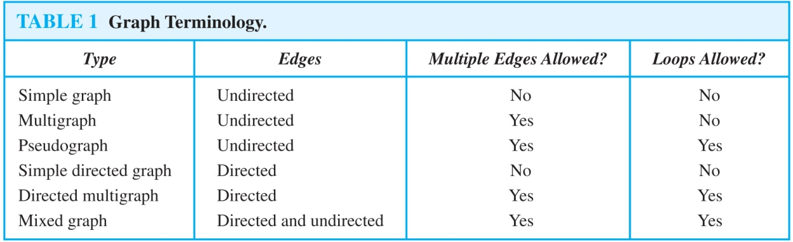
Graph Terminology: Summary
To understand the structure of a graph and to build a graph model, we ask these questions:
Are the edges of the graph undirected or directed (or both)?
If the edges are undirected, are multiple edges present that connect the same pair of vertices? If the edges are directed, are multiple directed edges present?
Are loops present?

Slide 12
Other Applications of Graphs
We will illustrate how graph theory can be used in models of:
Social networks
Communications networks
Information networks
Software design
Transportation networks
Biological networks
It’s a challenge to find a subject to which graph theory has not yet been applied. Can you find an area without applications of graph theory?

Slide 13
Graph Models: Social Networks
Graphs can be used to model social structures based on different kinds of relationships between people or groups.
In a social network, vertices represent individuals or organizations and edges represent relationships between them.
Useful graph models of social networks include:
friendship graphs - undirected graphs where two people are connected if they are friends (in the real world, on Facebook, or in a particular virtual world, and so on.)
collaboration graphs - undirected graphs where two people are connected if they collaborate in a specific way
influence graphs - directed graphs where there is an edge from one person to another if the first person can influence the second person

Slide 14
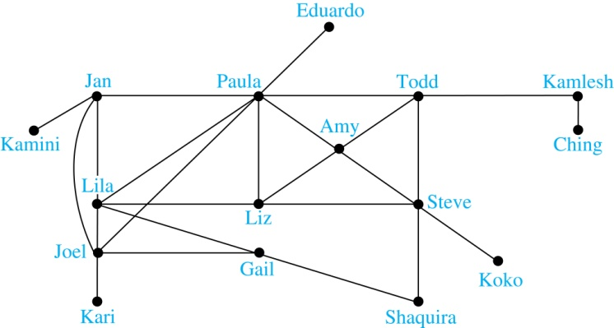
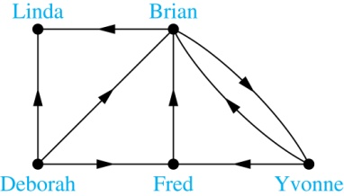
Graph Models: Social Networks (continued)
Example: A friendship graph where two people are connected if they are Facebook friends.
Example: An influence graph
Next Slide: Collaboration Graphs

Slide 15
Examples of Collaboration Graphs
The Hollywood graph models the collaboration of actors in films.
We represent actors by vertices and we connect two vertices if the actors they represent have appeared in the same movie.
We will study the Hollywood Graph in Section 10.4 when we discuss Kevin Bacon numbers.
An academic collaboration graph models the collaboration of researchers who have jointly written a paper in a particular subject.
We represent researchers in a particular academic discipline using vertices.
We connect the vertices representing two researchers in this discipline if they are coauthors of a paper.
We will study the academic collaboration graph for mathematicians when we discuss Erdős numbers in Section 10.4.

Slide 16
Applications to Information Networks
Graphs can be used to model different types of networks that link different types of information.
In a web graph, web pages are represented by vertices and links are represented by directed edges.
A web graph models the web at a particular time.
We will explain how the web graph is used by search engines in Section 11.4.
In a citation network:
Research papers in a particular discipline are represented by vertices.
When a paper cites a second paper as a reference, there is an edge from the vertex representing this paper to the vertex representing the second paper.

Slide 17
Transportation Graphs
Graph models are extensively used in the study of transportation networks.
Airline networks can be modeled using directed multigraphs where
airports are represented by vertices
each flight is represented by a directed edge from the vertex representing the departure airport to the vertex representing the destination airport
Road networks can be modeled using graphs where
vertices represent intersections and edges represent roads.
undirected edges represent two-way roads and directed edges represent one-way roads.

Slide 18
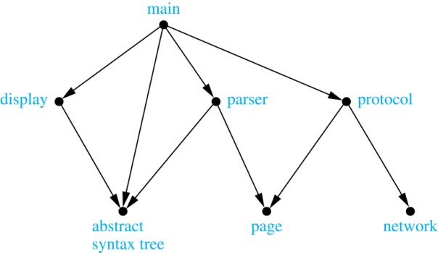
Software Design Applications
Graph models are extensively used in software design. We will introduce two such models here; one representing the dependency between the modules of a software application and the other representing restrictions in the execution of statements in computer programs.
When a top-down approach is used to design software, the system is divided into modules, each performing a specific task.
We use a module dependency graph to represent the dependency between these modules. These dependencies need to be understood before coding can be done.
In a module dependency graph vertices represent software modules and there is an edge from one module to another if the second module depends on the first.
Example: The dependencies between the seven modules in the design of a web browser are represented by this module dependency graph.

Slide 19
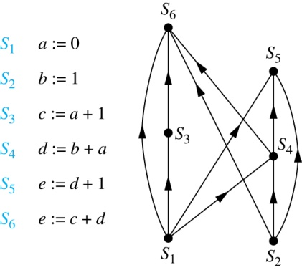
Software Design Applications (continued)
We can use a directed graph called a precedence graph to represent which statements must have already been executed before we execute each statement.
Vertices represent statements in a computer program
There is a directed edge from a vertex to a second vertex if the second vertex cannot be executed before the first
Example: This precedence graph shows which statements must already have been executed before we can execute each of the six statements in the program.

Slide 20
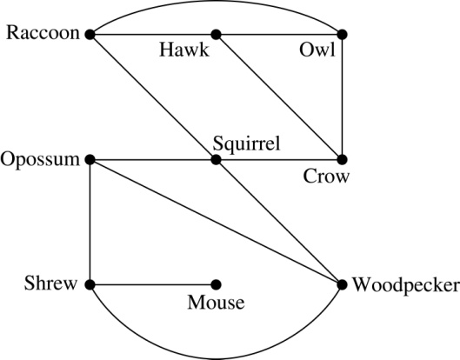
Biological Applications
Graph models are used extensively in many areas of the biological science. We will describe two such models, one to ecology and the other to molecular biology.
Niche overlap graphs model competition between species in an ecosystem
Vertices represent species and an edge connects two vertices when they represent species who compete for food resources.
Example: This is the niche overlap graph for a forest ecosystem with nine species.

Slide 21
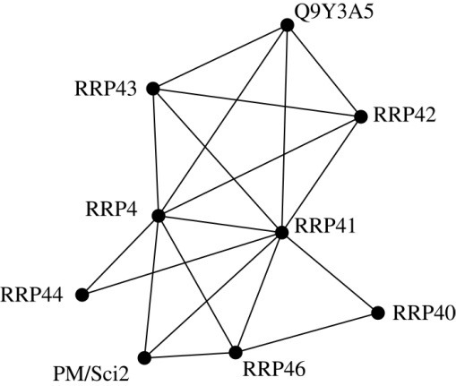
Biological Applications (continued)
We can model the interaction of proteins in a cell using a protein interaction network.
In a protein interaction graph, vertices represent proteins and vertices are connected by an edge if the proteins they represent interact.
Protein interaction graphs can be huge and can contain more than 100,000 vertices, each representing a different protein, and more than 1,000,000 edges, each representing an interaction between proteins
Protein interaction graphs are often split into smaller graphs, called modules, which represent the interactions between proteins involved in a particular function.
Example: This is a module of the protein interaction graph of proteins that degrade RNA in a human cell.

Slide 22
Exercise
P650-651 11, 33 7th edition
P596-597 11, 31 6th edition

Slide 23
Graph Terminology and Special Types of Graphs
Section 10.2

Slide 24
Section Summary
Basic Terminology
Some Special Types of Graphs
Bipartite Graphs
Bipartite Graphs and Matchings (not currently included in overheads)
Some Applications of Special Types of Graphs (not currently included in overheads)
New Graphs from Old

Slide 25
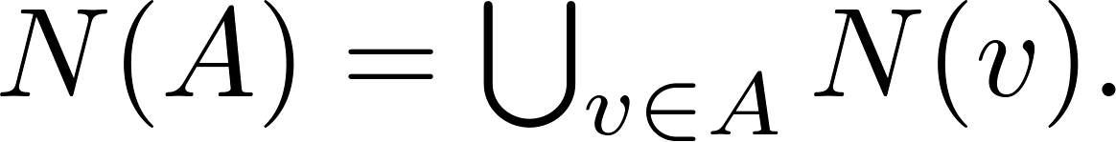
Basic Terminology
Definition 1. Two vertices u, v in an undirected graph G are called adjacent (or neighbors) in G if there is an edge e between u and v. Such an edge e is called incident with the vertices u and v and e is said to connect u and v.
Definition 2. The set of all neighbors of a vertex v of G = (V, E), denoted by N(v), is called the neighborhood of v. If A is a subset of V, we denote by N(A) the set of all vertices in G that are adjacent to at least one vertex in A. So,
Definition 3. The degree of a vertex in a undirected graph is the number of edges incident with it, except that a loop at a vertex contributes two to the degree of that vertex. The degree of the vertex v is denoted by deg(v).

Slide 26
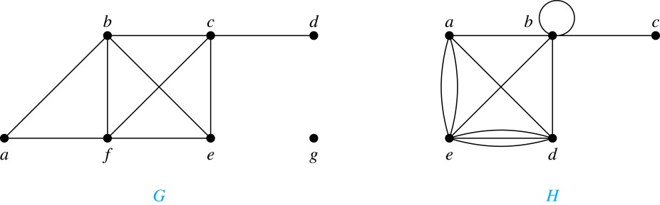
Degrees and Neighborhoods of Vertices
Example: What are the degrees and neighborhoods of the vertices in the graphs G and H?
Solution:
G: deg(a) = 2, deg(b) = deg(c) = deg(f ) = 4, deg(d ) = 1,
deg(e) = 3, deg(g) = 0.
N(a) = {b, f }, N(b) = {a, c, e, f }, N(c) = {b, d, e, f }, N(d) = {c},
N(e) = {b, c , f }, N(f) = {a, b, c, e}, N(g) = ∅ .
H: deg(a) = 4, deg(b) = deg(e) = 6, deg(c) = 1, deg(d) = 5.
N(a) = {b, d, e}, N(b) = {a, b, c, d, e}, N(c) = {b},
N(d) = {a, b, e}, N(e) = {a, b ,d}.

Slide 27
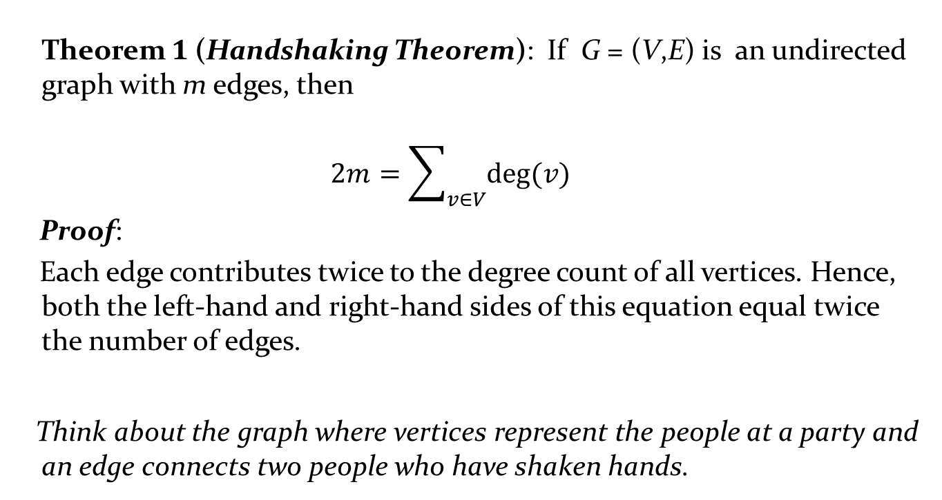
Degrees of Vertices
Theorem 1 (Handshaking Theorem): If G= (V,E) is an undirected graph with medges, then
$$2m=\sum_{v∈V}{deg⁡(v)}$$
Proof:
Each edge contributes twice to the degree count of all vertices. Hence, both the left-hand and right-hand sides of this equation equal twice the number of edges.
Think about the graph where vertices represent the people at a party and an edge connects two people who have shaken hands.

Slide 28
Handshaking Theorem
We now give two examples illustrating the usefulness of the handshaking theorem.
Example: How many edges are there in a graph with 10 vertices of degree six?
Solution: Because the sum of the degrees of the vertices is 6 ⋅ 10 = 60, the handshaking theorem tells us that 2m = 60. So the number of edges m = 30.
Example: If a graph has 5 vertices, can each vertex have degree 3?
Solution: This is not possible by the handshaking thorem, because the sum of the degrees of the vertices 3 ⋅ 5 = 15 is odd.

Slide 29
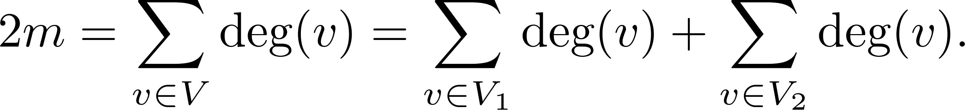
Degree of Vertices (continued)
Theorem 2: An undirected graph has an even number of vertices of odd degree.
Proof: Let V₁ be the vertices of even degree and V₂ be the vertices of odd degree in an undirected graph G = (V, E) with m edges. Then
even
This sum must be even because 2m is even and the sum of the degrees of the vertices of even degrees is also even. Because this is the sum of the degrees of all vertices of odd degree in the graph, there must be an even number of such vertices.
must be even since deg(v) is even for each v ∈ V₁

Slide 30
Directed Graphs
Recall the definition of a directed graph.
Definition: An directed graph G = (V, E) consists of V, a nonempty set of vertices (or nodes), and E, a set of directed edges or arcs. Each edge is an ordered pair of vertices. The directed edge (u,v) is said to start at u and end at v.
Definition: Let (u,v) be an edge in G. Then u is the initial vertex of this edge and is adjacent to v and v is the terminal (or end) vertex of this edge and is adjacent from u. The initial and terminal vertices of a loop are the same.

Slide 31
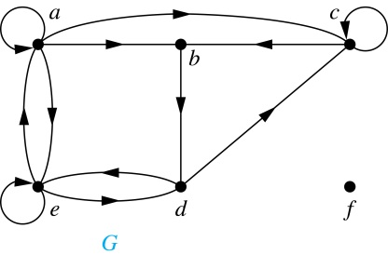
Directed Graphs (continued)
Definition: The in-degree of a vertex v, denoted deg⁻(v), is the number of edges which terminate at v. The out-degree of v, denoted deg⁺(v), is the number of edges with v as their initial vertex. Note that a loop at a vertex contributes 1 to both the in-degree and the out-degree of the vertex.
Example: In the graph G we have
deg⁻(a) = 2, deg⁻(b) = 2, deg⁻(c) = 3, deg⁻(d) = 2,
deg⁻(e) = 3, deg⁻(f) = 0.
deg⁺(a) = 4, deg⁺(b) = 1, deg⁺(c) = 2, deg⁺(d) = 2,
deg⁺ (e) = 3, deg⁺(f) = 0.

Slide 32
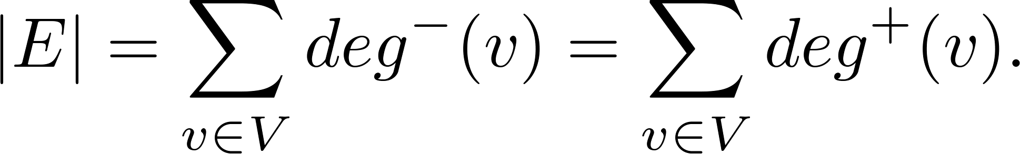
Directed Graphs (continued)
Theorem 3: Let G = (V, E) be a graph with directed edges. Then:
Proof: The first sum counts the number of outgoing edges over all vertices and the second sum counts the number of incoming edges over all vertices. It follows that both sums equal the number of edges in the graph.

Slide 33
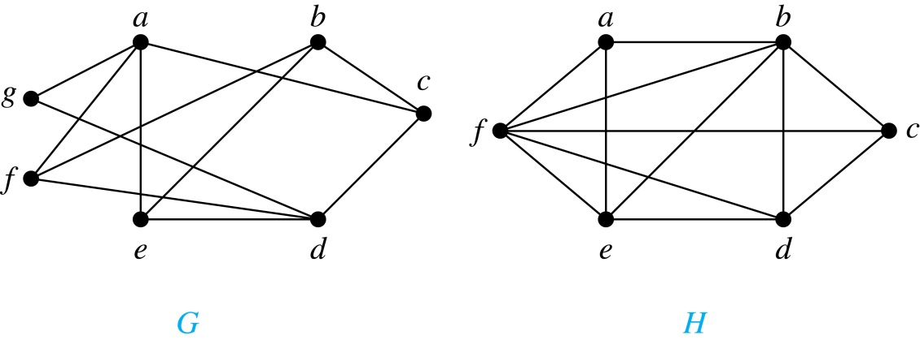
Bipartite Graphs
Definition: A simple graph G is bipartite if V can be partitioned into two disjoint subsets V₁ and V₂ such that every edge connects a vertex in V₁ and a vertex in V₂. In other words, there are no edges which connect two vertices in V₁ or in V₂.
It is not hard to show that an equivalent definition of a bipartite graph is a graph where it is possible to color the vertices red or blue so that no two adjacent vertices are the same color.
H is not bipartite
since if we color a red, then the adjacent vertices f and b must both be blue.
G is bipartite

Slide 34
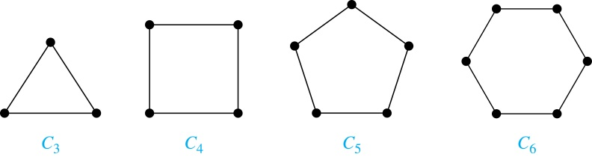
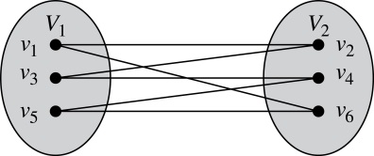
Bipartite Graphs (continued)
Example: Show that C₆ is bipartite.
Solution: We can partition the vertex set into V₁ = {v₁, v₃, v₅} and V₂ = {v₂, v₄, v₆} so that every edge of C₆ connects a vertex in V₁ and V₂ .
Example: Show that C₃ is not bipartite.
Solution: If we divide the vertex set of C₃ into two nonempty sets, one of the two must contain two vertices. But in C₃ every vertex is connected to every other vertex. Therefore, the two vertices in the same partition are connected. Hence, C₃ is not bipartite.

Slide 35
Example Is the graph G bipartite
a
b
a
c
g
e
c
b
f
d
f
d
g
e
Theorem 4 A simple graph is bipartite if and only if it is possible to assign one of two different colors to each vertex of the graph so that no two adjacent vertices are assigned the same color

Slide 36
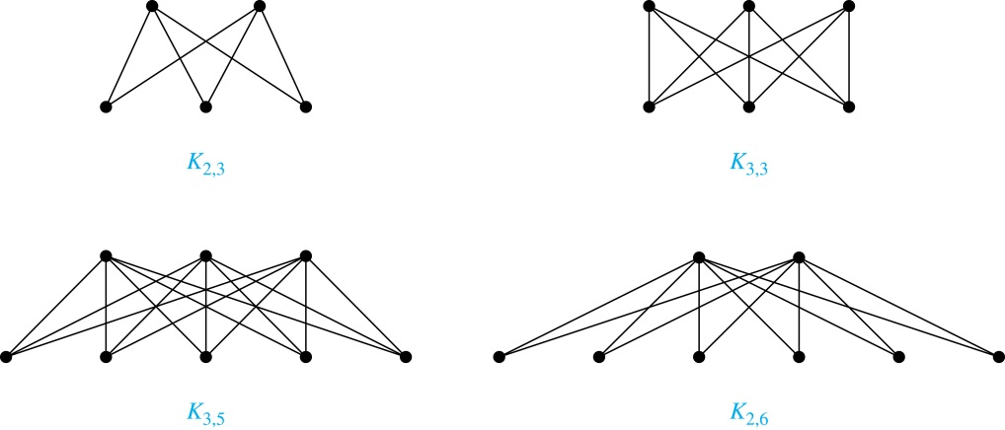
Complete Bipartite Graphs
Definition: A complete bipartite graph K_{m,n} is a graph that has its vertex set partitioned into two subsets V₁ of size m and V₂ of size n such that there is an edge from every vertex in V₁ to every vertex in V₂.
Example: We display four complete bipartite graphs here.

Slide 37
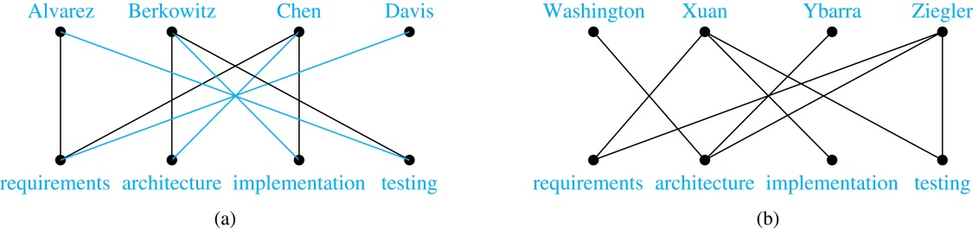
Bipartite Graphs and Matchings
Bipartite graphs are used to model applications that involve matching the elements of one set to elements in another, for example:
Job assignments - vertices represent the jobs and the employees, edges link employees with those jobs they have been trained to do. A common goal is to match jobs to employees so that the most jobs are done.
Marriage - vertices represent the men and the women and edges link a a man and a woman if they are an acceptable spouse. We may wish to find the largest number of possible marriages.
See the text for more about matchings in bipartite graphs.

Slide 38
Theorem 5 (Hall 1935)
HALL’S MARRIAGE THEOREM The bipartite graph G = (V ,E) with bipartition (V1, V2) has a complete matching from V1 to V2 if and only if |N(A)| ≥ |A| for all A ⊆ V1.
(⇒) Proof: We first prove the only if part of the theorem
a ∈ V1 has at least one neighbor, i.e., |N({a})|≥|{a}|=1.
For any a∈ V1, there is an edge ab in M for some b∈ V2
Neighbors of a and a’ in M can be distinct if a ≠ a’.
We can choose the other ends of a, a’ in M as the neighbors.
For any A, at least |A| distinct neighbors can be found.
That is, |N(A)|≥|A| for all A ⊆ V1.

Slide 39
Theorem 5 (Hall 1935) (2/6)
(⇐) To prove the if part of the theorem, the more difficult part, we need to show that if |N(A)| ≥ |A| for all A ⊆ V1, then there is a complete matching M from V1 to V2. We will use strong induction on |V1| to prove this.
Basis step: If |V1| = 1, then V1 contains a single vertex v0. Because |N({v0})| ≥ |{v0}| = 1,
there is at least one edge connecting v0 and a vertex w0 ∈ V2. Any such edge forms a complete
matching from V1 to V2.

Slide 40
Theorem 5 (Hall 1935) (3/6)
Inductive step: We first state the inductive hypothesis.
Inductive hypothesis: Let k be a positive integer. If G = (V ,E) is a bipartite graph with bipartition (V1, V2), and |V1| = j ≤ k, then there is a complete matching M from V1 to V2 whenever the condition that |N(A)| ≥ |A| for all A ⊆ V1 is met.
Now suppose that H = (W, F) is a bipartite graph with bipartition (W1,W2) and |W1| = k + 1. We will prove that the inductive holds using a proof by cases, using two case.
Case (i) applies when for all integers j with 1 ≤ j ≤ k, the vertices in every set of j elements fromW1 are adjacent to at least j + 1 elements of W2. Case (ii) applies when for some j with 1 ≤ j ≤ k there is a subset W1 of j vertices such that there are exactly j neighbors of these vertices inW2. Because either Case (i) or Case (ii) holds, we need only consider these cases to complete the inductive step.

Slide 41
Theorem 5 (Hall 1935) (4/6)
Case (i): Suppose that for all integers j with 1 ≤ j ≤ k, the vertices in every subset of j elements from W1 are adjacent to at least j + 1 elements of W2. Then, we select a vertex v ∈ W1 and an element w ∈ N({v}), which must exist by our assumption that |N({v}| ≥ |{v}| = 1. We delete v and w and all edges incident to them from H. This produces a bipartite graph H with bipartition (W1 − {v},W2 − {w}). Because |W1 − {v}| = k, the inductive hypothesis tells us there is a complete matching from W1 − {v} to W2 − {w}. Adding the edge from v to w to this complete matching produces a complete matching from W1 to W2.

Slide 42
Theorem 5 (Hall 1935) (5/6)
Case (ii): Suppose that for some j with 1 ≤ j ≤ k, there is a subset W’1 of j vertices such that there are exactly j neighbors of these vertices inW2. LetW’2 be the set of these neighbors. Then, by the inductive hypothesis there is a complete matching from W’1 to W’2. Remove these 2j vertices from W1 and W2 and all incident edges to produce a bipartite graph K with bipartition(W1 − W’1,W2 − W’2).

Slide 43
Theorem 5 (Hall 1935) (6/6)
We will show that the graph K satisfies the condition |N(A)| ≥ |A| for all subsets A ofW1 − W’1. If not, there would be a subset of t vertices of W1 − W’1 where 1 ≤ t ≤ k + 1 − j such that the vertices in this subset have fewer than t vertices of W2 − W’2 as neighbors. Then, the set of j + t vertices of W1 consisting of these t vertices together with the j vertices we removed from W1 has fewer than j + t neighbors in W2, contradicting the hypothesis that |N(A)| ≥ |A| for all A ⊆ W1.

Slide 44
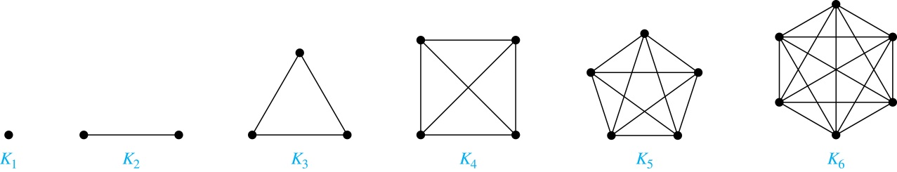
Special Types of Simple Graphs: Complete Graphs
A complete graph on n vertices, denoted by K_{n}, is the simple graph that contains exactly one edge between each pair of distinct vertices.

Slide 45
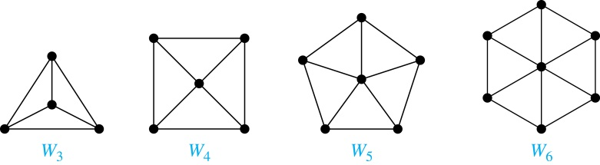
Special Types of Simple Graphs: Cycles and Wheels
A cycle C_{n} for n ≥ 3 consists of n vertices v₁, v₂ ,⋯ , v_{n}, and edges {v₁, v₂}, {v₂, v₃} ,⋯ , {v_{n-1}, v_{n}}, {v_{n}, v₁}.
A wheel W_{n} is obtained by adding an additional vertex to a cycle C_{n} for n ≥ 3 and connecting this new vertex to each of the n vertices in C_{n} by new edges.

Slide 46
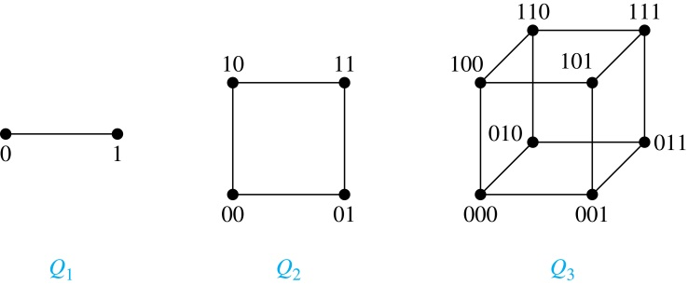
Special Types of Simple Graphs: n-Cubes
An n-dimensional hypercube, or n-cube, Q_{n}, is a graph with 2^{n} vertices representing all bit strings of length n, where there is an edge between two vertices that differ in exactly one bit position.

Slide 47
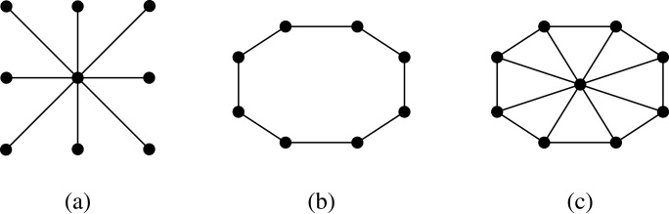
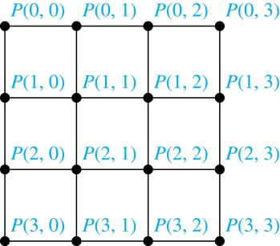
Special Types of Graphs and Computer Network Architecture
Various special graphs play an important role in the design of computer networks.
Some local area networks use a star topology, which is a complete bipartite graph K_{1,n} ,as shown in (a). All devices are connected to a central control device.
Other local networks are based on a ring topology, where each device is connected to exactly two others using C_{n} ,as illustrated in (b). Messages may be sent around the ring.
Others, as illustrated in (c), use a W_{n} – based topology, combining the features of a star topology and a ring topology.
Various special graphs also play a role in parallel processing where processors need to be interconnected as one processor may need the output generated by another.
The n-dimensional hypercube, or n-cube, Q_{n}, is a common way to connect processors in parallel, e.g., Intel Hypercube.
Another common method is the mesh network, illustrated here for 16 processors.

Slide 48
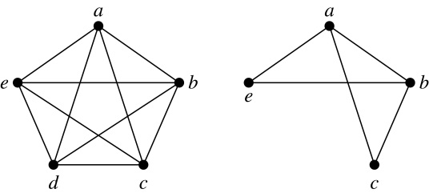
New Graphs from Old
Definition: A subgraph of a graph G = (V,E) is a graph (W,F), where W ⊂ V and F ⊂ E. A subgraph H of G is a proper subgraph of G if H ≠ G.
Example: Here we show K₅ and one of its subgraphs.
Definition: Let G = (V, E) be a simple graph. The subgraph induced by a subset W of the vertex set V is the graph (W,F), where the edge set F contains an edge in E if and only if both endpoints are in W.
Example: Here we show K₅ and the subgraph induced by W = {a,b,c,e}.

Slide 49
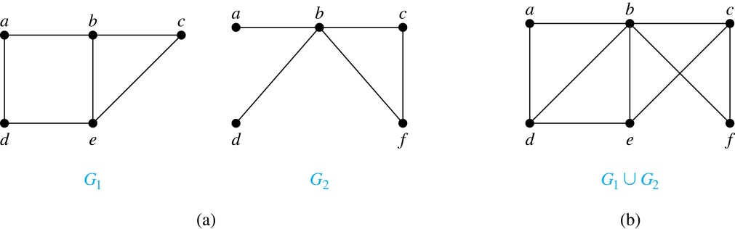
New Graphs from Old (continued)
Definition: The union of two simple graphs G₁ = (V₁, E₁) and G₂ = (V₂, E₂) is the simple graph with vertex set V₁ ⋃ V₂ and edge set E₁ ⋃ E₂. The union of G₁ and G₂ is denoted by G₁ ⋃ G₂.
Example:

Slide 50
Exercise
P666-667 25, 47 7th edition
P608-611 25, 41 6th edition

Slide 51
Representing Graphs and Graph Isomorphism
Section 10.3

Slide 52
Section Summary
Adjacency Lists
Adjacency Matrices
Incidence Matrices
Isomorphism of Graphs

Slide 53
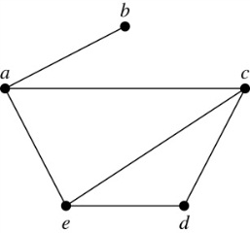
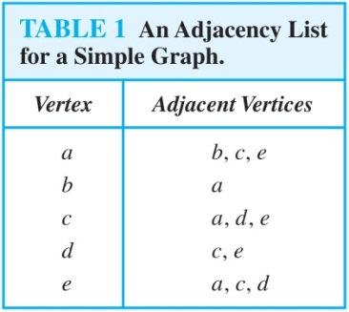
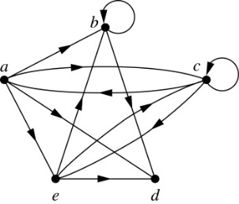
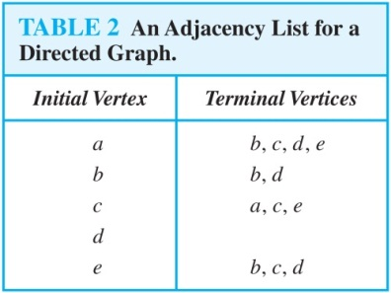
Representing Graphs: Adjacency Lists
Definition: An adjacency list can be used to represent a graph with no multiple edges by specifying the vertices that are adjacent to each vertex of the graph.
Example:
Example:

Slide 54
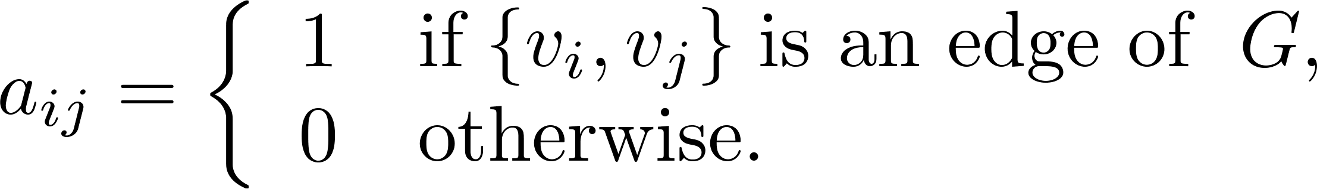
Representation of Graphs: Adjacency Matrices
Definition: Suppose that G = (V, E) is a simple graph where |V| = n. Arbitrarily list the vertices of G as v₁, v₂, … , v_{n}. The adjacency matrix A_{G} of G, with respect to the listing of vertices, is the n × n zero-one matrix with 1 as its (i, j)th entry when v_{i} and v_{j} are adjacent, and 0 as its (i, j)th entry when they are not adjacent.
In other words, if the graphs adjacency matrix is A_{G} = [a_{ij}], then

Slide 55
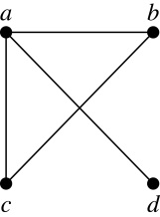
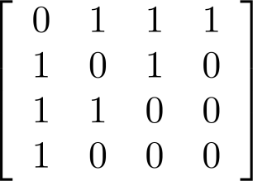
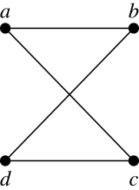
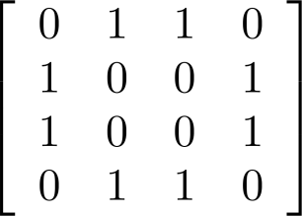
Adjacency Matrices (continued)
Example:
When a graph is sparse, that is, it has few edges relatively to the total number of possible edges, it is much more efficient to represent the graph using an adjacency list than an adjacency matrix. But for a dense graph, which includes a high percentage of possible edges, an adjacency matrix is preferable.
The ordering of
vertices is a, b, c, d.
The ordering of
vertices is a, b, c, d.
Note: The adjacency matrix of a simple graph is symmetric, i.e., a_{ij} = a_{ji}
Also, since there are no loops, each diagonal entry a_{ij} for i = 1, 2, 3, …, n, is 0.

Slide 56
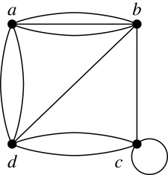
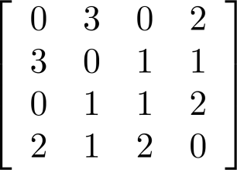
Adjacency Matrices (continued)
Adjacency matrices can also be used to represent graphs with loops and multiple edges.
A loop at the vertex v_{i} is represented by a 1 at the (i, j)th position of the matrix.
When multiple edges connect the same pair of vertices v_{i} and v_{j}, (or if multiple loops are present at the same vertex), the (i, j)th entry equals the number of edges connecting the pair of vertices.
Example: We give the adjacency matrix of the pseudograph shown here using the ordering of vertices a, b, c, d.

Slide 57
Adjacency Matrices (continued)
Adjacency matrices can also be used to represent directed graphs. The matrix for a directed graph G = (V, E) has a 1 in its (i, j)th position if there is an edge from v_{i} to v_{j}, where v₁, v₂, … v_{n} is a list of the vertices.
In other words, if the graphs adjacency matrix is A_{G} = [a_{ij}], then
The adjacency matrix for a directed graph does not have to be symmetric, because there may not be an edge from v_{i} to v_{j}, when there is an edge from v_{j} to v_{i}.
To represent directed multigraphs, the value of a_{ij} is the number of edges connecting v_{i} to v_{j}.

Slide 58
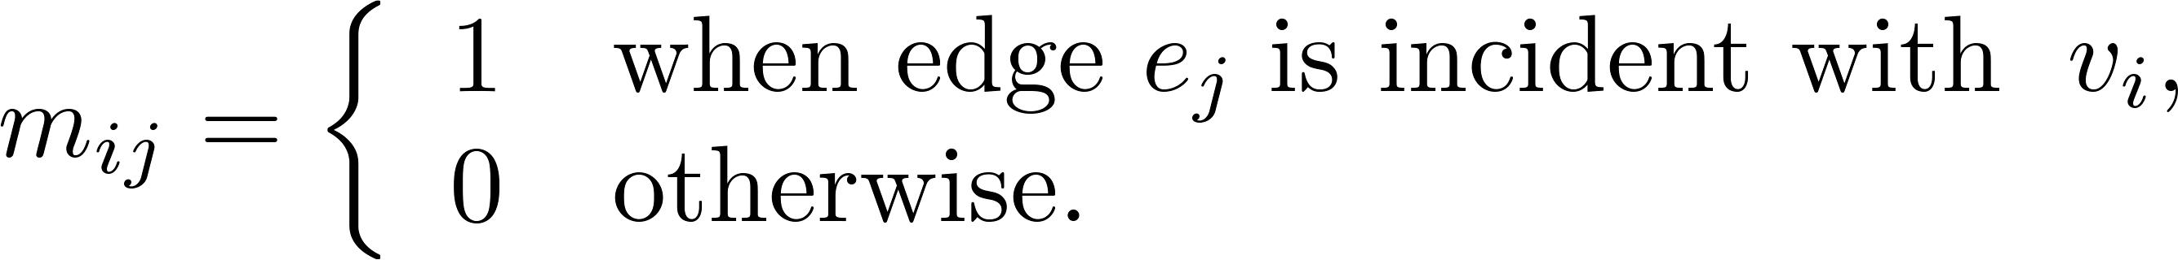
Representation of Graphs: Incidence Matrices
Definition: Let G = (V, E) be an undirected graph with vertices where v₁, v₂, … v_{n} and edges e₁, e₂, … e_{m}. The incidence matrix with respect to the ordering of V and E is the n × m matrix M = [m_{ij}], where

Slide 59
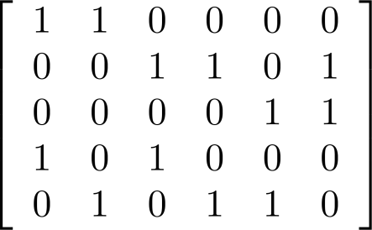
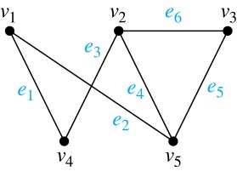
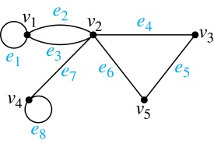
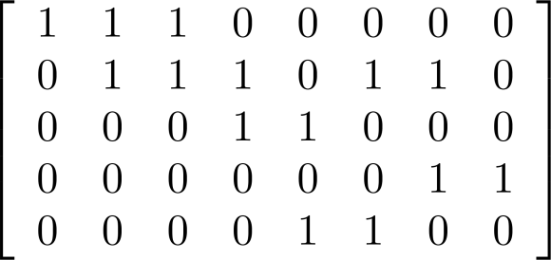
Incidence Matrices (continued)
Example: Simple Graph and Incidence Matrix
The rows going from top to bottom represent v₁ through v₅ and the columns going from left to right represent e₁ through e₆.
Example: Pseudograph and Incidence Matrix
The rows going from top to bottom represent v₁ through v₅ and the columns going from left to right represent e₁ through e₈.

Slide 60
Isomorphism of Graphs
Definition: The simple graphs G₁ = (V₁, E₁) and G₂ = (V₂, E₂) are isomorphic if there is a one-to-one and onto function f from V₁ to V₂ with the property that a and b are adjacent in G₁ if and only if f(a) and f(b) are adjacent in G₂ , for all a and b in V₁ . Such a function f is called an isomorphism. Two simple graphs that are not isomorphic are called nonisomorphic.

Slide 61
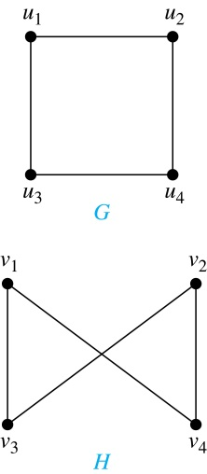
Isomorphism of Graphs (cont.)
Example: Show that the graphs G =(V, E) and H = (W, F) are isomorphic.
Solution: The function f with f(u₁) = v₁,
f(u₂) = v₄, f(u₃) = v₃, and f(u₄) = v₂ is a
one-to-one correspondence between V and W. Note that adjacent vertices in G are u₁ and u₂, u₁ and u₃, u₂ and u₄, and u₃ and u₄. Each of the pairs f(u₁) = v₁ and f(u₂) = v₄, f(u₁) = v₁ and f(u₃) = v₃ , f(u₂) = v₄ and f(u₄) = v₂ , and f(u₃) = v₃ and f(u₄) = v₂ consists of two adjacent vertices in H.

Slide 62
Isomorphism of Graphs (cont.)
It is difficult to determine whether two simple graphs are isomorphic using brute force because there are n! possible one-to-one correspondences between the vertex sets of two simple graphs with n vertices.
The best algorithms for determining weather two graphs are isomorphic have exponential worst case complexity in terms of the number of vertices of the graphs.
Sometimes it is not hard to show that two graphs are not isomorphic. We can do so by finding a property, preserved by isomorphism, that only one of the two graphs has. Such a property is called graph invariant.
There are many different useful graph invariants that can be used to distinguish nonisomorphic graphs, such as the number of vertices, number of edges, and degree sequence (list of the degrees of the vertices in nonincreasing order). We will encounter others in later sections of this chapter.

Slide 63
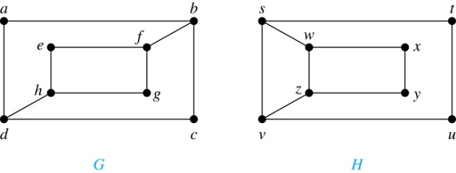
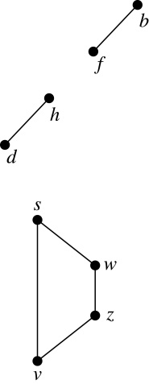
Isomorphism of Graphs (cont.)
Example: Determine whether these two graphs are isomorphic.
Solution: Both graphs have eight vertices and ten edges.
They also both have four vertices of degree two and four of degree three.
However, G and H are not isomorphic. Note that since deg(a) = 2 in G, a must correspond to t, u, x, or y in H, because these are the vertices of degree 2. But each of these vertices is adjacent to another vertex of degree two in H, which is not true for a in G.
Alternatively, note that the subgraphs of G and H made up of vertices of
degree three and the edges connecting them must be isomorphic.
But the subgraphs, as shown at the right, are not isomorphic.

Slide 64
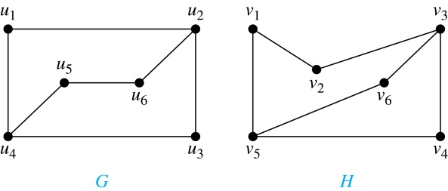
Isomorphism of Graphs (cont.)
Example: Determine whether these two graphs are isomorphic.
Solution: Both graphs have six vertices and seven edges.
They also both have four vertices of degree two and two of degree three.
The subgraphs of G and H consisting of all the vertices of degree two and the edges connecting them are isomorphic. So, it is reasonable to try to find an isomorphism f.
We define an injection f from the vertices of G to the vertices of H that preserves the degree of vertices. We will determine whether it is an isomorphism.
The function f with f(u₁) = v₆, f(u₂) = v₃, f(u₃) = v₄, and f(u₄) = v₅ , f(u₅) = v₁, and f(u₆) = v₂ is a one-to-one correspondence between G and H. Showing that this correspondence preserves edges is straightforward, so we will omit the details here. Because f is an isomorphism, it follows that G and H are isomorphic graphs.
See the text for an illustration of how adjacency matrices can be used for this verification.

Slide 65
Algorithms for Graph Isomorphism
The best algorithms known for determining whether two graphs are isomorphic have exponential worst-case time complexity (in the number of vertices of the graphs).
However, there are algorithms with linear average-case time complexity.
You can use a public domain program called NAUTY to determine in less than a second whether two graphs with as many as 100 vertices are isomoprhic.
Graph isomorphism is a problem of special interest because it is one of a few NP problems not known to be either tractable or NP-complete (see Section 3.3).

Slide 66
Applications of Graph Isomorphism
The question whether graphs are isomorphic plays an important role in applications of graph theory. For example,
chemists use molecular graphs to model chemical compounds. Vertices represent atoms and edges represent chemical bonds. When a new compound is synthesized, a database of molecular graphs is checked to determine whether the graph representing the new compound is isomorphic to the graph of a compound that this already known.
Electronic circuits are modeled as graphs in which the vertices represent components and the edges represent connections between them. Graph isomorphism is the basis for
the verification that a particular layout of a circuit corresponds to the design’s original schematics.
determining whether a chip from one vendor includes the intellectual property of another vendor.

Slide 67
Exercise
P675-676 9, 27, 37 7th edition
P618-621 9, 27, 37 6th edition

Slide 68
Connectivity
Section 10.4

Slide 69
Section Summary
Paths
Connectedness in Undirected Graphs
Vertex Connectivity and Edge Connectivity (not currently included in overheads)
Connectedness in Directed Graphs
Paths and Isomorphism (not currently included in overheads)
Counting Paths between Vertices

Slide 70
Paths
Informal Definition: A path is a sequence of edges that begins at a vertex of a graph and travels from vertex to vertex along edges of the graph. As the path travels along its edges, it visits the vertices along this path, that is, the endpoints of these.
Applications: Numerous problems can be modeled with paths formed by traveling along edges of graphs such as:
determining whether a message can be sent between two computers.
efficiently planning routes for mail delivery.

Slide 71
Paths
Definition: Let n be a nonnegative integer and G an undirected graph. A path of length n from u to v in G is a sequence of n edges e₁, … , e_{n} of G for which there exists a sequence x₀ = u, x₁, …, x_{n-1}, x_{n} = v of vertices such that e_{i} has, for i = 1, …, n, the endpoints x_{i-1} and x_{i}.
When the graph is simple, we denote this path by its vertex sequence x₀, x₁, … , x_{n}(since listing the vertices uniquely determines the path).
The path is a circuit if it begins and ends at the same vertex (u = v) and has length greater than zero.
The path or circuit is said to pass through the vertices x₁, x₂, … , x_{n-1} and traverse the edges e₁, … , e_{n}.
A path or circuit is simple if it does not contain the same edge more than once.
This terminology is readily extended to directed graphs. (see text)

Slide 72
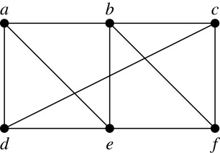
Paths (continued)
Example: In the simple graph here:
a, d, c, f, e is a simple path of length 4.
d, e, c, a is not a path because e is not connected to c.
b, c, f, e, b is a circuit of length 4.
a, b, e, d, a, b is a path of length 5, but it is not a simple path.

Slide 73

Degrees of Separation
Example: Paths in Acquaintanceship Graphs. In an acquaintanceship graph there is a path between two people if there is a chain of people linking these people, where two people adjacent in the chain know one another. In this graph there is a chain of six people linking Kamini and Ching.
Some have speculated that almost every pair of people in the world are linked by a small chain of no more than six, or maybe even, five people. The play Six Degrees of Separation by John Guare is based on this notion.

Slide 74


Erdős numbers
Paul Erdős
Example: Erdős numbers. In a collaboration graph, two people a and b are connected by a path when there is a sequence of people starting with a and ending with b such that the endpoints of each edge in the path are people who have collaborated.
In the academic collaboration graph of people who have written papers in mathematics, the Erdős number of a person m is the length of the shortest path between m and the prolific mathematician Paul Erdős.
To learn more about Erdős numbers, visit
http://www.ams.org/mathscinet/collaborationDistance.html

Slide 75

Bacon Numbrers
In the Hollywood graph, two actors a and b are linked when there is a chain of actors linking a and b, where every two actors adjacent in the chain have acted in the same movie.
The Bacon number of an actor c is defined to be the length of the shortest path connecting c and the well-known actor Kevin Bacon. (Note that we can define a similar number by replacing Kevin Bacon by a different actor.)
The oracle of Bacon web site http://oracleofbacon.org/how.php provides a tool for finding Bacon numbers.

Slide 76

Connectedness in Undirected Graphs
Definition: An undirected graph is called connected if there is a path between every pair of vertices. An undirected graph that is not connected is called disconnected. We say that we disconnect a graph when we remove vertices or edges, or both, to produce a disconnected subgraph.
Example: G₁ is connected because there is a path between any pair of its vertices, as can be easily seen. However G₂ is not connected because there is no path between vertices a and f, for example.

Slide 77

Connected Components
Definition: A connected component of a graph G is a connected subgraph of G that is not a proper subgraph of another connected subgraph of G. A graph G that is not connected has two or more connected components that are disjoint and have G as their union.
Example: The graph H is the union of three disjoint subgraphs H₁, H₂, and H₃, none of which are proper subgraphs of a larger connected subgraph of G.These three subgraphs are the connected components of H.

Slide 78
How Connected is a Graph?
Sometimes the removal from a graph of a vertex and all incident edges produces a subgraph with more connected components. Such vertices are called cut vertices(or articulation points). The removal of a cut vertex from a connected graph produces a subgraph that is not connected. Analogously, an edge whose removal produces a graph with more connected components than in the original graph is called a cut edge or bridge. Note that in a graph representing a computer network, a cut vertex and a cut edge represent an essential router and an essential link that cannot fail for all computers to be able to communicate.

Slide 79
the vertex connectivity
A subset V1 of the vertex set V1 of G = (V , E) is a vertex cut, or separating set, if G − V1 is disconnected. For instance, in the graph in Figure 1, the set {b, c, e} is a vertex cut with three vertices, as the reader should verify. We leave it to the reader (Exercise 51) to show that every connected graph, except a complete graph, has a vertex cut. We define the vertex connectivity of a noncomplete graph G, denoted by κ(G), as the minimum number of vertices in a vertex cut.

Slide 80
the vertex connectivity
When G is a complete graph, it has no vertex cuts, because removing any subset of its vertices and all incident edges still leaves a complete graph. Consequently, we cannot define κ(G) as the minimum number of vertices in a vertex cut when G is complete. Instead, we set κ(Kn) = n − 1, the number of vertices needed to be removed to produce a graph with a single vertex. Consequently, for every graph G, κ(G) is minimum number of vertices that can be removed from G to either disconnect G or produce a graph with a single vertex. We have 0 ≤ κ(G) ≤ n − 1 if G has n vertices, κ(G) = 0 if and only if G is disconnected or G = K1, and κ(G) = n − 1 if and only if G is complete

Slide 81
the vertex connectivity
The larger κ(G) is, the more connected we consider G to be. Disconnected graphs and K1 have κ(G) = 0, connected graphs with cut vertices and K2 have κ(G) = 1, graphs without cut vertices that can be disconnected by removing two vertices and K3 have κ(G) = 2, and so on. We say that a graph is k-connected (or k-vertex-connected), if κ(G) ≥ k. A graph G is 1- connected if it is connected and not a graph containing a single vertex; a graph is 2-connected, or biconnected, if it is nonseparable and has at least three vertices. Note that if G is a k-connected graph, then G is a j -connected graph for all j with 0 ≤ j ≤ k.

Slide 82
EDGE CONNECTIVITY
EDGE CONNECTIVITY We can also measure the connectivity of a connected graph G = (V , E) in terms of the minimum number of edges that we can remove to disconnect it. If a graph has a cut edge, then we need only remove it to disconnect G. If G does not have a cut edge, we look for the smallest set of edges that can be removed to disconnect it. A set of edges E is called an edge cut of G if the subgraph G − E is disconnected.

Slide 83
EDGE CONNECTIVITY
The edge of a graph G, denoted by λ(G), is the minimum number of edges in an edge cut of G. This defines λ(G) for all connected graphs with more than one vertex because it is always possible to disconnect such a graph by removing all edges incident to one of its vertices. Note that λ(G) = 0 if G is not connected. We also specify that λ(G) = 0 if G is a graph consisting of a single vertex. It follows that if G is a graph with n vertices, then 0 ≤ λ(G) ≤ n − 1. λ(G) = n − 1 where G is a graph with n vertices if and only if G = Kn, which is equivalent to the statement that λ(G) ≤ n − 2 when G is not a complete graph.

Slide 84
CONNECTIVITY
AN INEQUALITY FOR VERTEX CONNECTIVITY AND EDGE CONNECTIVITY
κ(G) ≤ λ(G) ≤ min_{v∈V} deg(v).

Slide 85
Connectedness in Directed Graphs
Definition: A directed graph is strongly connected if there is a path from a to b and a path from b to a whenever a and b are vertices in the graph.
Definition: A directed graph is weakly connected if there is a path between every two vertices in the underlying undirected graph, which is the undirected graph obtained by ignoring the directions of the edges of the directed graph.

Slide 86

Connectedness in Directed Graphs (continued)
Example: G is strongly connected because there is a path between any two vertices in the directed graph. Hence, G is also weakly connected. The graph H is not strongly connected, since there is no directed path from a to b, but it is weakly connected.
Definition: The subgraphs of a directed graph G that are strongly connected but not contained in larger strongly connected subgraphs, that is, the maximal strongly connected subgraphs, are called the strongly connected components or strong components of G.
Example (continued): The graph H has three strongly connected components, consisting of the vertex a; the vertex e; and the subgraph consisting of the vertices b, c, d and edges (b,c), (c,d), and (d,b).

Slide 87
The Connected Components of the Web Graph
Recall that at any particular instant the web graph provides a snapshot of the web, where vertices represent web pages and edges represent links. According to a 1999 study, the Web graph at that time had over 200 million vertices and over 1.5 billion edges. (The numbers today are several orders of magnitude larger.)
The underlying undirected graph of this Web graph has a connected component that includes approximately 90% of the vertices.
There is a giant strongly connected component (GSCC) consisting of more than 53 million vertices. A Web page in this component can be reached by following links starting in any other page of the component. There are three other categories of pages with each having about 44 million vertices:
pages that can be reached from a page in the GSCC, but do not link back.
pages that link back to the GSCC, but can not be reached by following links from pages in the GSCC.
pages that cannot reach pages in the GSCC and can not be reached from pages in the GSCC.

Slide 88
Counting Paths between Vertices
We can use the adjacency matrix of a graph to find the number of paths between two vertices in the graph.
Theorem: Let G be a graph with adjacency matrix A with respect to the ordering v₁, … , v_{n} of vertices (with directed or undirected edges, multiple edges and loops allowed). The number of different paths of length r from v_{i} to v_{j}, where r >0 is a positive integer, equals the (i,j)th entry of A^{r}.
Proof by mathematical induction:
Basis Step: By definition of the adjacency matrix, the number of paths from v_{i} to v_{j} of length 1 is the (i,j)th entry of A.
Inductive Step: For the inductive hypothesis, we assume that that the (i,j)th entry of A^{r} is the number of different paths of length r from v_{i} to v_{j}.
Because A^{r+1} = A^{r} A, the (i,j)th entry of A^{r+1} equals b_{i1}a_{1j} + b_{i2}a_{2j} + ⋯ + b_{in}a_{nj}, where b_{ik} is the (i,k)th entry of A^{r}. By the inductive hypothesis, b_{ik} is the number of paths of length r from v_{i} to v_{k}.
A path of length r + 1 from v_{i} to v_{j} is made up of a path of length r from v_{i} to some v_{k} , and an edge from v_{k} to v_{j}. By the product rule for counting, the number of such paths is the product of the number of paths of length r from v_{i} to v_{k} (i.e., b_{ik} ) and the number of edges from from v_{k} to v_{j} (i.e, a_{kj}). The sum over all possible intermediate vertices v_{k} is b_{i1}a_{1j} + b_{i2}a_{2j} + ⋯ + b_{in}a_{nj} .

Slide 89


Counting Paths between Vertices (continued)
Example: How many paths of length four are there from a to d in the graph G.
Solution: The adjacency matrix of G (ordering the vertices as a, b, c, d) is given above. Hence the number of paths of length four from a to d is the (1, 4)th entry of A⁴ . The eight paths are as:
adjacency matrix of G
G
A =
A⁴ =
a, b, a, b, d a, b, a, c, d
a, b, d, b, d a, b, d, c, d
a, c, a, b, d a, c, a, c, d
a, c, d, b, d a, c, d, c, d

Slide 90
Example
v₁
v₄
1 2 3 1
0 0 1 0
0 0 0 1
0 0 1 0
1 2 4 3
0 0 1 0
0 0 0 1
0 0 1 0
A²=
A³=
v₂
v₃
There are exactly 6 path of length 4 from v₁ to v₃,i.e.
(1)v₁v₁v₁v₂v₃ (2)v₁v₁v₁v₂v₃
(3)v₁v₂v₃v₄v₃ (4)v₁v₂v₃v₄v₃
(5)v₁v₁v₃v₄v₃ (6)v₁v₁v₁v₁v₃
1 2 1 0
0 0 1 0
0 0 0 1
0 0 1 0
1 2 6 4
0 0 1 0
0 0 0 1
0 0 1 0
A=
A⁴=

Slide 91
Connected matrix
A*= A+A² +A³ ……+A^{n}
A* is called Connected matrix, if all of its entries are nonzero, then G is strongly connected.
We can also use Warshall algorithm to computer A* effectively.

Slide 92
Exercise
P690-692 15, 41 7th edition
P629-633 15, 39 6th edition

Slide 93
Euler and Hamiltonian Graphs
Section 10.5

Slide 94
Section Summary
Euler Paths and Circuits
Hamilton Paths and Circuits
Applications of Hamilton Circuits

Slide 95



Euler Paths and Circuits
Leonard Euler (1707-1783)
The town of Kӧnigsberg, Prussia (now Kalingrad, Russia) was divided into four sections by the branches of the Pregel river. In the 18th century seven bridges connected these regions.
People wondered whether whether it was possible to follow a path that crosses each bridge exactly once and returns to the starting point.
The Swiss mathematician Leonard Euler proved that no such path exists. This result is often considered to be the first theorem ever proved in graph theory.
Multigraph Model of the Bridges of Kӧnigsberg
The 7 Bridges of Kӧnigsberg

Slide 96

Euler Paths and Circuits (continued)
Definition: An Euler circuit in a graph G is a simple circuit containing every edge of G. An Euler path in G is a simple path containing every edge of G.
Example: Which of the undirected graphs G₁, G₂, and G₃ has a Euler circuit? Of those that do not, which has an Euler path?
Solution: The graph G₁ has an Euler circuit (e.g., a, e, c, d, e, b, a). But, as can easily be verified by inspection, neither G₂ nor G₃ has an Euler circuit. Note that G₃ has an Euler path (e.g., a, c, d, e, b, d, a, b), but there is no Euler path in G₂, which can be verified by inspection.

Slide 97
Necessary Conditions for Euler Circuits and Paths
An Euler circuit begins with a vertex a and continues with an edge incident with a, say {a, b}. The edge {a, b} contributes one to deg(a).
Each time the circuit passes through a vertex it contributes two to the vertex’s degree.
Finally, the circuit terminates where it started, contributing one to deg(a). Therefore deg(a) must be even.
We conclude that the degree of every other vertex must also be even.
By the same reasoning, we see that the initial vertex and the final vertex of an Euler path have odd degree, while every other vertex has even degree. So, a graph with an Euler path has exactly two vertices of odd degree.
In the next slide we will show that these necessary conditions are also sufficient conditions.

Slide 98

Sufficient Conditions for Euler Circuits and Paths
Suppose that G is a connected multigraph with ≥ 2 vertices, all of even degree. Let x₀ = a be a vertex of even degree. Choose an edge {x₀, x₁} incident with a and proceed to build a simple path {x₀, x₁}, {x₁, x₂}, …, {x_{n-1}, x_{n}} by adding edges one by one until another edge can not be added.
The path begins at a with an edge of the form {a, x}; we show that it must terminate at a with an edge of the form {y, a}. Since each vertex has an even degree, there must be an even number of edges incident with this vertex. Hence, every time we enter a vertex other than a, we can leave it. Therefore, the path can only end at a.
If all of the edges have been used, an Euler circuit has been constructed. Otherwise, consider the subgraph H obtained from G by deleting the edges already used.
We illustrate this idea in the graph G here. We begin at a and choose the edges {a, f}, {f, c}, {c, b}, and {b, a} in succession.
In the example H consists of the vertices c, d, e.

Slide 99
Sufficient Conditions for Euler Circuits and Paths (continued)
Because G is connected, H must have at least one vertex in common with the circuit that has been deleted.
Every vertex in H must have even degree because all the vertices in G have even degree and for each vertex, pairs of edges incident with this vertex have been deleted. Beginning with the shared vertex construct a path ending in the same vertex (as was done before). Then splice this new circuit into the original circuit.
Continue this process until all edges have been used. This produces an Euler circuit. Since every edge is included and no edge is included more than once.
Similar reasoning can be used to show that a graph with exactly two vertices of odd degree must have an Euler path connecting these two vertices of odd degree
In the example, the vertex is c.
In the example, we end up with the circuit a, f, c, d, e, c, b, a.

Slide 100
Algorithm for Constructing an Euler Circuits
In our proof we developed this algorithms for constructing a Euler circuit in a graph with no vertices of odd degree.
procedure Euler(G: connected multigraph with all vertices of even degree)
circuit := a circuit in G beginning at an arbitrarily chosen vertex with edges
successively added to form a path that returns to this vertex.
H := G with the edges of this circuit removed
while H has edges
subciruit := a circuit in H beginning at a vertex in H that also is
an endpoint of an edge in circuit.
H := H with edges of subciruit and all isolated vertices removed
circuit := circuit with subcircuit inserted at the appropriate vertex.
return circuit{circuit is an Euler circuit}

Slide 101
Necessary and Sufficient Conditions for Euler Circuits and Paths (continued)
Theorem: A connected multigraph with at least two vertices has an Euler circuit if and only if each of its vertices has an even degree and it has an Euler path if and only if it has exactly two vertices of odd degree.
Example: Two of the vertices in the multigraph model of the Kӧnigsberg bridge problem have odd degree. Hence, there is no Euler circuit in this multigraph and it is impossible to start at a given point, cross each bridge exactly once, and return to the starting point.

Slide 102

Euler Circuits and Paths
Example:
G₁ contains exactly two vertices of odd degree (b and d). Hence it has an Euler path, e.g., d, a, b, c, d, b.
G₂ has exactly two vertices of odd degree (b and d). Hence it has an Euler path, e.g., b, a, g, f, e, d, c, g, b, c, f, d.
G₃ has six vertices of odd degree. Hence, it does not have an Euler path.

Slide 103
Applications of Euler Paths and Circuits
Euler paths and circuits can be used to solve many practical problems such as finding a path or circuit that traverses each
street in a neighborhood,
road in a transportation network,
connection in a utility grid,
link in a communications network.
Other applications are found in the
layout of circuits,
network multicasting,
molecular biology, where Euler paths are used in the sequencing of DNA.

Slide 104



Hamilton Paths and Circuits
William Rowan Hamilton (1805- 1865)
Euler paths and circuits contained every edge only once. Now we look at paths and circuits that contain every vertex exactly once.
William Hamilton invented the Icosian puzzle in 1857. It consisted of a wooden dodecahedron (with 12 regular pentagons as faces), illustrated in (a), with a peg at each vertex, labeled with the names of different cities. String was used to used to plot a circuit visiting 20 cities exactly once
The graph form of the puzzle is given in (b).
The solution (a Hamilton circuit) is given here.

Slide 105
Hamilton Paths and Circuits
Definition: A simple path in a graph G that passes through every vertex exactly once is called a Hamilton path, and a simple circuit in a graph G that passes through every vertex exactly once is called a Hamilton circuit.
That is, a simple path x₀, x₁, …, x_{n-1}, x_{n} in the graph G = (V, E) is called a Hamilton path if V = {x₀, x₁, … , x_{n-1,} x_{n} } and x_{i} ≠ x_{j} for 0≤ i < j ≤ n, and the simple circuit x₀, x₁, …, x_{n-1}, x_{n}, x₀ (with n > 0) is a Hamilton circuit if x₀, x₁, … , x_{n-1}, x_{n} is a Hamilton path.

Slide 106
Hamilton Paths and Circuits (continued)
Example: Which of these simple graphs has a Hamilton circuit or, if not, a Hamilton path?
Solution: G₁ has a Hamilton circuit: a, b, c, d, e, a.
G₂ does not have a Hamilton circuit (Why?), but does have a Hamilton path : a, b, c, d.
G₃ does not have a Hamilton circuit, or a Hamilton path. Why?

Slide 107


Necessary Conditions for Hamilton Circuits
Gabriel Andrew Dirac
(1925-1984)
Unlike for an Euler circuit, no simple necessary and sufficient conditions are known for the existence of a Hamiton circuit.
However, there are some useful necessary conditions. We describe two of these now.
Dirac’s Theorem: If G is a simple graph with n ≥ 3 vertices such that the degree of every vertex in G is ≥ n/2, then G has a Hamilton circuit.
Ore’s Theorem: If G is a simple graph with n ≥ 3 vertices such that deg(u) + deg(v) ≥ n for every pair of nonadjacent vertices, then G has a Hamilton circuit.
Øysten Ore
(1899-1968)

Slide 108
Applications of Hamilton Paths and Circuits
Applications that ask for a path or a circuit that visits each intersection of a city, each place pipelines intersect in a utility grid, or each node in a communications network exactly once, can be solved by finding a Hamilton path in the appropriate graph.
The famous traveling salesperson problem (TSP) asks for the shortest route a traveling salesperson should take to visit a set of cities. This problem reduces to finding a Hamilton circuit such that the total sum of the weights of its edges is as small as possible.
A family of binary codes, known as Gray codes, which minimize the effect of transmission errors, correspond to Hamilton circuits in the n-cube Q_{n}. (See the text for details.)

Slide 109
Exercise
P704-705 29,35 7th edition
p643-647 29.35 6th edition

Slide 110
Shortest Path Problems
Section 10.6

Slide 111
Weighted graph
Weighted graph. The weight can be distance, time, and price between two different cities in a map graph
Mileage
Detroit
New York
357
423
San Francisco
722
957
908
602
281
Chicago
349
834
Denver
Washington
Los Angeles

Slide 112
Weighted graph
Flight times
Detroit
New York
0:51
1:24
San Francisco
1:50
2:20
2:10
1:18
0:38
Chicago
1:15
2:00
Denver
Washington
Los Angeles

Slide 113
Weighted graph
Fares
Detroit
New York
$48
$67
San Francisco
$79
$89
$120
$54
$43
Chicago
$39
$91
Denver
Washington
Los Angeles
Other weighted graphs can also model computer Networks, telephone networks, transportation networks, etc.

Slide 114
Dijkstra’s Algorithm
Procedure Dijkstra(G: weighted connected simple graph, with all weights positive)
{G has vertices a = v₀, v₁, …, v_{n} = z and weights w(v_{i}, v_{j}) where w(v_{i}, v_{j}) = ∞ if {v_{i}, v_{j}} is not an edge in G}
for i := 1 to n L(v_{i}) := ∞
L(a) := 0
S := ∅
while z ∉ S
begin
u := a vertex not in S with L(u) minimal
S := S ∪ {u}
for all vertices v not in S
if L(u) + w(u, v) < L(v) then L(v) := L(u) + w(u, v)
end {L(z) = length of a shortest path from a to z}
This algorithm can be extended to construct a shortest path path.
previous(v) := u update L(v) for all v not in S

Slide 115
Example 2
b
d
b∞
d ∞
5
5
4
6
4
6
a
8
2
z
0a
8
2
z ∞
2
3
2
3
10
10
c
e
c ∞
e ∞
b 4(a)
d ∞
b 3(a,c)
d 10(a,c)
5
5
4
6
4
6
0a
8
2
z ∞
0a
8
2
z ∞
2
3
2
3
10
10
c 2(a)
e ∞
c 2(a)
e 12(a,c)

Slide 116
Example 2 cont.
b 3(a,c)
d 8(a,c,b)
b 3(a,c)
d 8(a,c,b)
5
5
4
6
4
6
0a
8
2
z ∞
0a
8
2
z 14(a,c,b,d)
2
3
2
3
10
10
c 2(a)
e 12(a,c)
c 2(a)
e 10(a,c,b,d)
b 3(a,c)
d 8(a,c,b)
b 3(a,c)
d 8(a,c,b)
5
4
6
5
4
6
0a
8
2
z 13(a,c,b,d)
0a
8
2
2
z 13(a,c,b,d)
10
3
2
10
3
c 2(a)
e 10(a,c,b,d)
c 2(a)
e 10(a,c,b,d)

Slide 117
Theorems
Thm. 1 Dijkstra’s algorithm finds the length of a shortest path between two vertices in a connected simple undirected weighted graph.
Thm. 2 Dijkstra’s algorithm uses O(n²) operations (additions and comparisons) to find the length of a shortest path between two vertices in a connected simple undirected weighted graph with n vertices.

Slide 118
Floyd’s Algorithm (find the distance d(a, b) ∀a, b)
Procedure Floyd(G: weighted simple graph)
{G has vertices v₁, …, v_{n} and weights w(v_{i}, v_{j}) with w(v_{i}, v_{j}) = ∞ if {v_{i}, v_{j}} is not an edge}
for i := 1 to n for j := 1 to n d(v_{i}, v_{j}) := w(v_{i}, v_{j})
for i := 1 to n for j := 1 to n for k := 1 to n if d(v_{j}, v_{i}) + d(v_{i}, v_{k}) < d(v_{j}, v_{k}) then d(v_{j}, v_{k}) := d(v_{j}, v_{i}) + d(v_{i}, v_{k})
{d(v_{i}, v_{j}) is the length of a shortest path between v_{i} and v_{j}}
v_{i}
v_{j}
v_{k}
对每个v_{i}，检查任何一对点目前的距离会不会因为改走 v_{i} 而变小。
This algorithm cannot be used to construct shortest paths.

Slide 119
The Traveling Salesman Problem：
A traveling salesman wants to visit each of n cities exactly once and return to his starting point. In which order should he visit these cities to travel the minimum total distance?
Example (starting point D)
S
113
D→T→K→G→S →D: 458
G
137
147
142
98
167
D→T→S→G→K→D: 504
56
D
135
D→T→S→K→G→D: 540
58
K
133
No polynomial time algorithm
T
…
Finding minimum weight Hamiltonian circuit in complete weighted graph

Slide 120
Exercises
P716-718 5,27 7th edition
P655-657 5,27 6th edition

Slide 121
Planar Graphs
Section 10.7

Slide 122
Planar Graphs
A graph is called planar if it can be drawn in the plane without any edges crossing.
A crossing of edges is the intersection of the lines or arcs representing them at a point other than their common endpoint.
Such a drawing is called a planar representation of the graph.

Slide 123
Example

Slide 124
Regions and its degree
Euler showed that all planar representations of a graph split the plane into the same number of regions, including an unbounded region. The degree of a region R is the number of edges enclose the region, denote by d(R)
d(R₁)=3 d(R₂)=3
d(R₃)=3 d(R₄)=3
R₄ R₃ R₂
R₁

Slide 125
The degree of Regions and the number of edges
∑d(R_{i})=2|E|
c
d(R₁)=3, d(R₂)=6, d(R₃)=7,
∑d(R_{i})=16, |E|=8
b
a
R₁
g
d
R₃
R₂
f
e

Slide 126
Euler’s Formula
Let G be a connected planar simple graph with e edges and v vertices. Let r be the number of regions in a planar representation of G. Then r = e - v + 2.
# of Edges, e = 6
# of Vertices, v = 4
# of Regions, r = e - v + 2 = 4
R₄ R₃ R₂
R₁
Euler’s formula can be used to derive formulas to show that certain graphs are not planar.

Slide 127
Euler’s Formula (Cont..)
Corollary 1: If G is a connected planar simple graph with e edges and v vertices where v ≥ 3, then e ≤ 3v - 6.
Is K₅ planar?
e = 10, v = 5
3v - 6 = 9
e > 3v - 6
K₅ is not planar

Slide 128
Euler’s Formula (Cont..)
Corollary 2: If a connected planar simple graph has e edges and v vertices with v ≥ 3 and no circuits of length 3, then e ≤ 2v - 4.
Is K_{3,3} planar?
e = 9, v = 6, No circuits of length 3 (it’s bipartite)
2v - 4 = 8
e > 2v - 4
K_{3,3} is not planar

Slide 129
Kuratowski’s Theorem
If a graph is planar, so will be any graph obtained by removing an edge {u, v} and adding a new vertex w together with edges {u, w} and {v, w}.
u
w
v
Such an operation is called an elementary subdivision.
Two graphs G₁ = (V₁, E₁), G₂=(V₂, E₂) are called homeomorphic if they can be obtained from the same graph by a sequence of elementary subdivisons.

Slide 130
Kuratowski’s theorem
Theorem 2: A graph is nonplanar if and only if it contains a subgraph homeomorphic to K_{3,3} or K₅
a
a
f
f
f
e
b
e
e
j
g
j
g
j
i
h
i
h
i
h
d
c
d
c
d

Slide 131
Example 7
Whether G is planar?
a
a
b
a
b
b
c
j
c
d
h
e
c
k
e
d
g
f
d
e
H
K₅
g
f
G

Slide 132
Exercises
P725-726 15, 23
P665-666 15, 23

Slide 133
Graph Coloring
Section 10.8

Slide 134
Introduction
When a map is colored, two regions with a common border are customarily assigned different colors.
We want to use a small amount of colors instead of just assigning every region its own color.

Slide 135
Graph Coloring
Each map in a plane can be represented by a graph.
Each region is represented by a vertex.
Edges connect to vertices if the regions represented by these vertices have a common border.
Two regions that touch at only one point are not considered adjacent.
The resulting graph is called the dual graph of the map.

Slide 136
Dual Graph Examples
B
B
G
A
C
D
A
F
C
D
E
E
B
A D F G
E
B
A E
D
C
C

Slide 137
Graph Coloring
A coloring of a simple graph is the assignment of a color to each vertex of the graph so that no two adjacent vertices are assigned the same color.
The chromatic number of a graph is the least number of colors needed for a coloring of the graph.(denoted by χ(G))

Slide 138
Examples
χ(K₅)=5
Note: χ(K_{n})=n

Slide 139
Example
What is the chromatic number of the graph shown below?
b e
a d g
c f
The chromatic number must be
at least 3 since a, b, and c must
be assigned different colors. So
lets try 3 colors first.
b
a
c
e
3 colors work, so the chromatic
number of this graph is 3.
χ(G)=3
d
g
f

Slide 140
Example
What is the chromatic number of the graph shown below?
χ(C₄)=2
χ(C₅)=3
χ(K₄)=4
χ(K_{2,3})=2

Slide 141
Example
What is the chromatic number for each graph?
White
White
Yellow
Green
Yellow
Yellow
White
White
Yellow
Yellow
White
Chromatic number: 2
Chromatic number: 3

Slide 142
Example
Example 4: χ(C_{n}) = 2 if n is even, 3 if n is odd.
C_{n} is bipartite when n is even.

Slide 143
Color Algorithm
Floyd algorithm
The problem of finding a minimum coloring of a graph is NP-Hard
The corresponding decision problem (Is there a coloring which uses at most k colors?) is NP-complete

Slide 144
The Four Color Theorem
The Four Color Theorem: The chromatic number of a planar graph is no greater than four.
G2
G1
Corollary Any graph with chromatic number >4 is nonplanar.

Slide 145
Applications
Scheduling Final Exams
How would you model this with a graph?
After you have drawn a graph, what should you do?

Slide 146
Exercises
P733 9, 13 7th edition
P672-675 9, 13 6th edition

