Slide 1
Induction and recursion
Chapter 5
With Question/Answer Animations

Slide 2
Chapter Summary
Mathematical Induction
Strong Induction
Well-Ordering
Recursive Definitions
Structural Induction
Recursive Algorithms
Program Correctness (not yet included in overheads)

Slide 3
Mathematical Induction
Section 5.1

Slide 4
Section Summary
Mathematical Induction
Examples of Proof by Mathematical Induction
Mistaken Proofs by Mathematical Induction
Guidelines for Proofs by Mathematical Induction

Slide 5
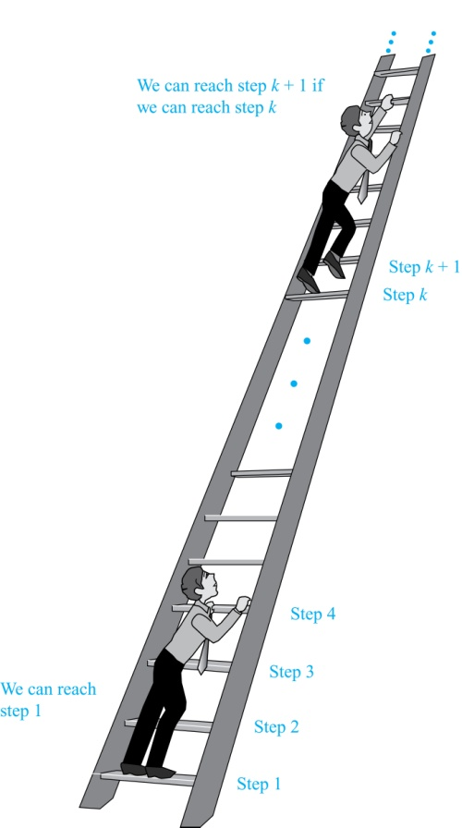
Climbing an Infinite Ladder
Suppose we have an infinite ladder:
We can reach the first rung of the ladder.
If we can reach a particular rung of the ladder, then we can reach the next rung.
From (1), we can reach the first rung. Then by applying (2), we can reach the second rung. Applying (2) again, the third rung. And so on. We can apply (2) any number of times to reach any particular rung, no matter how high up.
This example motivates proof by mathematical induction.

Slide 6
Principle of Mathematical Induction
Principle of Mathematical Induction: To prove that P(n) is true for all positive integers n, we complete these steps:
Basis Step: Show that P(1) is true.
Inductive Step: Show that P(k) → P(k + 1) is true for all positive integers k.
To complete the inductive step, assuming the inductive hypothesis that P(k) holds for an arbitrary integer k, show that must P(k + 1) be true.
Climbing an Infinite Ladder Example:
BASIS STEP: By (1), we can reach rung 1.
INDUCTIVE STEP: Assume the inductive hypothesis that we can reach rung k. Then by (2), we can reach rung k + 1.
Hence, P(k) → P(k + 1) is true for all positive integers k. We can reach every rung on the ladder.

Slide 7
Important Points About Using Mathematical Induction
Mathematical induction can be expressed as the rule of inference
where the domain is the set of positive integers.
In a proof by mathematical induction, we don’t assume that P(k) is true for all positive integers! We show that if we assume that P(k) is true, then P(k + 1) must also be true.
Proofs by mathematical induction do not always start at the integer 1. In such a case, the basis step begins at a starting point b where b is an integer. We will see examples of this soon.
(P(1) ∧ ∀k (P(k) → P(k + 1))) → ∀n P(n),

Slide 8
Validity of Mathematical Induction
Mathematical induction is valid because of the well ordering property, which states that every nonempty subset of the set of positive integers has a least element (see Section 5.2 and Appendix 1). Here is the proof:
Suppose that P(1) holds and P(k) → P(k + 1) is true for all positive integers k.
Assume there is at least one positive integer n for which P(n) is false. Then the set S of positive integers for which P(n) is false is nonempty.
By the well-ordering property, S has a least element, say m.
We know that m can not be 1 since P(1) holds.
Since m is positive and greater than 1, m − 1 must be a positive integer. Since m − 1 < m, it is not in S, so P(m − 1) must be true.
But then, since the conditional P(k) → P(k + 1) for every positive integer k holds, P(m) must also be true. This contradicts P(m) being false.
Hence, P(n) must be true for every positive integer n.

Slide 9
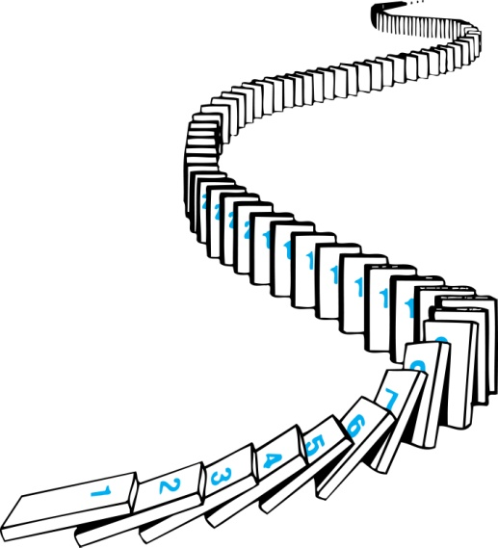
Remembering How Mathematical Induction Works
Consider an infinite sequence of dominoes, labeled 1,2,3, …, where each domino is standing.
We know that the first domino is knocked down, i.e., P(1) is true .
We also know that if whenever the kth domino is knocked over, it knocks over the (k + 1)st domino, i.e, P(k) → P(k + 1) is true for all positive integers k.
Let P(n) be the proposition that the nth domino is knocked over.
Hence, all dominos are knocked over.
P(n) is true for all positive integers n.

Slide 10
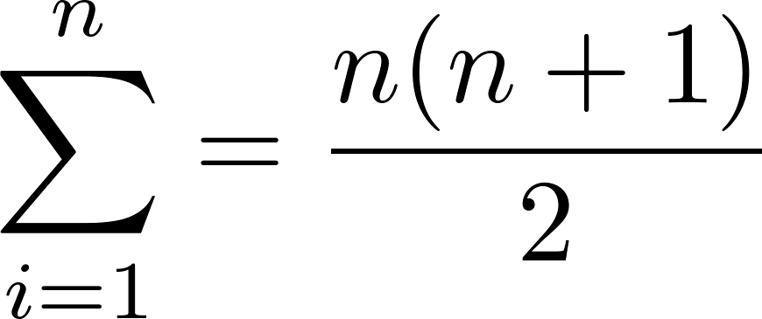
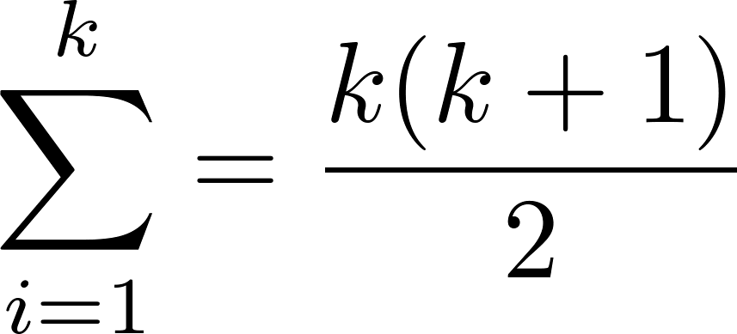
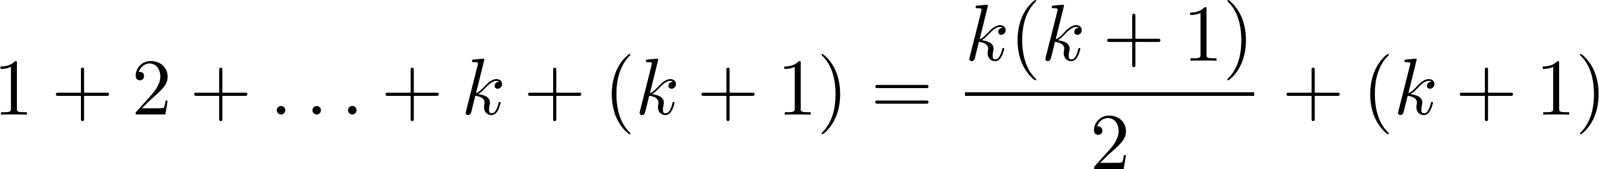
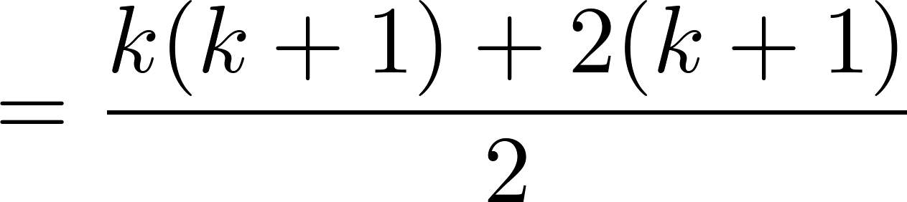
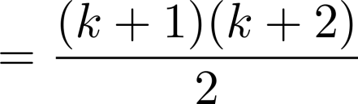
Proving a Summation Formula by Mathematical Induction
Note: Once we have this conjecture, mathematical induction can be used to prove it correct.
Example: Show that:
Solution:
BASIS STEP: P(1) is true since 1(1 + 1)/2 = 1.
INDUCTIVE STEP: Assume true for P(k).
The inductive hypothesis is
Under this assumption,

Slide 11
Conjecturing and Proving Correct a Summation Formula
Example: Conjecture and prove correct a formula for the sum of the first n positive odd integers. Then prove your conjecture.
Solution: We have: 1= 1, 1 + 3 = 4, 1 + 3 + 5 = 9, 1 + 3 + 5 + 7 = 16, 1 + 3 + 5 + 7 + 9 = 25.
We can conjecture that the sum of the first n positive odd integers is n²,
We prove the conjecture is proved correct with mathematical induction.
BASIS STEP: P(1) is true since 1² = 1.
INDUCTIVE STEP: P(k) → P(k + 1) for every positive integer k.
Assume the inductive hypothesis holds and then show that P(k) holds has well.
So, assuming P(k), it follows that:
Hence, we have shown that P(k + 1) follows from P(k). Therefore the sum of the first n positive odd integers is n².
1 + 3 + 5 + ∙∙∙+ (2n − 1) + (2n + 1) =n² .
Inductive Hypothesis: 1 + 3 + 5 + ∙∙∙+ (2k − 1) =k²
1 + 3 + 5 + ∙∙∙+ (2k − 1) + (2k + 1) =[1 + 3 + 5 + ∙∙∙+ (2k − 1)] + (2k + 1)
= k² + (2k + 1) (by the inductive hypothesis)
= k² + 2k + 1
= (k + 1) ²

Slide 12
Proving Inequalities
Example: Use mathematical induction to prove that n < 2^{n} for all positive integers n.
Solution: Let P(n) be the proposition that n < 2^{n}.
BASIS STEP: P(1) is true since 1 < 2¹ = 2.
INDUCTIVE STEP: Assume P(k) holds, i.e., k < 2^{k}, for an arbitrary positive integer k.
Must show that P(k + 1) holds. Since by the inductive hypothesis, k < 2^{k}, it follows that:
k + 1 < 2^{k} + 1 ≤ 2^{k} + 2^{k} = 2 ∙ 2^{k} = 2^{k+1}
Therefore n < 2^{n} holds for all positive integers n.

Slide 13
Proving Inequalities
Example: Use mathematical induction to prove that 2^{n} < n!, for every integer n ≥ 4.
Solution: Let P(n) be the proposition that 2^{n} < n!.
BASIS STEP: P(4) is true since 2⁴ = 16 < 4! = 24.
INDUCTIVE STEP: Assume P(k) holds, i.e., 2^{k} < k! for an arbitrary integer k ≥ 4. To show that P(k + 1) holds:
2^{k+1} = 2∙2^{k}
< 2∙ k! (by the inductive hypothesis)
< (k + 1)k!
= (k + 1)!
Therefore, 2^{n} < n! holds, for every integer n ≥ 4.
Note that here the basis step is P(4), since P(0), P(1), P(2), and P(3) are all false.

Slide 14
Proving Divisibility Results
Example: Use mathematical induction to prove that n³ − n is divisible by 3, for every positive integer n.
Solution: Let P(n) be the proposition that n³ − n is divisible by 3.
BASIS STEP: P(1) is true since 1³ − 1 = 0, which is divisible by 3.
INDUCTIVE STEP: Assume P(k) holds, i.e., k³ − k is divisible by 3, for an arbitrary positive integer k. To show that P(k + 1) follows:
(k + 1)³ − (k + 1) = (k³ + 3k² + 3k + 1) − (k + 1)
= (k³ − k) + 3(k² + k)
By the inductive hypothesis, the first term (k³ − k) is divisible by 3 and the second term is divisible by 3 since it is an integer multiplied by 3. So by part (i) of Theorem 1 in Section 4.1 , (k + 1)³ − (k + 1) is divisible by 3.
Therefore, n³ − n is divisible by 3, for every integer positive integer n.

Slide 15
Example 9
Use mathematical induction to prove that Cdivisible by 57 for every nonnegative integer n.
Solution: To construct the proof, let P(n) denote the proposition: “7^{n+2}+ 8^{2n+1}is divisible by 57.”
BASIS STEP: To complete the basis step, we must show that P(0) is true, because we want to prove that P(n) is true for every nonnegative integer. We see that P(0) is true because 7⁰⁺²+ 8^{2*0+1} = 7²+ 8⁰ = 57 is divisible by 57. This completes the basis step.
INDUCTIVE STEP: For the inductive hypothesis we assume that P(k) is true for an arbitrary nonnegative integer k; that is, we assume that 7 ^{k+2} + 8^{2k+1} is divisible by 57. To complete the

Slide 16
Example 9
inductive step, we must show that when we assume that the inductive hypothesis P(k) is true,
then P(k + 1), the statement that 7^{(k+1)+2} + 8^{2(k+1)+1} is divisible by 57, is also true.
The difficult part of the proof is to see howto use the inductive hypothesis. To take advantage
of the inductive hypothesis, we use these steps:
7 ^{(k+1)+2} + 8^{2(k+1)+1} = 7 ^{k+3}+ 8 ^{2k+3} = 7 · 7 ^{k+2} + 8 ² · 8 ^{2k+1} = 7 · 7 ^{k+2} + 64 · 8 ^{2k+1} =
= 7(7 ^{k+2} + 8^{2k+1} ) + 57 · 8^{2k+1}.
In the other hand (7 ^{k+2} + 8^{2k+1} ) = 49⋅7 ^{k} + 8 ⋅ 64^{k} ≡ ((-8) ⋅7 ^{k} + 8 ⋅ 7^{k} )mod 57
≡ 0 (mod 57)

Slide 17
Number of Subsets of a Finite Set
Example 10: Use mathematical induction to show that if S is a finite set with n elements, where n is a nonnegative integer, then S has 2^{n} subsets.
(Chapter 6 uses combinatorial methods to prove this result.)
Solution: Let P(n) be the proposition that a set with n elements has 2^{n} subsets.
Basis Step: P(0) is true, because the empty set has only itself as a subset and 2⁰ = 1.
Inductive Step: Assume P(k) is true for an arbitrary nonnegative integer k.
continued →

Slide 18
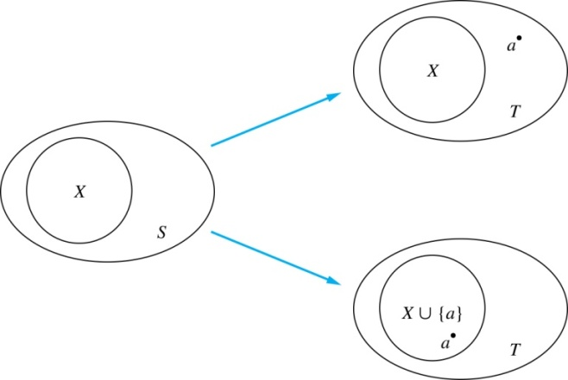
Number of Subsets of a Finite Set
Inductive Hypothesis: For an arbitrary nonnegative integer k, every set with k elements has 2^{k} subsets.
Let T be a set with k + 1 elements. Then T = S ∪ {a}, where a ∈ T and S = T − {a}. Hence |T| = k.
For each subset X of S, there are exactly two subsets of T, i.e., X and X ∪ {a}.
By the inductive hypothesis S has 2^{k} subsets. Since there are two subsets of T for each subset of S, the number of subsets of T is 2 ∙2^{k} = 2^{k+1} .

Slide 19
Scheduling most talks in a hall
Without loss of generality, we assume that the talks are listed in order of nondecreasing ending time, so that e₁ ≤ e₂ ≤ · · · ≤ e_{m}. The greedy algorithm proceeds by selecting at each stage a talk with the earliest ending time among all those talks that begin no sooner than when the last talk scheduled in the main lecture hall has ended. Note that a talk with the earliest end time is always selected first by the algorithm. We will show that this greedy algorithm is optimal in the sense that it always schedules the most talks possible in the main lecture hall.
We let P(n) be the proposition that if the greedy algorithm schedules n talks in the main lecture hall, then it is not possible to schedule more than n talks in this hall.

Slide 20
Example 12
BASIS STEP: Suppose that the greedy algorithm managed to schedule just one talk, t1, in the main lecture hall. This means that no other talk can start at or after e1, the end time of t1.
Otherwise, if we can select at least two talks in the hall, Then there is a schedule including at least two talks possible that contains talk t1. This is easy to see because a schedule that begins with the talk ti in the list, where i > 1, can be changed so that talk t1 replaces talk ti . To see this, note that because e1 ≤ ei , all talks that were scheduled to follow talk ti can still be scheduled.
But in this case we can schedule at least two talks by the greedy algorithm, because there is a talk begins after e1，this is a contradiction that the greedy algorithm managed to schedule just one talk, t1.

Slide 21
Example 12
INDUCTIVE STEP: The inductive hypothesis is that P(k) is true, where k is an arbitrary positive integer, that is, that the greedy algorithm always schedules the most possible talks when it selects k talks, where k is a positive integer, given any set of talks, no matter how many. We must show that P(k + 1) follows from the assumption that P(k) is true, that is, we must show that under the assumption of P(k), the greedy algorithm always schedules the most possible talks when it selects k + 1 talks.
Now suppose that the greedy algorithm has selected k + 1 talks. Our first step in completing the inductive step is to show there is a schedule including the most talks possible that contains talk t1, a talk with the earliest end time. This is easy to see because a schedule that begins with the talk ti in the list, where i > 1, can be changed so that talk t1 replaces talk ti . To see this, note that because e1 ≤ ei , all talks that were scheduled to follow talk ti can still be scheduled.

Slide 22
Example 12
Once we included talk t1, scheduling the talks so that as many as possible are scheduled is reduced to scheduling as many talks as possible that begin at or after time e1. So, if we have scheduled as many talks as possible, the schedule of talks other than talk t1 is an optimal schedule of the original talks that begin once talk t1 has ended. Because the greedy algorithm schedules k talks when it creates this schedule, we can apply the inductive hypothesis to conclude that it has scheduled the most possible talks. The first talk of schedule is ti, there is no talk between t1 and ti, It follows that the greedy algorithm has scheduled the most possible talks, k + 1, when it produced a schedule with k + 1 talks, so P(k + 1) is true. This completes the inductive step.

Slide 23
Example 13 Odd Pie Fights
An odd number of people stand in a yard at mutually distinct distances.
At the same time each person throws a pie at their nearest neighbor, hitting this person. Use mathematical induction to show that there is at least one survivor, that is, at least one person who is not hit by a pie.
Solution: Let P(n) be the statement that there is a survivor whenever 2n + 1 people stand in a yard at distinct mutual distances and each person throws a pie at their nearest neighbor. To prove this result, we will show that P(n) is true for all positive integers n. This follows because as n runs through all positive integers, 2n + 1 runs through all odd integers greater than or equal to 3. Note that one person cannot engage in a pie fight because there is no one else to throw the pie at.

Slide 24
Odd Pie Fights
BASIS STEP: When n = 1, there are 2n + 1 = 3 people in the pie fight. Of the three people, suppose that the closest pair are A and B, and C is the third person. Because distances between pairs of people are different, the distance between A and C and the distance between B and C are both different from, and greater than, the distance between A and B. It follows that A and B throw pies at each other, while C throws a pie at either A or B, whichever is closer. Hence, C is not hit by a pie. This shows that at least one of the three people is not hit by a pie, completing the basis step.

Slide 25
Odd Pie Fights
INDUCTIVE STEP: For the inductive step, assume that P(k) is true for an arbitrary odd integer k with k ≥ 3. That is, assume that there is at least one survivor whenever 2k + 1 people stand in a yard at distinct mutual distances and each throws a pie at their nearest neighbor. We must show that if the inductive hypothesis P(k) is true, then P(k + 1), the statement that there is at least one survivor whenever 2(k + 1) + 1 = 2k + 3 people stand in a yard at distinct mutual distances and each throws a pie at their nearest neighbor, is also true.

Slide 26
Odd Pie Fights
So suppose that we have 2(k + 1) + 1 = 2k + 3 people in a yard with distinct distances between pairs of people. Let A and B be the closest pair of people in this group of 2k + 3 people. When each person throws a pie at the nearest person, A and B throw pies at each other. We have two cases to consider, (i) when someone else throws a pie at either A or B and (ii) when no one else throws a pie at either A or B.
Case (i): Because A and B throw pies at each other and someone else throws a pie at either A and B, at least three pies are thrown at A and B, and at most (2k + 3) − 3 = 2k pies are thrown at the remaining 2k + 1 people. This guarantees that at least one person is a survivor, for if each of these 2k + 1 people was hit by at least one pie, a total of at least 2k + 1 pies would have to be thrown at them.

Slide 27
Odd Pie Fights
Case (ii): No one else throws a pie at either A and B. Besides A and B, there are 2k + 1 people. Because the distances between pairs of these people are all different, we can use the inductive hypothesis to conclude that there is at least one survivor S when these 2k + 1 people each throws a pie at their nearest neighbor. Furthermore, S is also not hit by either the pie thrown by A or the pie thrown by B because A and B throw their pies at each other, so S is a survivor because S is not hit by any of the pies thrown by these 2k + 3 people.

Slide 28


Tiling Checkerboards
Example 14: Show that every 2^{n} ×2^{n} checkerboard with one square removed can be tiled using right triominoes.
Solution: Let P(n) be the proposition that every 2^{n} ×2^{n} checkerboard with one square removed can be tiled using right triominoes. Use mathematical induction to prove that P(n) is true for all positive integers n.
BASIS STEP: P(1) is true, because each of the four 2 ×2 checkerboards with one square removed can be tiled using one right triomino.
INDUCTIVE STEP: Assume that P(k) is true for every 2^{k} ×2^{k} checkerboard, for some positive integer k.
A right triomino is an L-shaped tile which covers three squares at a time.
continued →

Slide 29
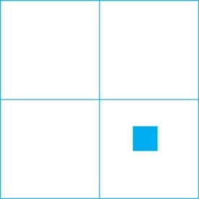

Tiling Checkerboards
Consider a 2^{k+1} ×2^{k+1} checkerboard with one square removed. Split this checkerboard into four checkerboards of size 2^{k} ×2^{k},by dividing it in half in both directions.
Remove a square from one of the four 2^{k} ×2^{k} checkerboards. By the inductive hypothesis, this board can be tiled. Also by the inductive hypothesis, the other three boards can be tiled with the square from the corner of the center of the original board removed. We can then cover the three adjacent squares with a triominoe.
Hence, the entire 2^{k+1} ×2^{k+1} checkerboard with one square removed can be tiled using right triominoes.
Inductive Hypothesis: Every 2^{k} ×2^{k} checkerboard, for some positive integer k, with one square removed can be tiled using right triominoes.

Slide 30
An Incorrect “Proof” by Mathematical Induction
Example: Let P(n) be the statement that every set of n lines in the plane, no two of which are parallel, meet in a common point. Here is a “proof” that P(n) is true for all positive integers n ≥ 2.
BASIS STEP: The statement P(2) is true because any two lines in the plane that are not parallel meet in a common point.
INDUCTIVE STEP: The inductive hypothesis is the statement that P(k) is true for the positive integer k ≥ 2, i.e., every set of k lines in the plane, no two of which are parallel, meet in a common point.
We must show that if P(k) holds, then P(k + 1) holds, i.e., if every set of k lines in the plane, no two of which are parallel, k ≥ 2, meet in a common point, then every set of k + 1 lines in the plane, no two of which are parallel, meet in a common point.
continued →

Slide 31
An Incorrect “Proof” by Mathematical Induction
Consider a set of k + 1 distinct lines in the plane, no two parallel. By the inductive hypothesis, the first k of these lines must meet in a common point p₁. By the inductive hypothesis, the last k of these lines meet in a common point p₂.
If p₁ and p₂ are different points, all lines containing both of them must be the same line since two points determine a line. This contradicts the assumption that the lines are distinct. Hence, p₁ = p₂ lies on all k + 1 distinct lines, and therefore P(k + 1) holds. Assuming that k ≥2, distinct lines meet in a common point, then every k + 1 lines meet in a common point.
There must be an error in this proof since the conclusion is absurd. But where is the error?
Answer: P(k)→ P(k + 1) only holds for k ≥3. It is not the case that P(2) implies P(3). The first two lines must meet in a common point p₁ and the second two must meet in a common point p₂. They do not have to be the same point since only the second line is common to both sets of lines.
Inductive Hypothesis: Every set of k lines in the plane, where k ≥ 2, no two of which are parallel, meet in a common point.

Slide 32
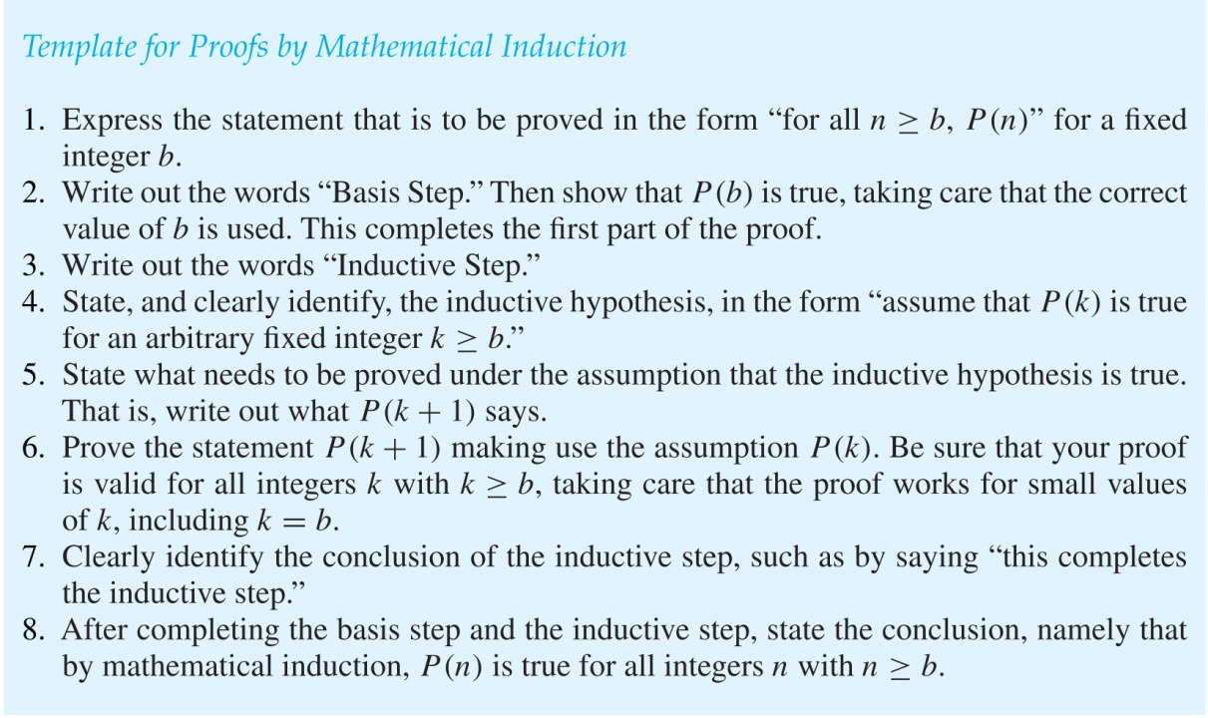
Guidelines: Mathematical Induction Proofs

Slide 33
Exercise
Pages 330 13, 27 7th edition
Pages 280 13, 27 6th edition

Slide 34
Strong Induction and Well-Ordering
Section 5.2

Slide 35
Section Summary
Strong Induction
Example Proofs using Strong Induction
Using Strong Induction in Computational Geometry (not yet included in overheads)
Well-Ordering Property

Slide 36
Strong Induction
Strong Induction: To prove that P(n) is true for all positive integers n, where P(n) is a propositional function, complete two steps:
Basis Step: Verify that the proposition P(1) is true.
Inductive Step: Show the conditional statement [P(1) ∧ P(2) ∧∙∙∙ ∧ P(k)] → P(k + 1) holds for all positive integers k.
Strong Induction is sometimes called the second principle of mathematical induction or complete induction.

Slide 37
Strong Induction and the Infinite Ladder
Strong induction tells us that we can reach all rungs if:
We can reach the first rung of the ladder.
For every integer k, if we can reach the first k rungs, then we can reach the (k + 1)st rung.
To conclude that we can reach every rung by strong induction:
BASIS STEP: P(1) holds
INDUCTIVE STEP: Assume P(1) ∧ P(2) ∧∙∙∙ ∧ P(k)
holds for an arbitrary integer k, and show that
P(k + 1) must also hold.
We will have then shown by strong induction that for every positive integer n, P(n) holds, i.e., we can
reach the nth rung of the ladder.

Slide 38
Proof using Strong Induction
Example: Suppose we can reach the first and second rungs of an infinite ladder, and we know that if we can reach a rung, then we can reach two rungs higher. Prove that we can reach every rung.
(Try this with mathematical induction.)
Solution: Prove the result using strong induction.
BASIS STEP: We can reach the first step.
INDUCTIVE STEP: The inductive hypothesis is that we can reach the first k rungs, for any k ≥ 2. We can reach the (k + 1)st rung since we can reach the (k − 1)st rung by the inductive hypothesis.
Hence, we can reach all rungs of the ladder.

Slide 39
Which Form of Induction Should Be Used?
We can always use strong induction instead of mathematical induction. But there is no reason to use it if it is simpler to use mathematical induction. (See page 335 of text.)
In fact, the principles of mathematical induction, strong induction, and the well-ordering property are all equivalent. (Exercises 41-43)
Sometimes it is clear how to proceed using one of the three methods, but not the other two.

Slide 40
Completion of the proof of the Fundamental Theorem of Arithmetic
Example: Show that if n is an integer greater than 1, then n can be written as the product of primes.
Solution: Let P(n) be the proposition that n can be written as a product of primes.
BASIS STEP: P(2) is true since 2 itself is prime.
INDUCTIVE STEP: The inductive hypothesis is P(j) is true for all integers j with 2 ≤ j ≤ k. To show that P(k + 1) must be true under this assumption, two cases need to be considered:
If k + 1 is prime, then P(k + 1) is true.
Otherwise, k + 1 is composite and can be written as the product of two positive integers a and b with 2 ≤ a ≤ b < k + 1. By the inductive hypothesis a and b can be written as the product of primes and therefore k + 1 can also be written as the product of those primes.
Hence, it has been shown that every integer greater than 1 can be written as the product of primes.
(uniqueness proved in Section 4.3)

Slide 41
Proof using Strong Induction
Example: Prove that every amount of postage of 12 cents or more can be formed using just 4-cent and 5-cent stamps.
Solution: Let P(n) be the proposition that postage of n cents can be formed using 4-cent and 5-cent stamps.
BASIS STEP: P(12), P(13), P(14), and P(15) hold.
P(12) uses three 4-cent stamps.
P(13) uses two 4-cent stamps and one 5-cent stamp.
P(14) uses one 4-cent stamp and two 5-cent stamps.
P(15) uses three 5-cent stamps.
INDUCTIVE STEP: The inductive hypothesis states that P(j) holds for 12 ≤ j ≤ k, where k ≥ 15. Assuming the inductive hypothesis, it can be shown that P(k + 1) holds.
Using the inductive hypothesis, P(k − 3) holds since k − 3 ≥ 12. To form postage of k + 1 cents, add a 4-cent stamp to the postage for k − 3 cents.
Hence, P(n) holds for all n ≥ 12.

Slide 42
Proof of Same Example using Mathematical Induction
Example: Prove that every amount of postage of 12 cents or more can be formed using just 4-cent and 5-cent stamps.
Solution: Let P(n) be the proposition that postage of n cents can be formed using 4-cent and 5-cent stamps.
BASIS STEP: Postage of 12 cents can be formed using three 4-cent stamps.
INDUCTIVE STEP: The inductive hypothesis P(k) for any positive integer k is that postage of k cents can be formed using 4-cent and 5-cent stamps. To show P(k + 1) where k ≥ 12 , we consider two cases:
If at least one 4-cent stamp has been used, then a 4-cent stamp can be replaced with a 5-cent stamp to yield a total of k + 1 cents. k = 4s + 5t =4(s-1)+5t + 4, k+1 = 4(s-1)+5(t + 1)
Otherwise, no 4-cent stamp have been used and at least three 5-cent stamps were used. Three 5-cent stamps can be replaced by four 4-cent stamps to yield a total of k + 1 cents.
k = 5t = 5(t-3) + 15, k+1 = 5t = 5(t-3) + 15+1 = 5(t-3) + 4*4
Hence, P(n) holds for all n ≥ 12.

Slide 43
Using Strong Induction in Computational Geometry
Our next example of strong induction will come from computational geometry, the part of discrete mathematics that studies computational problems involving geometric objects. Computational geometry is used extensively in computer graphics, computer games, robotics, scientiﬁc calculations, and a vast array of other areas. Before we can present this result, we introduce some terminology, possibly familiar from earlier studies in geometry
Polygon is basic unit of Computational Geometry

Slide 44
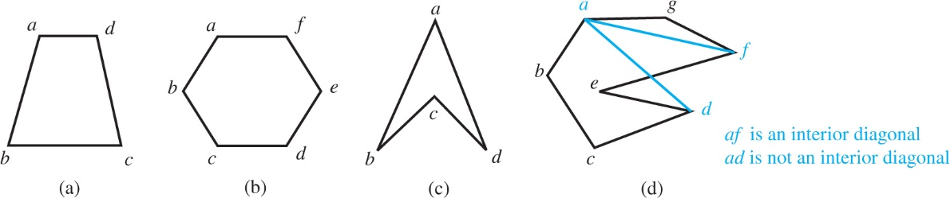
Polygon

Slide 45
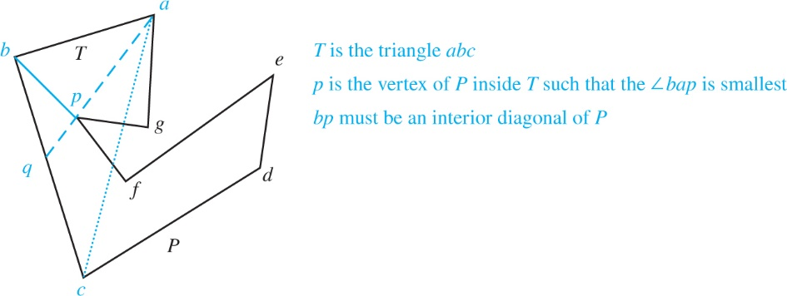
LEMMA 1 Every simple polygon with at least four sides has an interior diagonal.

Slide 46
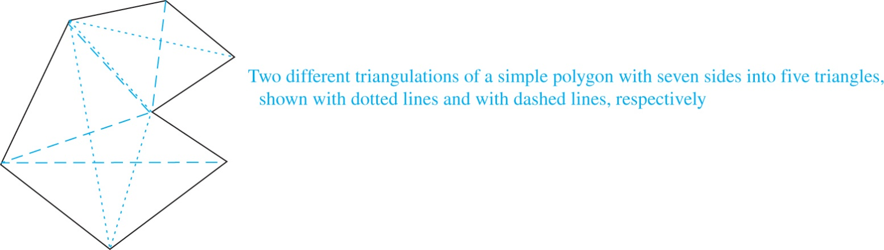
A simple polygon with n sides, where n is an integer with n ≥ 3, can be triangulated into n−2 triangles
a
b
Suppose that we have a simple polygon P with k+1 sides. Because k+1 ≥ 4, Lemma1 tells us that P has an interior diagonal ab. Now, ab splits P into two simple polygons Q, with s sides, and R, with t sides. The sides of Q and R are the sides of P, together with the side ab, which is a side of both Q and R. Note that 3 ≤ s ≤ k and 3 ≤ t ≤ k because both Q and R have at least one fewer side than P does .

Slide 47
Furthermore, the number of sides of P is two less than the sum of the numbers of sides of Q and the number of sides of R, because each side of P is a side of either Q or of R, but not both, and the diagonal ab is a side of both Q and R, but not P. That is, k+1 = s +t −2. We now use the inductive hypothesis. Because both 3≤ s ≤ k and 3≤ t ≤ k, by the inductive hypothesis we can triangulate Q and R into s −2 and t −2 triangles, respectively. Next, note that these triangulations together produce a triangulation of P. (Each diagonal added to triangulate one of these smaller polygons is also a diagonal of P.) Consequently, we can triangulate P into a total of (s −2)+(t −2) = s +t −4 = (k+1)−2 triangles. This completes the proof by strong induction

Slide 48
Well-Ordering Property
Well-ordering property: Every nonempty set of nonnegative integers has a least element.
The well-ordering property is one of the axioms of the positive integers listed in Appendix 1.
The well-ordering property can be used directly in proofs, as the next example illustrates.
The well-ordering property can be generalized.
Definition: A set is well ordered if every subset has a least element.
N is well ordered under ≤.
The set of finite strings over an alphabet using lexicographic ordering is well ordered.
We will see a generalization of induction to sets other than the integers in the next section.

Slide 49
Well-Ordering Property
Example: Use the well-ordering property to prove the division algorithm, which states that if a is an integer and d is a positive integer, then there are unique integers q and r with 0 ≤ r < d, such that a = dq + r.
Solution: Let S be the set of nonnegative integers of the form a − dq, where q is an integer. The set is nonempty since −dq can be made as large as needed.
By the well-ordering property, S has a least element r = a − dq₀. The integer r is nonnegative. It also must be the case that r < d. If it were not, then there would be a smaller nonnegative element in S, namely, a − d(q₀ + 1) = a − dq₀ − d = r − d > 0.
Therefore, there are integers q and r with 0 ≤ r < d.
(uniqueness of q and r is Exercise 37)
⁻² .

Slide 50
Exercise
Pages 342-344 15, 35 7th edition
Pages 292-293 15, 35 6th edition

Slide 51
Recursive Definitions and Structural Induction
Section 5.3

Slide 52
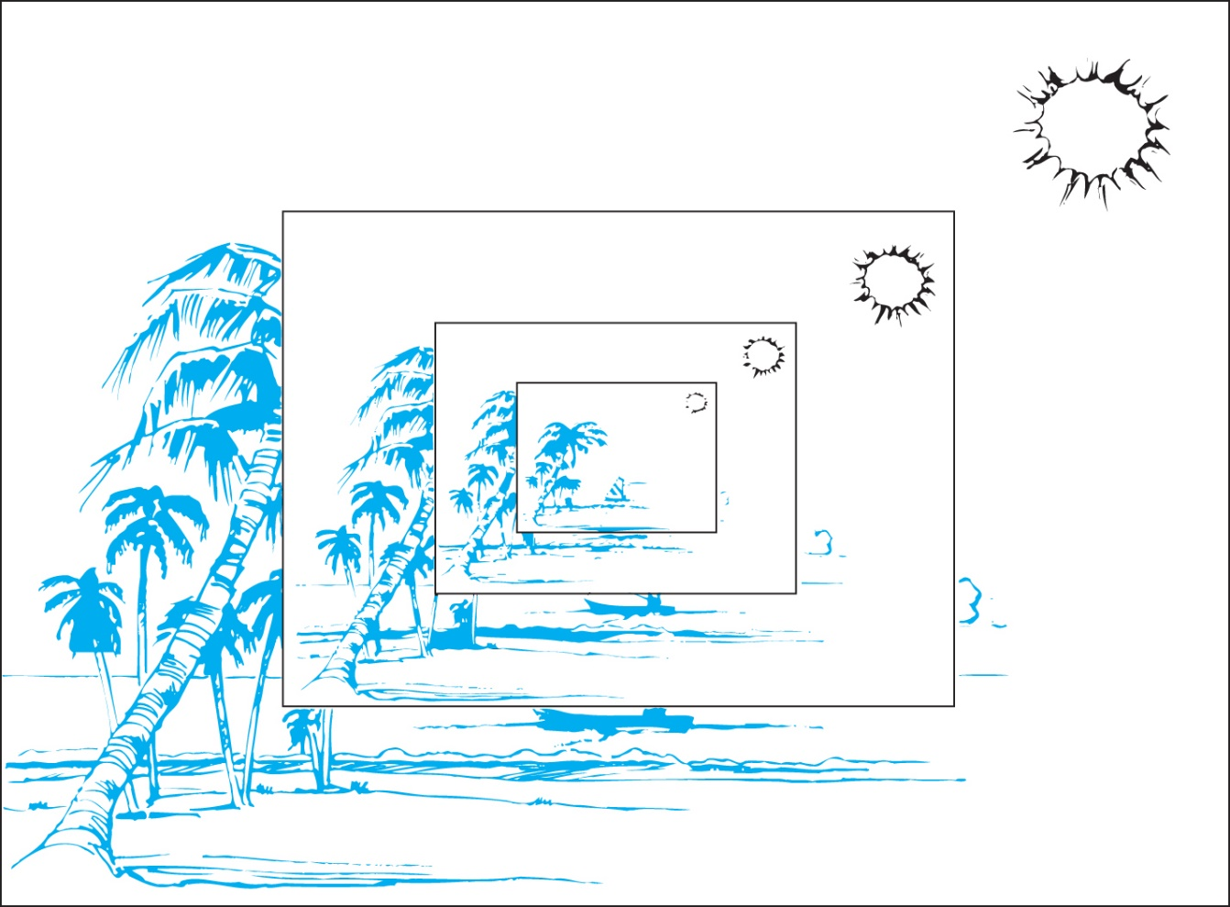
Section Summary
Recursively Defined Functions
Recursively Defined Sets and Structures
Structural Induction
Generalized Induction

Slide 53
Recursively Defined Functions
Definition: A recursive or inductive definition of a function consists of two steps.
BASIS STEP: Specify the value of the function at zero.
RECURSIVE STEP: Give a rule for finding its value at an integer from its values at smaller integers.
A function f(n) is the same as a sequence a₀, a₁, … , where a_{i}, where f(i) = a_{i}. This was done using recurrence relations in Section 2.4.

Slide 54
Recursively Defined Functions
Example: Suppose f is defined by:
f(0) = 3,
f(n + 1) = 2f(n) + 3
Find f(1), f(2), f(3), f(4)
Solution:
f(1) = 2f(0) + 3 = 2∙3 + 3 = 9
f(2) = 2f(1)+ 3 = 2∙9 + 3 = 21
f(3) = 2f(2) + 3 = 2∙21 + 3 = 45
f(4) = 2f(3) + 3 = 2∙45 + 3 = 93
Example: Give a recursive definition of the factorial function n!:
Solution:
f(0) = 1
f(n + 1) = (n + 1)∙ f(n)

Slide 55
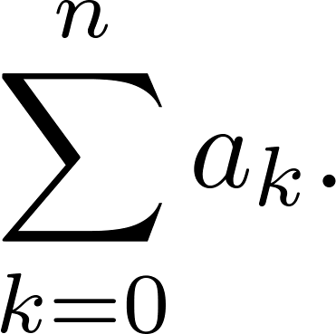
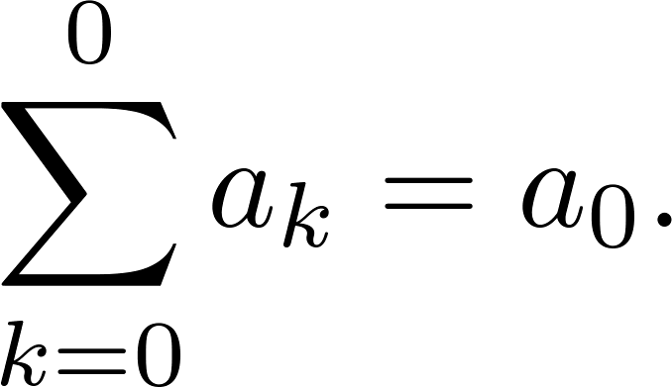
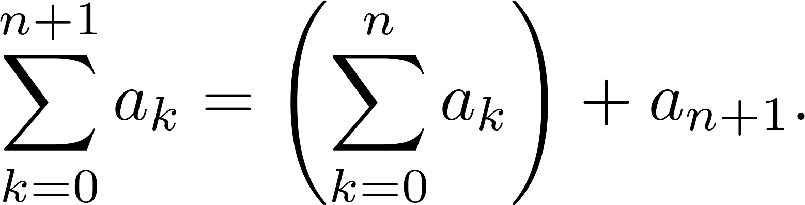
Recursively Defined Functions
Example: Give a recursive definition of:
Solution: The first part of the definition is
The second part is

Slide 56
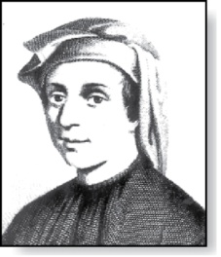
Fibonacci Numbers
Fibonacci
(1170- 1250)
Example : The Fibonacci numbers are defined as follows:
f₀ = 0
f₁ = 1
f_{n} = f_{n−1} + f_{n−2}
Find f₂, f₃ , f₄ , f₅ .
f₂ = f₁ + f₀ = 1 + 0 = 1
f₃ = f₂ + f₁ = 1 + 1 = 2
f₄ = f₃ + f₂ = 2 + 1 = 3
f₅ = f₄ + f₃ = 3 + 2 = 5
In Chapter 8, we will use the Fibonacci numbers to model population growth of rabbits. This was an application described by Fibonacci himself.
Next, we use strong induction to prove a result about the Fibonacci numbers.

Slide 57
Fibonacci Numbers
Example 4: Show that whenever n ≥ 3, f_{n} > α^{n − 2}, where α = (1 + √5)/2.
Solution: Let P(n) be the statement f_{n} > α^{n−2} . Use strong induction to show that P(n) is true whenever n ≥ 3.
BASIS STEP: P(3) holds since α < 2 = f₃
P(4) holds since α² = (3 + √5)/2 < 3 = f₄ .
INDUCTIVE STEP: Assume that P(j) holds, i.e., f_{j} > α^{j−2} for all integers j with
3 ≤ j ≤ k, where k ≥ 4. Show that P(k + 1) holds, i.e., f_{k+1} > α^{k−1} .
Since α² = α + 1 (because α is a solution of x² − x − 1 = 0),
By the inductive hypothesis, because k ≥ 4 we have
Therefore, it follows that
Hence, P(k + 1) is true.
α^{k−1} = α² ∙ α^{k−3} = ( α + 1) ∙α^{k−3} = α ∙α^{k−3}+ 1 ∙α^{k−3} = α^{k−2} + α^{k−3}
Why does this equality hold?
f_{k−1} > α^{k−3}, f_{k−1} > α^{k−2}.
f_{k+1} = f_{k+1} + f_{k−1} > α^{k−2} + α^{k−3} = α^{k−1}.
⁻² .

Slide 58
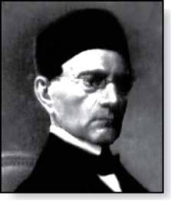
Lamé’s Theorem
Gabriel Lamé
(1795-1870)
Lamé’s Theorem: Let a and b be positive integers with a ≥ b. Then the number of divisions used by the Euclidian algorithm to find gcd(a,b) is less than or equal to five times the number of decimal digits in b.
Proof: When we use the Euclidian algorithm to find gcd(a,b) with a ≥ b,
n divisions are used to obtain (with a = r₀,b =r₁ ):
Since each quotient q₁, q₂ , …,q_{n-1} is at least 1 and q_{n} ≥ 2:
r₀ = r₁q₁ + r₂ 0 ≤ r₂ < r₁,
r₁ = r₂q₂ + r₃ 0 ≤ r₃ < r₂,
⋮
r_{n-2} = r_{n-1}q_{n-1} + r_{n} 0 ≤ r_{n} < r_{n-1},
r_{n-1} = r_{n}q_{n}.
r_{n} ≥ 1 = f₂,
r_{n-1} ≥ 2 r_{n} ≥ 2 f₂ = f₃,
r_{n-2} ≥ r_{n-1} + r_{n} ≥ f₃ + f₂ = f₄,
⋮
r₂ ≥ r₃ + r₄ ≥ f_{n-1} + f_{n-2} = f_{n},
b = r₁ ≥ r₂ + r₃ ≥ f_{n} + f_{n-1} = f_{n+1}.
continued →

Slide 59
Lamé’s Theorem
It follows that if n divisions are used by the Euclidian algorithm to find gcd(a,b) with a ≥ b, then b ≥ f_{n+1}. By Example 4, f_{n+1} > α^{n − 1}, for n > 2, where α = (1 + √5)/2. Therefore, b > α^{n−1}.
Because log₁₀ α ≈ 0.208 > 1/5, log₁₀ b > (n−1) log₁₀ α > (n−1)/5 . Hence,
Suppose that b has k decimal digits. Then b < 10^{k} and log₁₀ b < k. It follows that n − 1 < 5k and since k is an integer, n ≤ 5k.
As a consequence of Lamé’s Theorem, O(log b) divisions are used by the Euclidian algorithm to find gcd(a,b) whenever a > b.
By Lamé’s Theorem, the number of divisions needed to find gcd(a,b) with a > b is less than or equal to 5 (log₁₀ b + 1) since the number of decimal digits in b (which equals ⌊log₁₀ b⌋ + 1) is less than or equal to log₁₀ b + 1.
n−1 < 5 ∙log₁₀ b.
Lamé’s Theorem was the first result in computational complexity

Slide 60
Recursively Defined Sets and Structures
Recursive definitions of sets have two parts:
The basis step specifies an initial collection of elements.
The recursive step gives the rules for forming new elements in the set from those already known to be in the set.
Sometimes the recursive definition has an exclusion rule, which specifies that the set contains nothing other than those elements specified in the basis step and generated by applications of the rules in the recursive step.
We will always assume that the exclusion rule holds, even if it is not explicitly mentioned.
We will later develop a form of induction, called structural induction, to prove results about recursively defined sets.

Slide 61
Recursively Defined Sets and Structures
Example : Subset of Integers S:
BASIS STEP: 3 ∊ S.
RECURSIVE STEP: If x ∊ S and y ∊ S, then x + y is in S.
Initially 3 is in S, then 3 + 3 = 6, then 3 + 6 = 9, etc.
Example: The natural numbers N.
BASIS STEP: 0 ∊ N.
RECURSIVE STEP: If n is in N, then n + 1 is in N.
Initially 0 is in S, then 0 + 1 = 1, then 1 + 1 = 2, etc.

Slide 62
Strings
Definition: The set Σ* of strings over the alphabet Σ:
BASIS STEP: λ ∊ Σ* (λ is the empty string)
RECURSIVE STEP: If w is in Σ* and x is in Σ, then wx ∈ Σ*.
Example: If Σ = {0,1}, the strings in in Σ* are the set of all bit strings, λ,0,1, 00,01,10, 11, etc.
Example: If Σ = {a,b}, show that aab is in Σ*.
Since λ ∊ Σ* and a ∊ Σ, a ∊ Σ*.
Since a ∊ Σ* and a ∊ Σ, aa ∊ Σ*.
Since aa ∊ Σ* and b ∊ Σ, aab ∊ Σ*.

Slide 63
String Concatenation
Definition: Two strings can be combined via the operation of concatenation. Let Σ be a set of symbols and Σ* be the set of strings formed from the symbols in Σ. We can define the concatenation of two strings, denoted by ∙, recursively as follows.
BASIS STEP: If w ∈ Σ*, then w ∙ λ= w.
RECURSIVE STEP: If w₁ ∈ Σ* and w₂ ∈ Σ* and x ∈ Σ, then w ∙ (w₂ x)= (w₁ ∙ w₂)x.
Often w₁ ∙ w₂ is written as w₁ w₂.
If w₁ = abra and w₂ = cadabra, the concatenation w₁ w₂ = abracadabra.

Slide 64
Length of a String
Example: Give a recursive definition of l(w), the length of the string w.
Solution: The length of a string can be recursively defined by:
l(w) = 0;
l(wx) = l(w) + 1 if w ∊ Σ* and x ∊ Σ.

Slide 65
Balanced Parentheses
Example: Give a recursive definition of the set of balanced parentheses P.
Solution:
BASIS STEP: () ∊ P
RECURSIVE STEP: If w ∊ P, then () w ∊ P, (w) ∊ P and w () ∊ P.
Show that (() ()) is in P.
Why is ))(() not in P?

Slide 66
Well-Formed Formulae in Propositional Logic
Definition: The set of well-formed formulae in propositional logic involving T, F, propositional variables, and operators from the set {¬,∧,∨,→,↔}.
BASIS STEP: T,F, and s, where s is a propositional variable, are well-formed formulae.
RECURSIVE STEP: If E and F are well formed formulae, then (¬ E), (E ∧ F), (E ∨ F), (E → F), (E ↔ F), are well-formed formulae.
Examples: ((p ∨q) → (q ∧ F)) is a well-formed formula.
pq ∧ is not a well formed formula.

Slide 67
Rooted Trees
Definition: The set of rooted trees, where a rooted tree consists of a set of vertices containing a distinguished vertex called the root, and edges connecting these vertices, can be defined recursively by these steps:
BASIS STEP: A single vertex r is a rooted tree.
RECURSIVE STEP: Suppose that T₁, T₂, …,T_{n} are disjoint rooted trees with roots r₁, r₂,…,r_{n}, respectively. Then the graph formed by starting with a root r, which is not in any of the rooted trees T₁, T₂, …,T_{n}, and adding an edge from r to each of the vertices r₁, r₂,…,r_{n}, is also a rooted tree.

Slide 68
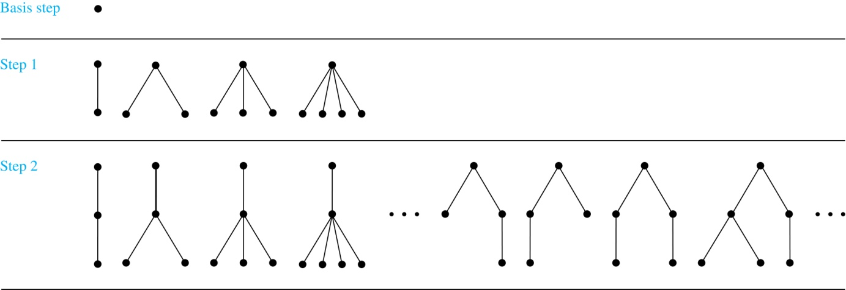
Building Up Rooted Trees
Trees are studied extensively in Chapter 11.
Next we look at a special type of tree, the full binary tree.

Slide 69
Full Binary Trees
Definition: The set of full binary trees can be defined recursively by these steps.
BASIS STEP: There is a full binary tree consisting of only a single vertex r.
RECURSIVE STEP: If T₁ and T₂ are disjoint full binary trees, there is a full binary tree, denoted by T₁∙T₂, consisting of a root r together with edges connecting the root to each of the roots of the left subtree T₁ and the right subtree T₂.

Slide 70
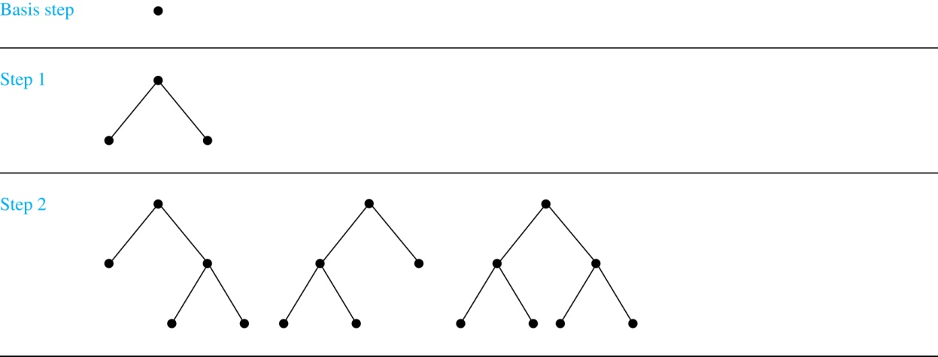
Building Up Full Binary Trees

Slide 71
Induction and Recursively Defined Sets
Example: Show that the set S defined by specifying that 3 ∊ S and that if x ∊ S and y ∊ S, then x + y is in S, is the set of all positive integers that are multiples of 3.
Solution: Let A be the set of all positive integers divisible by 3. To prove that A = S, show that A is a subset of S and S is a subset of A.
A⊂ S: Let P(n) be the statement that 3n belongs to S.
BASIS STEP: 3∙1 = 3 ∊ S, by the first part of recursive definition.
INDUCTIVE STEP: Assume P(k) is true. By the second part of the recursive definition, if 3k ∊ S, then since 3 ∊ S, 3k + 3 = 3(k + 1) ∊ S. Hence, P(k + 1) is true.
S ⊂ A:
BASIS STEP: 3 ∊ S by the first part of recursive definition, and 3 = 3∙1.
INDUCTIVE STEP: The second part of the recursive definition adds x +y to S, if both x and y are in S. If x and y are both in A, then both x and y are divisible by 3. By part (i) of Theorem 1 of Section 4.1, it follows that x + y is divisible by 3.
We used mathematical induction to prove a result about a recursively defined set. Next we study a more direct form induction for proving results about recursively defined sets.

Slide 72
Structural Induction
Definition: To prove a property of the elements of a recursively defined set, we use structural induction.
BASIS STEP: Show that the result holds for all elements specified in the basis step of the recursive definition.
RECURSIVE STEP: Show that if the statement is true for each of the elements used to construct new elements in the recursive step of the definition, the result holds for these new elements.
The validity of structural induction can be shown to follow from the principle of mathematical induction.

Slide 73
Full Binary Trees
Definition: The height h(T) of a full binary tree T is defined recursively as follows:
BASIS STEP: The height of a full binary tree T consisting of only a root r is h(T) = 0.
RECURSIVE STEP: If T₁ and T₂ are full binary trees, then the full binary tree T = T₁∙T₂ has height h(T) = 1 + max(h(T₁),h(T₂)).
The number of vertices n(T) of a full binary tree T satisfies the following recursive formula:
BASIS STEP: The number of vertices of a full binary tree T consisting of only a root r is n(T) = 1.
RECURSIVE STEP: If T₁ and T₂ are full binary trees, then the full binary tree T = T₁∙T₂ has the number of vertices n(T) = 1 + n(T₁) + n(T₂).

Slide 74
Structural Induction and Binary Trees
Theorem: If T is a full binary tree, then n(T) ≤ 2^{h(T)+1} – 1.
Proof: Use structural induction.
BASIS STEP: The result holds for a full binary tree consisting only of a root, n(T) = 1 and h(T) = 0. Hence, n(T) = 1 ≤ 2⁰⁺¹ – 1 = 1.
RECURSIVE STEP: Assume n(T₁) ≤ 2^{h(T1)+1} – 1 and also n(T₂) ≤ 2^{h(T2)+1} – 1 whenever T₁ and T₂ are full binary trees.
n(T) = 1 + n(T₁) + n(T₂) (by recursive formula of n(T))
≤ 1 + (2^{h(T1)+1} – 1) + (2^{h(T2)+1} – 1) (by inductive hypothesis)
≤ 2∙max(2^{h(T1)+1} ,2^{h(T2)+1} ) – 1
= 2∙2^{max(h(T1),h(T2))+1} – 1 (max(2^{x} , 2^{y})= 2^{max(x,y)} )
= 2∙2^{h(t)} – 1 (by recursive definition of h(T))
= 2^{h(t)+1} – 1
⁻² .

Slide 75
Generalized Induction
Generalized induction is used to prove results about sets other than the integers that have the well-ordering property. (explored in more detail in Chapter 9)
For example, consider an ordering on N⨉ N, ordered pairs of nonnegative integers. Specify that (x₁ ,y₁) is less than or equal to (x₂,y₂) if either x₁ < x₂, or x₁ = x₂ and y₁ <y₂ . This is called the lexicographic ordering.
Strings are also commonly ordered by a lexicographic ordering.
The next example uses generalized induction to prove a result about ordered pairs from N⨉ N.

Slide 76
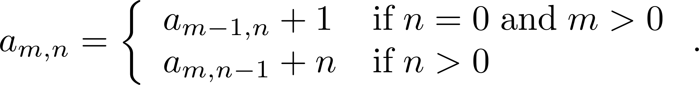
Generalized Induction
Example: Suppose that a_{m,n} is defined for (m,n)∊N ×N by a_{0,0} = 0 and
Show that a_{m,n} = m + n(n + 1)/2 is defined for all (m,n)∊N ×N.
Solution: Use generalized induction.
BASIS STEP: a_{0,0} = 0 = 0 + (0∙1)/2
INDUCTIVE STEP: Assume that a_{m̍,n̍} = m̍+ n̍(n̍ + 1)/2 whenever(m̍,n̍) is less than (m,n) in the lexicographic ordering of N ×N .
If n = 0, by the inductive hypothesis we can conclude
a_{m,n} = a_{m−1,n} + 1 = m − 1+ n(n + 1)/2 + 1 = m + n(n + 1)/2 .
If n > 0, by the inductive hypothesis we can conclude
a_{m,n} = a_{m−1,n} + 1 = m + n(n − 1)/2 +n = m + n(n + 1)/2 .
⁻² .

Slide 77
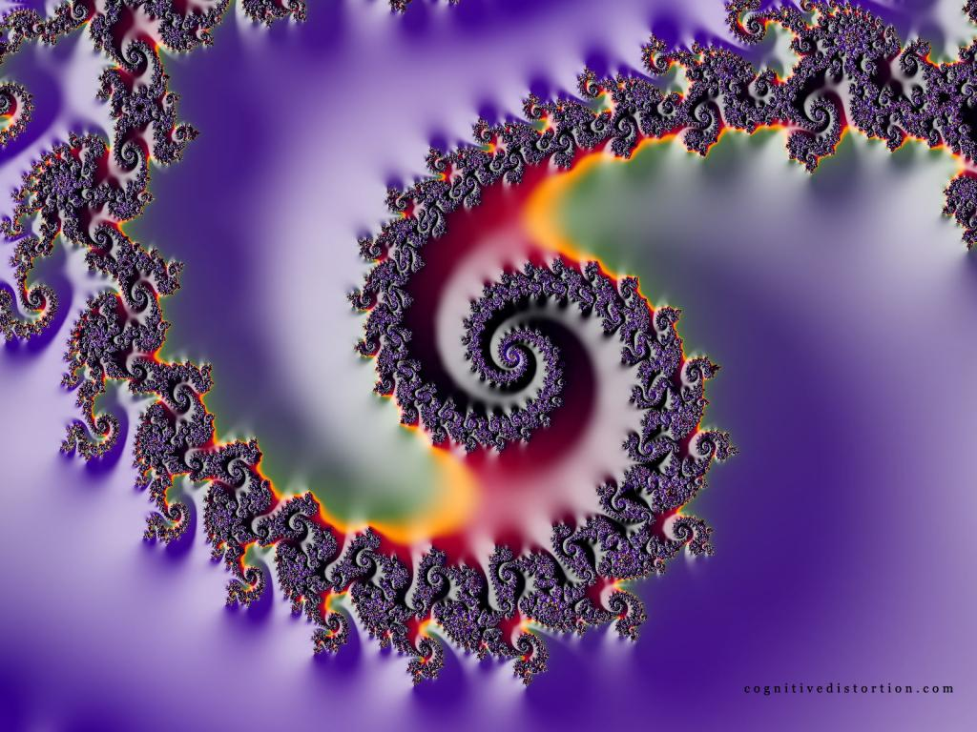
Fractals
A fractal is a pattern that uses recursion
The pattern itself repeats indefinitely

Slide 78
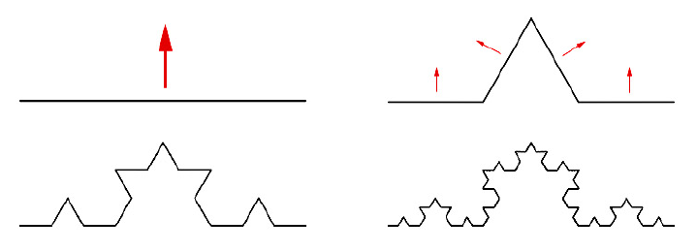
Fractals
A geometric shape made up of same pattern repeated in different sizes and orientations
Koch curve
A curve of order 0 is a straight line
A curve of order n consists of 4 curve of order n-1

Slide 79

Fractals
Koch curve
after five iteration steps (order 4 curve)

Slide 80
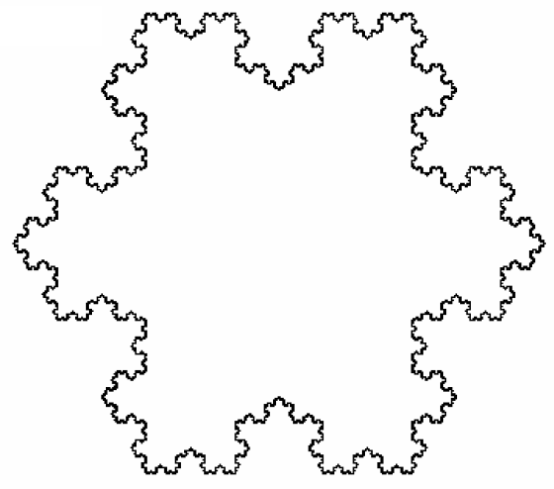
Fractals
Koch snowflake
From 3 Koch curves of order 4

Slide 81
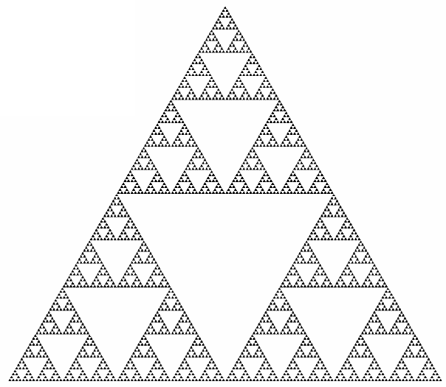
Sierpinski Triangle
A confined recursion of triangles to form a geometric lattice

Slide 82
Exercise
Pages 358-359 15, 47 7th edition
Pages 308-311 15, 47 6th edition

Slide 83
Recursive Algorithms
Section 5.4

Slide 84
Section Summary
Recursive Algorithms
Proving Recursive Algorithms Correct
Recursion and Iteration (not yet included in overheads)
Merge Sort

Slide 85
Recursive Algorithms
Definition: An algorithm is called recursive if it solves a problem by reducing it to an instance of the same problem with smaller input.
For the algorithm to terminate, the instance of the problem must eventually be reduced to some initial case for which the solution is known.

Slide 86
Recursive Factorial Algorithm
Example: Give a recursive algorithm for computing n!, where n is a nonnegative integer.
Solution: Use the recursive definition of the factorial function.
procedure factorial(n: nonnegative integer)
if n = 0 then return 1
else return n∙(n − 1)
{output is n!}

Slide 87
Recursive Exponentiation Algorithm
Example: Give a recursive algorithm for computing a^{n}, where a is a nonzero real number and n is a nonnegative integer.
Solution: Use the recursive definition of a^{n}.
procedure power(a: nonzero real number, n: nonnegative integer)
if n = 0 then return 1
else return a∙ power (a, n − 1)
{output is a^{n}}

Slide 88
Recursive GCD Algorithm
Example: Give a recursive algorithm for computing the greatest common divisor of two nonnegative integers a and b with a < b.
Solution: Use the reduction
gcd(a,b) = gcd(b mod a, a)
and the condition gcd(0,b) = b when b > 0.
procedure gcd(a,b: nonnegative integers
with a < b)
if a = 0 then return b
else return gcd (b mod a, a)
{output is gcd(a, b)}

Slide 89
Recursive Modular Exponentiation Algorithm
Example: Devise a a recursive algorithm for computing b^{n} mod m, where b, n, and m are integers with m ≥ 2, n ≥ 0, and 1≤ b ≤ m.
Solution:
(see text for full explanation)
procedure mpower(b,m,n: integers with b > 0 and m ≥ 2, n ≥ 0)
if n = 0 then
return 1
else if n is even then
return mpower(b,n/2,m)² mod m
else
return (mpower(b,⌊n/2⌋,m)² mod m∙ b mod m) mod m
{output is b^{n} mod m}

Slide 90
Recursive Binary Search Algorithm
Example: Construct a recursive version of a binary search algorithm.
Solution: Assume we have a₁,a₂,…, a_{n}, an increasing sequence of integers. Initially i is 1 and j is n. We are searching for x.
procedure binary search(i, j, x : integers, 1≤ i ≤ j ≤n)
m := ⌊(i + j)/2⌋
if x = a_{m} then
return m
else if (x < a_{m} and i < m) then
return binary search(i,m−1,x)
else if (x > a_{m} and j >m) then
return binary search(m+1,j,x)
else return 0
{output is location of x in a₁, a₂,…,a_{n} if it appears, otherwise 0}

Slide 91
Proving Recursive Algorithms Correct
Both mathematical and str0ng induction are useful techniques to show that recursive algorithms always produce the correct output.
Example: Prove that the algorithm for computing the powers of real numbers is correct.
Solution: Use mathematical induction on the exponent n.
BASIS STEP: a⁰ =1 for every nonzero real number a, and power(a,0) = 1.
INDUCTIVE STEP: The inductive hypothesis is that power(a,k) = a^{k}, for all a ≠0. Assuming the inductive hypothesis, the algorithm correctly computes a^{k+1}, since
power(a,k + 1) = a∙ power (a, k) = a∙ a^{k} = a^{k+1} .
procedure power(a: nonzero real number, n: nonnegative integer)
if n = 0 then return 1
else return a∙ power (a, n − 1)
{output is a^{n}}
⁻² .

Slide 92
Merge Sort
Merge Sort works by iteratively splitting a list (with an even number of elements) into two sublists of equal length until each sublist has one element.
Each sublist is represented by a balanced binary tree.
At each step a pair of sublists is successively merged into a list with the elements in increasing order. The process ends when all the sublists have been merged.
The succession of merged lists is represented by a binary tree.

Slide 93
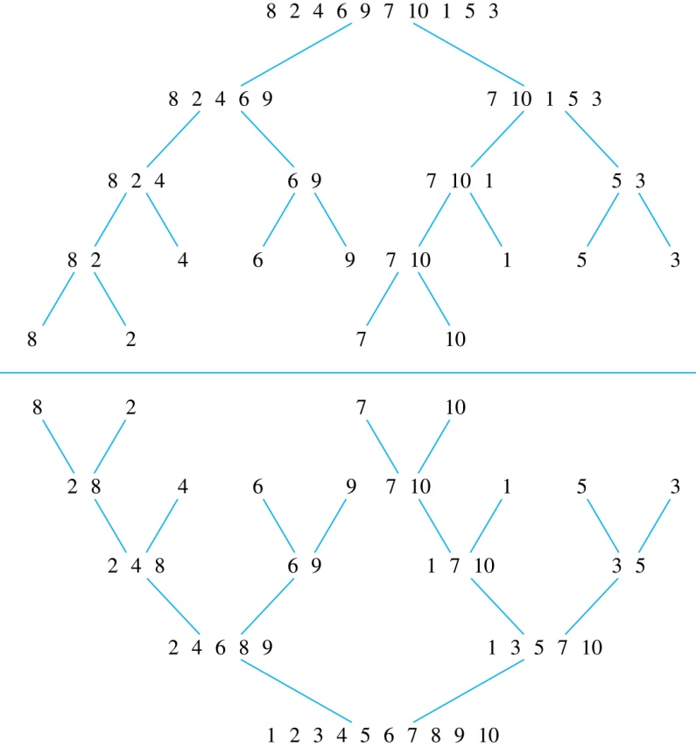
Merge Sort
Example: Use merge sort to put the list
8,2,4,6,9,7,10, 1, 5, 3
into increasing order.
Solution:

Slide 94
Recursive Merge Sort
Example: Construct a recursive merge sort algorithm.
Solution: Begin with the list of n elements L.
procedure mergesort(L = a₁, a₂,…,a_{n} )
if n > 1 then
m := ⌊n/2⌋
L₁ := a₁, a₂,…,a_{m}
L₂ := a_{m+1}, a_{m+2},…,a_{n}
L := merge(mergesort(L₁), mergesort(L₂ ))
{L is now sorted into elements in increasing order}
continued →

Slide 95
Recursive Merge Sort
Subroutine merge, which merges two sorted lists.
Complexity of Merge: Two sorted lists with m elements and n elements can be merged into a sorted list using no more than m + n − 1 comparisons.
procedure merge(L₁, L₂ :sorted lists)
L := empty list
while L₁ and L₂ are both nonempty
remove smaller of first elements of L₁ and L₂ from its list;
put at the right end of L
if this removal makes one list empty
then remove all elements from the other list and append them to L
return L {L is the merged list with the elements in increasing order}

Slide 96
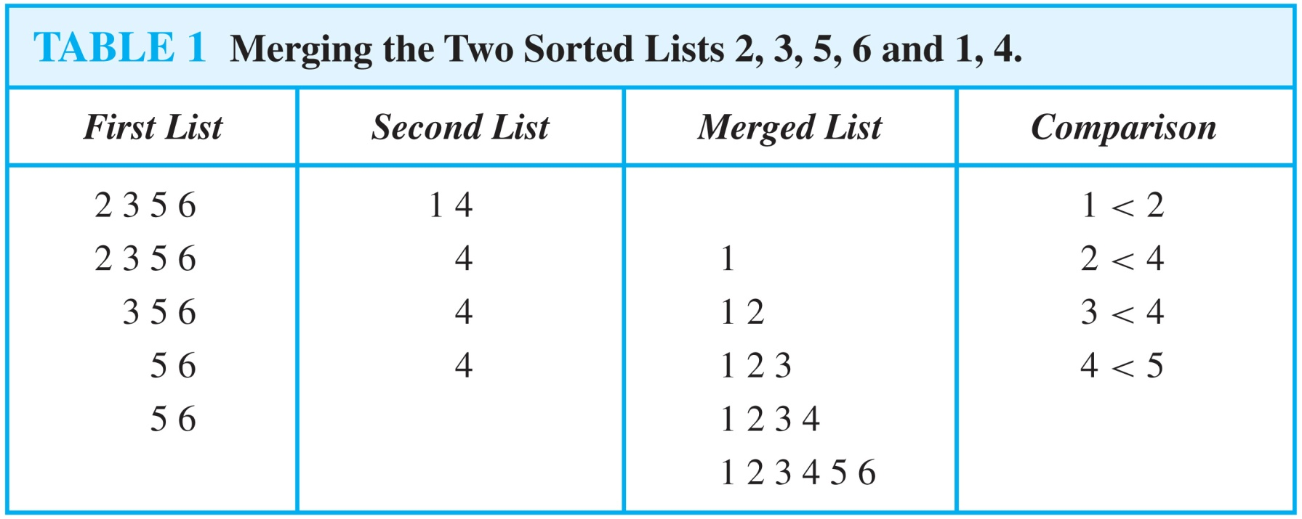
Merging Two Lists
Example: Merge the two lists 2,3,5,6 and 1,4.
Solution:

Slide 97
Complexity of Merge Sort
Complexity of Merge Sort: The number of comparisons needed to merge a list with n elements is O(n log n).
For simplicity, assume that n is a power of 2, say 2^{m}.
At the end of the splitting process, we have a binary tree with m levels, and 2^{m} lists with one element at level m.
The merging process begins at level m with the pairs of 2^{m} lists with one element combined into 2^{m−1} lists of two elements. Each merger takes two one comparison.
The procedure continues , at each level (k = m, m−1, m−1,…,3,2,1) 2^{k} lists with 2^{m−k} elements are merged into 2^{k−1} lists, with 2^{m−k + 1} elements at level k−1.
We know (by the complexity of the merge subroutine) that each merger takes at most 2^{m−k} + 2^{m−k} − 1 = 2^{m−k+ 1} − 1 comparisons.
continued →

Slide 98
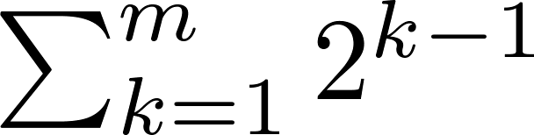
Complexity of Merge Sort
Summing over the number of comparisons at each level, shows that
because m = log n and n = 2^{m}.
(The expression in the formula above is evaluated as 2^{m} − 1 using the formula for the sum of the terms of a geometric progression, from Section 2.4.)
In Chapter 11, we’ll see that the fastest comparison-based sorting algorithms have O(n log n) time complexity. So, merge sort achieves the best possible big-O estimate of time complexity.

Slide 99
Exercise
Page 371 23 7th edition
Page 321 23 6th edition

