Slide 1
Counting
Chapter 6
With Question/Answer Animations

Slide 2
Chapter Summary
The Basics of Counting
The Pigeonhole Principle
Permutations and Combinations
Binomial Coefficients and Identities
Generalized Permutations and Combinations
Generating Permutations and Combinations (not yet included in overheads)

Slide 3
The Basics of Counting
Section 6.1

Slide 4
Section Summary
The Product Rule
The Sum Rule
The Subtraction Rule
The Division Rule
Examples, Examples, and Examples
Tree Diagrams

Slide 5
Basic Counting Principles: The Product Rule
The Product Rule: A procedure can be broken down into a sequence of two tasks. There are n₁ ways to do the first task and n₂ ways to do the second task. Then there are n₁∙n₂ ways to do the procedure.
Example: How many bit strings of length seven are there?
Solution: Since each of the seven bits is either a 0 or a 1, the answer is 2⁷ = 128.

Slide 6
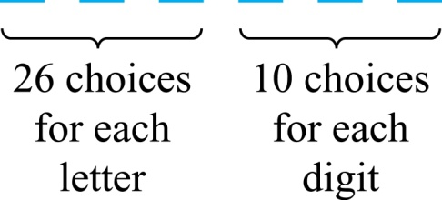
The Product Rule
Example: How many different license plates can be made if each plate contains a sequence of three uppercase English letters followed by three digits?
Solution: By the product rule,
there are 26 ∙ 26 ∙ 26 ∙ 10 ∙ 10 ∙ 10 = 17,576,000 different possible license plates.

Slide 7
Counting Functions
Counting Functions: How many functions are there from a set with m elements to a set with n elements?
Solution: Since a function represents a choice of one of the n elements of the codomain for each of the m elements in the domain, the product rule tells us that there are n ∙ n ∙ ∙ ∙ n = n^{m} such functions.
Counting One-to-One Functions: How many one-to-one functions are there from a set with m elements to one with n elements?
Solution: Suppose the elements in the domain are a₁, a₂,…, a_{m}. There are n ways to choose the value of a₁ and n−1 ways to choose a₂, etc. The product rule tells us that there are n(n−1) (n−2)∙∙∙(n−m +1) such functions.

Slide 8
Telephone Numbering Plan
Example: The North American numbering plan (NANP) specifies that a telephone number consists of 10 digits, consisting of a three-digit area code, a three-digit office code, and a four-digit station code. There are some restrictions on the digits.
Let X denote a digit from 0 through 9.
Let N denote a digit from 2 through 9.
Let Y denote a digit that is 0 or 1.
In the old plan (in use in the 1960s) the format was NYX-NNX-XXX.
In the new plan, the format is NXX-NXX-XXX.
How many different telephone numbers are possible under the old plan and the new plan?
Solution: Use the Product Rule.
There are 8 ∙2 ∙10 = 160 area codes with the format NYX.
There are 8 ∙10 ∙10 = 800 area codes with the format NXX.
There are 8 ∙8 ∙10 = 640 office codes with the format NNX.
There are 10 ∙10 ∙10 ∙10 = 10,000 station codes with the format XXXX.
Number of old plan telephone numbers: 160 ∙640 ∙10,000 = 1,024,000,000.
Number of new plan telephone numbers: 800 ∙800 ∙10,000 = 6,400,000,000.

Slide 9
Counting Subsets of a Finite Set
Counting Subsets of a Finite Set: Use the product rule to show that the number of different subsets of a finite set S is 2^{|S|}. (In Section 5.1, mathematical induction was used to prove this same result.)
Solution: When the elements of S are listed in an arbitrary order, there is a one-to-one correspondence between subsets of S and bit strings of length |S|. When the ith element is in the subset, the bit string has a 1 in the ith position and a 0 otherwise.
By the product rule, there are 2^{|S|} such bit strings, and therefore 2^{|S|} subsets.

Slide 10
Product Rule in Terms of Sets
If A₁, A₂, … , A_{m} are finite sets, then the number of elements in the Cartesian product of these sets is the product of the number of elements of each set.
The task of choosing an element in the Cartesian product A₁ ⨉ A₂ ⨉ ∙∙∙ ⨉ A_{m} is done by choosing an element in A₁, an element in A₂ , …, and an element in A_{m}.
By the product rule, it follows that:
|A₁ ⨉ A₂ ⨉ ∙∙∙ ⨉ A_{m} |= |A₁| ∙ |A₂| ∙ ∙∙∙ ∙ |A_{m}|.

Slide 11
DNA and Genomes
A gene is a segment of a DNA molecule that encodes a particular protein and the entirety of genetic information of an organism is called its genome.
DNA molecules consist of two strands of blocks known as nucleotides. Each nucleotide is composed of bases: adenine (A), cytosine (C), guanine (G), or thymine (T).
The DNA of bacteria has between 10⁵ and 10⁷ links (one of the four bases). Mammals have between 10⁸ and 10¹⁰ links. So, by the product rule there are at least 4¹⁰⁵ different sequences of bases in the DNA of bacteria and 4¹⁰⁸ different sequences of bases in the DNA of mammals.
The human genome includes approximately 23,000 genes, each with 1,000 or more links.
Biologists, mathematicians, and computer scientists all work on determining the DNA sequence (genome) of different organisms.
Notes:
DNA分子包括被称为核苷酸块的两条链。每个核苷酸由碱基：腺嘌呤（A ） ，胞嘧啶（C ） ，鸟嘌呤（G ）或胸腺嘧啶（T ） 。

Slide 12
Basic Counting Principles: The Sum Rule
The Sum Rule: If a task can be done either in one of n₁ ways or in one of n₂ ways to do the second task, where none of the set of n₁ ways is the same as any of the n₂ ways, then there are n₁ + n₂ ways to do the task.
Example: The mathematics department must choose either a student or a faculty member as a representative for a university committee. How many choices are there for this representative if there are 37 members of the mathematics faculty and 83 mathematics majors and no one is both a faculty member and a student.
Solution: By the sum rule it follows that there are 37 + 83 = 120 possible ways to pick a representative.

Slide 13
The Sum Rule in terms of sets.
The sum rule can be phrased in terms of sets.
|A ∪ B|= |A| + |B| as long as A and B are disjoint sets.
Or more generally,
The case where the sets have elements in common will be discussed when we consider the subtraction rule and taken up fully in Chapter 8.
|A₁ ∪ A₂ ∪ ∙∙∙ ∪ A_{m} |= |A₁| + |A₂| + ∙∙∙ + |A_{m}|
when A_{i} ∩ A_{j} = ∅ for all i, j.

Slide 14
Combining the Sum and Product Rule
Example: Suppose statement labels in a programming language can be either a single letter or a letter followed by a digit. Find the number of possible labels.
Solution: Use the product rule.
26 + 26 ∙ 10 = 286

Slide 15
Counting Passwords
Combining the sum and product rule allows us to solve more complex problems.
Example: Each user on a computer system has a password, which is six to eight characters long, where each character is an uppercase letter or a digit. Each password must contain at least one digit. How many possible passwords are there?
Solution: Let P be the total number of passwords, and let P₆, P₇, and P₈ be the passwords of length 6, 7, and 8.
By the sum rule P = P₆ + P₇ +P₈.
To find each of P₆, P₇, and P₈ , we find the number of passwords of the specified length composed of letters and digits and subtract the number composed only of letters. We find that:
P₆ = 36⁶ − 26⁶ =2,176,782,336 − 308,915,776 =1,867,866,560.
P₇ = 36⁷ − 26⁷ =
78,364,164,096 − 8,031,810,176 = 70,332,353,920.
P₈ = 36⁸ − 26⁸ =
2,821,109,907,456 − 208,827,064,576 =2,612,282,842,880.
Consequently, P = P₆ + P₇ +P₈ = 2,684,483,063,360.

Slide 16
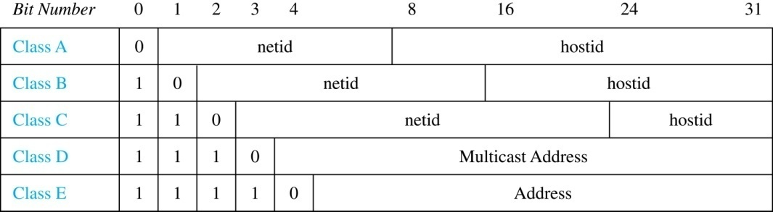
Internet Addresses
Version 4 of the Internet Protocol (IPv4) uses 32 bits.
Class A Addresses: used for the largest networks, a 0,followed by a 7-bit netid and a 24-bit hostid.
Class B Addresses: used for the medium-sized networks, a 10,followed by a 14-bit netid and a 16-bit hostid.
Class C Addresses: used for the smallest networks, a 110,followed by a 21-bit netid and a 8-bit hostid.
Neither Class D nor Class E addresses are assigned as the address of a computer on the internet. Only Classes A, B, and C are available.
1111111 is not available as the netid of a Class A network.
Hostids consisting of all 0s and all 1s are not available in any network.

Slide 17
Counting Internet Addresses
Example: How many different IPv4 addresses are available for computers on the internet?
Solution: Use both the sum and the product rule. Let x be the number of available addresses, and let x_{A}, x_{B}, and x_{C} denote the number of addresses for the respective classes.
To find, x_{A}: 2⁷ − 1 = 127 netids. 2²⁴ − 2 = 16,777,214 hostids.
x_{A} = 127∙ 16,777,214 = 2,130,706,178.
To find, x_{B}: 2¹⁴ = 16,384 netids. 2¹⁶ − 2 = 16,534 hostids.
x_{B} = 16,384 ∙ 16, 534 = 1,073,709,056.
To find, x_{C}: 2²¹ = 2,097,152 netids. 2⁸ − 2 = 254 hostids.
x_{C} = 2,097,152 ∙ 254 = 532,676,608.
Hence, the total number of available IPv4 addresses is
x = x_{A} + x_{B} + x_{C}
= 2,130,706,178 + 1,073,709,056 + 532,676,608
= 3, 737,091,842.
Not Enough Today !!
The newer IPv6 protocol solves the problem of too few addresses. uses 128 bits

Slide 18
Basic Counting Principles: Subtraction Rule
Subtraction Rule: If a task can be done either in one of n₁ ways or in one of n₂ ways, then the total number of ways to do the task is n₁ + n₂ minus the number of ways to do the task that are common to the two different ways.
Also known as, the principle of inclusion-exclusion:

Slide 19
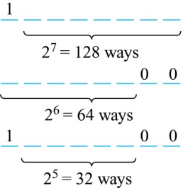
Counting Bit Strings
Example: How many bit strings of length eight either start with a 1 bit or end with the two bits 00?
Solution: Use the subtraction rule.
Number of bit strings of length eight that start with a 1 bit: 2⁷ = 128
Number of bit strings of length eight that start with bits 00: 2⁶ = 64
Number of bit strings of length eight that start with a 1 bit and end with bits 00 : 2⁵ = 32
Hence, the number is 128 + 64 − 32 = 160.

Slide 20
Basic Counting Principles: Division Rule
Division Rule: There are n/d ways to do a task if it can be done using a procedure that can be carried out in n ways, and for every way w, exactly d of the n ways correspond to way w.
Restated in terms of sets: If the finite set A is the union of n pairwise disjoint subsets each with d elements, then n = |A|/d.
In terms of functions: If f is a function from A to B, where both are finite sets, and for every value y ∈ B there are exactly d values x ∈ A such that f(x) = y, then |B| = |A|/d.
Example: How many ways are there to seat four people around a circular table, where two seatings are considered the same when each person has the same left and right neighbor?
Solution: Number the seats around the table from 1 to 4 proceeding clockwise. There are four ways to select the person for seat 1, 3 for seat 2, 2, for seat 3, and one way for seat 4. Thus there are 4! = 24 ways to order the four people. But since two seatings are the same when each person has the same left and right neighbor, for every choice for seat 1, we get the same seating.
Therefore, by the division rule, there are 24/4 = 6 different seating arrangements.

Slide 21
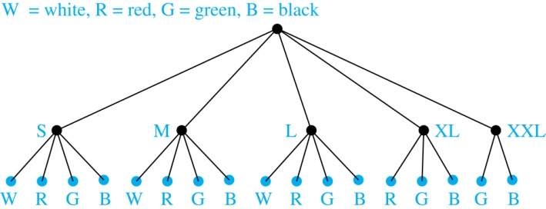
Tree Diagrams
Tree Diagrams: We can solve many counting problems through the use of tree diagrams, where a branch represents a possible choice and the leaves represent possible outcomes.
Example: Suppose that “I Love Discrete Math” T-shirts come in five different sizes: S,M,L,XL, and XXL. Each size comes in four colors (white, red, green, and black), except XL, which comes only in red, green, and black, and XXL, which comes only in green and black. What is the minimum number of stores that the campus book store needs to stock to have one of each size and color available?
Solution: Draw the tree diagram.
The store must stock 17 T-shirts.

Slide 22
Exercise
P. 396-397 27, 45 7th edition
P. 344-347 27, 45 6th edition

Slide 23
The Pigeonhole Principle
Section 6.2

Slide 24
Section Summary
The Pigeonhole Principle
The Generalized Pigeonhole Principle

Slide 25
The Pigeonhole Principle
Suppose a flock of pigeons fly into a set of pigeonholes to roost
If there are more pigeons than pigeonholes, then there must be at least 1 pigeonhole that has more than one pigeon in it
Main numbers
(1) the number of pigeon
(2)the number of pigeonhole

Slide 26
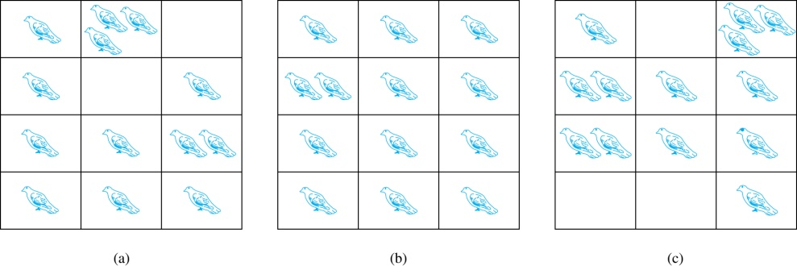
The Pigeonhole Principle
If a flock of 20 pigeons roosts in a set of 19 pigeonholes, one of the pigeonholes must have more than 1 pigeon.
Pigeonhole Principle: If k is a positive integer and k + 1 objects are placed into k boxes, then at least one box contains two or more objects.
Proof: We use a proof by contraposition. Suppose none of the k boxes has more than one object. Then the total number of objects would be at most k. This contradicts the statement that we have k + 1 objects.

Slide 27
The Pigeonhole Principle
Corollary 1: A function f from a set with k + 1 elements to a set with k elements is not one-to-one.
Proof: Use the pigeonhole principle.
Create a box for each element y in the codomain of f .
Put in the box for y all of the elements x from the domain such that f(x) = y.
Because there are k + 1 elements and only k boxes, at least one box has two or more elements.
Hence, f can’t be one-to-one.

Slide 28
Pigeonhole Principle
Example: Among any group of 367 people, there must be at least two with the same birthday, because there are only 366 possible birthdays.
Example (optional): Show that for every integer n there is a multiple of n that has only 0s and 1s in its decimal expansion.
Solution: Let n be a positive integer. Consider the n + 1 integers 1, 11, 111, …., 11…1 (where the last has n + 1 1s). There are n possible remainders when an integer is divided by n. By the pigeonhole principle, when each of the n + 1 integers is divided by n, at least two must have the same remainder. Subtract the smaller from the larger and the result is a multiple of n that has only 0s and 1s in its decimal expansion.

Slide 29
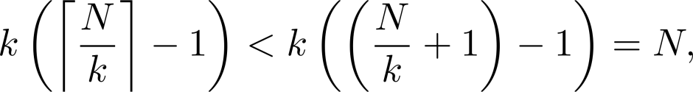
The Generalized Pigeonhole Principle
The Generalized Pigeonhole Principle: If N objects are placed into k boxes, then there is at least one box containing at least ⌈N/k⌉ objects.
Proof: We use a proof by contraposition. Suppose that none of the boxes contains more than ⌈N/k⌉ − 1 objects. Then the total number of objects is at most
where the inequality ⌈N/k⌉ < N/k + 1 has been used. This is a contradiction because there are a total of n objects.
Example: Among 100 people there are at least ⌈100/12⌉ = 9 who were born in the same month.

Slide 30
The Generalized Pigeonhole Principle
Example: a) How many cards must be selected from a standard deck of 52 cards to guarantee that at least three cards of the same suit are chosen?
b) How many must be selected to guarantee that at least three hearts are selected?
Solution: a) We assume four boxes; one for each suit. Using the generalized pigeonhole principle, at least one box contains at least ⌈N/4⌉ cards. At least three cards of one suit are selected if ⌈N/4⌉ ≥3. The smallest integer N such that ⌈N/4⌉ ≥3 is N = 2 ∙ 4 + 1 = 9.
b) A deck contains 13 hearts and 39 cards which are not hearts. So, if we select 41 cards, we may have 39 cards which are not hearts along with 2 hearts. However, when we select 42 cards, we must have at least three hearts. (Note that the generalized pigeonhole principle is not used here.)

Slide 31
Example 8
What is the least number of area codes needed to guarantee that 25 million phones in a state have distinct ten-digit telephone number?
Solution: number form:NXX-NXX-XXXX, there are 8×10⁶ different phone numbers of the form NXX-XXXX, hence, by generalized pigeonhole principle, at least ⎡25⁶ / 8×10⁶ ⎤=4 area codes

Slide 32
Elegant application
Example 10 during 30 days a baseball team plays at least one game a day, but no more than 45 games;show that there must be a period of some number of consecutive days during which the team must play exactly 14 games.
Solution: a_{j}: the number of games played on j-th day
B_{j} = Σ^{j}₁ a_{i}th b₁ ,b₂ ,…b₃₀ on are strictly increasing number.
C_{j} = b_{j}+14, then 15≤ B_{j} ≤45+14=59, the 60 integer numbers b₁ ,b₂ ,…b₃₀ , c₁ ,c₂ ,…c₃₀ are all less than or equal to 59, then two of these integers are equal, hence
b_{i} = c_{j} =b_{j}+14,it implies a_{j+1} + a_{j+2} + … + a_{i} =14

Slide 33
Ramsey Theorem
K₆ → K₃, K₃, of 6 (or more) people, either there are 3, each pair of whom are acquainted, or there are three, each pair of whom are unacquainted.
A
F
C
B
D
E

Slide 34
Ramsey number R(m, n)
The Ramsey number R(m, n) is the smallest number of people at a party that there either m mutual friends or n mutual enemies. e.g., R(3,3) = 6
R(2, n) = R(n, 2) = n

Slide 35
Exercises
P405-406 9, 35
P353-354 9, 31

Slide 36
Permutations and Combinations
Section 6.3

Slide 37
Section Summary
Permutations
Combinations
Combinatorial Proofs

Slide 38
Permutations
Definition: A permutation of a set of distinct objects is an ordered arrangement of these objects. An ordered arrangement of r elements of a set is called an r-permuation.
Example: Let S = {1,2,3}.
The ordered arrangement 3,1,2 is a permutation of S.
The ordered arrangement 3,2 is a 2-permutation of S.
The number of r-permuatations of a set with n elements is denoted by P(n,r).
The 2-permutations of S = {1,2,3} are 1,2; 1,3; 2,1; 2,3; 3,1; and 3,2. Hence, P(3,2) = 6.

Slide 39
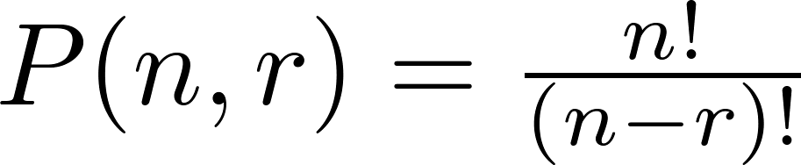
A Formula for the Number of Permutations
Theorem 1: If n is a positive integer and r is an integer with 1 ≤ r ≤ n, then there are
P(n, r) = n(n − 1)(n − 2) ∙∙∙ (n − r + 1)
r-permutations of a set with n distinct elements.
Proof: Use the product rule. The first element can be chosen in n ways. The second in n − 1 ways, and so on until there are (n − ( r − 1)) ways to choose the last element.
Note that P(n,0) = 1, since there is only one way to order zero elements.
Corollary 1: If n and r are integers with 1 ≤ r ≤ n, then

Slide 40
Solving Counting Problems by Counting Permutations
Example: How many ways are there to select a first-prize winner, a second prize winner, and a third-prize winner from 100 different people who have entered a contest?
Solution:
P(100,3) = 100 ∙ 99 ∙ 98 = 970,200

Slide 41
Solving Counting Problems by Counting Permutations (continued)
Example: Suppose that a saleswoman has to visit eight different cities. She must begin her trip in a specified city, but she can visit the other seven cities in any order she wishes. How many possible orders can the saleswoman use when visiting these cities?
Solution: The first city is chosen, and the rest are ordered arbitrarily. Hence the orders are:
7! = 7 ∙ 6 ∙ 5 ∙ 4 ∙ 3 ∙ 2 ∙ 1 = 5040
If she wants to find the tour with the shortest path that visits all the cities, she must consider 5040 paths!

Slide 42
Solving Counting Problems by Counting Permutations (continued)
Example: How many permutations of the letters ABCDEFGH contain the string ABC ?
Solution: We solve this problem by counting the permutations of six objects, ABC, D, E, F, G, and H.
6! = 6 ∙ 5 ∙ 4 ∙ 3 ∙ 2 ∙ 1 = 720

Slide 43

Combinations
Definition: An r-combination of elements of a set is an unordered selection of r elements from the set. Thus, an r-combination is simply a subset of the set with r elements.
The number of r-combinations of a set with n distinct elements is denoted by C(n, r). The notation is also used and is called a binomial coefficient. (We will see the notation again in the binomial theorem in Section 6.4.)
Example: Let S be the set {a, b, c, d}. Then {a, c, d} is a 3-combination from S. It is the same as {d, c, a} since the order listed does not matter.
C(4,2) = 6 because the 2-combinations of {a, b, c, d} are the six subsets {a, b}, {a, c}, {a, d}, {b, c}, {b, d}, and {c, d}.

Slide 44
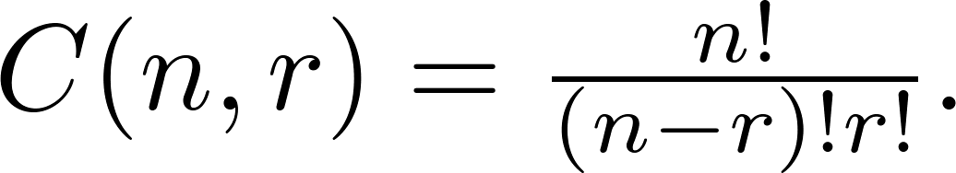
Combinations
Theorem 2: The number of r-combinations of a set with n elements, where n ≥ r ≥ 0, equals
Proof: By the product rule P(n, r) = C(n,r) ∙ P(r,r). Therefore,

Slide 45
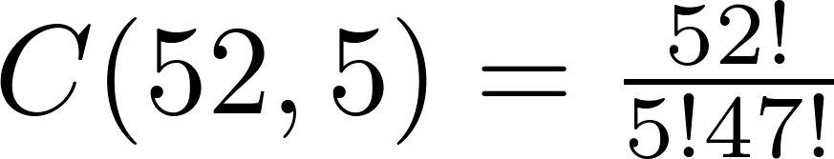
Combinations
Example: How many poker hands of five cards can be dealt from a standard deck of 52 cards? Also, how many ways are there to select 47 cards from a deck of 52 cards?
Solution: Since the order in which the cards are dealt does not matter, the number of five card hands is:
The different ways to select 47 cards from 52 is
This is a special case of a general result. →

Slide 46
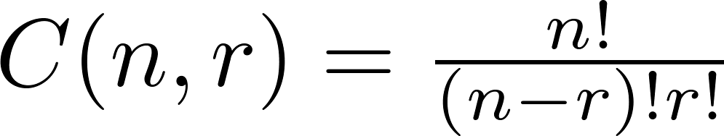
Combinations
Corollary 2: Let n and r be nonnegative integers with r ≤ n. Then C(n, r) = C(n, n − r).
Proof: From Theorem 2, it follows that
and
Hence, C(n, r) = C(n, n − r).
This result can be proved without using algebraic manipulation. →

Slide 47
Combinatorial Proofs
Definition 1: A combinatorial proof of an identity is a proof that uses one of the following methods.
A double counting proof uses counting arguments to prove that both sides of an identity count the same objects, but in different ways.
A bijective proof shows that there is a bijection between the sets of objects counted by the two sides of the identity.

Slide 48

Combinatorial Proofs
Here are two combinatorial proofs that
C(n, r) = C(n, n − r)
when r and n are nonnegative integers with r < n:
Bijective Proof: Suppose that S is a set with n elements. The function that maps a subset A of S to is a bijection between the subsets of S with r elements and the subsets with n − r elements. Since there is a bijection between the two sets, they must have the same number of elements.
Double Counting Proof: By definition the number of subsets of S with r elements is C(n, r). Each subset A of S can also be described by specifying which elements are not in A, i.e., those which are in . Since the complement of a subset of S with r elements has n − r elements, there are also C(n, n − r) subsets of S with r elements.

Slide 49
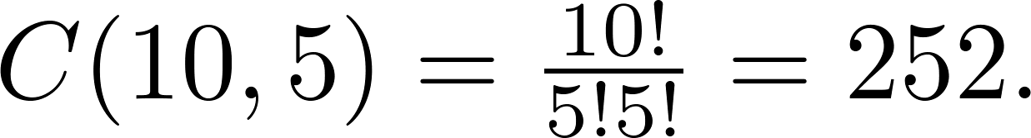
Combinations
Example: How many ways are there to select five players from a 10-member tennis team to make a trip to a match at another school.
Solution: By Theorem 2, the number of combinations is
Example: A group of 30 people have been trained as astronauts to go on the first mission to Mars. How many ways are there to select a crew of six people to go on this mission?
Solution: By Theorem 2, the number of possible crews is

Slide 50
Exercise
p413-414 9, 27 7th edition
p361-362 9, 27 6th edition

Slide 51
Binomial Coefficients and Identities
Section 6.4

Slide 52
Section Summary
The Binomial Theorem
Pascal’s Identity and Triangle
Other Identities Involving Binomial Coefficients (not currently included in overheads)

Slide 53


Powers of Binomial Expressions
Definition: A binomial expression is the sum of two terms, such as x + y. (More generally, these terms can be products of constants and variables.)
We can use counting principles to find the coefficients in the expansion of (x + y)^{n} where n is a positive integer.
To illustrate this idea, we first look at the process of expanding (x + y)³.
(x + y) (x + y) (x + y) expands into a sum of terms that are the product of a term from each of the three sums.
Terms of the form x³, x²y, x y², y³ arise. The question is what are the coefficients?
To obtain x³ , an x must be chosen from each of the sums. There is only one way to do this. So, the coefficient of x³ is 1.
To obtain x²y, an x must be chosen from two of the sums and a y from the other. There are ways to do this and so the coefficient of x²y is 3.
To obtain xy², an x must be chosen from of the sums and a y from the other two . There are ways to do this and so the coefficient of xy² is 3.
To obtain y³ , a y must be chosen from each of the sums. There is only one way to do this. So, the coefficient of y³ is 1.
We have used a counting argument to show that (x + y)³ = x³ + 3x²y + 3x y² + y³ .
Next we present the binomial theorem gives the coefficients of the terms in the expansion of (x + y)^{n} .

Slide 54


Binomial Theorem
Binomial Theorem: Let x and y be variables, and n a nonnegative integer. Then:
Proof: We use combinatorial reasoning . The terms in the expansion of (x + y)^{n} are of the form x^{n−j}y^{j} for j = 0,1,2,…,n. To form the term x^{n−j}y^{j}, it is necessary to choose n−j xs from the n sums. Therefore, the coefficient of x^{n−j}y^{j} is which equals .

Slide 55
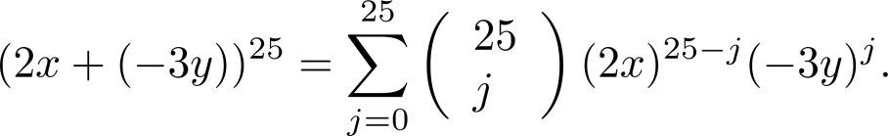
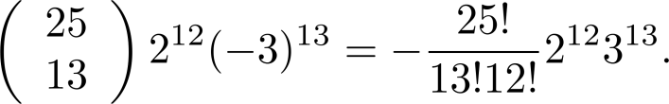
Using the Binomial Theorem
Example: What is the coefficient of x¹²y¹³ in the expansion of (2x − 3y)²⁵?
Solution: We view the expression as (2x +(−3y))²⁵. By the binomial theorem
Consequently, the coefficient of x¹²y¹³ in the expansion is obtained when j = 13.

Slide 56
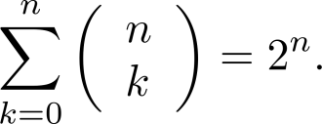
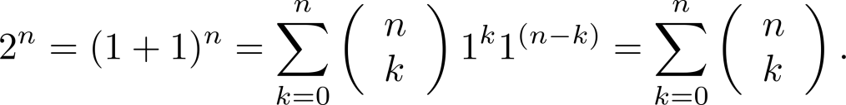




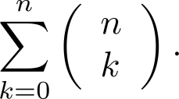
A Useful Identity
Corollary 1: With n ≥0,
Proof (using binomial theorem): With x = 1 and y = 1, from the binomial theorem we see that:
Proof (combinatorial): Consider the subsets of a set with n elements. There are subsets with zero elements, with one element, with two elements, …, and with n elements. Therefore the total is
Since, we know that a set with n elements has 2^{n} subsets, we conclude:

Slide 57
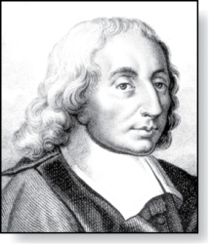
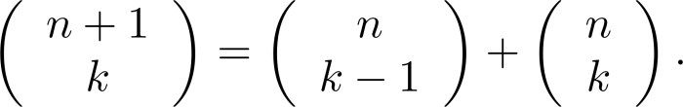



Pascal’s Identity
Blaise Pascal
(1623-1662)
Pascal’s Identity: If n and k are integers with n ≥ k ≥ 0, then
Proof (combinatorial): Let T be a set where |T| = n + 1, a ∊T, and S = T − {a}. There are subsets of T containing k elements. Each of these subsets either:
contains a with k − 1 other elements, or
contains k elements of S and not a.
There are
subsets of k elements that contain a, since there are subsets of k − 1 elements of S,
subsets of k elements of T that do not contain a, because there are subsets of k elements of S.
Hence,
See Exercise 19 for an algebraic proof.

Slide 58
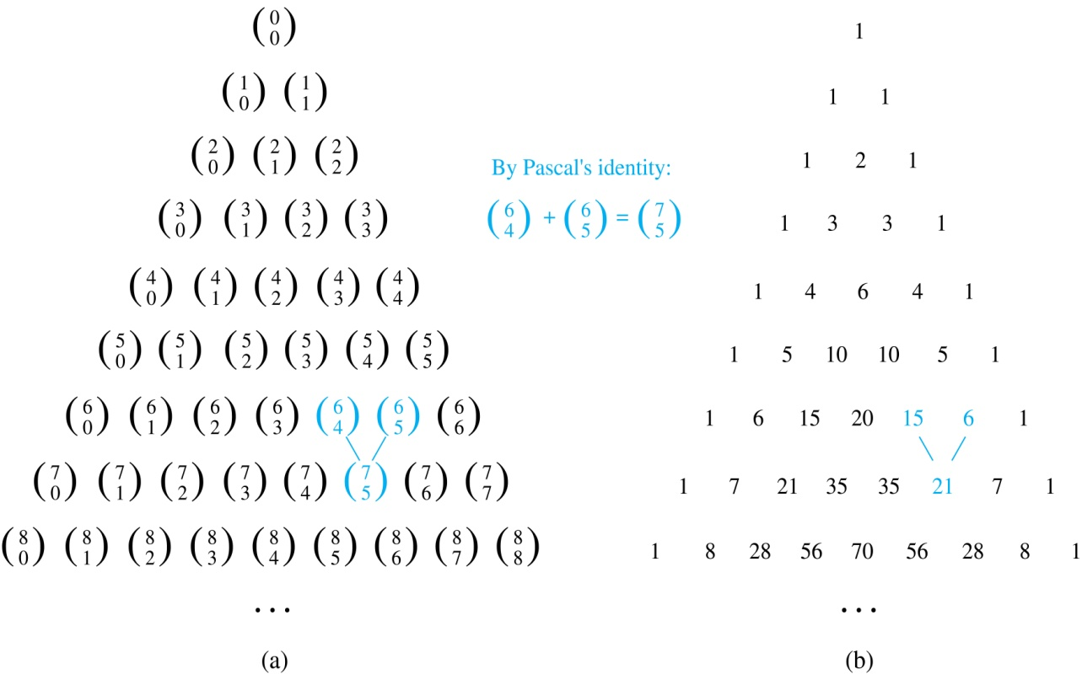
Pascal’s Triangle
The nth row in the triangle consists of the binomial coefficients ,
k = 0,1,….,n.
By Pascal’s identity, adding two adjacent bionomial coefficients results is the binomial coefficient in the next row between these two coefficients.

Slide 59
Exercise
P.422 31 7th editon
P. 370 31 6th edition

Slide 60
Generalized Permutations and Combinations
Section 6.5

Slide 61
Section Summary
Permutations with Repetition
Combinations with Repetition
Permutations with Indistinguishable Objects
Distributing Objects into Boxes

Slide 62
Permutations with Repetition
Theorem 1: The number of r-permutations of a set of n objects with repetition allowed is n^{r}.
Proof: There are n ways to select an element of the set for each of the r positions in the r-permutation when repetition is allowed. Hence, by the product rule there are n^{r} r-permutations with repetition.
Example: How many strings of length r can be formed from the uppercase letters of the English alphabet?
Solution: The number of such strings is 26^{r}, which is the number of r-permutations of a set with 26 elements.

Slide 63
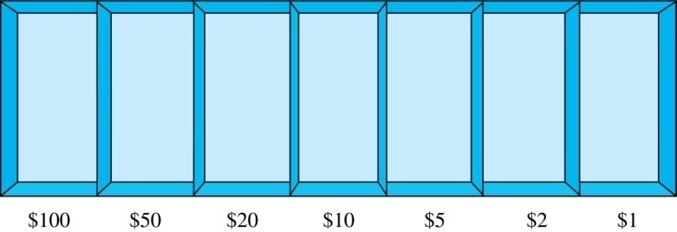
Combinations with Repetition
Example: How many ways are there to select five bills from a box containing at least five of each of the following denominations: $1, $2, $5, $10, $20, $50, and $100?
Solution: Place the selected bills in the appropriate position of a cash box illustrated below:
continued →

Slide 64
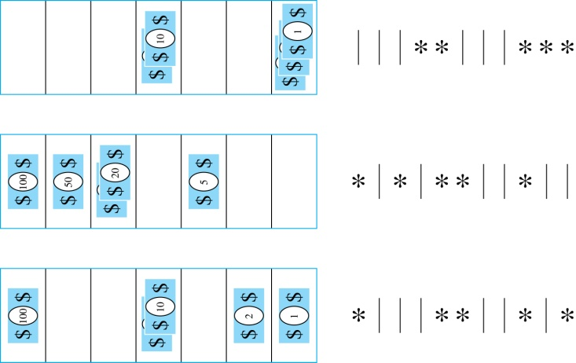

Combinations with Repetition
Some possible ways of
placing the five bills:
The number of ways to select five bills corresponds to the number of ways to arrange six bars and five stars in a row.
This is the number of unordered selections of 5 objects from a set of 11. Hence, there are
ways to choose five bills with seven types of bills.

Slide 65
Combinations with Repetition
Theorem 2: The number 0f r-combinations from a set with n elements when repetition of elements is allowed is
C(n + r – 1,r) = C(n + r – 1, n –1).
Proof: Each r-combination of a set with n elements with repetition allowed can be represented by a list of n –1 bars and r stars. The bars mark the n cells containing a star for each time the ith element of the set occurs in the combination.
The number of such lists is C(n + r – 1, r), because each list is a choice of the r positions to place the stars, from the total of n + r – 1 positions to place the stars and the bars. This is also equal to C(n + r – 1, n –1), which is the number of ways to place the n –1 bars.

Slide 66
Combinations with Repetition
Example: How many solutions does the equation
x₁ + x₂ + x₃ = 11
have, where x₁ , x₂ and x₃ are nonnegative integers?
Solution: Each solution corresponds to a way to select 11 items from a set with three elements; x₁ elements of type one, x₂ of type two, and x₃ of type three.
By Theorem 2 it follows that there are
solutions.

Slide 67
Combinations with Repetition
Example: Suppose that a cookie shop has four different kinds of cookies. How many different ways can six cookies be chosen?
Solution: The number of ways to choose six cookies is the number of 6-combinations of a set with four elements. By Theorem 2
is the number of ways to choose six cookies from the four kinds.

Slide 68
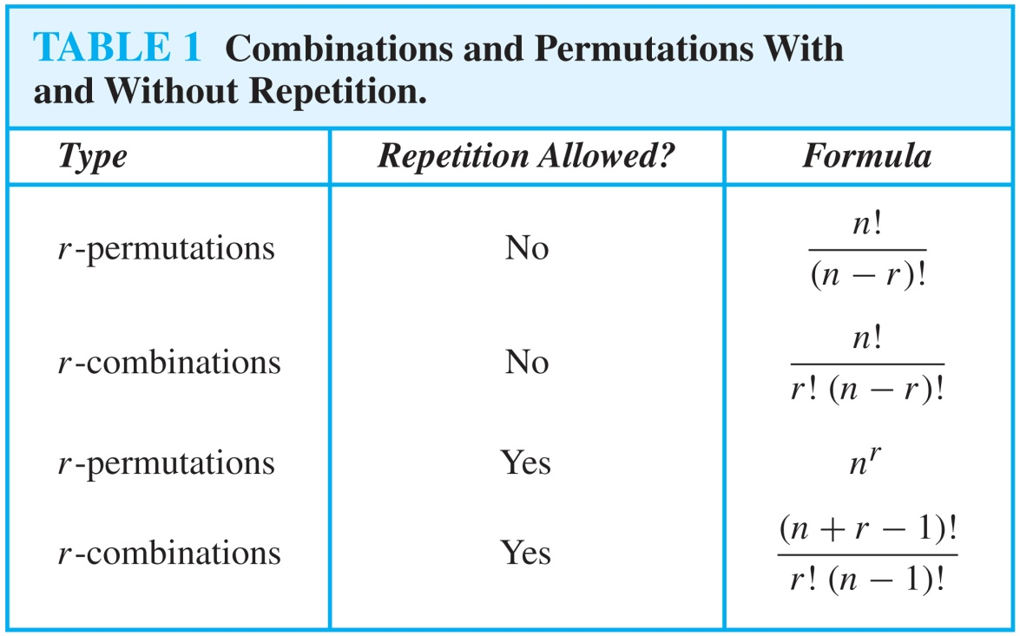
Summarizing the Formulas for Counting Permutations and Combinations with and without Repetition

Slide 69
Permutations with Indistinguishable Objects
Example: How many different strings can be made by reordering the letters of the word SUCCESS.
Solution: There are seven possible positions for the three Ss, two Cs, one U, and one E.
The three Ss can be placed in C(7,3) different ways, leaving four positions free.
The two Cs can be placed in C(4,2) different ways, leaving two positions free.
The U can be placed in C(2,1) different ways, leaving one position free.
The E can be placed in C(1,1) way.
By the product rule, the number of different strings is:
The reasoning can be generalized to the following theorem. →

Slide 70
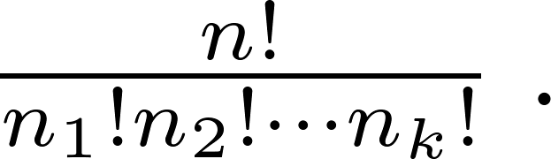
Permutations with Indistinguishable Objects
Theorem 3: The number of different permutations of n objects, where there are n₁ indistinguishable objects of type 1, n₂ indistinguishable objects of type 2, …., and n_{k} indistinguishable objects of type k, is:
Proof: By the product rule the total number of permutations is:
C(n, n₁ ) C(n − n₁, n₂ ) ∙∙∙ C(n − n₁ − n₂ − ∙∙∙ − n_{k}, n_{k}) since:
The n₁ objects of type one can be placed in the n positions in C(n, n₁ ) ways, leaving n − n₁ positions.
Then the n₂ objects of type two can be placed in the n − n₁ positions in C(n − n₁, n₂ ) ways, leaving n − n₁ − n₂ positions.
Continue in this fashion, until n_{k} objects of type k are placed in C(n − n₁ − n₂ − ∙∙∙ − n_{k}, n_{k}) ways.
The product can be manipulated into the desired result as follows:

Slide 71
Distributing Objects into Boxes
Many counting problems can be solved by counting the ways objects can be placed in boxes.
The objects may be either different from each other (distinguishable) or identical (indistinguishable).
The boxes may be labeled (distinguishable) or unlabeled (indistinguishable).
Distinguishable objects and distinguishable boxes.
There are k^{n} ways to distribute n distinguishable objects into k distinguishable boxes, where each box can contain any number of objects.

Slide 72
Distributing Objects into Boxes
Distinguishable objects and distinguishable boxes.
There are n!/(n₁!n₂! ∙∙∙n_{k}!) ways to distribute n distinguishable objects into k distinguishable boxes. where the boxes are restricted to contain n₁!, n₂! , ∙∙∙, n_{k}! objects respecterly.
(See Exercises 47 and 48 for two different proofs.)
Example: There are 52!/(5!5!5!5!32!) ways to distribute hands of 5 cards each to four players.
Indistinguishable objects and distinguishable boxes.
There are C(n + r − 1, n − 1) ways to place r indistinguishable objects into n distinguishable boxes.
Proof based on one-to-one correspondence between n-combinations from a set with k-elements when repetition is allowed and the ways to place n indistinguishable objects into k distinguishable boxes.
Example: There are C(8 + 10 − 1, 10) = C(17,10) = 19,448 ways to place 10 indistinguishable objects into 8 distinguishable boxes.

Slide 73
Distributing Objects into Boxes
Distinguishable objects and indistinguishable boxes.
Example 10: There are 14 ways to put four employees into three indistinguishable offices (see Example 10).
N =C(4,4)+C(4,3)+C(4,2)C(2,2)/2+C(4,2) = 14
There is no simple closed formula for the number of ways to distribute n distinguishable objects into j indistinguishable boxes.
But we can get a recurrence relation for this problem.

Slide 74
Distinguishable objects and indistinguishable boxes
Let S(n,j) denote the number of ways to distribute n distinguishable objects into j indistinguishable boxes so that no box is empty.
Let a is one object we selected, put a alone in a box or put it and with another object together in a box.
(1)S(n+1,j) = S(n,j-1) + jS(n,j) (j>1);
(2)S(n,1) = S(n,n) = 1;
(3)S(n,n-1) = C(n,2)
(4)S(n,2) = 2^{n-1} -1, there are only two box, we put a in one box, then put n-1 objects into two box has 2^{n-1} cases, but there is a case that one box is empty. For last example 10,
N = S(4,1)+S(4,2)+S(4,3) = 1+7+6 = 14

Slide 75
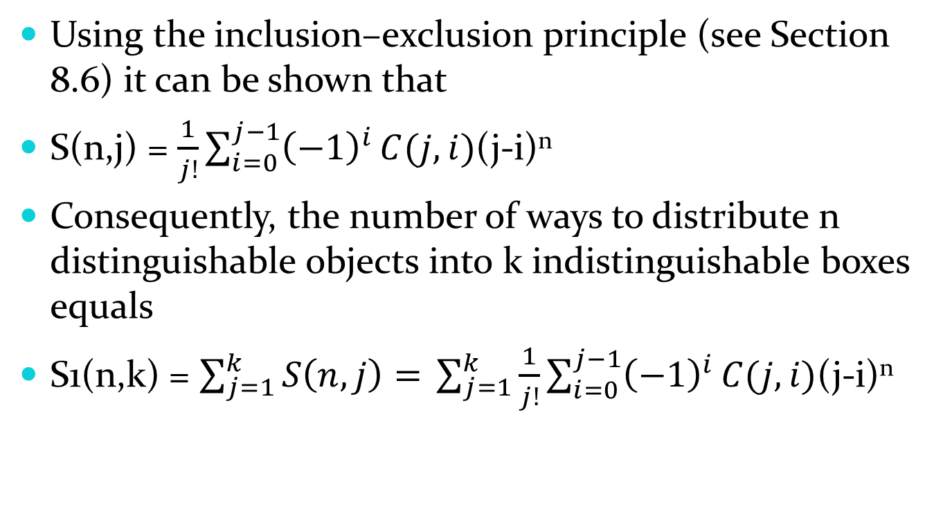
Distinguishable objects and indistinguishable boxes
Using the inclusion–exclusion principle (see Section 8.6) it can be shown that
S(n,j) = $\frac{1}{j!}\sum_{i=0}^{j−1}{{\left(−1\right)}^{i}}C(j,i)$(j-i)^{n}
Consequently, the number of ways to distribute n distinguishable objects into k indistinguishable boxes equals
S1(n,k) = $\sum_{j=1}^{k}{S\left(n,j\right)= }\sum_{j=1}^{k}{\frac{1}{j!}\sum_{i=0}^{j−1}{{\left(−1\right)}^{i}}C(j,i)\text{(}\text{j}\text{−}\text{i}\text{)}\text{n} }$

Slide 76
Indistinguishable objects and indistinguishable boxes
Example 11: There are 9 ways to pack six copies of the same book into four identical boxes.
{6}，{5,1}，{4,2}，{4,1,1}，{3,3}，{3,2,1}，{3,1,1,1}，{2,2,2}，{2,2,1,1}，enumeration result.
The number of ways of distributing n indistinguishable objects into k indistinguishable boxes equals p_{k}(n), the number of ways to write n as the sum of at most k positive integers in increasing order.
No simple closed formula exists for this number.
Let P(m,n) be the number of ways of distributing n indistinguishable objects into k indistinguishable boxes.

Slide 77
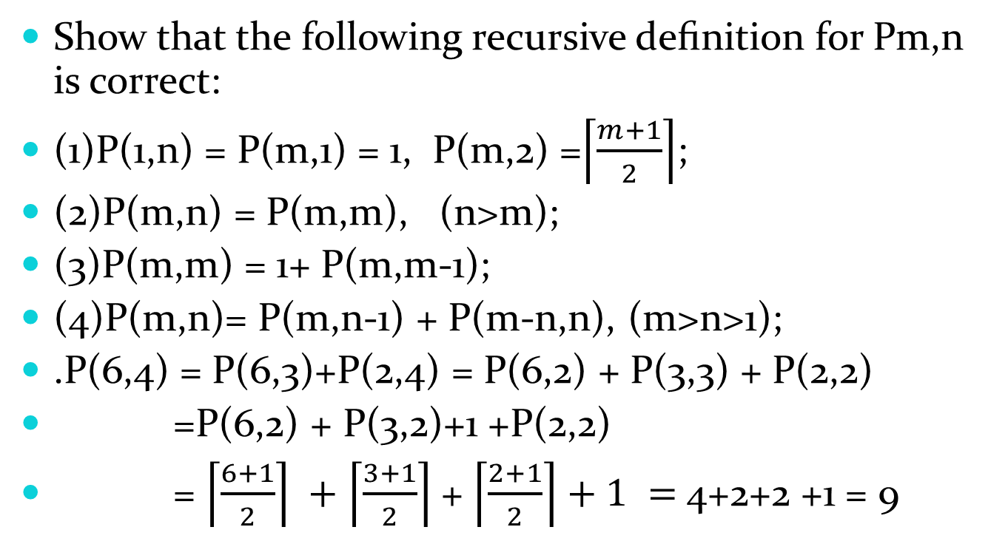
Indistinguishable objects and indistinguishable boxes
Show that the following recursive deﬁnition for Pm,n is correct:
(1)P(1,n) = P(m,1) = 1, P(m,2) =$\left\lceil \frac{m+1}{2}\right\rceil$;
(2)P(m,n) = P(m,m), (n>m);
(3)P(m,m) = 1+ P(m,m-1);
(4)P(m,n)= P(m,n-1) + P(m-n,n), (m>n>1);
.P(6,4) = P(6,3)+P(2,4) = P(6,2) + P(3,3) + P(2,2)
=P(6,2) + P(3,2)+1 +P(2,2)
= $\left\lceil \frac{6+1}{2}\right\rceil +$ $\left\lceil \frac{3+1}{2}\right\rceil$+ $\left\lceil \frac{2+1}{2}\right\rceil +1 =$4+2+2 +1 = 9

Slide 78
Exercise
P.431-432 15, 21 7th edition
P.379-382 15, 21 6th edition

