Slide 1
Relations
Chapter 9

Slide 2
Chapter Summary
Relations and Their Properties
n-ary Relations and Their Applications
Representing Relations
Closures of Relations (not currently included in overheads)
Equivalence Relations
Partial Orderings

Slide 3
Relations and Their Properties
Section 9.1

Slide 4
Section Summary
Relations and Functions
Properties of Relations
Reflexive Relations
Symmetric and Antisymmetric Relations
Transitive Relations
Combining Relations

Slide 5
Social Relationships
There are many kinds of relationships in the world:
Relative: Relationship by blood or by a common ancestor.
Friendship: boyfriend and girlfriend
Relations between Teachers and students
Relations between bosses and employees

Slide 6
Social Relationships
Relations between war and peace
Relations between city and village
Relations between God and mankind
Relations between mankind and their environment
Relations between Catholicism and Islam
And so on…

Slide 7
Abstract Relationships
The question is how to represent relationship in mathematical methods
N-ary relationships (complex ): relationships among many objects.
But most of the relationship can be formalized in the idea of binary relation.
Binary relation is the simplest relation, it is what we will study in this course.

Slide 8
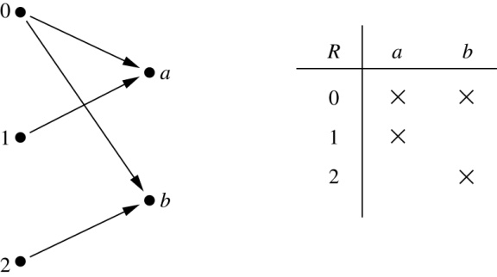
Binary Relations
Definition: A binary relation R from a set A to a set B is a subset R ⊆ A × B.
Example:
Let A = {0,1,2} and B = {a,b}
{(0, a), (0, b), (1,a) , (2, b)} is a relation from A to B.
We can represent relations from a set A to a set B graphically or using a table:
Relations are more general than functions. A function is a relation where exactly one element of B is related to each element of A.

Slide 9
Binary Relation on a Set
Definition: A binary relation R on a set A is a subset of A × A or a relation from A to A.
Example:
Suppose that A = {a,b,c}. Then R = {(a,a),(a,b), (a,c)} is a relation on A.
Let A = {1, 2, 3, 4}. The ordered pairs in the relation R = {(a,b) | a divides b} are
(1,1), (1, 2), (1,3), (1, 4), (2, 2), (2, 4), (3, 3), and (4, 4).

Slide 10
Binary Relation on a Set (cont.)
Question: How many relations are there on a set A?
Solution: Because a relation on A is the same thing as a subset of A ⨉ A, we count the subsets of A × A. Since A × A has n² elements when A has n elements, and a set with m elements has 2^{m} subsets, there are subsets of A × A. Therefore, there are relations on a set A.

Slide 11
Binary Relations on a Set (cont.)
Example: Consider these relations on the set of integers:
R₁ = {(a,b) | a ≤ b}, R₄ = {(a,b) | a = b},
R₂ = {(a,b) | a > b}, R₅ = {(a,b) | a = b + 1},
R₃ = {(a,b) | a = b or a = −b}, R₆ = {(a,b) | a + b ≤ 3}.
Which of these relations contain each of the pairs
(1,1), (1, 2), (2, 1), (1, −1), and (2, 2)?
Solution: Checking the conditions that define each relation, we see that the pair (1,1) is in R₁, R₃, R₄ , and R₆: (1,2) is in R₁ and R₆: (2,1) is in R₂, R₅, and R₆: (1, −1) is in R₂, R₃, and R₆ : (2,2) is in R₁, R₃, and R₄.
Note that these relations are on an infinite set and each of these relations is an infinite set.

Slide 12
Reflexive Relations
Definition: R is reflexive iff (a,a) ∊ R for every element a ∊ A. Written symbolically, R is reflexive if and only if
∀x[x∊U ⟶ (x,x) ∊ R]
Example: The following relations on the integers are reflexive:
R₁ = {(a,b) | a ≤ b},
R₃ = {(a,b) | a = b or a = −b},
R₄ = {(a,b) | a = b}.
The following relations are not reflexive:
R₂ = {(a,b) | a > b} (note that 3 ≯ 3),
R₅ = {(a,b) | a = b + 1} (note that 3 ≠3 + 1),
R₆ = {(a,b) | a + b ≤ 3} (note that 4 + 4 ≰ 3).
If A = ∅ then the empty relation is reflexive vacuously. That is the empty relation on an empty set is reflexive!

Slide 13
Symmetric Relations
Definition: R is symmetric iff (b,a) ∊ R whenever (a,b) ∊ R for all a,b ∊ A. Written symbolically, R is symmetric if and only if
∀x∀y [(x,y) ∊R ⟶ (y,x) ∊ R]
Example: The following relations on the integers are symmetric:
R₃ = {(a,b) | a = b or a = −b},
R₄ = {(a,b) | a = b},
R₆ = {(a,b) | a + b ≤ 3}.
The following are not symmetric:
R₁ = {(a,b) | a ≤ b} (note that 3 ≤ 4, but 4 ≰ 3),
R₂ = {(a,b) | a > b} (note that 4 > 3, but 3 ≯ 4),
R₅ = {(a,b) | a = b + 1} (note that 4 = 3 + 1, but 3 ≠4 + 1).

Slide 14
Antisymmetric Relations
Definition:A relation R on a set A such that for all a,b ∊ A if (a,b) ∊ R and (b,a) ∊ R, then a = b is called antisymmetric. Written symbolically, R is antisymmetric if and only if
∀x∀y [(x,y) ∊R ∧ (y,x) ∊ R ⟶ x = y]
Example: The following relations on the integers are antisymmetric:
R₁ = {(a,b) | a ≤ b},
R₂ = {(a,b) | a > b},
R₄ = {(a,b) | a = b},
R₅ = {(a,b) | a = b + 1}.
The following relations are not antisymmetric:
R₃ = {(a,b) | a = b or a = −b}
(note that both (1,−1) and (−1,1) belong to R₃),
R₆ = {(a,b) | a + b ≤ 3} (note that both (1,2) and (2,1) belong to R₆).
For any integer, if a a ≤ b and a ≤ b , then a = b.

Slide 15
Transitive Relations
Definition: A relation R on a set A is called transitive if whenever (a,b) ∊ R and (b,c) ∊ R, then (a,c) ∊ R, for all a,b,c ∊ A. Written symbolically, R is transitive if and only if
∀x∀y ∀z[(x,y) ∊R ∧ (y,z) ∊ R ⟶ (x,z) ∊ R ]
Example: The following relations on the integers are transitive:
R₁ = {(a,b) | a ≤ b},
R₂ = {(a,b) | a > b},
R₃ = {(a,b) | a = b or a = −b},
R₄ = {(a,b) | a = b}.
The following are not transitive:
R₅ = {(a,b) | a = b + 1} (note that both (3,2) and (4,3) belong to R₅, but not (3,3)),
R₆ = {(a,b) | a + b ≤ 3} (note that both (2,1) and (1,2) belong to R₆, but not (2,2)).
For every integer, a ≤ b
and b ≤ c, then b ≤ c.

Slide 16
Combining Relations
Given two relations R₁ and R₂, we can combine them using basic set operations to form new relations such as R₁ ∪ R₂, R₁ ∩ R₂, R₁ − R₂, and R₂ − R₁.
Example: Let A = {1,2,3} and B = {1,2,3,4}. The relations R₁ = {(1,1),(2,2),(3,3)} and R₂ = {(1,1),(1,2),(1,3),(1,4)} can be combined using basic set operations to form new relations:
R₁ ∪ R₂ ={(1,1),(1,2),(1,3),(1,4),(2,2),(3,3)}
R₁ ∩ R₂ ={(1,1)}
R₁ − R₂ ={(2,2),(3,3)}
R₂ − R₁ ={(1,2),(1,3),(1,4)}

Slide 17
Composition
Definition: Suppose
R₁ is a relation from a set A to a set B.
R₂ is a relation from B to a set C.
Then the composition (or composite) of R₂ with R₁, is a relation from A to C where
if (x,y) is a member of R₁ and (y,z) is a member of R₂, then (x,z) is a member of R₂∘ R₁.

Slide 18
Representing the Composition of a Relation
R₁
R₂
w
m
a
x
n
b
y
o
c
p
z
R₂∘ R₁ = {(b,x),(b,z)}

Slide 19
relational composition
Let M be the relation “is mother of”
Let F be the relation “is father of”
What is M ◦ F?
If (a,b) ∈ F, then a is the father of b
If (b,c) ∈ M, then b is the mother of c
Thus, M ◦ F denotes the relation “maternal grandfather”
What is F ◦ M?
If (a,b) ∈ M, then a is the mother of b
If (b,c) ∈ F, then b is the father of c
Thus, F ◦ M denotes the relation “paternal grandmother”
What is M ◦ M?
If (a,b) ∈ M, then a is the mother of b
If (b,c) ∈ M, then b is the mother of c
Thus, M ◦ M denotes the relation “maternal grandmother”
Note that M and F are not transitive relations!!!

Slide 20
Powers of a Relation
Definition: Let R be a binary relation on A. Then the powers R^{n} of the relation R can be defined inductively by:
Basis Step: R¹ = R
Inductive Step: R^{n+1} = R^{n} ∘ R
Example: R={(1,1),(2,1),(3,2),(4,3)}
Find R², R³, and R⁴
R² = R □ R = {(1,1),(2,1),(3,1),(4,2)}
R³ = R² □ R = {(1,1),(2,1),(3,1),(4,1)}
R⁴ = R³ □ R = {(1,1),(2,1),(3,1),(4,1)}

Slide 21
Example
R={(a,b), a is parent of b or vice versa}
R²= {(a,b), a is grandparent of b or vice versa}
N-generations blood relationship: if (a,b) ∈ R^{n} , we say a and b have n-generations blood relationship
a: you,
b: your cousin,
how many generations of blood relationship between a and b?

Slide 22
Theorem 1
Then relation R on a set A is transitive if and only if R^{n} ⊆ R.(n=1,2,3,…)
If part: R^{n} ⊆ R, R² ⊆ R. if (a,b)∈R and (b,c)∈R for any a,b,c ∈A, then (a,c) ∈R², hence, (a,c) ⊆ R, R is transitive.
Only if part: if R is transitive, (a,c)∈R², then there exist b∈A such that (a,b)∈R and (b,c)∈R. Hence (a,c)∈R
This implies that R² ⊆ R

Slide 23
Cont…
Further more, R³=R^{2○}R⊆ R○R =R²⊆R
Then for any n=1,2,3,…
R^{n}=R^{n-1○}R⊆…… ⊆ R○R =R²⊆R
Inverse Relation: Let R be a relation from set A to set B, the inverse of R is a relation from B to A such that :
R⁻¹ = {(a,b)|(b,a) ∈R}

Slide 24
Exercise
P581-583 7, 31, 55 7th edition
P527-529 7, 29, 53 6th edition

Slide 25
n-ary Relations and Their Applications
Section 8.2

Slide 26
Relation between more than just 2 sets
A binary relation involves 2 sets and can be described by a set of pairs
A ternary relation involves 3 sets and can be described by a set of triples
…
An n-ary relation involves n sets and can be described by a set of n-tuples
Relations are used to represent computer databases
Also used to represent constraints!

Slide 27
n-ary Relations

Slide 28
Example 1
Note: N is the set of natural numbers {0,1,2,3,…}
The relation has degree 3
The domains of the relation are the set of natural numbers
Note: R could be considered as an extensional representation of the
ternary relation a<b<c, assuming domains are finite and really quite small

Slide 29
Example 2
Note: N is the set of natural numbers {0,1,2,3,…}
Z is the set of integers {…,-2,-1,0,1,2,…}
The relation has degree 4
Note: R could be considered as an extensional representation of the
ternary relation a<b<c, assuming domains are finite and really quite small

Slide 30
Databases and Relations
Database is made up of records.
Typical operations on a database are
find records that satisfy a given criteria
delete records
add records
update records
Some everyday databases
student records
health records
tax information
telephone directories
banking records
…
Databases may be represented
using the relational data model

Slide 31
The relational data model
Database made up of records, they are n-tuples, made up of fields, Student record might look as follows
(Name, ID_No, Major, Gpa)
gpa is an attribute
(Jones,200401986,Arts,4.9)
(Lee,200408972,Science,3.6)
(Kuhns,200501728,Humanities,5.0)
(Moore,200308327,Science,5.5)
relations (in relDB) also called tables

Slide 32
The relational data model
Attributes: name, metric No, Dept and GPA
Example from the book

Slide 33
primary key:
An attribute/domain/column is a primary key when the value of this attribute uniquely defines tuples i.e. no two tuples have the same value for that attribute
Name cannot be a primary key, neither can Dept or GPA. metricNo is a primary key

Slide 34
The current collection of n-tuples (records) in the relation (table) is called the extension of the relation
The permanent aspects of the relation (table) such as the attribute names is called the intention of the relation

Slide 35
A composite key is a combination of attributes That uniquely define tuples

Slide 36
Operations on n-ary relations

Slide 37
Selection

Slide 38
Projection
It strips out specific columns

Slide 39
Projection

Slide 40
Join
Joins two tables/relations together, matching up on specific attributes

Slide 41
Join

Slide 42
SQL
SQL (Structured Query Language)
The standard for Relational Database Management Systems (RDBMS)
SELECT Statement
SELECT
List the columns (and expressions) that should be returned from the query
FROM
Indicate the table(s) from which data will be obtained
WHERE
Indicate the conditions under which a row will be included in the result

Slide 43
Example 12
SELECT Departure_time
FROM Flights
WHERE Destination = ‘Detroit”
TABLE 8 Flights
Airline | Flight_No | Gate | Destination | Departure time
Nadir | 122 | 34 | Detroit | 08:10
Acme | 221 | 22 | Denver | 08:17
Acme | 122 | 33 | Anchorage | 08:22
Acme | 323 | 34 | Honolulu | 08:30
Nadir | 199 | 13 | Detroit | 08:47
Acme | 222 | 22 | Detroit | 09:10
Nadir | 322 | 34 | Detroit | 09:44

Slide 44
Example 13
SELECT Professor, Time
FROM Teaching_assignments, Class_schedule
WHERE Department = ‘Mathematics”
Rosen,3:00 p.m.
The SQL clause is used here to find the join of two different databases.

Slide 45
Exercises
P590 9 7th edition
P536 9 6th edition

Slide 46
Representing Relations
Section 9.3

Slide 47
Section Summary
Representing Relations using Matrices
Representing Relations using Digraphs

Slide 48
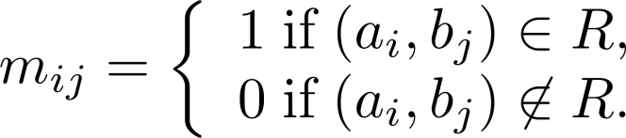
Representing Relations Using Matrices
A relation between finite sets can be represented using a zero-one matrix.
Suppose R is a relation from A = {a₁, a₂, …, a_{m}} to B = {b₁, b₂, …, b_{n}}.
The elements of the two sets can be listed in any particular arbitrary order. When A = B, we use the same ordering.
The relation R is represented by the matrix M_{R} = [m_{ij}], where
The matrix representing R has a 1 as its (i,j) entry when a_{i} is related to b_{j} and a 0 if a_{i} is not related to b_{j}.

Slide 49
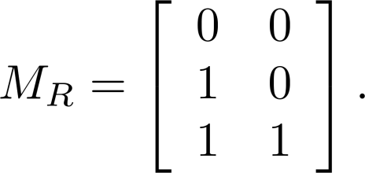
Examples of Representing Relations Using Matrices
Example 1: Suppose that A = {1,2,3} and B = {1,2}. Let R be the relation from A to B containing (a,b) if a ∈ A, b ∈ B, and a > b. What is the matrix representing R (assuming the ordering of elements is the same as the increasing numerical order)?
Solution: Because R = {(2,1), (3,1),(3,2)}, the matrix is

Slide 50
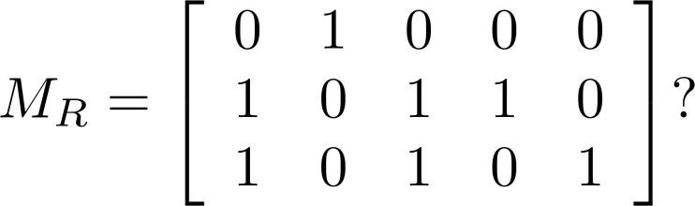
Examples of Representing Relations Using Matrices (cont.)
Example 2: Let A = {a₁,a₂, a₃} and B = {b₁,b₂, b₃,b₄, b₅}. Which ordered pairs are in the relation R represented by the matrix
Solution: Because R consists of those ordered pairs (a_{i},b_{j}) with m_{ij} = 1, it follows that:
R = {(a₁, b₂), (a₂, b₁),(a₂, b₃), (a₂, b₄),(a₃, b₁), {(a₃, b₃), (a₃, b₅)}.

Slide 51
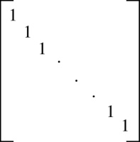
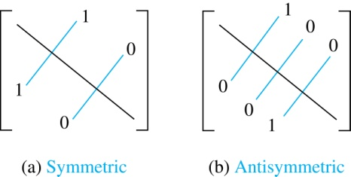
Matrices of Relations on Sets
If R is a reflexive relation, all the elements on the main diagonal of M_{R} are equal to 1.
R is a symmetric relation, if and only if m_{ij} = 1 whenever m_{ji} = 1. R is an antisymmetric relation, if and only if m_{ij} = 0 or m_{ji} = 0 when i≠ j.

Slide 52
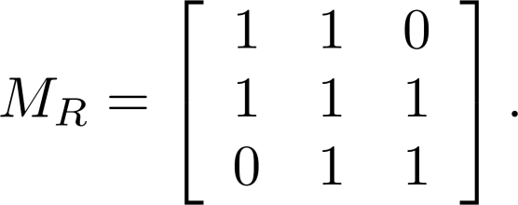
Example of a Relation on a Set
Example 3: Suppose that the relation R on a set is represented by the matrix
Is R reflexive, symmetric, and/or antisymmetric?
Solution: Because all the diagonal elements are equal to 1, R is reflexive. Because M_{R} is symmetric, R is symmetric and not antisymmetric because both m_{1,2} and m_{2,1} are 1.

Slide 53
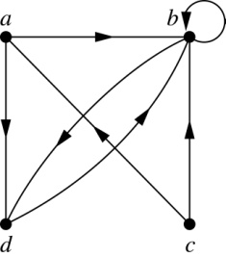
Representing Relations Using Digraphs
Definition: A directed graph, or digraph, consists of a set V of vertices (or nodes) together with a set E of ordered pairs of elements of V called edges (or arcs). The vertex a is called the initial vertex of the edge (a,b), and the vertex b is called the terminal vertex of this edge.
An edge of the form (a,a) is called a loop.
Example 7: A drawing of the directed graph with vertices a, b, c, and d, and edges (a, b), (a, d), (b, b), (b, d), (c, a), (c, b), and (d, b) is shown here.

Slide 54
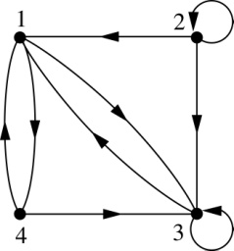
Examples of Digraphs Representing Relations
Example 8: What are the ordered pairs in the relation
represented by this directed graph?
Solution: The ordered pairs in the relation are
(1, 3), (1, 4), (2, 1), (2, 2), (2, 3), (3, 1), (3, 3), (4, 1), and (4, 3)

Slide 55
Determining which Properties a Relation has from its Digraph
Reflexivity: A loop must be present at all vertices in the graph.
Symmetry: If (x,y) is an edge, then so is (y,x).
Antisymmetry: If (x,y) with x ≠ y is an edge, then (y,x) is not an edge.
Transitivity: If (x,y) and (y,z) are edges, then so is (x,z).

Slide 56
Determining which Properties a Relation has from its Digraph – Example 1
a
b
c
d
Reflexive? No, not every vertex has a loop
Symmetric? Yes (trivially), there is no edge from one vertex to another
Antisymmetric? Yes (trivially), there is no edge from one vertex
to another
Transitive? Yes, (trivially) since there is no edge from one vertex to another

Slide 57
Determining which Properties a Relation has from its Digraph – Example 2
a
b
c
d
Reflexive? No, there are no loops
Symmetric? No, there is an edge from a to b, but not from b to a
Antisymmetric? No, there is an edge from d to b and b to d
Transitive? No, there are edges from a to c and from c to b,
but there is no edge from a to d

Slide 58
Determining which Properties a Relation has from its Digraph – Example 3
a
b
c
d
Reflexive? No, there are no loops
Symmetric? No, for example, there is no edge from c to a
Antisymmetric? Yes, whenever there is an edge from one
vertex to another, there is not one going back
Transitive? No, there is no edge from a to b

Slide 59
Determining which Properties a Relation has from its Digraph – Example 4
b
a
c
d
Reflexive? No, there are no loops
Symmetric? No, for example, there is no edge from d to a
Antisymmetric? Yes, whenever there is an edge from one vertex
to another, there is not one going back
Transitive? Yes (trivially), there are no two edges where the first
edge ends at the vertex where the second edge begins

Slide 60
Example of the Powers of a Relation
b
a
b
a
d
c
d
c
R
R²
a
b
a
b
d
c
d
c
R⁴
R³
The pair (x,y) is in R^{n} if there is a path of length n from x to y in R
(following the direction of the arrows).

Slide 61
Exercise
P597 21 7th edition
P543 21 6th edition

Slide 62
Closures of Relations
Section 8.4

Slide 63
Definition of Closure
The closure of a relation R with respect to property P is the relation obtained by adding the minimum number of ordered pairs to R to obtain property P.

Slide 64
Reflexive Closure
In terms of the digraph representation of R:
Add loops to all vertices to find the reflexive closure
In terms of the 0-1 matrix representation:
Put 1’s on the diagonal to find the reflexive closure
r(R)=R∪⊿ where ⊿={(a,a)|a∈A}

Slide 65
Symmetric Closure
In terms of the digraph representation of R:
Add arcs in the opposite direction to find the symmetric closure
S(R)= R∪R⁻¹
In terms of the 0-1 matrix representation:
Add 1’s to the pairs across the diagonals that differ in value
0 0 1
0 0 0
0 1 0
0 0 1
0 0 1
1 1 0

Slide 66
Transitive Closure
It is very easy to find the reflexive closure and the symmetric closure, but it is difficult to find the transitive closure
In terms of the digraph representation of R:
To find the transitive closure, if there is a path from a to b, add an arc from a to b (can be complicated)

Slide 67
Transitive Closure
R={(1,3),(1,4),(2,1),(3,2)} first adding the pairs (1,2),(2,3),(2,4) to R obtain R’={(1,3),(1,4),(2,1),(3,2), (1,2),(2,3),(2,4)} is not transitive either.
A path from a to b in the digraph G is a sequence of one or more edges (x₀,x₁), (x₁,x₂), …, (x_{n-1},x_{n}) in G where x₀=a and x_{n}=b. if a=b, the path is called circuit or cycle.

Slide 68
Transitive Closure (Cont.)
This path is denoted by x₀,x₁,x₂, …, x_{n} and has length n. the path is called a cycle if it starts and ends at the same vertex.
Theorem 1: Let R be a relation on a set A, there is a path of length n from a to b if and only if (a,b) ∈R^{n}

Slide 69
Transitive Closure (Cont.)
R*=∪₁∞R^{n}, is called the connectivity relation of R,which consists of the (a,b) such that there is path from a to b.
Theorem 2: the transitive closure of a relation R (denoted by t(R)) equals the connectivity R*
R*=∪₁ ∞ R^{i} = t(R).

Slide 70
Proof
To prove R* is transitive closure we must prove:
(1) R*⊇R. It is obvious by definition
(2)R* is transitive. If (a,b)∈R*,(b,c)∈R*, it implies there is a path from a to b and a path from b to c, hence there is a path from a to c through b.
(3)R* is minimum. If S is also a transitive relation containing R, then S ⊇R*. It is obvious that S*=S. since S ⊇R, then S*⊇R*, hence S ⊇R*.

Slide 71
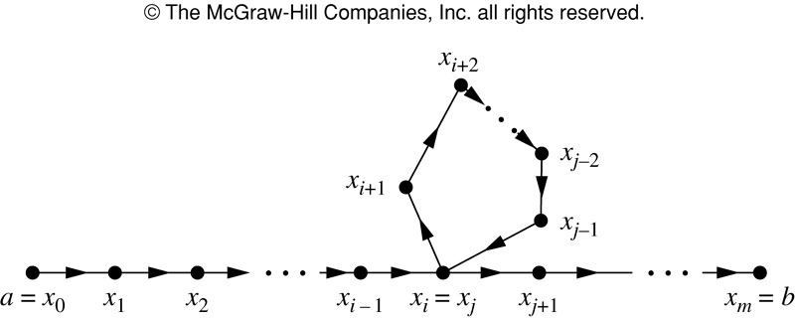
Lemma 1
A is a set containing n elements. R is relation on A. if there is a path from a to b, then there is such path with length not exceeding n. if a≠b, there is such path with length not exceeding n-1.
From this lemma, t(R)= ∪₁ ^{n} R^{i}
FIGURE 2 Producing a Path with Length Not Exceeding n.

Slide 72
Transitive Closure (Cont.)
Theorem 3 M_{R*}= M_{R}∨ M_{R}²∨ M_{R}³∨…∨ M_{R}^{n}
⎡
1
0
1
⎤
⎡
1
1
1
⎤
⎢
⎥
⎢
⎥
M
=
0
1
0
M²
=
0
1
0
⎢
⎥
R
⎢
⎥=M_{R}³=M_{R*}
R
⎢
1
1
1
⎥
⎢
1
1
0
⎥
⎣
⎦
⎣
⎦

Slide 73
Cont…
Algorithm 1 A procedure for computing the transitive closure
procedure transitive_closure (M_{R}: zero-one n×n matrix)
A := M_{R}
B := A
for i := 2 to n
begin
A := A ๏ M_{R}
B := B ∨ A
end { B is the zero-one matrix for R* }

Slide 74
Transitive Closure (Cont.)
Warshall’s algorithm an efficient method for computing the transitive closure of a relation.
Interior vertices of a path: a,x₁,x₂, …, x_{m-1} , b. x₁,x₂, …, x_{m-1} are interior vertices
Matrices: M_{R} =W₀,W₁,W₂, …, W_{n} = M_{R*}
Named after Stephen Warshall in 1960
2n³ bit operation
Also called Roy-Warshall algorithm, Bernard Roy in 1959
Previous algorithm 1 using 2n³ (n-1) bit operation

Slide 75
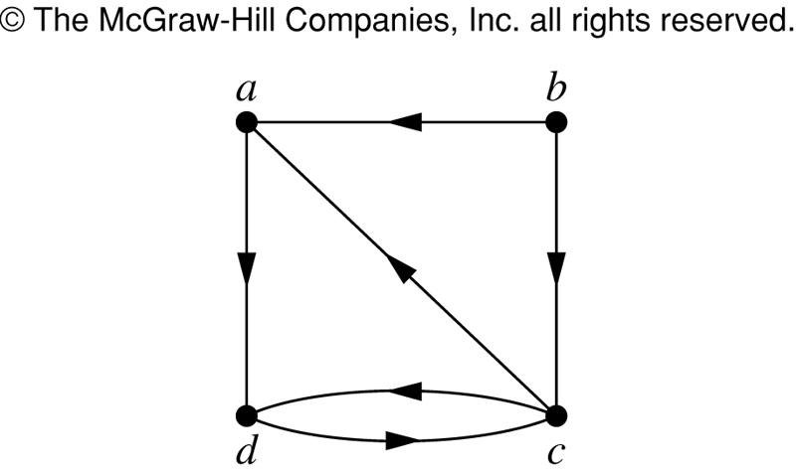

FIGURE 3 (9.4,p604)
FIGURE 3 The Directed Graph of the Relations R.
歐亞書局
P. 551
Notes:
p:\msoffice\My Projects\Rosen 6e 2007\Imagebank\JPEGs07-24-06\ch08\jpeg\08_4_03.jpg

Slide 76
Warshall’s algorithm
Observation: we can compute W_{k} directly from W_{k-1}
Two cases (Fig. 4)
(a) There is a path from v_{i} to v_{j} with its interior vertices among the first k-1 vertices
w_{ij}^{(k-1)}=1
(b) There are paths from v_{i} to v_{k} and from v_{k} to v_{j} that have interior vertices only among the first k-1 vertices
w_{ik}^{(k-1)}=1 and w_{kj}^{(k-1)}=1

Slide 77
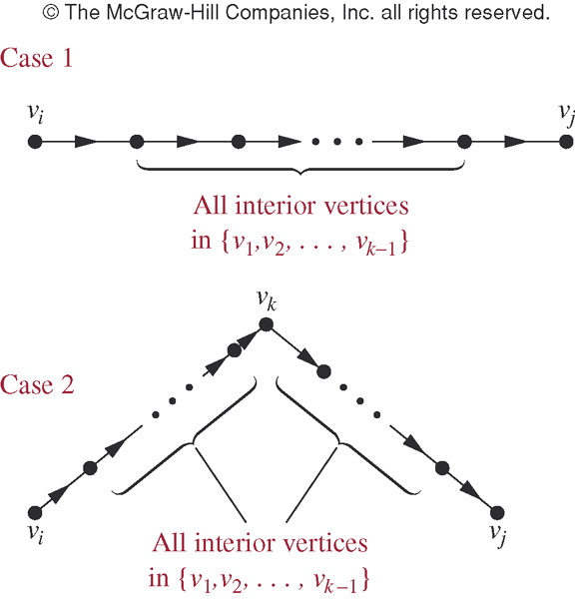
FIGURE 4 (9.4)
FIGURE 4 p605 Adding v_{k} to the Set of Allowable Interior Vertices.
歐亞書局
P. 553
Notes:
p:\msoffice\My Projects\Rosen 6e 2007\Imagebank\JPEGs07-24-06\ch08\jpeg\08_4_04.jpg

Slide 78
Warshall’s algorithm
Lemma 2: Let Wk=w_{ij}^{(k)} be the zero-one matrix that has a 1 in its (i,j)th position iff there is a path from v_{i} to v_{j} with interior vertices from the set {v₁, v₂, …, v_{k}}. Then w_{ij}^{(k)}=w_{ij}^{(k-1)}∨ (w_{ik}^{(k-1)}∧ w_{kj}^{(k-1)}), whenever I, j, and k are positive integers not exceeding n.

Slide 79
Transitive Closure (Cont.)
Algorithm 2 warshall algorithm
Procedure warshall(M_{R}:n×n zero-one matrix)
W= M_{R}
For k=1 to n
Begin
For I=1 to n
Begin
For j=1 to n
W_{ij}=w_{ij}∨(w_{ik}∧w_{kj})
End
End

Slide 80
example
W_{ij}=w_{ij}∨(w_{ik}∧w_{kj})
If (w_{ik} == 1)
W_{ij}=w_{ij}∨w_{kj}

Slide 81
Exercises
P607 25, 27 7th edition
P554 25, 27 6th edition

Slide 82
Equivalence Relations
Section 9.5

Slide 83
Section Summary
Equivalence Relations
Equivalence Classes
Equivalence Classes and Partitions

Slide 84
Equivalence Relations
Definition 1: A relation on a set A is called an equivalence relation if it is reflexive, symmetric, and transitive.
Definition 2: Two elements a, and b that are related by an equivalence relation are called equivalent. The notation a ∼ b is often used to denote that a and b are equivalent elements with respect to a particular equivalence relation.

Slide 85
Strings
Example: Suppose that R is the relation on the set of strings of English letters such that aRb if and only if l(a) = l(b), where l(x) is the length of the string x. Is R an equivalence relation?
Solution: Show that all of the properties of an equivalence relation hold.
Reflexivity: Because l(a) = l(a), it follows that aRa for all strings a.
Symmetry: Suppose that aRb. Since l(a) = l(b), l(b) = l(a) also holds and bRa.
Transitivity: Suppose that aRb and bRc. Since l(a) = l(b),and l(b) = l(c), l(a) = l(a) also holds and aRc.

Slide 86
Congruence Modulo m
Example: Let m be an integer with m > 1. Show that the relation
R = {(a,b) | a ≡ b (mod m)}
is an equivalence relation on the set of integers.
Solution: Recall that a ≡ b (mod m) if and only if m divides a − b.
Reflexivity: a ≡ a (mod m) since a − a = 0 is divisible by m since 0 = 0 ∙ m.
Symmetry: Suppose that a ≡ b (mod m). Then a − b is divisible by m, and so a − b = km, where k is an integer. It follows that b − a = (− k) m, so b ≡ a (mod m).
Transitivity: Suppose that a ≡ b (mod m) and b ≡ c (mod m). Then m divides both a − b and b − c. Hence, there are integers k and l with a − b = km and b − c = lm. We obtain by adding the equations:
a − c = (a − b) + (b − c) = km + lm = (k + l) m.
Therefore, a ≡ c (mod m).

Slide 87
Divides
Example: Show that the “divides” relation on the set of positive integers is not an equivalence relation.
Solution: The properties of reflexivity, and transitivity do hold, but there relation is not transitive. Hence, “divides” is not an equivalence relation.
Reflexivity: a ∣ a for all a.
Not Symmetric: For example, 2 ∣ 4, but 4 ∤ 2. Hence, the relation is not symmetric.
Transitivity: Suppose that a divides b and b divides c. Then there are positive integers k and l such that b = ak and c = bl. Hence, c = a(kl), so a divides c. Therefore, the relation is transitive.

Slide 88
Equivalence Classes
Definition 3: Let R be an equivalence relation on a set A. The set of all elements that are related to an element a of A is called the equivalence class of a. The equivalence class of a with respect to R is denoted by [a]_{R}.
When only one relation is under consideration, we can write [a], without the subscript R, for this equivalence class.
Note that [a]_{R} = {s|(a,s) ∈ R}.
If b ∈ [a]_{R}, then b is called a representative of this equivalence class. Any element of a class can be used as a representative of the class.
The equivalence classes of the relation congruence modulo m are called the congruence classes modulo m. The congruence class of an integer a modulo m is denoted by [a]_{m}, so [a]_{m} = {…, a−2m, a−m, a+2m, a+2m, … }. For example,
[0]₄ = {…, −8, −4 , 0, 4 , 8 , …} [1]₄ = {…, −7, −3 , 1, 5 , 9 , …}
[2]₄ = {…, −6, −2 , 2, 6 , 10 , …} [3]₄ = {…, −5, −1 , 3, 7 , 11 , …}

Slide 89
Equivalence Classes and Partitions
Theorem 1: let R be an equivalence relation on a set A. These statements for elements a and b of A are equivalent:
(i) aRb
(ii) [a] = [b]
(iii) [a] ∩ [b] = ∅
Proof: We show that (i) implies (ii). Assume that aRb. Now suppose that c ∈ [a]. Then aRc. Because aRb and R is symmetric, bRa. Because R is transitive and bRa and aRc, it follows that bRc. Hence, c ∈ [b]. Therefore, [a]⊆ [b]. A similar argument (omitted here) shows that [b]⊆ [a]. Since [a]⊆ [b] and [b]⊆ [a], we have shown that [a] = [b].
(see text for proof that (ii) implies (iii) and (iii) implies (i))

Slide 90
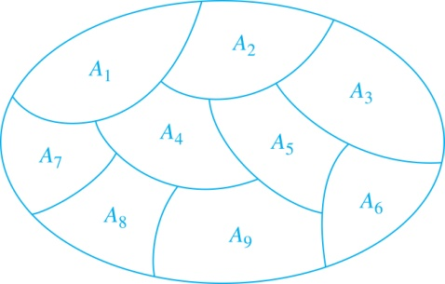
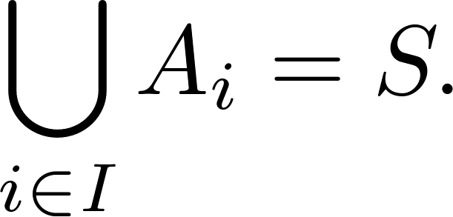
Partition of a Set
Definition: A partition of a set S is a collection of disjoint nonempty subsets of S that have S as their union. In other words, the collection of subsets A_{i}, where i ∈ I (where I is an index set), forms a partition of S if and only if
A_{i} ≠ ∅ for i ∈ I,
A_{i} ∩ A_{j}=∅ when i ≠ j,
and
A Partition of a Set

Slide 91
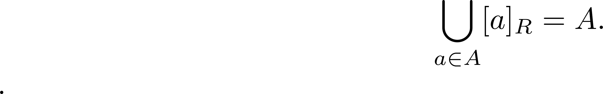
An Equivalence Relation Partitions a Set
Let R be an equivalence relation on a set A. The union of all the equivalence classes of R is all of A, since an element a of A is in its own equivalence class [a]_{R}. In other words,
From Theorem 1, it follows that these equivalence classes are either equal or disjoint, so [a]_{R} ∩[b]_{R}=∅ when [a]_{R} ≠ [b]_{R}.
Therefore, the equivalence classes form a partition of A, because they split A into disjoint subsets.

Slide 92
An Equivalence Relation Partitions a Set (continued)
Theorem 2: Let R be an equivalence relation on a set S. Then the equivalence classes of R form a partition of S. Conversely, given a partition {A_{i} | i ∈ I} of the set S, there is an equivalence relation R that has the sets A_{i}, i ∈ I, as its equivalence classes.
Proof: We have already shown the first part of the theorem.
For the second part, assume that {A_{i} | i ∈ I} is a partition of S. Let R be the relation on S consisting of the pairs (x, y) where x and y belong to the same subset A_{i} in the partition. We must show that R satisfies the properties of an equivalence relation.
Reflexivity: For every a ∈ S, (a,a) ∈ R, because a is in the same subset as itself.
Symmetry: If (a,b) ∈ R, then b and a are in the same subset of the partition, so (b,a) ∈ R.
Transitivity: If (a,b) ∈ R and (b,c) ∈ R, then a and b are in the same subset of the partition, as are b and c. Since the subsets are disjoint and b belongs to both, the two subsets of the partition must be identical. Therefore, (a,c) ∈ R since a and c belong to the same subset of the partition.

Slide 93
The combining of the Equivalence Relations
Let R and S be equivalence relations on A, how about R∩S, R∪S?
The answer for R∩S is yes.
(1) Is it reflexive?:
Since (a,a) ∈ R (a,a) ∈ S ,then (a,a) ∈ R∩S for every a ∈ A
(2) Is it symmetric?
Since R⁻¹=R S⁻¹=S, then (R∩S ) ⁻¹= R⁻¹∩S⁻¹ = R∩S

Slide 94
The combining of the Equivalence Relations
Is it transitive?
Since R and S are transitive, then R²⊆R, S²⊆S
Then (R∩S) ² = R² ∩RoS ∩SoR∩S² ⊆ R² ∩ S² = R∩S
So R∩S is equivalence relation.
But the answer for R∪S is No!

Slide 95
Exercise
P615-616 13, 31
P562-566 13, 31

Slide 96
Partial Orderings
Section 9.6

Slide 97
Section Summary
Partial Orderings and Partially-ordered Sets
Lexicographic Orderings
Hasse Diagrams
Lattices
Topological Sorting

Slide 98
Partial Orderings
Definition 1: A relation R on a set S is called a partial ordering, or partial order, if it is reflexive, antisymmetric, and transitive. A set together with a partial ordering R is called a partially ordered set, or poset, and is denoted by (S, R). Members of S are called elements of the poset.

Slide 99
Partial Orderings (continued)
Example 1: Show that the “greater than or equal” relation (≥) is a partial ordering on the set of integers.
Reflexivity: a ≥ a for every integer a.
Antisymmetry: If a ≥ b and b ≥ a , then a = b.
Transitivity: If a ≥ b and b ≥ c , then a ≥ c.
These properties all follow from the order axioms for the integers. (See Appendix 1).

Slide 100
Partial Orderings (continued)
Example 2: Show that the divisibility relation (∣) is a partial ordering on the set of integers.
Reflexivity: a ∣ a for all integers a. (see Example 9 in Section 9.1)
Antisymmetry: If a and b are positive integers with a | b and b | a, then a = b. (see Example 12 in Section 9.1)
Transitivity: Suppose that a divides b and b divides c. Then there are positive integers k and l such that b = ak and c = bl. Hence, c = a(kl), so a divides c. Therefore, the relation is transitive.
(Z⁺, ∣) is a poset.

Slide 101
Partial Orderings (continued)
Example 3: Show that the inclusion relation (⊆) is a partial ordering on the power set of a set S.
Reflexivity: A ⊆ A whenever A is a subset of S.
Antisymmetry: If A and B are positive integers with A ⊆ B and B ⊆ A, then A = B.
Transitivity: If A ⊆ B and B ⊆ C, then A ⊆ C.
The properties all follow from the definition of set inclusion.

Slide 102
Comparability
Definition 2: The elements a and b of a poset (S,≼ ) are comparable if either a ≼ b or b ≼ a. When a and b are elements of S so that neither a ≼ b nor b ≼ a, then a and b are called incomparable.
Definition 3: If (S,≼ ) is a poset and every two elements of S are comparable, S is called a totally ordered or linearly ordered set, and ≼ is called a total order or a linear order. A totally ordered set is also called a chain.
Definition 4: (S,≼ ) is a well-ordered set if it is a poset such that ≼ is a total ordering and every nonempty subset of S has a least element.
The symbol ≼ is used to denote the relation in any poset.

Slide 103
Lexicographic Order
Definition: Given two posets (A₁,≼₁) and (A₂,≼₂), the lexicographic ordering on A₁ ⨉ A₂ is defined by specifying that (a₁, a₂) is less than (b₁,b₂), that is,
(a₁, a₂) ≺ (b₁,b₂),
either if a₁ ≺₁ b₁ or if a₁ = b₁ and a₂ ≺₂ b₂.
This definition can be easily extended to a lexicographic ordering on strings (see text).
Example: Consider strings of lowercase English letters. A lexicographic ordering can be defined using the ordering of the letters in the alphabet. This is the same ordering as that used in dictionaries.
discreet ≺ discrete, because these strings differ in the seventh position and e ≺ t.
discreet ≺ discreetness, because the first eight letters agree, but the second string is longer.

Slide 104
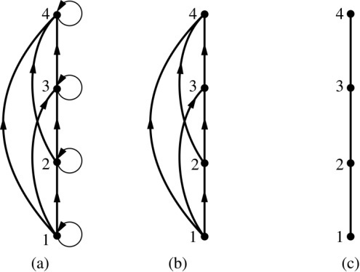
Hasse Diagrams
Definition: A Hasse diagram is a visual representation of a partial ordering that leaves out edges that must be present because of the reflexive and transitive properties.
A partial ordering is shown in (a) of the figure above. The loops due to the reflexive property are deleted in (b). The edges that must be present due to the transitive property are deleted in (c). The Hasse diagram for the partial ordering (a), is depicted in (c).

Slide 105
Procedure for Constructing a Hasse Diagram
To represent a finite poset (S,≼ ) using a Hasse diagram, start with the directed graph of the relation:
Remove the loops (a, a) present at every vertex due to the reflexive property.
Remove all edges (x, y) for which there is an element z ∈ S such that x ≺ z and z ≺ y. These are the edges that must be present due to the transitive property.
Arrange each edge so that its initial vertex is below the terminal vertex. Remove all the arrows, because all edges point upwards toward their terminal vertex.

Slide 106
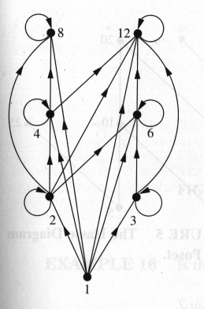
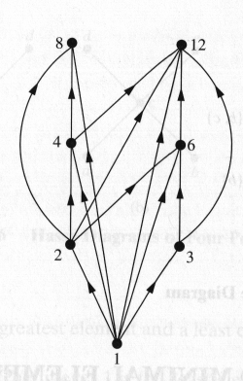
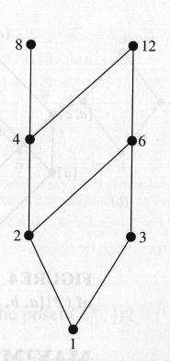
For the poset ({1,2,3,4,6,8,12}, |)

Slide 107
Hasse Diagram Terminology
Let (S, ≼) be a poset.
a is maximal in (S, ≼) if there is no b∈S such that a≼b. (top of the Hasse diagram)
a is minimal in (S, ≼) if there is no b∈S such that b≼a. (bottom of the Hasse diagram)
a is the greatest element of (S, ≼) if b≼a for all b∈S.
a is the least element of (S, ≼) if a≼b for all b∈S.

Slide 108
Hasse Diagram Terminology (Cont ..)
Let A be a subset of (S, ≼).
If u∈S such that a≼u for all a∈A, then u is called an upper bound of A.
If l∈S such that l≼a for all a∈A, then l is called an lower bound of A.
If x is an upper bound of A and x≼z whenever z is an upper bound of A, then x is called the least upper bound of A.
If y is a lower bound of A and z≼y whenever z is a lower bound of A, then y is called the greatest lower bound of A.

Slide 109
Example
h j
g f
d e
b c
a
Maximal elements: h, j
Minimal elements: a
Greatest element: none
Least element: a
Upper bound of {a,b,c}: {e, f, j, h}
Least upper bound of {a,b,c}: e
Lower bound of {a,b,c}: {a}
Greatest lower bound of {a,b,c}: a

Slide 110
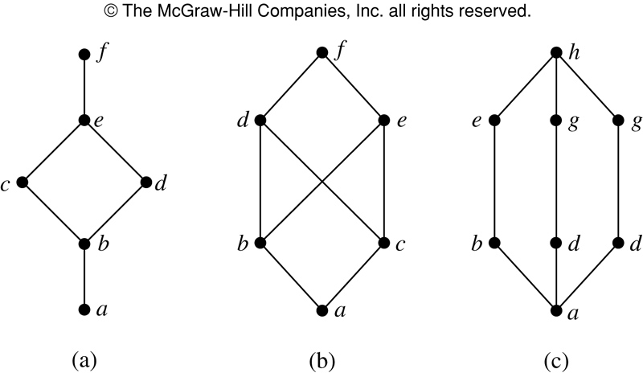
Lattices
A partially ordered set in which every pair of elements has both a least upper bound and greatest lower bound is called a lattice.
FIGURE 8 Hasse Diagrams of Three Posets.

Slide 111
Lattice
Example 21 Determine whether the posets in above figure 8 (a)(c)are lattices,(b) is not.
Example 22 Is the poset (Z⁺, ∣) a lattice?
Example 23 Determine whether the posets
({1,2,3,4,5}, ∣) and ({1,2,4,8,16}, ∣) are lattices
Example 24 Determine whether the posets (P(S),⊆) is
a lattice, where S is set.

Slide 112
Topological Sorting
A total ordering is said to be compatible with the partial ordering R if a b whenever a R b.
Topological sorting: constructing a compatible total ordering from a partial ordering
Lemma 1: Every finite nonempty poset (S, ) has at least one minimal element.

Slide 113
Topological Sorting
Algorithm 1: topological sorting
Procedure topological sort(S, : finite poset) k:=1 while S≠ ∅ begin a_{k}:=a minimal element of S S:=S-{a_{k}} k:=k+1 end
( See Fig. 9,Fig. 10, 11)

Slide 114
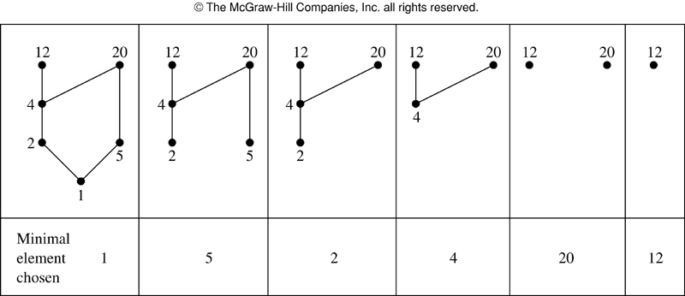
FIGURE 9 (9.6,p629)
FIGURE 9 A Topological Sort of ({1,2,4,5,12,20},｜).
P. 577
Notes:
p:\msoffice\My Projects\Rosen 6e 2007\Imagebank\JPEGs07-24-06\ch08\jpeg\08_6_09.jpg

Slide 115
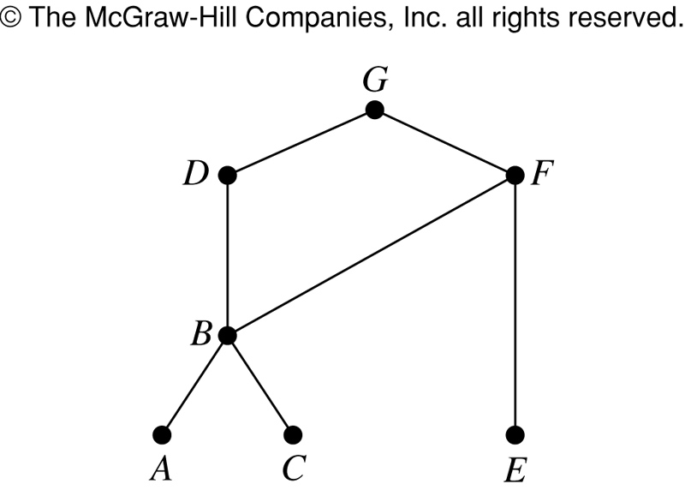
FIGURE 10 (9.6)
FIGURE 10 The Hasse Diagram for Seven Tasks.
Notes:
p:\msoffice\My Projects\Rosen 6e 2007\Imagebank\JPEGs07-24-06\ch08\jpeg\08_6_10.jpg

Slide 116
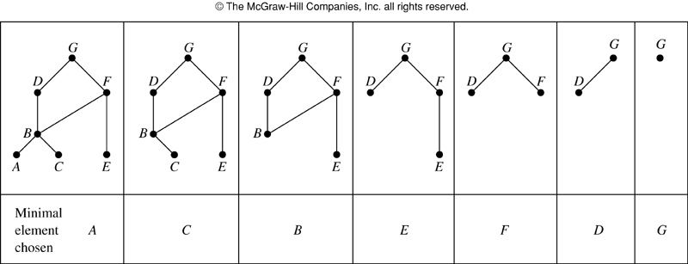
FIGURE 11 (9.6)
FIGURE 11 A Topological Sort of the Tasks.
Notes:
p:\msoffice\My Projects\Rosen 6e 2007\Imagebank\JPEGs07-24-06\ch08\jpeg\08_6_11.jpg

Slide 117
Exercise
P630-631 9, 13, 35
P579-581 9, 13, 35

