Slide 1
高级数据结构和算法分析
Advanced Data Structures and Algorithm Analysis
主讲教师： 杨 洋
Instructor: Yang Yang
E-mail: yangya@zju.edu.cn
Courseware and homework sets can be downloaded from https://pintia.cn/

Slide 2
杨洋
  副教授，浙江大学计算机学院，人工智能研究所
  2016年获清华大学博士学位，师从李涓子教授、唐杰教授
  2012年访问美国康奈尔大学（与John Hopcroft教授合作）
  2013年访问比利时鲁汶大学
  获中国电子学会优秀博士毕业论文，清华大学优秀博士毕业生，北京市优秀博士毕业生等
  办公室：浙江大学玉泉校区曹光彪楼415
研究和论文
  研究课题：社交网络挖掘（e.g.,网络表示学习、网络异常检测、信息传播、用户行为建模等）
  在国际顶级学术会议/期刊共发表论文20余篇 (e.g., KDD, WWW, AAAI, etc.)
获奖和学术服务
  KDD’15分会主席，CIKM’16 BigNet研讨会主席，第一届数据挖掘前沿论坛主席
  KDD’19, AAAI’19, WSDM’16'17’19, KDD’18, WWW’17, CIKM’16’17, ICWSM’17, ASONAM 2015等程序委员会成员
  WSDM’19 Outstanding PC
Homepage: http://yangy.org Email: yangya@zju.edu.cn

Slide 3
助教
周乐夔
  E-mail: luckiezhou@zju.edu.cn
  Phone: 18768117389
  Office: 浙江大学玉泉校区则通楼205

Slide 4
注意事项
上课请带纸笔
课堂上同一时刻请保持有且仅有一个人讲话，发言无需举手，但请起立
请在PTA中加入用户组
  ADS-Yang2019，分享码：195905

Slide 5



 教材 (Text Book)
Data Structures and
Algorithm Analysis in C
(2nd Edition)
Mark Allen Weiss
陈 越 改编
Email: weiss@fiu.edu

Slide 6
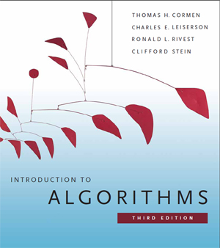
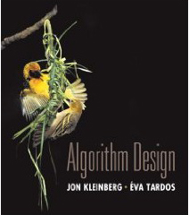
 教材 (Text Book)
Algorithm Design
Jon Kleinberg, Eva Tardos
Addison Wesley, 2005
Introduction to Algorithms
(3rd Edition)
Thomas H. Cormen, Charles E. Leiserson, Ronald L. Rivest and Clifford Stein
The MIT Press. 2009

Slide 7
 参考书目 (Reference)
➢ 数据结构课程设计
何钦铭、冯雁、陈越 著 浙江大学出版社
➢ 数据结构与算法分析（C语言版）
魏宝刚、陈越、王申康 编著 浙江大学出版社
➢ 数据结构学习与实验指导
陈越、何钦铭、徐镜春、魏宝刚、杨枨 编著
高等教育出版社

Slide 8







课程评分方法 (Grading Policies)
Homework
(10)
Discussions
(10)
Research Project
+Peer Review (30)
MidTerm
(10*)
Total ≤ 60
Q&A
(0.5 each)
Final Exam (40*)

Slide 9
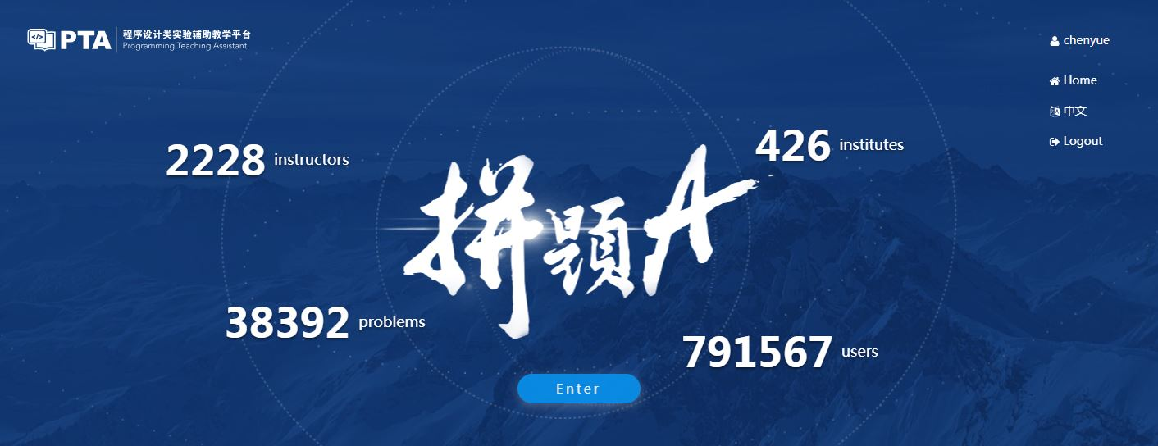
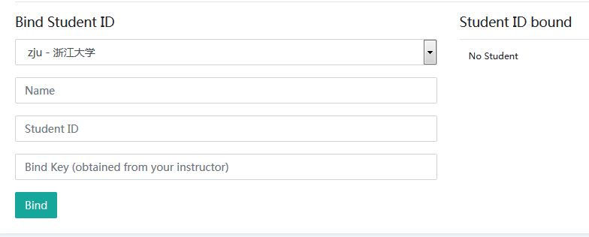
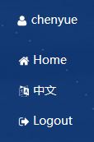
Homework Assignments (10)
Register and login at https://pintia.cn/
Bind your student ID with bind key
Enter
357964

Slide 10
Research topics (26)
Done in groups of 3
8 topics to choose from
Report (20 points)
In-class presentation (10~15 minutes, 6 points)
The speaker will be chosen randomly from all the contributors
If there are many volunteers, at most 3 groups will be chosen to give presentations
For those groups not to give presentations, each will gain bonus points = report points / 10

Slide 11

Research Reports
Peer Review
Group_Total = G_{T} × 50% + G_{PR} × 50%
Fullmark = 20

Slide 12
Peer review is for the reviewer
Editing someone else’s work is one of the best ways to learn how to edit your own
  It’s much easier to see what’s working and what isn’t in someone else’s paper than in your own.
Writing is revision
  The more you practice reading and critiquing someone else’s work, the stronger your editing skills will be when it’s time to apply them to your own work.
Any skill level works
  You can learn a great deal about the fundamentals of good writing from carefully reading and reviewing poor writing, figuring out why it’s not succeeding and what it needs to succeed.

Slide 13
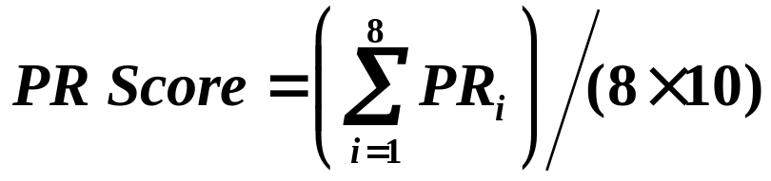
Process
Submit initial version for peer review (1 week)
Participate in peer review (2 days)
Revise paper and submit to TA (2 days)
Receive final grading from TA
ALL Groups
PR_{i} Fullmark = 40

Slide 14
Discussions (10)
Done in groups
Random in-class discussion topics
Each takes 3~5 minutes
Each full-mark is 10

Slide 15

Q&A
For volunteers only
0.5 point for each question asked/answered
come and claim your credits after each class session

Slide 16
诚信守则
（Code of Academic Honesty）
One must get a full mark to be eligible to take the final exam.
As long as there is one action of academic dishonesty in this semester, one will not be eligible to take the final exam and one’s course score will be zero.

Slide 17
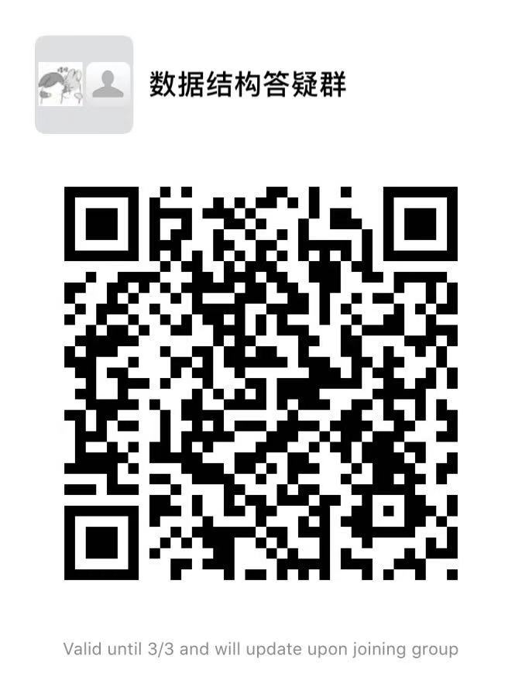
Please send your group members’ names and student ID’s to luckiezhou@gmail.com before 11:59pm this Wednesday. In return, you will receive your group ID.
Please specify your group leader in the email.

