Slide 1
Performance Comparison among Unbalanced Tree, AVL Tree and Splay Tree
Present by

Slide 2
Content
01
Testing Results &
Analysis
Introduction
1
2
3
4
Key Data Structures &
Algorithms
Conclusions

Slide 3
1. Introduction
02
The Target:
Compare the performance by implementing the following three sequences on Unbalanced BST, AVL tree and Splay tree:
Insert N integers in increasing order and delete them in the same order.
Insert N integers in increasing order and delete them in the reverse order
Insert N integers in random order and delete them in random order.

Slide 4
2. Key Data Structures & Algorithms
03
Unbalanced Binary Search Tree
Data Structure Definiton
Features
Left.key < key
Right.key > key
key
left
right

Slide 5
2. Key Data Structures & Algorithms
04
Unbalanced Binary Search Tree
Insertion
Compare to find the position
Insert the new node
It could be unbalanced when the sequence of keys to be inserted is not so ideal

Slide 6
2. Key Data Structures & Algorithms
05
Unbalanced Binary Search Tree
Deletion
Delete in Decreasing order
Find the distinct node
Find the one replacing it
Leaf node: replace it with NULL
Not a leaf: find the minium in the left or maxium in the right

Slide 7
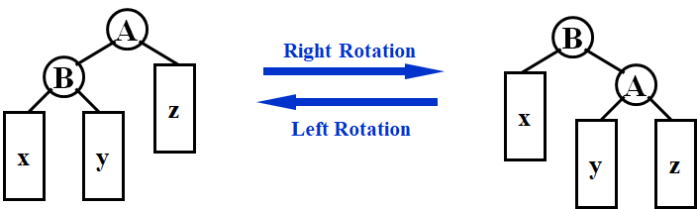
2. Key Data Structures & Algorithms
06
AVL Tree
Data Structure Definiton
Rotation
height
key
left
right

Slide 8
2. Key Data Structures & Algorithms
07
AVL Tree
Insertion
Compare to find the position
Insert the new node
Rotate to keep balanced

Slide 9
2. Key Data Structures & Algorithms
08
AVL Tree
Deletion
Find the distinct node
Find the one replace it
Leaf node: delete it, replace with NULL
Not a leaf: find the minium in the left or maxium in the right. Delete the replaced node
Rotate to keep balanced

Slide 10
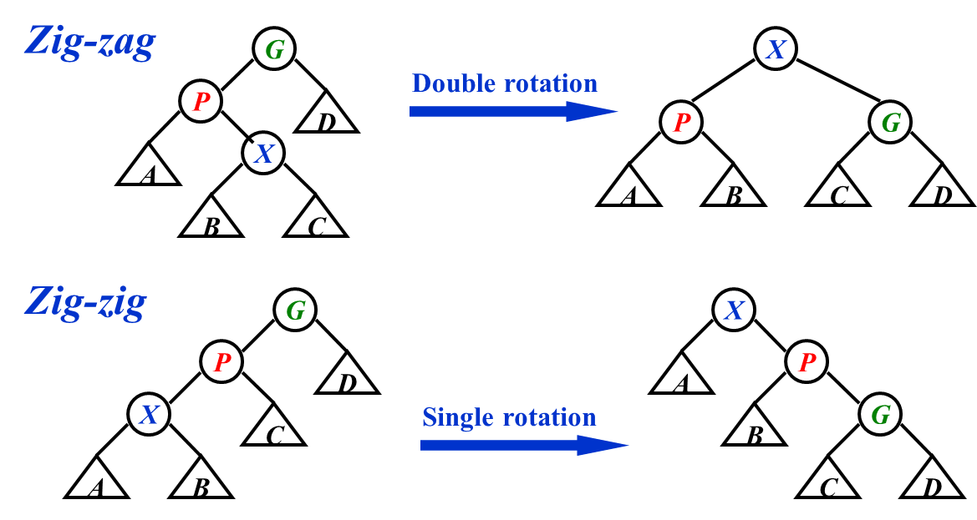
2. Key Data Structures & Algorithms
09
Splay Tree(Bottom-up)
Data Structure Definiton
Rotation
parent
key
left
right
For top-down method, there is no need for the pointer to parent

Slide 11
2. Key Data Structures & Algorithms
10
Splay Tree(Bottom-up)
Insertion
Insert the new key like insert it into a binary search tree
Move the node to the root

Slide 12
2. Key Data Structures & Algorithms
11
Splay Tree(Bottom-up)
Deletion
Find the distinct node
Move the node to the root
Find the node containing the largest key in the left subtree, which will become the new root, and make the right subtree the right child of the root

Slide 13
3. Testing Results & Analysis
12
Time Complexities
Worst Case: O(N)
Average Case: O(logN)
Unbalanced BST
AVL Tree
O(logN)
Worst Case: O(N)
Amortized: O(logN)
Splay Tree

Slide 14
3. Testing Results & Analysis
13
Space Complexity
Only related to the number of nodes in the tree and the attributes.
= O(N)
Visualization
We make use of matplotlib to visualize the (aggregate) result.

Slide 15
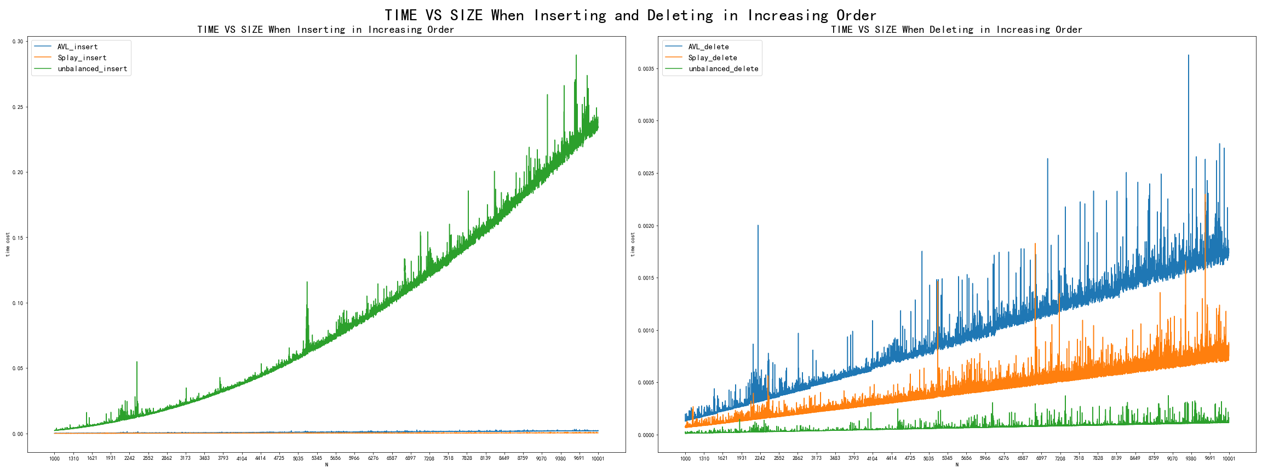
3. Testing Results & Analysis
14
Inserting and deleting both in increasing order

Slide 16
3. Testing Results & Analysis
15
inserting in increasing order
Unbalanced BST
Insert to a linked list (chain)
Time Complexity: O(N²)
AVL Tree
Time Complexity: O(NlogN)
Splay Tree
A chain too
Time Complexity: O(N)

Slide 17
3. Testing Results & Analysis
16
deleting both in increasing order
Unbalanced BST
Deleting is actually simply removing the root
O(1) in one deletion
AVL Tree
Time Complexity: O(NlogN)
Possible Reason for underperformance: frequent adjustments
Splay Tree
Time Complexity: O(NlogN)
Costly at the beginning
Cheap afterwards

Slide 18
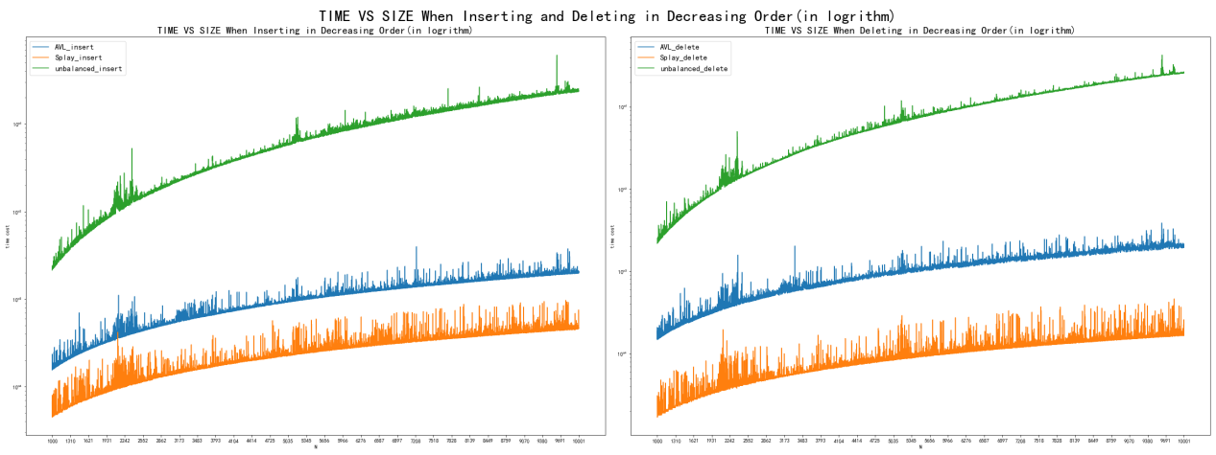
3. Testing Results & Analysis
17
Inserting in Increasing Order and Deleting in Decreasing Order
Attention: the value of ordinate is the logarithm of running time

Slide 19
3. Testing Results & Analysis
18
Deleting in decreasing order
Unbalanced BST
Removing the last node in a list every time
O(N) in one deletion
Time Complexity: O(N²)
AVL Tree
Time Complexity: O(NlogN)
Stably efficient
Splay Tree
The lastly inserted(accessed) keys are left on the top of the tree
Time Complexity: O(N)
Attention: the value of ordinate is the logarithm of running time

Slide 20
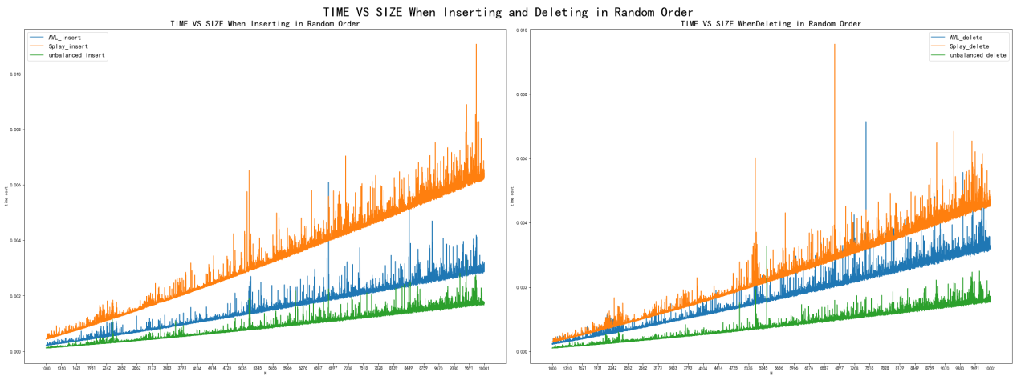
3. Testing Results & Analysis
19
Inserting and deleting both in random order

Slide 21
3. Testing Results & Analysis
20
Inserting and deleting both in random order
AVL Tree
Time Complexity: O(NlogN)
Natural balance decides that less adjustment happens
Splay Tree
the worst performance
Possible Reasons:
1. Adjustment of a splay tree is unavoidable in this case
2. The balance given by randomness may be ruined by the adjustment that ‘roughly halves’ the tree
Unbalanced BST
BST shows the best performance since it has no adjustment and the randomness helps it gain balance.

Slide 22
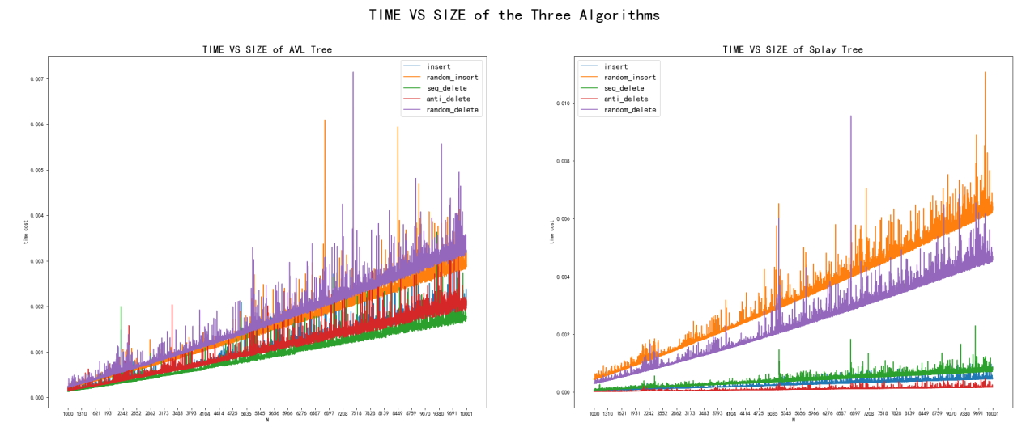
3. Testing Results & Analysis
21
AVL Tree
Splay Tree
Insert increasingly
Insert randomly
Delete increasingly
Delete decreasingly
Delete randomly

Slide 23
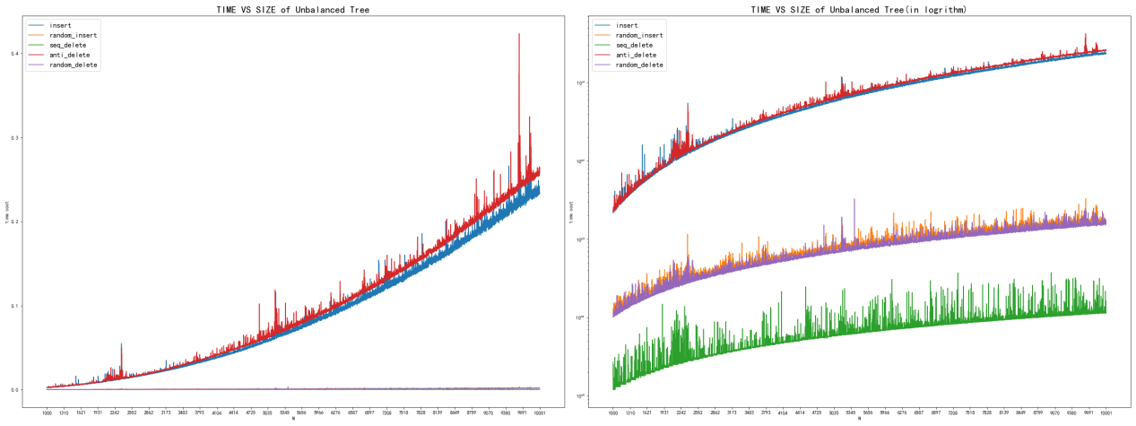
3. Testing Results & Analysis
22
Unbalanced BST Tree
Insert increasingly
Insert randomly
Delete increasingly
Delete decreasingly
Delete randomly

Slide 24
3. Testing Results & Analysis
23
Unbalanced BST Tree
Unstable
Best in average cases
AVL Tree
Most stable
Splay Tree
Unstable
Unfair cheated in the project
Reduce height at every access
Recently accessed elements are quick to access again

Slide 25
4. Conclusion
24
Unbalanced BST Tree
Easy coding
Unstable performance:
terrible performance under worst situation
but excellent performance under average cases
No extra space is needed
Suitable for binary search in an average case
Show better performance when adjustment is introduced

Slide 26
4. Conclusion
25
AVL Tree
Difficult coding.
Very stable performance, O(logN) for every single operation.
Extra space is needed for bookkeeping data
Suitable for structures with features:
Needing single operation mostly
Little differences in the frequency of access to various data
High demands on a single operation

Slide 27
4. Conclusion
26
Splay Tree
1.Relatively easy coding.
2.Unstable performance:
bad performance under worst situation but average-case performance is as efficient as other trees
3.No extra space is needed (for the top-down method)
4.Suitable for structures with features:
1) Needing a series of operations or large-scale operation mostly
2) Significant differences in the frequency of access to various data
3) Moderate demands on a single operation
Unfair：If a test for random access(visiting), allowing multiple access(visiting), a splay tree will show better performance.

Slide 28
THANK YOU!
Enjoy & Good Luck

