Slide 1
Computer Architecture
A Quantitative Approach, Sixth Edition
Chapter 4
Data-Level Parallelism in Vector, SIMD, and GPU Architectures

Slide 2
Introduction
Introduction
SIMD architectures can exploit significant data-level parallelism for:
Matrix-oriented scientific computing
Media-oriented image and sound processors
SIMD is more energy efficient than MIMD
Only needs to fetch one instruction per data operation
Makes SIMD attractive for personal mobile devices
SIMD allows programmer to continue to think sequentially

Slide 3
SIMD Parallelism
Introduction
Vector architectures
SIMD extensions
Graphics Processor Units (GPUs)
For x86 processors:
Expect two additional cores per chip per year
SIMD width to double every four years
Potential speedup from SIMD to be twice that from MIMD!

Slide 4
Vector Architectures
Vector Architectures
Basic idea:
Read sets of data elements into “vector registers”
Operate on those registers
Disperse the results back into memory
Registers are controlled by compiler
Used to hide memory latency
Leverage memory bandwidth

Slide 5
VMIPS
Vector Architectures
Example architecture: RV64V
Loosely based on Cray-1
32 62-bit vector registers
Register file has 16 read ports and 8 write ports
Vector functional units
Fully pipelined
Data and control hazards are detected
Vector load-store unit
Fully pipelined
One word per clock cycle after initial latency
Scalar registers
31 general-purpose registers
32 floating-point registers

Slide 6
VMIPS Instructions
Vector Architectures
.vv: two vector operands
.vs and .sv: vector and scalar operands
LV/SV: vector load and vector store from address
Example: DAXPY
vsetdcfg 4*FP64 # Enable 4 DP FP vregs
fld f0,a # Load scalar a
vld v0,x5 # Load vector X
vmul v1,v0,f0 # Vector-scalar mult
vld v2,x6 # Load vector Y
vadd v3,v1,v2 # Vector-vector add
vst v3,x6 # Store the sum
vdisable # Disable vector regs
8 instructions, 258 for RV64V (scalar code)

Slide 7
Vector Execution Time
Vector Architectures
Execution time depends on three factors:
Length of operand vectors
Structural hazards
Data dependencies
RV64V functional units consume one element per clock cycle
Execution time is approximately the vector length
Convey
Set of vector instructions that could potentially execute together

Slide 8
Chimes
Vector Architectures
Sequences with read-after-write dependency hazards placed in same convey via chaining
Chaining
Allows a vector operation to start as soon as the individual elements of its vector source operand become available
Chime
Unit of time to execute one convey
m conveys executes in m chimes for vector length n
For vector length of n, requires m x n clock cycles

Slide 9
Example
Vector Architectures
vld v0,x5 # Load vector X
vmul v1,v0,f0 # Vector-scalar multiply
vld v2,x6 # Load vector Y
vadd v3,v1,v2 # Vector-vector add
vst v3,x6 # Store the sum
Convoys:
1 vld vmul
2 vld vadd
3 vst
3 chimes, 2 FP ops per result, cycles per FLOP = 1.5
For 64 element vectors, requires 32 x 3 = 96 clock cycles

Slide 10
Challenges
Vector Architectures
Start up time
Latency of vector functional unit
Assume the same as Cray-1
Floating-point add => 6 clock cycles
Floating-point multiply => 7 clock cycles
Floating-point divide => 20 clock cycles
Vector load => 12 clock cycles
Improvements:
> 1 element per clock cycle
Non-64 wide vectors
IF statements in vector code
Memory system optimizations to support vector processors
Multiple dimensional matrices
Sparse matrices
Programming a vector computer

Slide 11
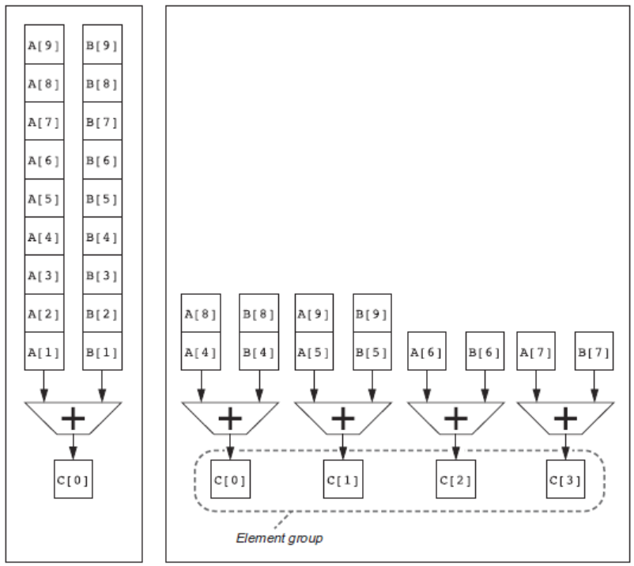
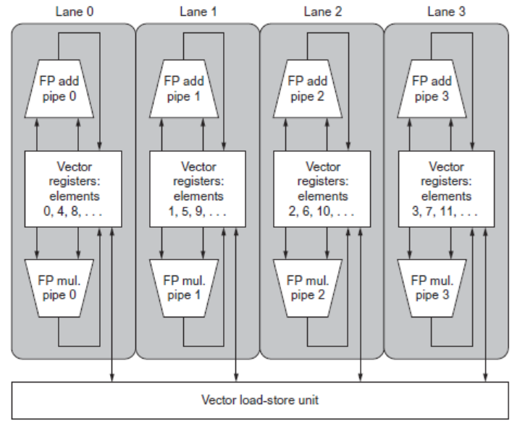
Multiple Lanes
Vector Architectures
Element n of vector register A is “hardwired” to element n of vector register B
Allows for multiple hardware lanes

Slide 12
Vector Length Register
Vector Architectures
for (i=0; i <n; i=i+1) Y[i] = a * X[i] + Y[i];
vsetdcfg 2 DP FP # Enable 2 64b Fl.Pt. registers
fld f0,a # Load scalar a
loop: setvl t0,a0 # vl = t0 = min(mvl,n)
vld v0,x5 # Load vector X
slli t1,t0,3 # t1 = vl * 8 (in bytes)
add x5,x5,t1 # Increment pointer to X by vl*8
vmul v0,v0,f0 # Vector-scalar mult
vld v1,x6 # Load vector Y
vadd v1,v0,v1 # Vector-vector add
sub a0,a0,t0 # n -= vl (t0)
vst v1,x6 # Store the sum into Y
add x6,x6,t1 # Increment pointer to Y by vl*8
bnez a0,loop # Repeat if n != 0
vdisable # Disable vector regs}

Slide 13
Vector Mask Registers
Vector Architectures
Consider:
for (i = 0; i < 64; i=i+1)
if (X[i] != 0)
X[i] = X[i] – Y[i];
Use predicate register to “disable” elements:
vsetdcfg 2*FP64 # Enable 2 64b FP vector regs
vsetpcfgi 1 # Enable 1 predicate register
vld v0,x5 # Load vector X into v0
vld v1,x6 # Load vector Y into v1
fmv.d.x f0,x0 # Put (FP) zero into f0
vpne p0,v0,f0 # Set p0(i) to 1 if v0(i)!=f0
vsub v0,v0,v1 # Subtract under vector mask
vst v0,x5 # Store the result in X
vdisable # Disable vector registers
vpdisable # Disable predicate registers

Slide 14
Memory Banks
Vector Architectures
Memory system must be designed to support high bandwidth for vector loads and stores
Spread accesses across multiple banks
Control bank addresses independently
Load or store non sequential words (need independent bank addressing)
Support multiple vector processors sharing the same memory
Example:
32 processors, each generating 4 loads and 2 stores/cycle
Processor cycle time is 2.167 ns, SRAM cycle time is 15 ns
How many memory banks needed?
32x(4+2)x15/2.167 = ~1330 banks

Slide 15
Stride
Vector Architectures
Consider:
for (i = 0; i < 100; i=i+1)
for (j = 0; j < 100; j=j+1) {
A[i][j] = 0.0;
for (k = 0; k < 100; k=k+1)
A[i][j] = A[i][j] + B[i][k] * D[k][j];
}
Must vectorize multiplication of rows of B with columns of D
Use non-unit stride
Bank conflict (stall) occurs when the same bank is hit faster than bank busy time:
#banks / LCM(stride,#banks) < bank busy time

Slide 16
Scatter-Gather
Vector Architectures
Consider:
for (i = 0; i < n; i=i+1)
A[K[i]] = A[K[i]] + C[M[i]];
Use index vector:
vsetdcfg 4*FP64 # 4 64b FP vector registers
vld v0, x7 # Load K[]
vldx v1, x5, v0 # Load A[K[]]
vld v2, x28 # Load M[]
vldi v3, x6, v2 # Load C[M[]]
vadd v1, v1, v3 # Add them
vstx v1, x5, v0 # Store A[K[]]
vdisable # Disable vector registers

Slide 17
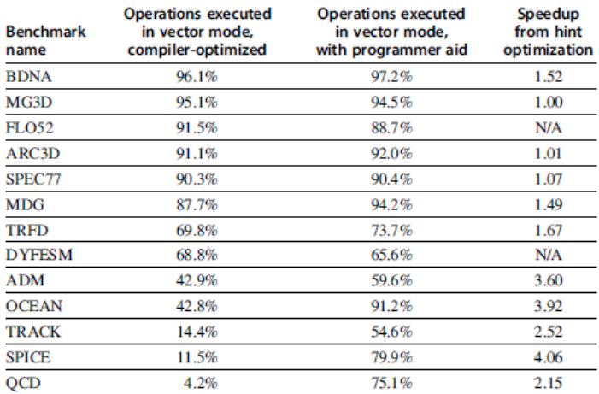
Programming Vec. Architectures
Vector Architectures
Compilers can provide feedback to programmers
Programmers can provide hints to compiler

Slide 18
SIMD Extensions
Media applications operate on data types narrower than the native word size
Example: disconnect carry chains to “partition” adder
Limitations, compared to vector instructions:
Number of data operands encoded into op code
No sophisticated addressing modes (strided, scatter-gather)
No mask registers
SIMD Instruction Set Extensions for Multimedia

Slide 19
SIMD Implementations
Implementations:
Intel MMX (1996)
Eight 8-bit integer ops or four 16-bit integer ops
Streaming SIMD Extensions (SSE) (1999)
Eight 16-bit integer ops
Four 32-bit integer/fp ops or two 64-bit integer/fp ops
Advanced Vector Extensions (2010)
Four 64-bit integer/fp ops
AVX-512 (2017)
Eight 64-bit integer/fp ops
Operands must be consecutive and aligned memory locations
SIMD Instruction Set Extensions for Multimedia

Slide 20
Example SIMD Code
Example DXPY:
fld f0,a # Load scalar a
splat.4D f0,f0 # Make 4 copies of a
addi x28,x5,#256 # Last address to load
Loop: fld.4D f1,0(x5) # Load X[i] ... X[i+3]
fmul.4D f1,f1,f0 # a x X[i] ... a x X[i+3]
fld.4D f2,0(x6) # Load Y[i] ... Y[i+3]
fadd.4D f2,f2,f1 # a x X[i]+Y[i]...
# a x X[i+3]+Y[i+3]
fsd.4D f2,0(x6) # Store Y[i]... Y[i+3]
addi x5,x5,#32 # Increment index to X
addi x6,x6,#32 # Increment index to Y
bne x28,x5,Loop # Check if done
SIMD Instruction Set Extensions for Multimedia

Slide 21
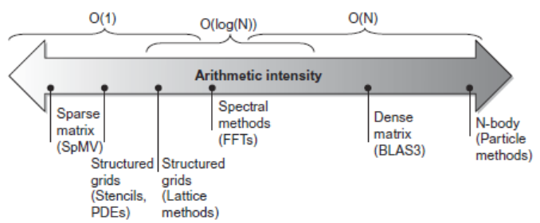
Roofline Performance Model
Basic idea:
Plot peak floating-point throughput as a function of arithmetic intensity
Ties together floating-point performance and memory performance for a target machine
Arithmetic intensity
Floating-point operations per byte read
SIMD Instruction Set Extensions for Multimedia

Slide 22
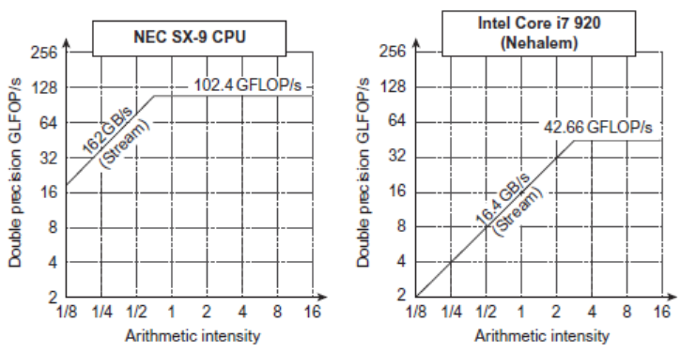
Examples
Attainable GFLOPs/sec = (Peak Memory BW × Arithmetic Intensity, Peak Floating Point Perf.)
SIMD Instruction Set Extensions for Multimedia

Slide 23
Graphical Processing Units
Basic idea:
Heterogeneous execution model
CPU is the host, GPU is the device
Develop a C-like programming language for GPU
Unify all forms of GPU parallelism as CUDA thread
Programming model is “Single Instruction Multiple Thread”
Graphical Processing Units

Slide 24
Threads and Blocks
A thread is associated with each data element
Threads are organized into blocks
Blocks are organized into a grid
GPU hardware handles thread management, not applications or OS
Graphical Processing Units

Slide 25
NVIDIA GPU Architecture
Similarities to vector machines:
Works well with data-level parallel problems
Scatter-gather transfers
Mask registers
Large register files
Differences:
No scalar processor
Uses multithreading to hide memory latency
Has many functional units, as opposed to a few deeply pipelined units like a vector processor
Graphical Processing Units

Slide 26
Example
Code that works over all elements is the grid
Thread blocks break this down into manageable sizes
512 threads per block
SIMD instruction executes 32 elements at a time
Thus grid size = 16 blocks
Block is analogous to a strip-mined vector loop with vector length of 32
Block is assigned to a multithreaded SIMD processor by the thread block scheduler
Current-generation GPUs have 7-15 multithreaded SIMD processors
Graphical Processing Units

Slide 27
Terminology
Each thread is limited to 64 registers
Groups of 32 threads combined into a SIMD thread or “warp”
Mapped to 16 physical lanes
Up to 32 warps are scheduled on a single SIMD processor
Each warp has its own PC
Thread scheduler uses scoreboard to dispatch warps
By definition, no data dependencies between warps
Dispatch warps into pipeline, hide memory latency
Thread block scheduler schedules blocks to SIMD processors
Within each SIMD processor:
32 SIMD lanes
Wide and shallow compared to vector processors
Graphical Processing Units

Slide 28
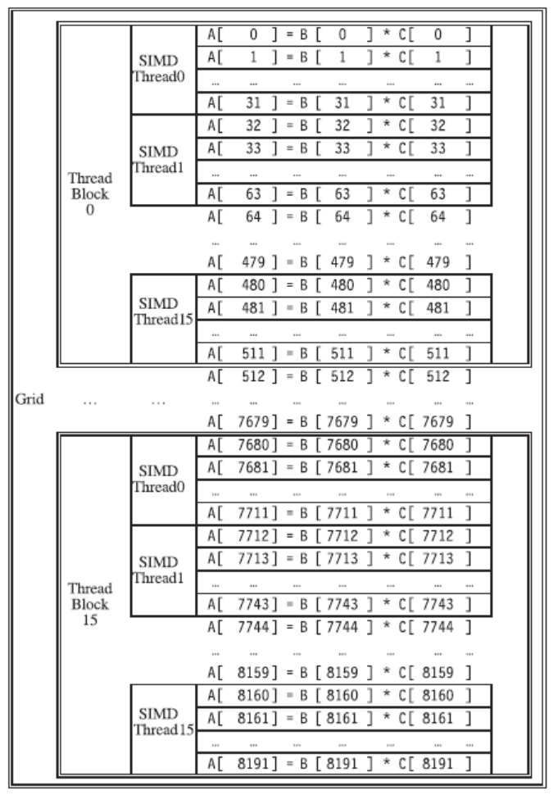
Example
Graphical Processing Units

Slide 29
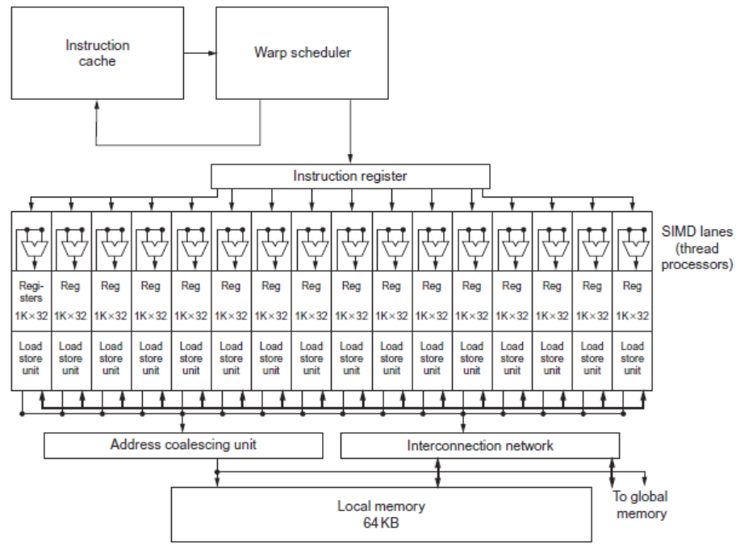
GPU Organization
Graphical Processing Units

Slide 30
NVIDIA Instruction Set Arch.
ISA is an abstraction of the hardware instruction set
“Parallel Thread Execution (PTX)”
opcode.type d,a,b,c;
Uses virtual registers
Translation to machine code is performed in software
Example:
shl.s32 R8, blockIdx, 9 ; Thread Block ID * Block size (512 or 29)
add.s32 R8, R8, threadIdx ; R8 = i = my CUDA thread ID
ld.global.f64 RD0, [X+R8] ; RD0 = X[i]
ld.global.f64 RD2, [Y+R8] ; RD2 = Y[i]
mul.f64 R0D, RD0, RD4 ; Product in RD0 = RD0 * RD4 (scalar a)
add.f64 R0D, RD0, RD2 ; Sum in RD0 = RD0 + RD2 (Y[i])
st.global.f64 [Y+R8], RD0 ; Y[i] = sum (X[i]*a + Y[i])
Graphical Processing Units

Slide 31
Conditional Branching
Like vector architectures, GPU branch hardware uses internal masks
Also uses
Branch synchronization stack
Entries consist of masks for each SIMD lane
I.e. which threads commit their results (all threads execute)
Instruction markers to manage when a branch diverges into multiple execution paths
Push on divergent branch
…and when paths converge
Act as barriers
Pops stack
Per-thread-lane 1-bit predicate register, specified by programmer
Graphical Processing Units

Slide 32
Example
if (X[i] != 0)
X[i] = X[i] – Y[i];
else X[i] = Z[i];
ld.global.f64 RD0, [X+R8] ; RD0 = X[i]
setp.neq.s32 P1, RD0, #0 ; P1 is predicate register 1
@!P1, bra ELSE1, *Push ; Push old mask, set new mask bits
; if P1 false, go to ELSE1
ld.global.f64 RD2, [Y+R8] ; RD2 = Y[i]
sub.f64 RD0, RD0, RD2 ; Difference in RD0
st.global.f64 [X+R8], RD0 ; X[i] = RD0
@P1, bra ENDIF1, *Comp ; complement mask bits
; if P1 true, go to ENDIF1
ELSE1: ld.global.f64 RD0, [Z+R8] ; RD0 = Z[i]
st.global.f64 [X+R8], RD0 ; X[i] = RD0
ENDIF1: <next instruction>, *Pop ; pop to restore old mask
Graphical Processing Units

Slide 33
NVIDIA GPU Memory Structures
Each SIMD Lane has private section of off-chip DRAM
“Private memory”
Contains stack frame, spilling registers, and private variables
Each multithreaded SIMD processor also has local memory
Shared by SIMD lanes / threads within a block
Memory shared by SIMD processors is GPU Memory
Host can read and write GPU memory
Graphical Processing Units

Slide 34
Pascal Architecture Innovations
Each SIMD processor has
Two or four SIMD thread schedulers, two instruction dispatch units
16 SIMD lanes (SIMD width=32, chime=2 cycles), 16 load-store units, 4 special function units
Two threads of SIMD instructions are scheduled every two clock cycles
Fast single-, double-, and half-precision
High Bandwith Memory 2 (HBM2) at 732 GB/s
NVLink between multiple GPUs (20 GB/s in each direction)
Unified virtual memory and paging support
Graphical Processing Units

Slide 35
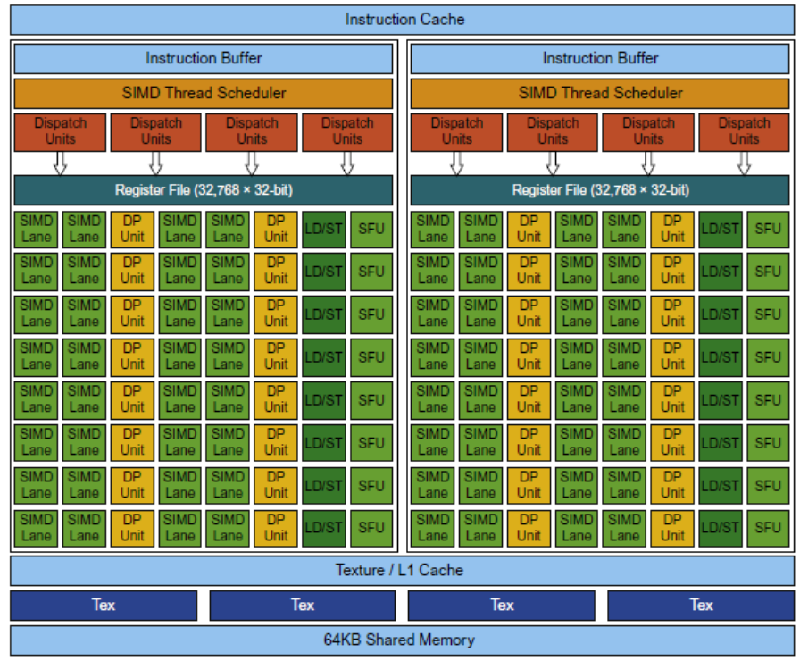
Pascal Multithreaded SIMD Proc.
Graphical Processing Units

Slide 36
Vector Architectures vs GPUs
SIMD processor analogous to vector processor, both have MIMD
Registers
RV64V register file holds entire vectors
GPU distributes vectors across the registers of SIMD lanes
RV64 has 32 vector registers of 32 elements (1024)
GPU has 256 registers with 32 elements each (8K)
RV64 has 2 to 8 lanes with vector length of 32, chime is 4 to 16 cycles
SIMD processor chime is 2 to 4 cycles
GPU vectorized loop is grid
All GPU loads are gather instructions and all GPU stores are scatter instructions
Graphical Processing Units

Slide 37
SIMD Architectures vs GPUs
GPUs have more SIMD lanes
GPUs have hardware support for more threads
Both have 2:1 ratio between double- and single-precision performance
Both have 64-bit addresses, but GPUs have smaller memory
SIMD architectures have no scatter-gather support
Graphical Processing Units

Slide 38
Loop-Level Parallelism
Focuses on determining whether data accesses in later iterations are dependent on data values produced in earlier iterations
Loop-carried dependence
Example 1:
for (i=999; i>=0; i=i-1)
x[i] = x[i] + s;
No loop-carried dependence
Detecting and Enhancing Loop-Level Parallelism

Slide 39
Loop-Level Parallelism
Example 2:
for (i=0; i<100; i=i+1) {
A[i+1] = A[i] + C[i]; /* S1 */
B[i+1] = B[i] + A[i+1]; /* S2 */
}
S1 and S2 use values computed by S1 in previous iteration
S2 uses value computed by S1 in same iteration
Detecting and Enhancing Loop-Level Parallelism

Slide 40
Loop-Level Parallelism
Example 3:
for (i=0; i<100; i=i+1) {
A[i] = A[i] + B[i]; /* S1 */
B[i+1] = C[i] + D[i]; /* S2 */
}
S1 uses value computed by S2 in previous iteration but dependence is not circular so loop is parallel
Transform to:
A[0] = A[0] + B[0];
for (i=0; i<99; i=i+1) {
B[i+1] = C[i] + D[i];
A[i+1] = A[i+1] + B[i+1];
}
B[100] = C[99] + D[99];
Detecting and Enhancing Loop-Level Parallelism

Slide 41
Loop-Level Parallelism
Example 4:
for (i=0;i<100;i=i+1) {
A[i] = B[i] + C[i];
D[i] = A[i] * E[i];
}
Example 5:
for (i=1;i<100;i=i+1) {
Y[i] = Y[i-1] + Y[i];
}
Detecting and Enhancing Loop-Level Parallelism

Slide 42
Finding dependencies
Assume indices are affine:
a x i + b (i is loop index)
Assume:
Store to a x i + b, then
Load from c x i + d
i runs from m to n
Dependence exists if:
Given j, k such that m ≤ j ≤ n, m ≤ k ≤ n
Store to a x j + b, load from a x k + d, and a x j + b = c x k + d
Detecting and Enhancing Loop-Level Parallelism

Slide 43
Finding dependencies
Generally cannot determine at compile time
Test for absence of a dependence:
GCD test:
If a dependency exists, GCD(c,a) must evenly divide (d-b)
Example:
for (i=0; i<100; i=i+1) {
X[2*i+3] = X[2*i] * 5.0;
}
Detecting and Enhancing Loop-Level Parallelism

Slide 44
Finding dependencies
Example 2:
for (i=0; i<100; i=i+1) {
Y[i] = X[i] / c; /* S1 */
X[i] = X[i] + c; /* S2 */
Z[i] = Y[i] + c; /* S3 */
Y[i] = c - Y[i]; /* S4 */
}
Watch for antidependencies and output dependencies
Detecting and Enhancing Loop-Level Parallelism

Slide 45
Finding dependencies
Example 2:
for (i=0; i<100; i=i+1) {
Y[i] = X[i] / c; /* S1 */
X[i] = X[i] + c; /* S2 */
Z[i] = Y[i] + c; /* S3 */
Y[i] = c - Y[i]; /* S4 */
}
Watch for antidependencies and output dependencies
Detecting and Enhancing Loop-Level Parallelism

Slide 46
Reductions
Reduction Operation:
for (i=9999; i>=0; i=i-1)
sum = sum + x[i] * y[i];
Transform to…
for (i=9999; i>=0; i=i-1)
sum [i] = x[i] * y[i];
for (i=9999; i>=0; i=i-1)
finalsum = finalsum + sum[i];
Do on p processors:
for (i=999; i>=0; i=i-1)
finalsum[p] = finalsum[p] + sum[i+1000*p];
Note: assumes associativity!
Detecting and Enhancing Loop-Level Parallelism

Slide 47
Fallacies and Pitfalls
Fallacies and Pitfalls
GPUs suffer from being coprocessors
GPUs have flexibility to change ISA
Concentrating on peak performance in vector architectures and ignoring start-up overhead
Overheads require long vector lengths to achieve speedup
Increasing vector performance without comparable increases in scalar performance
You can get good vector performance without providing memory bandwidth
On GPUs, just add more threads if you don’t have enough memory performance

