Slide 1
Computer Architecture
A Quantitative Approach, Sixth Edition
Chapter 6
Warehouse-Scale Computers to Exploit Request-Level and Data-Level Parallelism

Slide 2
Introduction
Introduction
Warehouse-scale computer (WSC)
Provides Internet services
Search, social networking, online maps, video sharing, online shopping, email, cloud computing, etc.
Differences with HPC “clusters”:
Clusters have higher performance processors and network
Clusters emphasize thread-level parallelism, WSCs emphasize request-level parallelism
Differences with datacenters:
Datacenters consolidate different machines and software into one location
Datacenters emphasize virtual machines and hardware heterogeneity in order to serve varied customers

Slide 3
Introduction
Introduction
Important design factors for WSC:
Cost-performance
Small savings add up
Energy efficiency
Affects power distribution and cooling
Work per joule
Dependability via redundancy
Network I/O
Interactive and batch processing workloads

Slide 4
Introduction
Introduction
Ample computational parallelism is not important
Most jobs are totally independent
“Request-level parallelism”
Operational costs count
Power consumption is a primary, not secondary, constraint when designing system
Scale and its opportunities and problems
Can afford to build customized systems since WSC require volume purchase
Location counts
Real estate, power cost; Internet, end-user, and workforce availability
Computing efficiently at low utilization
Scale and the opportunities/problems associated with scale
Unique challenges: custom hardware, failures
Unique opportunities: bulk discounts

Slide 5
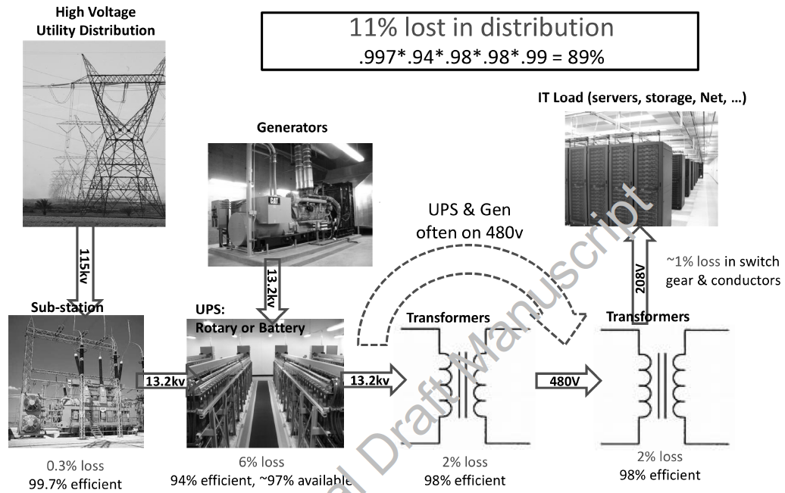
Efficiency and Cost of WSC
Location of WSC
Proximity to Internet backbones, electricity cost, property tax rates, low risk from earthquakes, floods, and hurricanes
Power distribution
Efficiency and Cost of WSC

Slide 6
Prgrm’g Models and Workloads
Batch processing framework: MapReduce
Map: applies a programmer-supplied function to each logical input record
Runs on thousands of computers
Provides new set of key-value pairs as intermediate values
Reduce: collapses values using another programmer-supplied function
Programming Models and Workloads for WSCs

Slide 7
Prgrm’g Models and Workloads
Example:
map (String key, String value):
// key: document name
// value: document contents
for each word w in value
EmitIntermediate(w,”1”); // Produce list of all words
reduce (String key, Iterator values):
// key: a word
// value: a list of counts
int result = 0;
for each v in values:
result += ParseInt(v); // get integer from key-value pair
Emit(AsString(result));
Programming Models and Workloads for WSCs

Slide 8
Prgrm’g Models and Workloads
Availability:
Use replicas of data across different servers
Use relaxed consistency:
No need for all replicas to always agree
File systems: GFS and Colossus
Databases: Dynamo and BigTable
Programming Models and Workloads for WSCs

Slide 9
Prgrm’g Models and Workloads
MapReduce runtime environment schedules map and reduce task to WSC nodes
Workload demands often vary considerably
Scheduler assigns tasks based on completion of prior tasks
Tail latency/execution time variability: single slow task can hold up large MapReduce job
Runtime libraries replicate tasks near end of job
Programming Models and Workloads for WSCs

Slide 10
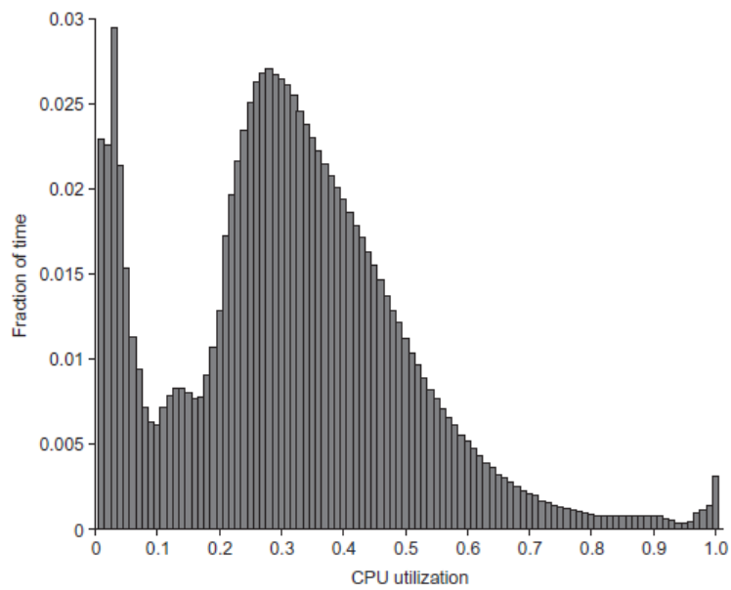
Prgrm’g Models and Workloads
Programming Models and Workloads for WSCs

Slide 11
Computer Architecture of WSC
WSC often use a hierarchy of networks for interconnection
Each 19” rack holds 48 1U servers connected to a rack switch
Rack switches are uplinked to switch higher in hierarchy
Uplink has 6-24X times lower bandwidthGoal is to maximize locality of communication relative to the rack
Computer Ar4chitecture of WSC

Slide 12
Storage
Storage options:
Use disks inside the servers, or
Network attached storage through Infiniband
WSCs generally rely on local disks
Google File System (GFS) uses local disks and maintains at least three relicas
Computer Ar4chitecture of WSC

Slide 13
Array Switch
Switch that connects an array of racks
Array switch should have 10 X the bisection bandwidth of rack switch
Cost of n-port switch grows as n²
Often utilize content addressible memory chips and FPGAs
Computer Ar4chitecture of WSC

Slide 14
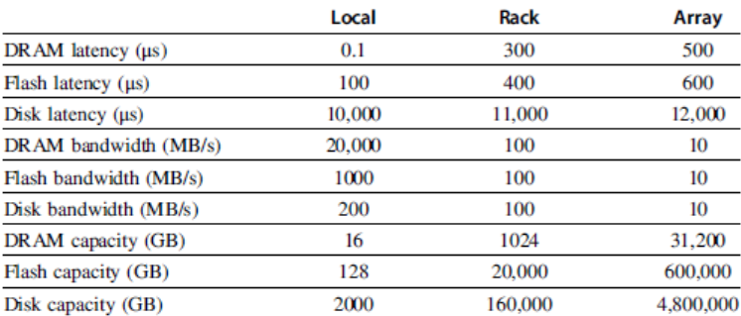
WSC Memory Hierarchy
Servers can access DRAM and disks on other servers using a NUMA-style interface
Computer Ar4chitecture of WSC

Slide 15
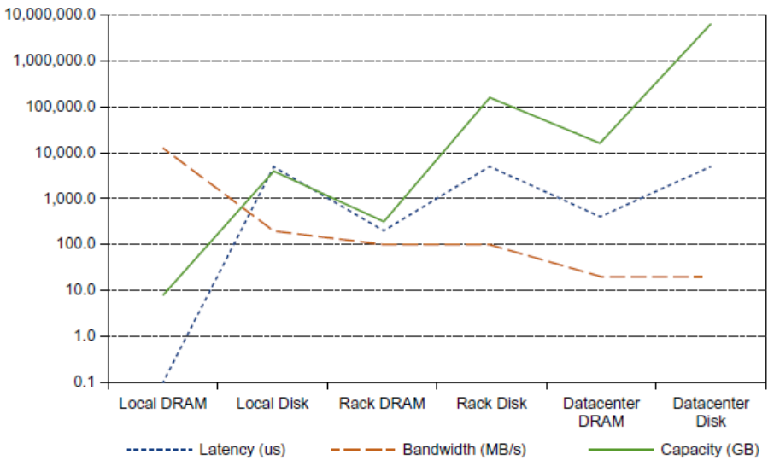
WSC Memory Hierarchy
Computer Ar4chitecture of WSC

Slide 16
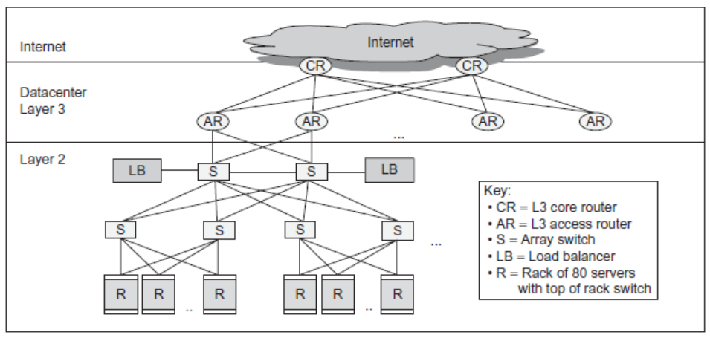
WSC Memory Hierarchy
Computer Ar4chitecture of WSC

Slide 17
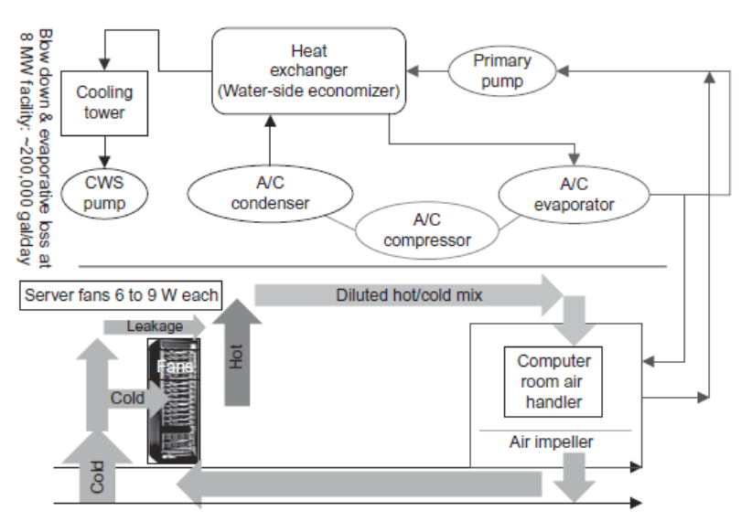
Infrastructure and Costs of WSC
Cooling
Air conditioning used to cool server room
64 F – 71 F
Keep temperature higher (closer to 71 F)
Cooling towers can also be used
Minimum temperature is “wet bulb temperature”
Physcical Infrastrcuture and Costs of WSC

Slide 18
Infrastructure and Costs of WSC
Cooling system also uses water (evaporation and spills)
E.g. 70,000 to 200,000 gallons per day for an 8 MW facility
Power cost breakdown:
Chillers: 30-50% of the power used by the IT equipment
Air conditioning: 10-20% of the IT power, mostly due to fans
How man servers can a WSC support?
Each server:
“Nameplate power rating” gives maximum power consumption
To get actual, measure power under actual workloads
Oversubscribe cumulative server power by 40%, but monitor power closely
Physcical Infrastrcuture and Costs of WSC

Slide 19
Infrastructure and Costs of WSC
Determining the maximum server capacity
Nameplate power rating: maximum power that a server can draw
Better approach: measure under various workloads
Oversubscribe by 40%
Typical power usage by component:
Processors: 42%
DRAM: 12%
Disks: 14%
Networking: 5%
Cooling: 15%
Power overhead: 8%
Miscellaneous: 4%
Physcical Infrastrcuture and Costs of WSC

Slide 20
Measuring Efficiency of a WSC
Power Utilization Effectiveness (PEU)
= Total facility power / IT equipment power
Median PUE on 2006 study was 1.69
Performance
Latency is important metric because it is seen by users
Bing study: users will use search less as response time increases
Service Level Objectives (SLOs)/Service Level Agreements (SLAs)
E.g. 99% of requests be below 100 ms
Physcical Infrastrcuture and Costs of WSC

Slide 21
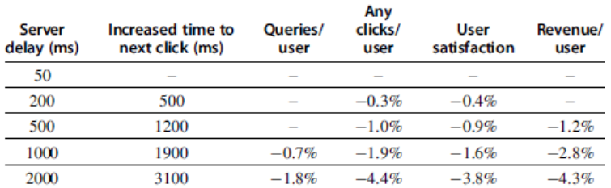
Measuring Efficiency of a WSC
Physcical Infrastrcuture and Costs of WSC

Slide 22
Cost of a WSC
Capital expenditures (CAPEX)
Cost to build a WSC
$9 to 13/watt
Operational expenditures (OPEX)
Cost to operate a WSC
Physcical Infrastrcuture and Costs of WSC

Slide 23
Cloud Computing
Cloud Computing
Amazon Web Services
Virtual Machines: Linux/Xen
Low cost
Open source software
Initially no guarantee of service
No contract

Slide 24
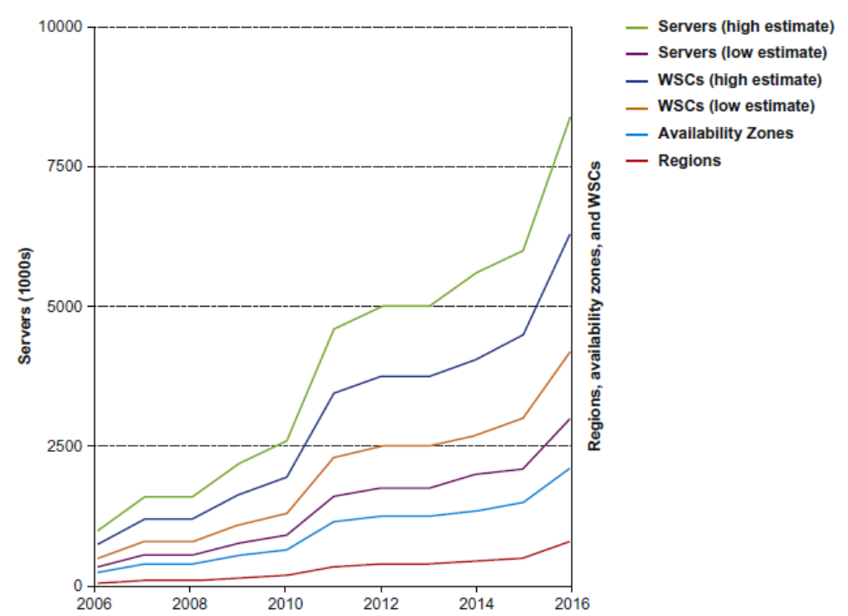
Cloud Computing
Cloud Computing
Cloud Computing Growth

Slide 25
Fallacies and Pitfalls
Fallcies and Pitfalls
Cloud computing providers are losing money
AWS has a margin of 25%, Amazon retail 3%
Focusing on average performance instead of 99th percentile performance
Using too wimpy a processor when trying to improve WSC cost-performance
Inconsistent Measure of PUE by different companies
Capital costs of the WSC facility are higher than for the servers that it houses

Slide 26
Fallacies and Pitfalls
Fallcies and Pitfalls
Trying to save power with inactive low power modes versus active low power modes
Given improvements in DRAM dependability and the fault tolerance of WSC systems software, there is no need to spend extra for ECC memory in a WSC
Coping effectively with microsecond (e.g. Flash and 100 GbE) delays as opposed to nansecond or millisecond delays
Turning off hardware during periods of low activity improves the cost-performance of a WSC

