Slide 1
Chapter 2
Instructions: Language of the Computer

Slide 2
Instruction Set
§2.1 Introduction
The repertoire of instructions of a computer
Different computers have different instruction sets
But with many aspects in common
Early computers had very simple instruction sets
Simplified implementation
Many modern computers also have simple instruction sets

Slide 3
The RISC-V Instruction Set
Used as the example throughout the book
Developed at UC Berkeley as open ISA
Now managed by the RISC-V Foundation (riscv.org)
Typical of many modern ISAs
See RISC-V Reference Data tear-out card
Similar ISAs have a large share of embedded core market
Applications in consumer electronics, network/storage equipment, cameras, printers, …

Slide 4
Arithmetic Operations
Add and subtract, three operands
Two sources and one destination
add a, b, c // a gets b + c
All arithmetic operations have this form
Design Principle 1: Simplicity favours regularity
Regularity makes implementation simpler
Simplicity enables higher performance at lower cost
§2.2 Operations of the Computer Hardware

Slide 5
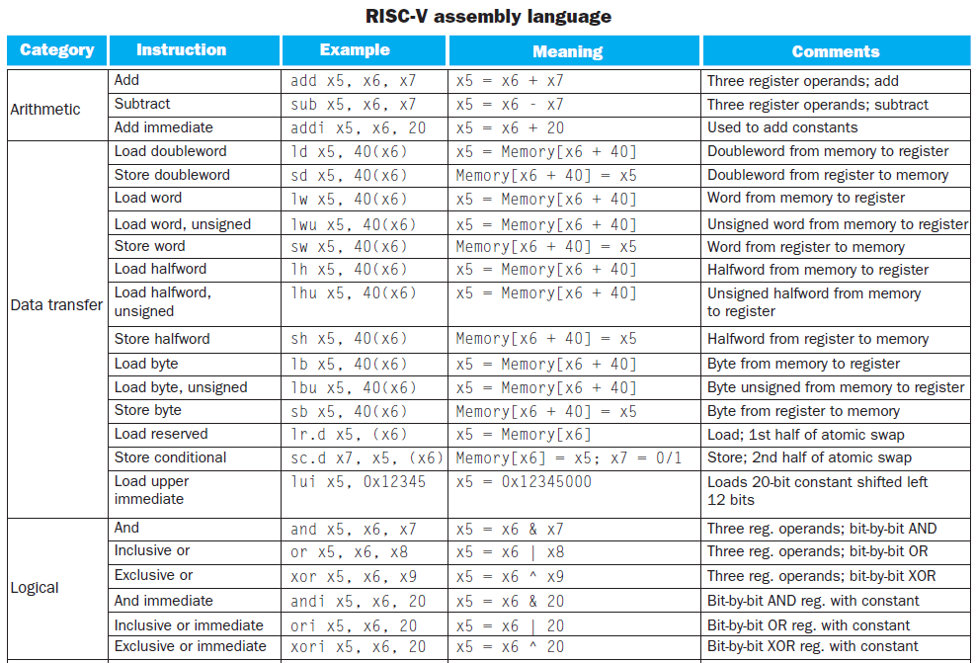

Slide 6
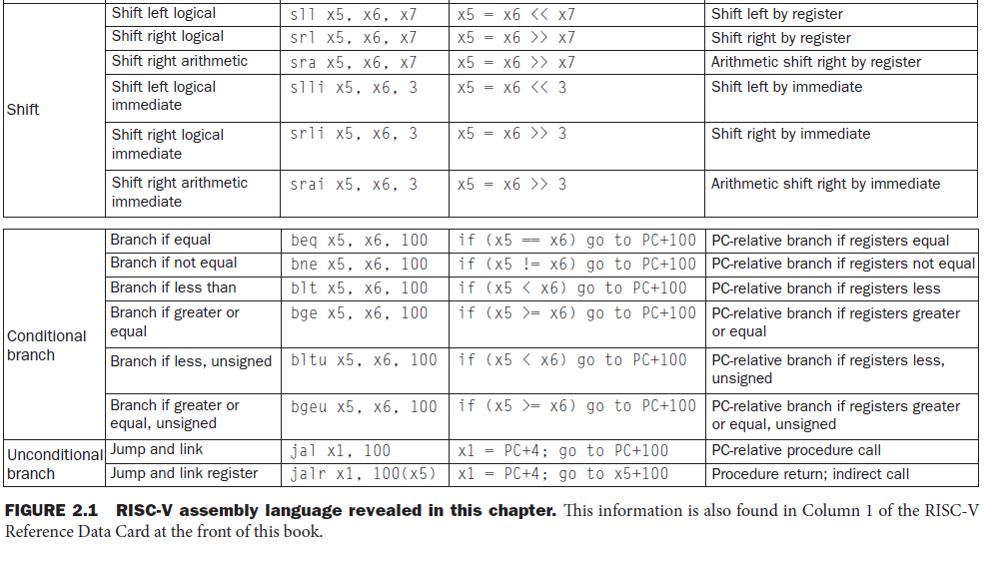

Slide 7
Arithmetic Example
C code:
f = (g + h) - (i + j);
Compiled RISC-V code:
add t0, g, h // temp t0 = g + h add t1, i, j // temp t1 = i + j add f, t0, t1 // f = t0 - t1

Slide 8
Register Operands
Arithmetic instructions use register operands
RISC-V has a 32 × 64-bit register file
Use for frequently accessed data
64-bit data is called a “doubleword”
32 x 64-bit general purpose registers x0 to x30(应是x31?)
32-bit data is called a “word”
Design Principle 2: Smaller is faster
c.f. main memory: millions of locations
§2.3 Operands of the Computer Hardware

Slide 9
RISC-V Registers
x0: the constant value 0
x1: return address
x2: stack pointer
x3: global pointer
x4: thread pointer
x5 – x7, x28 – x31: temporaries
x8: frame pointer
x9, x18 – x27: saved registers
x10 – x11: function arguments/results
x12 – x17: function arguments

Slide 10
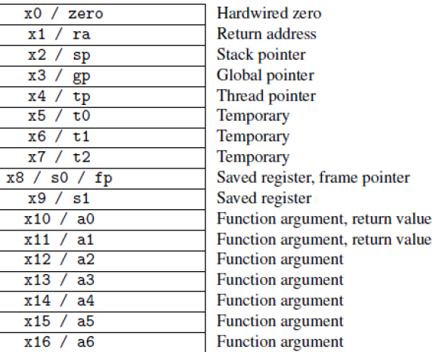
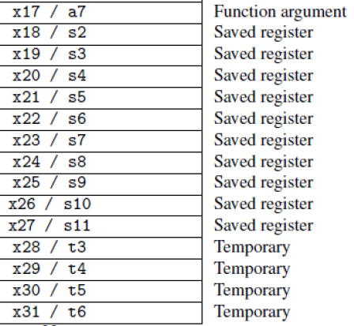
x0: the constant value 0
x1: return address
x2: stack pointer
x3: global pointer
x4: thread pointer
x5 – x7, x28 – x31: temporaries
x8: frame pointer
x9, x18 – x27: saved registers
x10 – x11: function arguments/results
x12 – x17: function arguments
右边资料来自于《RISC-V手册》【RISC-V-Reader-Chinese-v2p1.pdf】 P28

Slide 11
RISC-V register conventions
Name | Register name | Usage | Preserved On call?
x0 | 0 | The constant value 0 | n.a.
x1(ra) | 1 | Return address(link register) | yes
x2(sp) | 2 | Stack pointer | yes
x3(gp) | 3 | Global pointer | yes
x4(tp) | 4 | Thread pointer | yes
x5-x7 | 5-7 | Temporaries | no
x8-x9 | 8-9 | Saved | yes
x10-x17 | 10-17 | Arguments/results | no
x18-x27 | 18-27 | Saved | yes
x28-x31 | 28-31 | Temporaries | no
Notes:
x5

Slide 12
Register Operand Example
C code:
f = (g + h) - (i + j);
f, …, j in x19, x20, …, x23
Compiled RISC-V code:
add x5, x20, x21 add x6, x22, x23 sub x19, x5, x6

Slide 13
Memory Operands
Main memory used for composite data
Arrays, structures, dynamic data
To apply arithmetic operations
Load values from memory into registers
Store result from register to memory
Memory is byte addressed
Each address identifies an 8-bit byte
RISC-V is Little Endian
Least-significant byte at least address of a word
c.f. Big Endian: most-significant byte at least address
RISC-V does not require words to be aligned in memory
Unlike some other ISAs

Slide 14
Memory Operand Example
C code:
A[12] = h + A[8];
h in x21, base address of A in x22
Each element of array A is doubleword.
Compiled RISC-V code:
Index 8 requires offset of 64
8 bytes per doubleword
ld x9, 64(x22) add x9, x21, x9 sd x9, 96(x22)

Slide 15
Registers vs. Memory
Registers are faster to access than memory
Operating on memory data requires loads and stores
More instructions to be executed
Compiler must use registers for variables as much as possible
Only spill to memory for less frequently used variables
Register optimization is important!

Slide 16
Immediate Operands
Constant data specified in an instruction
addi x22, x22, 4
Make the common case fast
Small constants are common
Immediate operand avoids a load instruction

Slide 17
Constant or Immediate Operands
Constant or immediate Operands
Many time a program will use a constant in an operation
Incrementing index to point to next element of array
Add the constant 4 to register x22
Assuming AddrConstants4 is address pointer of constant 4
AddrConstants4是具体的位移量，例如24
ld x9, AddrConstant4(x3) // x9=constant 4
add x22, x22, x9
Immediate: Other method for adding constant 4 to x22
Avoids the load instruction
Offer versions of the instruction
addi x22, x22, 4 // x22= x22+ 4
Constant zero: a register x0
Design Principle 3
Make the common case fast: (why?) Constant operands occur frequently it is very common Loading them from memory is very slow
x3
….
AddrConstants4
4

Slide 18
Unsigned Binary Integers
Given an n-bit number
§2.4 Signed and Unsigned Numbers
Range: 0 to +2^{n} – 1
Example
0000 0000 … 0000 1011₂ = 0 + … + 1×2³ + 0×2² +1×2¹ +1×2⁰ = 0 + … + 8 + 0 + 2 + 1 = 11₁₀
Using 64 bits: 0 to +18,446,774,073,709,551,615

Slide 19
2’s-Complement Signed Integers
Given an n-bit number
Range: –2^{n – 1} to +2^{n – 1} – 1
Example
1111 1111 … 1111 1100₂ = –1×2³¹ + 1×2³⁰ + … + 1×2² +0×2¹ +0×2⁰ = –2,147,483,648 + 2,147,483,644 = –4₁₀
Using 64 bits: −9,223,372,036,854,775,808 to 9,223,372,036,854,775,807
2^31=2 147 483 648

Slide 20
2’s-Complement Signed Integers
Unsigned Binary Integers
Bit 63 is sign bit
1 for negative numbers
0 for non-negative numbers
–(–2^{n – 1}) can’t be represented
Non-negative numbers have the same unsigned and 2’s complement representation
Some specific numbers
0: 0000 0000 … 0000
–1: 1111 1111 … 1111
Most-negative: 1000 0000 … 0000
Most-positive: 0111 1111 … 1111

Slide 21
Signed Negation
Complement and add 1
Complement means 1 → 0, 0 → 1
Example: negate +2
+2 = 0000 0000 … 0010_{two}
–2 = 1111 1111 … 1101_{two} + 1 = 1111 1111 … 1110_{two}

Slide 22
Sign Extension
Representing a number using more bits
Preserve the numeric value
Replicate the sign bit to the left
c.f. unsigned values: extend with 0s
Examples: 8-bit to 16-bit
+2: 0000 0010 => 0000 0000 0000 0010
–2: 1111 1110 => 1111 1111 1111 1110
In RISC-V instruction set
lb: sign-extend loaded byte
lbu: zero-extend loaded byte

Slide 23
Representing Instructions
Instructions are encoded in binary
Called machine code
RISC-V instructions
Encoded as 32-bit instruction words
Small number of formats encoding operation code (opcode), register numbers, …
Regularity!
§2.5 Representing Instructions in the Computer

Slide 24
Hexadecimal
Base 16
Compact representation of bit strings
4 bits per hex digit
0 | 0000 | 4 | 0100 | 8 | 1000 | c | 1100
1 | 0001 | 5 | 0101 | 9 | 1001 | d | 1101
2 | 0010 | 6 | 0110 | a | 1010 | e | 1110
3 | 0011 | 7 | 0111 | b | 1011 | f | 1111
Example: eca8 6420
1110 1100 1010 1000 0110 0100 0010 0000

Slide 25
RISC-V R-format Instructions
funct7
rs2
rs1
funct3
rd
opcode
7 bits
5 bits
5 bits
3 bits
5 bits
7 bits
Instruction fields
opcode: operation code
rd: destination register number
funct3: 3-bit function code (additional opcode)
rs1: the first source register number
rs2: the second source register number
funct7: 7-bit function code (additional opcode)

Slide 26
R-format Example
funct7
rs2
rs1
funct3
rd
opcode
7 bits
5 bits
5 bits
3 bits
5 bits
7 bits
add x9,x20,x21
0
21
20
0
9
51
0000000
10101
10100
000
01001
0110011
0000 0001 0101 1010 0000 0100 1011 0011_{two} =
015A04B3₁₆

Slide 27
RISC-V I-format Instructions
immediate
rs1
funct3
rd
opcode
12 bits
5 bits
3 bits
5 bits
7 bits
Immediate arithmetic and load instructions
rs1: source or base address register number
immediate: constant operand, or offset added to base address
2s-complement, sign extended
Design Principle 3: Good design demands good compromises
Different formats complicate decoding, but allow 32-bit instructions uniformly
Keep formats as similar as possible
ld x9, 64(x22) sd x9, 96(x22)

Slide 28
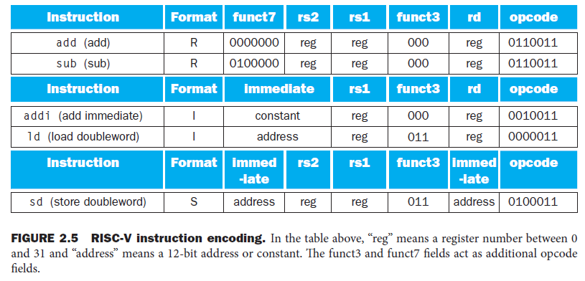
RISC-V S-format Instructions
imm[11:5]
rs2
rs1
funct3
imm[4:0]
opcode
7 bits
5 bits
5 bits
3 bits
5 bits
7 bits
Different immediate format for store instructions
rs1: base address register number
rs2: source operand register number
immediate: offset added to base address
Split so that rs1 and rs2 fields always in the same place

Slide 29
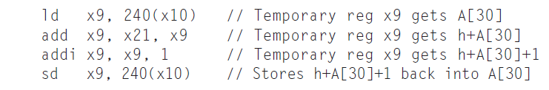
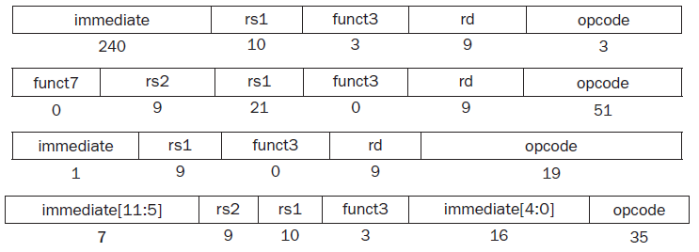
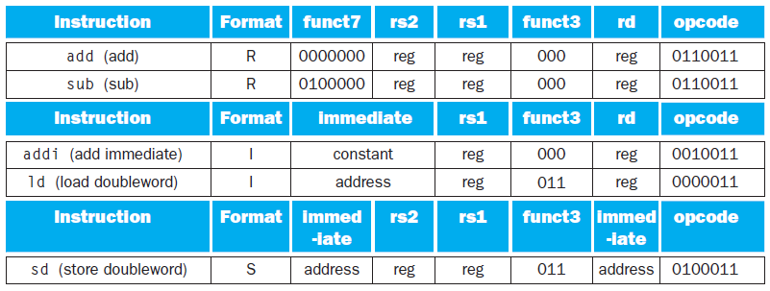

Slide 30
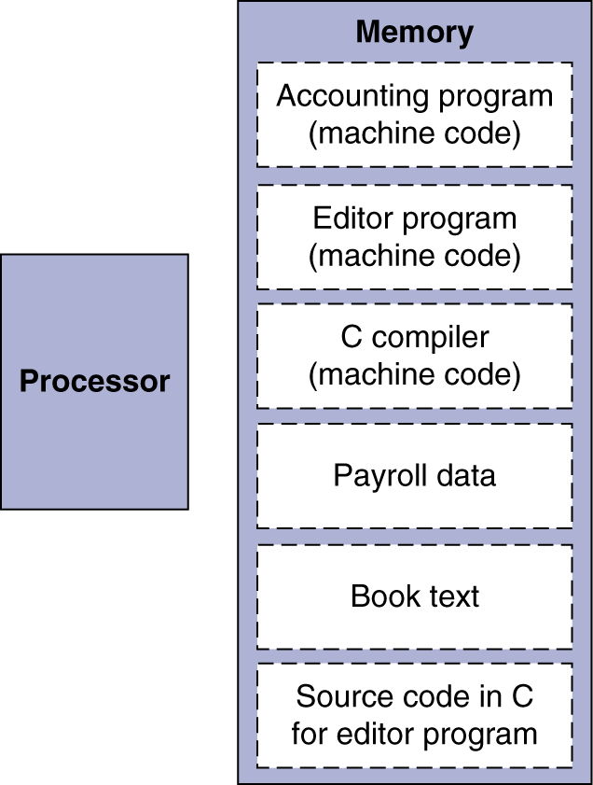
Stored Program Computers
The BIG Picture
Instructions represented in binary, just like data
Instructions and data stored in memory
Programs can operate on programs
e.g., compilers, linkers, …
Binary compatibility allows compiled programs to work on different computers
Standardized ISAs

Slide 31
Logical Operations
Instructions for bitwise manipulation
§2.6 Logical Operations
Operation | C | Java | RISC-V
Shift left | << | << | slli
Shift right | >> | >>> | srli
Bit-by-bit AND | & | & | and, andi
Bit-by-bit OR | | | | | or, ori
Bit-by-bit XOR | ^ | ^ | xor, xori
Bit-by-bit NOT | ~ | ~
Useful for extracting and inserting groups of bits in a word

Slide 32
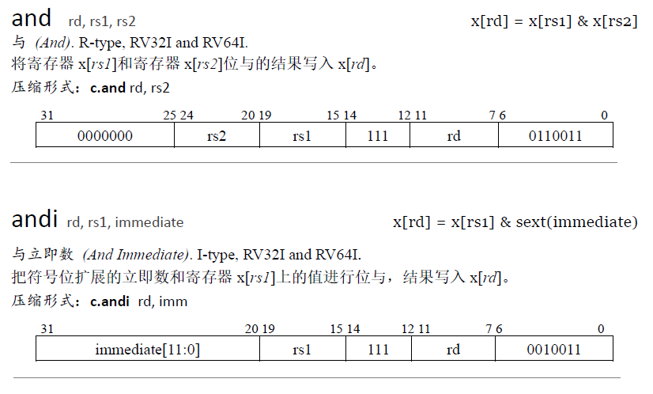
来源：【RISC-V-Reader-Chinese-v2p1.pdf 】 P120

Slide 33
Shift Operations
funct6
immed
rs1
funct3
rd
opcode
6 bits
6 bits
5 bits
3 bits
5 bits
7 bits
immed: how many positions to shift
Shift left logical
Shift left and fill with 0 bits
slli by i bits multiplies by 2^{i}
Shift right logical
Shift right and fill with 0 bits
srli by i bits divides by 2^{i} (unsigned only)

Slide 34
AND Operations
Useful to mask bits in a word
Select some bits, clear others to 0
and x9,x10,x11
x10
00000000 00000000 00000000 00000000 00000000 00000000 00001101 11000000
x11
00000000 00000000 00000000 00000000 00000000 00000000 00111100 00000000
x9
00000000 00000000 00000000 00000000 00000000 00000000 00001100 00000000

Slide 35
OR Operations
Useful to include bits in a word （删掉）
Set some bits to 1, leave others unchanged
or x9,x10,x11
x10
00000000 00000000 00000000 00000000 00000000 00000000 00001101 11000000
x11
00000000 00000000 00000000 00000000 00000000 00000000 00111100 00000000
x9
00000000 00000000 00000000 00000000 00000000 00000000 00111101 11000000

Slide 36
XOR Operations
Differencing operation （删掉）
Set some bits to 1, leave others unchanged
xor x9,x10,x12 // NOT operation
x10
00000000 00000000 00000000 00000000 00000000 00000000 00001101 11000000
x12
11111111 11111111 11111111 11111111 11111111 11111111 11111111 11111111
x9
11111111 11111111 11111111 11111111 11111111 11111111 11110010 00111111

Slide 37
Conditional Operations
Branch to a labeled instruction if a condition is true
Otherwise, continue sequentially
beq rs1, rs2, L1 ------SB类型指令
if (rs1 == rs2) branch to instruction labeled L1
bne rs1, rs2, L1 ------SB类型指令
if (rs1 != rs2) branch to instruction labeled L1
§2.7 Instructions for Making Decisions

Slide 38
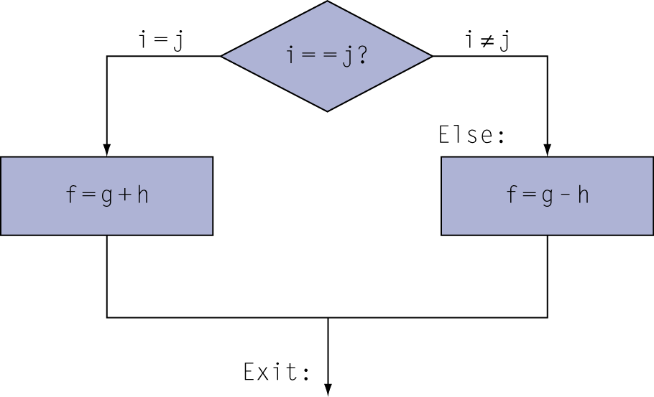
Compiling If Statements
C code:
if (i==j) f = g+h; else f = g-h;
f, g, h, i, j
x19, x20,x21,x22,x23
Compiled RISC-V code:
bne x22, x23, Else add x19, x20, x21 beq x0,x0,Exit // unconditional Else: sub x19, x20, x21 Exit: …
Assembler calculates addresses

Slide 39
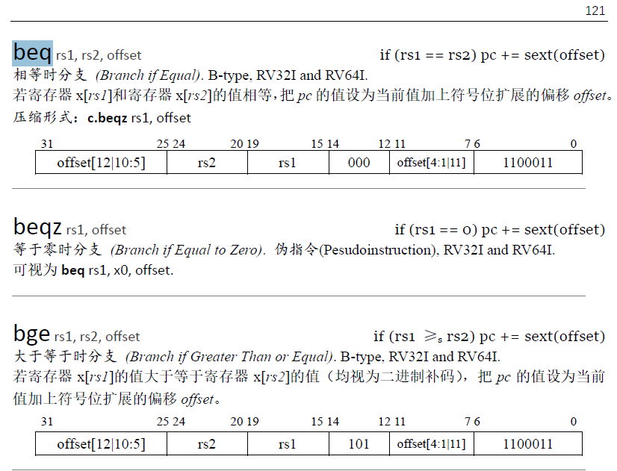
SB类型指令格式
来源：【RISC-V-Reader-Chinese-v2p1.pdf】 P121

Slide 40
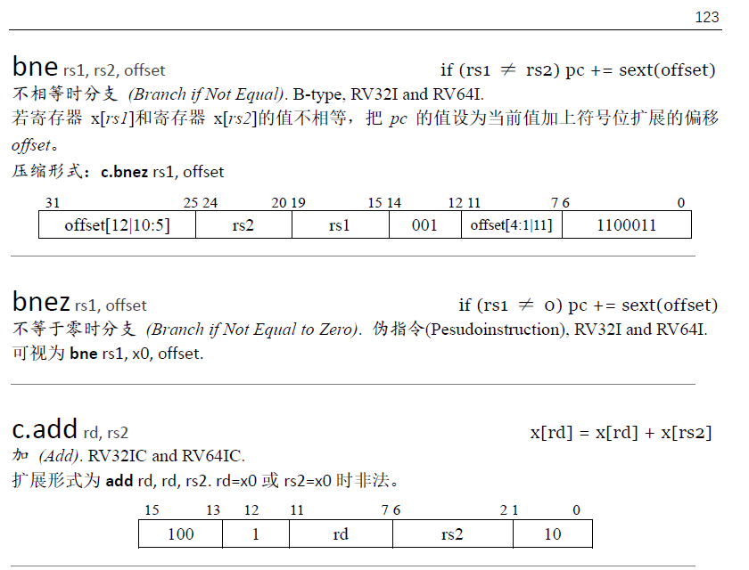
SB类型指令格式
来源：【RISC-V-Reader-Chinese-v2p1.pdf】 P123

Slide 41
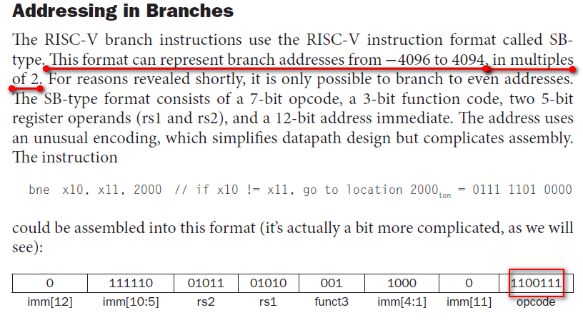
书P115 有BNE指令的机器码说明，见下图，红框内机器码1100111是错的，改成1100011，依据：【RISC-V手册】（RISC-V-Reader-Chinese-v2p1.pdf）P123/总162页。 SB类型的指令（BEQ，BNE，BLT，BLTU，BGE，BGEU），指令机器码仅提供了imm[12:1]共12位，最右边应补1位0（等价于左移1位，即下面划红线文字所说的乘2），变成13位，是13位补码2进制数，范围-4096到+4094。

Slide 42
Compiling Loop Statements
C code:
while (save[i] == k) i += 1;
i in x22, k in x24, address of save in x25
Compiled RISC-V code:
Loop: slli x10, x22, 3 add x10, x10, x25 ld x9, 0(x10) bne x9, x24, Exit
addi x22, x22, 1 beq x0, x0, Loop Exit: …

Slide 43
Basic Blocks
A basic block is a sequence of instructions with
No embedded branches (except at end)
No branch targets (except at beginning)
A compiler identifies basic blocks for optimization
An advanced processor can accelerate execution of basic blocks

Slide 44
More Conditional Operations
blt rs1, rs2, L1 ------SB类型指令
if (rs1 < rs2) branch to instruction labeled L1
bge rs1, rs2, L1 ------SB类型指令
if (rs1 >= rs2) branch to instruction labeled L1
Example
if (a > b) a += 1;
a in x22, b in x23
bge x23, x22, Exit // branch if b >= a
addi x22, x22, 1
Exit:

Slide 45
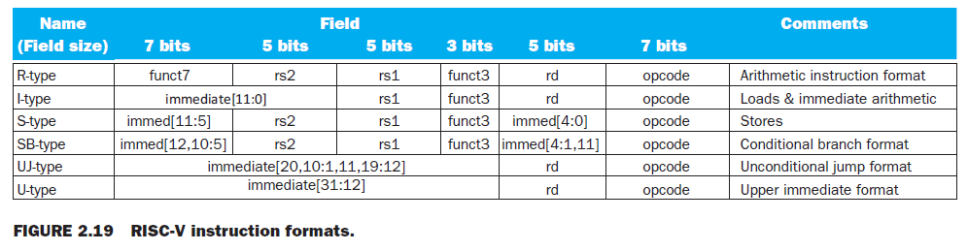

Slide 46
Signed vs. Unsigned
Signed comparison: blt, bge
Unsigned comparison: bltu, bgeu
Example
x22 = 1111 1111 1111 1111 1111 1111 1111 1111
x23 = 0000 0000 0000 0000 0000 0000 0000 0001
x22 < x23 // signed
–1 < +1
x22 > x23 // unsigned
+4,294,967,295 > +1

Slide 47
Procedure Calling
Steps required
Place parameters in registers x10 to x17
Transfer control to procedure
Acquire storage for procedure
Perform procedure’s operations
Place result in register for caller
Return to place of call (address in x1)
§2.8 Supporting Procedures in Computer Hardware

Slide 48
Procedure Call Instructions
Procedure call: jump and link
jal x1, ProcedureLabel ----UJ类型指令
Address of following instruction put in x1
Jumps to target address
Procedure return: jump and link register
jalr x0, 0(x1) ----------I类型指令
Like jal, but jumps to 0 + address in x1
Use x0 as rd (x0 cannot be changed)
Can also be used for computed jumps
e.g., for case/switch statements

Slide 49
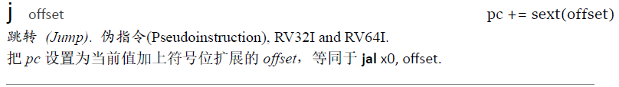
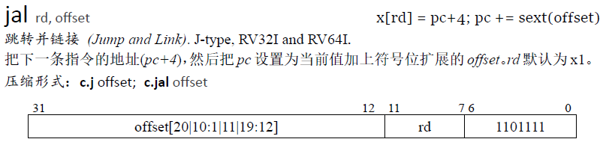
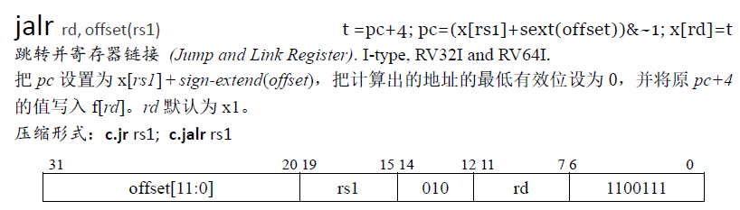
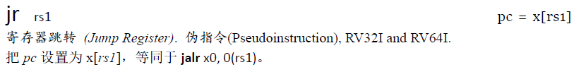
UJ类型指令（仅jal）格式，jalr是I类型指令
来源：【RISC-V手册】（RISC-V-Reader-Chinese-v2p1.pdf）P148-149/总162页

Slide 50
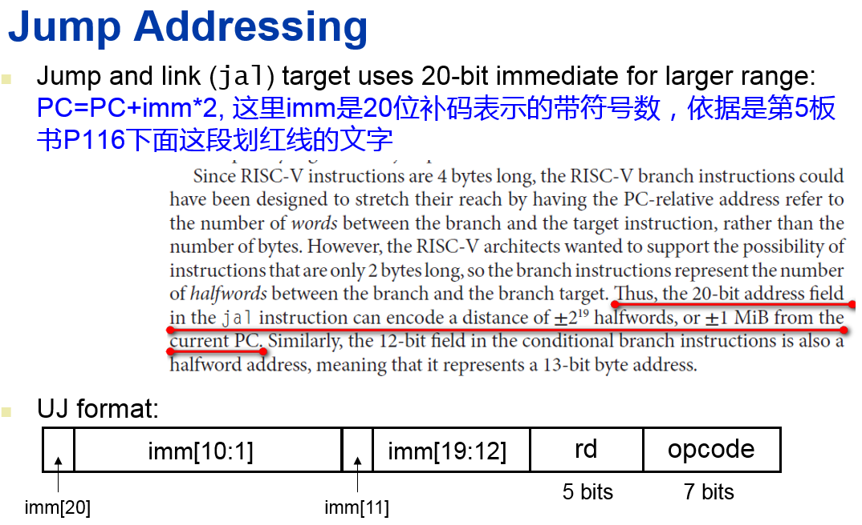

Slide 51
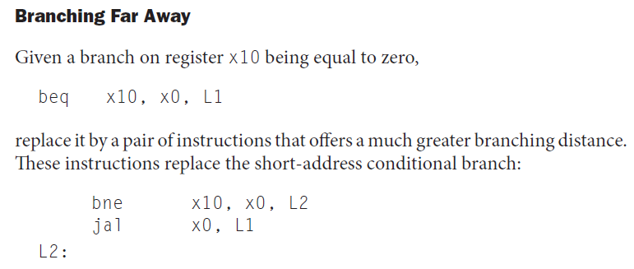
beq x10, x0, L1 // target location：-4096 to 4094 away from this beq // instruction, 13 bit offset including appended 1-bit 0
jal x0, L1 // target location：-2^20 to 2^20-2 away from this jal // instruction, 21 bit offset including appended 1-bit 0
jalr x0, 0(x1) // target location：64-bit target PC address in X1,any // palce

Slide 52
x0: the constant value 0
x1: return address
x2: stack pointer
x3: global pointer
x4: thread pointer
x5 – x7, x28 – x31: temporaries
x8: frame pointer
x9, x18 – x27: saved registers
x10 – x11: function arguments/results
x12 – x17: function arguments
右边资料来自于《RISC-V手册》【RISC-V-Reader-Chinese-v2p1.pdf】 P28

Slide 53

Leaf Procedure Example
C code:
long long int leaf_example ( long long int g, long long int h, long long int i, long long int j) { long long int f; f = (g + h) - (i + j); return f; }
Arguments g, …, j in x10, …, x13, f in x20
temporaries x5, x6
Need to save x5, x6, x20 on stack
书P73

Slide 54
Leaf Procedure Example
RISC-V code:
leaf_example:
addi sp,sp,-24
sd x5,16(sp) // x5 is t0
sd x6,8(sp) // x6 is t1
sd x20,0(sp) // x20 is s4
add x5,x10,x11
add x6,x12,x13
sub x20,x5,x6
addi x10,x20,0 //move a0,s4
ld x20,0(sp)
ld x6,8(sp)
ld x5,16(sp)
addi sp,sp,24
jalr x0,0(x1) // jr ra
Save x5, x6, x20 on stack
x5 = g + h
x6 = i + j
f = x5 – x6
//copy f to return register a0
Resore x5, x6, x20 from stack
//Return to caller

Slide 55
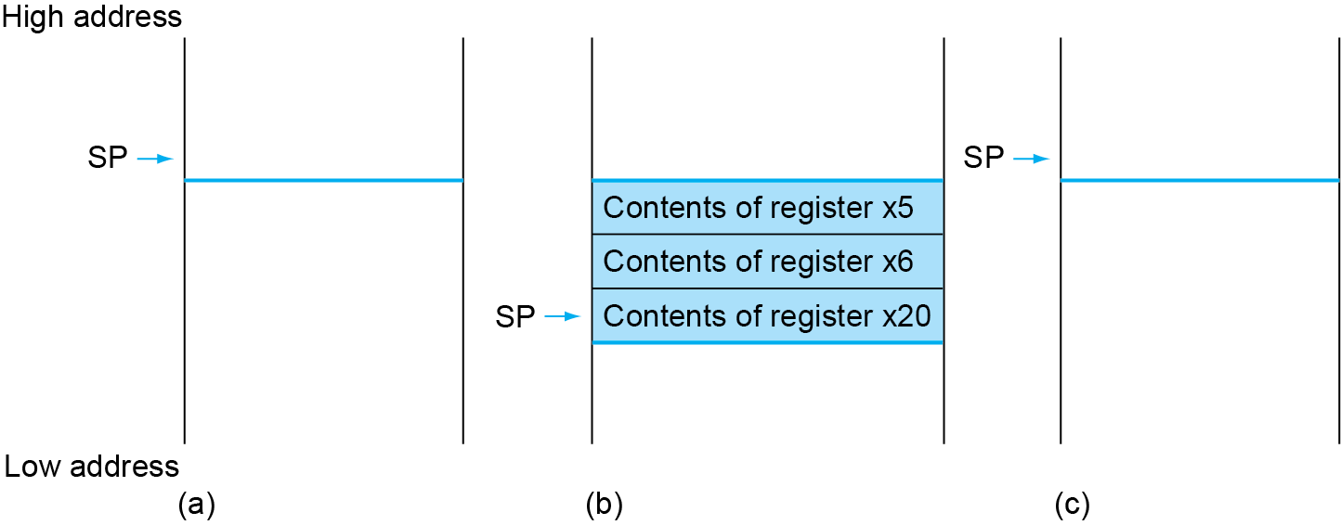
Local Data on the Stack

Slide 56
Register Usage
x5 – x7, x28 – x31: temporary registers
Not preserved by the callee
x8 – x9, x18 – x27: saved registers
If used, the callee saves and restores them

Slide 57
Non-Leaf Procedures
Procedures that call other procedures
For nested call, caller needs to save each following register on the stack before modifying it:
Its return address
Any arguments and temporaries needed after the call
Restore from the stack after the call

Slide 58
Saves on Stack
Procedure A call procedure B
Caller A saved
a0-a7 -- if you will set new arguments for the callee and a0-a7 will still be used after return, old arguments must be saved before the jal instruction over-writes them. Conditionally save.
ra -- must be saved before the jal proc-B instruction over-writes this value. But it need not be saved in leaf procedure. Unconditionally save.
t0-t9 -- if you plan to use your temps after the return, save them. note that callees are free to use temps as they please. Conditionally save.
You need not save s0-s11 as the callee will take care of them
Callee B saved
s0-s11 -- before the callee B uses such a register, it must save the old contents since the caller will usually need it on return. Unconditionally save.

Slide 59
Non-Leaf Procedure Example
C code:
long long int fact (long long int n) { if (n < 1) return 1; else return n * fact(n - 1); }
Argument n in x10
Result in x10

Slide 60
RISC-V code:
fact:
addi sp,sp,-16
sd x1,8(sp)
sd x10,0(sp)
addi x5,x10,-1
bge x5,x0,L1
addi x10,x0,1
addi sp,sp,16
jalr x0,0(x1)
L1: addi x10,x10,-1
jal x1,fact
addi x6,x10,0
ld x10,0(sp)
ld x1,8(sp)
addi sp,sp,16
mul x10,x10,x6
jalr x0,0(x1)
Save return address and n on stack
x5 = n - 1
if n >= 1, go to L1
Else, set return value to 1
Pop stack, don’t bother restoring values
Return
n = n - 1
call fact(n-1)
move result of fact(n - 1) to x6
Restore caller’s n
Restore caller’s return address
Pop stack
return n * fact(n-1)
return

Slide 61
long long int fact (long long int n) { if (n < 1) return 1; else return n * fact(n - 1); }
RISC-V code:
fact:
addi sp,sp,-16
sd ra,8(sp)
sd a0,0(sp)
addi x5,a0,-1
bge x5,x0,L1
addi a0,x0,1
addi sp,sp,16
jalr x0,0(ra) //jr ra
L1: addi a0,a0,-1
jal ra,fact
addi x6,a0,0 //mov x6,a0
ld a0,0(sp)
ld ra,8(sp)
addi sp,sp,16
mul a0,a0,x6
jalr x0,0(ra) //jr ra
Save return address and n on stack
x5 = n - 1
if n >= 1, go to L1
Else, set return value to 1
Pop stack, don’t bother restoring values
Return
n = n - 1
call fact(n-1)
move result of fact(n - 1) to x6
Restore caller’s n
Restore caller’s return address
Pop stack
return n * fact(n-1)
return

Slide 62
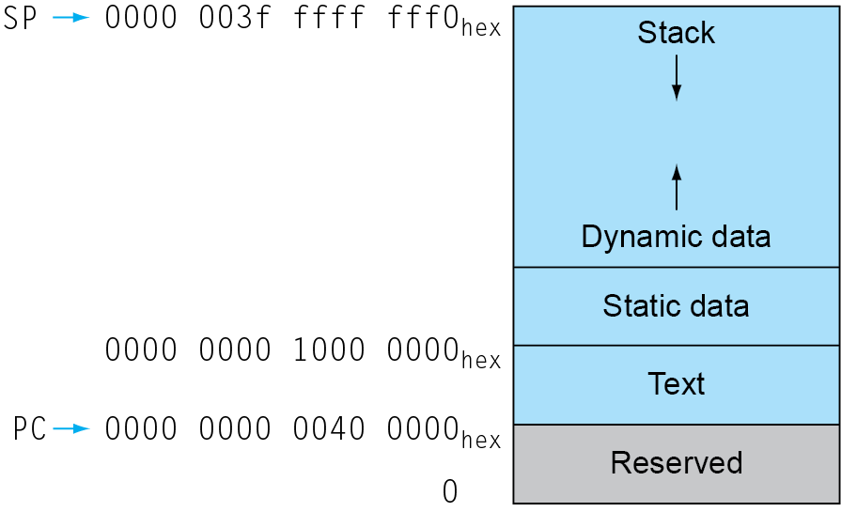
Memory Layout
Text: program code
Static data: e.g. m, n at right example
global variables, static variables in C, constant arrays and strings
x3 (global pointer) initialized to address allowing ±offsets into this segment
Dynamic data: heap
E.g., malloc in C, new in Java
Stack: automatic storage
Such as right 【 int i, j; 】
Address of first byte in static data is 0000 0000 1000 0000_{hex}
int m; /* global variable */
void strcpy (char x[], char y[]) { int i,j;
static int n; i = 0; while ((x[i]=y[i])!='\0') i += 1; }

Slide 63
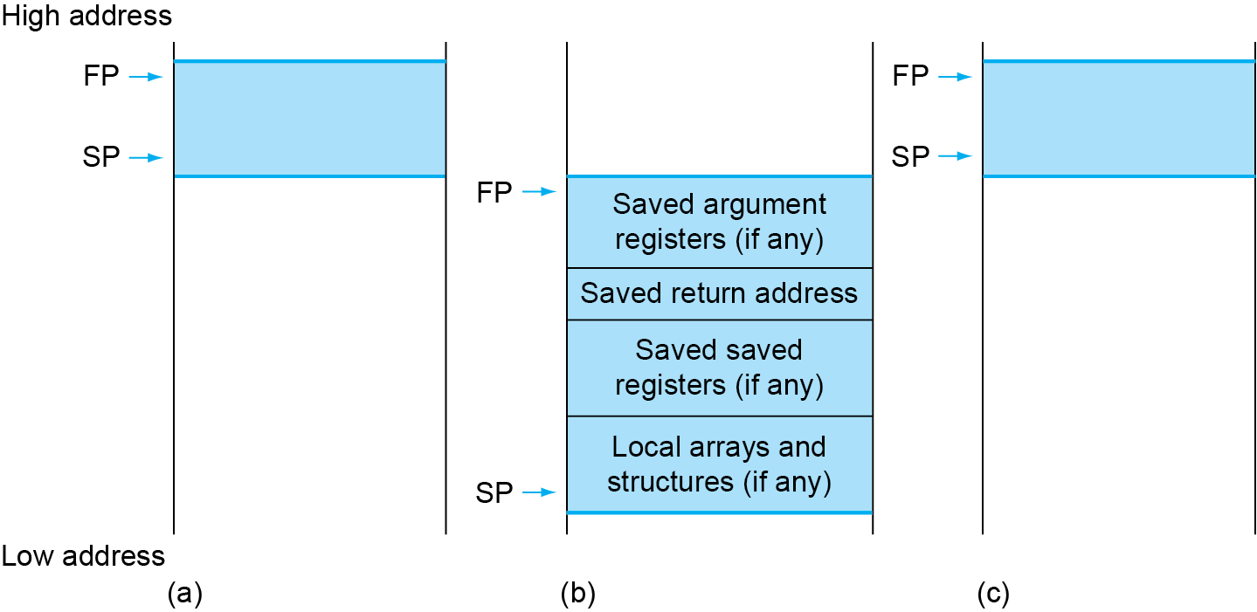
Local Data on the Stack
Local data allocated by callee
e.g., C automatic variables
Procedure frame (activation record)
Used by some compilers to manage stack storage

Slide 64
Character Data
Byte-encoded character sets
ASCII: 128 characters
95 graphic, 33 control
Latin-1: 256 characters
ASCII, +96 more graphic characters
Unicode: 32-bit character set, 0-0x10FFFF
Used in Java, C++ wide characters, …
Most of the world’s alphabets, plus symbols
UTF-8, UTF-16: variable-length encodings
§2.9 Communicating with People

Slide 65
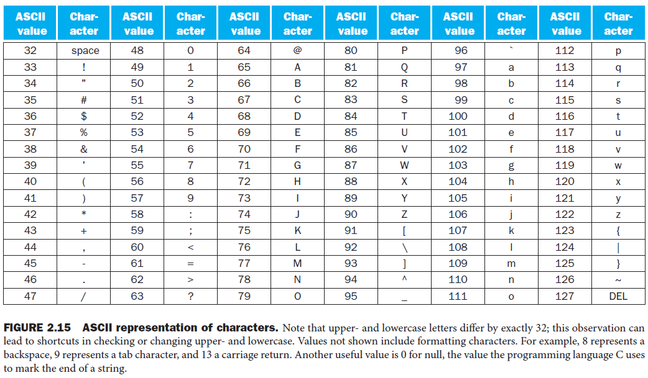

Slide 66
Byte/Halfword/Word Operations
RISC-V byte/halfword/word load/store
Load byte/halfword/word: Sign extend to 64 bits in rd
lb rd, offset(rs1)
lh rd, offset(rs1)
lw rd, offset(rs1)
Load byte/halfword/word unsigned: Zero extend to 64 bits in rd
lbu rd, offset(rs1)
lhu rd, offset(rs1)
lwu rd, offset(rs1)
Store byte/halfword/word: Store rightmost 8/16/32 bits
sb rs2, offset(rs1)
sh rs2, offset(rs1)
sw rs2, offset(rs1)

Slide 67
String Copy Example
C code:
Null-terminated string
void strcpy (char x[], char y[]) { size_t i; i = 0; while ((x[i]=y[i])!='\0') i += 1; }

Slide 68
String Copy Example
void strcpy (char x[], char y[]) { size_t i; i = 0; while ((x[i]=y[i])!='\0') i += 1; }
RISC-V code:
strcpy: addi sp,sp,-8 // adjust stack for 1 doubleword sd x19,0(sp) // push x19 add x19,x0,x0 // i=0 L1: add x5,x19,x11 // x5 = addr of y[i] lbu x6,0(x5) // x6 = y[i] add x7,x19,x10 // x7 = addr of x[i] sb x6,0(x7) // x[i] = y[i] beq x6,x0,L2 // if y[i] == 0 then exit addi x19,x19, 1 // i = i + 1 jal x0,L1 // next iteration of loop L2: ld x19,0(sp) // restore saved x19 addi sp,sp,8 // pop 1 doubleword from stack jalr x0,0(x1) // and return

Slide 69
String Copy Example
void strcpy (char x[], char y[]) { size_t i; i = 0; while ((x[i]=y[i])!='\0') i += 1; }
RISC-V code:
strcpy: addi sp,sp,-8 // adjust stack for 1 doubleword sd x19,0(sp) // push x19 (x19=s3,used as i) add x19,x0,x0 // i=0 L1: add x5,x19,a1 // x5 = addr of y[i] lbu x6,0(x5) // x6 = y[i] add x7,x19,a0 // x7 = addr of x[i] sb x6,0(x7) // x[i] = y[i] beq x6,x0,L2 // if y[i] == 0 then exit addi x19,x19, 1 // i = i + 1 jal x0,L1 // j L1 // next iteration of loop L2: ld x19,0(sp) // restore saved x19 addi sp,sp,8 // pop 1 doubleword from stack jalr x0,0(x1) // jr ra // and return

Slide 70
32-bit Constants
Most constants are small
12-bit immediate is sufficient
For the occasional 32-bit constant
lui rd, constant //U-Type instruction
Copies 20-bit constant(补码带符号数) to bits [31:12] of rd
Extends bit 31 to bits [63:32]
Clears bits [11:0] of rd to 0
§2.10 RISC-V Addressing for Wide Immediates and Addresses
lui x19, 976 // 0x003D0
0000 0000 0000 0000
0000 0000 0000 0000
0000 0000 0011 1101 0000
0000 0000 0000
addi x19,x19,1280 // 0x500
0000 0000 0000 0000
0000 0000 0000 0000
0000 0000 0011 1101 0000
0101 0000 0000

Slide 71
Branch Addressing
Branch instructions specify
Opcode, two registers, target address
Most branch targets are near branch
Forward or backward
SB format:
imm [10:5]
rs2
rs1
funct3
imm [4:1]
opcode
imm[12]
imm[11]
PC-relative addressing
Target address = PC + immediate × 2，这里immediate是12位补码表示的带符号数

Slide 72
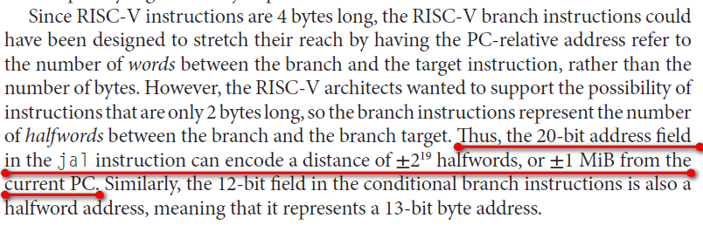
Jump Addressing
Jump and link (jal) target uses 20-bit immediate for larger range: PC=PC+imm*2, 这里imm是20位补码表示的带符号数，依据是第5板书P116下面这段划红线的文字
UJ format:
imm[10:1]
imm[19:12]
rd
opcode
5 bits
7 bits
imm[20]
imm[11]
For long jumps, eg, to 32-bit absolute address
lui: load address[31:12] to temp register
jalr: add address[11:0] and jump to target

Slide 73
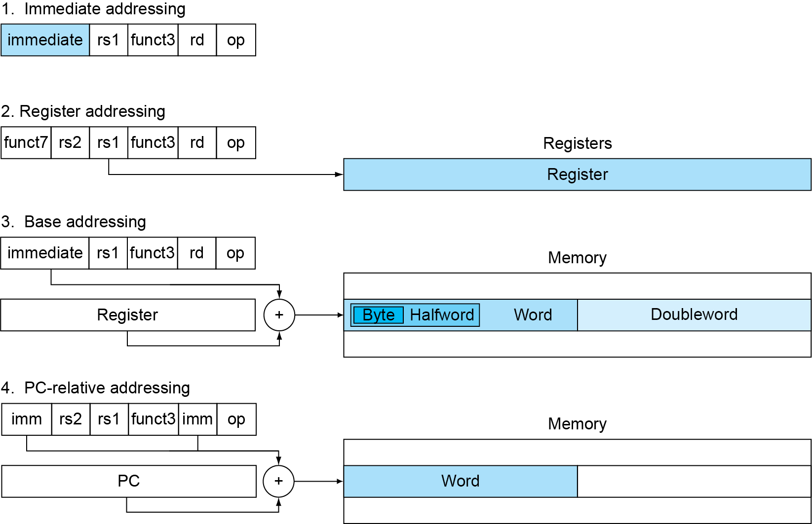
RISC-V Addressing Summary
e.g. addi x23,x28,-240
slli x10, x22, 63
e.g. add x23,x28, x29
ld x26, -48(x25)
e.g. ld x26, -48(x25)
sd x26, -48(x25)
e.g. beq x20,x23, exit1
jal x1, fact

Slide 74
S-type: 4 instructions，sd, sw, wh, sb
example：sd x28, -36(x24)
SB-type : 6 instructions， BEQ，BNE，BLT，BLTU，BGE，BGEU，
example： bne x22, x23, exit
UJ-type: Unconditional Jump-and-link, 1 instructions，jal
example： jal x1,fact // = [ jal ra,fact ], call a procedure or function, similar to x86 [call fact]
example: jal x0, labal1 // Unconditionally Jump to label1, similar to x86 [jump label1], similar to MIPS [ j label1],
U-type: 2 instructions，lui, auipc. example： lui x19, 0x3d0
本页课件每种类型的指令数量根据书末倒数第2页（P1048/总1049）的内容得出

Slide 75
3 I-type instructions in RV64I (slli, srli, srai) have 6-bit funct7 and 6-bit rs2, are different from most I-type instructions listed above.
3 I-type instructions in RV32I (slli, srli, srai) have 7-bit funct7 and 5-bit rs2, are different from most I-type instructions listed above.

Slide 76
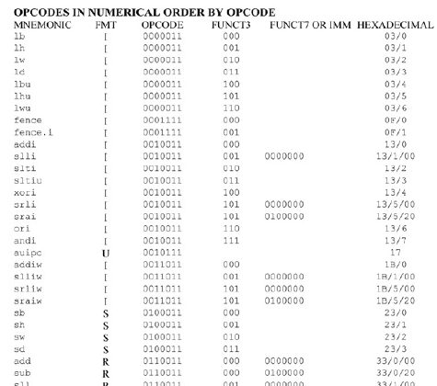
书末倒数第2页（PDF文件的P1048/总1049）的内容：

Slide 77
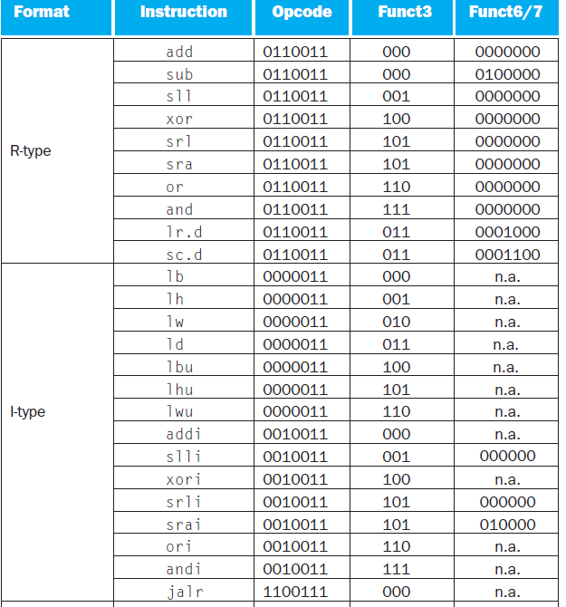
FIGURE 2.18 RISC-V instruction encoding.

Slide 78
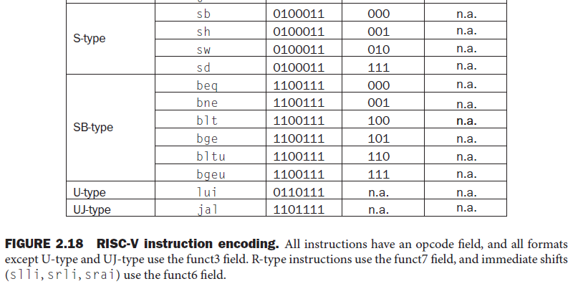

Slide 79
Synchronization
Two processors sharing an area of memory
P1 writes, then P2 reads
Data race if P1 and P2 don’t synchronize
Result depends of order of accesses
Hardware support required
Atomic read/write memory operation
No other access to the location allowed between the read and write
Could be a single instruction
E.g., atomic swap of register ↔ memory
Or an atomic pair of instructions
§2.11 Parallelism and Instructions: Synchronization

Slide 80
Synchronization in RISC-V
Load reserved: lr.d rd,(rs1)
Load from address in rs1 to rd
Place reservation on memory address
Store conditional: sc.d rd,(rs1),rs2
Store from rs2 to address in rs1
Succeeds if location not changed since the lr.d
Returns 0 in rd
Fails if location is changed
Returns non-zero value in rd

Slide 81
Synchronization in RISC-V
Example 1: atomic swap (to test/set lock variable)
again: lr.d x10,(x20)
sc.d x11,(x20),x23 // X11 = status
bne x11,x0,again // branch if store failed
addi x23,x10,0 // X23 = loaded value
Example 2: lock
addi x12,x0,1 // copy locked value
again: lr.d x10,(x20) // read lock
bne x10,x0,again // check if it is 0 yet
sc.d x11,(x20),x12 // attempt to store
bne x11,x0,again // branch if fails
Unlock:
sd x0,0(x20) // free lock

Slide 82
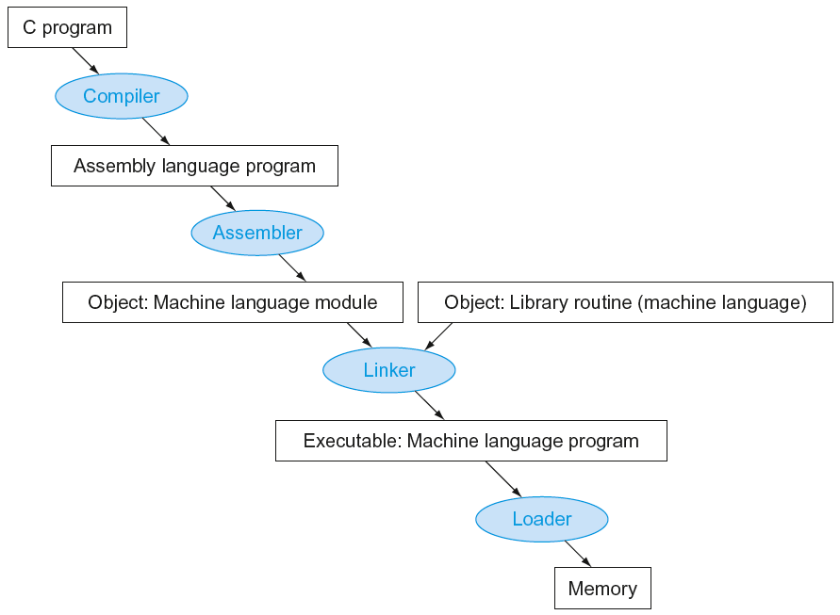
Translation and Startup
Many compilers produce object modules directly
§2.12 Translating and Starting a Program
Static linking

Slide 83
RISC-V programming: 下面的汇编语言源程序格式参考MIPS汇编程序书写，不一定符合RISC-V汇编语言源程序格式
File A.asm File B.asm
.data
X .dword 0x11112222AAAABBBB
……
.text
A: ld x10, X // procedure A
jal x1, B // call B
add x8, x9,x10
……
.data
Y .dword 0x33334444CCCCDDDD
……
.text
B: sd x11, Y // procedure B
jal A // call A
sub x6,x7,x8
……

Slide 84
Producing an Object Module
Assembler (or compiler) translates program into machine instructions
Header: describes the size of text and data, position of the other pieces of the object file.
Text segment: translated instructions
Static data segment: data allocated for the life of the program
Relocation info: identifies instructions and data words that depend on absolute addresses when the program is loaded into memory.
Symbol table: contains labels name of instruction and data, and their addresses.
Debug info: for associating with source code

Slide 85
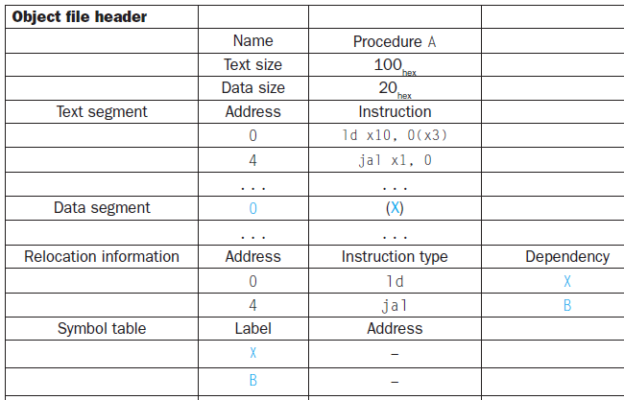
File A.asm
.data
X .dword 0x11112222AAAABBBB
……
.text
A: ld x10, X // procedure A
jal x1, B // call B
add x8, x9,x10
……
在windows系统中，A.OBJ 和 B.OBJ可连接成为my.exe文件

Slide 86
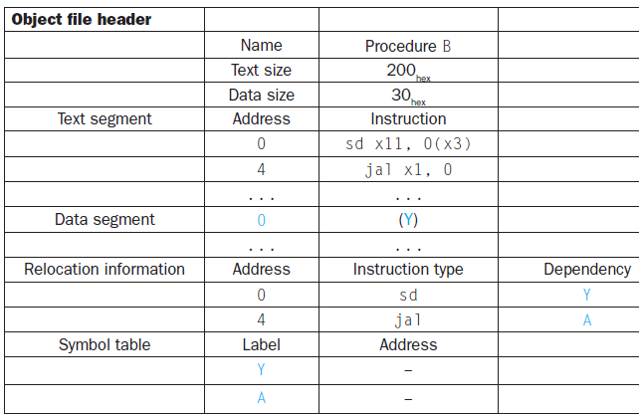
File B.asm
.data
Y .dword 0x33334444CCCCDDDD
……
.text
B: sd x11, Y // procedure B
jal A // call A
sub x6,x7,x8
……

Slide 87
Linking Object Modules
Produces an executable image
1. Merges segments
2. Determine the addresses of data labels and instruction labels
3. Patch both the internal and external references

Slide 88
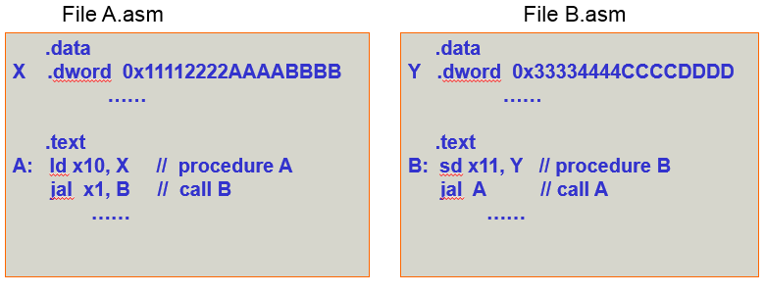
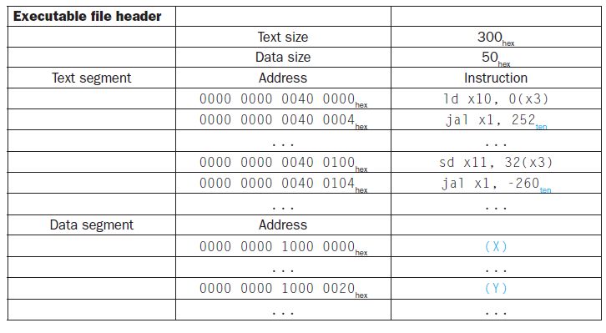

Slide 90
Loading a Program
Load from image file on disk into memory
1. Read header to determine segment sizes
2. Create virtual address space large enough for the text and data
3. Copy text and initialized data into memory
4. Set up arguments on stack
5. Initialize registers (including sp, fp, gp)
6. Jump to startup routine
Copies arguments to x10, … and calls main
When main returns, syscall “exit” is executed.

Slide 91
Dynamic Linking
Only link/load library procedure when it is called
Requires procedure code to be relocatable
Avoids image bloat caused by static linking of all referenced libraries
Automatically picks up new library versions

Slide 92
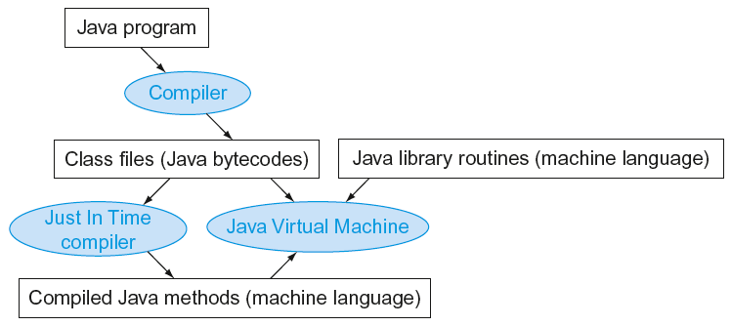
Starting Java Applications
Simple portable instruction set for the JVM
Compiles bytecodes of “hot” methods into native code for host machine
Interprets bytecodes
Java program VS Compiled C program
the factor of 10 slowdown(慢10倍)

Slide 93
C Sort Example
Illustrates use of assembly instructions for a C bubble sort function
Swap procedure (leaf)
void swap(long long int v[], long long int k) { long long int temp; temp = v[k]; v[k] = v[k+1]; v[k+1] = temp; }
v in x10, k in x11, temp in x5
§2.13 A C Sort Example to Put It All Together

Slide 94
The Procedure Swap
swap:
slli x6,x11,3 // reg x6 = k * 8
add x6,x10,x6 // reg x6 = v + (k * 8)
ld x5,0(x6) // reg x5 (temp) = v[k]
ld x7,8(x6) // reg x7 = v[k + 1]
sd x7,0(x6) // v[k] = reg x7
sd x5,8(x6) // v[k+1] = reg x5 (temp)
jalr x0,0(x1) // return to calling routine
void swap(long long int v[], long long int k) { long long int temp; temp = v[k]; v[k] = v[k+1]; v[k+1] = temp; }
v in x10, k in x11, temp in x5

Slide 95
The Procedure Swap
swap:
slli t1, a1,3 // reg t1 = k * 8
add t1,a0,t1 // reg t1 = v+(k*8)= addr of v[k]
ld t0,0(t1) // reg t0 (temp) = v[k]
ld t2,8(t1) // reg t2 = v[k + 1]
sd t2,0(t1) // v[k] = reg t2
sd t0,8(t1) // v[k+1] = reg t0 (temp)
jalr x0,0(ra) // return to calling routine
void swap(long long int v[], long long int k) { long long int temp; temp = v[k]; v[k] = v[k+1]; v[k+1] = temp; }
v in a0, k in a1, temp in t0

Slide 96
The Sort Procedure in C
Non-leaf (calls swap)
void sort (long long int v[], size_t n)
{
size_t i, j;
for (i = 0; i < n; i += 1) {
for (j = i – 1;
j >= 0 && v[j] > v[j + 1];
j -= 1) {
swap(v,j);
}
}
}
v in x10/a0, n in x11/a1, i in x19/s3, j in x20/s4

Slide 97
Procedure sort
C code
sort ( int v[ ] , int n )
{
int i , j ;
for ( i = 0 ; i < n ; i + = 1 ) {
for ( j = i - 1 ; j >= 0 && v[j] > v[j+1] ; j- = 1 )
swap ( v , j ) ;
}
}
i=0: inner loop do nothing
i=1: j=0, V[0]、V[1]小的上移
i=2: j=1开始, V[1]、V[2]小的上移， V[0]、V[1]小的上移
i=3: j=2开始, V[2]、V[3]小的上移， V[1]、V[2]小的上移， V[0]、V[1]小的上移
……
i=9: j=8开始, V[8]、V[9]小的上移， V[7]、V[8]小的上移…… V[0]、V[1]小的上移
If V[0]> V[1]
V[0]
V[1]
V[2]
……
V[n-1]
V[0]
V[1]
V[2]
V[3]
V[4]
V[5]
V[6]
V[7]
V[8]
V[9]

Slide 98
Procedure sort
C code
void sort (long long v[ ] , size_t n )
{
size_t i , j ;
for ( i = 0 ; i < n ; i + = 1 ) {
for ( j = i - 1 ; j >= 0 && v[j] > v[j+1] ; j -= 1 )
swap ( v , j ) ;
}
}
Register allocation for sort
v -- x10/a0 --> x21/s5 n -- x11/a1 --> x22/s6
i ---- x19/s3 j ---- x20/s4
Passing parameters in sort
Preserving registers in sort
x1 , x19, x20, x21, x22
If V[0]> V[1]
V[0]
V[1]
V[2]
……
V[n-1]

Slide 99
Code for the procedure sort
Saving registers
sort: addi sp, sp, -40 // make room on stack for 5 registers
sd x1, 32(sp) // save return address on stack
sd x22, 24(sp) // save x22 on stack
sd x21, 16(sp) // save x21 on stack
sd x20, 8(sp) // save x20 on stack
sd x19, 0(sp) // save x19 on stack
Procedure body{Outer loop {Inner loop} }
Restoring registers
exit1: ld x19, 0(sp) // restore x19 from stack
ld x20, 8(sp) // restore x20 from stack
ld x21, 16(sp) // restore x21 from stack
ld x22, 24(sp) // restore x22 from stack
ld x1, 32(sp) // restore return address from stack
addi sp, sp, 40 // restore stack pointer
Procedure return
jalr x0, 0(x1) // return to calling routine

Slide 100
v -- x10/a0 --> x21/s5 n -- x11/a1 --> x22/s6
i ---- x19/s3 j ---- x20/s4
Code for Procedure body
Move parameters
mv x21, x10 // copy parameter x10/a0 into x21
mv x22, x11 // copy parameter x11/a1 into x22
Outer loop—first for loop
for ( i = 0 ; i < n ; i + = 1 ) {
li x19, 0 // i = 0
for1tst: bge x19, x22, exit1 // go to exit1 if i >= n
………………
（body of first for loop is second for loop）
………………
exit2: addi x19, x19, 1 # i = i + 1
j for1tst # jump to test of outer loop
exit1:

Slide 101
v -- x10/a0 --> x21/s5 n -- x11/a1 --> x22/s6
i ---- x19/s3 j ---- x20/s4
Inner loop-- second for loop is body of first for loop
for ( j = i - 1 ; j >= 0 && v[j] > v[j+1] ; j- = 1 ){
addi x20, x19, -1 // j = i - 1
for2tst: blt x20, x0, exit2 // go to exit2 if j < 0
slli x5, x20, 3 // x5 = j * 8
add x5, x21, x5 // x5 = the address of v[j]
ld x6, 0(x5) // x6 = v[j]
ld x7, 8(x5) // x7 = v[j + 1]
ble x6, x7, exit2 // go to exit2 if v[j] <= v[j+1] // ………………
（body of second for loop ）
………………
addi x20, x20, -1 // j = j - 1
j for2tst // jump to test of inner loop
exit2:

Slide 102
v -- x10/a0 --> x21/s5 n -- x11/a1 --> x22/s6
i ---- x19/s3 j ---- x20/s4
body of second for loop: swap ( v , j ) ;
Pass parameters and call
mv x10，x21 // first swap parameter v
mv x11，x20 // second swap parameter j
Call function swap
jal x1, swap
Notice: 1.Why are x10 and x11 saved? x10 is the base of the array v. x10 will be used repeatedly and might be(actually not here) changed by the procedure swap. x11 is the size of the array v. x11 will be used repeatedly and changed before the procedure swap is called. 2.Why are they not pushed to stack?
Register variable is faster

Slide 103
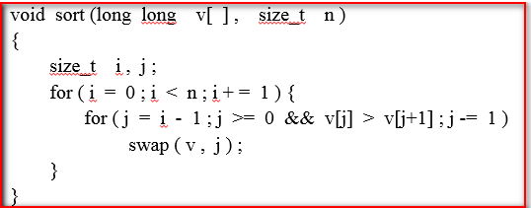
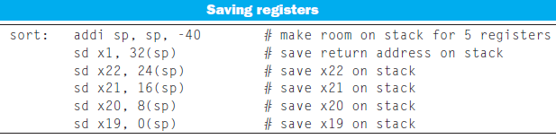
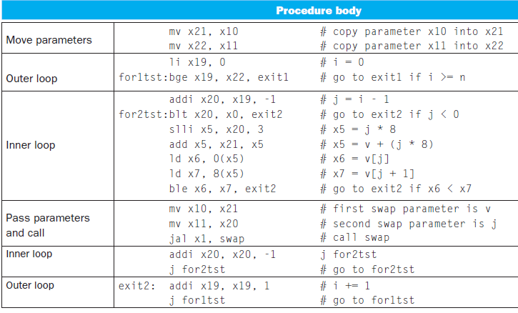
v -- x10/a0 --> x21/s5 n -- x11/a1 --> x22/s6
i ---- x19/s3 j ---- x20/s4

Slide 104
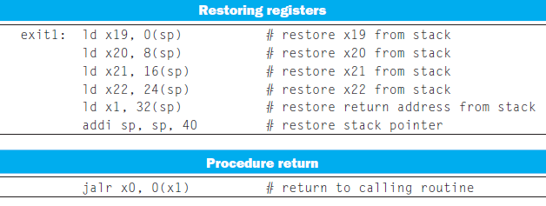

Slide 105
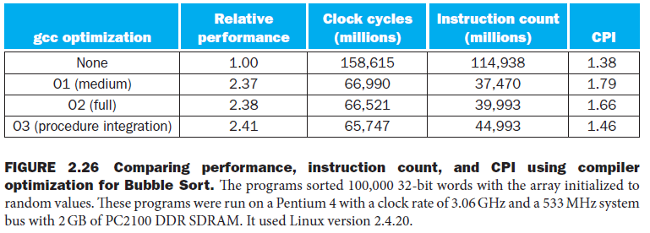
Effect of Compiler Optimization
Performance = 1/Execution Time
Compiled with gcc for Pentium 4 under Linux
O1, O2, O3 are gcc compile options
Procedure inlining: Instead of passing arguments and invoking the code with a jal instruction, the compiler would copy the code from the swap procedure into caller.
A method of compile optimization.

Slide 106
Effect of Compiler Optimization
Compiled with gcc for Pentium 4 under Linux

Slide 107
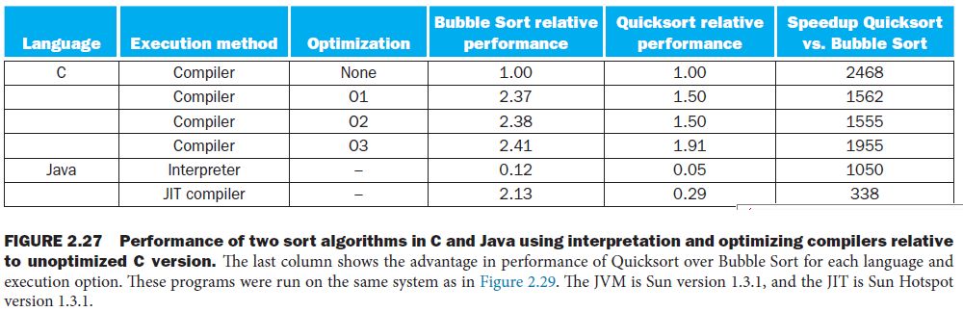
Instruction count and CPI are not good performance indicators in isolation
Time (similar to Instruction count * CPI ) is the only accurate measure of program performance.
Compiler optimizations are sensitive to the algorithm
Java/JIT compiled code is significantly faster than JVM interpreted
Comparable to optimized C in some cases

Slide 108
Effect of Language and Algorithm

Slide 109
Arrays vs. Pointers
Array indexing involves
Multiplying index by element size
Adding to array base address
Pointers correspond directly to memory addresses
Can avoid indexing complexity
§2.14 Arrays versus Pointers

Slide 110
Example: Clearing an Array
clear1(int array[], int size) { int i; for (i = 0; i < size; i += 1) array[i] = 0; } | clear2(int *array, int size) { int *p; for (p = &array[0]; p < &array[size]; p = p + 1) *p = 0; }
li x5,0 // i = 0 loop1: slli x6,x5,3 // x6 = i * 8 add x7,x10,x6 // x7 = address // of array[i] sd x0,0(x7) // array[i] = 0 addi x5,x5,1 // i = i + 1 blt x5,x11,loop1 // if (i<size) // go to loop1 | mv x5,x10 // p = address // of array[0] slli x6,x11,3 // x6 = size * 8 add x7,x10,x6 // x7 = address // of array[size] loop2: sd x0,0(x5) // Memory[p] = 0 addi x5,x5,8 // p = p + 8 bltu x5,x7,loop2 // if (p<&array[size]) // go to loop2

Slide 111
Comparison of Array vs. Ptr
Multiply “strength reduced”(复杂运算简化) to shift
Array version requires shift to be inside loop
Part of index calculation for incremented i
c.f. incrementing pointer
Compiler can achieve same effect as manual use of pointers
Induction variable elimination(归纳变量的去除)
Better to make program clearer and safer

Slide 112
MIPS Instructions
MIPS: commercial predecessor to RISC-V
Similar basic set of instructions
32-bit instructions
32 general purpose registers, register 0 is always 0
32 floating-point registers
Memory accessed only by load/store instructions
Consistent use of addressing modes for all data sizes
Different conditional branches
For <, <=, >, >=
RISC-V: blt, bge, bltu, bgeu
MIPS: slt, sltu (set less than, result is 0 or 1)
Then use beq, bne to complete the branch
§2.16 Real Stuff: MIPS Instructions

Slide 113
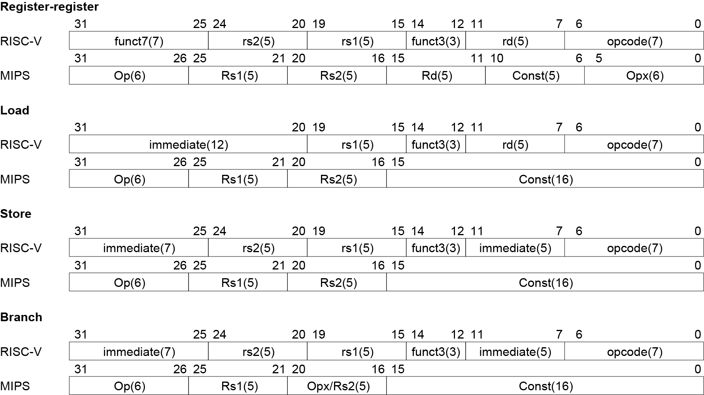
Instruction Encoding

Slide 114
The Intel x86 ISA
Evolution with backward compatibility
8080 (1974): 8-bit microprocessor
Accumulator, plus 3 index-register pairs
8086 (1978): 16-bit extension to 8080
Complex instruction set (CISC)
8087 (1980): floating-point coprocessor
Adds FP instructions and register stack
80286 (1982): 24-bit addresses, MMU
Segmented memory mapping and protection
80386 (1985): 32-bit extension (now IA-32)
Additional addressing modes and operations
Paged memory mapping as well as segments
§2.17 Real Stuff: x86 Instructions

Slide 115
The Intel x86 ISA
Further evolution…
i486 (1989): pipelined, on-chip caches and FPU
Compatible competitors: AMD, Cyrix, …
Pentium (1993): superscalar, 64-bit datapath
Later versions added MMX (Multi-Media eXtension) instructions
The infamous FDIV bug
Pentium Pro (1995), Pentium II (1997)
New microarchitecture (see Colwell, The Pentium Chronicles)
Pentium III (1999)
Added SSE (Streaming SIMD Extensions) and associated registers
Pentium 4 (2001)
New microarchitecture
Added SSE2 instructions

Slide 116
The Intel x86 ISA
And further…
AMD64 (2003): extended architecture to 64 bits
EM64T – Extended Memory 64 Technology (2004)
AMD64 adopted by Intel (with refinements)
Added SSE3 instructions
Intel Core (2006)
Added SSE4 instructions, virtual machine support
AMD64 (announced 2007): SSE5 instructions
Intel declined to follow, instead…
Advanced Vector Extension (announced 2008)
Longer SSE registers, more instructions
If Intel didn’t extend with compatibility, its competitors would!
Technical elegance ≠ market success

Slide 117
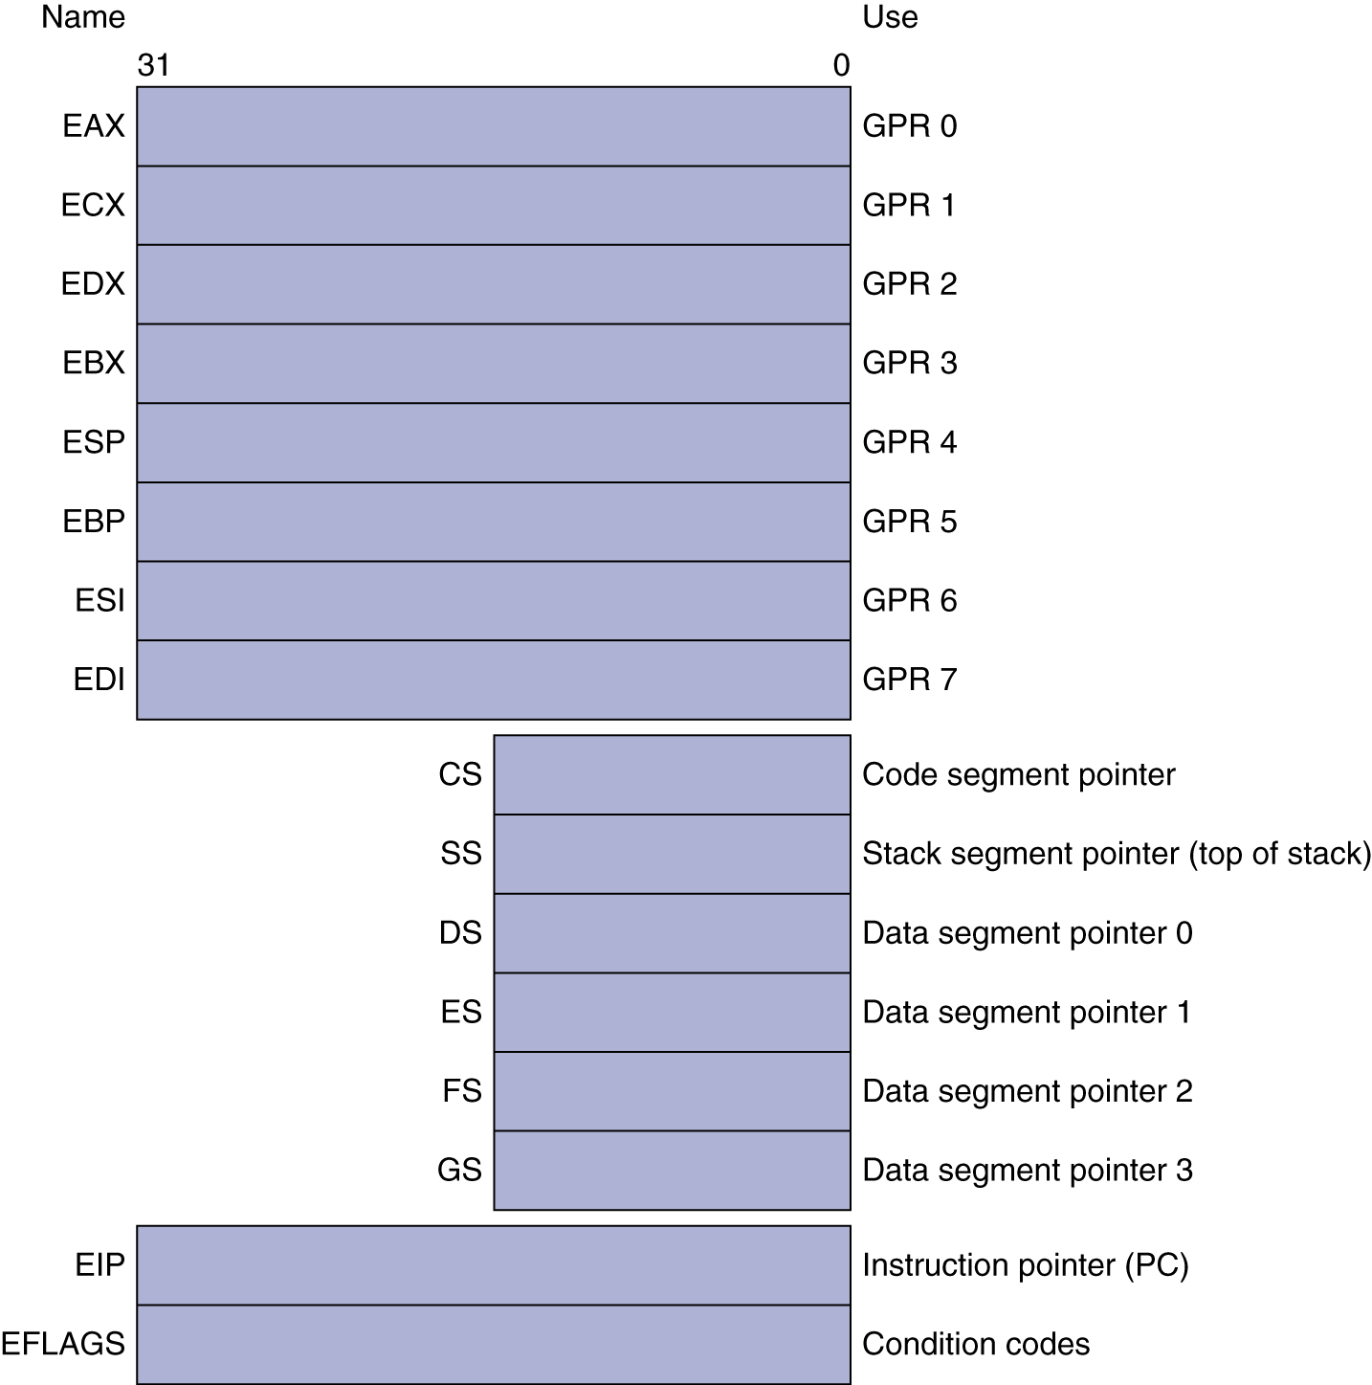
Basic x86 Registers

Slide 118
Basic x86 Addressing Modes
Two operands per instruction
Source/dest operand | Second source operand
Register | Register
Register | Immediate
Register | Memory
Memory | Register
Memory | Immediate
Memory addressing modes
Address in register
Address = R_{base} + displacement
Address = R_{base} + 2^{scale} × R_{index} (scale = 0, 1, 2, or 3)
Address = R_{base} + 2^{scale} × R_{index} + displacement

Slide 119
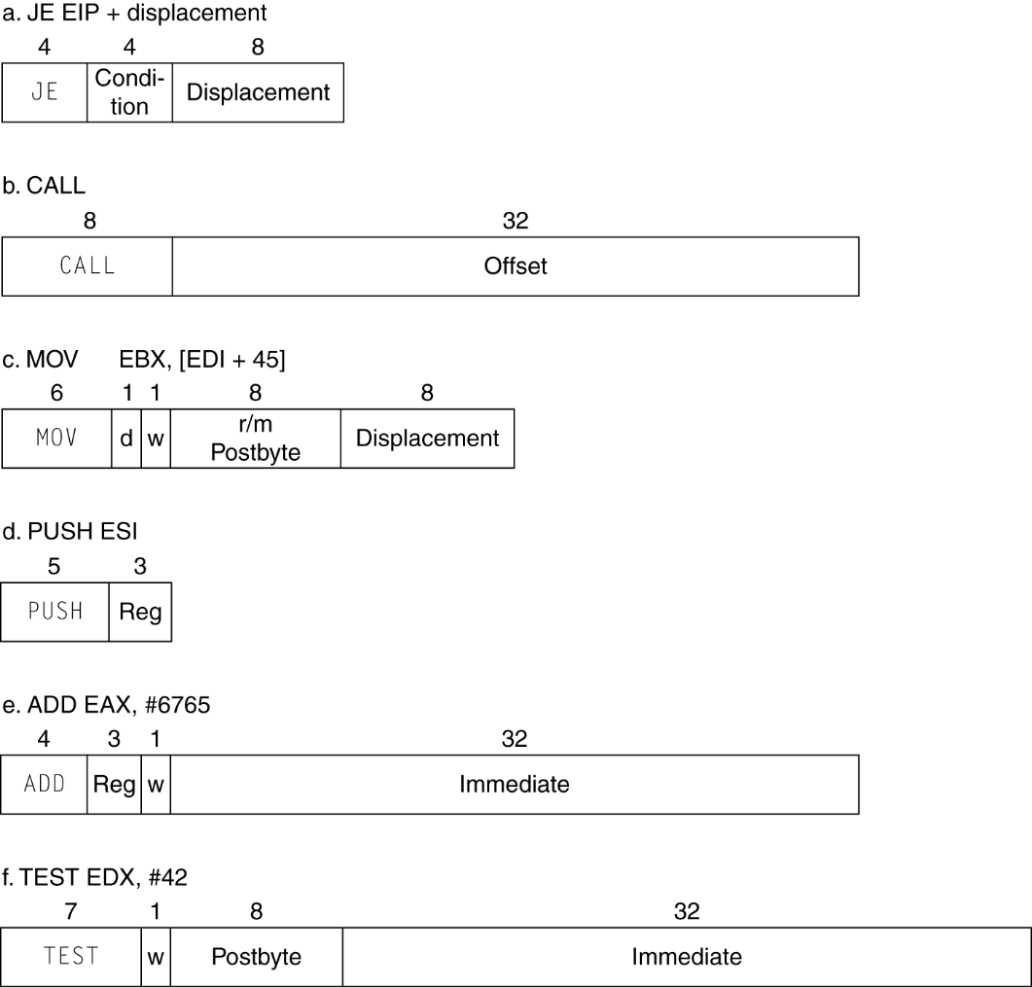
x86 Instruction Encoding
Variable length encoding
Postfix bytes specify addressing mode
Prefix bytes modify operation
Operand length, repetition, locking, …

Slide 120
Implementing IA-32
Complex instruction set makes implementation difficult
Hardware translates instructions to simpler microoperations
Simple instructions: 1–1
Complex instructions: 1–many
Microengine similar to RISC
Market share makes this economically viable
Comparable performance to RISC
Compilers avoid complex instructions

Slide 121
Other RISC-V Instructions
Base integer instructions (RV64I)
Those previously described, plus
auipc rd, immed // rd = (imm<<12) + pc
follow by jalr (adds 12-bit immed) for long jump
slt, sltu, slti, sltui: set less than (like MIPS)
addw, subw, addiw: 32-bit add/sub
sllw, srlw, srlw, slliw, srliw, sraiw: 32-bit shift
32-bit variant: RV32I
registers are 32-bits wide, 32-bit operations
§2.18 The Rest of the RISC-V Instruction Set

Slide 122
Instruction Set Extensions
M: integer multiply, divide, remainder
A: atomic memory operations
F: single-precision floating point
D: double-precision floating point
C: compressed instructions
16-bit encoding for frequently used instructions

Slide 123
Fallacies
Powerful instruction ⇒ higher performance
Fewer instructions required
But complex instructions are hard to implement
May slow down all instructions, including simple ones
Compilers are good at making fast code from simple instructions
Use assembly code for high performance
But modern compilers are better at dealing with modern processors
More lines of code ⇒ more errors and less productivity
§2.19 Fallacies and Pitfalls

Slide 124
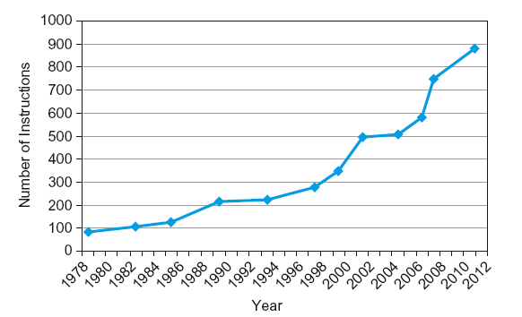
Fallacies
Backward compatibility ⇒ instruction set doesn’t change
But they do accrete more instructions
x86 instruction set

Slide 125
Pitfalls
Sequential words are not at sequential addresses
Increment by 4, not by 1!
Keeping a pointer to an automatic variable after procedure returns
e.g., passing pointer back via an argument
Pointer becomes invalid when stack popped

Slide 126
Concluding Remarks
Design principles
1. Simplicity favors regularity
2. Smaller is faster
3. Good design demands good compromises
Make the common case fast
Layers of software/hardware
Compiler, assembler, hardware
RISC-V: typical of RISC ISAs
c.f. x86
§2.20 Concluding Remarks

