Slide 1
Chapter 5
Large and Fast: Exploiting Memory Hierarchy
Notes:
Morgan Kaufmann Publishers
Chapter 5 — Large and Fast: Exploiting Memory Hierarchy

Slide 2
5.1 Introduction
Principle of Locality
§5.1 Introduction
Programs access a small proportion of their address space at any time
Temporal locality
  Items accessed recently are likely to be accessed again soon
  e.g., instructions in a loop, induction variables
Spatial locality
  Items near those accessed recently are likely to be accessed soon
  E.g., sequential instruction access, array data
Notes:
Morgan Kaufmann Publishers
Chapter 5 — Large and Fast: Exploiting Memory Hierarchy

Slide 3
Taking Advantage of Locality
Memory hierarchy
Store everything on disk
Copy recently accessed (and nearby) items from disk to smaller DRAM memory
  Main memory
Copy more recently accessed (and nearby) items from DRAM to smaller SRAM memory
  Cache memory attached to CPU
Notes:
Morgan Kaufmann Publishers
Chapter 5 — Large and Fast: Exploiting Memory Hierarchy

Slide 4

Memory Hierarchy Levels
Block (aka line): unit of copying
  May be multiple words
If accessed data is present in upper level
  Hit: access satisfied by upper level
    Hit ratio: hits/accesses
If accessed data is absent
  Miss: block copied from lower level
    Time taken: miss penalty
    Miss ratio: misses/accesses
    = 1 – hit ratio
  Then accessed data supplied from upper level
Notes:
Morgan Kaufmann Publishers
Chapter 5 — Large and Fast: Exploiting Memory Hierarchy

Slide 5
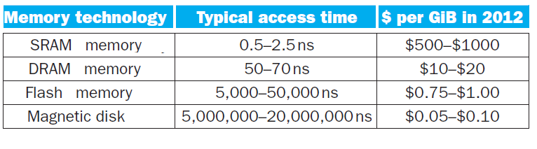
5.2 Memory Technology
Static RAM (SRAM)
  0.5ns – 2.5ns, $2000 – $5000 per GB
Dynamic RAM (DRAM)
  50ns – 70ns, $20 – $75 per GB
Magnetic disk
  5ms – 20ms, $0.20 – $2 per GB
Ideal memory
  Access time of SRAM
  Capacity and cost/GB of disk
§5.2 Memory Technologies
Notes:
Morgan Kaufmann Publishers
Chapter 5 — Large and Fast: Exploiting Memory Hierarchy

Slide 6
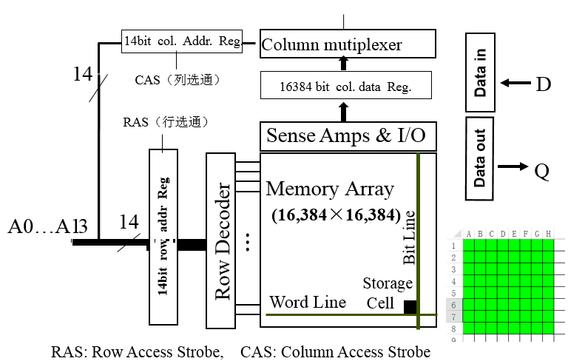
DRAM Technology
Data stored as a charge in a capacitor
  Single transistor used to access the charge, The charge can be kept for several milliseconds.
  Must periodically be refreshed
    This consumes 1% to 2% of the active cycles of the DRAM
    Performed on a DRAM “row”: refreshing an entire row (which shares a word line) with a read cycle followed immediately by a write cycle.

Slide 7
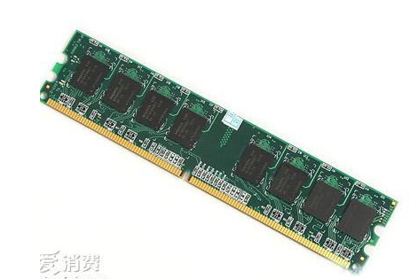
下图1条DRAM内存条有8片chip（市场上也有9片或4片的）。
例子：1个chip内有4个bank，每个bank内有8个array（8个array决定了位宽是8bit），一个特定地址的数据只在其中1个bank中，1个bank的容量是16K*8bit，则这个chip有64k*8bit，位宽8bit。
  Chip的位宽由array数量决定，无关bank数量，增加chip内的bank数只会增加容量，不增加位宽。
  输入地址时，地址译码电路会选择其中的一个bank
  读数据的地址0xA1B4，clk1输入row-addr=0xA1, 接着clk2输入col-addr=0xB4, 会读出0xA1B4处的8bit，row-addr不变 ，clk3和clk4输入col-addr=0xB5,0xB6, 依次读出0xA1B5处的8bit， 0xA1B6处的8bit。
  When the row is in the buffer, it can be transferred by successive column addresses at whatever the width of the DRAM is (typically 4, 8, or 16 bits in DDR3). ➔ 在上例中，When the row is in the buffer, it can be transferred by successive column addresses at 8bit.
\课-计算机组成\电子书及补充读物\DRAM\DRAM的结构原理剖析-CSDN博客-210525.docx 很有用

Slide 8

FIGURE 5.4 Internal organization of a DRAM.
Modern DRAMs are organized in banks, typically four for DDR3.
Sending a PRE (precharge) command opens or closes a bank.
  Memory addr: [bank-addr ] [row-addr] [column-addr],
  Memory addr example: 24-bit address 2-11-11
  Each bank consists of a series of rows.
A row address is sent with an Act (activate), which causes the row to transfer to a buffer.
When the row is in the buffer, it can be transferred by successive column addresses at whatever the width of the DRAM is (typically 4, 8, or 16 bits in DDR3) or by specifying a block transfer and the starting address.

Slide 9
Advanced DRAM Organization
Bits in a DRAM are organized as a rectangular array
  DRAM accesses an entire row
  Burst mode: supply successive words from a row with reduced latency
Double data rate (DDR) DRAM
  Transfer on rising and falling clock edges
  Example of Burst mode
Notes:
Morgan Kaufmann Publishers
Chapter 5 — Large and Fast: Exploiting Memory Hierarchy

Slide 10
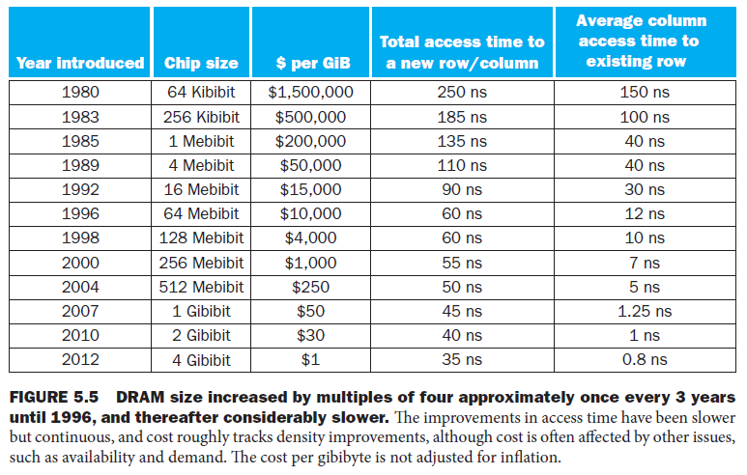
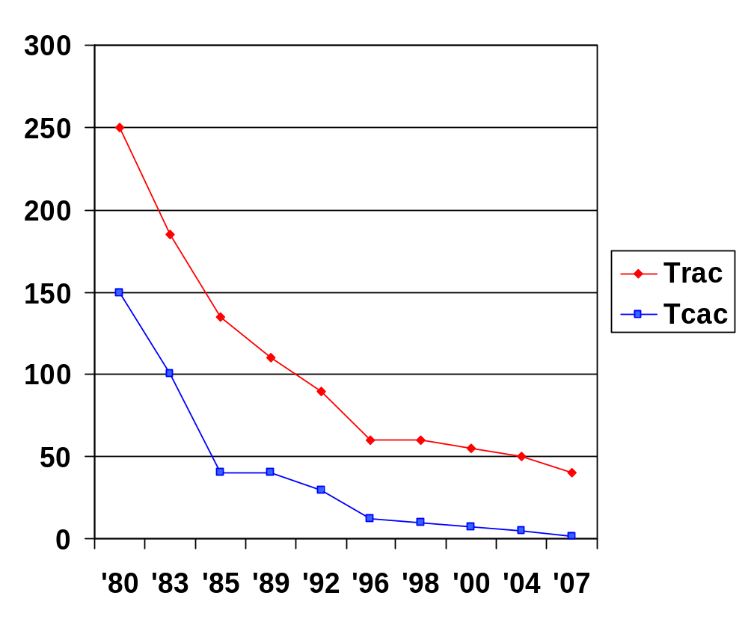
DRAM Generations
Year | Capacity | $/GB
1980 | 64Kbit | $1500000
1983 | 256Kbit | $500000
1985 | 1Mbit | $200000
1989 | 4Mbit | $50000
1992 | 16Mbit | $15000
1996 | 64Mbit | $10000
1998 | 128Mbit | $4000
2000 | 256Mbit | $1000
2004 | 512Mbit | $250
2007 | 1Gbit | $50
Notes:
Morgan Kaufmann Publishers
Chapter 5 — Large and Fast: Exploiting Memory Hierarchy

Slide 11
DRAM Performance Factors
Row buffer
  Allows several words to be read and refreshed in parallel
Synchronous DRAM (SDRAM)
  DRAMs added clocks
  Allows for consecutive accesses in bursts without needing to send each address
  Improves bandwidth
DRAM banking
  Allows simultaneous access to multiple DRAMs
  Improves bandwidth

Slide 12
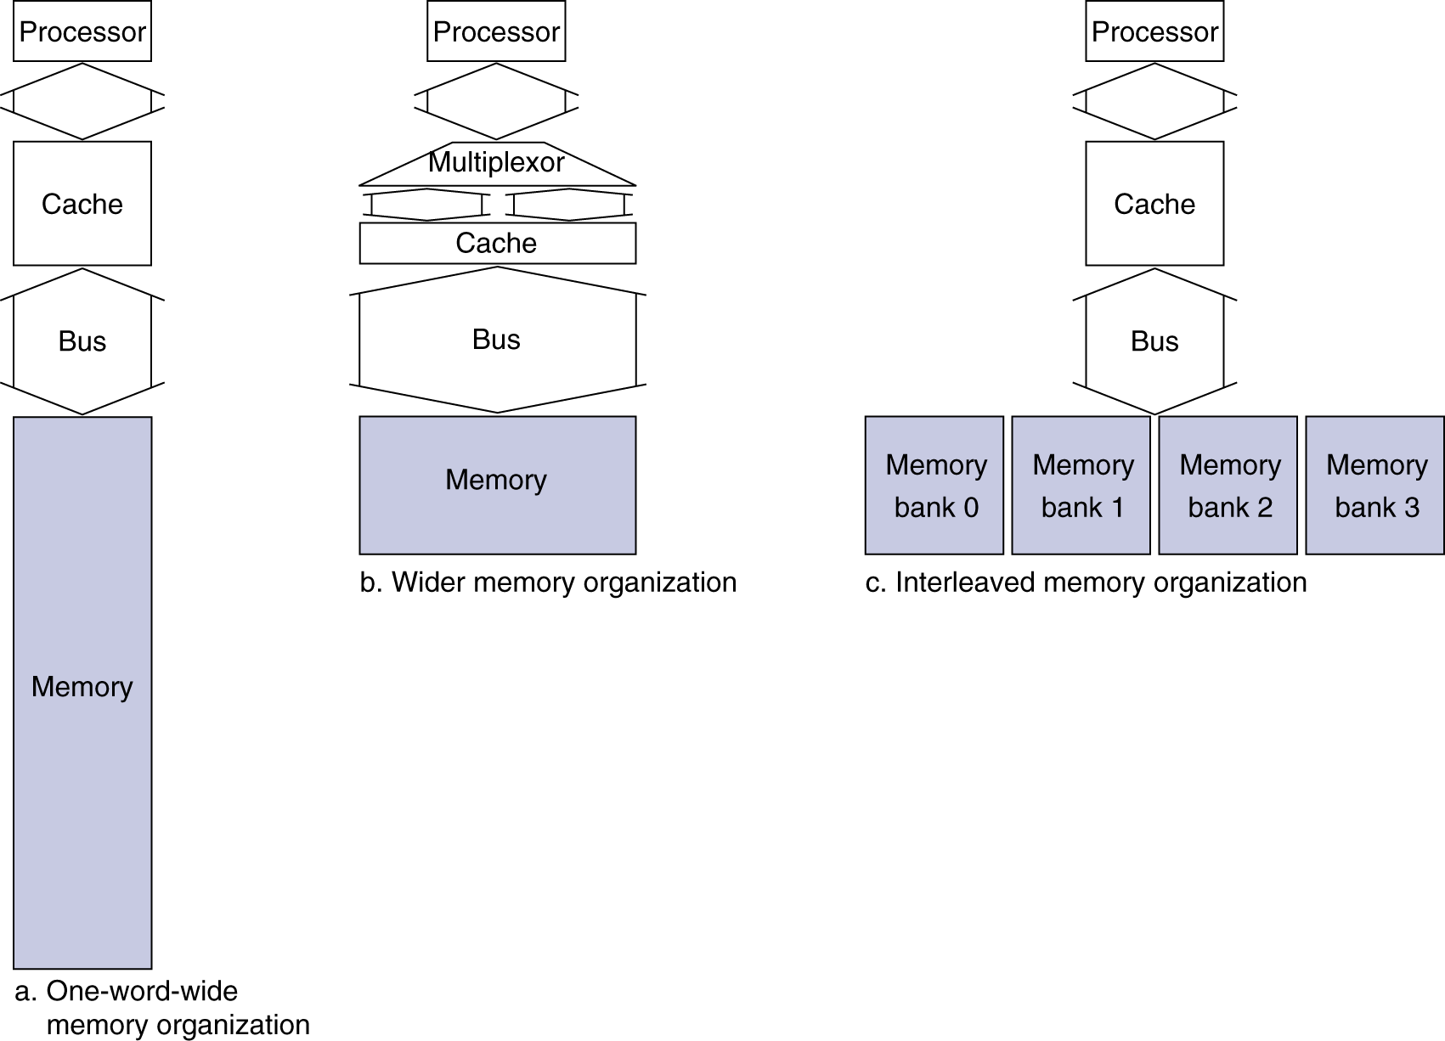
Increasing Memory Bandwidth
以后再讲
4-word wide memory
  Miss penalty = 1 + 15 + 1 = 17 bus cycles
  Bandwidth = 16 bytes / 17 cycles = 0.94 B/cycle
4-bank interleaved memory
  Miss penalty = 1 + 15 + 4×1 = 20 bus cycles
  Bandwidth = 16 bytes / 20 cycles = 0.8 B/cycle
Notes:
Morgan Kaufmann Publishers
Chapter 5 — Large and Fast: Exploiting Memory Hierarchy

Slide 13


Flash Storage
Nonvolatile semiconductor storage
  100× – 1000× faster than disk
  Smaller, lower power, more robust
  But more $/GB (between disk and DRAM)
Notes:
Morgan Kaufmann Publishers
Chapter 6 — Storage and Other I/O Topics

Slide 14
Flash Types
NOR flash: bit cell like a NOR gate
  Random read/write access
  Used for instruction memory in embedded systems
NAND flash: bit cell like a NAND gate
  Denser (bits/area), but block-at-a-time access
  Cheaper per GB
  Used for USB keys, media storage, …
Flash bits wears out after 1000’s of accesses
  Not suitable for direct RAM or disk replacement
  Wear leveling: remap data to less used blocks
Notes:
Morgan Kaufmann Publishers
Chapter 6 — Storage and Other I/O Topics

Slide 15


Disk Storage
Nonvolatile, rotating magnetic storage
Notes:
Morgan Kaufmann Publishers
Chapter 6 — Storage and Other I/O Topics

Slide 16
Disk Sectors and Access
Each sector records
  Sector ID
  Data (512 bytes, 4096 bytes proposed)
  Error correcting code (ECC)
    Used to hide defects and recording errors lkj：SSD固态硬盘
  Synchronization fields and gaps
Access to a sector involves
  Queuing delay if other accesses are pending
  Seek: move the heads
  Rotational latency
  Data transfer
  Controller overhead
Notes:
Morgan Kaufmann Publishers
Chapter 6 — Storage and Other I/O Topics

Slide 17
Disk Access Example
Given
  512B sector, 15,000rpm, 4ms average seek time, 100MB/s transfer rate, 0.2ms controller overhead, idle disk
Average read time
  4ms seek time
  + ½ / (15,000/60) = 2ms rotational latency
  + 512 / 100MB/s = 0.005ms transfer time
  + 0.2ms controller delay
  = 6.2ms
If actual average seek time is 1ms
  Average read time = 3.2ms
Notes:
Morgan Kaufmann Publishers
Chapter 6 — Storage and Other I/O Topics

Slide 18
Disk Performance Issues
Manufacturers quote average seek time
  Based on all possible seeks
  Locality and OS scheduling lead to smaller actual average seek times
Smart disk controller allocate physical sectors on disk
  Present logical sector interface to host
  SCSI, ATA, SATA
Disk drives include caches
  Prefetch sectors in anticipation of access
  Avoid seek and rotational delay
Notes:
Morgan Kaufmann Publishers
Chapter 6 — Storage and Other I/O Topics

Slide 19

Cache Memory
Cache memory
  The level of the memory hierarchy closest to the CPU
Given accesses X₁, …, X_{n–1}, X_{n}
§5.3 The Basics of Caches
How do we know if the data is present?
Where do we look?
Notes:
Morgan Kaufmann Publishers
Chapter 5 — Large and Fast: Exploiting Memory Hierarchy

Slide 20

Direct Mapped Cache
Location determined by address
Direct mapped: only one choice
  (Block address) modulo (#Blocks in cache)
#Blocks is a power of 2
Use low-order address bits
Notes:
Morgan Kaufmann Publishers
Chapter 5 — Large and Fast: Exploiting Memory Hierarchy

Slide 21
Tags and Valid Bits
How do we know which particular block is stored in a cache location?
  Store block address as well as the data
  Actually, only need the high-order bits
  Called the tag
What if there is no data in a location?
  Valid bit: 1 = present, 0 = not present
  Initially 0
Notes:
Morgan Kaufmann Publishers
Chapter 5 — Large and Fast: Exploiting Memory Hierarchy

Slide 22
Cache Example
8-blocks, 1 word/block, direct mapped
Initial state
Index | V | Tag | Data
000 | N
001 | N
010 | N
011 | N
100 | N
101 | N
110 | N
111 | N
Notes:
Morgan Kaufmann Publishers
Chapter 5 — Large and Fast: Exploiting Memory Hierarchy

Slide 23
Cache Example
Word addr | Binary addr | Hit/miss | Cache block
22 | 10 110 | Miss | 110
Index | V | Tag | Data
000 | N
001 | N
010 | N
011 | N
100 | N
101 | N
110 | Y | 10 | Mem[10110]
111 | N
Notes:
Morgan Kaufmann Publishers
Chapter 5 — Large and Fast: Exploiting Memory Hierarchy

Slide 24
Cache Example
Word addr | Binary addr | Hit/miss | Cache block
26 | 11 010 | Miss | 010
Index | V | Tag | Data
000 | N
001 | N
010 | Y | 11 | Mem[11010]
011 | N
100 | N
101 | N
110 | Y | 10 | Mem[10110]
111 | N
Notes:
Morgan Kaufmann Publishers
Chapter 5 — Large and Fast: Exploiting Memory Hierarchy

Slide 25
Cache Example
Word addr | Binary addr | Hit/miss | Cache block
22 | 10 110 | Hit | 110
26 | 11 010 | Hit | 010
Index | V | Tag | Data
000 | N
001 | N
010 | Y | 11 | Mem[11010]
011 | N
100 | N
101 | N
110 | Y | 10 | Mem[10110]
111 | N
Notes:
Morgan Kaufmann Publishers
Chapter 5 — Large and Fast: Exploiting Memory Hierarchy

Slide 26
Cache Example
Word addr | Binary addr | Hit/miss | Cache block
16 | 10 000 | Miss | 000
3 | 00 011 | Miss | 011
16 | 10 000 | Hit | 000
Index | V | Tag | Data
000 | Y | 10 | Mem[10000]
001 | N
010 | Y | 11 | Mem[11010]
011 | Y | 00 | Mem[00011]
100 | N
101 | N
110 | Y | 10 | Mem[10110]
111 | N
Notes:
Morgan Kaufmann Publishers
Chapter 5 — Large and Fast: Exploiting Memory Hierarchy

Slide 27
Cache Example
Word addr | Binary addr | Hit/miss | Cache block
18 | 10 010 | Miss | 010
Index | V | Tag | Data
000 | Y | 10 | Mem[10000]
001 | N
010 | Y | 10 | Mem[10010]
011 | Y | 00 | Mem[00011]
100 | N
101 | N
110 | Y | 10 | Mem[10110]
111 | N
Notes:
Morgan Kaufmann Publishers
Chapter 5 — Large and Fast: Exploiting Memory Hierarchy

Slide 28
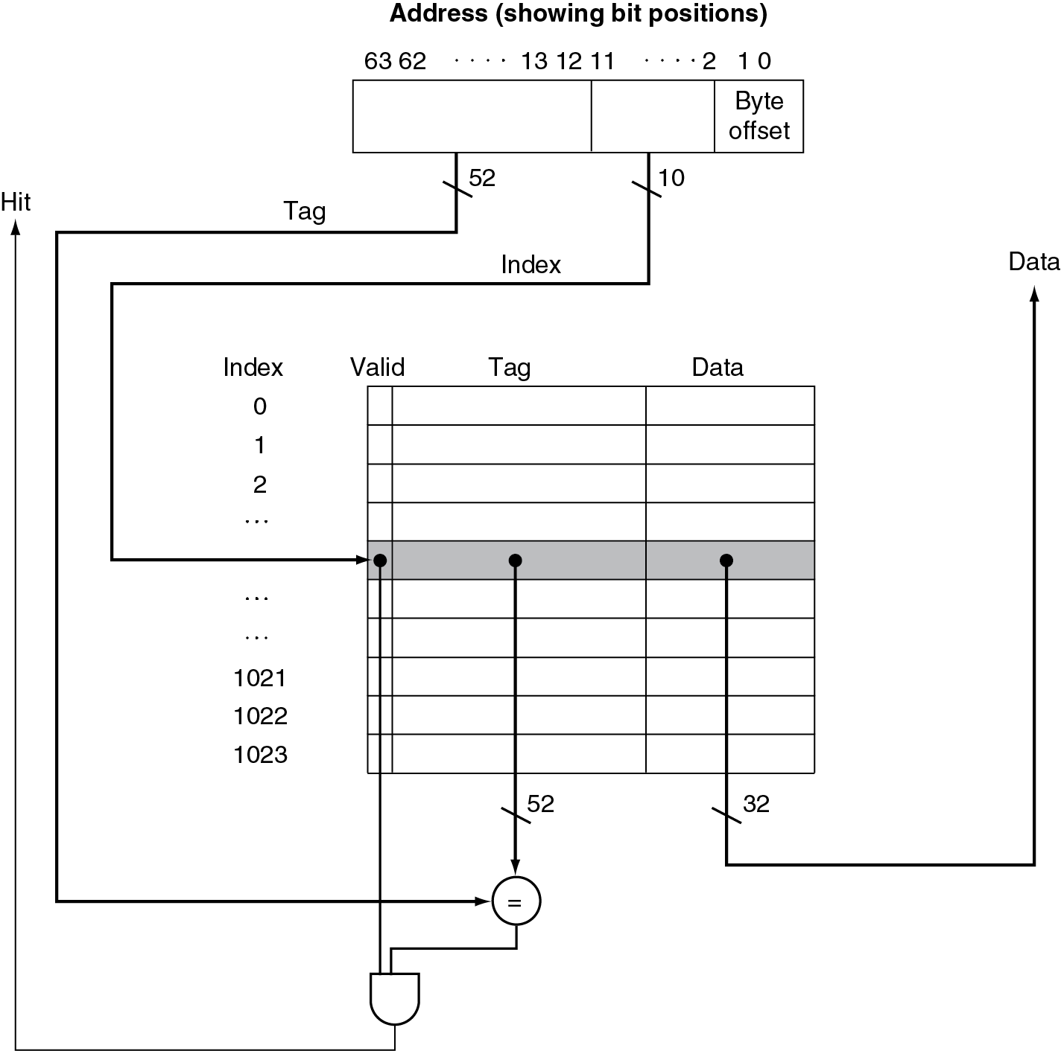
Address Subdivision
Notes:
Morgan Kaufmann Publishers
Chapter 5 — Large and Fast: Exploiting Memory Hierarchy

Slide 29
Example: Larger Block Size
64 blocks, 16 bytes/block
  To what block number does address 1200 map?
Block address = ⎣1200/16⎦ = 75
Block number = 75 modulo 64 = 11
63
10
9
4
3
0
Tag
Index
Offset
22 bits
6 bits
4 bits
Notes:
Morgan Kaufmann Publishers
Chapter 5 — Large and Fast: Exploiting Memory Hierarchy

Slide 30
Block Size Considerations
Larger blocks should reduce miss rate
  Due to spatial locality
But in a fixed-sized cache
  Larger blocks ⇒ fewer of them
    More competition ⇒ increased miss rate
  Larger blocks ⇒ pollution
Larger miss penalty
  Can override benefit of reduced miss rate
  Early restart and critical-word-first can help
Notes:
Morgan Kaufmann Publishers
Chapter 5 — Large and Fast: Exploiting Memory Hierarchy

Slide 31
Cache Misses
On cache hit, CPU proceeds normally
On cache miss
  Stall the CPU pipeline
  Fetch block from next level of hierarchy
  Instruction cache miss
    Restart instruction fetch
  Data cache miss
    Complete data access
Notes:
Morgan Kaufmann Publishers
Chapter 5 — Large and Fast: Exploiting Memory Hierarchy

Slide 32
Write-Through
On data-write hit, could just update the block in cache
  But then cache and memory would be inconsistent
Write through: also update memory
But makes writes take longer
  e.g., if base CPI = 1, 10% of instructions are stores, write to memory takes 100 cycles
    Effective CPI = 1 + 0.1×100 = 11
Solution: write buffer
  Holds data waiting to be written to memory
  CPU continues immediately
    Only stalls on write if write buffer is already full
Notes:
Morgan Kaufmann Publishers
Chapter 5 — Large and Fast: Exploiting Memory Hierarchy

Slide 33
Write-Back
Alternative: On data-write hit, just update the block in cache
  Keep track of whether each block is dirty
When a dirty block is replaced
  Write it back to memory
  Can use a write buffer to allow replacing block to be read first
Notes:
Morgan Kaufmann Publishers
Chapter 5 — Large and Fast: Exploiting Memory Hierarchy

Slide 34
Write Allocation
What should happen on a write miss?
Alternatives for write-through
  Allocate on miss: fetch the block
  Write around: don’t fetch the block
    Since programs often write a whole block before reading it (e.g., initialization)
For write-back
  Usually fetch the block
Notes:
Morgan Kaufmann Publishers
Chapter 5 — Large and Fast: Exploiting Memory Hierarchy

Slide 35
Example: Intrinsity FastMATH
Embedded MIPS processor
  12-stage pipeline
  Instruction and data access on each cycle
Split cache: separate I-cache and D-cache
  Each 16KB: 256 blocks × 16 words/block
  D-cache: write-through or write-back
SPEC2000 miss rates
  I-cache: 0.4%
  D-cache: 11.4%
  Weighted average: 3.2%
Notes:
Morgan Kaufmann Publishers
Chapter 5 — Large and Fast: Exploiting Memory Hierarchy

Slide 36

Example: Intrinsity FastMATH
Notes:
Morgan Kaufmann Publishers
Chapter 5 — Large and Fast: Exploiting Memory Hierarchy

Slide 37
Main Memory Supporting Caches
Use DRAMs for main memory
  Fixed width (e.g., 1 word)
  Connected by fixed-width clocked bus
    Bus clock is typically slower than CPU clock
Example cache block read
  1 bus cycle for address transfer
  15 bus cycles per DRAM access
  1 bus cycle per data transfer
For 4-word block, 1-word-wide DRAM
  Miss penalty = 1 + 4×15 + 4×1 = 65 bus cycles
  Bandwidth = 16 bytes / 65 cycles = 0.25 B/cycle
Notes:
Morgan Kaufmann Publishers
Chapter 5 — Large and Fast: Exploiting Memory Hierarchy

Slide 38
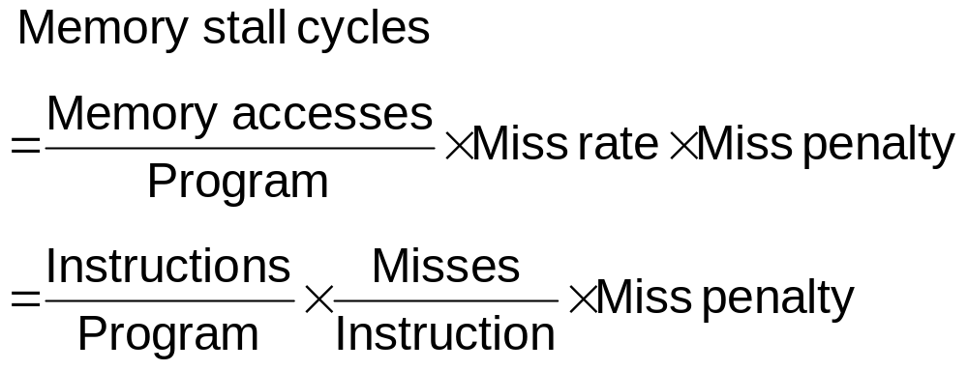
Measuring Cache Performance
Components of CPU time
  Program execution cycles
    Includes cache hit time
  Memory stall cycles
    Mainly from cache misses
With simplifying assumptions:
§5.4 Measuring and Improving Cache Performance
Notes:
Morgan Kaufmann Publishers
Chapter 5 — Large and Fast: Exploiting Memory Hierarchy

Slide 39
Cache Performance Example
Given
  I-cache miss rate = 2%
  D-cache miss rate = 4%
  Miss penalty = 100 cycles
  Base CPI (ideal cache) = 2
  Load & stores are 36% of instructions
Miss cycles per instruction
  I-cache: 0.02 × 100 = 2
  D-cache: 0.36 × 0.04 × 100 = 1.44
Actual CPI = 2 + 2 + 1.44 = 5.44
  Ideal CPU is 5.44/2 =2.72 times faster
Notes:
Morgan Kaufmann Publishers
Chapter 5 — Large and Fast: Exploiting Memory Hierarchy

Slide 40
Average Access Time
Hit time is also important for performance
Average memory access time (AMAT)
  AMAT = Hit time + Miss rate × Miss penalty
Example
  CPU with 1ns clock, hit time = 1 cycle, miss penalty = 20 cycles, I-cache miss rate = 5%
  AMAT = 1 + 0.05 × 20 = 2ns
    2 cycles per instruction
Notes:
Morgan Kaufmann Publishers
Chapter 5 — Large and Fast: Exploiting Memory Hierarchy

Slide 41
Performance Summary
When CPU performance increased
  Miss penalty becomes more significant
Decreasing base CPI
  Greater proportion of time spent on memory stalls
Increasing clock rate
  Memory stalls account for more CPU cycles
Can’t neglect cache behavior when evaluating system performance
Notes:
Morgan Kaufmann Publishers
Chapter 5 — Large and Fast: Exploiting Memory Hierarchy

Slide 42
Associative Caches
Fully associative
  Allow a given block to go in any cache entry
  Requires all entries to be searched at once
  Comparator per entry (expensive)
n-way set associative
  Each set contains n entries
  Block number determines which set
    (Block number) modulo (#Sets in cache)
  Search all entries in a given set at once
  n comparators (less expensive)
Notes:
Morgan Kaufmann Publishers
Chapter 5 — Large and Fast: Exploiting Memory Hierarchy

Slide 43

Associative Cache Example
Notes:
Morgan Kaufmann Publishers
Chapter 5 — Large and Fast: Exploiting Memory Hierarchy

Slide 44
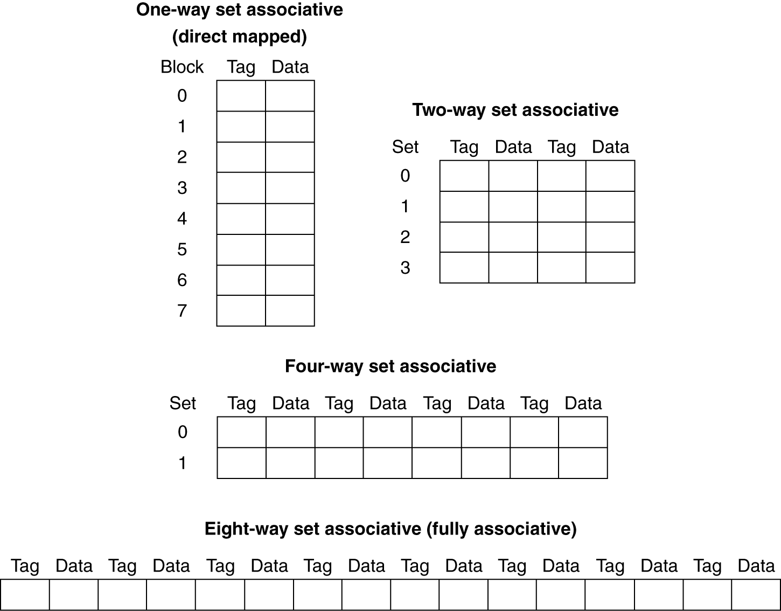
Spectrum of Associativity
For a cache with 8 entries
Notes:
Morgan Kaufmann Publishers
Chapter 5 — Large and Fast: Exploiting Memory Hierarchy

Slide 45
Associativity Example
Compare 4-block caches
  Direct mapped, 2-way set associative,
  fully associative
  Block access sequence: 0, 8, 0, 6, 8
Direct mapped
Block address | Cache index | Hit/miss | Cache content after access
 |  |  | 0 | 1 | 2 | 3
0 | 0 | miss | Mem[0]
8 | 0 | miss | Mem[8]
0 | 0 | miss | Mem[0]
6 | 2 | miss | Mem[0] |  | Mem[6]
8 | 0 | miss | Mem[8] |  | Mem[6]
Notes:
Morgan Kaufmann Publishers
Chapter 5 — Large and Fast: Exploiting Memory Hierarchy

Slide 46
Associativity Example
2-way set associative
Block address | Cache index | Hit/miss | Cache content after access
 |  |  | Set 0 |  | Set 1
0 | 0 | miss | Mem[0]
8 | 0 | miss | Mem[0] | Mem[8]
0 | 0 | hit | Mem[0] | Mem[8]
6 | 0 | miss | Mem[0] | Mem[6]
8 | 0 | miss | Mem[8] | Mem[6]
Fully associative
Block address |  | Hit/miss | Cache content after access
0 |  | miss | Mem[0]
8 |  | miss | Mem[0] | Mem[8]
0 |  | hit | Mem[0] | Mem[8]
6 |  | miss | Mem[0] | Mem[8] | Mem[6]
8 |  | hit | Mem[0] | Mem[8] | Mem[6]
Notes:
Morgan Kaufmann Publishers
Chapter 5 — Large and Fast: Exploiting Memory Hierarchy

Slide 47
How Much Associativity
Increased associativity decreases miss rate
  But with diminishing returns
Simulation of a system with 64KB
D-cache, 16-word blocks, SPEC2000
  1-way: 10.3%
  2-way: 8.6%
  4-way: 8.3%
  8-way: 8.1%
Notes:
Morgan Kaufmann Publishers
Chapter 5 — Large and Fast: Exploiting Memory Hierarchy

Slide 48

Set Associative Cache Organization
Notes:
Morgan Kaufmann Publishers
Chapter 5 — Large and Fast: Exploiting Memory Hierarchy

Slide 49
Replacement Policy
Direct mapped: no choice
Set associative
  Prefer non-valid entry, if there is one
  Otherwise, choose among entries in the set
Least-recently used (LRU)
  Choose the one unused for the longest time
    Simple for 2-way, manageable for 4-way, too hard beyond that
Random
  Gives approximately the same performance as LRU for high associativity
Notes:
Morgan Kaufmann Publishers
Chapter 5 — Large and Fast: Exploiting Memory Hierarchy

Slide 50
Multilevel Caches
Primary cache attached to CPU
  Small, but fast
Level-2 cache services misses from primary cache
  Larger, slower, but still faster than main memory
Main memory services L-2 cache misses
Some high-end systems include L-3 cache
Notes:
Morgan Kaufmann Publishers
Chapter 5 — Large and Fast: Exploiting Memory Hierarchy

Slide 51
Multilevel Cache Example
Given
  CPU base CPI = 1, clock rate = 4GHz
  Miss rate/instruction = 2%
  Main memory access time = 100ns
With just primary cache
  Miss penalty = 100ns/0.25ns = 400 cycles
  Effective CPI = 1 + 0.02 × 400 = 9
Notes:
Morgan Kaufmann Publishers
Chapter 5 — Large and Fast: Exploiting Memory Hierarchy

Slide 52
Example (cont.)
Now add L-2 cache
  Access time = 5ns
  Global miss rate to main memory = 0.5%
Primary miss with L-2 hit
  Penalty = 5ns/0.25ns = 20 cycles
Primary miss with L-2 miss
  Extra penalty = 500 cycles
CPI = 1 + 0.02 × 20 + 0.005 × 400 = 3.4
Performance ratio = 9/3.4 = 2.6
Notes:
Morgan Kaufmann Publishers
Chapter 5 — Large and Fast: Exploiting Memory Hierarchy

Slide 53
Multilevel Cache Considerations
Primary cache
  Focus on minimal hit time
L-2 cache
  Focus on low miss rate to avoid main memory access
  Hit time has less overall impact
Results
  L-1 cache usually smaller than a single cache
  L-1 block size smaller than L-2 block size
Notes:
Morgan Kaufmann Publishers
Chapter 5 — Large and Fast: Exploiting Memory Hierarchy

Slide 54
Interactions with Advanced CPUs
Out-of-order CPUs can execute instructions during cache miss
  Pending store stays in load/store unit
  Dependent instructions wait in reservation stations
    Independent instructions continue
Effect of miss depends on program data flow
  Much harder to analyse
  Use system simulation
Notes:
Morgan Kaufmann Publishers
Chapter 5 — Large and Fast: Exploiting Memory Hierarchy

Slide 55

Interactions with Software
Misses depend on memory access patterns
  Algorithm behavior
  Compiler optimization for memory access
Notes:
Morgan Kaufmann Publishers
Chapter 5 — Large and Fast: Exploiting Memory Hierarchy

Slide 56
Software Optimization via Blocking
Goal: maximize accesses to data before it is replaced
Consider inner loops of DGEMM:
for (int j = 0; j < n; ++j)
{
double cij = C[i+j*n];
for( int k = 0; k < n; k++ )
cij += A[i+k*n] * B[k+j*n];
C[i+j*n] = cij;
}

Slide 57
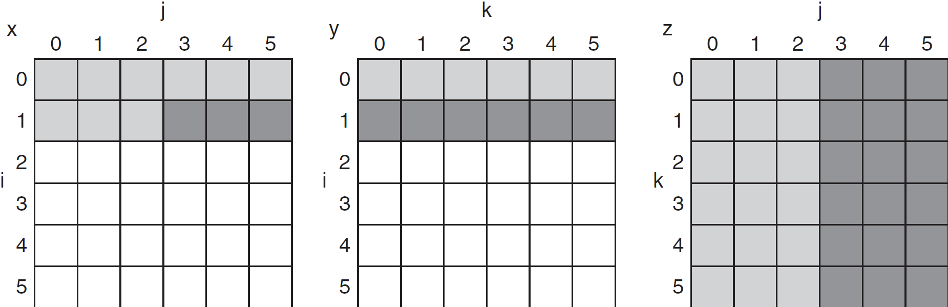
DGEMM Access Pattern
C, A, and B arrays
older accesses
new accesses

Slide 58
Cache Blocked DGEMM
1 #define BLOCKSIZE 32
2 void do_block (int n, int si, int sj, int sk, double *A, double
3 *B, double *C)
4 {
5 for (int i = si; i < si+BLOCKSIZE; ++i)
6 for (int j = sj; j < sj+BLOCKSIZE; ++j)
7 {
8 double cij = C[i+j*n];/* cij = C[i][j] */
9 for( int k = sk; k < sk+BLOCKSIZE; k++ )
10 cij += A[i+k*n] * B[k+j*n];/* cij+=A[i][k]*B[k][j] */
11 C[i+j*n] = cij;/* C[i][j] = cij */
12 }
13 }
14 void dgemm (int n, double* A, double* B, double* C)
15 {
16 for ( int sj = 0; sj < n; sj += BLOCKSIZE )
17 for ( int si = 0; si < n; si += BLOCKSIZE )
18 for ( int sk = 0; sk < n; sk += BLOCKSIZE )
19 do_block(n, si, sj, sk, A, B, C);
20 }

Slide 59
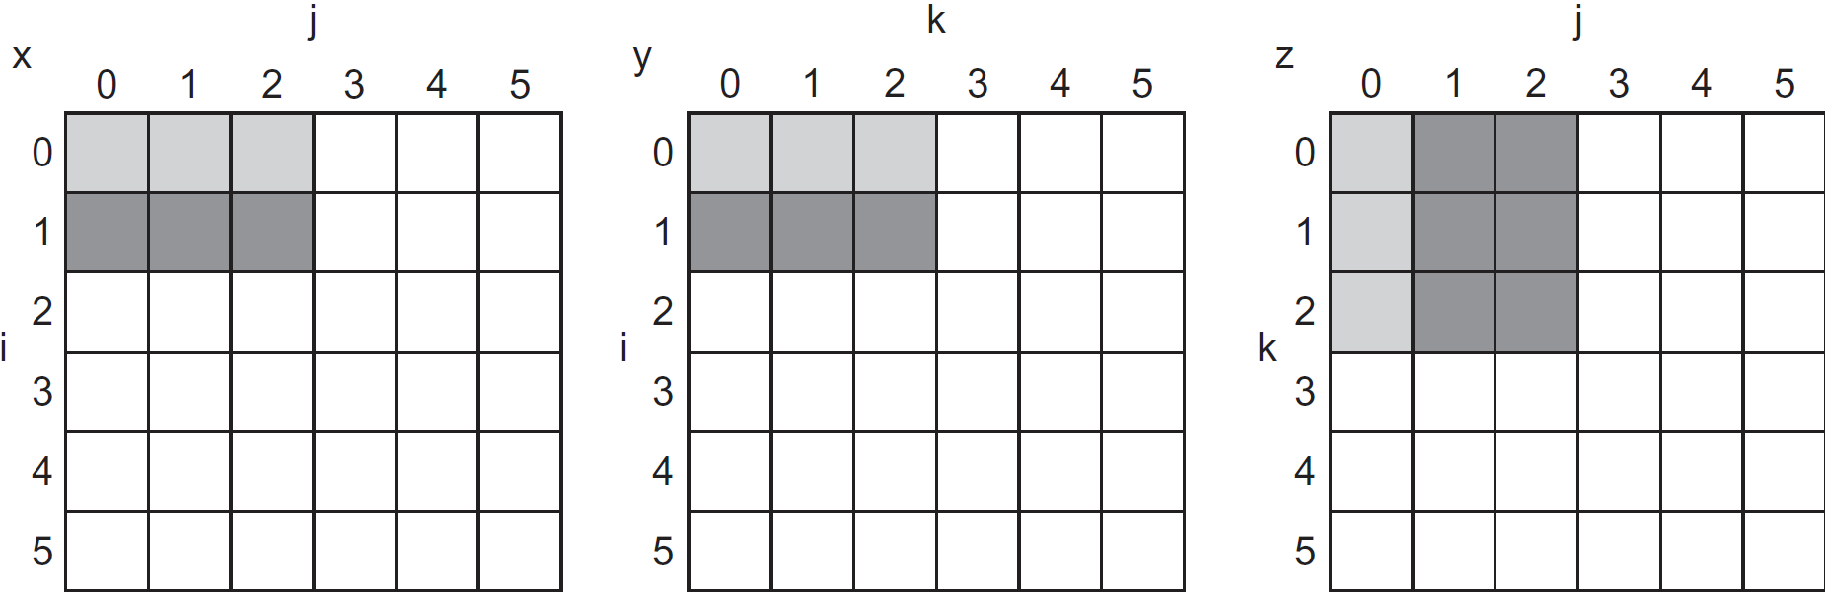
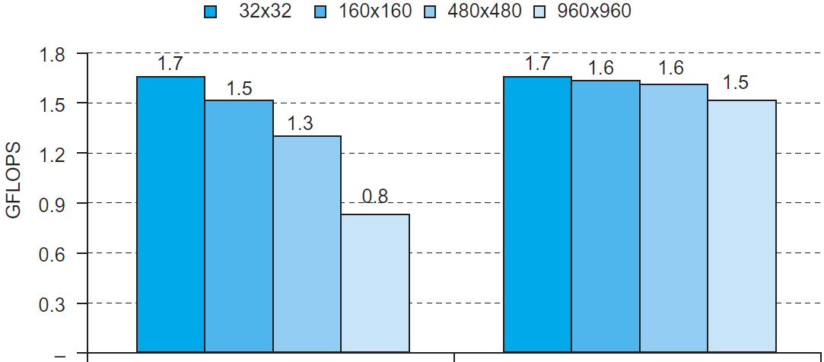
Blocked DGEMM Access Pattern
Unoptimized
Blocked

Slide 60
Dependability
Service accomplishment
Service delivered
as specified
§5.5 Dependable Memory Hierarchy
Fault: failure of a component
  May or may not lead to system failure
Restoration
Failure
Service interruption
Deviation from
specified service
Notes:
Morgan Kaufmann Publishers
Chapter 6 — Storage and Other I/O Topics

Slide 61
Dependability Measures
Reliability: mean time to failure (MTTF)
Service interruption: mean time to repair (MTTR)
Mean time between failures
  MTBF = MTTF + MTTR
Availability = MTTF / (MTTF + MTTR)
Improving Availability
  Increase MTTF: fault avoidance, fault tolerance, fault forecasting
  Reduce MTTR: improved tools and processes for diagnosis and repair
Notes:
Morgan Kaufmann Publishers
Chapter 6 — Storage and Other I/O Topics

Slide 62
The Hamming SEC Code
Hamming distance
  Number of bits that are different between two bit patterns
Minimum distance = 2 provides single bit error detection
  E.g. parity code
Minimum distance = 3 provides single error correction, 2 bit error detection

Slide 63

Encoding SEC
To calculate Hamming code:
  Number bits from 1 on the left
  All bit positions that are a power 2 are parity bits
  Each parity bit checks certain data bits:

Slide 64
Decoding SEC
Value of parity bits indicates which bits are in error
  Use numbering from encoding procedure
  E.g.
    Parity bits = 0000 indicates no error
    Parity bits = 1010 indicates bit 10 was flipped

Slide 65
SEC/DEC Code
Add an additional parity bit for the whole word (p_{n})
Make Hamming distance = 4
Decoding:
  Let H = SEC parity bits
    H even, p_{n} even, no error
    H odd, p_{n} odd, correctable single bit error
    H even, p_{n} odd, error in p_{n} bit
    H odd, p_{n} even, double error occurred
Note: ECC DRAM uses SEC/DEC with 8 bits protecting each 64 bits

Slide 66
Virtual Machines
Host computer emulates guest operating system and machine resources
  Improved isolation of multiple guests
  Avoids security and reliability problems
  Aids sharing of resources
Virtualization has some performance impact
  Feasible with modern high-performance comptuers
Examples
  IBM VM/370 (1970s technology!)
  VMWare
  Microsoft Virtual PC
§5.6 Virtual Machines
Notes:
Morgan Kaufmann Publishers
Chapter 5 — Large and Fast: Exploiting Memory Hierarchy

Slide 67
Virtual Machine Monitor
Maps virtual resources to physical resources
  Memory, I/O devices, CPUs
Guest code runs on native machine in user mode
  Traps to VMM on privileged instructions and access to protected resources
Guest OS may be different from host OS
VMM handles real I/O devices
  Emulates generic virtual I/O devices for guest
Notes:
Morgan Kaufmann Publishers
Chapter 5 — Large and Fast: Exploiting Memory Hierarchy

Slide 68
Example: Timer Virtualization
In native machine, on timer interrupt
  OS suspends current process, handles interrupt, selects and resumes next process
With Virtual Machine Monitor
  VMM suspends current VM, handles interrupt, selects and resumes next VM
If a VM requires timer interrupts
  VMM emulates a virtual timer
  Emulates interrupt for VM when physical timer interrupt occurs
Notes:
Morgan Kaufmann Publishers
Chapter 5 — Large and Fast: Exploiting Memory Hierarchy

Slide 69
Instruction Set Support
User and System modes
Privileged instructions only available in system mode
  Trap to system if executed in user mode
All physical resources only accessible using privileged instructions
  Including page tables, interrupt controls, I/O registers
Renaissance of virtualization support
  Current ISAs (e.g., x86) adapting
Notes:
Morgan Kaufmann Publishers
Chapter 5 — Large and Fast: Exploiting Memory Hierarchy

Slide 70
Virtual Memory
§5.7 Virtual Memory
Use main memory as a “cache” for secondary (disk) storage
  Managed jointly by CPU hardware and the operating system (OS)
Programs share main memory
  Each gets a private virtual address space holding its frequently used code and data
  Protected from other programs
CPU and OS translate virtual addresses to physical addresses
  VM “block” is called a page
  VM translation “miss” is called a page fault
Notes:
Morgan Kaufmann Publishers
Chapter 5 — Large and Fast: Exploiting Memory Hierarchy

Slide 71
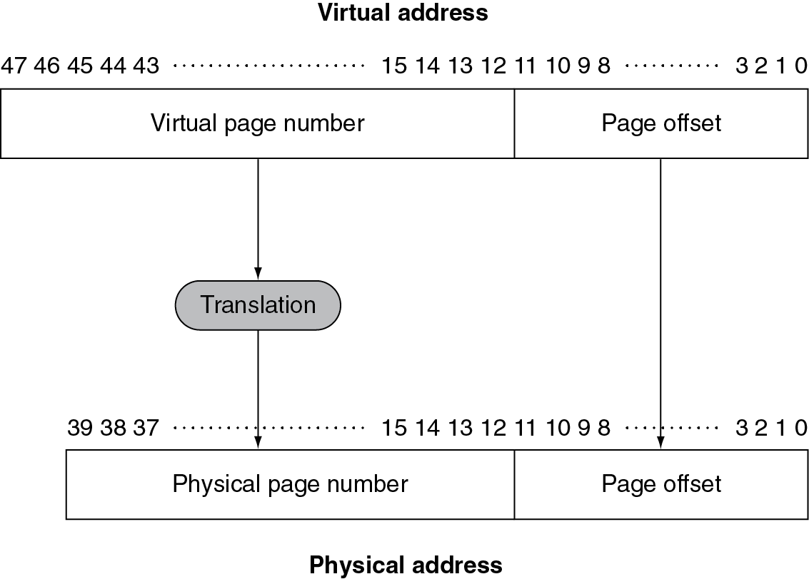

Address Translation
Fixed-size pages (e.g., 4K)
Notes:
Morgan Kaufmann Publishers
Chapter 5 — Large and Fast: Exploiting Memory Hierarchy

Slide 72
Page Fault Penalty
On page fault, the page must be fetched from disk
  Takes millions of clock cycles
  Handled by OS code
Try to minimize page fault rate
  Fully associative placement
  Smart replacement algorithms
Notes:
Morgan Kaufmann Publishers
Chapter 5 — Large and Fast: Exploiting Memory Hierarchy

Slide 73
Page Tables
Stores placement information
  Array of page table entries, indexed by virtual page number
  Page table register in CPU points to page table in physical memory
If page is present in memory
  PTE stores the physical page number
  Plus other status bits (referenced, dirty, …)
If page is not present
  PTE can refer to location in swap space on disk
Notes:
Morgan Kaufmann Publishers
Chapter 5 — Large and Fast: Exploiting Memory Hierarchy

Slide 74
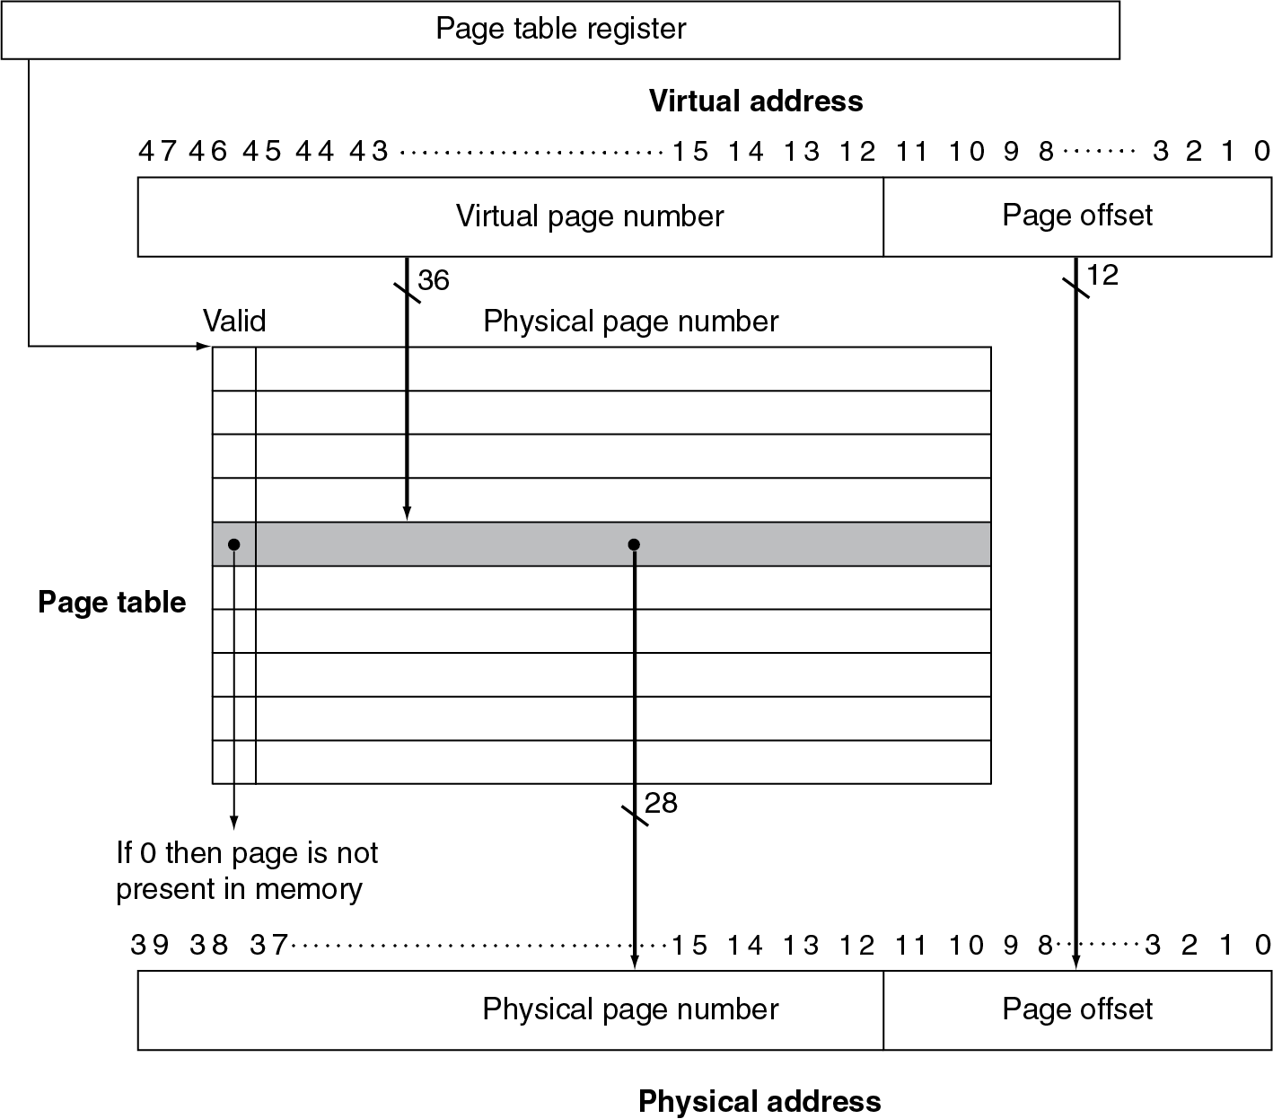
Translation Using a Page Table
Notes:
Morgan Kaufmann Publishers
Chapter 5 — Large and Fast: Exploiting Memory Hierarchy

Slide 75

Mapping Pages to Storage
Notes:
Morgan Kaufmann Publishers
Chapter 5 — Large and Fast: Exploiting Memory Hierarchy

Slide 76
Replacement and Writes
To reduce page fault rate, prefer least-recently used (LRU) replacement
  Reference bit (aka use bit) in PTE set to 1 on access to page
  Periodically cleared to 0 by OS
  A page with reference bit = 0 has not been used recently
Disk writes take millions of cycles
  Block at once, not individual locations
  Write through is impractical
  Use write-back
  Dirty bit in PTE set when page is written
Notes:
Morgan Kaufmann Publishers
Chapter 5 — Large and Fast: Exploiting Memory Hierarchy

Slide 77
Fast Translation Using a TLB
Address translation would appear to require extra memory references
  One to access the PTE
  Then the actual memory access
But access to page tables has good locality
  So use a fast cache of PTEs within the CPU
  Called a Translation Look-aside Buffer (TLB)
  Typical: 16–512 PTEs, 0.5–1 cycle for hit, 10–100 cycles for miss, 0.01%–1% miss rate
  Misses could be handled by hardware or software
Notes:
Morgan Kaufmann Publishers
Chapter 5 — Large and Fast: Exploiting Memory Hierarchy

Slide 78

Fast Translation Using a TLB
Notes:
Morgan Kaufmann Publishers
Chapter 5 — Large and Fast: Exploiting Memory Hierarchy

Slide 79
TLB Misses
If page is in memory
  Load the PTE from memory and retry
  Could be handled in hardware
    Can get complex for more complicated page table structures
  Or in software
    Raise a special exception, with optimized handler
If page is not in memory (page fault)
  OS handles fetching the page and updating the page table
  Then restart the faulting instruction
Notes:
Morgan Kaufmann Publishers
Chapter 5 — Large and Fast: Exploiting Memory Hierarchy

Slide 80
TLB Miss Handler
TLB miss indicates
  Page present, but PTE not in TLB
  Page not preset
Must recognize TLB miss before destination register overwritten
  Raise exception
Handler copies PTE from memory to TLB
  Then restarts instruction
  If page not present, page fault will occur
Notes:
Morgan Kaufmann Publishers
Chapter 5 — Large and Fast: Exploiting Memory Hierarchy

Slide 81
Page Fault Handler
Use faulting virtual address to find PTE
Locate page on disk
Choose page to replace
  If dirty, write to disk first
Read page into memory and update page table
Make process runnable again
  Restart from faulting instruction
Notes:
Morgan Kaufmann Publishers
Chapter 5 — Large and Fast: Exploiting Memory Hierarchy

Slide 82

TLB and Cache Interaction
If cache tag uses physical address
  Need to translate before cache lookup
Alternative: use virtual address tag
  Complications due to aliasing
    Different virtual addresses for shared physical address
Notes:
Morgan Kaufmann Publishers
Chapter 5 — Large and Fast: Exploiting Memory Hierarchy

Slide 83
Memory Protection
Different tasks can share parts of their virtual address spaces
  But need to protect against errant access
  Requires OS assistance
Hardware support for OS protection
  Privileged supervisor mode (aka kernel mode)
  Privileged instructions
  Page tables and other state information only accessible in supervisor mode
  System call exception (e.g., ecall in RISC-V)
Notes:
Morgan Kaufmann Publishers
Chapter 5 — Large and Fast: Exploiting Memory Hierarchy

Slide 84
The Memory Hierarchy
The BIG Picture
Common principles apply at all levels of the memory hierarchy
  Based on notions of caching
At each level in the hierarchy
  Block placement
  Finding a block
  Replacement on a miss
  Write policy
§5.8 A Common Framework for Memory Hierarchies
Notes:
Morgan Kaufmann Publishers
Chapter 5 — Large and Fast: Exploiting Memory Hierarchy

Slide 85
Block Placement
Determined by associativity
  Direct mapped (1-way associative)
    One choice for placement
  n-way set associative
    n choices within a set
  Fully associative
    Any location
Higher associativity reduces miss rate
  Increases complexity, cost, and access time
Notes:
Morgan Kaufmann Publishers
Chapter 5 — Large and Fast: Exploiting Memory Hierarchy

Slide 86
Finding a Block
Associativity | Location method | Tag comparisons
Direct mapped | Index | 1
n-way set associative | Set index, then search entries within the set | n
Fully associative | Search all entries | #entries
 | Full lookup table | 0
Hardware caches
  Reduce comparisons to reduce cost
Virtual memory
  Full table lookup makes full associativity feasible
  Benefit in reduced miss rate
Notes:
Morgan Kaufmann Publishers
Chapter 5 — Large and Fast: Exploiting Memory Hierarchy

Slide 87
Replacement
Choice of entry to replace on a miss
  Least recently used (LRU)
    Complex and costly hardware for high associativity
  Random
    Close to LRU, easier to implement
Virtual memory
  LRU approximation with hardware support
Notes:
Morgan Kaufmann Publishers
Chapter 5 — Large and Fast: Exploiting Memory Hierarchy

Slide 88
Write Policy
Write-through
  Update both upper and lower levels
  Simplifies replacement, but may require write buffer
Write-back
  Update upper level only
  Update lower level when block is replaced
  Need to keep more state
Virtual memory
  Only write-back is feasible, given disk write latency
Notes:
Morgan Kaufmann Publishers
Chapter 5 — Large and Fast: Exploiting Memory Hierarchy

Slide 89
Sources of Misses
Compulsory misses (aka cold start misses)
  First access to a block
Capacity misses
  Due to finite cache size
  A replaced block is later accessed again
Conflict misses (aka collision misses)
  In a non-fully associative cache
  Due to competition for entries in a set
  Would not occur in a fully associative cache of the same total size
Notes:
Morgan Kaufmann Publishers
Chapter 5 — Large and Fast: Exploiting Memory Hierarchy

Slide 90
Cache Design Trade-offs
Design change | Effect on miss rate | Negative performance effect
Increase cache size | Decrease capacity misses | May increase access time
Increase associativity | Decrease conflict misses | May increase access time
Increase block size | Decrease compulsory misses | Increases miss penalty. For very large block size, may increase miss rate due to pollution.
Notes:
Morgan Kaufmann Publishers
Chapter 5 — Large and Fast: Exploiting Memory Hierarchy

Slide 91
Cache Control
Example cache characteristics
  Direct-mapped, write-back, write allocate
  Block size: 4 words (16 bytes)
  Cache size: 16 KB (1024 blocks)
  32-bit byte addresses
  Valid bit and dirty bit per block
  Blocking cache
    CPU waits until access is complete
§5.9 Using a Finite State Machine to Control A Simple Cache
31
14
13
4
3
0
Tag
Index
Offset
18 bits
10 bits
4 bits
Notes:
Morgan Kaufmann Publishers
Chapter 5 — Large and Fast: Exploiting Memory Hierarchy

Slide 92
Interface Signals
CPU
Cache
Memory
Read/Write
Read/Write
Valid
Valid
Address
32
Address
32
Write Data
32
Write Data
128
Read Data
32
Read Data
128
Ready
Ready
Multiple cycles per access
Notes:
Morgan Kaufmann Publishers
Chapter 5 — Large and Fast: Exploiting Memory Hierarchy

Slide 93

Finite State Machines
Use an FSM to sequence control steps
Set of states, transition on each clock edge
  State values are binary encoded
  Current state stored in a register
  Next state
  = f_{n} (current state,
  current inputs)
Control output signals
= f_{o} (current state)
Notes:
Morgan Kaufmann Publishers
Chapter 5 — Large and Fast: Exploiting Memory Hierarchy

Slide 94

Cache Controller FSM
Could partition into separate states to reduce clock cycle time
Notes:
Morgan Kaufmann Publishers
Chapter 5 — Large and Fast: Exploiting Memory Hierarchy

Slide 95
Cache Coherence Problem
Suppose two CPU cores share a physical address space
  Write-through caches
Time step | Event | CPU A’s cache | CPU B’s cache | Memory
0 |  |  |  | 0
1 | CPU A reads X | 0 |  | 0
2 | CPU B reads X | 0 | 0 | 0
3 | CPU A writes 1 to X | 1 | 0 | 1
§5.10 Parallelism and Memory Hierarchies: Cache Coherence
Notes:
Morgan Kaufmann Publishers
Chapter 5 — Large and Fast: Exploiting Memory Hierarchy

Slide 96
Coherence Defined
Informally: Reads return most recently written value
Formally:
  P writes X; P reads X (no intervening writes)
  ⇒ read returns written value
  P₁ writes X; P₂ reads X (sufficiently later)
  ⇒ read returns written value
    c.f. CPU B reading X after step 3 in example
  P₁ writes X, P₂ writes X
  ⇒ all processors see writes in the same order
    End up with the same final value for X
Notes:
Morgan Kaufmann Publishers
Chapter 5 — Large and Fast: Exploiting Memory Hierarchy

Slide 97
Cache Coherence Protocols
Operations performed by caches in multiprocessors to ensure coherence
  Migration of data to local caches
    Reduces bandwidth for shared memory
  Replication of read-shared data
    Reduces contention for access
Snooping protocols
  Each cache monitors bus reads/writes
Directory-based protocols
  Caches and memory record sharing status of blocks in a directory
Notes:
Morgan Kaufmann Publishers
Chapter 5 — Large and Fast: Exploiting Memory Hierarchy

Slide 98
Invalidating Snooping Protocols
Cache gets exclusive access to a block when it is to be written
  Broadcasts an invalidate message on the bus
  Subsequent read in another cache misses
    Owning cache supplies updated value
CPU activity | Bus activity | CPU A’s cache | CPU B’s cache | Memory
 |  |  |  | 0
CPU A reads X | Cache miss for X | 0 |  | 0
CPU B reads X | Cache miss for X | 0 | 0 | 0
CPU A writes 1 to X | Invalidate for X | 1 |  | 0
CPU B read X | Cache miss for X | 1 | 1 | 1
Notes:
Morgan Kaufmann Publishers
Chapter 5 — Large and Fast: Exploiting Memory Hierarchy

Slide 99
Memory Consistency
When are writes seen by other processors
  “Seen” means a read returns the written value
  Can’t be instantaneously
Assumptions
  A write completes only when all processors have seen it
  A processor does not reorder writes with other accesses
Consequence
  P writes X then writes Y
  ⇒ all processors that see new Y also see new X
  Processors can reorder reads, but not writes
Notes:
Morgan Kaufmann Publishers
Chapter 5 — Large and Fast: Exploiting Memory Hierarchy

Slide 100
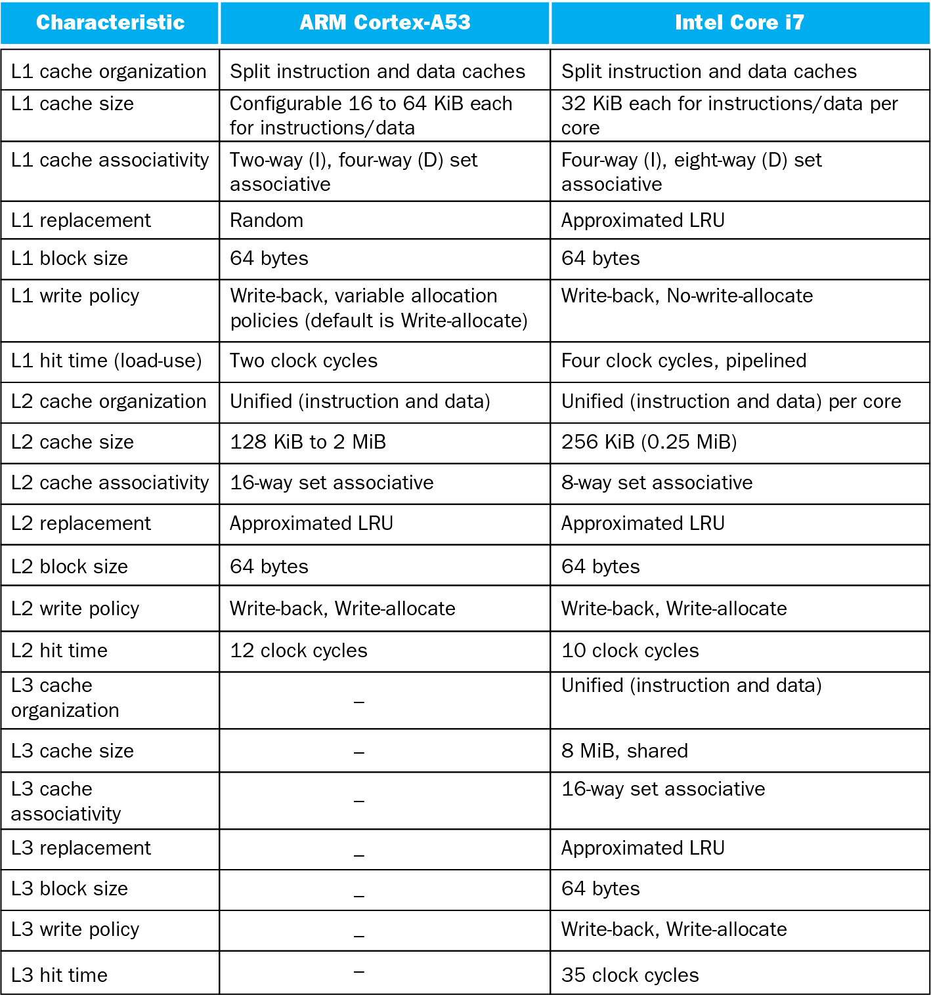
Multilevel On-Chip Caches
§5.13 The ARM Cortex-A53 and Intel Core i7 Memory Hierarchies
Notes:
Morgan Kaufmann Publishers
Chapter 5 — Large and Fast: Exploiting Memory Hierarchy

Slide 101
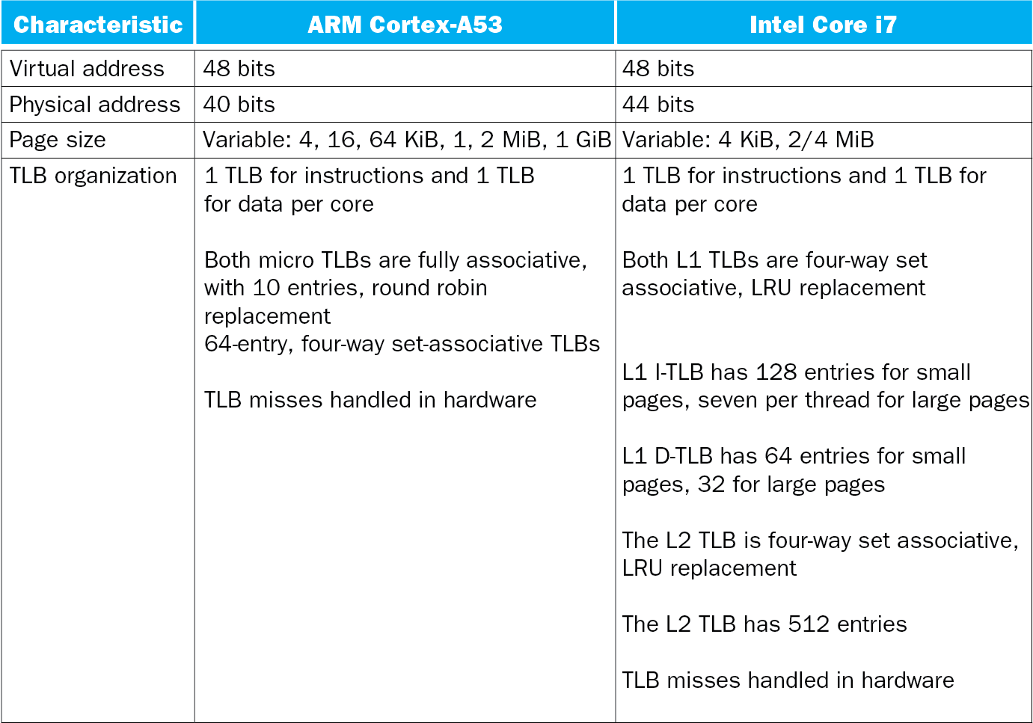
2-Level TLB Organization
Notes:
Morgan Kaufmann Publishers
Chapter 5 — Large and Fast: Exploiting Memory Hierarchy

Slide 102
Supporting Multiple Issue
Both have multi-banked caches that allow multiple accesses per cycle assuming no bank conflicts
Other optimizations
  Return requested word first
  Non-blocking cache
    Hit under miss
    Miss under miss
  Data prefetching
Notes:
Morgan Kaufmann Publishers
Chapter 5 — Large and Fast: Exploiting Memory Hierarchy

Slide 103
RISC-V System Instructions
Type | Mnemonic | Name
Mem ordering | fence.i | Instruction fence
 | fence | Fence
 | sfence.vm | Address translation fence
CSR access | csrrwi | CSR read/write immediate
 | csrrsi | CSR read/set immediate
 | csrrci | CSR read/clear immediate
 | csrrw | CSR read/write
 | csrrs | CSR read/set
 | csrrc | CSR read/clear
System | ecall | Environment call
 | ebreak | Environment breakpoint
 | sret | Supervisor exception return
 | wfi | Wait for interrupt
§5.14 Real Stuff: RISC-V System and Special Instructions

Slide 104

DGEMM
Combine cache blocking and subword parallelism
§5.15 Going Faster: Cache Blocking and Matrix Multiply

Slide 105
Pitfalls
Byte vs. word addressing
  Example: 32-byte direct-mapped cache,
  4-byte blocks
    Byte 36 maps to block 1
    Word 36 maps to block 4
Ignoring memory system effects when writing or generating code
  Example: iterating over rows vs. columns of arrays
  Large strides result in poor locality
§5.16 Fallacies and Pitfalls
Notes:
Morgan Kaufmann Publishers
Chapter 5 — Large and Fast: Exploiting Memory Hierarchy

Slide 106
Pitfalls
In multiprocessor with shared L2 or L3 cache
  Less associativity than cores results in conflict misses
  More cores ⇒ need to increase associativity
Using AMAT to evaluate performance of out-of-order processors
  Ignores effect of non-blocked accesses
  Instead, evaluate performance by simulation
Notes:
Morgan Kaufmann Publishers
Chapter 5 — Large and Fast: Exploiting Memory Hierarchy

Slide 107
Pitfalls
Extending address range using segments
  E.g., Intel 80286
  But a segment is not always big enough
  Makes address arithmetic complicated
Implementing a VMM on an ISA not designed for virtualization
  E.g., non-privileged instructions accessing hardware resources
  Either extend ISA, or require guest OS not to use problematic instructions
Notes:
Morgan Kaufmann Publishers
Chapter 5 — Large and Fast: Exploiting Memory Hierarchy

Slide 108
Concluding Remarks
Fast memories are small, large memories are slow
  We really want fast, large memories ☹
  Caching gives this illusion ☺
Principle of locality
  Programs use a small part of their memory space frequently
Memory hierarchy
  L1 cache ↔ L2 cache ↔ … ↔ DRAM memory
  ↔ disk
Memory system design is critical for multiprocessors
§5.17 Concluding Remarks
Notes:
Morgan Kaufmann Publishers
Chapter 5 — Large and Fast: Exploiting Memory Hierarchy

