Slide 1
Chapter 8
Storage, Networks and Other Peripherals

Slide 2
Contents of Chapter 8
8.1 Introduction
8.2 Disk Storage and Dependability
8.3 Networks (Skim)
8.4 Buses and Other Connections between
Processors Memory, and I/O Devices
8.5 Interfacing I/O Devices to the Memory,
Processor, and Operating System
8.6 I/O Performance Measures:
Examples from Disk and File Systems
8.7 Designing an I/O system
8.8 Real Stuff: A Typical Desktop I/O System

Slide 3
8.1 Introduction
I/O Designers must consider many factors
  such as expandability and resilience (resume), as well as performance.
Assessing I/O system performance is very difficult.
  In different situations, needs use different measurements.
Performance of I/O system depends on:
  connection between devices and the system
  the memory hierarchy
  the operating system

Slide 4
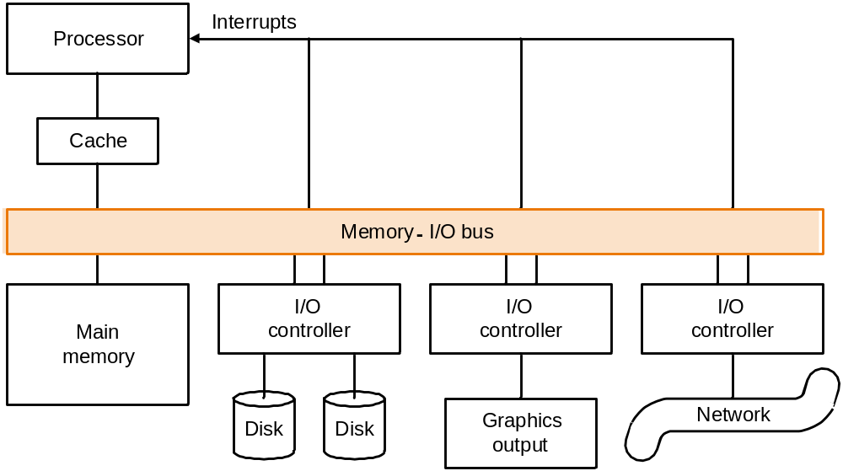
Typical collection of I/O devices

Slide 5
Three characteristics
  Behavior
    Input (read only), output (write only, cannot read) ,or storage (can be reread and usually rewritten)
  Partner
    Either a human or a machine is at the other end of the I/O device, either feeding data on input or reading data on output.
  Data rate
    The peak rate at which data can be transferred between the I/O device and the main memory or processor.

Slide 6
I/O performance depends on the application:
  throughput:
    In theses cases, I/O bandwidth will be most important. I/O bandwidth can be measured in two different ways :
      1.How much data can we move through the system in a certain time?
      For examples, in many supercomputer applications, most I/O requires are for long streams of data, and transfer bandwidth is the important characteristic. e.g., File download, data rate 6.8 MB/s

Slide 7
      2.How many I/O operations can we do per unit of time?
      For example, National Income Tax Service in USA mainly processes large number of small files.
  response time (e.g., I/O operation delay of workstation and PC)
  both throughput and response time (e.g., File server, Web server)

Slide 8
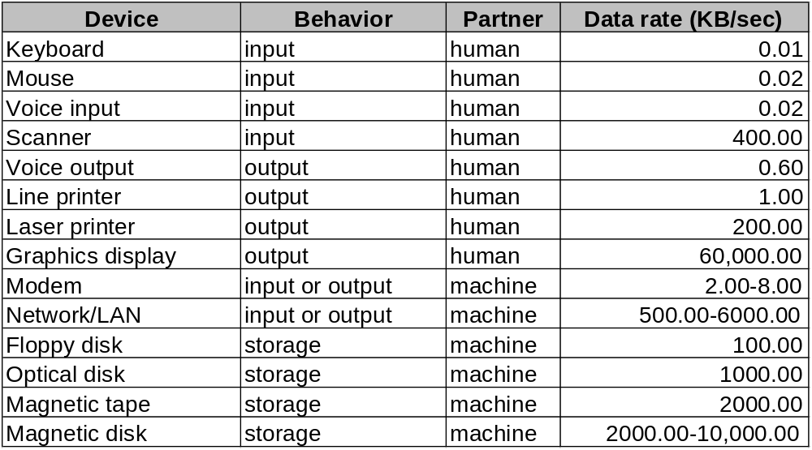
The diversity of I/O devices

Slide 9
补充内容
Amdahl’s law remind us that ignoring I/O is dangerous
  Assume:
    a benchmark executes in 100 seconds of elapsed time , where 90 seconds is CPU time and the rest is I/O time.
    CPU time improves by 50% per year, 90s→60s, but I/O time doesn’t improve.
    After five years, the improvement in CPU performance is 7.59 times(1.5 ^ 5 =7.59).
  The elapsed time is reduced to 90/7.59+10=12+10=22 seconds.
  So, the improvement in elapsed time is only 4.5 times. 100/22=4.5

Slide 10
8.2 Disk Storage and Dependability
Two major types of magnetic disks
  floppy disks
  hard disks
    larger
    higher density
    higher data rate
    more than one platter

Slide 11
The organization of hard disk
  platters: disk consists of a collection of platters, each of which has two recordable disk surfaces
  tracks: each disk surface is divided into concentric circles
  sectors: each track is in turn divided into sectors, which is the smallest unit that can be read or written

Slide 12
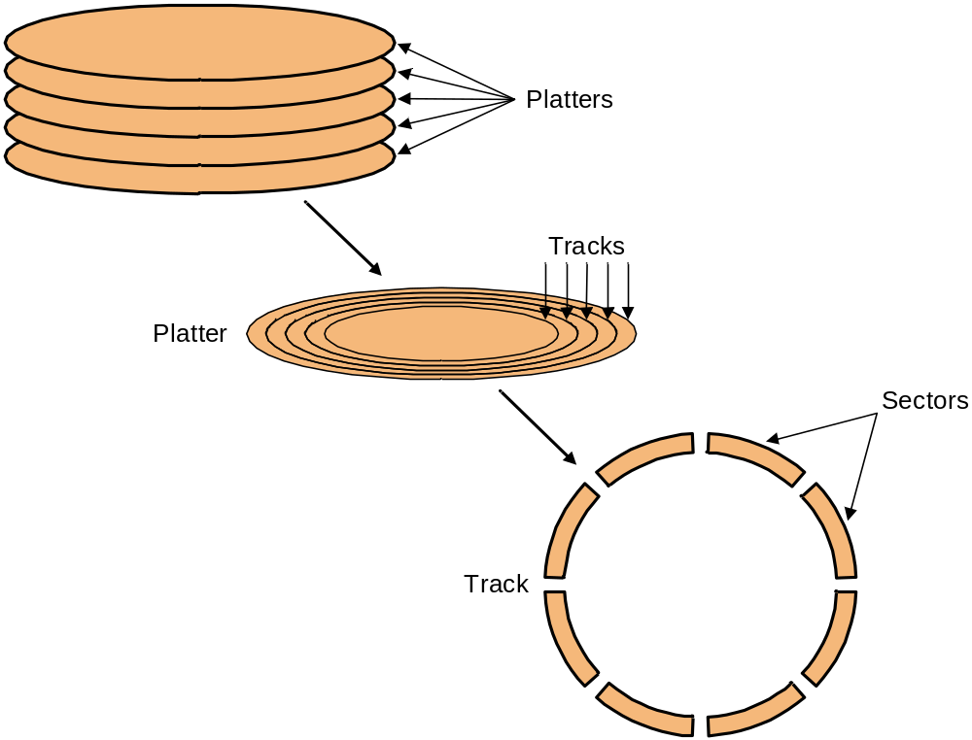
Disks are organized into platters, tracks, and sectors

Slide 13
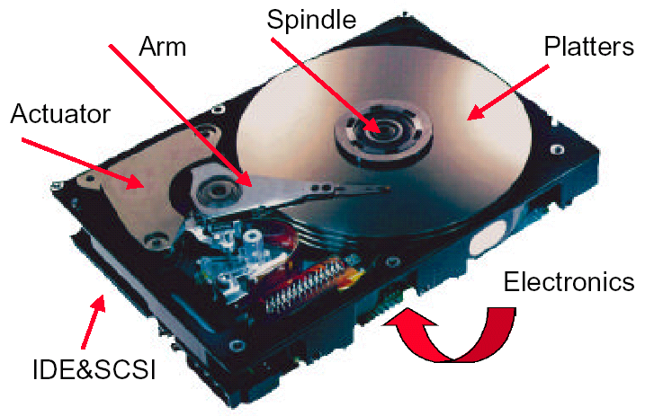
What’s Inside A Disk Drive?
传动机构

Slide 14
To access data of disk:
  Seek: position read/write head over the proper track
    minimum seek time
    maximum seek time
    average seek time (3 to 14 ms)
  Rotational latency: wait for desired sector
    average latency is the half-way round of the disk.
For 5400RPM (Revolution Per Minute)
0.5
rotation
0.5
rotation
Average rotational latency =
=
5400RPM
5400RPM
/
60
seconds
minute
= 0.0056
seconds =
5.6 ms
For 15000RPM
0.5
rotation
0.5
rotation
Average rotational latency =
=
seconds
15000RPM
15000RPM
/
60
minute
= 0.0020
seconds =
2.0 ms

Slide 15
  Transfer: time to transfer a sector (1 KB/sector).
    A function of rotation speed, sector size and recording density of a track.
    Transfer rate of today’s drives - 30 to 80 MBytes/second
  Disk controller, which control the transfer between
  the disk and the memory
Disk Read Time Page-570 512B/sector 50MB/S
Access Time = Seek time + Rotational Latency + Transfer time + Controller Time
0.5
0.5KB
＝6ms ＋
＋
＋ 0.2ms
10,000RPM
50MB/sec
＝6ms ＋ 3.0 ＋ 0.01 ＋ 0.2 ＝9.2ms
Assuming the measured seek time is 25% of the advertised average time
Access Time ＝25%×6ms ＋ 3.0 ms＋ 0.01ms ＋ 0.2ms ＝4.7ms

Slide 16
8.2.1 Dependability, Reliability, Availability
Computer system dependability（可依赖性） is the quality of delivered (提供） reliable service.
  The service delivered by a system：is its observed actual behavior when other system (s) interacts with this system.
Each module also has an ideal specified（规定的） behavior that is expected.
A system failure occurs when the actual behavior deviates from the specified behavior.
Service accomplishment, where the service is delivered as specified
Service interruption, where the delivered service is different from the specified service
Notes:
reliability
[ri7laiE5biliti]
n.
可靠性

Slide 17
Measure
MTTF mean time to failure（平均无故障时间）
MTTR mean time to repair
MTBF (Mean Time Between Failures)
= MTTF+ MTTR
Availability
MTTF
Availability=
MTTF+MTTR
Notes:
MTBF= Mean Time Between Failures

Slide 18
Three way to improve MTTF
Fault avoidance:
  preventing fault occurrence by construction
Fault tolerance 容错:
  using redundancy to allow the service to comply（依从） with the service specification（规范） despite faults occurring。
  This applies primarily to hardware faults
Fault forecasting:
  predicting the presence and creation of faults, which applies to hardware and software faults

Slide 19
RAID: Redundant Arrays of Inexpensive Disks
A disk arrays replace larger disk
3.5”
5.25”
10”
14”
Low End
High End

Slide 20
Redundant Arrays of (Inexpensive) Disks
Files are “striped” （条带化存放）across multiple disks
Redundancy yields high data availability
  Availability: service still provided to user, even if some components failed
Disks will still fail
data is redundantly stored in the array
  Capacity penalty（害处，损失） to store redundant info
  Bandwidth penalty to update redundant info

Slide 21
RAID 0: No Redundancy
Data is striped across a disk array
There is no redundancy to tolerate disk failure.
It also improves performance for large accesses,
since many disks can operate at once.
RAID 0 is something of a misnomer （用词不当）as there is no redundancy。

Slide 22
RAID 1: Disk Mirroring
recovery
group
• Each disk is fully duplicated onto its “mirror”
Very high availability can be achieved
• Most expensive solution: 100% capacity overhead
(RAID 2 not interesting, so skip)

Slide 23
RAID 3: Bit-Interleaved（位交叉） Parity Disk
10100011
11001101
10100011
. . .
P
logical record
1
0
1
0
0
0
1
1
1
1
0
0
1
1
0
1
1
0
1
0
0
0
1
1
1
1
0
0
1
1
0
1
Striped physical
records
P contains sum of
other disks per stripe
mod 2 (“parity”)
If disk fails, subtract
P from sum of other
disks to find missing information

Slide 24
Inspiration（启示）for RAID 4
RAID 3 relies on parity disk to discover errors on Read
But every sector has an error detection field
Rely on error detection field to catch errors on read, not on the parity disk
Allows independent reads to different disks simultaneously
后面图的D0、D1、D2往往指不同磁盘，偶尔指不同的block（磁盘块，大小1KB）

Slide 25
Difference between RAID3 and RAID4
Supporse 4 data disk D1、D2、D3、D4，and a parity disk, 4 byte data B1、B2、B3、B4 will be written.
  For RAID3, 4 byte data B1、B2、B3、B4 will be written to D1、D2、D3、D4 sequentially
  For RAID4, 4 byte data B1、B2、B3、B4 will be written to D1 only
Supporse 4 data disk D1、D2、D3、D4，and a parity disk, 4 sectors data S1、S2、S3、S4 will be written.
  For RAID4, data S1 will be written to D1, data S2 will be written to D2, data S3 will be written D3……

Slide 26

RAID 4: High I/O Rate Parity
Increasing
Logical
Disk
Address
D0
D1
D2
D3
P
Insides of 5 disks
D4
D5
D6
D7
P
D8
D9
D10
D11
P
Example:
small read D0 & D5,
large write D12-D15
D12
D13
D14
D15
P
Stripe
D16
D17
D18
D19
P
D20
D21
D22
D23
P
.
.
.
.
.
.
.
.
.
.
.
.
.
.
.
Disk Columns

Slide 27
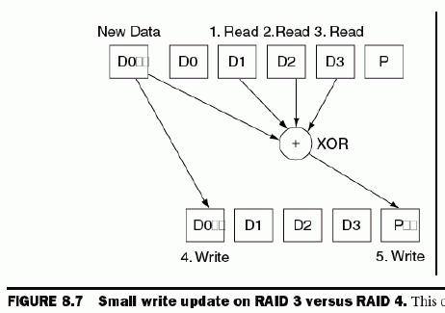
Problems of Disk Arrays:Small Writes
RAID-5: Small Write Algorithm
上面图中的D0、D1、D2指不同的磁盘
下面公式中D0、D1、D2指不同的block
P’=D0’ ⊕ D1⊕ D2⊕D3，
D1⊕ D2⊕D3=P ⊕D0，
所以P’=D0’ ⊕ P ⊕D0

Slide 28
Problems of Disk Arrays:
Small Writes
RAID-5: Small Write Algorithm
1 Logical Write = 2 Physical Reads + 2 Physical Writes
D0'
D0
D1
D2
D3
P
new
data
old
data
old
parity
(1. Read)
(2. Read)
+
XOR
P’=D0’ ⊕ D1⊕ D2⊕D3，
D1⊕ D2⊕D3=P ⊕D0，
所以P’=D0’ ⊕ P ⊕D0
= D0’ ⊕ D0 ⊕ P
+
XOR
(3. Write)
(4. Write)
D0'
D1
D2
D3
P'

Slide 29
Inspiration for RAID 5
RAID 4 works well for small reads
Small writes (write to one disk):
  Option 1: read other data disks, create new sum and write to Parity Disk
  Option 2: since P has old sum, compare old data to new data, add the difference to P
Small writes are limited by Parity Disk: Write to D0, D5 both also write to P disk
  Suppose the time to write a block to disk is T, 2T is needed to finish writing disk of following figure,because simultaneous write of 4 disks is impossible, only 2 disks (D0 and P) can be written during time T。校验盘上的两块P只能分两次写。
D0
D1
D2
D3
P
D4
D5
D6
D7
P

Slide 30
RAID 5: High I/O Rate Interleaved Parity
Simultaneous write of 4 disks (D0,D5,P,P) is possible , only time T is needed for following figure.不同盘上的两块P可以同时写。
D0
D1
D2
D3
P
Increasing
Logical
Disk
Addresses
Independent writes
possible because of
interleaved parity
D4
D5
D6
P
D7
D8
D9
P
D10
D11
D12
P
D13
D14
D15
Example: write to D0, D5 uses disks 0, 1, 3, 4
P
D16
D17
D18
D19
D20
D21
D22
D23
P
.
.
.
.
.
.
.
.
.
.
.
.
.
.
.
Disk Columns

Slide 31
RAID 6: P+Q Redundancy
When a single failure correction is not sufficient, Parity can be generalized to have a second calculation over data and another check disk of information.
可以理解成：使用两个 Parity盘.一个数据盘坏，一个Parity盘坏，则数据可恢复。

Slide 32
Summary: RAID Techniques: Goal was performance, popularity due to reliability of storage
• Disk Mirroring, Shadowing (RAID 1)
1
0
0
1
0
0
1
1
1
0
0
1
0
0
1
1
Each disk is fully duplicated onto its "shadow"
Logical write = two physical writes
100% capacity overhead
• Parity Data Bandwidth Array (RAID 3)
1
0
0
1
0
0
1
1
1
1
0
0
1
1
0
1
1
0
0
1
0
0
1
1
0
0
1
1
0
0
1
0
Parity computed horizontally
Logically a single high data bandwidth disk
• High I/O Rate Parity Array (RAID 5)
Interleaved parity blocks
Independent reads and writes
Logical write = 2 reads + 2 writes

Slide 33
8.3 Networks (skim)
  Key characteristics of typical networks include
  the following
    Distance: 0.01 to 10,000 kilometers
    Speed: 0.001MB/sec to 100MB/sec
    Topology: Bus, ring, star, tree
    Shared lines: None (point-to-point) or shared (multidrop)

Slide 34
  Local area network (LAN) e.g., Ethernet
  Packet-switched network ,which are common in long-haul networks
  e.g., ARPANET
  TCP/IP is the key to interconnecting different networks
  The bandwidths of networks are probably growing faster than the bandwidth of any other type of device at present.

Slide 35
8.4 Buses and Other Connections between Processors, Memory and I/O Devices
Shared communication link (one or more wires)
Difficult design:
  may be bottleneck
  The maximum bus speed (data rate) is limited by:
    length of the bus
    number of devices
  support for many different devices

Slide 36
A bus contains two or more types of lines
  Control lines, which are used to signal requests and
  acknowledgments, and to indicate what types of
  information is on the data lines.
  Data lines, which carry information (e.g., data, addresses, and
  complex commands) between the source and destination.
  Address lines, which may be not exist, and multiplex with data lines.
Bus transaction
  include two parts: sending the address and receiving or
  sending the data
  two operations
    input: inputting data from the device to memory or CPU
    output: outputting data to a device from memory or CPU

Slide 37
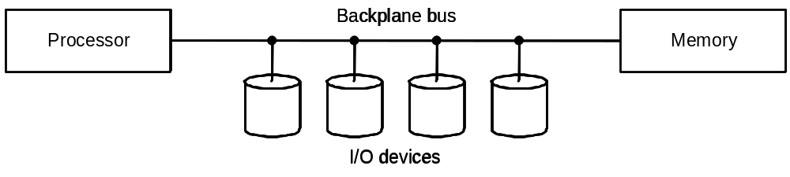
Types of buses:
  processor-memory (short high speed, custom design)
  backplane : to allow processors、memory、I/O devices to coexist on a single bus.
  I/O (lengthy, different devices, standardized, e.g., SCSI)

Slide 38
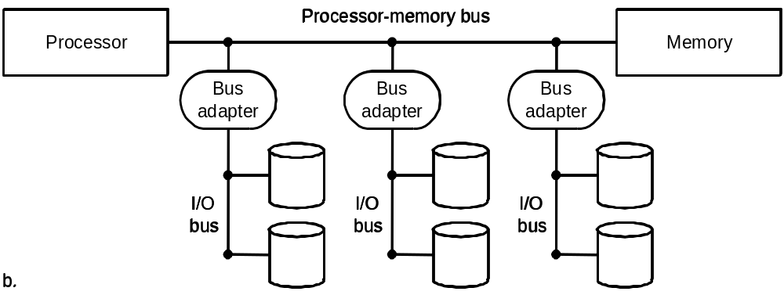
A separate bus is used for processor-memory traffic. The I/O bus use a bus adapter to interface to the processor-memory bus.
PCs often use above bus architecture for processor-to-memory communication, as well as communication between I/O devices and memory.

Slide 39
Synchronous vs. Asynchronous
  Synchronous bus use a clock and a synchronous protocol,
  fast and small but every device must operate at same rate
  and the bus requires to be short to avoid clock skew(偏离).
  e.g. SPI, I²C
  Asynchronous bus don’t use a clock and instead use
  handshaking. e.g. USB, IEEE 1394
  example: asynchronous buses use handshaking. Partner: memory, I/O device. assumes there are three control lines.
    ReadReq: Used to indicate a read request for memory. The address is
    put on the data lines at the same time.
    DataRdy: Used to indicate that data word is now ready on the data lines.
    Ack: Used to acknowledge the ReadReq or the DataRdy signal of the
    other party
Handshaking protocol

Slide 40
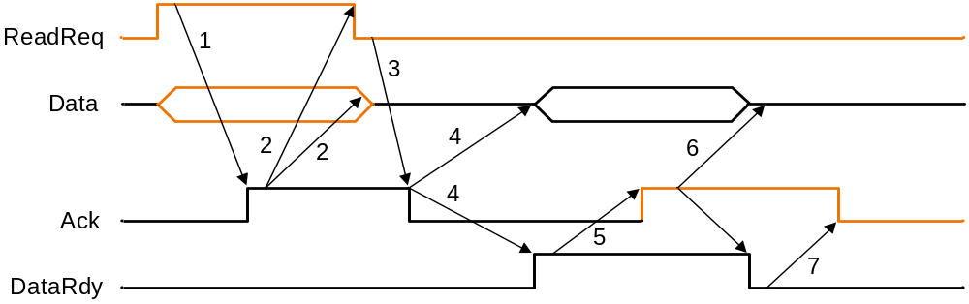
Example: The asynchronous handshaking consists of seven steps to read a word from memory and receive it in an I/O device.
Fig. 8-10 The asynchronous handshaking protocol
Note: Signal of yellow line is asserted by I/O device, and black signal is asserted by memory.
I/O device provides memory address in data bus and raise ReadReq. When memory sees the ReadReq line, it reads the address from the data bus, begin the memory read operation，then raises Ack to tell the device that the ReadReq signal has been seen.
I/O device sees the Ack line high and releases the ReadReq and data lines.
3. Memory sees that ReadReq is low and drops the Ack line.

Slide 41
Example: The asynchronous handshaking consists of seven steps to read a word from memory and receive it in an I/O device.
When the memory has the data ready, it places the data on the data lines and raises DataRdy.
5. The I/O device sees DataRdy, reads the data from the bus , and signals that it has the data by raising ACK.
The memory sees Ack signals, drops DataRdy, and releases the data lines.
7. Finally, the I/O device, seeing DataRdy go low, drops the ACK line, which indicates that the transmission is completed.

Slide 42
Bus Standards
  SCSI (small computer system interface)
  PCI (peripheral component interconnect)
  IPI (intelligent peripheral interface)
  ISA EISA

Slide 43
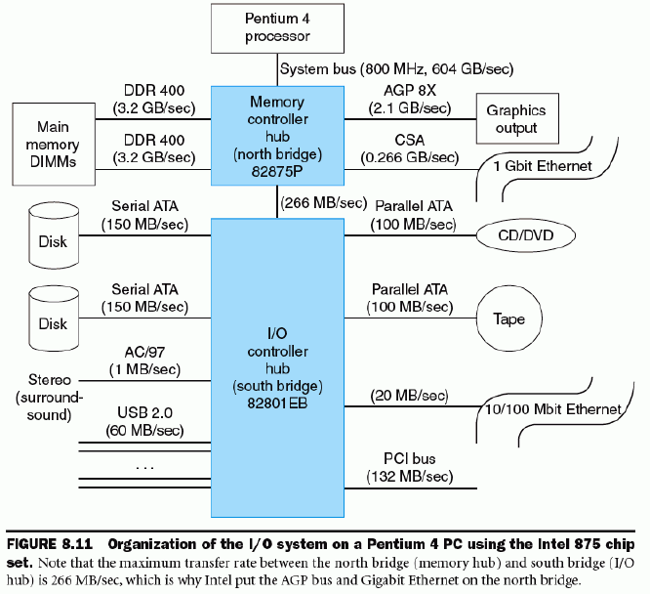
The Buses and Networks of Pentium

Slide 44
The Buses and Networks of Pentium
Processor
FSB
Analog
Display
VGA
(G)MCH
G_Ethernet
System
Memory
Graphics
Card
AGP or
PCI Exp.
DMI/Hub Interface
IDE (& SATA))
ICH
Power Management
USB
Clock Generation
AC’97 Codecs
LAN
PCI Exp.
System Management
PCI Bus
SMBus/I2C
GPIO
Key Board
Low Pin Count
(LPC) Interfaces
Super IO
…
Other ASIC
(Optional)
Mouse
BIOS Support
/ Firmware Hub

Slide 45
8.5 Interfacing I/O Devices to the Memory, Processor, and Operating System
Three characteristics of I/O systems
  shared by multiple programs using the processor.
  often use interrupts to communicate information about I/O operations.
  The low-level control of an I/O devices is complex
Three types of communication are required:
  The OS must be able to give commands to the I/O devices.
  The device must be able to notify the OS, when I/O device completed an operation or has encountered an error.
  Data must be transferred between memory and an I/O device

Slide 46
  Giving Commands to I/O Devices
  Two methods used to address the device
  memory-mapped I/O:
    portions of the memory address space are assigned to I/O devices(e.g. addr. 0xFFFE0000 and above is port address of I/O devices, and lw and sw instructions can be used to access the I/O port.
  special I/O instructions
    in al, 60H out 62H, al
    60H,62H is port address of I/O device
  command port ,data port
    The Status register (a done bit, an error bit……)
    The Data register, The command register

Slide 47
  Communication with the Processor
  I/O SYTEM DATA TRANSFER CONTROL MODE
  Polling: The processor periodically checks status bit to see if it is time for the next I/O operation.
  Interrupt: When an I/O device wants to notify processor that it has completed some operation or needs attentions, it causes processor to be interrupted.
  DMA (direct memory access): the device controller transfer data directly to or from memory without involving processor.

Slide 48
Interrupt-Driven I/O mode
Advantage: concurrent operation
Service for interruption
Service for interruption
Running
main program
go on doing
main program
main program
CPU
t
Response
interrupt
start
I/O
Response
interrupt
return
Interrupt return
Transfer
Data
Transfer
Data
Ready
Printing
Printing
t
Printer
Idle
start
Request
interrupt
Request
interrupt
Incept Data
Incept Data

Slide 49
DMA transfer mode
CPU
DMA
I/O DEVICE
memory
CPU INITIATION DMA
NO DMA ：I/O-CPU--M
DMA： I/O---M I/O DIRECT ACCESS MEMORY

Slide 50
A DMA transfer need three steps:
  The processor sets up the DMA by supplying some
  information, including the identity of the device, the
  operation, the memory address that is the source or
  destination of the data to be transferred, and the number
  of bytes to transfer.
  The DMA starts the operation on the device and arbitrates
  for the bus. If the request requires more than one transfer
  on the bus, the DMA unit generates the next memory
  address and initiates the next transfer.
  Once the DMA transfer is complete, the I/O controller
  interrupts the processor, which then examines whether
  errors occur.

Slide 51
Compare polling, interrupts, DMA
  The disadvantage of polling is that it wastes a lot of
  processor time.When the CPU polls the I/O devices periodically,the I/O devices maybe have no request or have not get ready.
  If the I/O operations is interrupt driven, the OS can work
  on other tasks while data is being read from or written to
  the device.
  Because DMA doesn’t need the control of processor, it
  will not consume much of processor time.

Slide 52
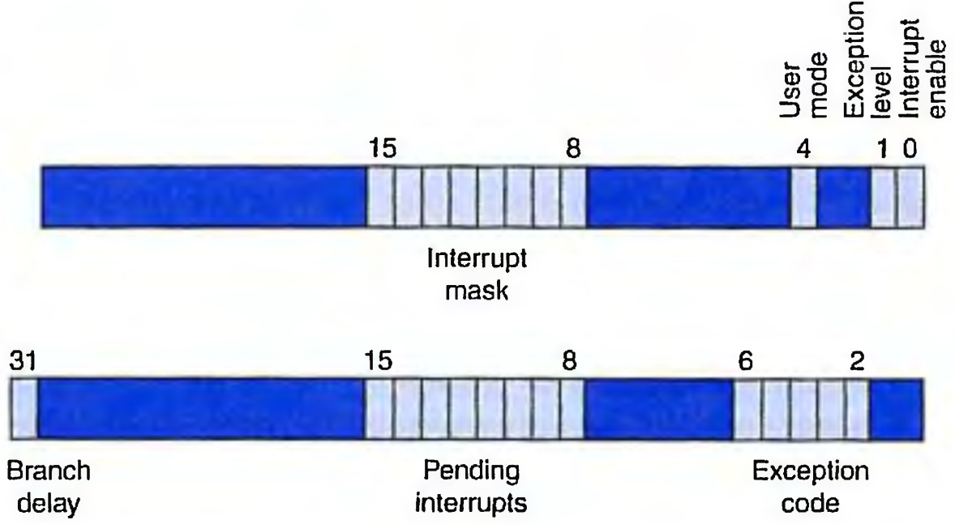
Interrupt Priority Levels
indicate the order in which the processor should process interrupts. The Cause and Status registers is as bellows:
Status Register
Cause Register

Slide 53
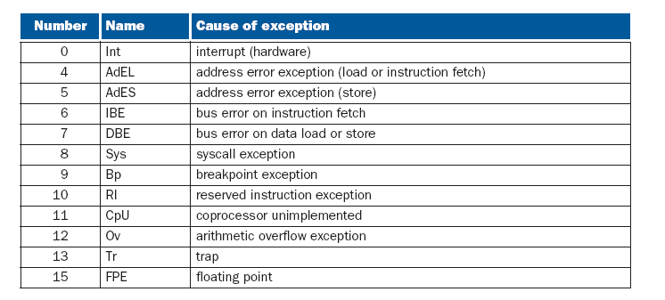
Exception Code

Slide 54
Interrupt Priority Levels
User mode: 1----current process is in user mode; 0----kernel mode
Exception Level: 1---- exception occurred, then any interrupts and new exception are disabled; 0---- no exception occurred
Interrupt enable: programmer may set its value, 1---- interrupts are allowed. 0---- interrupts are disabled.
Interrupt mask: 某位为1，对应的中断允许被响应；为0则中断不能被响应。
Status Register（起配置作用，名不副实）
Cause Register
Int. Priority: high －－－→ low

Slide 55
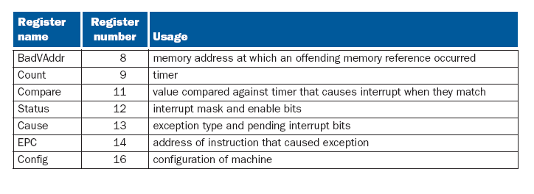
Coprocessor 0’s register set
mfc0 $k0, $13 moves coprocessor 0’s register 13 (the Cause register) into CPU register $k0.
mtc0 $k0, $13 moves CPU register $k0 into coprocessor 0’s register 13 (the Cause register)

Slide 56
Exceptions and interrupts cause a MIPS processor to jump to a piece of code, at address 0x80000180 (in the kernel, not user address space), called an exception handler.
This code examines the exception’s cause and jumps to an appropriate point in the operating system.
The operating system responds to an exception
  either by terminating the process that caused the exception, e.g. A process that causes an error, such as executing an unimplemented instruction, is killed by the operating system.
  or by performing some action. e.g. Page faults are requests from a process to the operating system to perform a service, such as bringing in a page from disk.

Slide 57
Name | Register no. | Usage | Preserved on call
$zero | 0 | The constant value 0 | n,.a.
$v0-$v1 | 2-3 | Values for results and expression evaluation | no
$a0-$a3 | 4-7 | Arguments | no
$t0-$t7 | 8-15 | Temporaries | no
$s0-$s7 | 16-23 | Saved | yes
$t8-$t9 | 24-25 | More temporaries | no
$gp | 28 | Global pointer | yes
$sp | 29 | Stack pointer | yes
$fp | 30 | Framer pointer | yes
$ra | 31 | Return address | yes
Other Registers
1----$at, reserved for assembler
26----$k0,reserver for operating system
27----$k1 , reserver for operating system

Slide 58
MIPS assembler directives:
.kdata <addr> Subsequent data items are stored in the kernel data segment. If the optional argument addr is present, subsequent items are stored starting at address addr.
.ktext <addr> Subsequent items are put in the kernel text segment.In SPIM, these items may only be instructions or words (see the .word directive below). If the optional argument addr is present, subsequent items are stored starting at address addr.
.word w1,..., wn Store the n 32-bit quantities in successive memory words.
以上内容在英文第三版教材光盘的附录A的A-48页

Slide 59
The code in the example below is a simple exception handler, which invokes a routine to print a message at each exception (but not interrupts). This code is similar to the exception handler (exceptions.s) used by the SPIM simulator.
.ktext 0x80000180
mov $k1, $at # Save $at register
sw $a0, save0 # Handler is not re-entrant and can’t use
sw $a1, save1 # stack to save $a0, $a1；# Don’t need to save $k0/$k1
mfc0 $k0, $13 # Move Cause reg（13# in Coprocessor 0）into $k0
srl $a0, $k0, 2 # Extract ExcCode field
andi $a0, $a0, 0xf
#bgtz $a0, done # Branch if ExcCode is Int (0)
# bgtz $a0, done if $a0>0, jump to done,所以本指令有错，换成 # 下面的指令
Beqz $a0, done # Branch if ExcCode is Int (0)
mov $a0, $k0 # Move Cause into $a0
mfc0 $a1, $14 # Move EPC into $a1
jal print_excp # Print exception error message（ cause register、EPC ）

Slide 60
done: mfc0 $k0, $14 # $k0← EPC($14 in in Coprocessor 0)
addiu $k0, $k0, 4 # Do not reexecute
# faulting instruction
mtc0 $k0, $14 # EPC($14)←$k0，本指令及上面2指令让EPC加 4，这样执行eret时返回到原异常指令的下一条指令
mtc0 $zero, $13 # Clear Cause register
mfc0 $k0, $12 # Fix Status register
andi $k0, 0xfffd # Clear EXL bit，允许后继异常发生
ori $k0, 0x1 # Enable interrupts
mtc0 $k0, $12
lw $a0, save0 # Restore registers
lw $a1, save1
mov $at, $k1
eret # Return to EPC, reset the EXL(Exception level)
bit to 0
.kdata
save0: .word 0
save1: .word 0
注意：本程序仅仅显示一下异常的号码、异常指令的地址（即cause register、EPC）等信息，并不真的处理异常，也不处理中断，无实用价值，仅在SPIM这样的模拟器中有用。

Slide 61
8.6 I/O Performance Measures: Examples from Disk and File Systems
Supercomputer I/O Benchmarks（基准测试程序）
Transaction Processing I/O Benchmarks
  I/O rate: the number of disk access per second, as opposed to data rate.
The most popular File System I/O Benchmarks include 5 phases：
  MakeDir, Copy, ScanDir, ReadAll, Make

Slide 62
8.7 Designing an I/O system
The general approaches to designing I/O system
  Find the weakest link in the I/O system, which is the component in the I/O path that will constrain the design. Both the workload and configuration limits may dictate where the weakest link is located.
  Configure this component to sustain(支持) the required bandwidth.
  Determine the requirements for the rest of the system and configure them to support this bandwidth.

Slide 63
I/O System Design
Examples:
Consider the following computer system:
  1. A CPU sustains （支持） 3 billion instructions per second and it takes average 100,000 instructions in the operating system per I/O operation.
  2. A memory backplane bus is capable of sustaining a transfer rate of 1000 MB/sec.
  3. SCSI-Ultra320 controllers with a transfer rate of 320 MB/sec and accommodating up to 7 disks.
  4. Disk drives with a read/write bandwidth of 75 MB/sec and an average seek plus rotational latency of 6 ms.

Slide 64
If the workload consists of 64-KB reads (assuming the the data block is sequential on a track), and the user program need 200,000 instructions per I/O operation, please find the maximum sustainable I/O rate and the number of disks and SCSI controllers required.
Answer:
The two fixed component of the system are the memory bus and the CPU. Let’s first find the I/O rate that these two components can sustain and determine which of these is the bottleneck.

Slide 65
Instruction execution rate
Maximum I/O rate of CPU =
Instruction per I/O
3
×
10
9
I/Os
=
＝
10000
3
seconds
(200
＋
100)
×
10
Bus bandwidth
1000
×
10
6
I/Os
Maximum I/O rate of bus =
=
= 15625
Bytes per I/O
64
×
10
3
seconds
The CPU is the bottleneck, so we can now configure the rest of the system at the level dictated by the CPU, 10000 I/Os per second.

Slide 66
Now, let’s determine how many disks we need to be able to Accommodate 10000 I/Os per second. To find the number of disks, we first find the time per I/O operation at the disk:
Time per I/O at disk =
Seek/rotational time + Transfer time
64KB
= 6 ms
＋
= 6.9 ms
75MB/sec
This means each disk can complete 1000ms/6.9ms, or 146 I/Os per second. To saturate the bus, the system need 10000/146≈69 disks.

Slide 67
To compute the number of SCSI buses, we need to know the average transfer rate per disk, which is given by:
Transfer size
64KB
Transfer rate =
=
≈ 9.56MB/sec
Transfer time
6.9ms
7 × 9.56MB/sec<320MB/s
69 ÷ 7 ≈ 10
Assuming the disk accesses are not clustered so that we can use all the bus bandwidth, we can place 7 disks per bus and controller. This means we will need 69/7, or 10 SCSI buses and controllers.

