Slide 1
Compile Principle and Technology

Slide 2
Chapter 8 Code Generation
the characteristics of the source language
information about the target architecture
the structure of the runtime environment
the operating system running on the target machine.
a compiler typically breaks up this phase into several steps, involving various intermediate data structures, often including some form of abstract code called intermediate code.

Slide 3
8.6 Code Generation in Commercial Compilers
( x = x +3 ) + 4
mov ax, word ptr [bp-2]
add ax, 3
mov word ptr [bp-2], ax
add ax, 4

Slide 4
The Borland 3.0 C Compiler for the 80X86
8.6 Code Generation in Commercial Compilers
1) Array Reference
A example:
( a [ i + 1 ] = 2 ) + a [ j ]
int i,j;
int a[10]
( 1 ) mov bx,word ptr [bp-2]
( 2 ) shl bx , 1
( 3 ) lea ax, word ptr [bp-22] load the address
( 4 ) add bx , ax computes the resulting address of a[i+1] into bx
( 5 ) mov ax , 2
( 6 ) mov word ptr [bx],ax
( 7 ) mov bx,word ptr [bp-4]
( 8 ) shl bx , 1
( 9 ) lea dx,word ptr [bp-24]
( 1 0 ) add bx , dx
( 1 1 ) add ax,word ptr [bx]

Slide 5
The Borland 3.0 C Compiler for the 80X86
8.6 Code Generation in Commercial Compilers
2) Pointer and Field References
  typedef struct rec
  { int i; offset 0
  char c; offset 2
  int j; offset 3
  } Rec;
  typedef struct treeNode
  { int val; offset 0
  struct treeNode * lchild, * rchild; offset 2 and offset 4
  } TreeNode;
  …
  Rec x; （have 5 bytes） bp -6
  TreeNode *p; ( 2 bytes “near” pointers) register si
  x.j = x.i mov ax, word ptr [bp-6]
  mov word ptr [bp-3], ax
  p->lchild = p mov word ptr [si+2], si

Slide 6
The Borland 3.0 C Compiler for the 80X86
8.6 Code Generation in Commercial Compilers
3) If and While-Statement
  if (x>y) y++;else x--;
  while (x<y) y -= x;
The Borland compiler generates the following 80x86 code for the given if-statement:
x is located in register bx
y is located in register dx.

Slide 7
The Borland 3.0 C Compiler for the 80X86
8.6 Code Generation in Commercial Compilers
if (x>y) y++;else x--;
cmp bx , dx
jle short @1@86
inc dx
jmp short @1@114
@1@86 :
dec bx
@1@114 :

Slide 8
The Borland 3.0 C Compiler for the 80X86
8.6 Code Generation in Commercial Compilers
while (x<y) y -= x;
jmp short @1@170
@1@142 :
sub dx , bx
@1@170 :
cmp bx , dx
jl short @1@142
the test is placed at the end, and an initial unconditional jump is made to this test.

Slide 9
The Borland 3.0 C Compiler for the 80X86
8.6 Code Generation in Commercial Compilers
4) function definition and call
  int f( int x, int y)
  { return x+y+1 ；}
  f (2+3, 4)
  _f proc near
  push bp
  mov bp,sp
  mov ax,word ptr [ bp+4]
  add ax,word ptr [bp+6]
  inc ax
  jmp short @1@58
  @1@58:
  pop bp
  ret
  _f
  mov ax,4
  push ax
  mov ax,5
  push ax
  call near ptr _f
  pop cx
  pop cx

Slide 10
8.7 TM: A Simple Target Machine
We generate target code directly for a very simple machine that can be easily simulated. We call this machine TM (for Tiny Machine).

Slide 11
8.7.1 Basic Architecture of the Tiny Machine
TM consists of a read-only instruction memory, a data memory, and a set of eight general-purpose registers.
These all use nonnegative integer addresses beginning at 0. Register 7 is the program counter and is the only special register.

Slide 12
8.7.1 Basic Architecture of the Tiny Machine
A register-only instruction has the format
opcode r, s, t
A register-memory instruction has the format
opcode r, d(s)

Slide 13
8.8 Code Generation for the Tiny Language
the interface of the TINY code generator to the TM.
describe the steps of the code generator proper.
describe the use of the TINY compiler in combination with the TM simulator.
discuss the target code file for the sample TINY program used throughout the book.

Slide 14
8.9 A Survey of Code Optimizations Techniques
The quality of the code can be measured by the speed and the size of the target code.
It is important to realize that a compiler writer cannot hope to include every single optimization technique that has ever been developed.
techniques are most likely to result in a significant code improvement with the smallest increase in the complexity of the compiler.

Slide 15
8.9.1 Principal Sources of Code Optimizations
the areas in which a code generator may fail to produce good code:
1) Register Allocation :Good use of registers is the most important feature of efficient code. Historically, the number of available registers was severely limited.
One approach: increase the number and speed of operations that can be performed directly in memory.
Another approach:
  (the so-called RISC approach) has been to decrease the number of operations that can be performed directly in memory (often to zero),
  increase the number of available registers to 32, 64 or 128. In such architectures proper register allocation becomes even more critical.

Slide 16
8.9.1 Principal Sources of Code Optimizations
2) Unnecessary Operations:
The second major source of code improvement is to avoid generating code for operations that are redundant or unnecessary.
This kind of optimization :
  a very simple search of localized code
  complex analysis of the semantic properties of the entire program.
avoiding storing the value of a variable or temporary that is not subsequently used.
  Unreachable or dead code
  #define DEBUG 0
  …..
  if (DEBUG)
  {………}

Slide 17
8.9.1 Principal Sources of Code Optimizations
3) Costly Operations
A code generator: to reduce the cost of operations that are necessary.
The replacement of arithmetic operations by cheaper operations.
For instance
  multiplication by 2 can be implemented as a shift operation.
  a small integer power, such as x³, can be implemented as a multiplication, such as x*x*x.
This optimization is called reduction in strength.

Slide 18
8.9.1 Principal Sources of Code Optimizations
Constant folding:
use information about constants
  to remove as many operations as possible
  to precompute as many operations as possible.
Constant propagation: if a variable might also have a constant value for part or all of a program.

Slide 19
8.9.1 Principal Sources of Code Optimizations
Two standard ways to remove procedure calls:
1. replacing the procedure call with the code for the procedure body (with suitable replacement of parameters by arguments). (Procedure in lining)
2. recognize tail recursion:
  when the last operation of a procedure is to call itself.
  tail recursion removal

Slide 20
8.9.1 Principal Sources of Code Optimizations
int gcd ( int u, int v)
{ if (v == 0) return u;
else return gcd(v, u%v);} /is a tail recursive
int fact (int n )
{ if (n==0) return 1;
else return n*fact(n-1); } / is not a tail recursive

Slide 21
8.9.1 Principal Sources of Code Optimizations
int gcd( int u, int v)
{ begin:
if ( v==0) return u;
else
{ int t1 = v, t2 = u%v;
u = t1; v = t2;
goto begin;
}
}

Slide 22
8.9.1 Principal Sources of Code Optimizations
4) Prediction Program Behavior:
To perform some of the previously described optimizations, a compiler must collect information about the uses of variables, values and procedures in programs
  whether expressions are reused
  whether or when variables change their values or remain constant
  whether procedures are called or not.
A different approach is taken by some compilers:
  statistical behavior about a program is gathered from actual executions
  which paths are most likely to be taken
  which procedures are most likely to be called often
  which sections of code are likely to be executed the most frequently.

Slide 23
8.9.2 Classification of Optimizations
Two useful classifications :
  the time during the compilation process when an optimization can be applied .
  the area of the program over which the optimization applies.

Slide 24
8.9.2 Classification of Optimizations
1、the time of application during compilation:
Optimizations can be performed at practically every stage of compilation.
constant folding can be performed as early as during parsing.
Some optimizations can be delayed until after target code has been generated (peephole optimizations).
Typically the majority of optimizations are performed
  during intermediate code generation.
  after intermediate code generation.
  during target code generation.
  source-level optimization
  target-level optimization

Slide 25
8.9.2 Classification of Optimizations
in ordering the various optimizations, it is important to consider the effect that one optimization may have on another.
x = 1;
. . .
y = 0;
. . .
if (y) x = 0;
. . .
if (x) y = 1;
x = 1;
. . .
y = 0;
. . .
if (0) x = 0;
. . .
if (x) y = 1;
x = 1;
. . .
y = 0;
. . .
if (x) y = 1;

Slide 26
8.9.2 Classification of Optimizations
2、The second classification scheme for optimizations that we consider is by the area of the program over which the optimization
（1）local optimizations: applied to straight-line segments of code, or basic blocks. That is , code sequences with no jumps into or out of the sequence.
（2）Global optimizations: applied to an individual procedure. Loop discovery are necessary
(3）Interprocedural optimizations: extend beyond the boundaries of procedures to the entire program.
Interprocedural optimization is even more difficult. .

Slide 27
8.9.3 Data Structures and Implementation Techniques for Optimizations
Some optimizations can be made by transformations on the syntax tree itself, including constant folding and unreachable code elimination.
an optimizer construct a graphical representation of the code called a flow graph.
  The nodes of a flow graph are the basic blocks.
  the edges are formed from the conditional and unconditional jumps.
  Each basic block node contains the sequence of intermediate code instructions of the block.

Slide 28
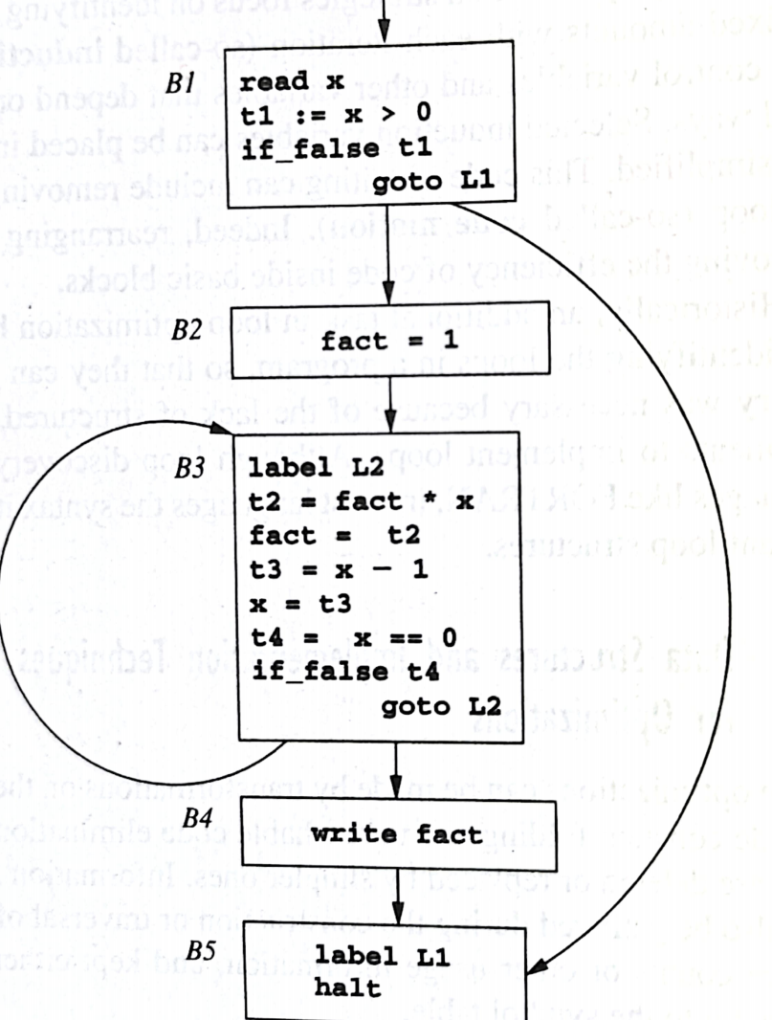
8.9.3 Data Structures and Implementation Techniques for Optimizations
A flow graph, together with each of its basic blocks, can be constructed by a single pass over the intermediate code. Each new basic block is identified as follows:
  (1) The first instruction begins a new basic block;
  (2) Each label that is the target of a jump begin a new basic block;
  (3) Each instruction that follows a jump begins a new basic block;

Slide 29
8.9.3 Data Structures and Implementation Techniques for Optimizations
A standard data flow analysis problem is to compute, for each variable, the set of so-called reaching definitions of that variable at the beginning of each basic block.
  a definition : an intermediate code instruction that can set the value of the variable, such as an assignment or a read.
  A definition is said to reach a basic block if at the beginning of the block the variable can still have the value established by this definition.
  Reaching definitions can be used in a number of optimizations.(in constant propagation)

Slide 30
8.9.3 Data Structures and Implementation Techniques for Optimizations
Another data structure is frequently constructed for each block, called the DAG of a basic block.
DAG traces the computation and reassignment of values and variables in a basic block as follows.
  (1) Values that are used in the block that come from elsewhere are represented as leaf nodes.
  (2) Operations on those and other values are represented by interior nodes.
  (3) Assignment of a new value is represented by attaching the name of the target variable or temporary to the node representing the value assigned.

Slide 31
8.9.3 Data Structures and Implementation Techniques for Optimizations
Repeated use of the same value also is represented in the DAG structure. For example, the C assignment x = (x+1)*(x+1) translates into the three-address instructions:
t1 = x + 1
t2 = x + 1
t3 = t1 * t2
x = t3

Slide 32
8.9.3 Data Structures and Implementation Techniques for Optimizations
The DAG of a basic block can be constructed by maintaining two dictionaries.
(1) a table containing variable names and constants, with a lookup operation that returns the DAG node to which a variable name is currently assigned.
(2) A table of DAG nodes, with a lookup operation that, given an operation and child node, returns the node with that operation and children or nil if there is no such node.

Slide 33
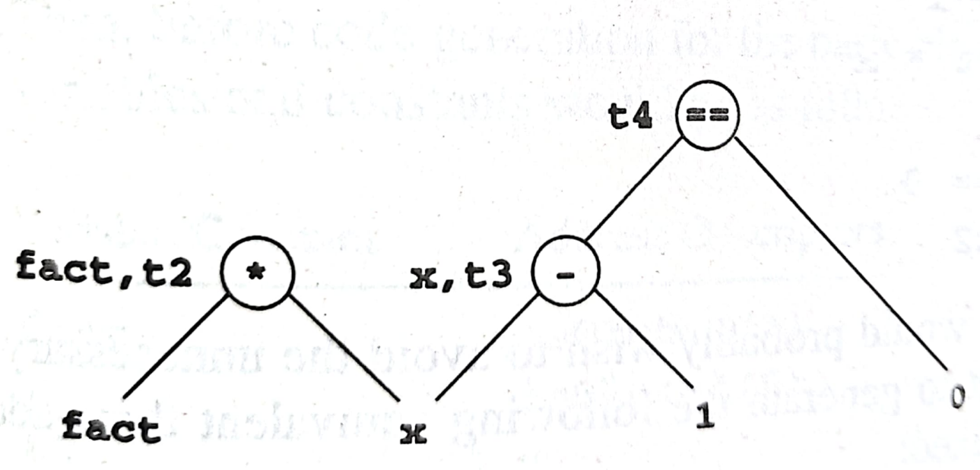
8.9.3 Data Structures and Implementation Techniques for Optimizations
Target code, or a revised version of intermediate code, can be generated from a DAG by a traversal according to any of the possible topological sorts of the nonleaf nodes.
For example, one of the legal traversal sequences of the three nonleaf nodes of Figure 8.19 would result in the following new sequence of three address instructions, which could replace the original basic block:
  t3 = x - 1
  t2 = fact * x
  x = t3
  t4 = x == 0
  fact = t2

Slide 34
8.9.3 Data Structures and Implementation Techniques for Optimizations
wish to avoid the unnecessary use of temporaries, and so would want to generate the following equivalent three-address code, whose order must remain fixed:
  fact = fact * x
  x = x - 1
  t4 = x == 0

Slide 35
8.9.3 Data Structures and Implementation Techniques for Optimizations
A similar traversal of the DAG of Figure 8.20 results in the following revised three-address code:
t1 = x + 1
x = t1 * t1
Using DAG to generate target code for a basic block, we automatically get local common subexpression elimination.
The DAG representation :
to eliminate redundant stores .
tells us how many references to each value there are.
This gives us information that permits good register allocation.

Slide 36
8.9.3 Data Structures and Implementation Techniques for Optimizations
A final mothod that is often used to assist register allocation as code generation proceeds involves the maintenance of data called register descriptors and address descriptors.
Register descriptors: associate with each register a list of the variable names whose value is currently in that register.
Address descriptors: associate with each variable name the locations in memory where its value is to be found.

