Slide 1
Chapter 5
Bottom-Up Parsing

Slide 2
Outline
A more powerful parsing technology
LR grammars -- more expressive than LL
Construct right-most derivation of program
  Left-recursion is not a problem
  Easier to express programming language syntax
L: the input is processed from left to right
R: a rightmost derivation is produced
Shift-reduce parsers
  Parsers for LR grammars
  Automatic parser generators (e.g., yacc)

Slide 3
5.3 SLR(1) Parsing
Difinition:
  The SLR(1) parsing algorithm.
  1. If state s contains any item of form A → α·Xβ, then the action is to shift the current input token X onto the stack, and the new state to be pushed on the stack is the state containing the item A → αX·β.
  2. If state s contains the complete item A → γ·, and the next token in the input string is in Follow(A), then the action is to reduce by the rule A → γ.

Slide 4
5.3.1 The SLR(1) Parsing Algorithm
  A reduction by the rule S' →S, where S' is the start state, this will happen only if the next input token is $.
  Remove the string γ and all of its corresponding states from the parsing stack.,
  back up in the DFA to the state from which the construction of γ began.
  This state must contain an item of the form B → α·Aβ. Push A onto the stack, and push the state containing the item B → αA·β.
3. If the next input token is such that neither of the above two cases applies, an error is declared

Slide 5
5.3.1 The SLR(1) Parsing Algorithm
A grammar is an SLR(l) grammar: the SLR( 1 ) parsing rules results in no ambiguity.
a grammar is SLR( 1) if and only if, for any state s, the following two conditions are satisfied:
For any item A → α·Xβ in s with X a terminal, there is no complete item B → γ. in s with X in Follow(B).
2. For any two complete items A → α·and B →β· in s, Follow(A) ∩ Follow(B) is empty.

Slide 6
5.3.1 The SLR(1) Parsing Algorithm
Example 5. 1 0
  this grammar is not LR(0), but it is SLR(l).
  Follow(E') ={$ } and Follow(E) = { $, +} .
conflict
E′→• E
E→ • E +n
E→ • n
E
E′→ E•
E→ E • +n
0
1
n
+
E→ n •
E→ E + • n
n
E→ E + n •
2
3
4

Slide 7
5.3.1 The SLR(1) Parsing Algorithm
Example 5. 11
the grammar of balanced parentheses, Follow(S') = {$} and Follow(S)={$,)}.
  Note how the non-LR(0) states 0, 2, and 4 have both shifts and reductions by theε-production S →
S' → •S
S → •(S)S
S → •
S
S' → S •
1
0
(
S → (S •)S
S
3
S → (• S)S
S → •(S)S
S → •
)
2
(
(
S → (S) • S
S → •(S)S
S → •
S
S → (S)S •
5
4

Slide 8
5.3.1 The SLR(1) Parsing Algorithm
Note how the stack continues to grow until the final reductions.
This is characteristic of bottom-up parsers in the presence of right-recursive rules such as S → (S)S.
Right recursion can cause stack overflow, and so is to be avoided if possible.

Slide 9
5.3.2 Disambiguating Rules for Parsing Conflicts
two kinds of parsing conflicts in SLR( l ) parsing
  shift-reduce conflicts
  reduce-reduce conflicts.
In the case of shift-reduce conflicts, there is a natural disambiguating rule
  always prefer the shift over the reduce.
The case of reduce-reduce conflicts is more difficult
  such conflicts often (but not always) indicate
  an error in the design of the grammar.

Slide 10
5.3.2 Disambiguating Rules for Parsing Conflicts
Example 5. 1 2
  statement →if-stmt| other
  if-stmt → if (exp) statement
  |if (exp) statement else statement
  exp→0|1
  S→I| other
  I→if S | if S else S

Slide 11
5.3.2 Disambiguating Rules for Parsing Conflicts
S′→• S
S→• I
S →• other
I →• if S
I→• if S else S
S
S′→S•
1
I
S→ I•
2
0
I
I
if
other
other
I → if • S
I→ if • S else S
S→• I
S →• other
I →• if S
I→• if S else S
I→ if S else • S
S→• I
S →• other
I →• if S
I→• if S else S
S→ other•
3
if
4
6
if
else
S
S
I → if S •
I→ if S • else S
other
5
I→ if S else S •
7
The conflict occurs in states 5 of the DFA.
A disambiguating rule: prefers the shift over the reduce.

Slide 12
5.3.3 Limits of SLR(1) Parsing Power
SLR(1) parsing is not quite powering enough
  Example 5. 13 :the statements extracted and simplified from Pascal (a similar situation occurs in C)
  stmt → call-stmt | assign-stmt
  call-stmt → identifier
  assign-stmt → var :=exp
  var →var [ exp ] | identifier
  exp → var | number

Slide 13
5.3.3 Limits of SLR(1) Parsing Power
S → id | V := E
V→ id
E → V | n
  S’ → ·S
  S → ·id
  S → ·V := E
  V→ ·id
This state has a shift transition on id to the state
  S → id·
  V→ id·
  Follow(S)={$} Follow(V)={:=, $}
the SLR(l) parsing algorithm calls for a reduction :
the rule S → id and the rule V→ id under
input symbol $.
(This is a reduce-reduce conflict.)

Slide 14
5.4 General LR(1) and LALR(1) Parsing
The difficulty with the SLR(1) method :
  applies lookaheads after the construction of the DFA of LR(0) items
The power of the general LR(1) method :
  it uses a new DFA that has the lookaheads built into its construction from the start.
an LR(l) item is a pair consisting of an LR(0) item and a lookahead token.

Slide 15
5.4.1 Finite Automata of LR(1) Items
We write LR(1) items using square brackets as
  [A → α.β, a]
where A → αβis an LR(0) item and a is a token (the lookahead).
The major difference between the LR(0)and LR(1) automata:
  the definition of theε-transitions.

Slide 16
5.4.1 Finite Automata of LR(1) Items
Definition of LR(1) transitions (part 1).
Given an LR(1) item [A→α·Xγ,a], where X is any symbol (terminal or nontermilnal), there is a transition on X to the item [A→ αX·γ,a]
Definition of LR(1) transitions (part 2).
Given an LR(1) item [A→α·Bγ,a], where B is a nonterminal, there areε-transitions to items [B→·β,b] for every production
B →βand for every token b in First(γa).

Slide 17
5.4.1 Finite Automata of LR(1) Items
The start state :
  augmenting the grammar with a new start symbol S’
  a new production S’ —> S
The start symbol of the NFA of LR(1) items becomes the item [S’ —>.S, $].

Slide 18
5.4.1 Finite Automata of LR(1) Items
Example 5.14
Consider the grammar :A→(A) | a
A’→.A, $
A →.(A), $
A →.a, $
A
A’→A ., $
a
(
A→ a., $
A → (.A), $
A → .(A), )
A →.a, )
A
)
A → (A .), $
A → (A) ., $
a
A→ a., )
(
a
(
A → (.A), )
A → .(A), )
A →.a, )
A
)
A → (A .), )
A → (A) ., )

Slide 19
5.4.2 The LR(1) Parsing Algorithm
The General LR(1) parsing algorithm :
  Let s be the current state (a the top of the parsing stack). Then actions are defined as follows:
  1. If state s: any LR(l ) item of the form [A→α·Xβ,a], X is a terminal, and X is the next token in the input string
  2. If state s : the complete LR(1) item [A→α·,a] , the next token: in the input string is a
  3. If the next input token is such that neither of the above two cases applies, an error is declared.

Slide 20
5.4.2 The LR(1) Parsing Algorithm
A grammar is an LR(1) grammar :
  if the application of the above general LR( l ) parsing rules results in no ambiguity.
a grammar is LR(1) if and only if, for any state s. the following two conditions are satisfied.
  l. For any item [A→α·Xβ,a] in s with X a terminal, there is no item in s of the form [B→γ·,X] (otherwise there is a shift-reduce conflict).
  2. There are no two items in s of the form [A→α·, a] and [B→β·,a] (otherwise, there is a reduce-reduce conflict).

Slide 21
5.4.2 The LR(1) Parsing Algorithm
Example 5.15 (l) A→(A) (2) A→a
State | Input |  |  |  | Goto
 | ( | a | ) | $ | A
0 | s2 | s3 |  |  | 1
1 |  |  |  | accept
2 | s5 | s6 |  |  | 4
3 |  |  |  | r2
4 |  |  | s7
5 | s5 | s6 |  |  | 8
6 |  |  | r2
7 |  |  |  | r1
8 |  |  | s9
9 |  |  | r1

Slide 22
5.4.2 The LR(1) Parsing Algorithm
Example 5.16
S → id | V := E
V→ id
E → V | n
S′→• S, $
S→• id, $
S→• V := E, $
V→• id, :=
S
S′→S• , $
1
id
S→id• , $
V→ id•, :=
0
2
V
:=
S→V := • E, $
E→• V,$
E →• n,$
V→• id, $
S→ V• := E, $
3
E
4
S→ V := E •, $
5
id
V
n
E→ V•,$
E →n• ,$
V→ id• , $
6
7
8

Slide 23
5.4.3 LALR(1) Parsing
the size of the DFA of sets of LR(1) items is too large
the same set of first components
differing only in their second components (the lookahead symbols).

Slide 24
5.4.3 LALR(1) Parsing
The LALR(1 ) parsing algorithm : it makes sense to identify all such states and combine their lookaheads.
LALR(l) parsing retains some of the benefit of LR(l) parsing over SLR(l) parsing,
preserving the smaller size of the DFA of LR(0) items.

Slide 25
5.4.3 LALR(1) Parsing
FIRST PRINCIPLE OF LALR(1) PARSING
  The core of a state of the DFA of LR(l) items is a state of the DFA of LR(0) items.
SECOND PRINCIPLE OF LALR(1) PARSING
  Given two states s₁ and s₂ of the DFA of LR(l) items that have the same core, suppose there is a transition on the symbol X from s₁ to a state t₁. Then there is also a transition on X from state s₂ to a state t₂, and the states t₁ and t₂ have the same core.

Slide 26
5.4.3 LALR(1) Parsing
these two principles allow us to construct the DFA of LALR(l) items
  identifying all states that have the same core
  forming the union of the lookahead symbols for each LR(0) item.

Slide 27
5.4.3 LALR(1) Parsing
Example 5.17 Consider the grammar of Example 5.14. (l) A→(A) (2) A→a
A’→.A, $
A →.(A), $
A →.a, $
A
A’→A ., $
1
0
a
(
A→ a., $/ )
a
3
A → (.A), $/ )
A → .(A), )
A →.a, )
)
A → (A .), $/ )
A → (A) ., $/ )
A
4
5
2
(

Slide 28
5.4.3 LALR(1) Parsing
A grammar is an LALR(l) grammar if no parsing conflicts arise in the LALR( l) parsing algorithm.
If a grammar is LR(l), then the LALR(l) parsing table cannot have any shift-reduce conflicts, there may be reduce-reduce conflicts.
[A → α. a]
[B → α. b]
[A → α. b]
[B → α. a]
[A → α. a/b]
[B → α. a/b]

Slide 29
5.4.3 LALR(1) Parsing
If a grammar is SLR(l), then it certainly is LALR(l)
LALR(1) parsers often do as well as general LR(1) parsers in removing typical conflicts that occur in SLR(l) parsing.

Slide 30
5.4.3 LALR(1) Parsing
If the grammar is already LALR( l ), the only consequence of using LALR( l ) parsing over general LR parsing as following. in the presence of errors,
some spurious reductions may be made before error is declared. for example a)
A’→.A, $
A →.(A), $
A →.a, $
A
A’→A ., $
0
a
1
(
A→ a., $/ )
a
3
A → (.A), $/ )
A → .(A), )
A →.a, )
)
A → (A) ., $/ )
A → (A .), $/ )
(
A
4
5
2

Slide 31
5.4.3 LALR(1) Parsing
compute the DFA of LALR( l) items directly from the DFA of LR(0) items through a process of propagating lookaheads.

Slide 32
5.7 ERROR RECOVERY IN BOTTOM-UP PARSERS
A bottom-up parser will detect an error when a blank (or error) entry is detected in the parsing table.
that errors should be detected as soon as possible.
This goal conflicts with an equally important one: reducing the size of the parsing table.

Slide 33
5.7 ERROR RECOVERY IN BOTTOM-UP PARSERS
An LR(l) parser can, for example, detect errors earlier than an LALR(l) or SLR( 1) parser, and these latter can detect errors earlier than an LR(0) parser.

Slide 34
5.7 ERROR RECOVERY IN BOTTOM-UP PARSERS
A good error recovery in bottom-up parsers: removing symbol from either the parsing stack or the input or both.
There are three possible alternative actions:
  l. Pop a state from the stack.
  2. Successively pop tokens from the input until a token is seen for which we can restart the parse.
  3. push a new state onto the stack.

Slide 35
5.7 ERROR RECOVERY IN BOTTOM-UP PARSERS
l. Pop states from the parsing stack until a state is found with nonempty Goto entries.
2. If there is a legal action on the current input token from one of the Goto states, push that state onto the stack and restart the parse.
3. If there is no legal action on the current input token from one of the Goto states, advance the input.
Example 5.19

Slide 36
5.7 ERROR RECOVERY IN BOTTOM-UP PARSERS
There are several possible solutions (infinite loop)
1、 insist on a shift action from a Goto state in step 2. （ too restrictive ）
2、 if the next legal move is a reduction, to set a flag that causes the parser to keep track of the sequence of states during the following reductions
3、 if the same state recurs, to pop stack states until the original state is removed.

Slide 37
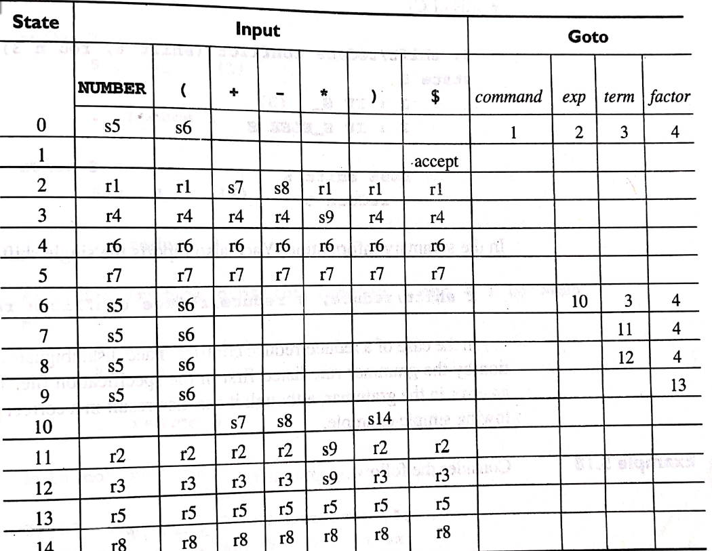
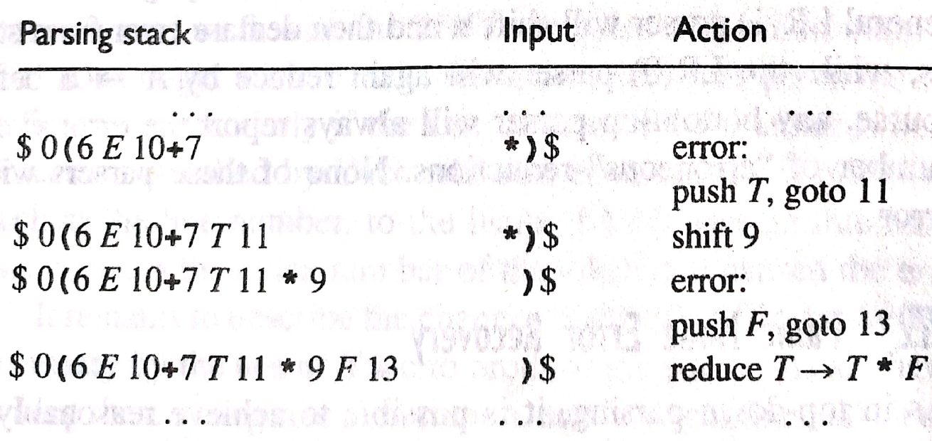
5.7 ERROR RECOVERY IN BOTTOM-UP PARSERS
for the input (2+*)

Slide 38
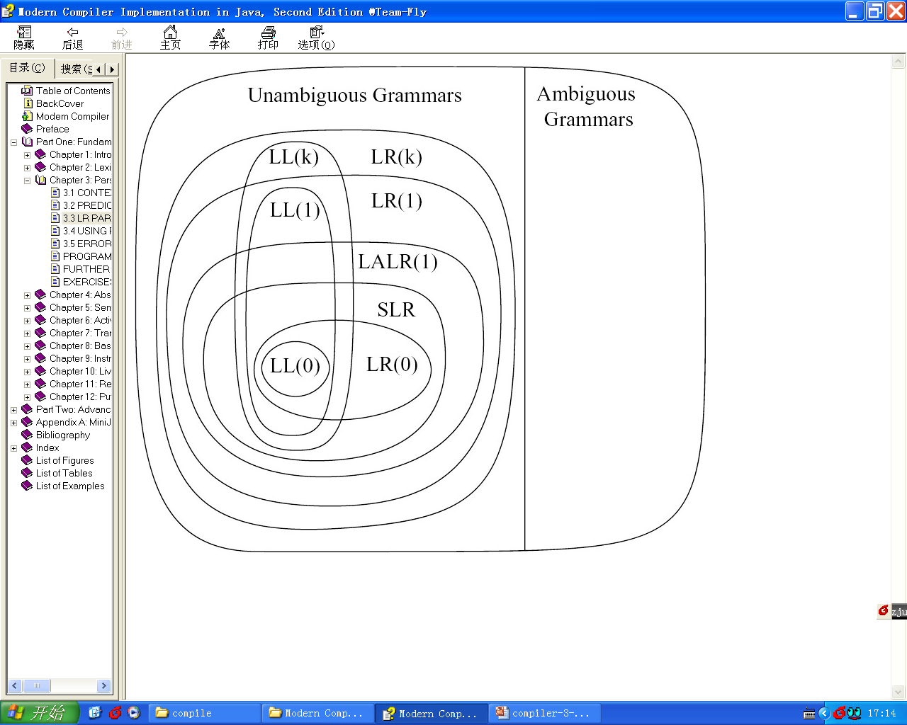
Hierarchy of Grammar Classes
the relationship between several classes of grammars.
Example:
All SLR grammars are LALR(1)
but not vice versa.

