Slide 1
Chapter 9
TRAP Routines and
Subroutines

Slide 2
System Calls
Certain operations require specialized knowledge
and protection:
  specific knowledge of I/O device registers
  and the sequence of operations needed to use them
  I/O resources shared among multiple users/programs;
  a mistake could affect lots of other users!
Not every programmer knows (or wants to know)
this level of detail
Provide service routines or system calls
(part of operating system) to safely and conveniently
perform low-level, privileged operations

Slide 3
System Call
1. User program invokes system call.
2. Operating system code performs operation.
3. Returns control to user program.
In LC-3, this is done through the TRAP mechanism.

Slide 4
LC-3 TRAP Mechanism
1. A set of service routines.
  part of operating system -- routines start at arbitrary addresses
  (convention is that system code is below x3000)
  up to 256 routines
2. Table of starting addresses.
  stored at x0000 through x00FF in memory
  called System Control Block in some architectures
3. TRAP instruction.
  used by program to transfer control to operating system
  8-bit trap vector names one of the 256 service routines
4. A linkage back to the user program.
  want execution to resume
  immediately after the TRAP instruction

Slide 5
TRAP Instruction
Trap vector
  identifies which system call to invoke
  8-bit index into table of service routine addresses
    in LC-3, this table is stored in memory at 0x0000 – 0x00FF
    8-bit trap vector is zero-extended into 16-bit memory address
Where to go
  lookup starting address from table; place in PC
How to get back
  save address of next instruction (current PC) in R7

Slide 6
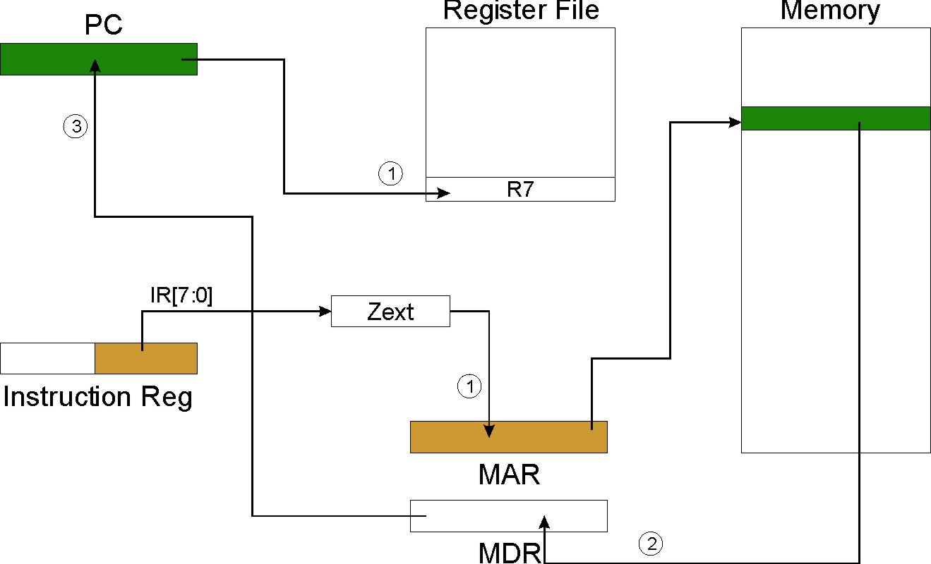
TRAP
NOTE: PC has already been incremented
during instruction fetch stage.

Slide 7
RET (JMP R7)
How do we transfer control back to
instruction following the TRAP?
We saved old PC in R7.
  JMP R7 gets us back to the user program at the right spot.
  LC-3 assembly language lets us use RET (return)
  in place of “JMP R7”.
Must make sure that service routine does not
change R7, or we won’t know where to return.

Slide 8
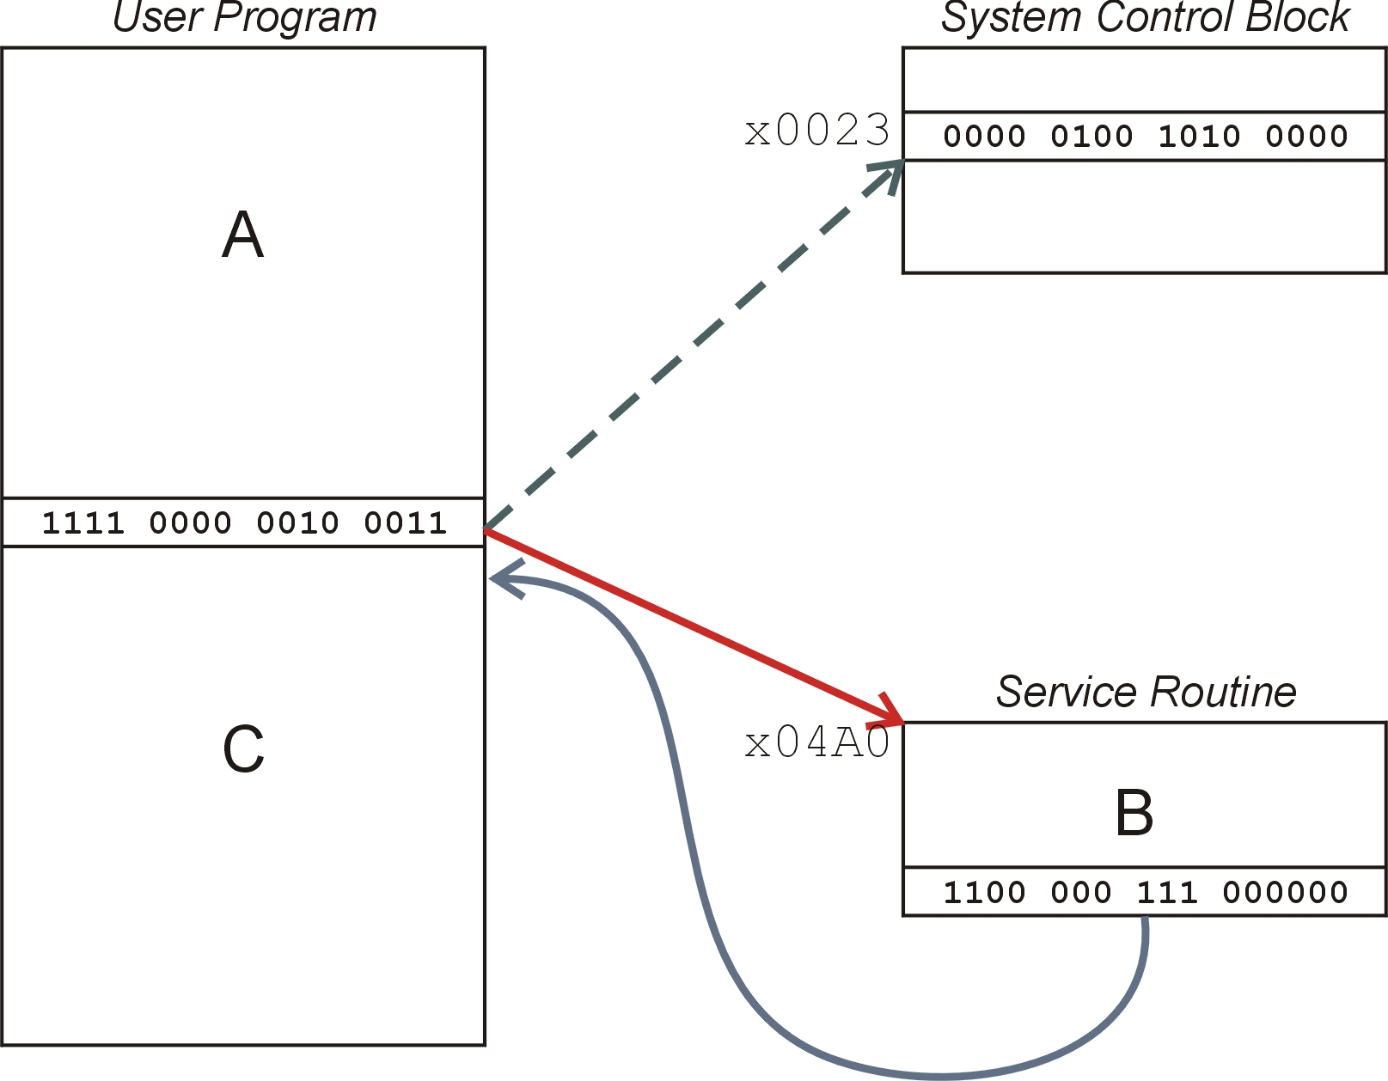
TRAP Mechanism Operation
Lookup starting address.
Transfer to service routine.
Return (JMP R7).

Slide 9
Example: Using the TRAP Instruction
.ORIG x3000
LD R2, TERM ; Load negative ASCII ‘7’
LD R3, ASCII ; Load ASCII difference
AGAIN TRAP x23 ; input character
ADD R1, R2, R0 ; Test for terminate
BRz EXIT ; Exit if done
ADD R0, R0, R3 ; Change to lowercase
TRAP x21 ; Output to monitor...
BRnzp AGAIN ; ... again and again...
TERM .FILL xFFC9 ; -‘7’
ASCII .FILL x0020 ; lowercase bit
EXIT TRAP x25 ; halt
.END

Slide 10
Example: Output Service Routine
.ORIG x0430 ; syscall address
ST R7, SaveR7 ; save R7 & R1
ST R1, SaveR1
; ----- Write character
TryWrite LDI R1, CRTSR ; get status
BRzp TryWrite ; look for bit 15 on
WriteIt STI R0, CRTDR ; write char
; ----- Return from TRAP
Return LD R1, SaveR1 ; restore R1 & R7
LD R7, SaveR7
RET ; back to user
CRTSR .FILL xF3FC
CRTDR .FILL xF3FF
SaveR1 .FILL 0
SaveR7 .FILL 0
.END
stored in table,
location x21

Slide 11
TRAP Routines and their Assembler Names
vector | symbol | routine
x20 | GETC | read a single character (no echo)
x21 | OUT | output a character to the monitor
x22 | PUTS | write a string to the console
x23 | IN | print prompt to console, read and echo character from keyboard
x25 | HALT | halt the program

Slide 12
Saving and Restoring Registers
Must save the value of a register if:
  Its value will be destroyed by service routine, and
  We will need to use the value after that action.
Who saves?
  caller of service routine?
    knows what it needs later, but may not know what gets altered by called routine
  called service routine?
    knows what it alters, but does not know what will be needed later by calling routine

Slide 13
Example
LEA R3, Binary
LD R6, ASCII ; char->digit template LD R7, COUNT ; initialize to 10
AGAIN TRAP x23 ; Get char
ADD R0, R0, R6 ; convert to number
STR R0, R3, #0 ; store number
ADD R3, R3, #1 ; incr pointer
ADD R7, R7, -1 ; decr counter
BRp AGAIN ; more?
BRnzp NEXT
ASCII .FILL xFFD0
COUNT .FILL #10
Binary .BLKW #10
What’s wrong with this routine?
What happens to R7?

Slide 14
Saving and Restoring Registers
Called routine -- “callee-save”
  Before start, save any registers that will be altered
  (unless altered value is desired by calling program!)
  Before return, restore those same registers
Calling routine -- “caller-save”
  Save registers destroyed by own instructions or
  by called routines (if known), if values needed later
    save R7 before TRAP
    save R0 before TRAP x23 (input character)
  Or avoid using those registers altogether
Values are saved by storing them in memory.

Slide 15
Question
Can a service routine call another service routine?
If so, is there anything special the calling service routine
must do?

Slide 16
What about User Code?
Service routines provide three main functions:
1. Shield programmers from system-specific details.
2. Write frequently-used code just once.
3. Protect system resources from malicious/clumsy
programmers.
Are there any reasons to provide the same functions
for non-system (user) code?

Slide 17
Subroutines
A subroutine is a program fragment that:
  lives in user space
  performs a well-defined task
  is invoked (called) by another user program
  returns control to the calling program when finished
Like a service routine, but not part of the OS
  not concerned with protecting hardware resources
  no special privilege required
Reasons for subroutines:
  reuse useful (and debugged!) code without having to
  keep typing it in
  divide task among multiple programmers
  use vendor-supplied library of useful routines

Slide 18
JSR Instruction
Jumps to a location (like a branch but unconditional),
and saves current PC (addr of next instruction) in R7.
  saving the return address is called “linking”
  target address is PC-relative (PC + Sext(IR[10:0]))
  bit 11 specifies addressing mode
    if =1, PC-relative: target address = PC + Sext(IR[10:0])
    if =0, register: target address = contents of register IR[8:6]

Slide 19
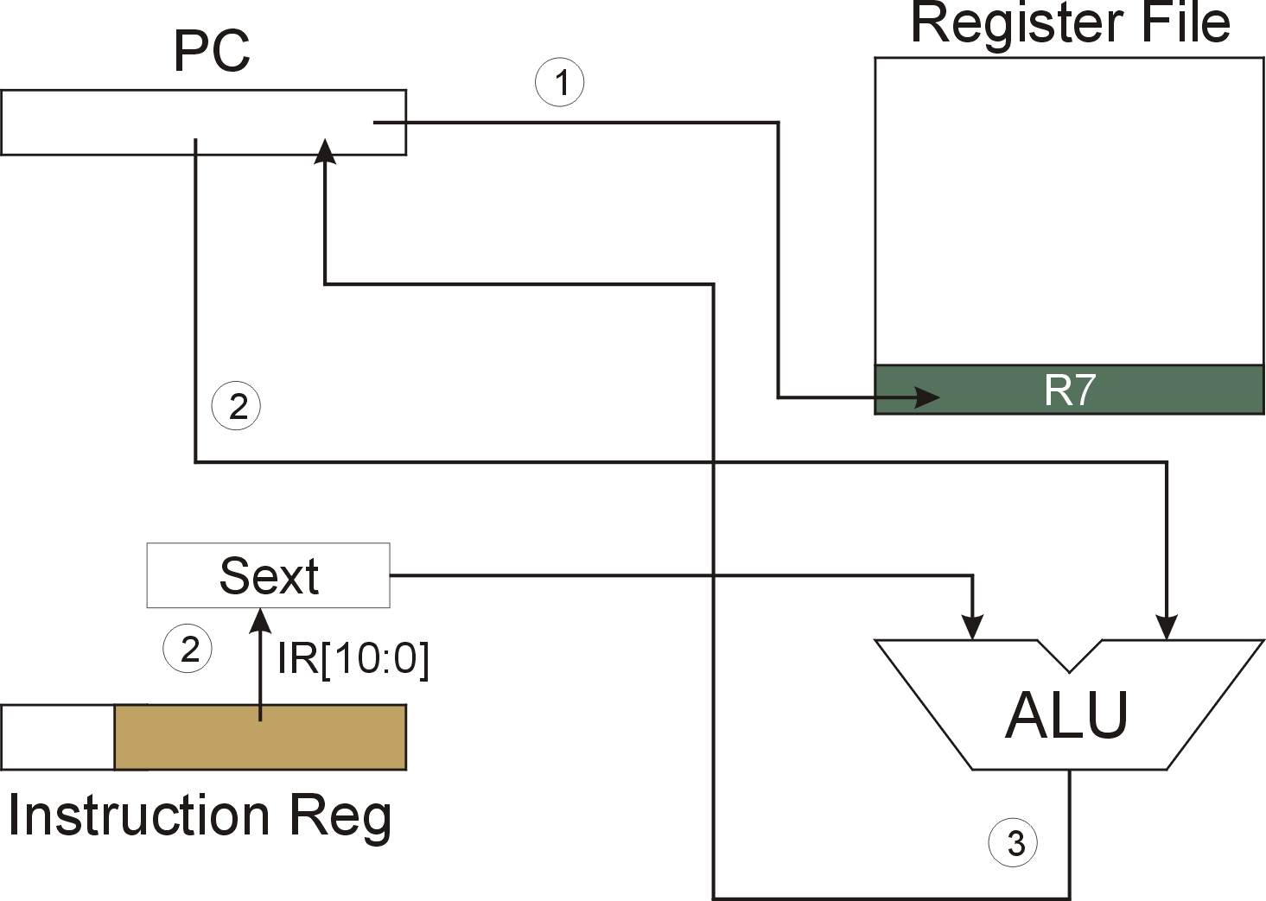
JSR
NOTE: PC has already been incremented
during instruction fetch stage.

Slide 20
JSRR Instruction
Just like JSR, except Register addressing mode.
  target address is Base Register
  bit 11 specifies addressing mode
What important feature does JSRR provide
that JSR does not?

Slide 21
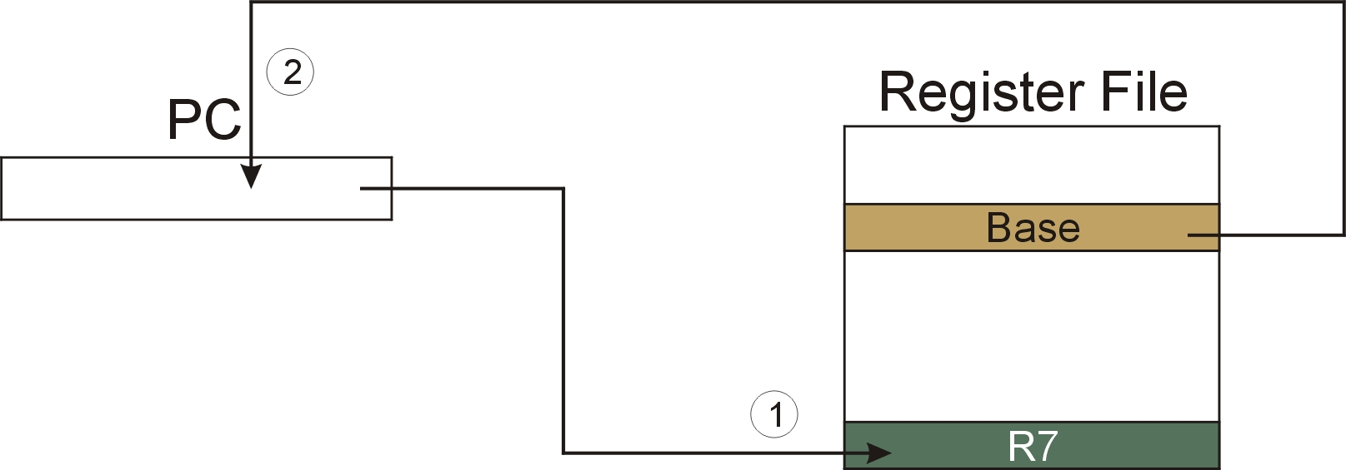
JSRR
NOTE: PC has already been incremented
during instruction fetch stage.

Slide 22
Returning from a Subroutine
RET (JMP R7) gets us back to the calling routine.
  just like TRAP

Slide 23
Example: Negate the value in R0
2sComp NOT R0, R0 ; flip bits
ADD R0, R0, #1 ; add one
RET ; return to caller
To call from a program (within 1024 instructions):
; need to compute R4 = R1 - R3
ADD R0, R3, #0 ; copy R3 to R0
JSR 2sComp ; negate
ADD R4, R1, R0 ; add to R1
...
Note: Caller should save R0 if we’ll need it later!

Slide 24
Passing Information to/from Subroutines
Arguments
  A value passed in to a subroutine is called an argument.
  This is a value needed by the subroutine to do its job.
  Examples:
    In 2sComp routine, R0 is the number to be negated
    In OUT service routine, R0 is the character to be printed.
    In PUTS routine, R0 is address of string to be printed.
Return Values
  A value passed out of a subroutine is called a return value.
  This is the value that you called the subroutine to compute.
  Examples:
    In 2sComp routine, negated value is returned in R0.
    In GETC service routine, character read from the keyboard
    is returned in R0.

Slide 25
Using Subroutines
In order to use a subroutine, a programmer must know:
  its address (or at least a label that will be bound to its address)
  its function (what does it do?)
    NOTE: The programmer does not need to know
    how the subroutine works, but
    what changes are visible in the machine’s state
    after the routine has run.
  its arguments (where to pass data in, if any)
  its return values (where to get computed data, if any)

Slide 26
Saving and Restore Registers
Since subroutines are just like service routines,
we also need to save and restore registers, if needed.
Generally use “callee-save” strategy,
except for return values.
  Save anything that the subroutine will alter internally
  that shouldn’t be visible when the subroutine returns.
  It’s good practice to restore incoming arguments to
  their original values (unless overwritten by return value).
Remember: You MUST save R7 if you call any other
subroutine or service routine (TRAP).
  Otherwise, you won’t be able to return to caller.

Slide 27
Example
Write a subroutine FirstChar to:
  find the first occurrence
  of a particular character (in R0)
  in a string (pointed to by R1);
  return pointer to character or to end of string (NULL) in R2.
(2) Use FirstChar to write CountChar, which:
  counts the number of occurrences
  of a particular character (in R0)
  in a string (pointed to by R1);
  return count in R2.
Can write the second subroutine first,
without knowing the implementation of FirstChar!

Slide 28
CountChar Algorithm (using FirstChar)
save regs
R1 <- R2 + 1
call FirstChar
save R7,
since we’re using JSR
R3 <- M(R2)
restore
regs
R3=0
no
return
yes

Slide 29
CountChar Implementation
; CountChar: subroutine to count occurrences of a char
CountChar
ST R3, CCR3 ; save registers
ST R4, CCR4
ST R7, CCR7 ; JSR alters R7
ST R1, CCR1 ; save original string ptr
AND R4, R4, #0 ; initialize count to zero
CC1 JSR FirstChar ; find next occurrence (ptr in R2)
LDR R3, R2, #0 ; see if char or null
BRz CC2 ; if null, no more chars
ADD R4, R4, #1 ; increment count
ADD R1, R2, #1 ; point to next char in string BRnzp CC1
CC2 ADD R2, R4, #0 ; move return val (count) to R2
LD R3, CCR3 ; restore regs
LD R4, CCR4
LD R1, CCR1
LD R7, CCR7
RET ; and return

Slide 30
FirstChar Algorithm
R3=R0
save regs
yes
R2 <- R1
no
R2 <- R2 + 1
R3 <- M(R2)
restore
regs
R3=0
no
return
yes

Slide 31
FirstChar Implementation
; FirstChar: subroutine to find first occurrence of a char
FirstChar
ST R3, FCR3 ; save registers
ST R4, FCR4 ; save original char
NOT R4, R0 ; negate R0 for comparisons
ADD R4, R4, #1
ADD R2, R1, #0 ; initialize ptr to beginning of string
FC1 LDR R3, R2, #0 ; read character
BRz FC2 ; if null, we’re done
ADD R3, R3, R4 ; see if matches input char
BRz FC2 ; if yes, we’re done
ADD R2, R2, #1 ; increment pointer
BRnzp FC1
FC2 LD R3, FCR3 ; restore registers
LD R4, FCR4 ;
RET ; and return

Slide 32
Library Routines
Vendor may provide object files containing
useful subroutines
  don’t want to provide source code -- intellectual property
  assembler/linker must support EXTERNAL symbols
  (or starting address of routine must be supplied to user)
...
.EXTERNAL SQRT
...
LD R2, SQAddr ; load SQRT addr
JSRR R2
...
SQAddr .FILL SQRT
Using JSRR, because we don’t know whether SQRT
is within 1024 instructions.

