Slide 1
REVIEW Introduction to computing systems
2020.09.15

Slide 2
Exam info.
考试时间: 9.18 周五 2:30--5:00
考试地点: 东1A-203/ 东1A-209/东1A-207
闭卷
考试范围：全部
Final score >= 50

Slide 3
Problem types
Multiple choice 22%
Comprehensive problems 78%
Data representation 10%
Gate circuit/truth table 8%
Read LC3 programs / disassembly 9%
Implement a new instruction 12%
LC3 programming 12%
Interruption 13%
Read LC3 programs / programming 14%

Slide 4
Ch1
Why we need a computer?
Do calculation
Store information
Process different types of data
etc.

Slide 5
Ch2
How to present data?
Binary system( bit )
Unsigned integer
Signed integer(Complement Representation)
ASCII code
Floating-point
The operation of data

Slide 6
Ch3
How to implement a computer described before?
Little computer
Register
Memory
State machine
Decoder
MUX
Full Adder
R-S latch
D-latch
AND/OR/NOT gate
n-type/p-type transistor

Slide 7
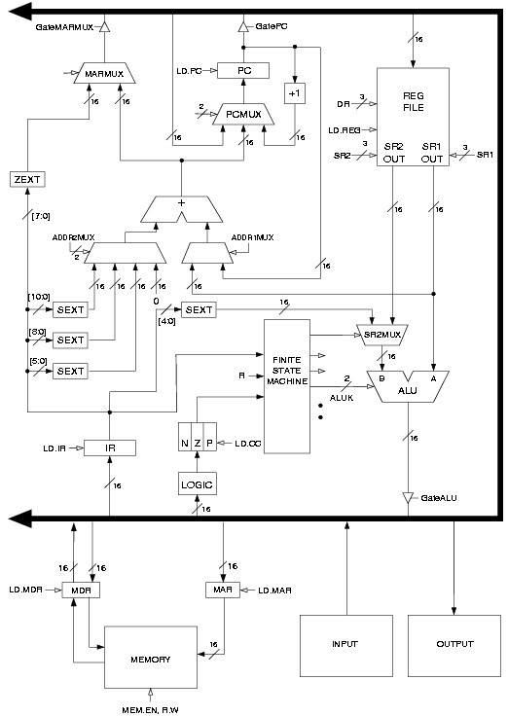
Instruction processing
(CH4)
Fetch
Decode
Evaluate Address
Fetch operands
Execute operation
Store result

Slide 8
Instruction Set Architecture
Machine language(CH5)
LC3
Memory
Register
Opcode
Data type
ADD, AND, NOT
LD, LDI, LDR, ST, STI, STR
BR, JSR/JSRR, JMP
TRAP(CH10), RTI
Notes:
需要了解所有指令的功能
指令涉及到的器件
不同指令每个步骤都干了些什么

Slide 9
Programming in LC3

Slide 10
Ch7
Assembly language, human-readable
Opcodes: ADD, AND, LD, ST…….
Operands: R0-R7, #3, x0F
Pseudo-operations: .orig .end .blkw .fill .stringz
Assembly process: two passes
Symbol table

Slide 11
Polling(CH8)
I/O
Interrupt-driven(CH10)
stack

Slide 12
Ch9
How to deal with Input / output ?
System call ---- Trap routine

Slide 13
We need more powerful programing language
C, Java, Python…….
High level abstraction
Complier translate high level programing language into assembly language
Fuctions in C language (CH14)
Pointer and Array in C (CH16)
Recursion (CH17)
Data structure (CH19)

Slide 14
CH1
Transformations Between Layers
Problems
stated using "natural language"
Algorithms
step-by-step procedure, guaranteed to finish
Language
express the algorithm using C, Java, Python
Instruction Set Architecture
the set of instructions, data type
Microarchitecture
detailed organization of a processor
Circuits
Addition, MUX, registers, memory
Devices
n-type/p-type MOS Transistor

Slide 15
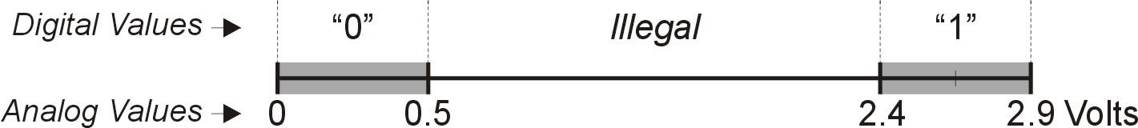
CH2 Data and Operation
Computer is a binary digital system
Basic unit of information is the binary digit, or bit.
Values with more than two states require multiple bits.
A collection of two bits has four possible states: 00, 01, 10, 11
A collection of three bits has eight possible states: 000, 001, 010, 011, 100, 101, 110, 111
A collection of n bits has 2^{n} possible states.

Slide 16
CH2 Data and Operation
Data type: representation and operations within the computer
Unsigned integer
Signed intergers
ASCII
Floating-point
String

Slide 17
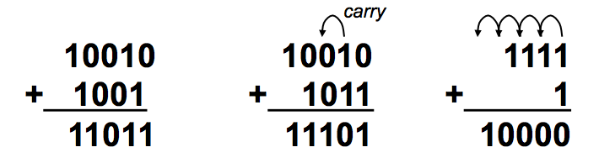
CH2 Data and Operation
Unsigned integers
most
significant
least
significant
329
101
10²
10¹
10⁰
2²
2¹
2⁰
3x100 + 2x10 + 9x1 = 329
1x4 + 0x2 + 1x1 = 5

Slide 18
CH2 Data and Operation
Signed integers
Two’s Complement Representation
Sign-extension
Converting Binary to Decimal
Converting Decimal to Binary
Operations: Arithmetic and Logical
Overflow

Slide 19
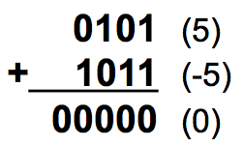
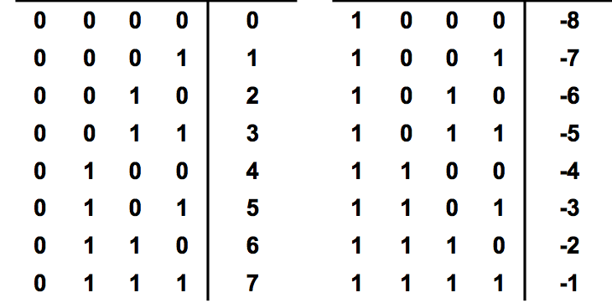
CH2 Data and Operation
Two’s Complement Representation
Most significent bit is sign bit
5₁₀ = 0101₂
-5₁₀ = ?

Slide 20
CH2 Data and Operation
Sign-extension
5₁₀ = 0101₂ = 00000101₂
-5₁₀ = 1011₂ = 11111011₂
0101 (5)
+ 1011 (-5)
0000 (0)
00000101 (5)
+ 1011 (-5)
00000000(0)
1111

Slide 21
CH2 Data and Operation
Converting Binary to Decimal
If leading bit is one, take two’s complement to get a positive number.
Add powers of 2 that have “1” in the corresponding bit positions.
If original number was negative, add a minus sign.
X = 11100110_{two}
-X = 00011010
= 2⁴+2³+2¹ = 16+8+2
= 26_{ten}
X = -26_{ten}
X = 01101000_{two}
= 2⁶+2⁵+2³
= 64+32+8
= 104_{ten}

Slide 22
CH2 Data and Operation
Converting Decimal to Binary
Find magnitude of decimal number. (Always positive.)
Divide by two – remainder is least significant bit.
Keep dividing by two until answer is zero, writing remainders from right to left.
Append a zero as the MS bit; if original number was negative, take two’s complement.
X = 104_{ten} 104/2 = 52 r0 bit 0
52/2 = 26 r0 bit 1
26/2 = 13 r0 bit 2
13/2 = 6 r1 bit 3
6/2 = 3 r0 bit 4
3/2 = 1 r1 bit 5
X = 01101000_{two} 1/2 = 0 r1 bit 6

Slide 23
CH2 Data and Operation
Operations: Arithmetic and Logical
arithmetic operations
Addition
Subtraction
Sign Extension
Logical operations
AND
OR
NOT
11 + 01010101 = 11111111
+ 01010101
= 01010100
Truth table

Slide 24
CH2 Data and Operation
Overflow: If operands are too big, then sum cannot be represented as an n-bit 2’s comp number.
01000 (8) 11000 (-8)
+ 01001 (9) + 10111 (-9)
10001 (-15) 01111 (+15)

Slide 25
CH2 Data and Operation
Hexadecimal Notation
It is often convenient to write binary (base-2) numbers as hexadecimal (base-16) numbers instead.
011101010001111010011010111
3
A
8
F
4
D
7

Slide 26
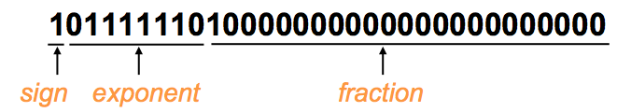
CH2 Data and Operation
Floating point
IEEE 754 Floating-Point Standard (32-bits):
1b
8b
23b
S
Exponent
Fraction
Value = -1.5 x 2⁽¹²⁶⁻¹²⁷⁾ = -1.5 x 2⁻¹ = -0.75.

Slide 27
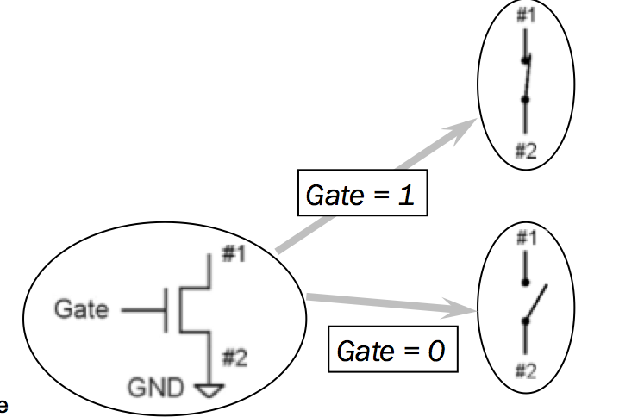
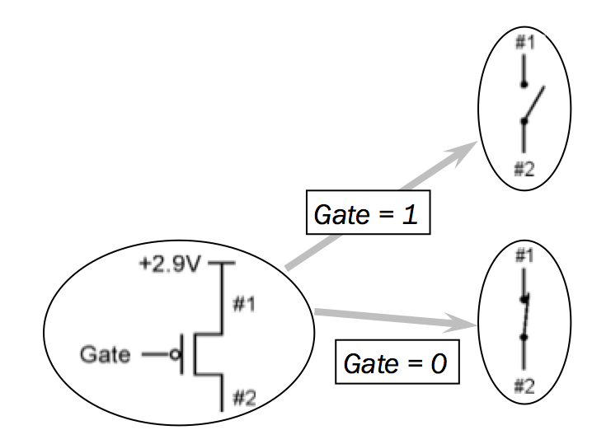
CH2 Data and Operation
n-type MOS Transistor p-type MOS Transistor

Slide 28
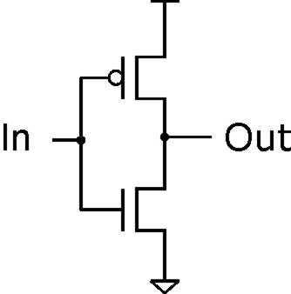
CH3 Digital logic
Inverter (NOT Gate)
Truth table
In | Out
0 V | 2.9 V
2.9 V | 0 V
In | Out
0 | 1
1 | 0

Slide 29
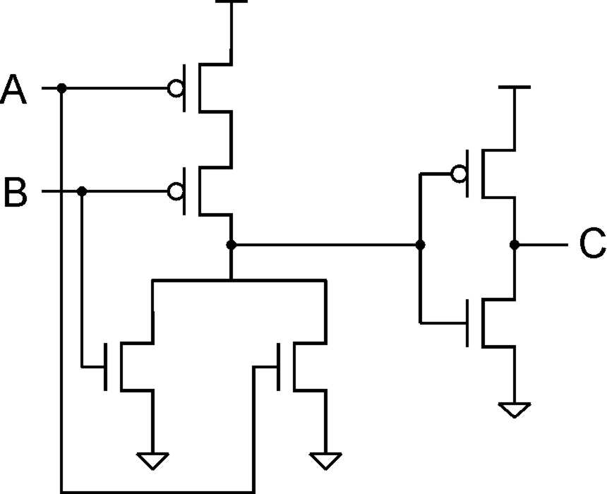
CH3 Digital logic
OR Gate
A | B | C
0 | 0 | 0
0 | 1 | 1
1 | 0 | 1
1 | 1 | 1

Slide 30
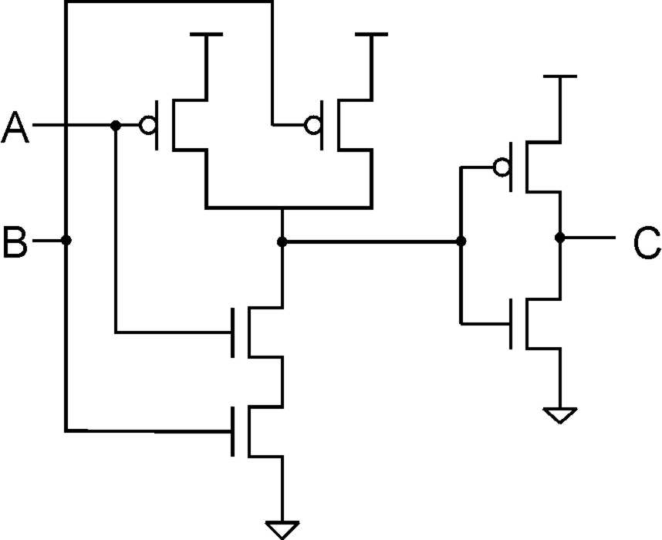
CH3 Digital logic
AND Gate
A | B | C
0 | 0 | 0
0 | 1 | 0
1 | 0 | 0
1 | 1 | 1

Slide 31
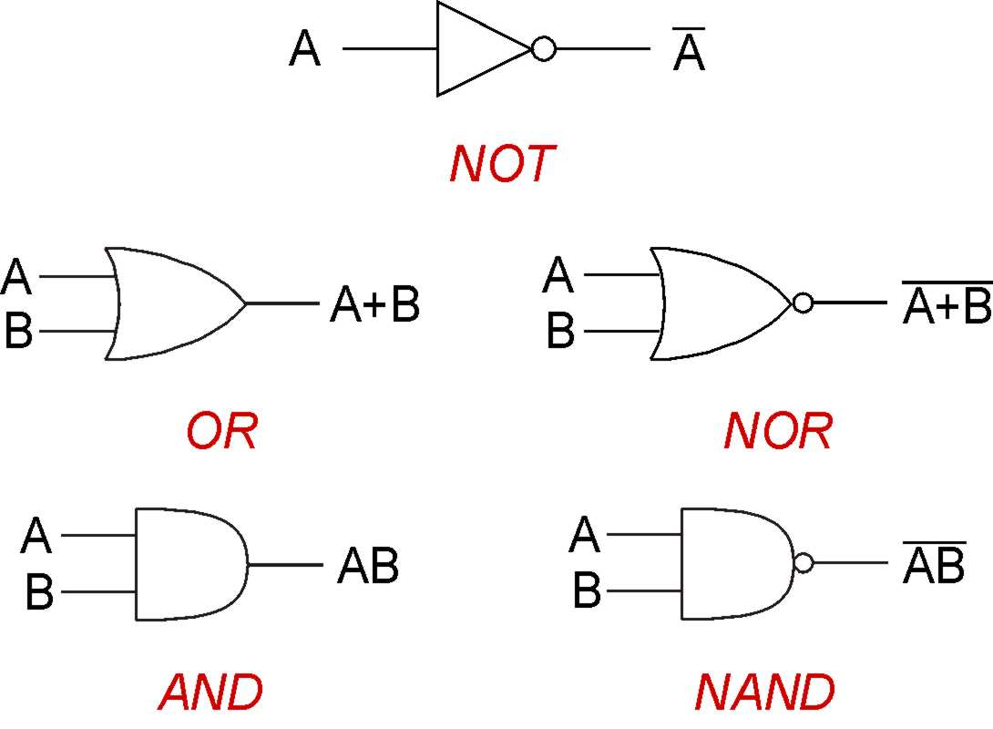
CH3 Digital logic

Slide 32
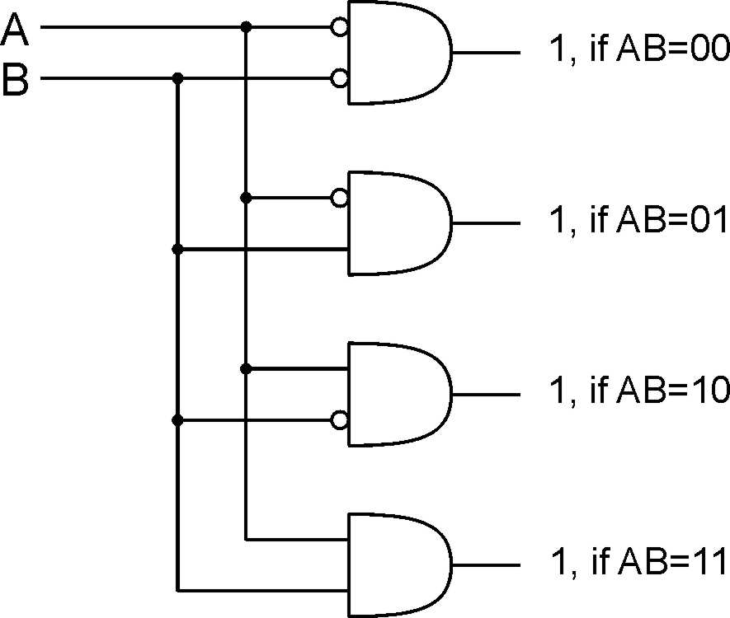
CH3 Digital logic
Decoder: n inputs, 2^{n} outputs

Slide 33
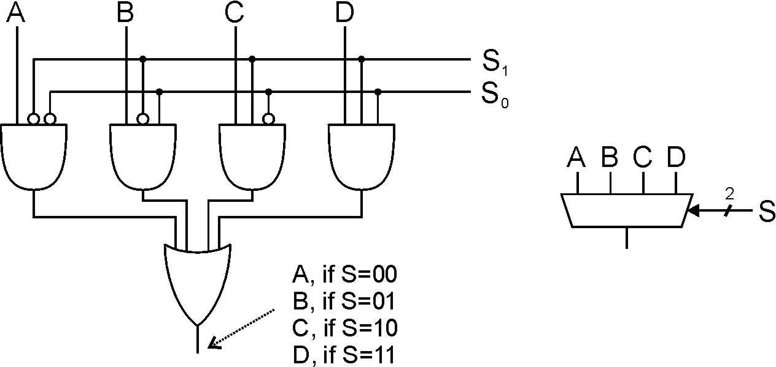
CH3 Digital logic
Multiplexer (MUX): n-bit selector and 2^{n} inputs, one output

Slide 34
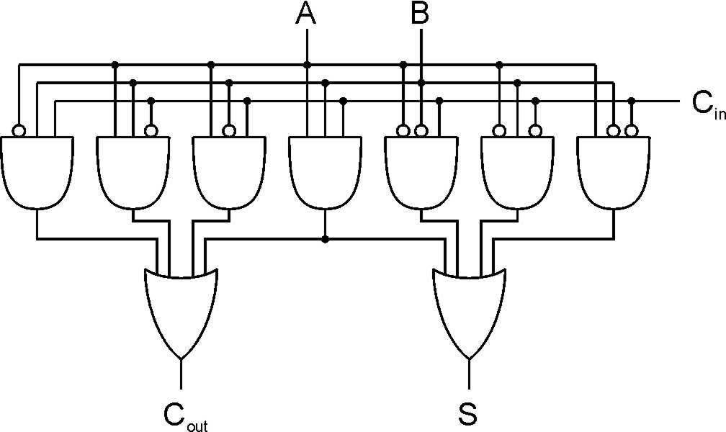
CH3 Digital logic
Full Adder: Add two bits and carry-in, produce one-bit sum and carry-out.
A | B | C_{in} | S | C_{out}
0 | 0 | 0 | 0 | 0
0 | 0 | 1 | 1 | 0
0 | 1 | 0 | 1 | 0
0 | 1 | 1 | 0 | 1
1 | 0 | 0 | 1 | 0
1 | 0 | 1 | 0 | 1
1 | 1 | 0 | 0 | 1
1 | 1 | 1 | 1 | 1

Slide 35
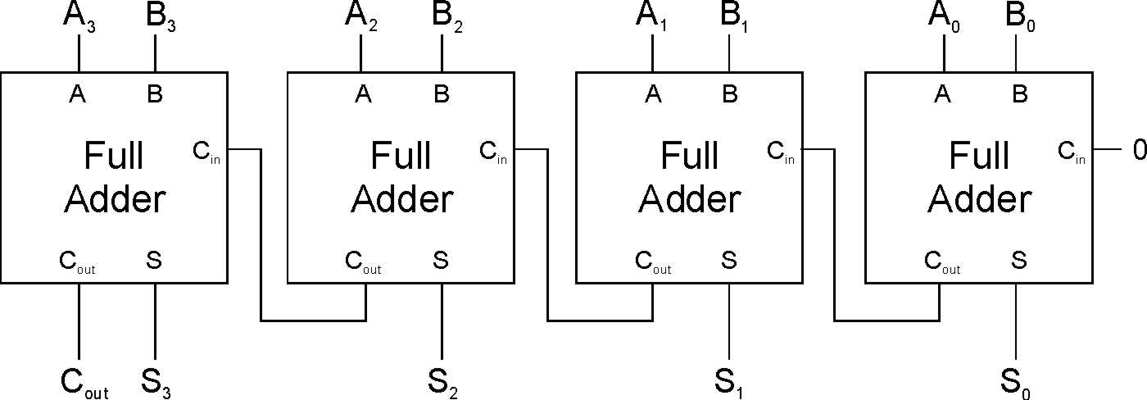
CH3 Digital logic
Four-bit Adder

Slide 36
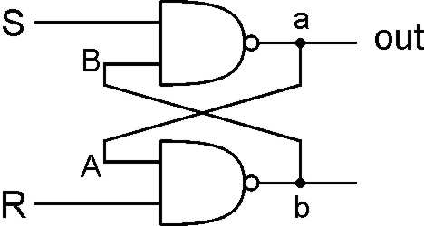
CH3 Digital logic
R-S Latch: Simple Storage Element
R is used to “reset” or “clear” the element – set it to zero.
S is used to “set” the element – set it to one.
R = S = 1
hold current value in latch
S = 0, R=1
set value to 1
R = 0, S = 1
set value to 0

Slide 37
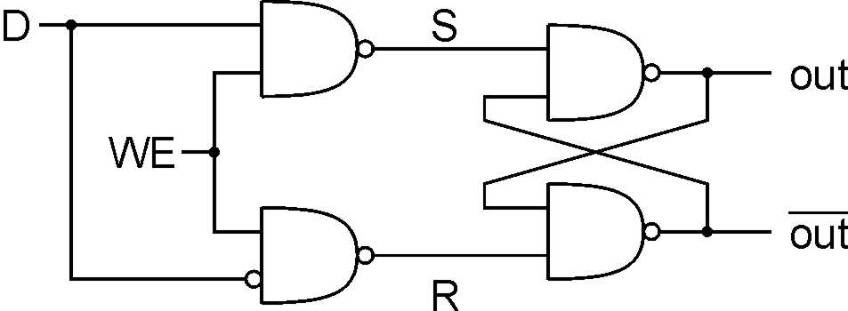
CH3 Digital logic
Gated D-Latch
Two inputs: D (data) and WE (write enable)
when WE = 1, latch is set to value of D
S = NOT(D), R = D
when WE = 0, latch holds previous value
S = R = 1

Slide 38
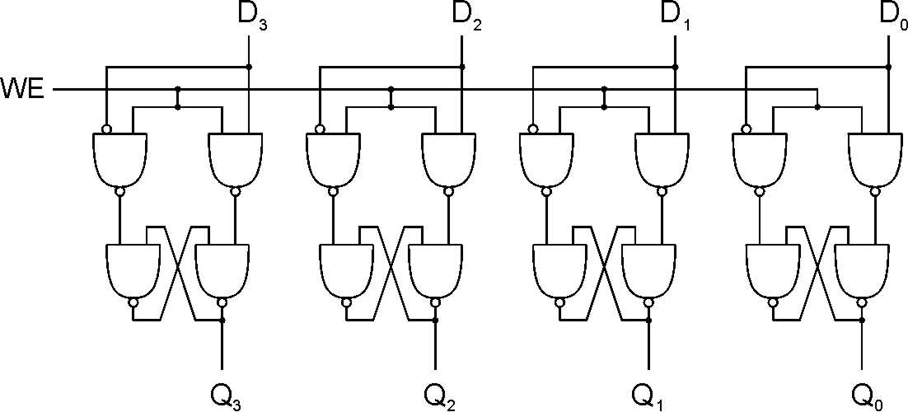
CH3 Digital logic
Register

Slide 39
CH3 Digital logic
Memory: a logical k × m array of stored bits.
Address Space:
number of locations (usually a power of 2)
k = 2^{n}
locations
•
•
•
Addressability:
number of bits per location (e.g., byte-addressable)
m bits

Slide 40
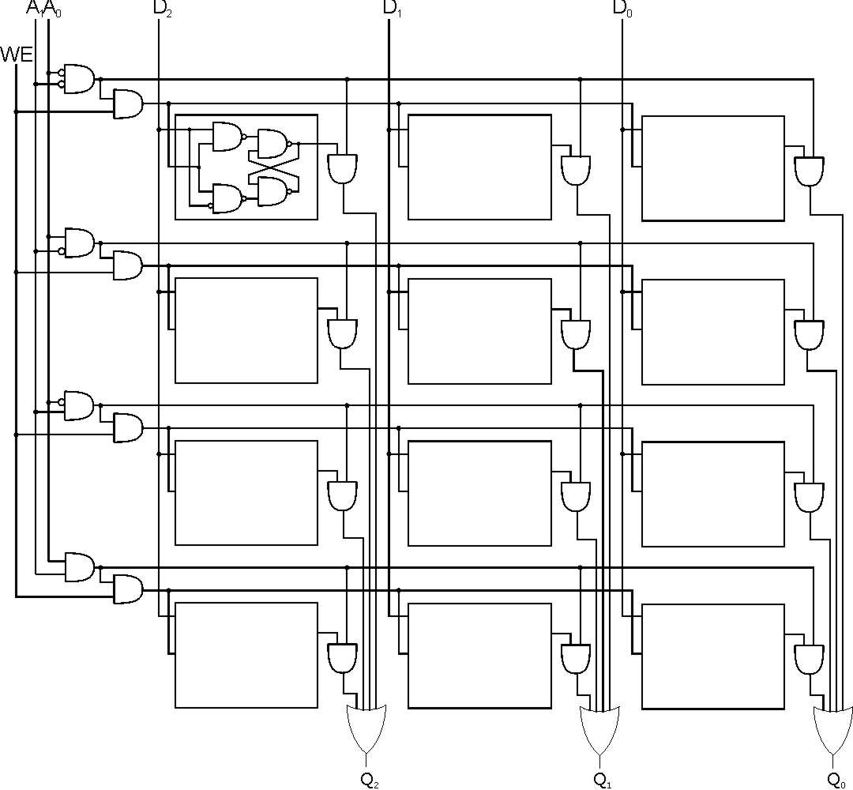
CH3 Digital logic
2² x 3 Memory
word select
word WE
input bits
address
write
enable
address
decoder
output bits

Slide 41
CH3 Digital logic
Finite State Machine
State Machine
Inputs
Combinational
Logic Circuit
Outputs
Storage
Elements
Clock
clock circuit triggers transition from one state to the next.

Slide 42
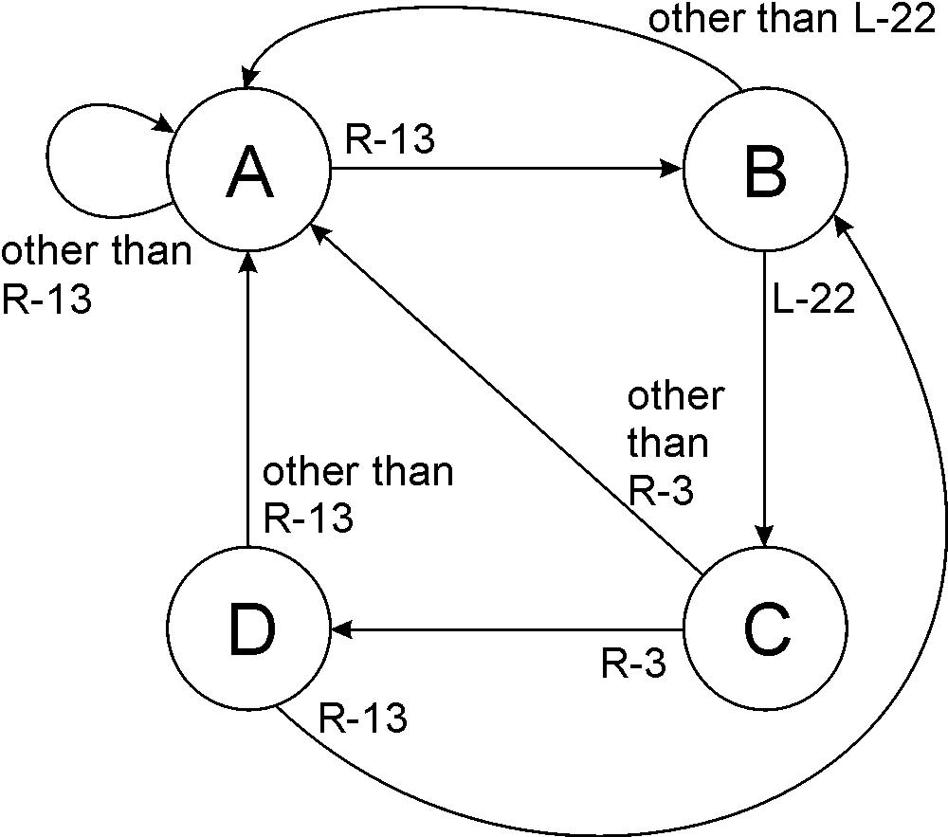
CH3 Digital logic
Finite State Machine

Slide 43
LC-3 Data Path
Combinational
Logic
Storage
State Machine

Slide 44
CH4 Von Newman Model
Von Neuman Model

Slide 45
CH4 Von Newman Model
How to read/write memory?
What is the function of ALU/PC/IR……
The I/O mechinism?

Slide 46
CH4 Von Newman Model
Instruction Processing
Fetch instruction from memory
Decode instruction
Evaluate address
Fetch operands from memory
Execute operation
Store result

Slide 47
CH4 Von Newman Model
What are the functions of each state
FETCH: Load next instruction
IR <- mem[PC]
PC <- PC + 1
DECODE:
identify the opcode
identify other operands from the remaining bit (for LDR, last six bits is offset)

Slide 48
CH4 Von Newman Model
What are the functions of each state
Evaluate address
For instructions that require memory access, compute address used for access(add offset to base register as in LDR)
Fetch operands
Obtain source operands needed to perform operation(load data from memory in LDR)

Slide 49
CH4 Von Newman Model
What are the functions of each state
Execute
Perform the operation, using the source operands(send operands to ALU and assert ADD signal)
Store result
Write results to destination (register or memory)

Slide 50
CH5 LC-3
ISA = All of the programmer-visible components and operations of the computer
memory organization
address space -- how may locations can be addressed?
addressibility -- how many bits per location?
register set
how many? what size? how are they used?
instruction set
Opcodes: ADD, AND, NOT, LD, LDI, LDR, LEA, ST, STR, STI, BR, JSR/JSRR, JMP, RTI, TRAP
data types
addressing modes: PC-relative, indirect, base+offset

Slide 51
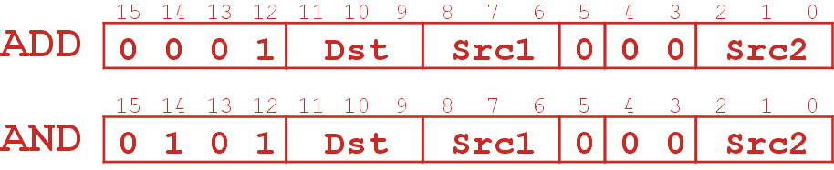
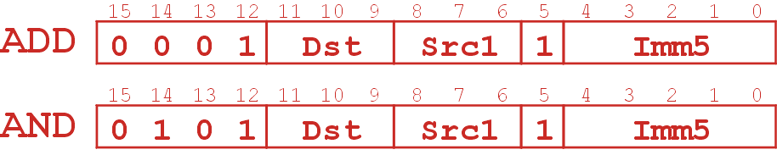
CH5 LC-3
NOT R1, R1 ; R1 <- ~R1
AND R1, R1, R2 ; R1 <- R1 and R2
ADD R1, R1, imm ; R1 <- R1 + imm (-2⁴<=imm<=2⁴-1)

Slide 52
CH5 LC-3
ST R1, PCoffset ;Memory[ PC + Pcoffset] <- R1
STI R1, PCoffset ;Memory[ Memory[ PC + Pcoffset] ]<- R1
STR R1, R2, PCoffset ;Memory[R2 + offset]<- R1

Slide 53
CH5 LC-3
LEA R1, PCoffset ;R1 <- PC + PCoffset
BRn PCoffset ;if(CC == n) PC <- PC + PCoffset
JMP R1 ;PC <- R1
TRAP x21 ;PC <- Memory[x21]

Slide 54
CH5 LC-3
JSR PCoffset11 ;R7 <- PC, PC <- PC + PCoffset
JSR R1 ;R7 <- PC, PC <- R1
RTI ;return from interrupt, pop PC, pop PSR, set stack pointer

Slide 55
CH5 LC-3
The function of all the elements in the data-path ?
Identify all the elements in the data-path to process an instruction of the LC3
How many times does an instruction(for example LDR) access the memory?

Slide 56
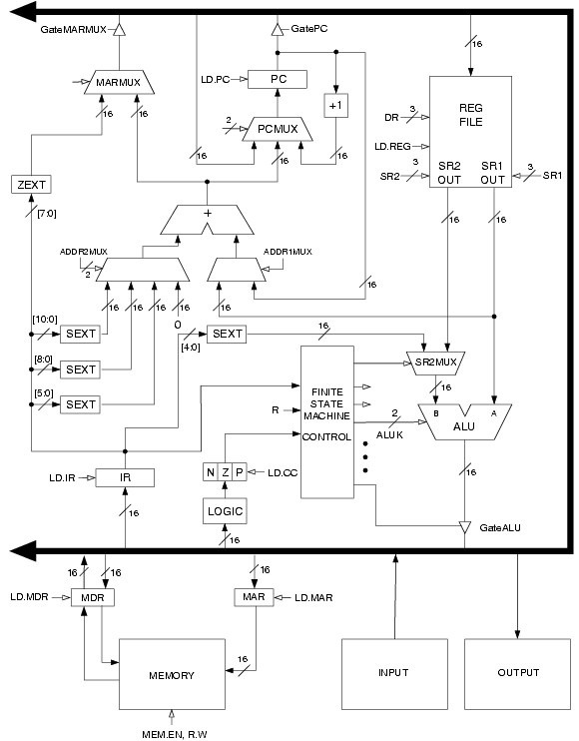

Slide 57
CH7 Assembly Language
Assembly language
Computers like ones and zeros…
Humans like symbols…
0001110010000110
ADD R6,R2,R6 ; increment index reg.

Slide 58
CH7 Assembly Language
Opcodes
ADD, AND, LD, ST…….
Operands
Registers: R0 – R7
Immediate numbers: x0F, #15
Label: symbolic name of memory location

Slide 59
CH7 Assembly Language
Label
assigns a symbolic name to the address corresponding to line
LOOP ADD R1, R1, #-1
BRp LOOP
Comment
anything after a semicolon is a comment

Slide 60
CH7 Assembly Language
Pseudo-operations
do not refer to operations executed by program
used by assembler
Opcode | Operand | Meaning
.ORIG | address | starting address of program
.END |  | end of program
.BLKW | n | allocate n words of storage
.FILL | n | allocate one word, initialize with value n
.STRINGZ | n-character string | allocate n+1 locations, initialize w/characters and null terminator

Slide 61
CH7 Assembly Language
What is the content of R0 after the following instruction?
.ORIG x3000
AND R0, R0, 0
.fill x1021
ADD R0, R0, 1
.END
1000 000 000 1 00001
Notes:
0001 0000 0010 0001
Add r0, r0, 1

Slide 62
CH7 Assembly Language
Assembly Process
Convert assembly language file into an executable file
First Pass:
scan program file
find all labels and calculate the corresponding addresses; this is called the symbol table
Second Pass:
convert instructions to machine language, using information from symbol table

Slide 63
CH7 Assembly Language
Translate following assembly program
.ORIG x3000
Begin AND R1, R1, 0
ADD R1, R1, #10
Loop LEA R0, Hello
TRAP x22
ADD R1, R1, #-1
BRzp Loop
TRAP x25
Hello .stringz "hello\n"
.end

Slide 64
CH7 Assembly Language
Translate following assembly program
First Pass: build the symbol table
.ORIG x3000
Begin AND R1, R1, 0
ADD R1, R1, #10
Loop LEA R0, Hello
TRAP x22
ADD R1, R1, #-1
BRzp Loop
TRAP x25
Hello .stringz "hello\n"
.end
Symbol | Address
Begin | X3000
Loop | X3002
Hello | X3007

Slide 65
CH7 Assembly Language
Symbol | Address
Begin | X3000
Loop | X3002
Hello | X3007
Translate following assembly program
Second Pass: translate into machine language
.ORIG x3000
Begin AND R1, R1, 0
ADD R1, R1, #10
Loop LEA R0, Hello
TRAP x22
ADD R1, R1, #-1
BRzp Loop
TRAP x25
Hello .stringz "hello\n"
.end
0011000000000000
0101 001 001 1 00000
0001 001 001 1 01010
1110 000 000000100
1111 0000 00100010
0001 001 001 1 11111
0000 011 111111100
1111 0000 00100101
0000000001101000
0000000001100101
0000000001101100
0000000001101100
0000000001101111
0000000000001010
0000000000000000

Slide 66
CH8 I/O
Memory-mapped I/O
Polling: CPU keeps checking status register
Interrupts: Device sends a special signal to CPU
POLL LDI R1, DSR BRzp POLL STI R0, DDR
……
DSR .FILL xFE04 DDR .FILL xFE06

Slide 67
CH8 I/O
Memory-mapped I/O
Location | I/O Register | Function
xFE00 | Keyboard Status Reg (KBSR) | Bit [15] is one when keyboard has received a new character. Bit[14] is one when interrupt is enabled
xFE02 | Keyboard Data Reg (KBDR) | Bits [7:0] contain the last character typed on keyboard.
xFE04 | Display Status Register (DSR) | Bit [15] is one when device ready to display another char on screen.
xFE06 | Display Data Register (DDR) | Character written to bits [7:0] will be displayed on screen.

Slide 68
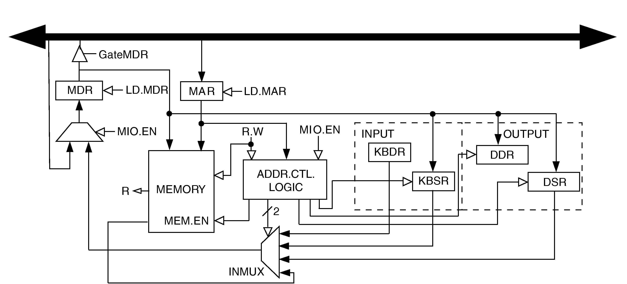
CH8 I/O
Implementation

Slide 69
CH9 TRAP
System call：TRAP
1. User program invokes system call.
2. Operating system code performs operation.
3. Returns control to user program.
vector | symbol | routine
x20 | GETC | read a single character (no echo)
x21 | OUT | output a character to the monitor
x22 | PUTS | write a string to the console
x23 | IN | print prompt to console, read and echo character from keyboard
x25 | HALT | halt the program

Slide 70
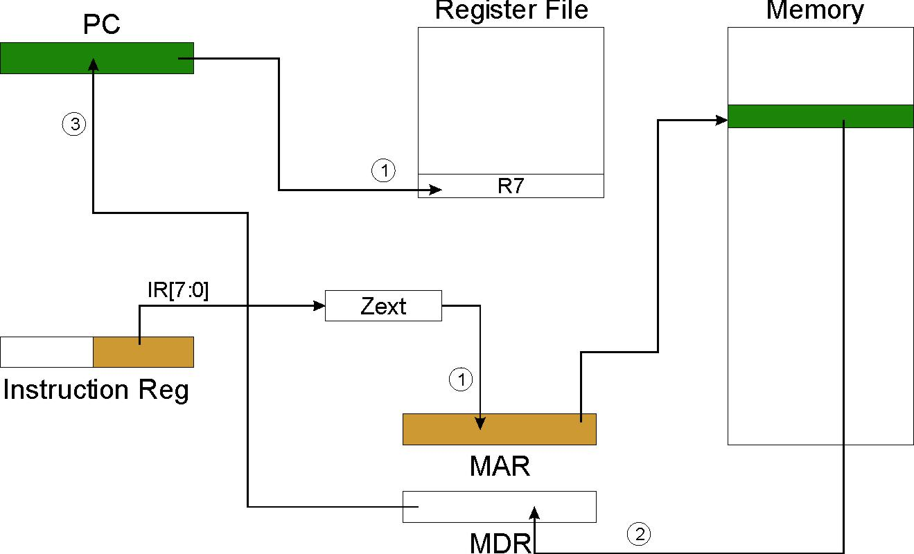
CH9 TRAP

Slide 71
CH9 TRAP
Write a trap routine
Memory[TrapVector]
Must save the value of registers
Caller save: Save registers destroyed by own instructions or by called routines (if known), if values needed later
save R7 before TRAP
save R0 before TRAP x23 (input character)
Callee save:
Before start, save any registers that will be altered
Before return, restore those same registers

Slide 72
CH9 TRAP
Subroutine
JSR JSRR
RET or JMP R7
How to pass arguments
How to get return values
Save registers: caller callee
Save R7 when call any other subroutine or TRAP

Slide 73
CH10 Stack and Interrupt
Abstract data type
Stack: LIFO(last-in first-out), push pop
Queue: FIFO(First-in first-out), rear front
Tree

Slide 74
CH10 Stack and Interrupt
Basic push and pop code
Push
ADD R6, R6, #-1 ; decrement stack ptr STR R0, R6, #0 ; store data (R0)
Pop
LDR R0, R6, #0 ; load data from TOS ADD R6, R6, #1 ; decrement stack ptr
Pop with underflow detection
Push with overflow detection

Slide 75
CH10 Stack and Interrupt
Implement Interrupt-Driven I/O with stack
What is PSR?
Overall mechanism of interrupt
What information need to store ?
Transform between supervisor stack and user stack

Slide 76
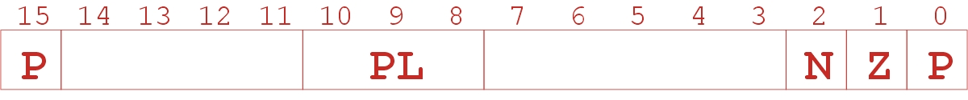
CH10 Stack and Interrupt
Implement Interrupt-Driven I/O with stack
What is PSR?
Processor Status Register
Privilege [15], Priority Level [10:8], Condition Codes [2:0]

Slide 77
CH10 Stack and Interrupt
Implement Interrupt-Driven I/O with stack
What information need to store ?
PSR (store in supervisor stack)
PC (store in supervisor stack)
Register(interrupt routine should save the registers it alters)

Slide 78
CH10 Stack and Interrupt
Overall mechanism of interrupt
If Priv = 1 (user), Saved.USP = R6, then R6 = Saved.SSP.
Push PSR and PC to Supervisor Stack.
Set PSR[15] = 0 (supervisor mode).
Set PSR[10:8] = priority of interrupt being serviced.
Set PSR[2:0] = 0.
Set MAR = x01IV, where IV = 8-bit interrupt vector provided by interrupting device (e.g., keyboard = x80).
Load memory location (M[x01IV]) into MDR.
Set PC = MDR; now first instruction of ISR will be fetched.

Slide 79
CH10 Stack and Interrupt
Overall mechanism of interrupt
9. store registers
10. perform the interrupt routine
11. resume registers
12. RTI return
Pop PC from supervisor stack. (PC = M[R6]; R6 = R6 + 1)
Pop PSR from supervisor stack. (PSR = M[R6]; R6 = R6 + 1)
If PSR[15] = 1, R6 = Saved.USP

Slide 80
CH14 Function
Function definition
Declaration
Run-time stack
What is activation Record ?

Slide 81
CH14 Function
int NoName(int a, int b) { int w, x, y; . . . return y; }
y
x
w
dynamic link
return address
return value
a
b
locals
R5
bookkeeping
args

Slide 82
CH14 Function
Activation record
Return value
space for value returned by function
allocated even if function does not return a value
Return address
Save pointer to next instruction in calling function
Dynamic link
Caller’s frame pointer

Slide 83
CH14 Function
LC-3 Function Call Implementation
Caller pushes arguments (last to first).
Caller invokes subroutine (JSR).
Callee allocates return value, pushes R7 and R5.
Callee allocates space for local variables.
Callee executes function code.
Callee stores result into return value slot.
Callee pops local vars, pops R5, pops R7.
Callee returns (JMP R7).
Caller loads return value and pops arguments.
Caller resumes computation…

Slide 84
CH14 Function
Example Function Call
int Volta(int q, int r) { int k; int m; ... return k; } int Watt(int a) { int w; ... w = Volta(w,10); ... return w; }

Slide 85
Calling the Function
25
10
25
q
r
w
dyn link
ret addr
ret val
a
w = Volta(w, 10);
; push second arg AND R0, R0, #0 ADD R0, R0, #10 ADD R6, R6, #-1 STR R0, R6, #0 ; push first argument LDR R0, R5, #0 ADD R6, R6, #-1 STR R0, R6, #0 ; call subroutine JSR Volta
new R6
R6
R5
xFD00
Note: Caller needs to know number and type of arguments, doesn't know about local variables.

Slide 86
Starting the Callee Function
xFCFB
x3100
25
10
25
m
k
dyn link
ret addr
ret val
q
r
w
dyn link
ret addr
ret val
a
; leave space for return value ADD R6, R6, #-1 ; push return address ADD R6, R6, #-1 STR R7, R6, #0 ; push dyn link (caller’s frame ptr) ADD R6, R6, #-1 STR R5, R6, #0 ; set new frame pointer ADD R5, R6, #-1 ; allocate space for locals ADD R6, R6, #-2
new R6
new R5
R6
R5
xFD00

Slide 87
Ending the Callee Function
-43
217
xFCFB
x3100
217
25
10
25
m
k
dyn link
ret addr
ret val
q
r
w
dyn link
ret addr
ret val
a
return k;
; copy k into return value LDR R0, R5, #0 STR R0, R5, #3 ; pop local variables ADD R6, R5, #1 ; pop dynamic link (into R5) LDR R5, R6, #0 ADD R6, R6, #1 ; pop return addr (into R7) LDR R7, R6, #0 ADD R6, R6, #1 ; return control to caller RET
R6
R5
new R6
new R5
xFD00

Slide 88
Resuming the Caller Function
217
25
10
217
ret val
q
r
w
dyn link
ret addr
ret val
a
w = Volta(w,10);
JSR Volta ; load return value (top of stack) LDR R0, R6, #0 ; perform assignment STR R0, R5, #0 ; pop return value ADD R6, R6, #1 ; pop arguments ADD R6, R6, #2
R6
new R6
R5
xFD00

Slide 89
CH16 Pointers and Arrays
Pointer
Address of a variable in memory
Allows us to indirectly access variables
in other words, we can talk about its address rather than its value
Array
A list of values arranged sequentially in memory
Example: a list of telephone numbers
Expression a[4] refers to the 5th element of the array a

Slide 90
ptr=&i=R5
i = 4
dynamic link
return address
return value
R5
Pointer
C language
int i;
int *ptr;
i = 4;
ptr = &i;
*ptr = *ptr + 1;
LC3
; i = 4;
AND R0, R0, #0 ; clear R0 ADD R0, R0, #4 ; put 4 in R0 STR R0, R5, #0 ; store in I
; ptr = &i; ADD R0, R5, #0 ; R0 = addr of i STR R0, R5, #-1 ; store in ptr
; *ptr = *ptr + 1; LDR R0, R5, #-1 ; R0 = ptr LDR R1, R0, #0 ; load *ptr ADD R1, R1, #1 ; add one STR R1, R0, #0 ; store result

Slide 91
CH16 Pointers and Arrays
Array
x
grid[0]
grid[1]
grid[2]
grid[3]
grid[4]
grid[5]
grid[6]
grid[7]
grid[8]
grid[9]
C language
int grid[10];
int x;
x = grid[3] + 1
grid[6] = 5;
LC3
; x = grid[3] + 1
ADD R0, R5, #-9 LDR R1, R0, #3 ADD R1, R1, #1
STR R1, R5, #-10
; grid[6] = 5; AND R0, R0, #0 ADD R0, R0, #5
ADD R1, R5, #-9 STR R0, R1, #6
R5

Slide 92

CH17 Recursion
A recursive function is one that solves its task by calling itself on smaller pieces of data.
Recursive Function:
int RunningSum(int n) { if (n == 1) return 1; else return n + RunningSum(n-1); }

Slide 93
CH17 Recursion
Binary Search
FindExam(studentName, start, end) { halfwayPoint = (end + start)/2; if (end < start) ExamNotFound(); /* exam not in stack */ else if (studentName == NameOfExam(halfwayPoint)) ExamFound(halfwayPoint); /* found exam! */ else if (studentName < NameOfExam(halfwayPoint)) /* search lower half */ FindExam(studentName, start, halfwayPoint - 1); else /* search upper half */ FindExam(studentName, halfwayPoint + 1, end); }

Slide 94
CH19 Data structures
A data structure is a particular organization of data in memory
Array
Struct
Linked list
Stack
Queue
Tree

Slide 95
CH19 Data structures
y
plane.flightNum[0]
plane.flightNum[6]
plane.altitude
plane.longitude
plane.latitude
plane.heading
plane.airspeed
x
//define a struct
struct flightType { char flightNum[7];
int altitude;
int longitude;
int latitude;
int headin;
double airSpeed;
};
int x;
Struct flightType plane;
int y;
R5

