Slide 1
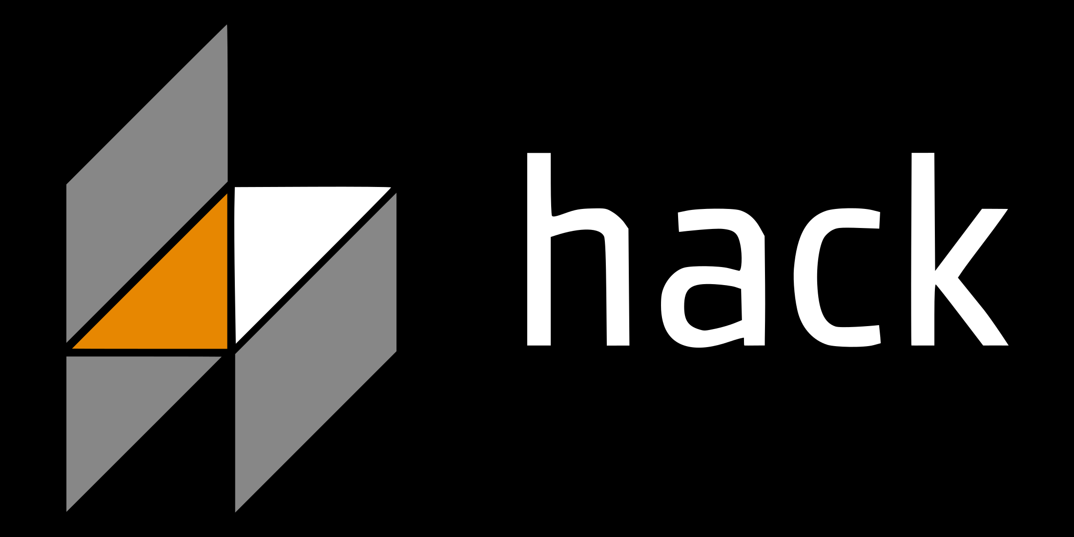
By Zach Shay

Slide 2
What is hack?
Facebook’s programming language for HHVM (HipHop VM)
Designed by Julien Verlaguet, Alok Menghrajani, Others
“Gradually typed”
PHP Compatibility
Exceptions

Slide 3
Why create hack?
Speed
Move away from dynamically typed PHP
Type Checkers
Less Complex API

Slide 4
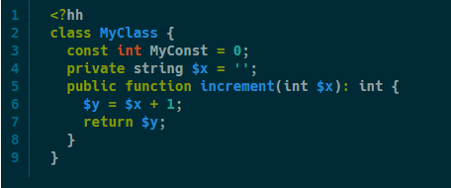
Interesting Things about hack
Type Annotations
Nullable Types
Collections
Vector, Set, Map
Lambdas
XHP
Shapes
Async
Typechecker

Slide 5
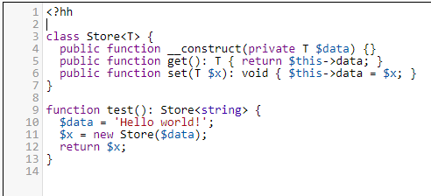
Example code

Slide 6
Should you learn it?

Slide 7
Citations
http://hacklang.org/
https://code.facebook.com/projects/564433143613123/hhvm/
https://www.fastcompany.com/3028778/why-facebook-invented-a-new-php-derived-language-called-hack
https://code.facebook.com/posts/264544830379293/hack-a-new-programming-language-for-hhvm

