Slide 1

HARNESSING
MOTIVATION WAVES
A new framework for quantifying and utilizing
your level of motivation for healthy habits
WWW . BRANDON . LYww

Slide 2
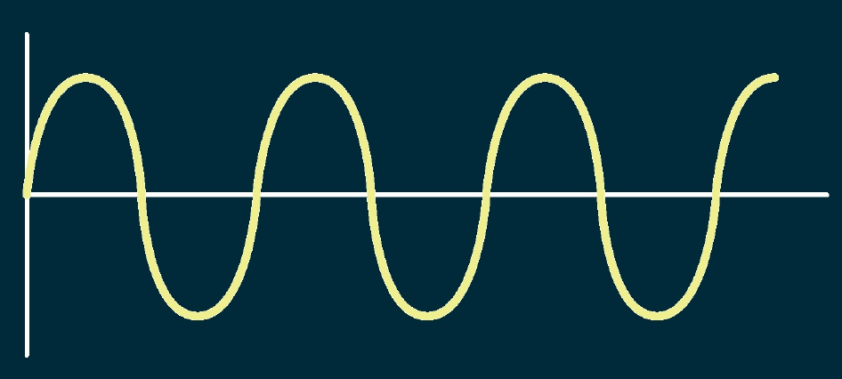
Our motivation can be deﬁned temporally as a series of waves with peaks
and troughs. This is what we call a motivation wave.
TIME
MOTIVATION
WWW . BRANDON . LYww

Slide 3
WHAT IF...
What if we consider the amplitude of
a wave as an “absolute value”?
WWW . BRANDON . LYww

Slide 4
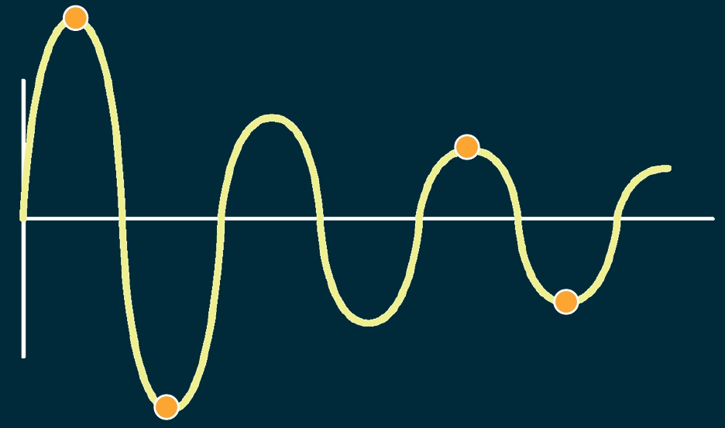
high level,
positive scale
low level,
positive scale
TIME
low level,
MOTIVATION
high level,
negative scale
negative scale
WWW . BRANDON . LYww

Slide 5
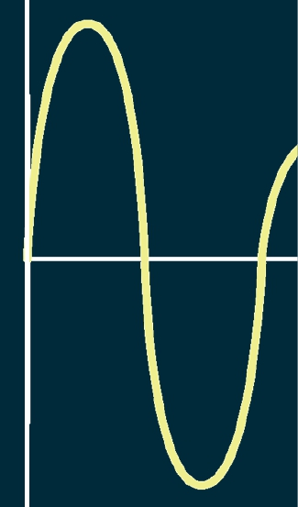
Let’s examine some
habit motivators and
place them on a scale
of amplitude.
Example Habit:
Walking 30 minutes
a day
MOTIVATION
WWW . BRANDON . LYww

Slide 6
Positive Motivators:
+
Any good situation
that increases your
level of motivation
MOTIVATION
WWW . BRANDON . LYww

Slide 7
Negative Motivators:
_
Any bad situation
that (still) increases
your level of
motivation
MOTIVATION
WWW . BRANDON . LYww

Slide 8
MOTIVATION
AMPLITUDE
+++SUCCESS!
++ ENCOURAGEMENT
+ INSPIRATION
- BOREDOM/INACTIVITY
-- GUILT/REALIZATION
---ANGER/REVENGE!
MOTIVATION
WWW . BRANDON . LYww

Slide 9
MOTIVATION
AMPLITUDE
TO BETTER ACCOMPLISH YOUR
HEALTH GOALS, REALIZE
WHICH LEVEL OF MOTIVATION
YOU ARE FEELING
ACT ON IT!
MOTIVATION
WWW . BRANDON . LYww

