Slide 1
TEXT HERE

Slide 2
CONTENTS
1
where my strategic and consultative
where my strategic and consultative
where my strategic and consultative
2
3

Slide 3
1
TEXT HERE
I aspire to senior management responsibility and seek a company .

Slide 4
TEXT HERE
I aspire to senior management responsibility and seek a company that embraces growth and change where compensation is performance-based and increased levels of responsibility offered those with demonstrated potential.

Slide 5
TEXT HERE
I aspire to senior management responsibility and seek a company that embraces growth and change where compensation is performance-based and increased levels of responsibility offered those with demonstrated potential.

Slide 6
I aspire to senior management responsibility and seek a company
I aspire to senior management responsibility and seek a company
I aspire to senior management responsibility and seek a company
1
2
3

Slide 7
TEXT HERE
TEXT HERE
TEXT HERE

Slide 8
2
TEXT HERE
I aspire to senior management responsibility and seek a company .

Slide 9
1
2
3
TEXT HERE
TEXT HERE
TEXT HERE

Slide 10
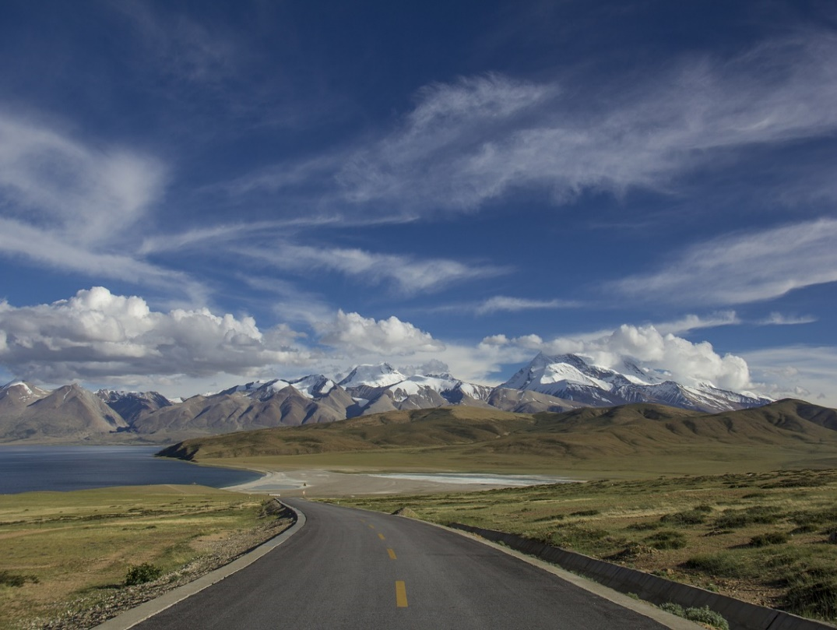
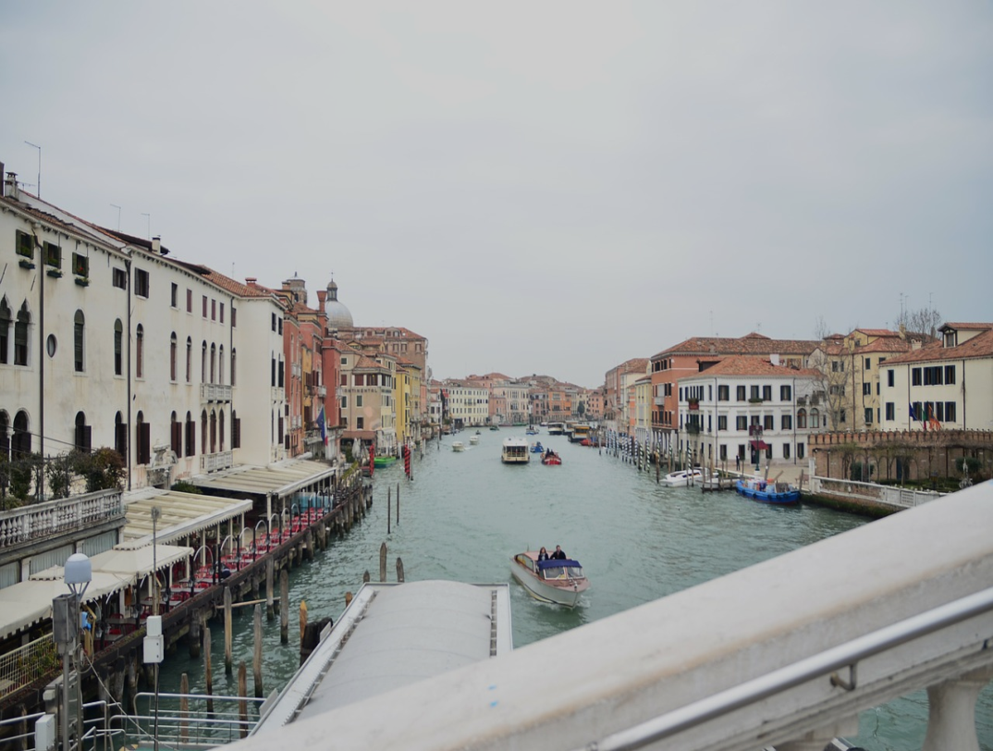
I aspire to senior management responsibility

Slide 11
TEXT HERE
I aspire to senior management responsibility and seek a company that embraces growth and change
TEXT HERE
I aspire to senior management responsibility and seek a company that embraces growth and change

Slide 12
TEXT HERE
TEXT HERE
TEXT HERE
TEXT HERE
TEXT HERE
TEXT HERE
TEXT HERE

Slide 13
3
TEXT HERE
I aspire to senior management responsibility and seek a company .

Slide 14
2011
2012
2013
2014
TEXT HERE
TEXT HERE
TEXT HERE
TEXT HERE

Slide 15
TEXT HERE
I aspire to senior management responsibility and seek a company

Slide 16
TEXT HERE
TEXT HERE
TEXT HERE
TEXT HERE

Slide 17
TEXT HERE
I aspire to senior management I aspire to senior management I aspire to senior management

Slide 18
hanks

