Slide 1

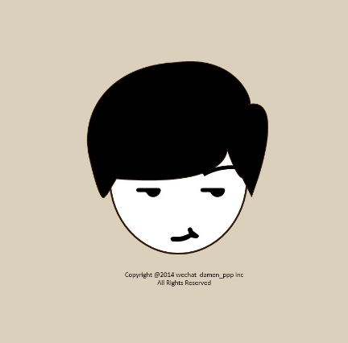
It’s me
DAMEN POWER
ABOUT ME
It was the best of times, it was the worst of times; it was the age of wisdom, it was the age of foolishness

Slide 2
HOBBIES&INTERESTS
SING
GAME
VIDEO
BALL

Slide 3
RESUME
EXPERIENCES
COMPANY
It was the best of times, it was the worst of times; it was the age of wisdom, it was the age of foolishness. It was the epoch of belief, and it was the epoch of incredulity
COMPANY
It was the best of times, it was the worst of times; it was the age of wisdom, it was the age of foolishness. It was the epoch of belief, and it was the epoch of incredulity
COMPANY
It was the best of times, it was the worst of times; it was the age of wisdom, it was the age of foolishness. It was the epoch of belief, and it was the epoch of incredulity
COMPANY
It was the best of times, it was the worst of times; it was the age of wisdom, it was the age of foolishness. It was the epoch of belief, and it was the epoch of incredulity

Slide 4
EDUCATION
SCHOOL
It was the best of times, it was the worst of times; it was the age of wisdom, it was the age of foolishness. It was the epoch of belief, and it was the epoch of incredulity
SCHOOL
It was the best of times, it was the worst of times; it was the age of wisdom, it was the age of foolishness. It was the epoch of belief, and it was the epoch of incredulity
SCHOOL
It was the best of times, it was the worst of times; it was the age of wisdom, it was the age of foolishness. It was the epoch of belief, and it was the epoch of incredulity
SCHOOL
It was the best of times, it was the worst of times; it was the age of wisdom, it was the age of foolishness. It was the epoch of belief, and it was the epoch of incredulity

Slide 5
CONTANT
Phone
It was the best of times, it was the worst of times; it was the age of wisdom, it was the age of foolishness. It was the epoch of belief, and it was the epoch of incredulity
Wechat
It was the best of times, it was the worst of times; it was the age of wisdom, it was the age of foolishness. It was the epoch of belief, and it was the epoch of incredulity
Email
It was the best of times, it was the worst of times; it was the age of wisdom, it was the age of foolishness. It was the epoch of belief, and it was the epoch of incredulity
Weibo
It was the best of times, it was the worst of times; it was the age of wisdom, it was the age of foolishness. It was the epoch of belief, and it was the epoch of incredulity

Slide 6
SKILLS
PS
Ai
PPT
It was the best of times, it was the worst of times; it was the age of wisdom, it was the age of foolishness
It was the best of times, it was the worst of times; it was the age of wisdom, it was the age of foolishness
It was the best of times, it was the worst of times; it was the age of wisdom, it was the age of foolishness
It was the best of times, it was the worst of times; it was the age of wisdom, it was the age of foolishness. It was the epoch of belief, and it was the epoch of incredulity

Slide 7

THANKS
DAMEN POWER

